Slide 1
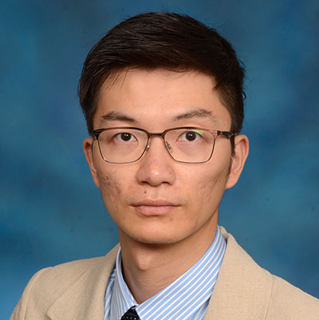
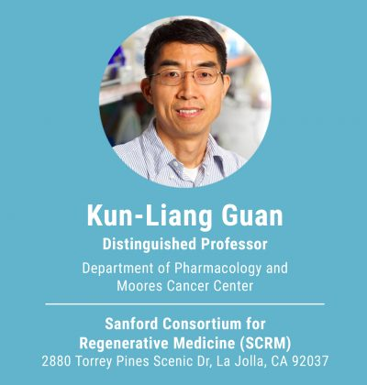
Peng Zhang
Assistant Professor
Division of Immunotherapy
University of Maryland
School of Medicine
725 West Lombard Street, Baltimore, MD 21201

Slide 2

Yixuan Huang
Research Intern
huangmimi@gwu.edu

Slide 3

Yan Zhao
Visiting Scholar

Slide 4

Junru Chen
Visiting Scholar

Slide 5

Xiao Yuan
Visiting Scholar

