Slide 1

Fine Tuning LLMs for Text-to-SQL-Generation
FRAUD RISK DOMAIN
Presenter: YOSHITA GUREJA

Slide 2
AGENDA
Data Set/Model Selection Rationale
Dataset Preparation
Model + Tokenizer Loading
MODEL Fine Tuning:
Full Fine-Tuning, LoRA, QLoRA, Prefix Tuning
Evaluation & Results
Text Generation on 500 test samples
13 metrics
Results

Slide 3
EXECUTIVE SUMMARY
Problem
Fraud analysts must translate complex investigative questions into SQL queries — a time-consuming and expertise-heavy process.
Approach
Fine-tuned Qwen2-0.5B-Instruct using:
Full Fine Tuning
LoRA
QLoRA
Prefix Tuning
Evaluated across 13 metrics on a domain-filtered Text-to-SQL dataset
Key findings
LoRA achieves near-parity with Full Fine-Tuning
QLoRA offers strong trade-offs(slight drop, major memory gain)
Prefix Tuning fails for structured SQL generation
Recommendation
LoRA provides the best balance of performance, cost, and scalability
Note: SQL- Structured Query Language

Slide 4
SUMMARY-FLOW
Section 0
Environment Set up
Section 0
Config block
Section 1
Data Preparation
Section 3
Model Fine Tuning
Section 2
Tokenization +Model Loading
Full FT
All weights
LoRA
Low Rank Adapters
QLoRA
4-bit quantized
Prefix Tuning
Virtual Tokens
Section 4
Text Generation
Section 5
Evaluate using BLEU, ROUGE, BERT etc.
Section 6: Results & Analysis

Slide 5
1. Data Set & Model Selection
Financial Fraud Detection relies on rapid querying of transactional databases
Fraud analysts at fintech organizations must translate investigative hypotheses- such as identifying velocity anomalies, geographic impossibilities, behavioral deviations etc. – into precise SQL* queries
Process is time consuming and requires technical expertise
Dataset: Synthetic Text-to-SQL (gretelai/synthetic_text_to_sql) — Filtered for financial, insurance, cybersecurity, and legal domains most relevant to fraud risk management.
Model: Qwen2-0.5B-Instruct
Compact, instruction-tuned causal language model chosen for its efficiency and suitability for parameter-efficient fine-tuning within compute constraints.

Slide 6

1. Data Set & Model Selection
Domain Filtering ensures the model learns SQL patterns most applicable to Fraud Investigation
ENVIRONMENT SET UP | Training : NVIDIA A100 (40GB VRAM) via Google Colab Pro. A fixed random seed of 42 is used across all methods for fair comparison. Both the dataset & model are publicly available and require no additional authentication.
DATASET PREPARATION | Synthetic Text-to-SQL dataset (Gretel AI) -> 100,000 training and 5,851 test examples spanning 100 domains.
Domain | Details
Finance & Financial Services | Transaction Analysis, Portfolio risk, customer profiling
Insurance | claims investigation, risk scoring
Cybersecurity | anomaly detection
Legal Services & Justice | case investigation
Blockchain | Transaction tracing
Public Safety | incident reporting, emergency response tracking, threat pattern analysis
Venture Capital | Portfolio monitoring, due diligence queries
Social Impact Investing | ESG* scoring, Impact measurement
Filtered for Fraud Risk domain
Note: Refer Appendix for detailed distribution of domain
*ESG: Environmental, Social and Governance

Slide 7
2.MODEL FINE-TUNING
Below are the details corresponding to each Training method used
Sl No | METHOD | TRAINABLE PARAMETERS | DESCRIPTION | RUNTIME(A100)
1 | Full Fine Tuning | 494 M parameters | This is the most computationally expensive approach but serves as our performance ceiling. We use fp32 precision to ensure gradient stability — mixed precision (fp16) causes gradient scaling errors when all parameters are being updated simultaneously. Gradient checkpointing is enabled to manage VRAM usage. | ~35 minutes
2 | LoRA(Low-Rank Adaptation) | 8.8M(1.75%) | LoRA injects trainable low-rank decomposition matrices into the attention and MLP layers, freezing the original weights. The key insight is that model adaptations during fine-tuning have a low intrinsic rank. Rather than updating the full weight matrix W, LoRA learns two smaller matrices A and B such that the update ΔW = BA, where the rank of BA is at most r=16. | ~10 mins
3 | QLoRA (Quantized LoRA) | 8.8M(1.75%) | QLoRA combines 4-bit quantization of the base model with LoRA adapters, dramatically reducing memory requirements. This approach enables fine-tuning of models that would otherwise not fit in GPU memory, making it particularly valuable for deployment in resource-constrained environments — relevant for fintech organizations running inference on-premise. | ~10 mins
4 | Prefix Tuning | 61K (0.012%) | Prefix Tuning prepends a small set of learnable "virtual tokens" to the input sequence, steering the frozen model's behavior without modifying any weights. With 10 virtual tokens, only 61,440 parameters are trained — 0.012% of the model. This approach is fundamentally different from LoRA — rather than adapting the model's internal representations, it learns a task-specific prompt in the embedding space. While extremely parameter-efficient, its capacity is severely limited for tasks requiring precise structured output like SQL generation. | ~10 mins
Note: Refer appendix for detailed list of Hyperparameters

Slide 8
3.EVALUATION
Evaluation was carried out across the 4 dimensions as shown
Training Loss
Similarity Metrics
(BLEU, ROUGE-1/2/L, METEOR, GLEU, CoSIM, BERT Score)
Quality Metrics
(Repetition rate, Flesch Reading Ease, Toxicity, Novelty, Diversity)
Qualitative

Slide 9
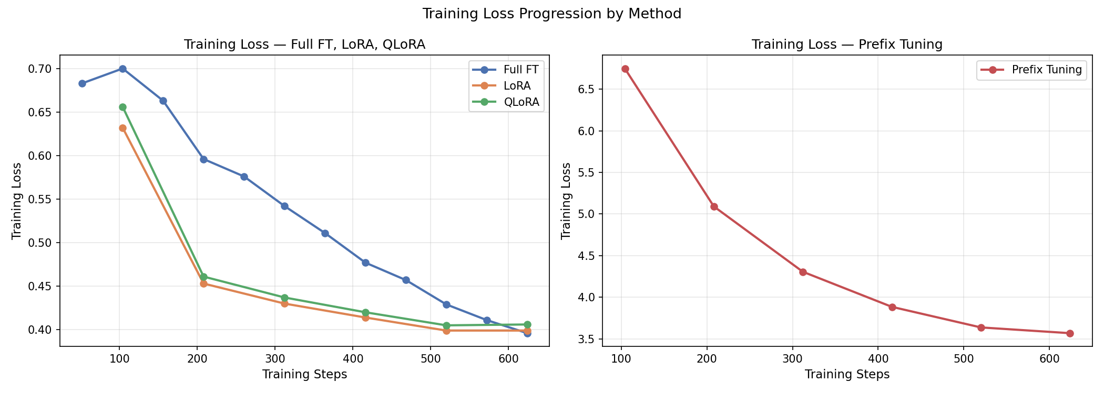
3.EVALUATION
TRAINING LOSS: LoRA & QLoRA converge fastest; Prefix Tuning lags
Full FT: Starts with the highest loss and converges the slowest(494M parameters)
LoRA &QLoRA: Drop sharply in the first 200 steps and then converge by step 200 onwards(Fewer parameters to optimize), while Full FT descends more gradually and continues improving through the full epoch
Prefix Tuning: Starts at a much higher loss, descends steeply and shows healthy learning- and ends still far above the others
Note: Prefix Tuning shown separately because it starts at a much higher value of >6.5 vs the other 3

Slide 10
3.EVALUATION
Similarity Metrics show LoRA and QLoRA achieve near-parity with Full FT
Sl No | METHOD | TRAINABLE PARAMETERS | DESCRIPTION
1 | Similarity to Reference SQL | BLEU | n-gram precision against reference (standard MT metric)
 |  | ROUGE-1/2/L | recall-oriented overlap at unigram, bigram, and longest common subsequence level
 |  | METEOR | Alignment based metric accounting for synonyms and stemming
 |  | GLEU | Sentence-level BLEU variant
 |  | CoSIM | Semantic Cosine similarity using sentence embeddings
 |  | BERT Score | Contextual embedding similarity using RoBERTa-large
Method | BLEU | ROUGE-1 | ROUGE-2 | ROUGE-L | METEOR | GLEU | CoSIM | BERT Score
Full FT | 0.4759 | 0.8121 | 0.6890 | 0.7833 | 0.7035 | 0.4676 | 0.9323 | 0.9565
LoRA | 0.4533 | 0.8129 | 0.6780 | 0.7789 | 0.6972 | 0.4515 | 0.9317 | 0.9555
QLoRA | 0.4501 | 0.8032 | 0.6687 | 0.7684 | 0.6847 | 0.4407 | 0.9287 | 0.9538
Prefix Tuning | 0.0005 | 0.0883 | 0.0119 | 0.0764 | 0.0329 | 0.0043 | 0.3029 | 0.7623
Note: Next page shows detailed chart-based view across all these

Slide 11
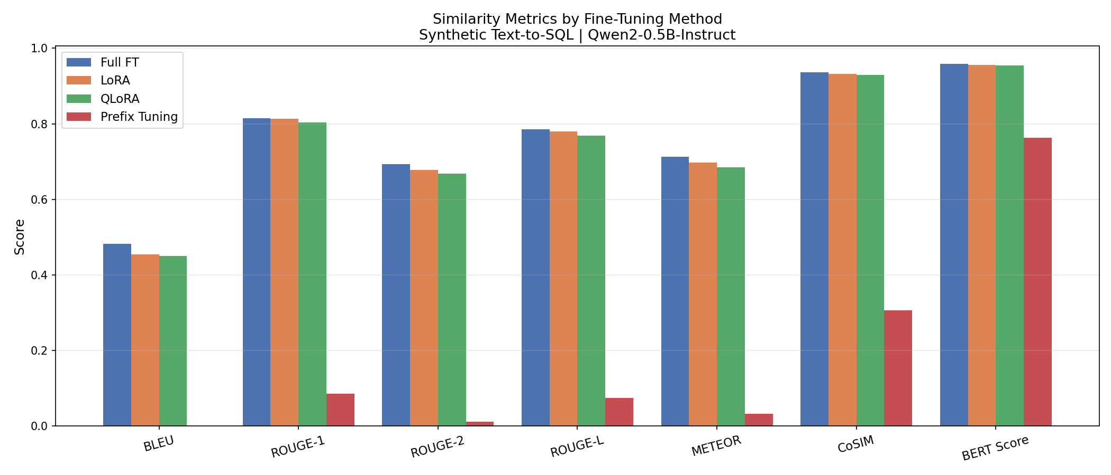
3.EVALUATION
SIMILARITY METRICS – LoRA and QLoRA achieve near-parity with Full Fine tuning
BLEU (n-gram overlap) | ROUGE-1 (unigram overlap) | ROUGE-2 (Bigram Overlap) | ROUGE-L (Longest common subsequence) | METEOR (outputs vary across examples) | CoSIM (outputs vary across examples) | BERT Score (outputs vary across examples)
Full FT leads slightly with LoRA/QLoRA close behind(~0.45-0.48) Prefix Tuning->near 0, not generating SQL tokens as expected | unigram overlap Full FT/LoRA/QLoRA->score high because SQL words (SELECT, FROM, WHERE) (~0.80-0.81) appear consistently Prefix Tuning->0.088- confirms failure to generate SQL tokens | Full FT/LoRA/QLoRA->Slightly lower than ROUGE-1 because exact 2-word sequences are hard to match, but still strong(~0.67-0.69) Prefix Tuning->Collapses to ~0.01 | Full FT/LoRA/QLoRA->high scores here indicate clause ordering-(~0.77-0.78) Prefix Tuning-> near 0 score -, it fails to produce right sequence | Full FT/LoRA/QLoRA-> Full FT leads - with QLoRA slightly behind LoRA(~0.69-0.71) Prefix Tuning-> near 0 score - indicates task level failure | Full FT/LoRA/QLoRA->All score high, generating SQL semantically equal to the reference(~0.92-0.93) Prefix Tuning->0.30- generating semantically unrelated SQL queries | Full FT/LoRA/QLoRA->near perfect scores indicate the models are generating SQL that are very close to the reference(~0.95-0.96) Prefix Tuning->0.76- one of its best results across, still well below other methods

Slide 12
3.EVALUATION
Quality metrics reveal a similar result-FT, LoRA and QLoRA are at par
Sl No | METHOD | TRAINABLE PARAMETERS | DESCRIPTION
2 | Output quality | Repetition Rate | Indicative of repeated tokens (is SQL structurally concise)
 |  | Flesch Reading Ease | Readability score(higher= more readable; lower expected for SQL)
 |  | Toxicity | Does SQL contain offensive words?
Method | Repetition Rate | Flesch Reading Ease | Toxicity
Full FT | 0.0535 | 17.64 | 0.0007
LoRA | 0.0540 | 16.28 | 0.0007
QLoRA | 0.0553 | 17.89 | 0.0007
Prefix Tuning | 0.4844 | 61.06 | 0.0022
Sl No | METHOD | TRAINABLE PARAMETERS | DESCRIPTION
2 | Diversity & Novelty | Novelty | Semantic distance between generated SQL and input question
 |  | Diversity | Average pairwise semantic distance across generated inputs
Method | Novelty | Diversity
Full FT | 0.3961 | 0.6717
LoRA | 0.3908 | 0.6740
QLoRA | 0.3909 | 0.6758
Prefix Tuning | 0.7556 | 0.7605
Note: Next page shows detailed chart-based view across all these

Slide 13
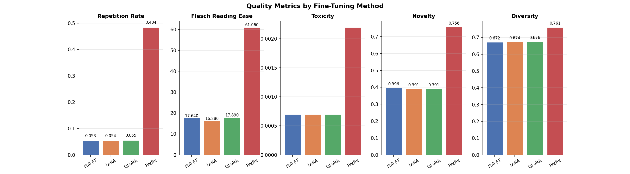
3.EVALUATION
QUALITY METRICS – FT, LoRA and QLoRA are at par
Repetition Rate (lower is better) | Flesch Reading Ease (context-dependent) | Toxicity (lower is better) | Novelty (higher=more different i/p ques) | Diversity (outputs vary across examples)
Full FT/LoRA/QLoRA: ~0.053-0.055, implying minimal repeated tokens Prefix Tuning: 0.484(10x higher)->less structured queries | Full FT/LoRA/QLoRA: ~16-18- which is right for SQL Prefix Tuning: ~61 -> readable English prose | Full FT/LoRA/QLoRA: ~0- no offensive language Prefix Tuning: 0.0022-> near 0 like others, slightly elevated due to natural language generation rather than SQL | Full FT/LoRA/QLoRA: ~0.391-0.39-SQL different from Natural language question(expected) Prefix Tuning: ~ 0.76 - high novelty, but for wrong reason(incoherent) | Full FT/LoRA/QLoRA: ~0.67-0.68- models not collapsing to repetitive outputs Prefix Tuning: 0.76- varied because they are random prose and not meaningful SQL variation
Note: Higher diversity and novelty in Prefix Tuning are misleading — they reflect incoherent natural language outputs rather than meaningful SQL variation.

Slide 14
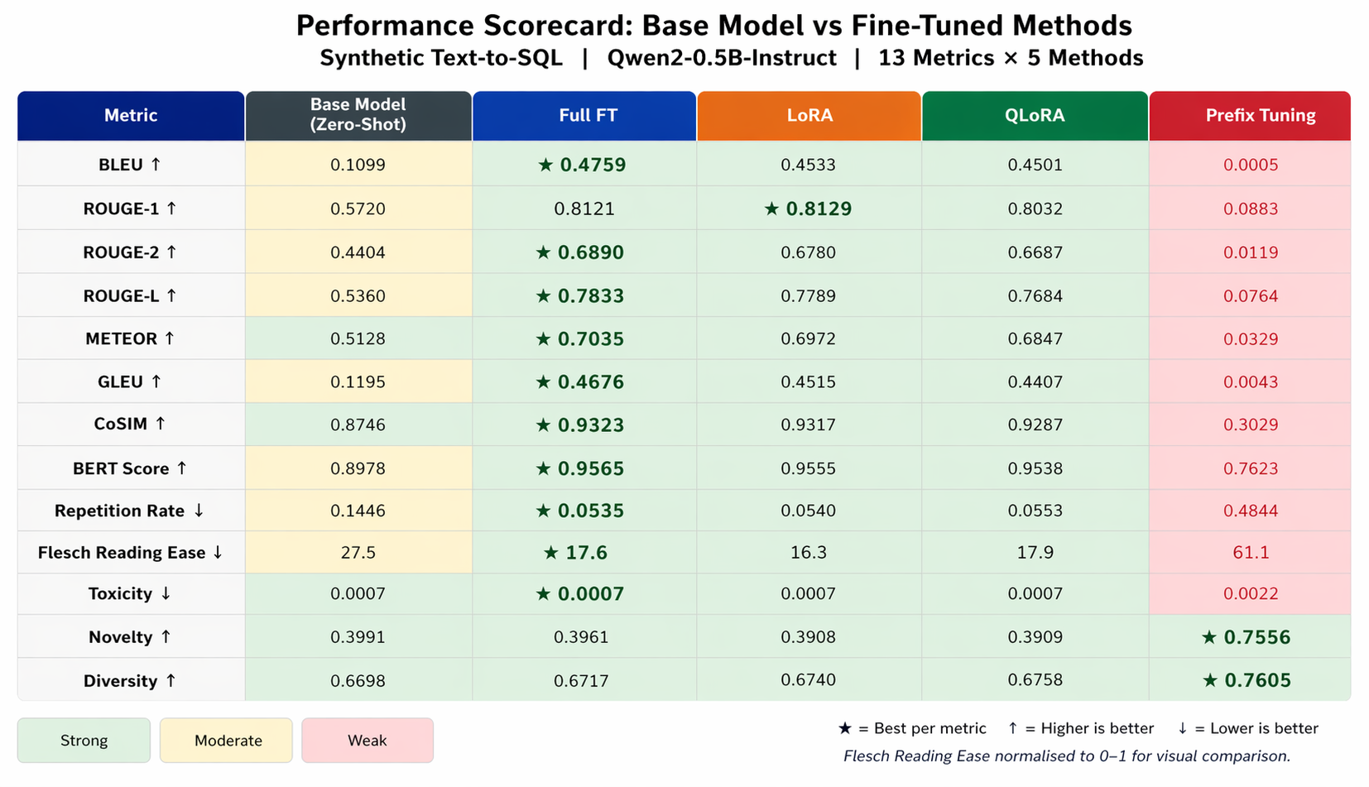
3.EVALUATION
Comparison with Base Model: Near-parity for LoRA/QLoRA
Base model significantly improves after fine-tuning; LoRA offers best efficiency-performance tradeoff
Note: The comparison was added separately and is not part of the main project submission notebook

Slide 15
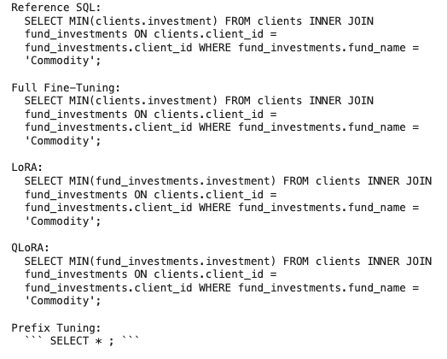
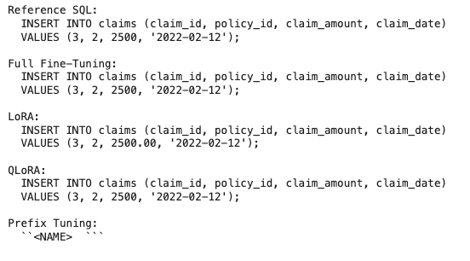
3.EVALUATION
To complement the quantitative metrics, we inspect few samples- Full FT, LoRA and QLoRA generate comparable SQL outputs, Prefix Tuning lags
FINANCIAL SERVICES | INSURANCE
What is the minimum investment of Clients in the ”commodity” Fund? | Insert a new record in the claims table with claim_id 3, policy_id 2, claim_amount 2500, and claim_date '2022-02-12'

Slide 16
4.RESULTS & ANALYSIS
Below is a summary of the evaluation across all metrics and the key takeaways
Results
Tradeoffs
Accuracy Metrics(BLEU, ROUGE and BERT Scores) | Full FT achieves the highest score across all these 3 Gap between Full FT and LoRA is small QLoRA performs slightly below LoRA- tradeoff is acceptable
Prefix Tuning Failure on Structured Output | near-0 BLEU and ROUGE-1 reveal a limitation: 61K trainable parameters are insufficient to learn SQL syntax from scratch in a single epoch. High Flesch Reading Ease score confirms the model is generating natural language rather than SQL
Toxicity and Safety | Full FT/LoRA/QLoRA->produce almost 0-toxicity scores Prefix Tuning->Tendency to generate natural language rather than SQL
Diversity and Novelty | Full FT/LoRA/QLoRA->QLoRA shows marginal higher diversity than Full FT, indicates slight output variation Prefix Tuning->Shows highest diversity and novelty- outputs are more varied
Full Fine Tuning: Great performance but high computational and storage cost
LoRA: Near-parity performance but with <2% trainable parameters
QLoRA: Further reduction in memory usage with minor quality degradation
Prefix Tuning: Ineffective for structured output tasks in this setting
FRAUD DOMAIN APPLICABILITY -- > LoRA represents an optimal choice
Performance within 3% of Full FT across all metrics
35MB adapter file vs 1.97GB full model- trivial to version, deploy and update
Can be re-trained on new fraud patterns in minutes
Multiple domain- specific adapters (card fraud, AML, identity fraud) can be swapped onto the same frozen base model

Slide 17
5.LIMITATIONS
Below are the limitations & Future Opportunities
1 | TRAINING DURATION | One epoch on 10,003 examples - additional epochs would likely improve all methods , particularly Prefix Tuning
2 | DATASET SPECIFICITY | While filtered for financial/fraud risk domains, the dataset does not contain card-specific fraud tables(transaction velocity, BIN analysis, chargeback rates)
3 | EVALUATION METRIC FIT | BLEU and ROUGE measure token overlap, not SQL correctness- a query can be semantically correct but score poorly if it uses different column aliases or table references
4 | PREFIX TUNING CONFIGURATION | Number of virtual tokens =10 is conservative - larger values may improve performance at the cost of inference speed
5 | EXECUTION-BASED EVALUATION | The SQLs were never really evaluated against a database to check if it executes correctly

Slide 18
6. CONCLUSION
CURRENT
NEXT STEPS
This PROJECT Demonstrates that parameter-efficient fine tuning especially LoRA, can match full fine-tuning performance for Text-to-SQL tasks at a fraction of the computational cost
Future work should explore:
Fine-tuning on fraud specific data(can be synthetic) from real payment fraud schema patterns
EXECUTION-Based evaluation using actual SQL interpreters
Using multi epoch train with learning rate scheduling for Prefix Tuning

Slide 19
APPENDIX

Slide 20
1. Data Set & Model Selection
Domain Distribution in filtered train domain
Domain | Data
Cybersecurity | 1,360
Financial Services | 1,134
Public safety | 1,131
Finance | 1,051
Blockchain | 1,051
Justice | 980
Insurance | 940
Legal Services | 916
Social Impact Investing | 732
Venture Capital | 708
Original Train Size: 100000
Filtered Train Size: 10003
Original Test Size: 5851
Filtered Test Size: 580
Formatted train examples: 10,003
Formatted Text examples: 580
Note: Refer Appendix for detailed distribution of domain

Slide 21
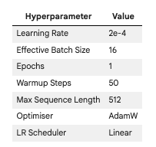
2.MODEL FINE-TUNING
Training was performed using identical Hyperparameters where possible, to ensure a fair comparison
Sl No | METHOD | SUMMARY
1 | Full Fine Tuning | All model parameters (494 M)
2 | LoRA(Low-Rank Adaptation) | Low-Rank adapters added to attention layers(8.8M paramters)
3 | QLoRA (Quantized LoRA) | Quantized model + LoRA adapters
4 | Prefix Tuning | Trainable prefix vectors added to input sequence

Slide 22
3.EVALUATION METRICS
All evaluation metrics shown for easy evaluation
Similarity to reference SQL | Output Quality | Diversity & novelty
BLEU — n-gram precision against reference (standard MT metric) ROUGE-1/2/L — recall-oriented overlap at unigram, bigram, and longest common subsequence level METEOR — alignment-based metric accounting for synonyms and stemming GLEU — sentence-level BLEU variant CoSIM — semantic cosine similarity using sentence embeddings (all-MiniLM-L6-v2) BERT Score — contextual embedding similarity using RoBERTa-large | Repetition Rate – proportion of repeated tokens(lower=better) Flesch Reading Ease – readability score(higher=more readable prose; for SQL, lower expected) Toxicity – detoxify model toxicity score(lower = better) | Novelty – semantic distance between generated SQL and input question Diversity - average pairwise semantic distance across generated outputs
Method | BLEU | ROUGE-1 | ROUGE-2 | ROUGE-L | METEOR | GLEU | Repetition Rate | Flesch Reading Ease | CoSIM | BERT Score | Toxicity | Novelty | Diversity
Full FT | 0.4759 | 0.8121 | 0.689 | 0.7833 | 0.7035 | 0.4676 | 0.0535 | 17.64 | 0.9323 | 0.9565 | 0.0007 | 0.3961 | 0.6717
LoRA | 0.4533 | 0.8129 | 0.678 | 0.7789 | 0.6972 | 0.4515 | 0.054 | 16.28 | 0.9317 | 0.9555 | 0.0007 | 0.3908 | 0.6740
QLoRA | 0.4501 | 0.8032 | 0.6687 | 0.7684 | 0.6847 | 0.4407 | 0.0553 | 17.89 | 0.9287 | 0.9538 | 0.0007 | 0.3909 | 0.6758
Prefix Tuning | 0.0005 | 0.0883 | 0.0119 | 0.0764 | 0.0329 | 0.0043 | 0.4844 | 61.06 | 0.3029 | 0.7623 | 0.0022 | 0.7556 | 0.7605

Slide 23
THANK YOU

