Slide 1
Improving information retrieval through correspondence analysis instead of latent semantic analysis. Comparison of LSA and CA regarding MAP
Introduction:
In our project, we explored two ways to turn text into numbers so we can find similar documents more effectively. The first method, Latent Semantic Analysis (LSA), simply runs a truncated singular‐value decomposition (SVD) on the raw term‐frequency matrix. The second, Correspondence Analysis (CA), uses the decomposed matrix that is not the original frequency or weighted matrix, but the matrix of standardized residuals. In information retrieval, the similarity between a given user query and each document in a document-term matrix is calculated and documents with high similarity are returned

Slide 2
Implementation of our project in R
Dataset:
We used the full BBC News corpus (Greene & Cunningham, 2006) of 2225 full-text articles across five categories. The data are organized in subfolders (business, entertainment, politics, sport, tech), with each .txt file containing a complete news article.
Each article is between about 90 and 4 400 words long (median ≈ 335 words), giving plenty of content for meaningful retrieval tests.
The reason why we have choosed this dataset is because of the size and variety: 2225 articles across diverse topics.
category | n
business | 510
entertainment | 386
politics | 417
sport | 511
tech | 401

Slide 3
Preprocessing steps and construction of our Data Term Matrix
To pre-process the three English datasets, we changed all characters to lower case, removed punctuation marks, numbers, and stop words, and applied lemmatization. Subsequently, terms with frequencies lower than 5 are ignored.
Later on after preprocessing phase during our further analysis we changed multiple times the threshold of filtering term frequencies to be ignored between 5,10,20,30. We realized that ending up with term frequency>=5 was the most optimal. We have mentioned about it later on during the performance evaluation of LSA’s and CA’s MAP.
Below is the DTM construction and the resulting summary tables for our full BBC‐News corpus.
Metric | Value
Number of documents | 2225
Vocabulary size (terms ≥10) | 8184
DTM dimensions (docs × terms) | 2225 × 8184
300m | 4 | 500m | 600m | account
ad | adjust | advert | advertise | alexander
amount | analyst | aol | benefit | big
book | boost | box | broadband | bros

Slide 4
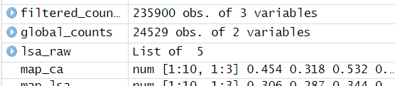
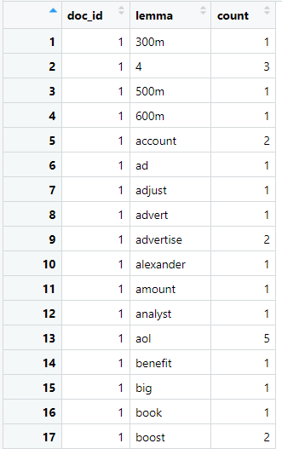
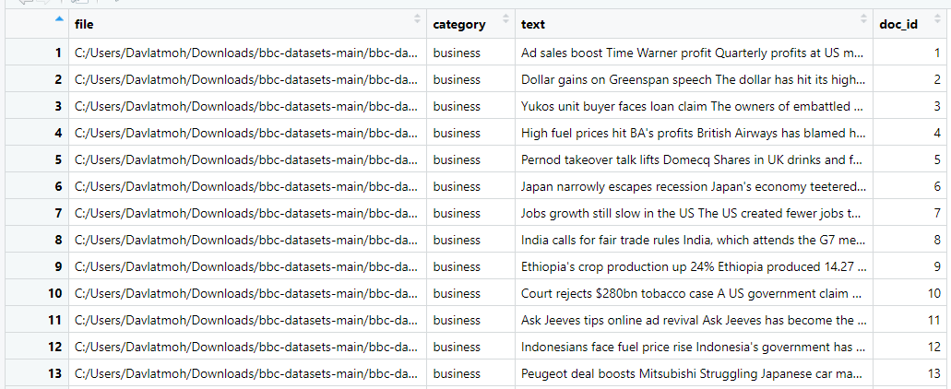
Data in R environment after preprocessing

Slide 5
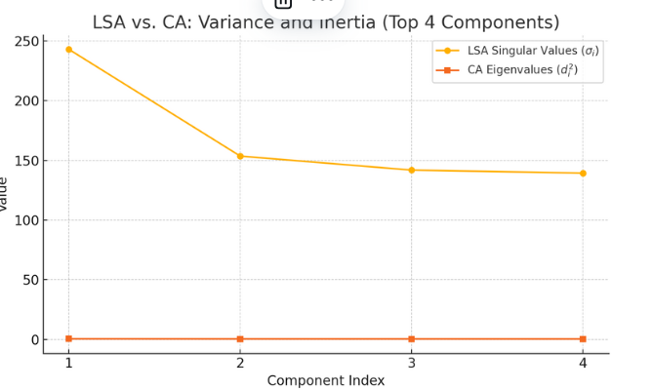
LSA and CA implementation
What we did:
LSA‐RAW: We performed a truncated SVD on the raw document–term matrix A and extracted the first k=4 singular values {σi}. In practice, this corresponds to the decomposition.
A≃Uk​Σk​VkT
We looked at the top 10 singular values (σ₁ to σ₁₀) to understand how quickly the main information captured by LSA becomes less significant.
CA‐RAW: We built the matrix of standardized residuals.
S=Dr^−1/2​(P−rc^T)Dc^−1/2​
We applied a truncated SVD to the matrix S, which gave us singular values d1,.....,dk​. The squares of these values (di^2​) represent the main components which are our eigenvalues in the Correspondence Analysis (CA). We focused on the top four eigenvalues to see how much of the total association each CA dimension explains.
Index | LSA Singular Value | CA Eigenvalue
1 | 242.8694 | 0.46197
2 | 153.4923 | 0.38690
3 | 141.7686 | 0.37335
4 | 139.2346 | 0.35165

Slide 6
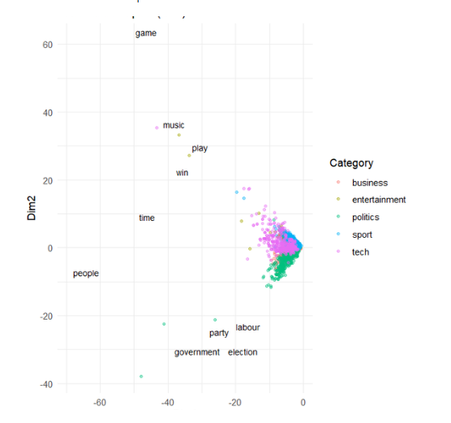
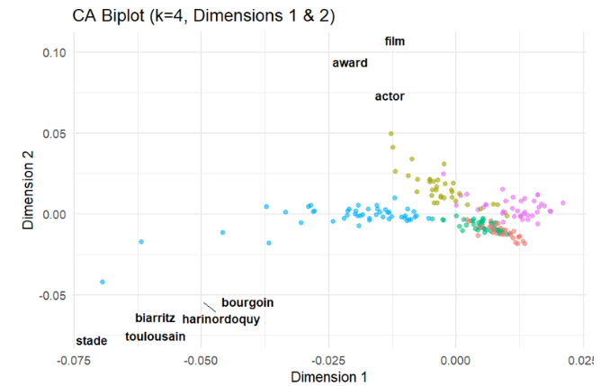
Biplots of LSA and CA

Slide 7
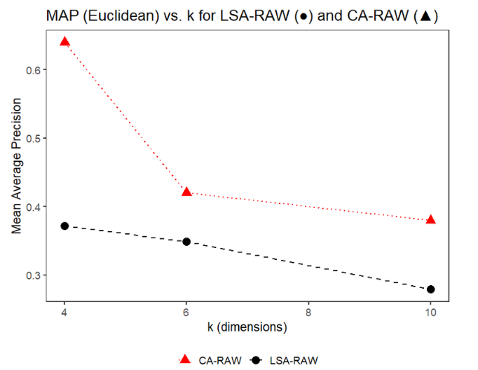
Evaluation of CA and LSA based on MAP
k | MAP_LSA | MAP_CA
4 | 0.371 | 0.640
6 | 0.349 | 0.420
10 | 0.279 | 0.380

Slide 8
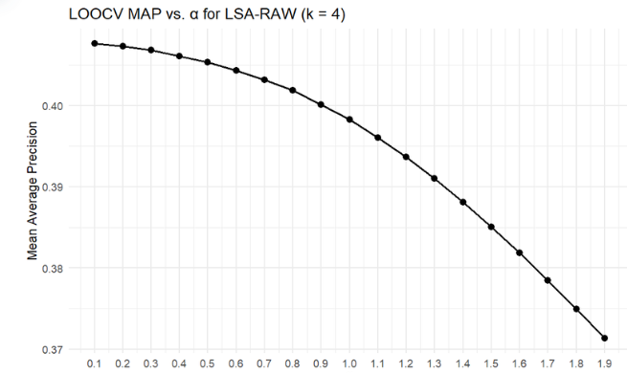
Weighting components of our LSA in order to improve the MAP
α | MAP (LSA-RAW)
0.1 | 0.408
0.2 | 0.407
0.3 | 0.407
0.4 | 0.406
0.5 | 0.405
0.6 | 0.404
0.7 | 0.403
0.8 | 0.402
0.9 | 0.400
1.0 | 0.398
1.1 | 0.396
1.2 | 0.394
1.3 | 0.391
1.4 | 0.388
1.5 | 0.385
1.6 | 0.382
1.7 | 0.378
1.8 | 0.375
1.9 | 0.371

Slide 9
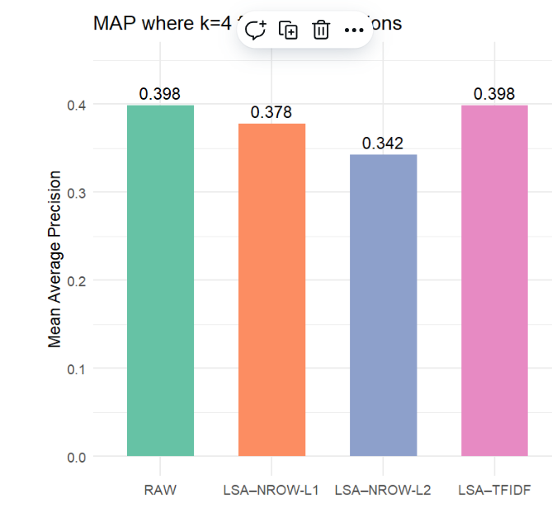
Looking at the map performance of 4 versions of LSA
Method | MAP
LSA_RAW | 0.398
LSA_NROW_L1 | 0.378
LSA_NROW_L2 | 0.342
LSA_TFIDF | 0.398

Slide 10
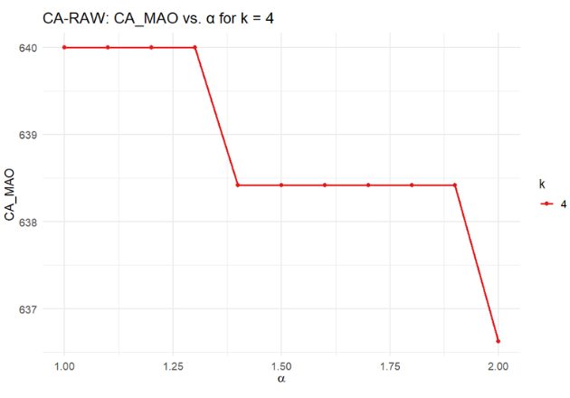
Looking for the MAP performance of CA based on weighting
k | alpha | CA_MAP
4 | 1.0 | 640.00
4 | 1.1 | 640.00
4 | 1.2 | 640.00
4 | 1.3 | 640.00
4 | 1.4 | 638.42
4 | 1.5 | 638.42
4 | 1.6 | 638.42
4 | 1.7 | 638.42
4 | 1.8 | 638.42
4 | 1.9 | 638.42
4 | 2.0 | 636.63

Slide 11
Conclusion
Both LSA and CA use SVD, but the key difference is the matrix they apply it to. LSA applies SVD to the weighted matrix A, which still contains marginal effects, while CA applies it to the matrix S of standardized residuals, where those marginal effects are removed.Because of this, CA focuses only on the relationships between documents and terms, whereas LSA includes extra information that isn’t useful for retrieval. The rank of S is also one less than that of A. With standard coordinates (α=1), LSA approximates Euclidean distances between document rows, while CA approximates chi-square distances. Adjusting α\alphaα changes how much weight is given to the top dimensions: values less than 1 downplay the early dimensions, and values greater than 1 emphasize them. The best α\alphaα for CA is usually higher than for LSA and often above 1. Bullinaria and Levy (2012) argued that the first few LSA dimensions often contain noise instead of helpful semantic information. Our results show that CA tends to rely more on these top dimensions than LSA, likely because CA removes margins while LSA does not. This suggests the margins in LSA contribute to early dimensions in ways that hurt retrieval. CA removes this irrelevant information, improving performance. CA is also connected to the idea of statistical independence (Greenacre, 1984), as its matrix S captures how much actual term-document associations differ from what would be expected under independence. The total departure from independence (measured by the chi-square statistic) is broken down into components using SVD. LSA, in contrast, is not linked to this statistical model. In our study, we compared four LSA variants—LSA-RAW, LSA-NROWL1, LSA-NROWL2, and LSA-TFIDF with CA, and found that CA consistently performed better in terms of MAP. Even when adjusting the exponent α\alphaα to improve LSA, CA still outperformed it across different numbers of dimensions.

Slide 12
Thank you for your attention!

