Slide 1
Data Science at Home
Final Project
Josipa Ljubicic
Amela Spica

Slide 2

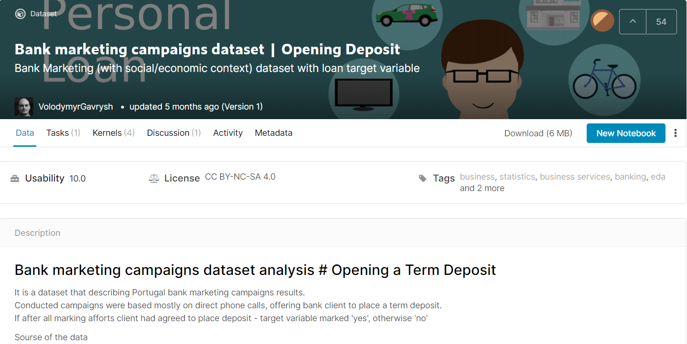
Input data set – Bank marketing campaigns
Size and order:
41188 rows
20 features + 1 output attribute
Features
Bank client data
Related with the last contact of the current campaign
Social and economic context attributes
Other attributes

Slide 3
Data Cleaning
Methods used
Dropping duplicates and NaNs
Missing Data
If „unknown“ data per column > 10% Simple imputer („most frequent“ strategy)
Otherwise delete rows with „unknown“ data
Deleting „duration“ column because we find it irrelevant

Slide 4
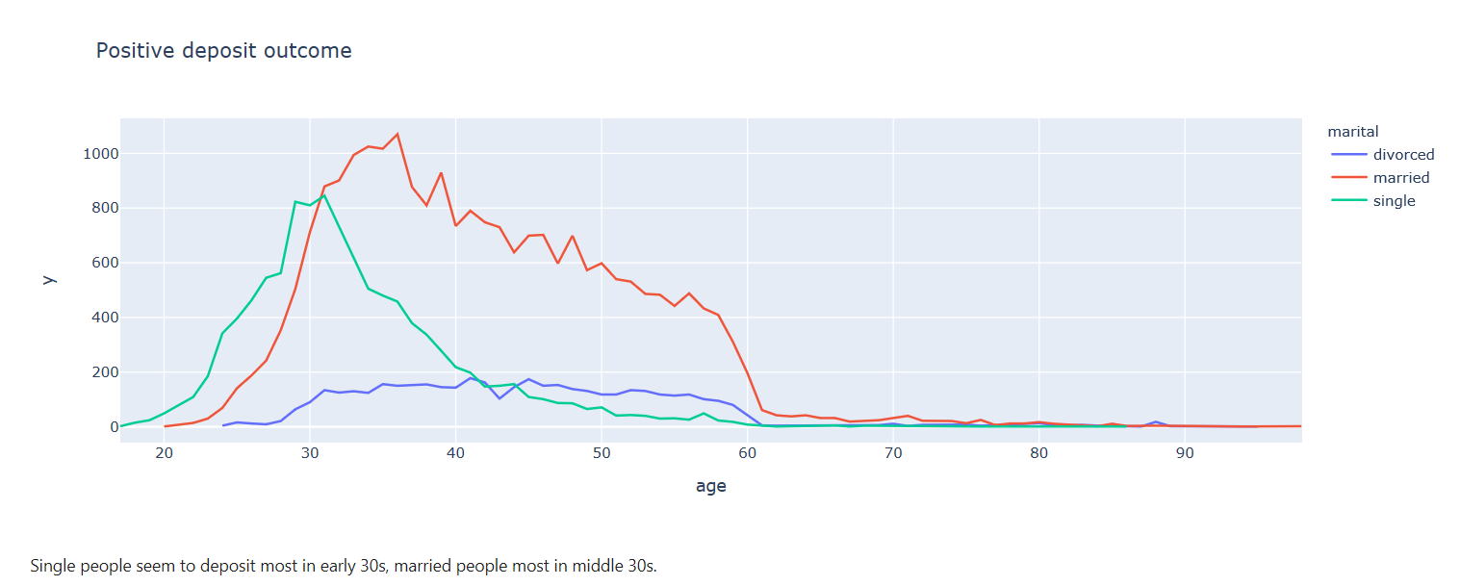
Exploratory Data Analysis
Bank Client Data
How does client age affect positive campaign outcome?

Slide 5
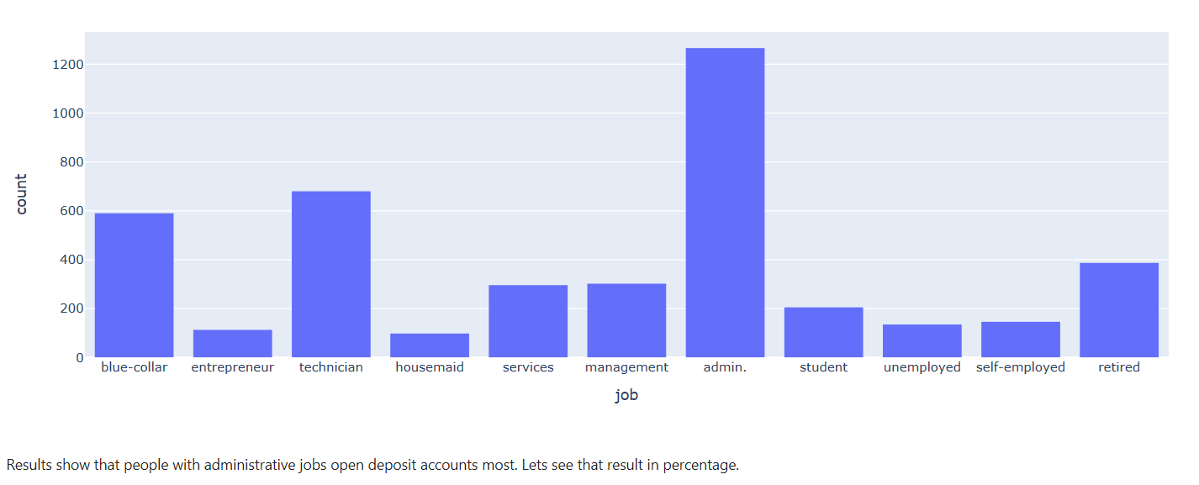
Exploratory Data Analysis
Bank Client Data
What jobs have people willing to deposit money?

Slide 6
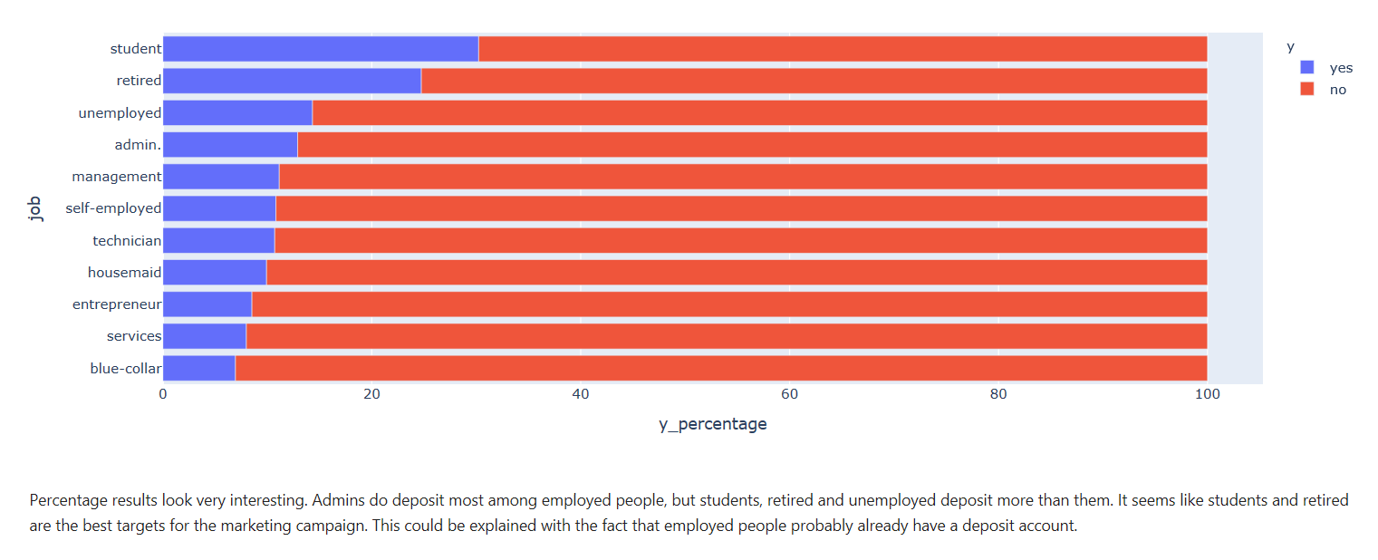
Exploratory Data Analysis
Bank Client Data
Lets see if "admins" are more likely to deposit or are they simply being called more than others on purpose?

Slide 7
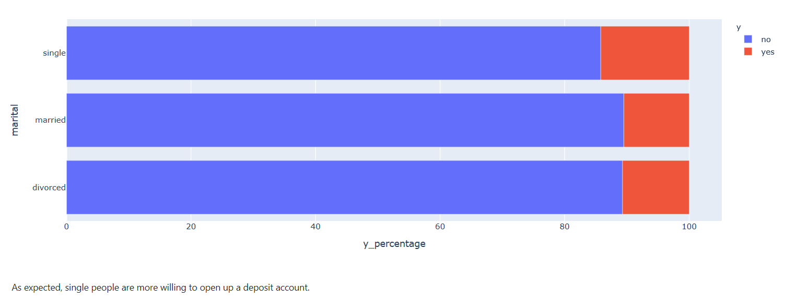
Exploratory Data Analysis
Bank Client Data
Deposit outcome considering marital status in percentage

Slide 8
Exploratory Data Analysis
Bank Client Data
Are people with loans and houses a good marketing target?
loan | y | %
no | no | 88.312
no | yes | 11.687
yes | no | 89.164
yes | yes | 10.835
housing
no | no | 88.892
no | yes | 11.180
yes | no | 88.129
yes | yes | 11.871
There is a 0.5% higher chance for a client without loan to open a deposit account.
There is a 0.5% higher chance for a client without loan to open a deposit account.

Slide 9
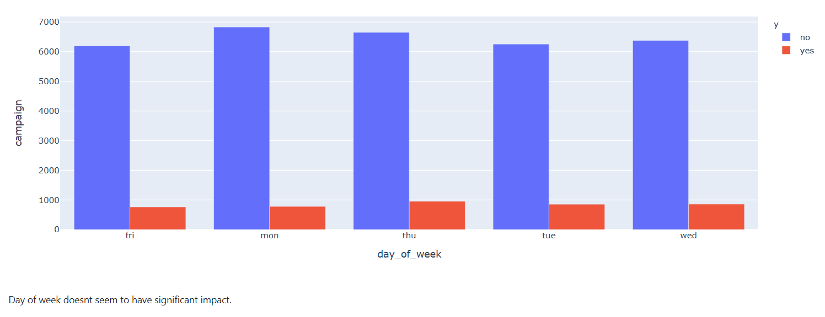
Exploratory Data Analysis
Data related with the last contact of the current campaign
Does the day of week affect deposit outcome?

Slide 10
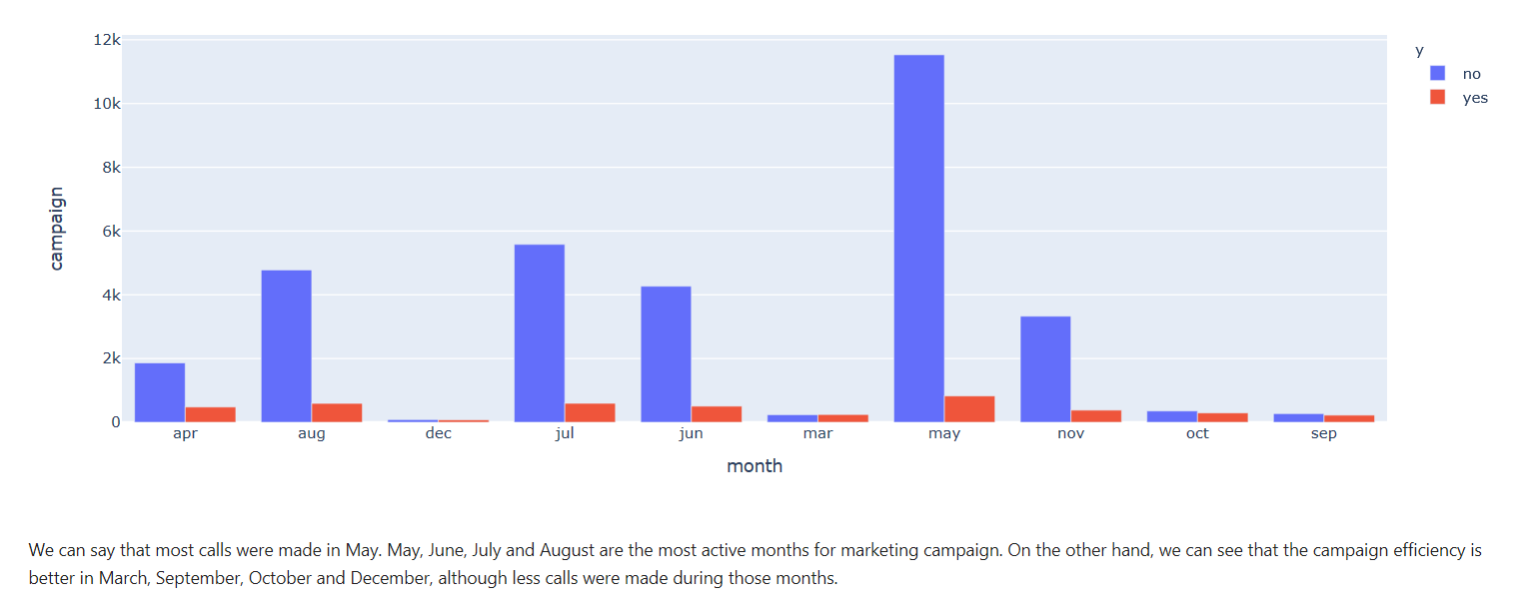
Exploratory Data Analysis
Data related with the last contact of the current campaign
How does month of the call affect deposit outcome?

Slide 11
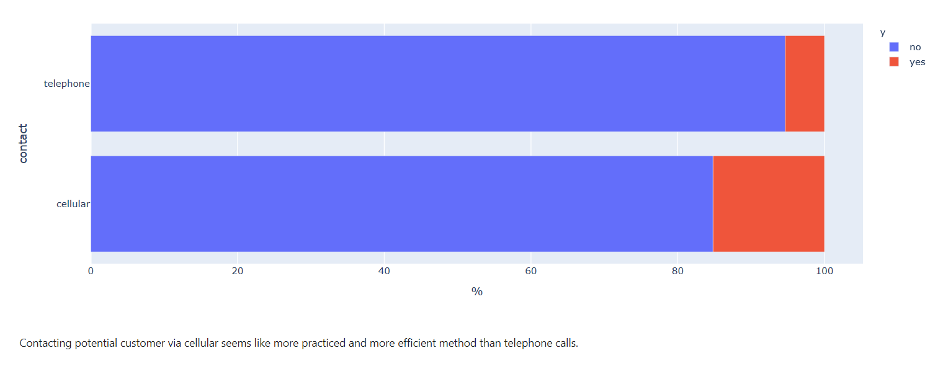
Exploratory Data Analysis
Data related with the last contact of the current campaign
Which way of contacting clients proves to be most efficient?

Slide 12
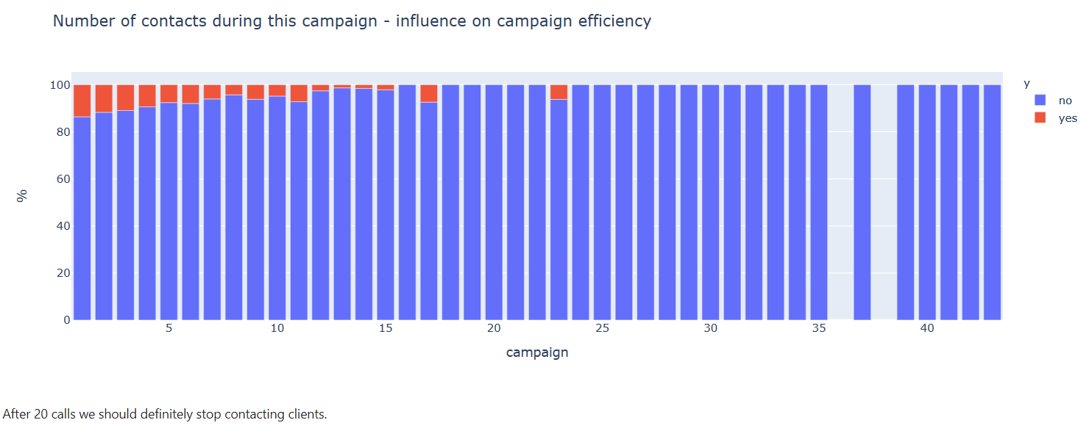
Exploratory Data Analysis
Other attributes
Does the increase in number of contacts per campaign affect the outcome?

Slide 13
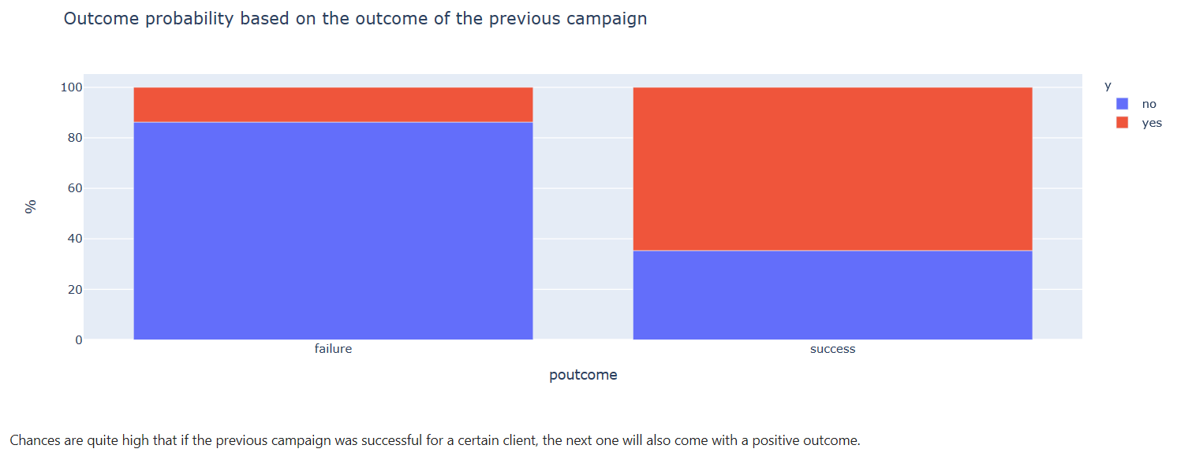
Exploratory Data Analysis
Other attributes
Does outcome of the previous campaign in any way influence outcome of the current campaign?

Slide 14
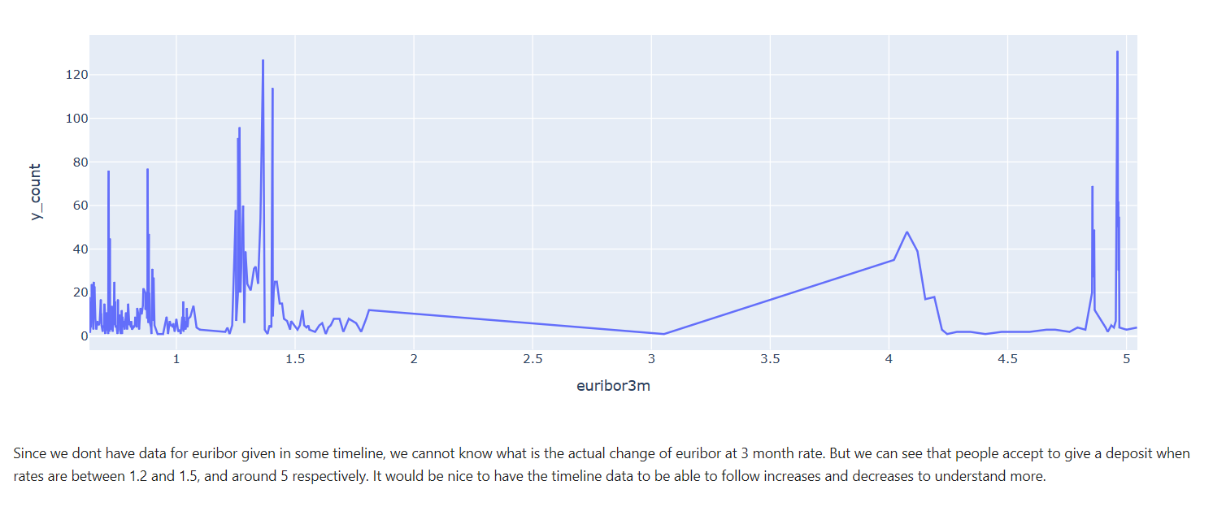
Exploratory Data Analysis
Social and economic context attributes
How does the euribor 3 month rate affect the campaign outcome?

Slide 15
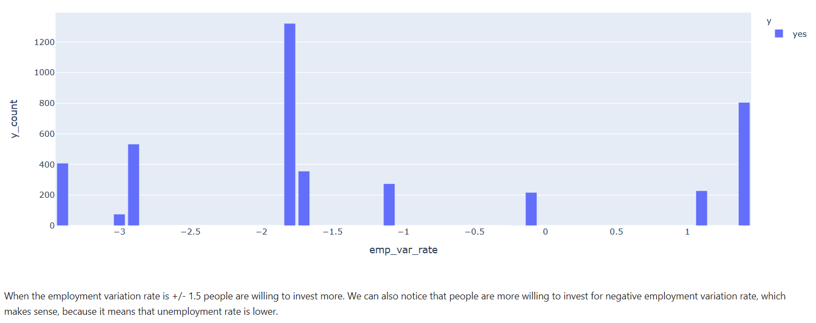
Exploratory Data Analysis
Social and economic context attributes
How does the emp_var_rate affect the answer?

Slide 16
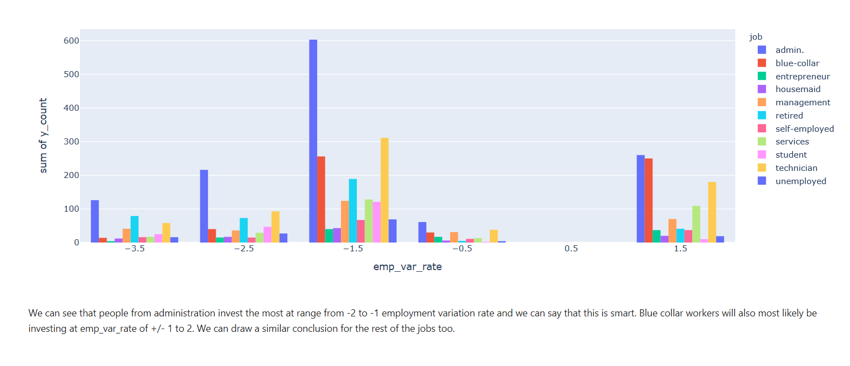
Exploratory Data Analysis
Social and economic context attributes
In which way do these rates affect clients considering jobs they have?

Slide 17
Modeling
Process and modelling parameters
Encoding categorical data
Categorical columns: job, marital, education, housing, default, loan, contact, education, day of week, poutcome
Train Test Split
Test size: 20%
Decision tree max depth: 16
Model used for prediction
Decision Tree Classifier
Test Result represented in Mean Square Error
0.150277

