Slide 1
TMDb 5000 Movies Data Analysis
Presented by: Youssef Maher Latif
Date: 5-4-2025

Slide 2
Introduction
Objective: Analyzing TMDb 5000 Movies dataset to extract meaningful insights.
Tools Used: Python (Pandas, NumPy, Matplotlib, Seaborn)
Dataset: TMDb 5000 Movies CSV file

Slide 3
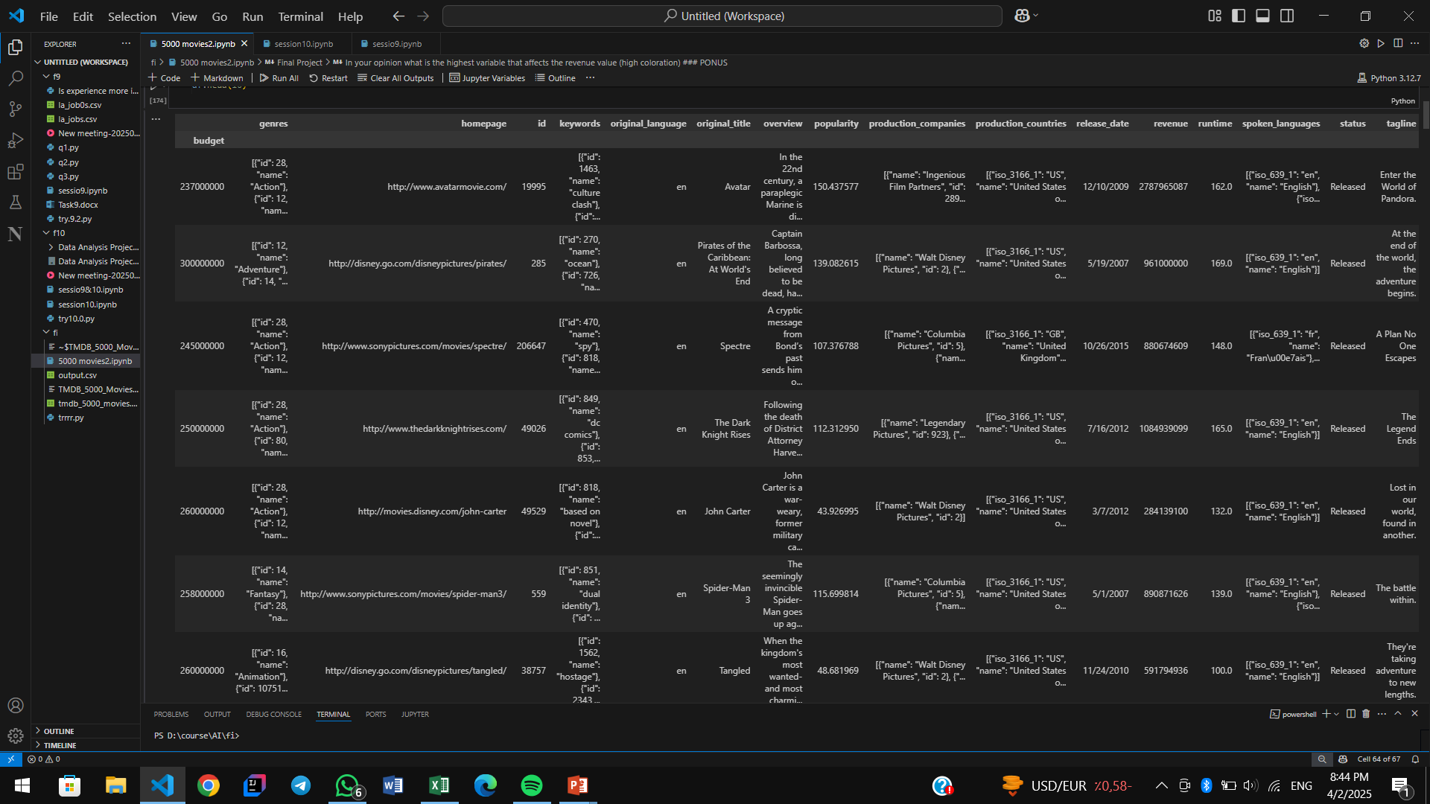
Data Exploration
Opened the dataset and displayed the first 10 rows for initial inspection.
data = pd.read_csv("tmdb_5000_movies.csv",index_col=0)
df = pd.DataFrame(data) df.head(10)

Slide 4
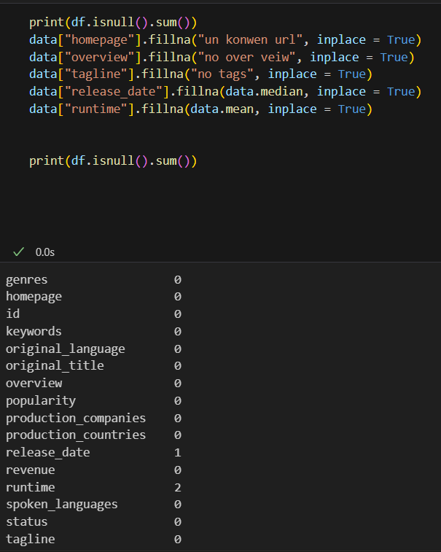
Checking Missing Values
Checked for missing values and applied appropriate handling techniques.

Slide 5
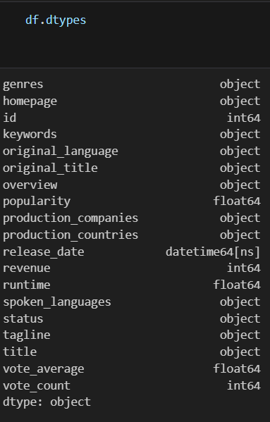
Data Types Modification

Slide 6
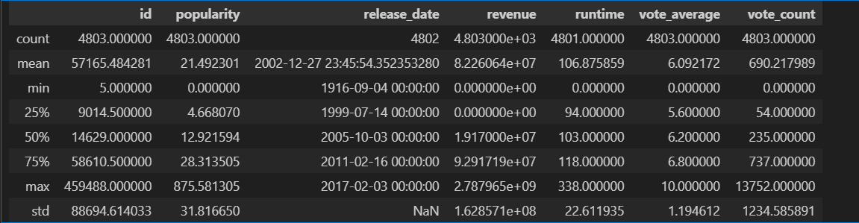
Statistical Analysis
Performed basic descriptive statistics on numerical columns.
df.describe()

Slide 7
Mean Ratings Analysis
Calculated the mean rating for movies in specific years.
x=df[(df['release_date'].dt.year == 1980) | (df['release_date'].dt.year == 1999) | (df['release_date'].dt.year == 2017) | (df['release_date'].dt.year == 2004) ]
average_rating = x['vote_average'].mean()
average_rating
6.13819095477387

Slide 8
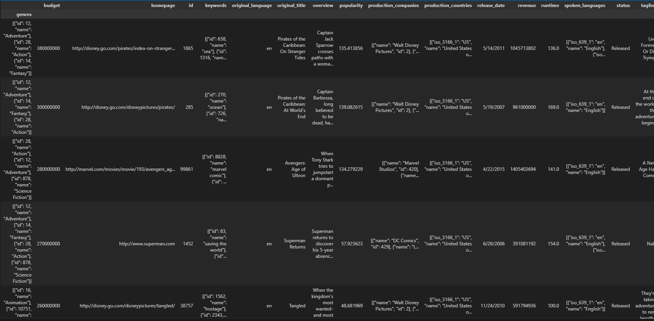
Revenue vs Budget
Ranked movies based on revenue - budget values.
data3=pd.read_csv("tmdb_5000_movies.csv",index_col=1)
df7=pd.DataFrame(data3)
df7["by_profits"]=df7["revenue"]-df7["budget"]
byprofitss=df7.sort_values("budget",ascending=False)
byprofitss

Slide 9
Movie Release Trends
Determined the year with the highest number of movie releases.
action_romance_movies = df[df['genres'].apply(lambda x: 'Action' in x or 'Romance' in x)]
action_romance_movies["years_release"]=action_romance_movies["release_date"].dt.year
top_year = action_romance_movies["years_release"].value_counts().idxmax()
number_of_reales=action_romance_movies["years_release"].value_counts().max()
print(f"top year was {top_year} with {number_of_reales} film")
top year was 2009 with 108 film

Slide 10
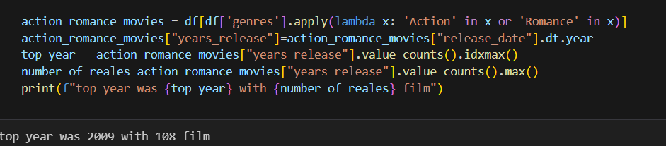
Genre-wise Analysis
Found the year with the most releases in Action and Romance.

Slide 11
Top Producing Countries & Companies
Identified top 2 countries and leading production company.
by_rev=df.sort_values("revenue",ascending=False)
by_rev["title"].head(5)
237000000 Avatar 200000000 Titanic 220000000 The Avengers 150000000 Jurassic World 190000000 Furious 7

Slide 12
Find the year with the highest number of movies release
numintheyear=df['release_date'].dt.year.value_counts()
print(f"the year is {int(numintheyear.idxmax())} with {numintheyear.max()} films")
the year is 2009 with 247 films

Slide 13
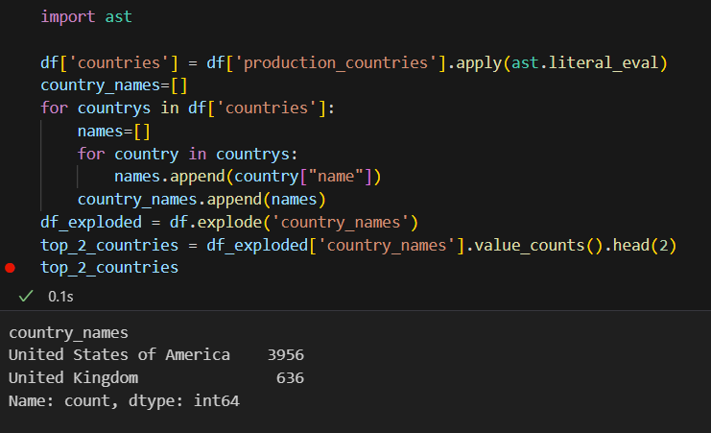
Top countries production

Slide 14
Top company production
df['companys'] = df['production_companies'].apply(ast.literal_eval)
company_names = []
for companies in df['companys']:
names = []
for company in companies:
names.append(company['name'])
company_names.append(names)
df['companys_names'] = company_names
df_exploded = df.explode('companys_names')
top_1= df_exploded['companys_names'].value_counts().head(1)
top_1
Warner Bros. 319

Slide 15
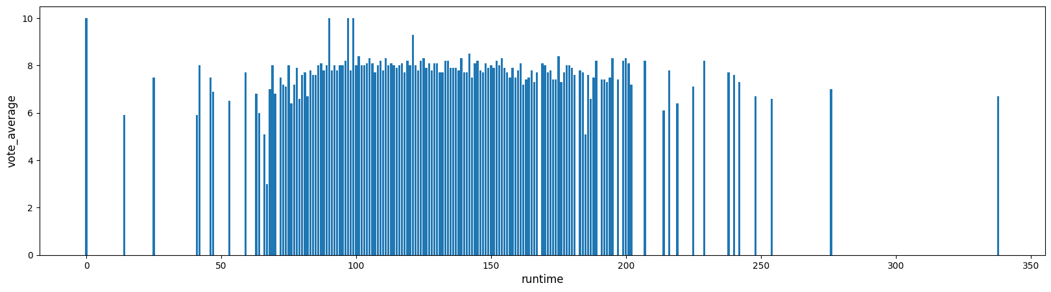
relation between the runtime and average vote
plt.figure(figsize=(20,5)) x=np.array(df["runtime"])
y=np.array(df["vote_average"])
plt.xlabel("runtime",fontsize=12)
plt.ylabel("vote_average",fontsize=12) plt.bar(x,y)
plt.show()

Slide 16
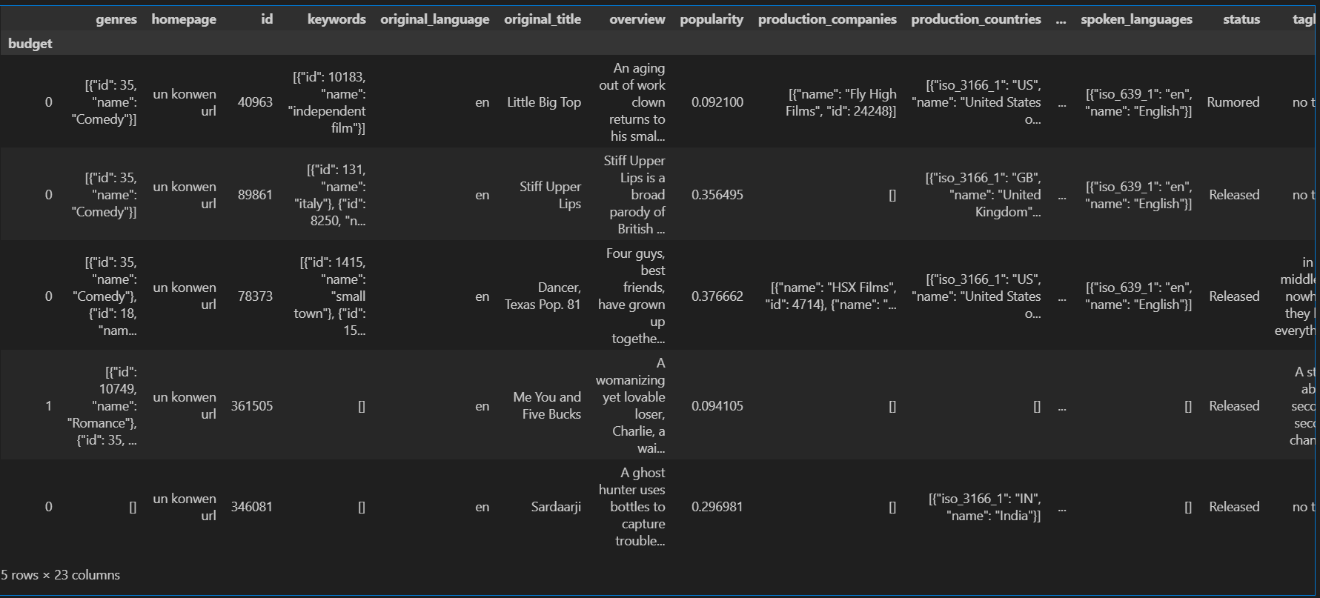
top 5 movies with the highest rate
sorted_film=df.sort_values("vote_average", ascending=False)
b=sorted_film.head(5)
b

Slide 17
most unsuccessful movie along time in terms of revenue - budget
data2 = pd.read_csv("tmdb_5000_movies.csv")
df2=pd.DataFrame(data2)
df2['profit'] = df2['revenue'] - df2['budget']
df2
sortedfilmbyprofit =df2.sort_values("profit",ascending=True)
sortedfilmbyprofit.head(1)
Profits
-165710090

Slide 18
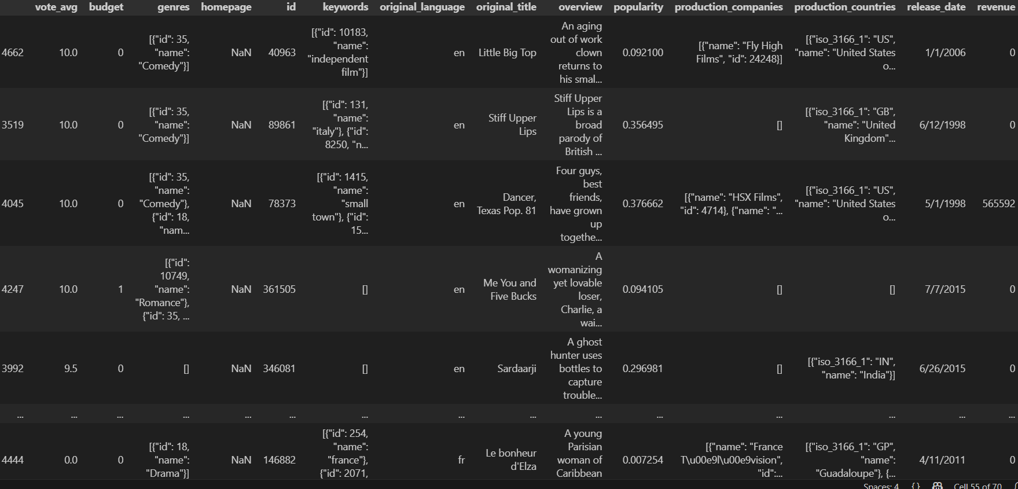
Rearange the dataframe based on vote_average
byvote=df22.sort_values("vote_average",ascending=False)
vote_avg_col = byvote["vote_average"]
byvote = byvote.drop("vote_average", axis=1)
byvote.insert(0, "vote_avg", vote_avg_col)
byvote

Slide 19
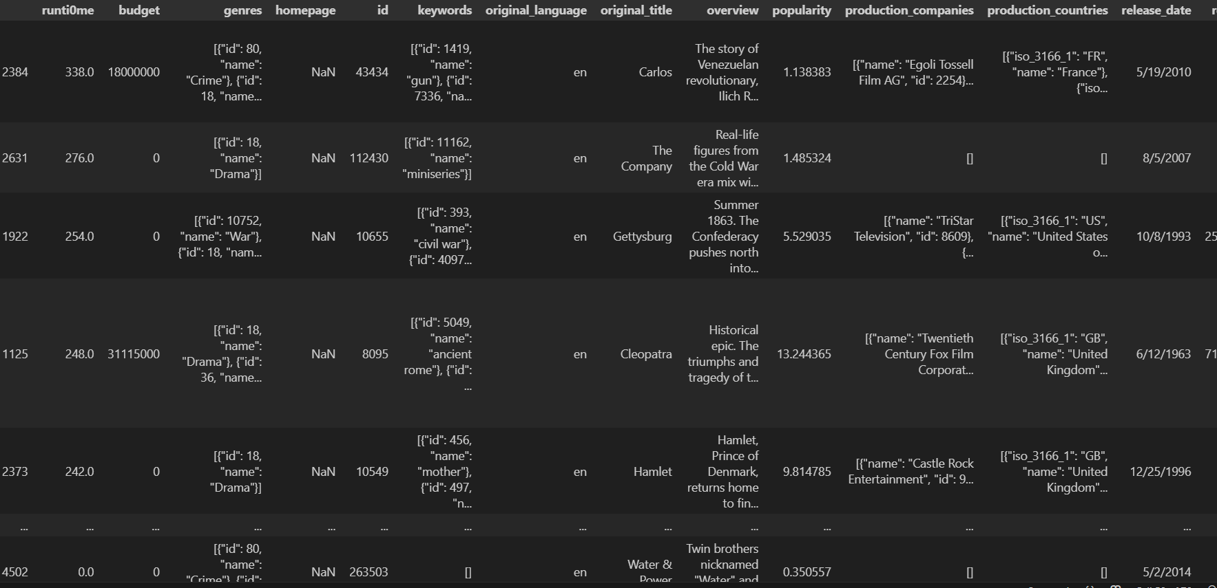
Rearange the dataframe based on runtime
byrun=df22.sort_values("runtime",ascending=False)
runtimecolll = byrun["runtime"]
byrun = byrun.drop("runtime", axis=1)
byrun.insert(0, "runti0me", runtimecolll)
byrun

Slide 20
Find the top 5 successful years for the USA cinema based on the total income devided by number of movies

Slide 21
usa = df[df["production_countries"].str.contains("United States of America", na=False)].copy()
usa.loc[:, "year"] = pd.to_datetime(usa["release_date"], errors='coerce').dt.year
top_years = (
usa.groupby('year')
.apply(lambda x: x['revenue'].sum() / len(x))
.sort_values(ascending=False)
.head(5))
print(top_years)
year
2016 1.603217e+08
1975 1.519088e+08
1939 1.478438e+08
2012 1.398315e+08
1942 1.389548e+08

Slide 22
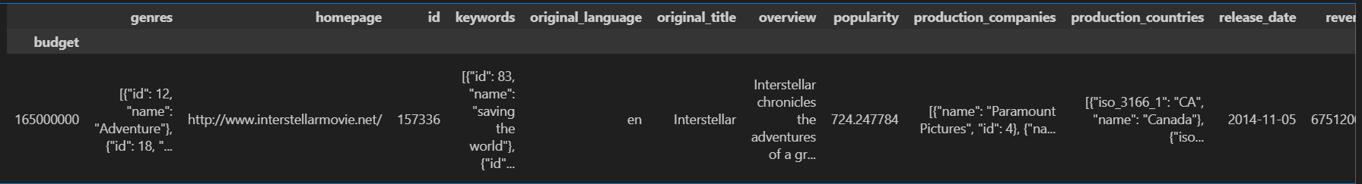
the most succesfull movie in [USA, UK]
usa_ukcima = df[df["production_countries"].str.contains("United States of America"and"United Kingdom", na=False)]
usa_ukcima.sort_values("popularity",inplace=True,ascending=False)
usa_ukcima.head(1)

Slide 23
what is the highest variable that affects the revenue value

Slide 24
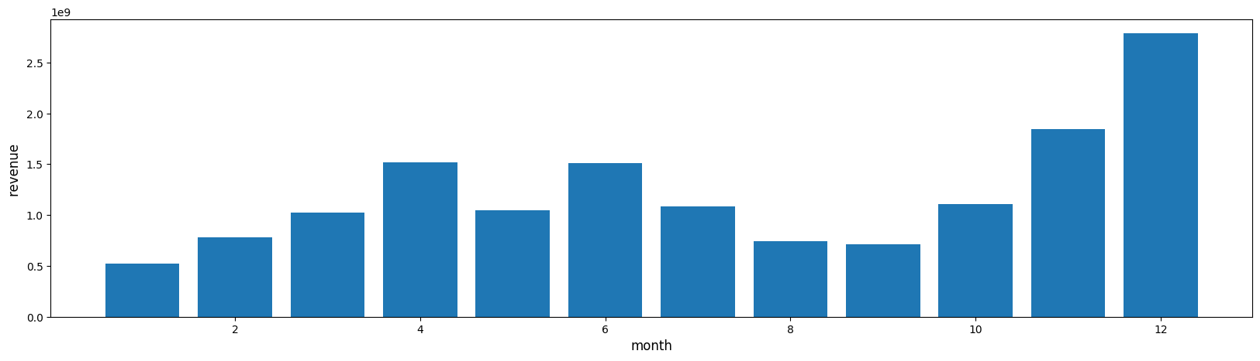
By month
plt.figure(figsize=(20,5))
df["month_release"]=df["release_date"].dt.month
x=np.array(df["years_release"])
y=np.array(df["revenue"])
plt.xlabel("month",fontsize=12)
plt.ylabel("revenue ",fontsize=12)
plt.bar(x,y)
plt.show()

Slide 25
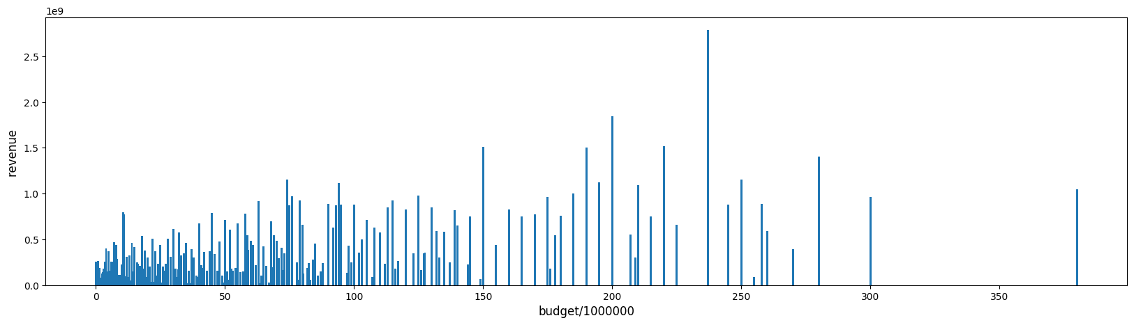
By budget
plt.figure(figsize=(20,5))
x2=np.array(df22["budget"]/1000000)
y2=np.array(df22["revenue"])
plt.xlabel("budget",fontsize=12)
plt.ylabel("revenue ",fontsize=12)
plt.bar(x2,y2)
plt.show()

Slide 26
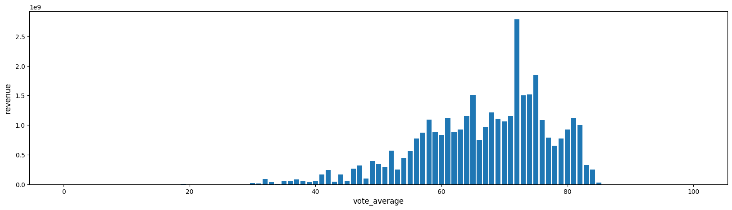
By vote
plt.figure(figsize=(20,5))
x2=np.array(df["vote_average"]*10)
y2=np.array(df["revenue"])
plt.xlabel("vote_average*10",fontsize=12)
plt.ylabel("revenue ",fontsize=12)
plt.bar(x2,y2)
plt.show()

Slide 27
I think the most important factor is the month
In witch the film was released
And the most month is December

Slide 28
Q&A
Open for any questions. Thank you for your attention!

