Slide 1


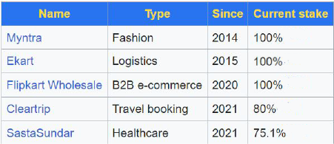
Presented by:
Debanuj Basak &
Souvick Sadhukhan

Slide 2
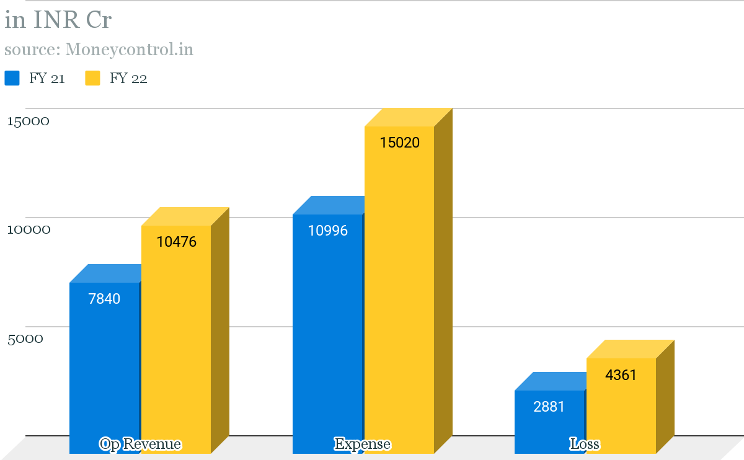
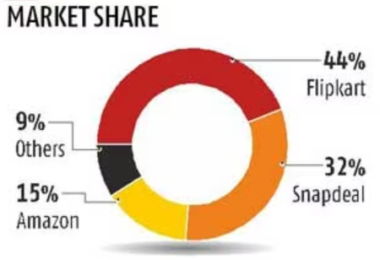
Company Statistics
Valuation: 40 Bn USD
Founders: Binny & Sachin Bansal (2007)
No. of employees: 30k
App Downloads: 4 Cr
Owners:
Walmart: 72%, tencent: 5.3%, Tiger Global: 4.1%
7840

Slide 3

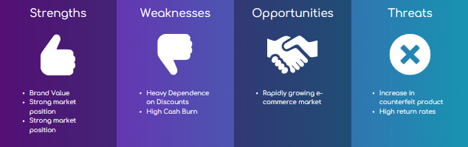
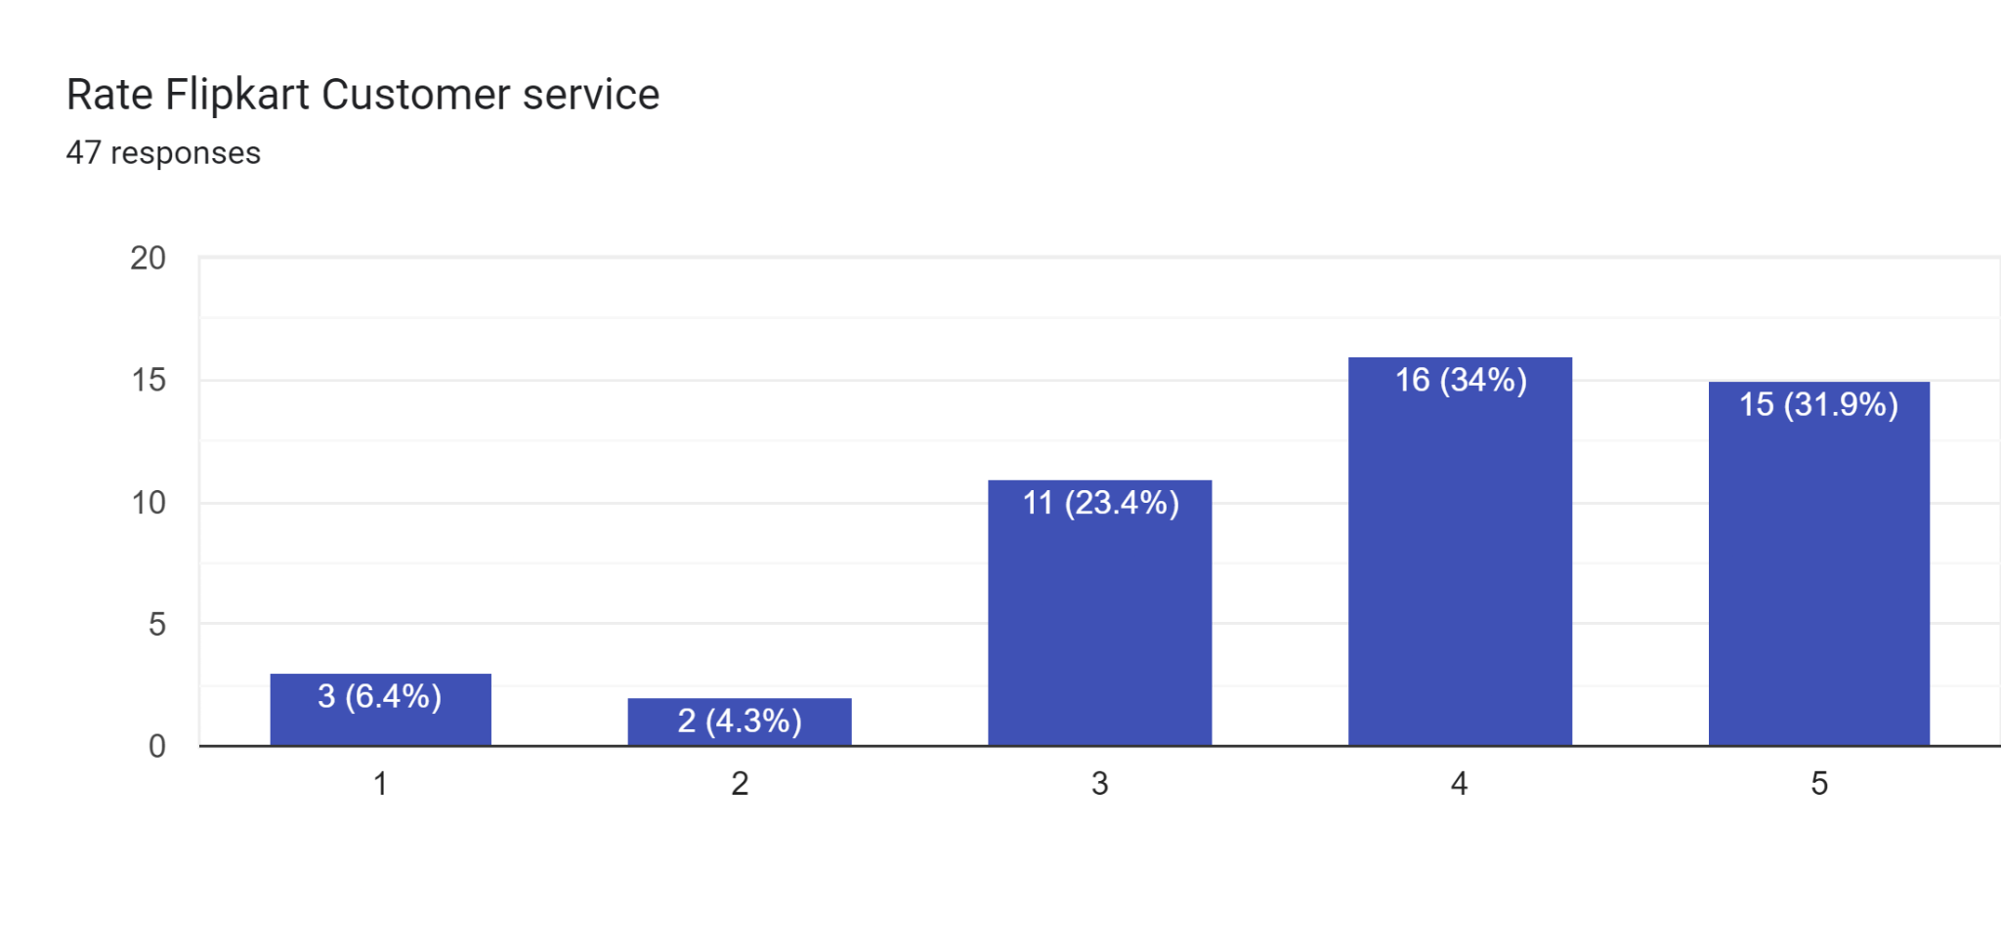
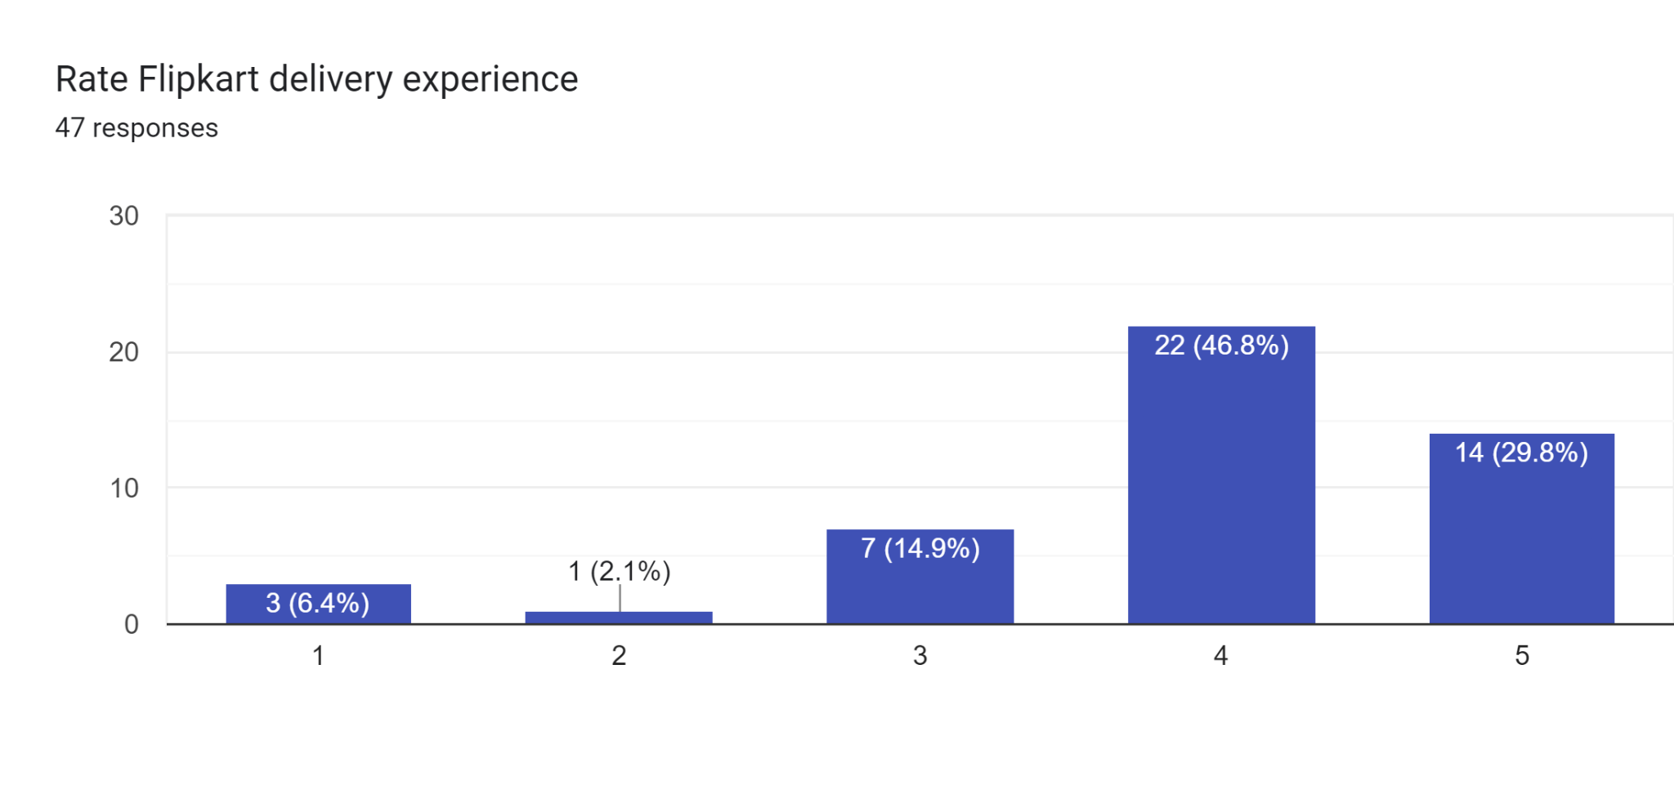
Source: https://docs.google.com/spreadsheets/d/18esFDGwnmLyKgeY8paLoeDNIfzqOxI51D7vETiZmLLg/edit?usp=sharing

Slide 4
