Slide 1
IoT
Protocols
M2M-5G
Teo GENEAU
Walid KHALED
Florian LEON
Yosra ZEYRI NEMRI

Slide 2
Summary :
1) Definition
2) How does it works?
3) Energy efficiency
4) Security
5) Miscellaneous
6) Advantages and inconvenient of M2M 5G
7) Conclusion

Slide 3
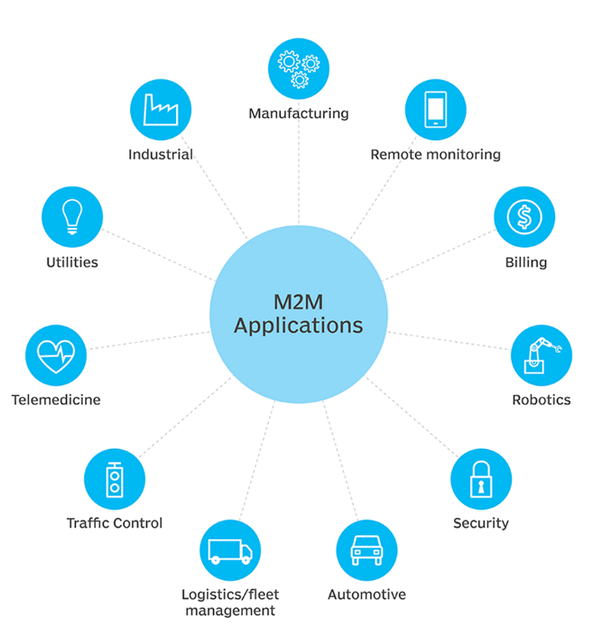
1) Introduction b) Definition
M2M communication is the system of communication for devices without human involvement.
This communication can be directly device to device communication or through a network.
For scalability and security, devices need to have connectivity with no human interaction.
Fig. M2M Applications

Slide 4
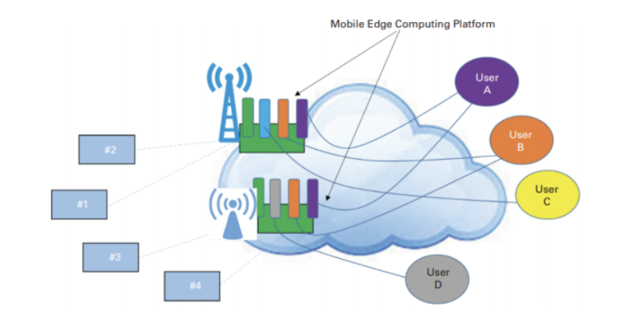
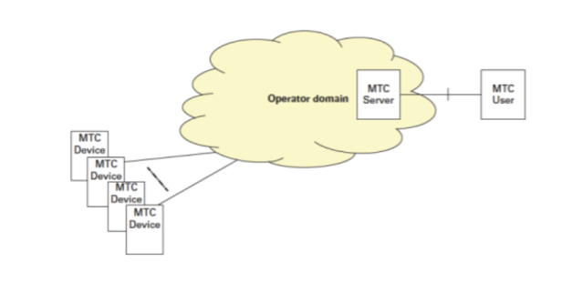
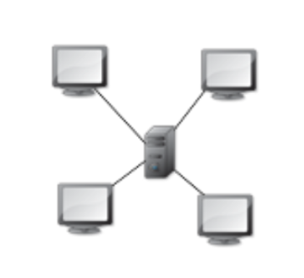
1) Introduction b) M2M Architectures
edge architecture: some of the applications are on the edge of the cloud architecture
benefits : - The response times between the machines and the applications are lower - Some of the data traffic can stay in the outskirts of all architecture
“star” architecture: several sensors or other objects communicate with a central telecom node
introduction of SIM cards on various types of machines
MTC server : manage the communication between each machine

Slide 5
2) How does it works? a) Physical Layer
European focus
of allocated 5G spectrum frequency
3,4-3,8Ghz
5,9-6,4Ghz
24,5-27,5Ghz
700Mhz
37-71Ghz
3,4-3,8GHz
700MHz
26Ghz
3,4-3,8Ghz
700Mhz
26Ghz

Slide 6
2) How does it works? a) Physical Layer
100GHz
30GHz
6GHz
1GHz
24-29,5GHz
57-71GHz
~700MHz
3,4-3,8GHz
Low-band
Bandwidth from 5MHz to 100MHz
Mid-band
Bandwidth from 5MHz to 100MHz
High-band (mmwave)
Bandwidth from 40MHz to 400MHz
Very High-band

Slide 7
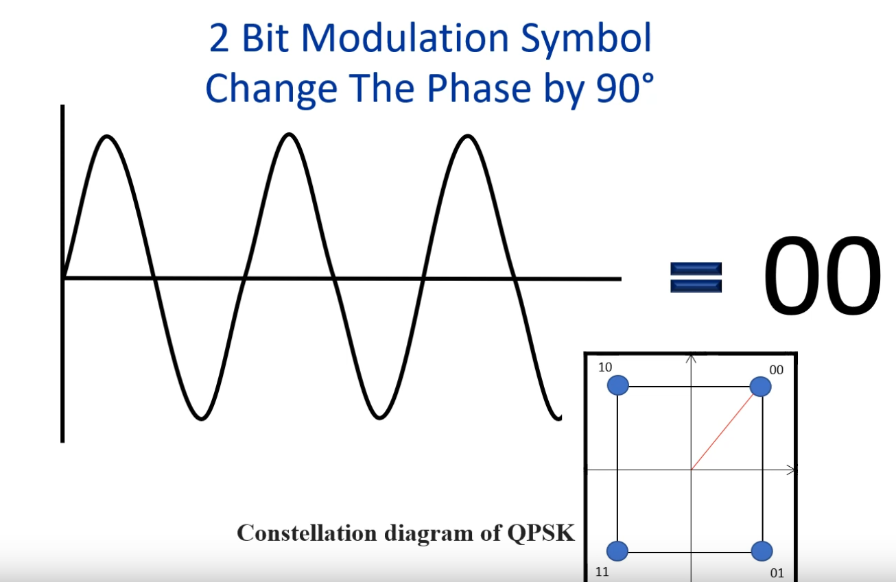
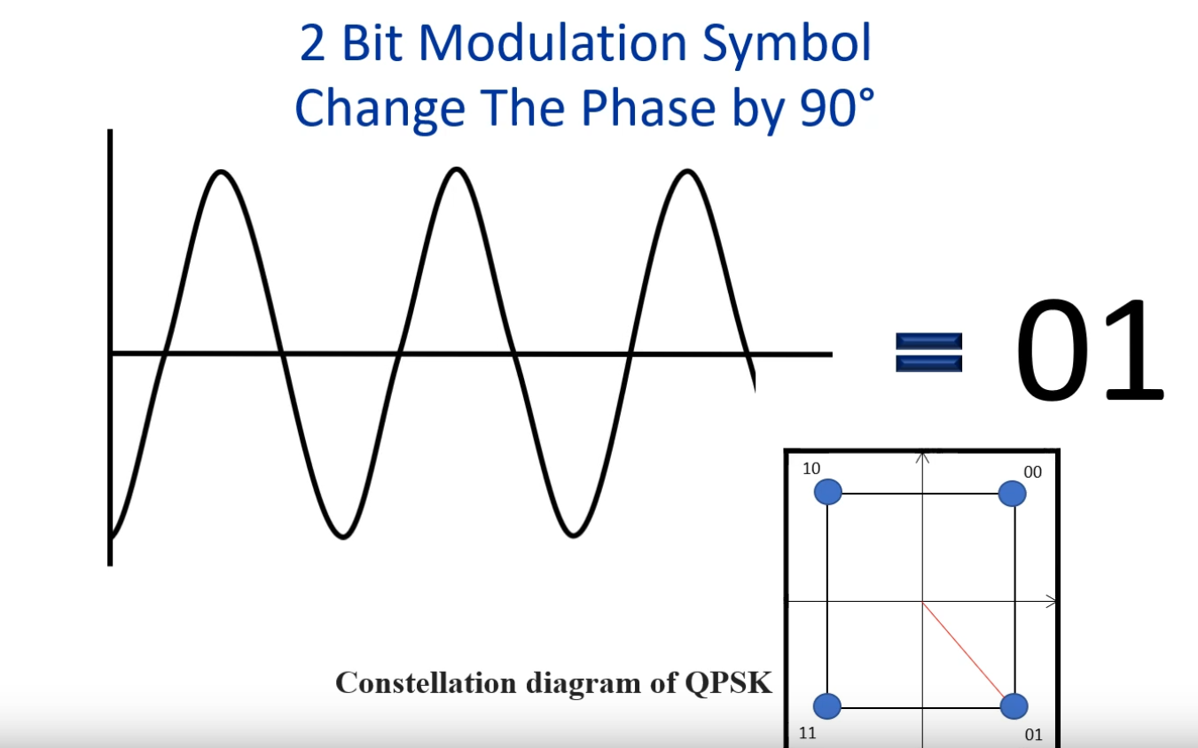
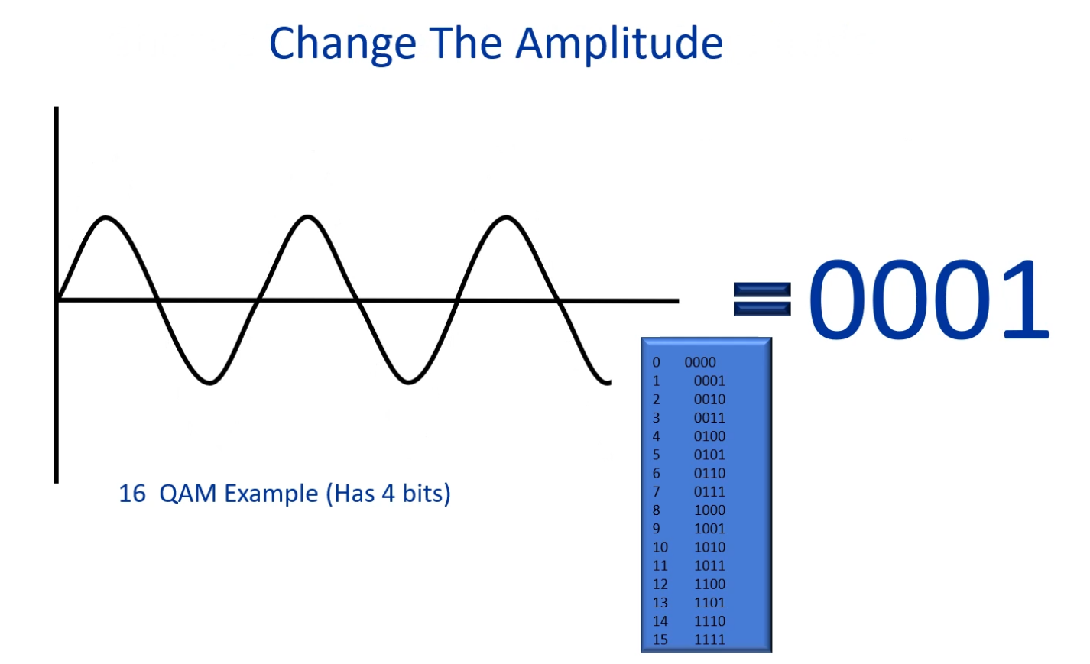
2) How does it works? a) Physical Layer
Modulation :
OFDM type with 16QAM variations = Quadrature Amplitude Modulation or QPSK variations Quadrature Phase Shift Keying
Quadrature Phase Shift Keying Principle (source alantalkstech : modulation base principle)
Quadrature Amplitude Modulation principle
7

Slide 8
Ref: https://www.rfwireless-world.com/Terminology/LTE-M-Protocol-Stack.html
2) How does it works? b) MAC Layer
The MAC layer is primarily responsible for channel access for nodes within a network that use a shared medium.
In the uplink: - Channel mapping - Multiplexing, - Handling control elements, - Random access procedure, - Logical channel priority, - HARQ.
In the downlink: - Channel mapping, - De-multiplexing, - DRX, - Handling control elements, - HARQ.
The vast number of devices in M2M communications, their diverse service requirements, and the unique traffic characteristics pose a real MAC layer design challenge.

Slide 9
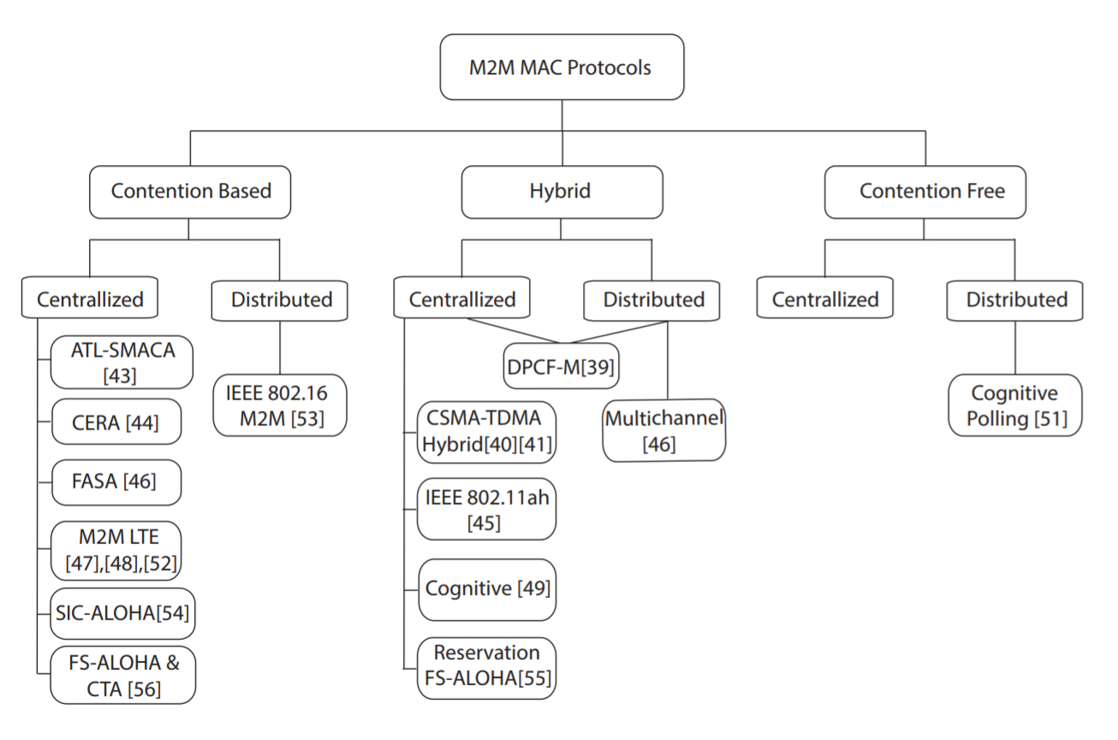
2) How does it works? b) MAC Layer
MAC protocols for M2M communications should be efficient, scalable, consume low power, have low latency, and be implementable using low cost hardware.
Fig. Taxonomy of M2M MAC protocols.
Ref: A. Rajandekar and B. Sikdar, "A Survey of MAC Layer Issues and Protocols for Machine-to-Machine Communications"

Slide 10
2) How does it works? b) MAC Layer
Methods to decrease the energy consumption by MAC layer is: 1) reducing collisions, 2) Sleep Scheduling, 3) power control, 4) Reduce idle listening.

Slide 11
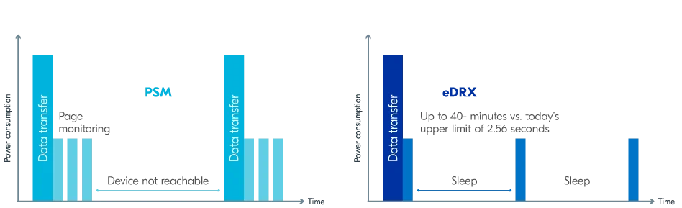
Img: https://www.nordicsemi.com/Products/Low-power-cellular-IoT/What-is-cellular-IoT
3) Energy efficiency a) Power saving techniques
Power Saving Mode:
The device enters a deep sleep mode where it can only send data
The sleeping time vary from 4 hours to 412 days
Only wakes up if it needs to send data or if the pre-defined timer expired
Extended Discontinuous Reception:
Extend the paging monitoring intervals by a few seconds/minutes
We tolerate that the device will not be reachable for a few minutes
The sleeping time vary from 5 seconds to 43 minutes

Slide 12
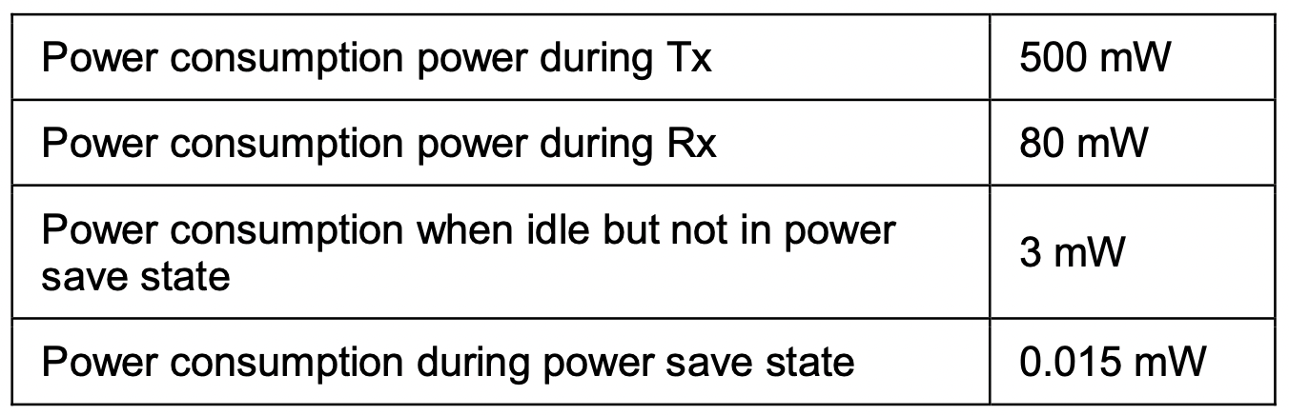

3) Energy efficiency b) Computation
Average power consumption of LTE-m
1 MB/s
Average network capacity
500 µJ/bit
Formula

Slide 13
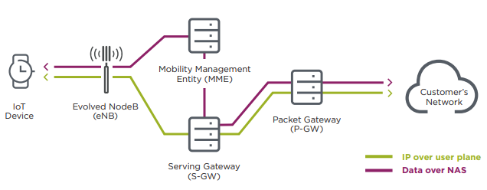
Security
1) DoNAS
Data over NAS (DoNAS) is a control plane cellular IoT optimisation that allows the network to transport user data within signalling messages. This feature transports user data or SMS messages via the MME (mobility management entity) by encapsulating them in NAS (non-access stratum) signalling.
Security-Features-of-LTE-M-and-NB-IoT-Networks.pdf (gsma.com)

Slide 14
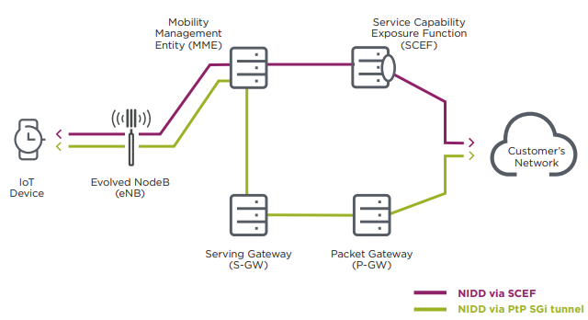
4) Security
2) Non-IP Data Delivery (NIDD)
1) Transport data using a point-to-point (PtP) 5G interface tunnel to the application server. This means that the device can only communicate with the pre-defined application server, making the communications link more secure by restricting the destination
2) Transport data using the service capability exposure function (SCEF). The SCEF provides a means to securely expose service and network capabilities through network application programming interfaces (APIs)

Slide 15
4) Security
Security fundamentals
Confidentiality
Confidentiality consists essentially in keeping information secret from unauthorized third parties. An integrated network should not disclose data neighboring networks or adversaries
Integrity
Integrity means that the data produced and consumed by the network must not be modified in a malicious manner. This is a mandatory property
Availability
Availability implies that the users of an integrated network must be able to access its services when needed
Freshness
Freshness means that the data must be recent in order to allow protection of old messages. This is an important security requirement to ensure that no message has been replayed

Slide 16
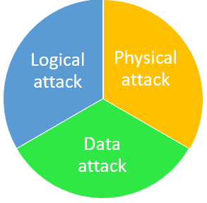
4) Security
Causes of security failures
Since the communication standards and protocols are the same, the same hacking methods are applied.
Machines are also connected to the Internet, an open door for remote attacks.
The machines operate autonomously in the field 24 hours a day, 7 days a week. It's much harder to quickly detect an attack and even harder (and more expensive) to physically access devices to fix them.
The nature of M2M deployments introduces a number of unique security vulnerabilities such as physical attacks, theft and tampering of the M2M device, core network attacks, compromise of credentials, user data and identity privacy attacks, etc
16

Slide 17
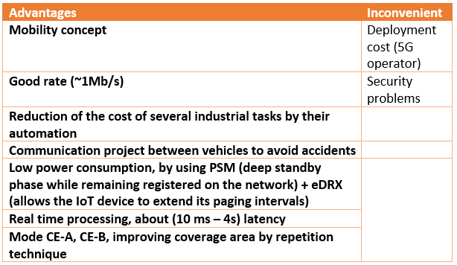
6) Advantages and disadvantages
17

Slide 18
Conclusion
There is a compromise to be found, and it depends on the application in question, if we want to give priority to the scope, security or the flow rate.
M2M is the right choice for an application that requires high throughput and wide range
18

Slide 19
References
[1] A. Talaminos-Barroso, M. A. Estudillo-Valderrama, L. M. Roa, J. Reina-Tosina, et F. Ortega-Ruiz, « A Machine-to-Machine protocol benchmark for eHealth applications – Use case: Respiratory rehabilitation », Computer Methods and Programs in Biomedicine, vol. 129, p. 1‑11, juin 2016, doi: 10.1016/j.cmpb.2016.03.004.
[2] « What is Machine-to-Machine (M2M)? », IoT Agenda. [Online]. Disponible sur: https://internetofthingsagenda.techtarget.com/definition/machine-to-machine-M2M. [Consulté le: 17-oct-2021]
[3] B. Ray, « What is M2M? [2018 Update] ». [Online]. Disponible sur: https://www.link-labs.com/blog/what-is-m2m. [Consulté le: 17-oct-2021]
[4] M. Ptiček, V. Cackovic, M. Pavelić, M. Kusek, et G. Jezic, « Architecture and functionality in M2M standards », 2015, p. 413‑418, doi: 10.1109/MIPRO.2015.7160306.
[5] « How Machine-to-Machine Communication Works », HowStuffWorks, 24-avr-2008. [Online]. Disponible sur: https://computer.howstuffworks.com/m2m-communication.htm. [Consulté le: 17-oct-2021]
[6] C. Anton-Haro et M. Dohler, Machine-to-machine (M2M) Communications: Architecture, Performance and Applications. Elsevier, 2014.
[7] « LTE-M Deployment Guide - Release 3 », Internet of Things. [Online]. Disponible sur: https://www.gsma.com/iot/resources/ltem-deployment-guide-v3/. [Consulté le: 17-oct-2021]
[8] R. Merz, D. Wenger, D. Scanferla, et S. Mauron, « Performance of LTE in a high-velocity environment: a measurement study », in Proceedings of the 4th workshop on All things cellular: operations, applications, & challenges, New York, NY, USA, 2014, p. 47‑52, doi: 10.1145/2627585.2627589 [Online]. Disponible sur: https://doi.org/10.1145/2627585.2627589. [Consulté le: 17-oct-2021]
[9] « Release 14 ». [Online]. Disponible sur: https://www.3gpp.org/release-14. [Consulté le: 17-oct-2021]
[10] alantalkstech, Modulation & QAM Basics. 2020 [Online]. Disponible sur: https://www.youtube.com/watch?v=vzIk9ungyvc. [Consulté le: 17-oct-2021]
[11] A. Rajandekar et B. Sikdar, « A Survey of MAC Layer Issues and Protocols for Machine-to-Machine Communications », IEEE Internet of Things Journal, vol. 2, nº 2, p. 175‑186, avr. 2015, doi: 10.1109/JIOT.2015.2394438.
[12] Georges, « LTE-M : tout comprendre sur le réseau LTE CAT-M1 ». [Online]. Disponible sur: https://www.matooma.com/fr/s-informer/actualites-iot-m2m/ltem-avantages-specificites-techniques. [Consulté le: 14-oct-2021]
[13] « Le LTE-M s’enrichit de nouvelles fonctionnalités », Orange Business Services. [Online]. Disponible sur: https://www.orange-business.com/fr/magazine/lte-m-version-2020-senrichit-par-nouvelles-fonctionnalites. [Consulté le: 14-oct-2021]
[14] D. Rapone, D. Sabella, et M. Fodrini, « Energy efficiency solutions for the mobile network evolution towards 5G: an operator perspective », in 2015 Sustainable Internet and ICT for Sustainability (SustainIT), 2015, p. 1‑9, doi: 10.1109/SustainIT.2015.7101367.
[15] « LTE-M connectivity optimized for IoT », Thales Group. [Online]. Disponible sur: https://www.thalesgroup.com/en/markets/digital-identity-and-security/iot/resources/innovation-technology/lte-m. [Consulté le: 14-oct-2021]
[16] R. Ratasuk, N. Mangalvedhe, D. Bhatoolaul, et A. Ghosh, « LTE-M Evolution Towards 5G Massive MTC », in 2017 IEEE Globecom Workshops (GC Wkshps), 2017, p. 1‑6, doi: 10.1109/GLOCOMW.2017.8269112.
[17] F. Ennesser, « Security in Machine-to-Machine Communication: The role of the Telecommunication Operator », p. 16.
[18] B. Nihad, « Etude et Application d’un Système de Communication M2M », Thesis, Faculté des Sciences et Technologies, 2019 [Online]. Disponible sur: https://dspace.univ-bba.dz:443/xmlui/handle/123456789/507. [Consulté le: 14-oct-2021]
[19] I. Cha, Y. Shah, A. U. Schmidt, A. Leicher, et M. Meyerstein, « Security and Trust for M2M Communications 1 ». .
19

Slide 20
THANK YOU FOR
YOUR ATTENTION
20

