Slide 1

MAC protocols dedicated to WSN/IoT
Yosra ZEYRI NEMRI
19/11/2021

Slide 2
Study of diﬀerent selected protocols based on:
Type of channel access
Description of the MAC protocol, how it works, its accuracy, its mechanisms
Clock synchronization
Operation, accuracy, security mechanisms, node mobility
Comparison between protocols
Energy consumption

Slide 3
Access Type:
CSMA: reduce the risk of collision.
TDMA: transmit over diﬀerent time slots.
MAC Protocol | Access Type
S-MAC | CSMA
T-MAC | CSMA
B-MAC | CSMA
DMAC | TDMA
ZMAC | CSMA + TDMA
TEEM | CSMA

Slide 4
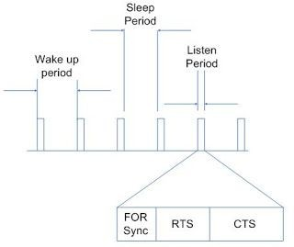
S-MAC Protocol (Sensor Medium Access Protocol) :
Protocol based on the synchronization of the wake-up and sleep periods of the sensors.
Each node in the network listens to the channel for a period of time T.
Synchronization of clocks, so that all objects are awake at the same time and can exchange data.
Each node can change its wake-up periods depending on the nodes around it.
Each node can thus be mobile and adapt permanently to its neighborhood.

Slide 5
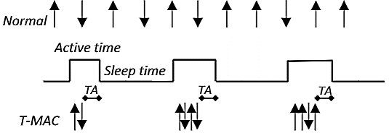
T-MAC Protocol (Timeout MAC) :
Same operation as the S-MAC protocol.
Able to improve on the poor results that the S-MAC protocol can achieve under varying traﬁc loads.
Dynamic sleep schedules.
Problem with early sleep that this protocol encounters.
Nodes may sleep according to their activation time resulting in data loss especially concerning long messages.

Slide 6
Berkeley-MAC Protocol:
It’s a carrier-sensing media access (CSMA) protocol for wireless sensor networks that provides a flexible interface to achieve ultra-low power operation, efficient collision avoidance, and high usage of canals.
B-MAC is an answer to problems that S-MAC and T-MAC are unable to solve such as: - Flexibility: The need for accounting for network condition change. - Simplicity: The need for simple implementations with small code for devices with limited RAM sizes - Scalability: When high-scalability is your top priority
To achieve low power operation, B-MAC uses an adaptive preamble sampling scheme to reduce duty cycle and minimize idle listening.

Slide 7
DMAC Protocol (Directional Medium Access Control) :
The most common communication pattern observed in sensor networks, unidirectional paths from the sources to the sink are represented as data collection trees.
Collision avoidance methods are not used by this protocol.
When a number of nodes have the same level in the data collection tree, they will try to send data simultaneously to the same node, causing collisions, knowing that the data transmission paths may not be known in advance.

Slide 8
ZMAC Protocol (Zebra Medium Access Protocol ) :
Z-MAC is known one of the most important example in hybrid scheme, as well as, the Scheduled Channel Polling MAC (SCP-MAC) and Funneling-MAC protocol
It combines the two approaches Carrier Sense Multiple Access (CSMA) and Time Division Multiple Access (TDMA)
It works as follows: an entity can use wasted time slots to send their packets. Consequently, an entity can use the time slot of other entities: the collision-free is not guaranteed.

Slide 9
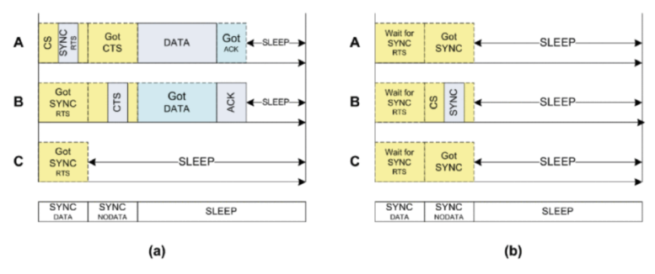
TEEM (Traffic Aware Energy Efficient MAC) :
TEEM consists of an improved version of S-MAC. The main modifications include reduced idle listening when no data is being transmitted by turning off node’s radio much earlier.
The most important optimization behind TEEM protocol is that a node with data to transmit can schedule its transmission together with an RTS packet, thus, it only needs to contend the channel once.
Advantages : Greater energy efficiency than S-MAC
Disadvantages : Higher end-to-end latency compared to S-MAC

Slide 10
References :
https://www.researchgate.net/publication/284800861_Wireless_sensor_network_mac_protocol_Smac_and_tmac/fulltext/57aa5a3d08ae42ba52ac4010/Wireless-sensor-network-mac-protocol-Smac-and-tmac.pdf
https://www.researchgate.net/publication/330381472_MAC_Layer_Protocols_for_Internet_of_Things_A_Survey
https://www.hindawi.com/journals/wcmc/2017/2801204/ https://dergipark.org.tr/en/download/article-file/83134 https://www.researchgate.net/publication/272623927_Comprative_Analysis_of_WSN_MAC_Protocols
https://www.researchgate.net/publication/329514255_A_Taxonomy_for_MAC_Protocols_in_Wireless_Sensor_Networks_Based_on_Traffic_Prioritization
https://www.semanticscholar.org/paper/A-traffic-aware%2C-energy-efficient-MAC-protocol-for-Suh-Ko/dcbf44ad41ef1803962fce2c5e821b718588ebf8

Slide 11
Thank You!

