Slide 1
Density-Based Spatial Clustering of Applications (DBSCAN)
By
Soham Jayantrao Deshmukh (SD1279, 203006007)
STAT 587 (Spring 2022)

Slide 2
DBSCAN: Introduction
As the name suggests, the algorithm uses density of the data points to form clusters
Requires two user set parameters to (neighborhood distance and threshold) begin
Insensitive to noise, can identify and exclude noise from results
Can find any shaped clusters (as opposed to traditional spherical clusters)

Slide 3
How It Works: Terms and Explanation
EPS: Neighborhood measure. Two points are neighbors if distance between them is less than or equal to eps
minPts: minimum data points to form a cluster
Core point: a point which has at least minPts points in its EPS radius (there can be more than one core points in a cluster)
Border point: a point reachable from a core point but has less than minPts in its neighborhood
Outlier: Neither a core point nor reachable from a core point

Slide 4
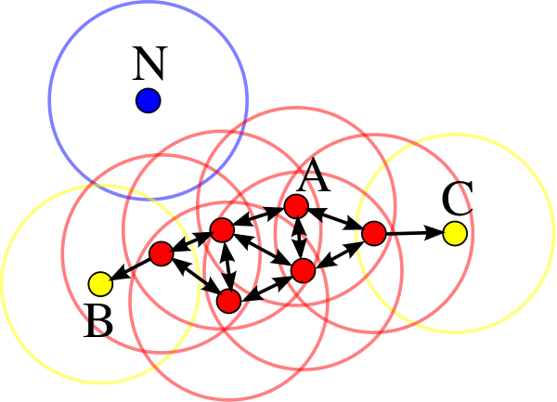
How It Works: continued…
Fig 1: Cluster formation

Slide 5
How It Works: The Algorithm
Choose values for EPS and minPts
Select a random point and check if it’s a core point
Start cluster formation if it’s a core point: cluster includes finding all the core points in the initial clusters and their neighbors
When we can no longer include any more points in the above cluster, go to step 2 and start with random unvisited point
Repeat the process until all points are visited

Slide 6
Some Remarks
A cluster includes core points and all their border points
A point that is not marked as a core point while traversing is marked as noise
Noise points maybe revisited later and become part of a cluster
The algorithm is very sensitive to the neighborhood radius, so the choice of the distance measure matters a lot
Choice of minPts is very domain dependent but a rule of thumb can be used if needed (D = number of dimensions):
minPts >= D + 1 (for small data) or minPts = 2*D (for large data)

Slide 7
DBSCAN: IRIS Dataset
Used eps = 0.4, and minPts = 4 after trying and testing different values
We have 4 clusters and some outliers
Table 1: Number of clusters for different EPS and minPts
Table 2: All four clusters

Slide 8
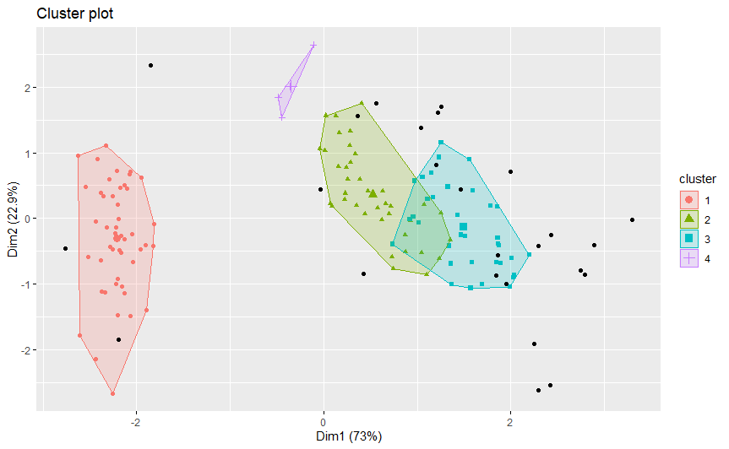
DBSCAN: IRIS - Clusters
Plot 1: IRIS Clusters

Slide 9
DBSCAN: Seismic Zones of India
https://ieeexplore.ieee.org/document/8674964
The dataset consists of longitude, latitude, depth, magnitude, and location of the seismic activities in Indian subcontinent
Location (chr) is not included in the analysis as we need to calculate distance matrix (for neighborhood radius)
Eps = 2.5 seems to result in desirable number of clusters
Table 3: Number of clusters for different EPS and minPts
Table 4: 11 clusters covering majority of the cases

Slide 10
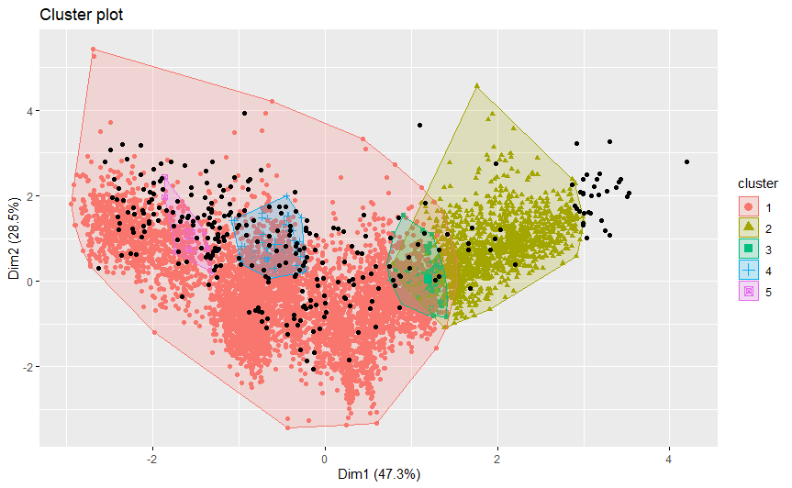
DBSCAN: Seismic Zones of India - Result
Plot 2: Earthquakes in India Output

Slide 11
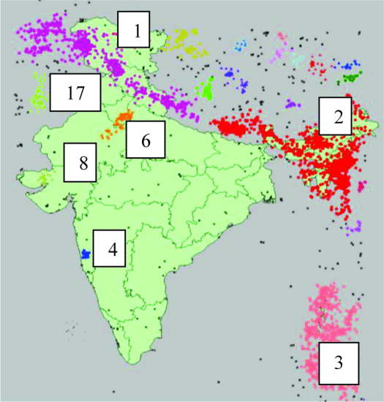
DBSCAN: Seismic Zones of India - Result
Plot 3: Earthquakes in India Actual

Slide 12
DBSCAN: Seismic Zones of India - Remarks
The algorithm identified major regions in India that have seismic activities
The original research uses Harvensine distance to calculate the neighborhood
Location data (included in the original analysis) is used to plot the clusters on the map
The differences in the output and original paper can be attributed to the above changes

Slide 13
Comparing DBSCAN with k-Means
Arbitrary shaped clusters with possibly different feature sizes
No need to specify number of clusters (but eps and minPts)
Inefficient for high dimensional datasets
Can identify and handle outliers/noise in datasets
Does not work well with datasets of varying density
More or less spherical clusters with same feature size
Sensitive to value of k
More efficient for larger datasets
Does not work well with outliers and noisy datasets
Varying density of data points has no effect

Slide 14
Thank you

Slide 15
Acknowledgments
Identification of Seismic Zones of India using DBSCAN - https://ieeexplore.ieee.org/document/8674964
Dataset - National Center for Seismology - https://riseq.seismo.gov.in/riseq/earthquake/archive
DBSCAN Clustering — Explained

