Slide 1

SQL
ENG : SAMEH
Elshafay

Slide 2

start
SQL
DDL
DML
Data Definition Language
Data manipulation Language
create alter drop truncae
select
insert
update
delete

Slide 3
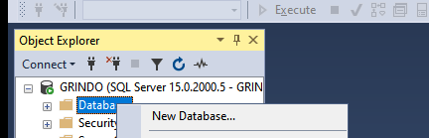
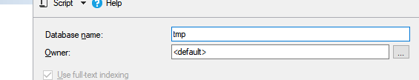


Create Database
OR

Slide 4
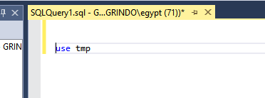

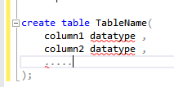
Create Table
Table name

Slide 5
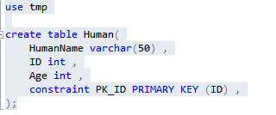
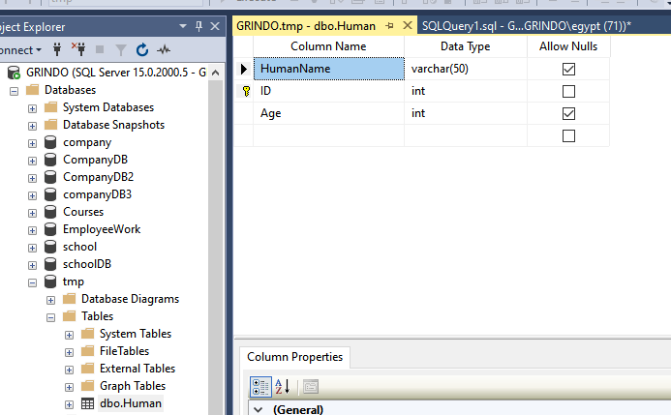
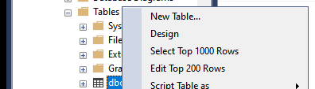
Ex
1
4
5
2
3

Slide 6
Not null

Slide 7

Drop database

Slide 8

Drop table

Slide 9

Alter - add

Slide 10

Alter - drop

Slide 11

Alter – drop constraint

Slide 12

truncate
To clear the table

Slide 13
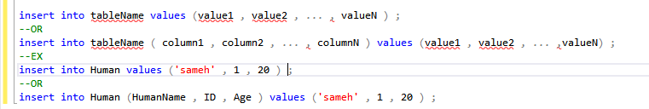
insert

Slide 14

Update

Slide 15


delete
All table

Slide 16
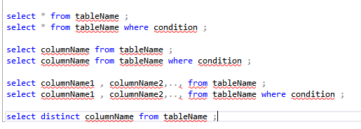
select

Slide 17

where

Slide 18

like
a in the Ending of word
a in the middle of word
a in the start of word

Slide 19

Order by

Slide 20

And - or

Slide 21

Between - and

Slide 22

Alias

Slide 23


Primary key
OR

Slide 24


Foreign key
OR

Slide 25
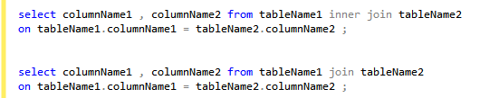
Join – inner join
intersection
OR

Slide 26
outer join – left join
L

Slide 27
outer join – right join
R

Slide 28

Join – full join

Slide 29

union
Without Repetition

Slide 30

All union
With Repetition

Slide 31

Function - min

Slide 32

Function - max

Slide 33

avg

Slide 34

count

Slide 35
sum

Slide 36

having

Slide 38
END

