Slide 1
charts
Taught by Yossef Ayman Zedan

Slide 2
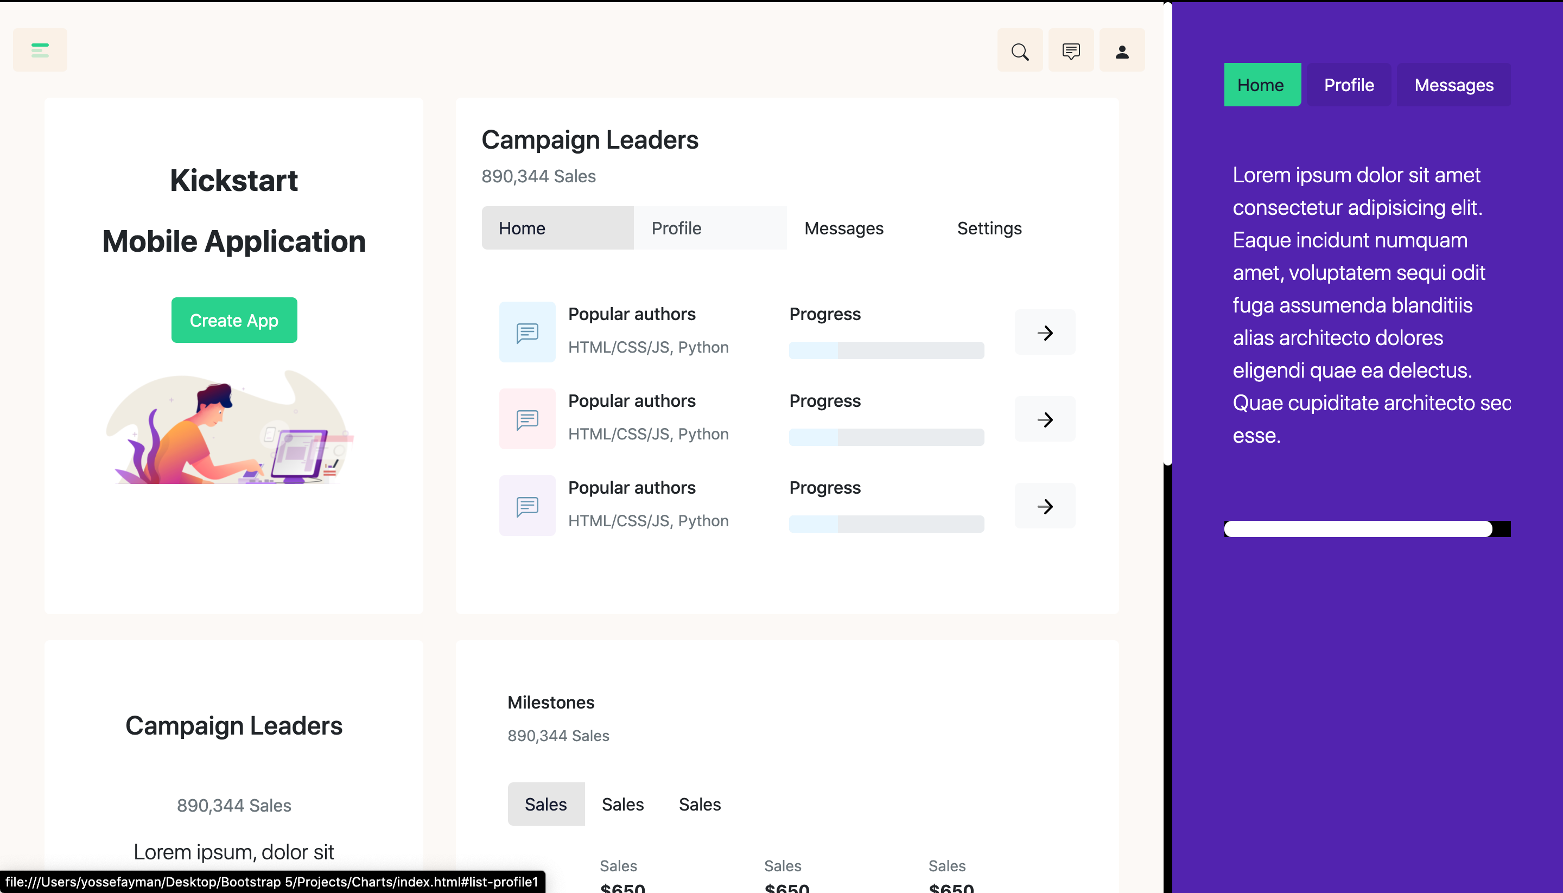
The layout

Slide 3

The layout

Slide 4
The layout
We can notice that the navbar is at the right for the large screen and at the top for the smaller screen

Slide 5
Body
We will add class: bg-danger and edit its Style to be:
$danger: #fbf9f6;

Slide 6
Navbar
The Navbar is the idea of this project
The navbar has $info: #5710b2; (bg-info)
The first thing to do is to make the navbar float for the large screen by adding: float-lg-end inside div element before the nav tag
The navbar has align-items-center. So we need to give align-items-start to make the content at the top instead of the center. We will also add px-5
The navbar brand will take d-lg-none d-block
We can add overflow-auto to the navbar-collapse if you wish to add a long scrolling x-axis content
The ul of the navbar is flex-row. We will add to it flex-column
Then list group with JS behavior and horizontal list group items

Slide 7
Navbar
$list-group-active-color: #181C32;
$list-group-active-bg: #e6e6e6;
$list-group-border-radius: 5px;
$list-group-border-width: none;
Main content has overflow-auto

Slide 8
Menu

Slide 9
Menu
We will add d-flex to this menu
We will add button with me-auto for the offcanvas to move the rest of items to the right side and then add the content
$offcanvas-vertical-height: 100vh;
A button for the modal, a button for the toast with form and the last button for the dropdown
The ul of the dropdown has: style="width: 270px;”
And then we will add flexible classes to reach the form of the dropdown
For the upper part: d-flex text-white align-items-center justify-content-evenly p-3 bg-info rounded-2
A div for the image and the second one for the text

Slide 10
Menu
Then add row text-center px-3 text-dark mb-0 position-relative
col-6 border border-2 py-3 border-top-0 border-start-0 position-relative
<a href="#" class="stretched-link btn"> and type the content inside

Slide 11
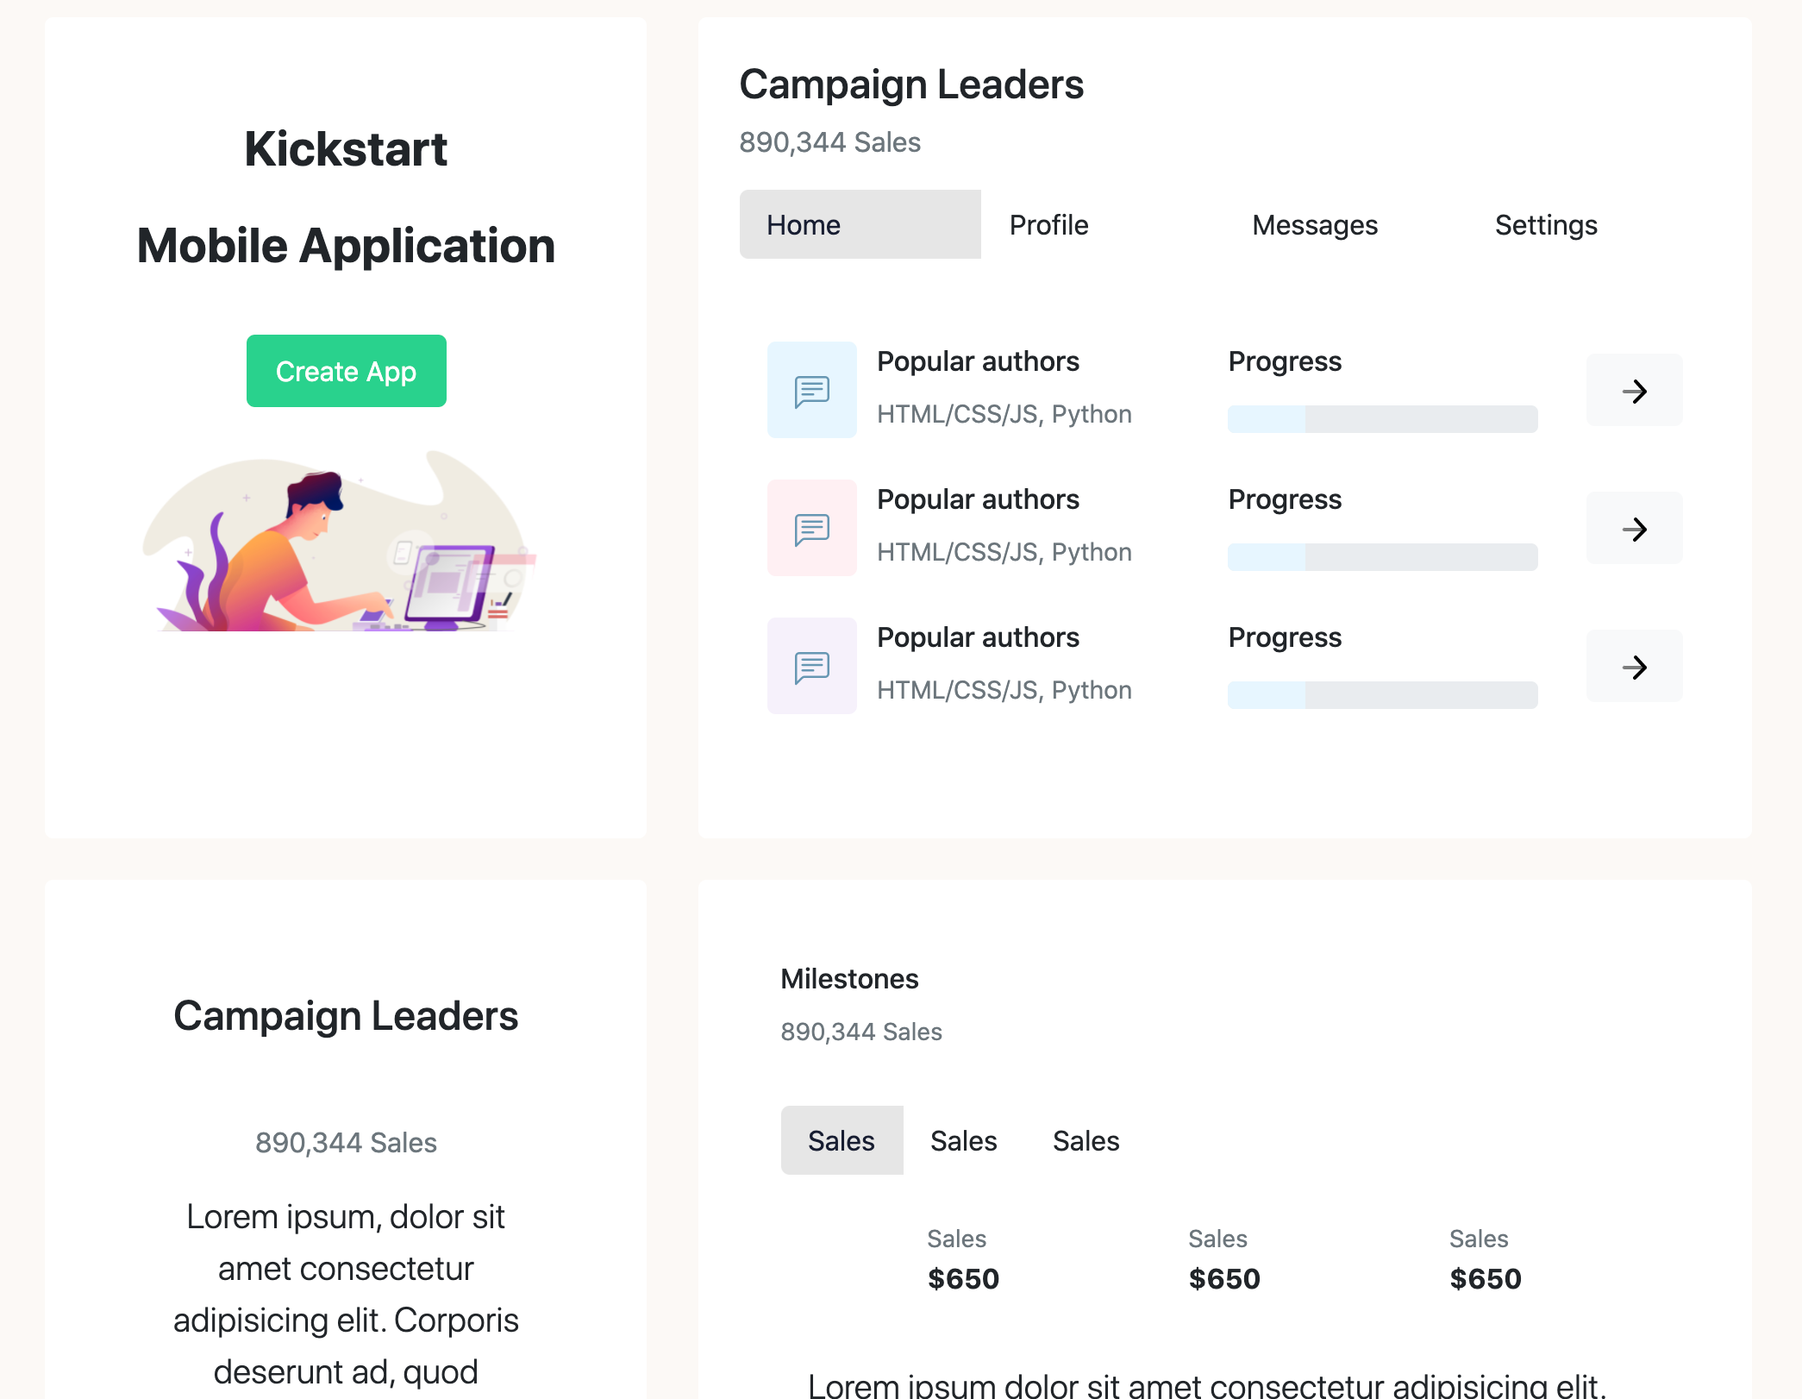
Main content

Slide 12
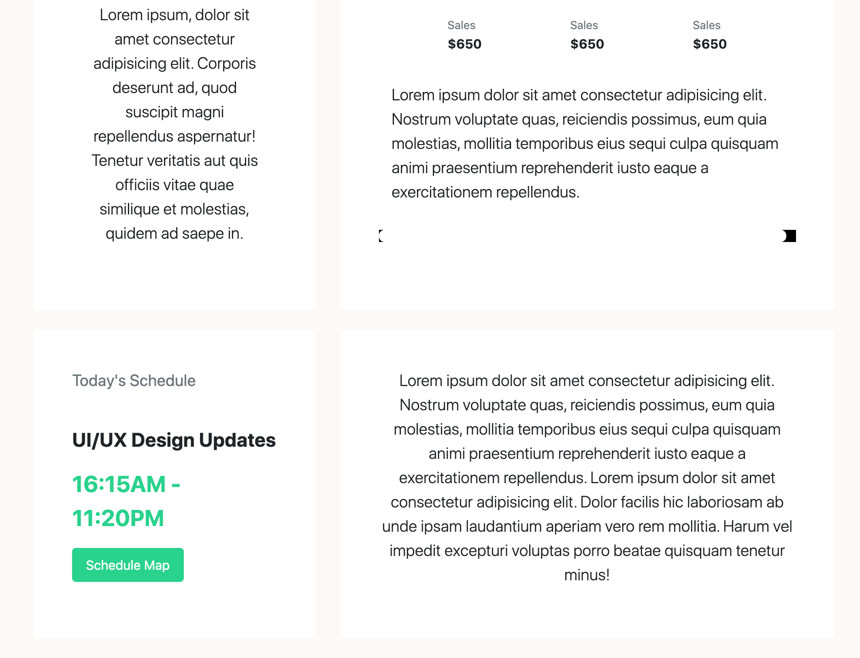
Main content

Slide 13
Main content
It contains 3 rows with <div class="col-md-4 col-8 p-5 text-center bg-body rounded-3"> and col-md-7 mt-md-0 mt-4 rounded-3 p-4 bg-body.
We will add list groups and some content

