Slide 1
newspaper
Taught by Yossef Ayman Zedan

Slide 2
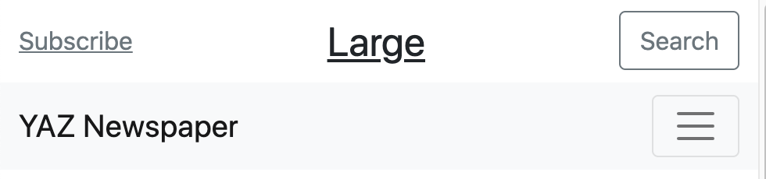
Top section
Top section doesn’t collapse, just the Navbar.
We will use our own custom flexbox for this section.
<div class="container d-flex justify-content-between align-items-center">
<div class="container d-flex justify-content-between align-items-center">
<div>
<a href="#" class="link-secondary">Subscribe</a>
</div>
<div>
<a href="#" class="link-dark fs-2">Large</a>
</div>
<div>
<button class="btn btn-outline-secondary">Search</button>
</div>
</div>

Slide 3
Top section

Slide 4
Navbar
<nav class="navbar navbar-expand-lg navbar-light bg-light">. That means that the navbar will expand starting from the large screen. Otherwise, it will be collapsed.
From the large screen, we want the navbar-brand to have display: none; so we can get the text horizontally centered using mx-auto. Smaller than large, the Navbar will be collapsed and the brand will appear.
<a class="navbar-brand d-lg-none" href="#">YAZ Newspaper</a>
<ul class="navbar-nav mx-auto mb-2 mb-lg-0">
</ul>

Slide 5
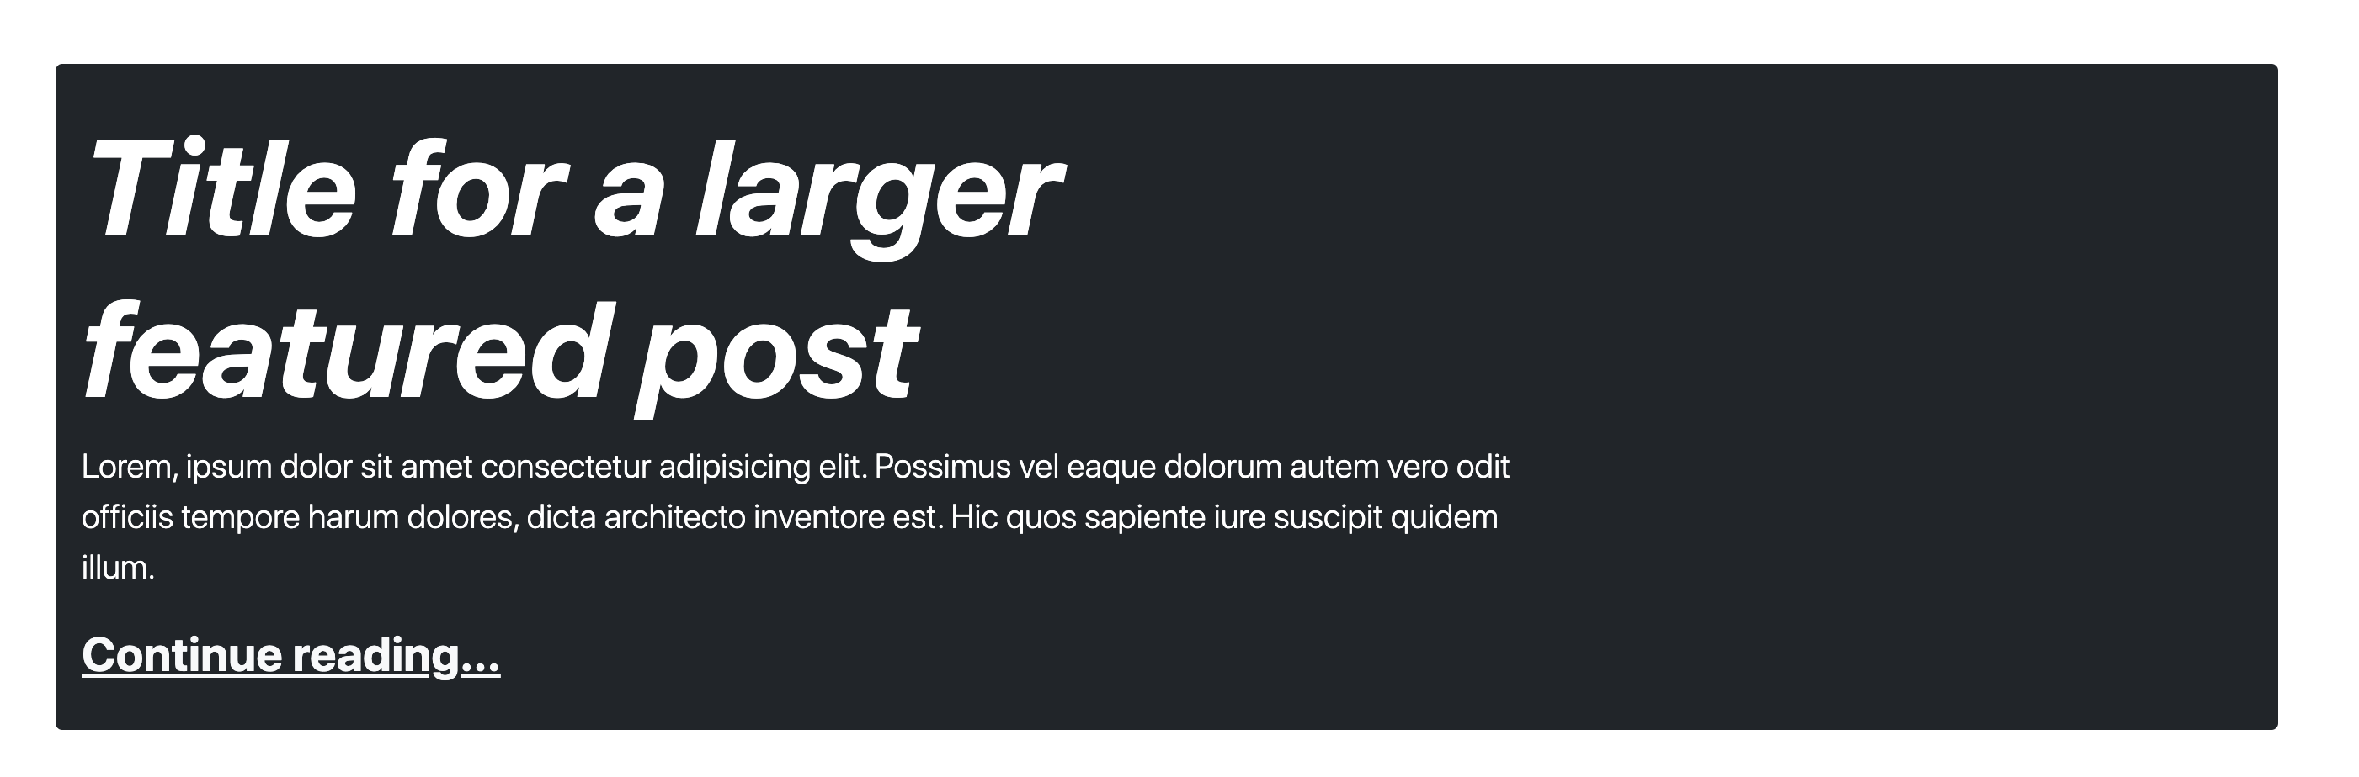
Home Section

Slide 6
Home Section
For this section, we use container class with bg-dark, text-white, rounded and some paddings.
As you can see, the content does not occupy 100% of the this container. Because we use <div class="row"> <div class="col-lg-8"> to prevent it from taking 100% of the width.

Slide 7
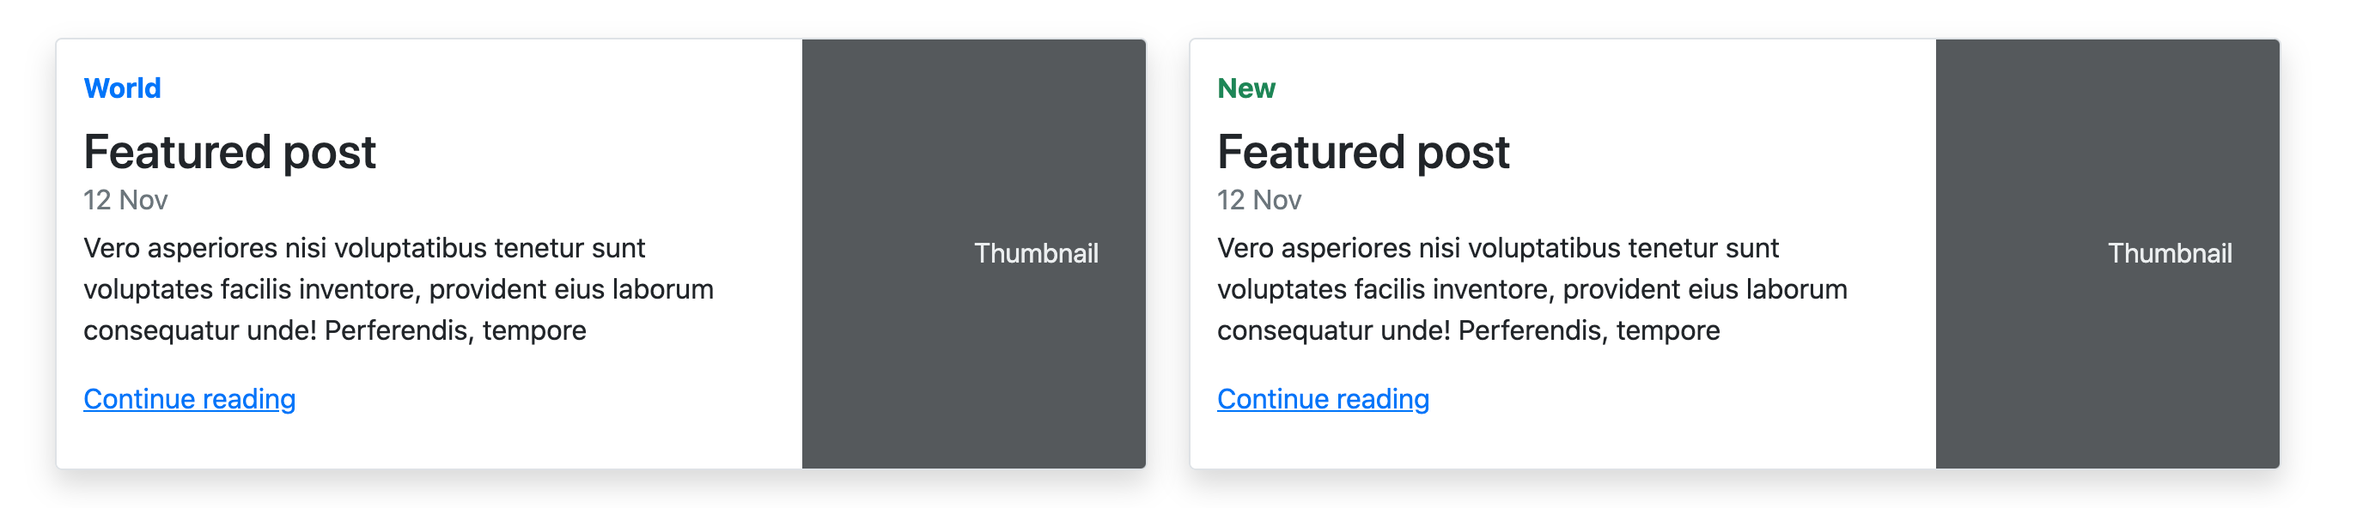
Featured posts

Slide 8
Featured posts
For this section, we use container class with row.
We added horizontal cards from: https://getbootstrap.com/docs/5.1/components/card/#horizontal
Then we added our custom content using text-primary, success and some classes.
This images have d-lg-block d-none. This means that they will have display: block; from large. Otherwise, they will have display: none;

Slide 9
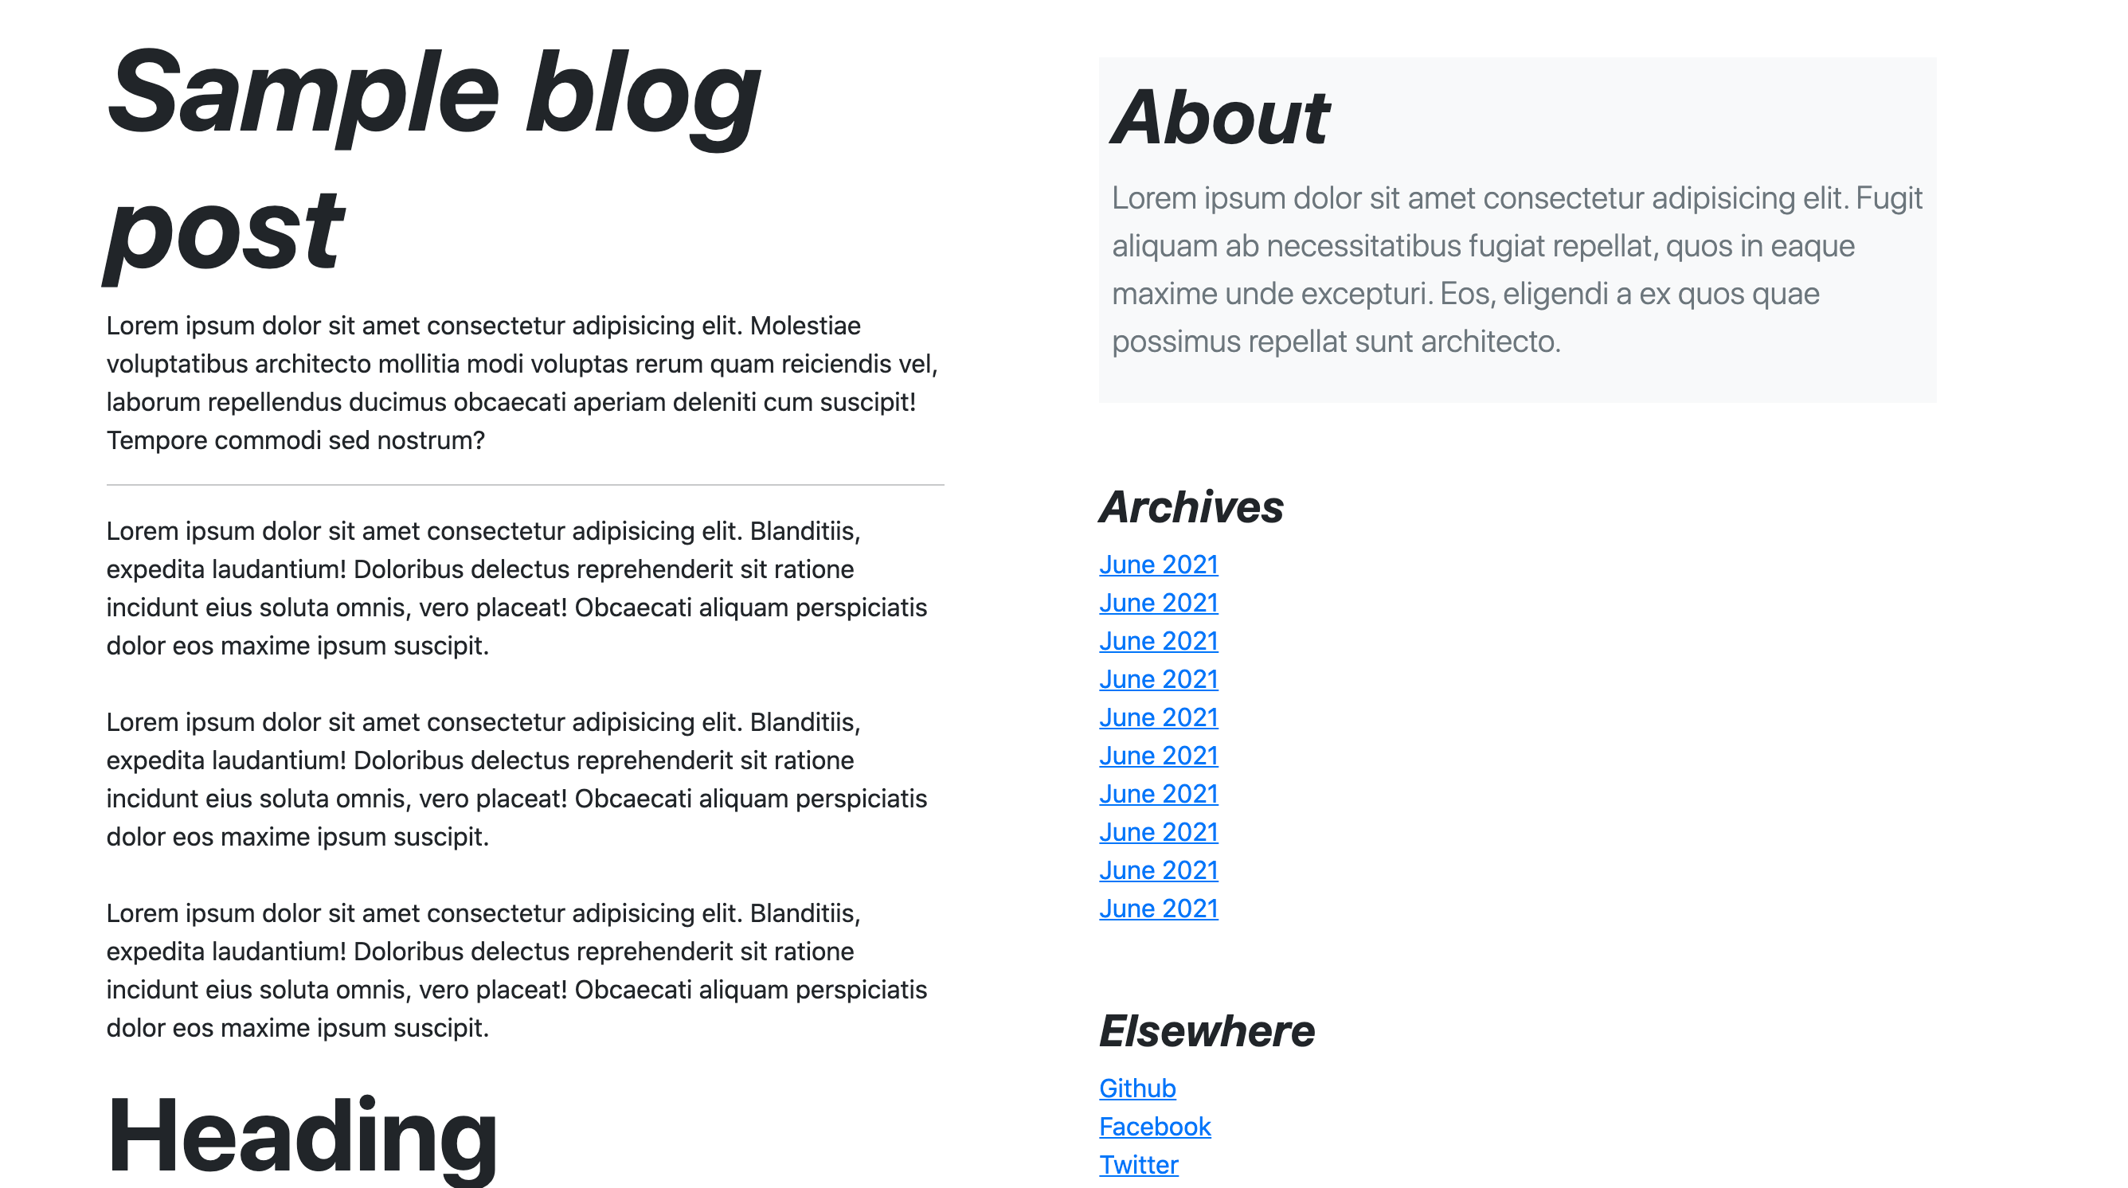
Sample Blog post

Slide 10
Sample Blog post
This concept is not that challenging, we just use <div class="row justify-content-evenly">, two <div class="col-md-5"> and some content.

