Slide 1

        Automation Vision
A description of proposed security gateway automation pipeline
Yossi Rosenberg

Slide 2

System requirements and spec
1. Support on and off prem deliveries, but the main infrastructure should be on prem
2. You are not allowed to expose source code to public cloud (pre prod ISO files etc are allowed)
3.The pipeline should be unified, including monitoring, reporting and gating, you can achieve it by using multiple FW/IS but the results should be unified
4.Consider ease of use and minimal resource allocation for the tasks

Slide 3
System requirements and spec#2
A security gateway, composed of 4 components:
1.Windows application – serves as the products front for management and configuration - coded in Java Deployed by an exe file.
2.Management sever – Linux based server, serves as the back end for management and configuration – Coded in Java/C/C++,Deployed as an image on VM/physical.
3.Firewall – Linux based server, apply the management’s configuration and enforces its policy on the traffic in hand – Coded in C/C++/Python Deployed as an image on VM/physical.
4.Cloud components, linked to the on pre, solution, providing added functionality – coded in any available front oriented language.

Slide 4
System requirements and spec#3
Currently, the automation methodology in the organization is as follows:
1. Code is saved in git
2. Automation gates are manual and preformed:
Pre compilation – unit tests
Pre-commit on a delivery – requires installation of all 3 components
After image creation – a full nightly run of all available regression cycles (800 hours run time - parallelized) requires installation of all 3 components
Current coverage:
a. 10% of the code is covered by unit tests
b. 40% is covered by GUI tests
c. 60% is covered by E2E tests

Slide 5
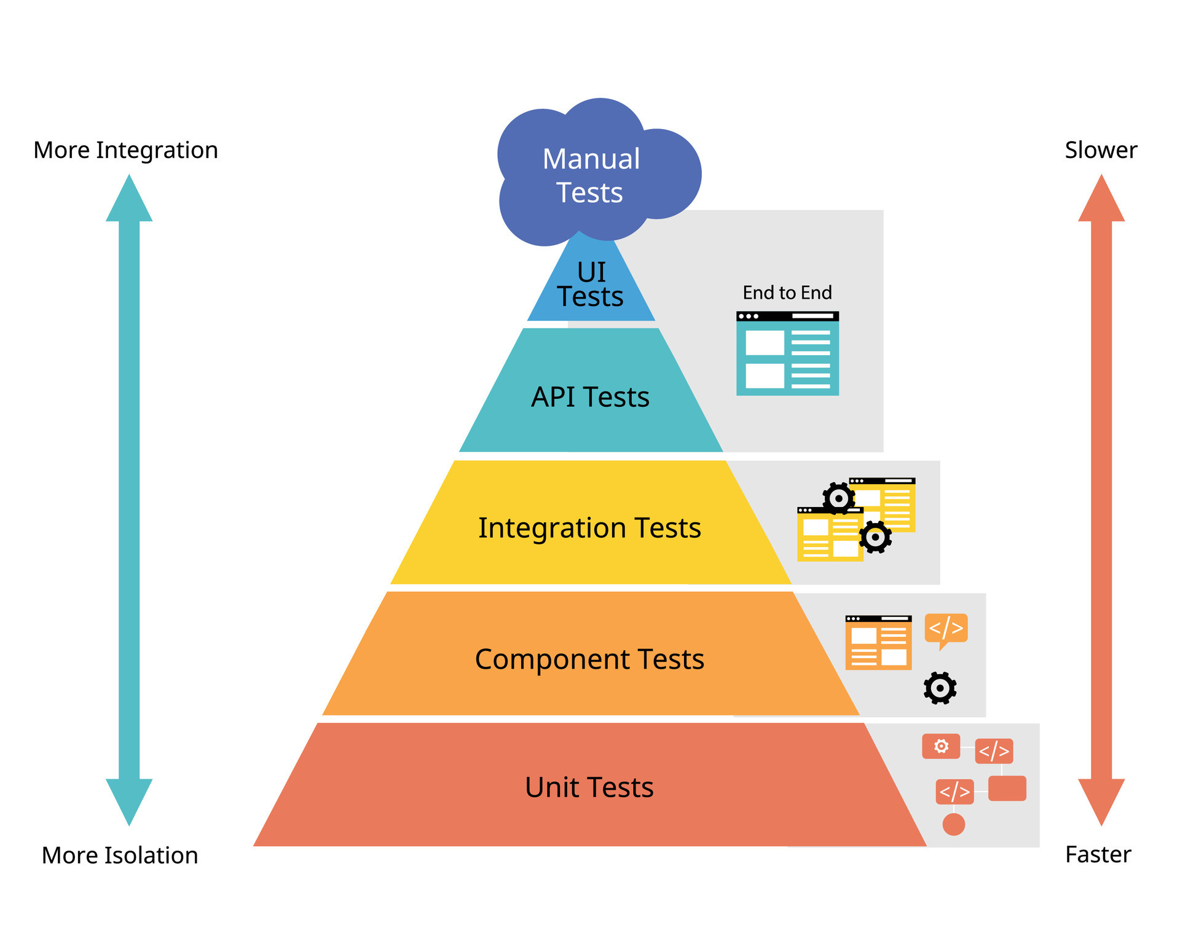
The testing pyramid

Slide 6
Agenda
Windows application automation infra
Management sever application automation infra
Firewall automation infra
Cloud components automation infra
Overall automation organizational pipeline (nightly + ci/cd)
Short and long terms goals

Slide 7
Windows application automation infra

Slide 8
WinAppDriver
Can be used with any language and test runner you prefer to test your Windows apps thanks to WebDriver(We going to use java)
It’s Web Driver-based so Selenium/Appium testers feel right at home
You can use the industry-standard POM
You can use XPath and other properties to locate Windows UI elements
Can be ran easily using bat file with command: “start /d "path" file.exe”

Slide 9
Management sever automation infra

Slide 10
TestNG
TestNG provides parallel execution of test methods(can reduce the 800 hours run time after image creation)
It allows to define dependency of one test method over other method
It allows to assign priority to test methods
It has support for parameterize test cases using @Parameters annotation
It allows data driven testing using @DataProvider annotation
Detailed (HTML) reports

Slide 11
Management sever automation infra

Slide 12
Back-end and UI Testing Pytest
Pytest has its own way to detect the test file and test functions automatically, if not mentioned explicitly.
It allows us to execute a specific part of a test suite and also skip a subset of the entire test suite.
Pytest can run multiple tests in parallel, so it reduced the execution time of the test suite significantly.(Again can reduce the 800 hours run time after image creation
It has a simple syntax and is easy to learn and start using.

Slide 13
Load Testing Artillery.io
Test at cloud-scale - Distributed load testing built in. Run distributed multi-region load tests using AWS Lambda or AWS Fargate without managing any infrastructure
Test any stack - Test HTTP APIs, Web-socket and Socket.io services, or complex web apps with real browsers
Go from zero to production-grade fast - Designed to be easy to start with, with extensions and plugins for common tasks and integrations with monitoring, o11y and CI/CD
Extensible - Extend Artillery and build custom integrations with Node.js
Scalable and cost-efficient - Run large-scale load tests from your own AWS account with AWS Lambda or serverless AWS Fargate cluster
Open source

Slide 14
Cloud components automation infra

Slide 15
Mocha
Mocha supports Test Driven Development (TDD) and Behavior Driving Development (BDD).
Mocha test runs serially, so results are always accurate.
It provides various ways to generate the test report; you can even choose to create custom reports.
It can be configured for synchronous or asynchronous testing.
Mocha supports the retry failed tests feature, which helps to configure re-running the failed tests if tests are flaky.

Slide 16
Nigthly Tests Jenkins

Slide 17
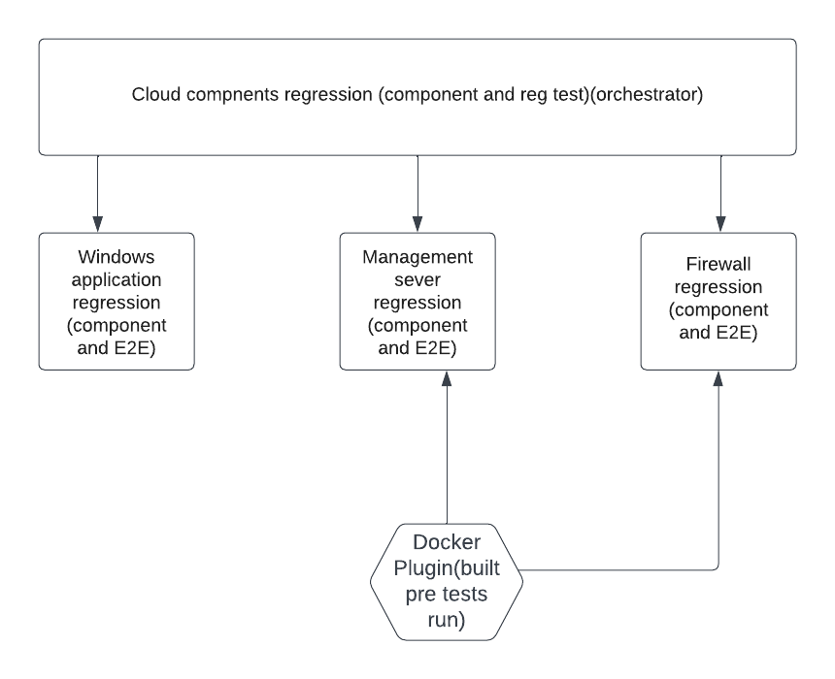
Jenkins

Slide 18
Why choose Jenkins?
It is an open-source tool with great community support.
It is easy to install.
It has 1000+ plugins to ease your work. If a plugin does not exist, you can code it and share it with the community.(include docker plugin)
It is free of cost.
It is built with Java and hence, it is portable to all the major platforms.

Slide 19
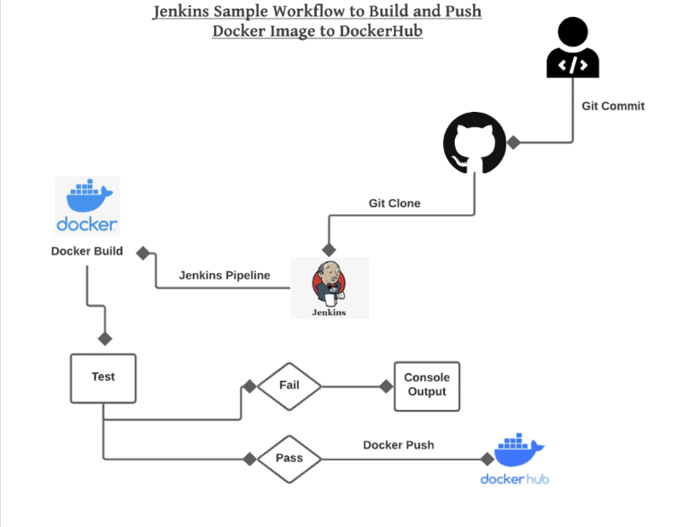
Jenkins docker plugin

Slide 20
CI Tests – GitHub actions

Slide 21
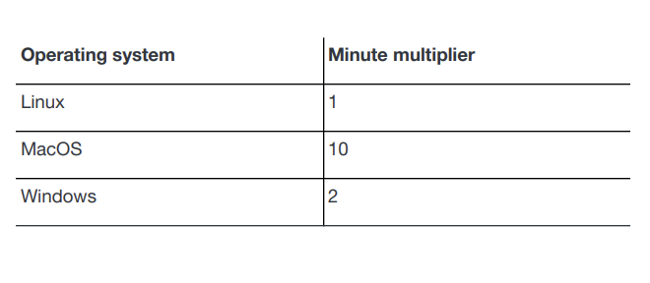
Why choose GitHub actions?
If we are already hosting a project on GitHub, you have a built-in CI/CD tool that works right alongside your code.
GitHub Actions is built by and for developers and is designed to make it easy to build a CI/CD pipeline without a dedicated Devops engineer.
Workflows executed on a Windows or mac OS hosted GitHub runner
consume minutes at 2 and 10 times the rate that jobs on Linux consume

Slide 22
CI/CD Tests
In the cd process Switched regression tests to in integration tests to be run every commit
CI tests will run only sanity tests and selected component test & E2E tests(not all of them)
This will be achieved by dividing test into groups/suits/tags(e.g mocha tags)

Slide 23
Short and long terms goals
Increase E2E coverage to 85%(Short term)
Increase unit tests coverage from 10% into 80% if dev has no capacity to perform this task Automation infra team will dev it (Long term)
Reduce running time from 800 hours(using methods presented on previous slides (Long term)

Slide 24
Questions?
Yossi.rosenberg@gmail.com

