Slide 1

Advanced Software Development
Flight Gear Simulator Project
Lecturer: Dr. Eliyahu Khalastchi
Presented by: Yossi Ashkenazi & Omer Kappon

Slide 2

Introduction
This project is about creating a user interface to Flight Simulator desktop application, based on a known flight simulator
The project is written in Java and implements design patterns, as well as SOLID and GRASP programming principles

Slide 3
Project Milestones
1
1
1
1
1
1
2
3
4
5
General design of server side’s architecture using GRASP and SOLID principles
Simple server solver using cache manager and file streaming
Implementation of BFS and A-Star algorithms in the solver server
Custom language interpreter using lexical analysis and syntax analysis
Designing and building a graphic user interface (GUI) to the simulator using JavaFX

Slide 4
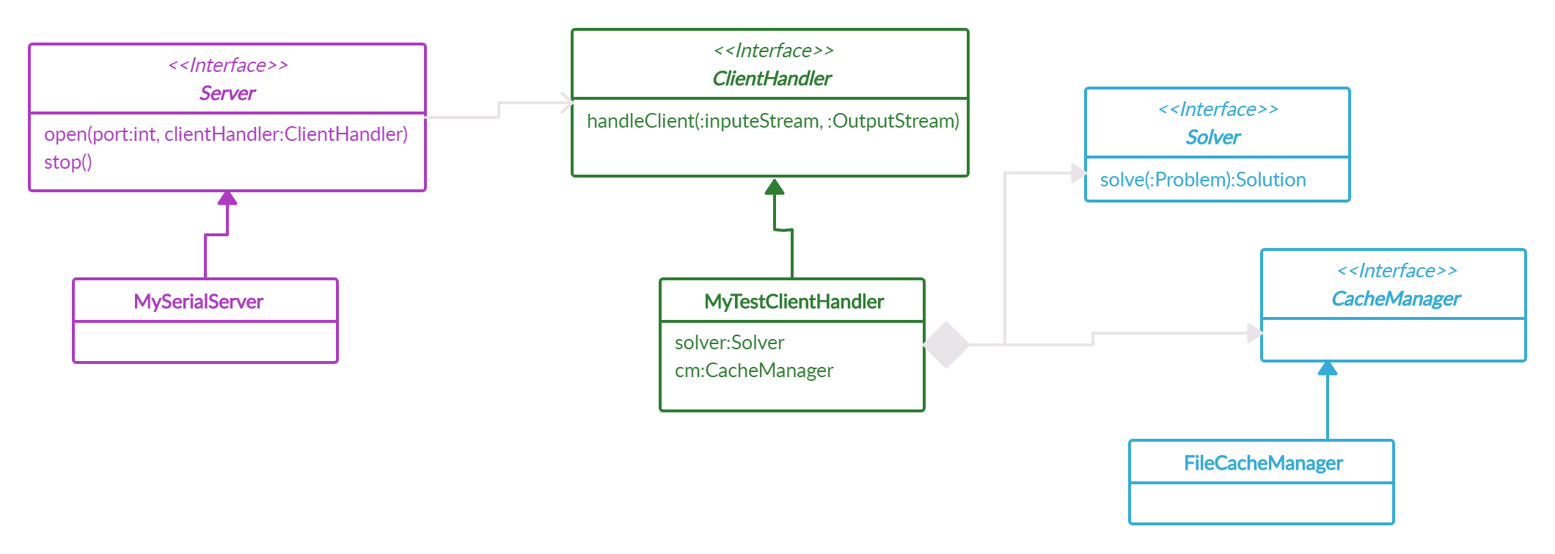
Server Side

Slide 5
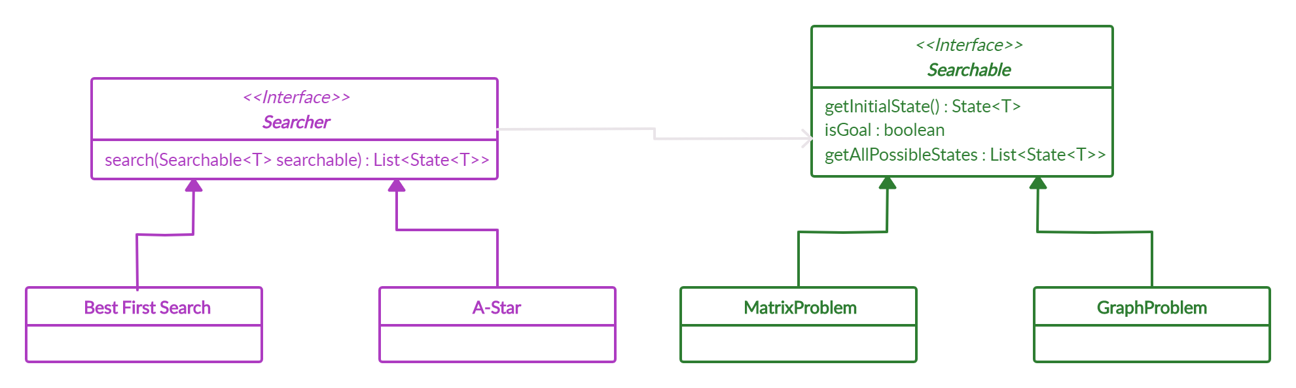
Server Side - UML

Slide 6
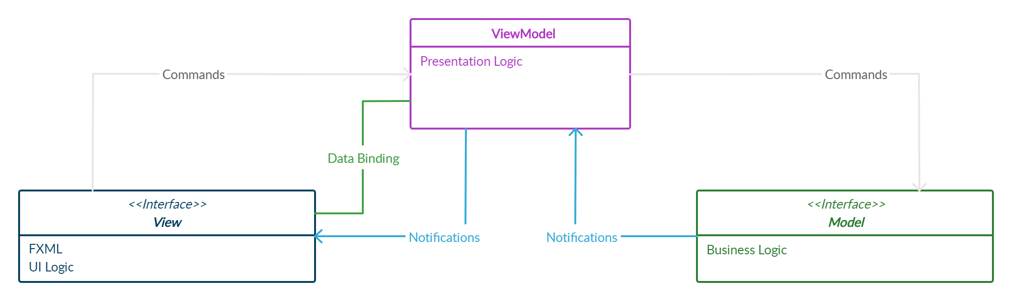
Client Side
1
Extensibility
Has the ability to replace or add new pieces of the code
JavaFX GUI - MVVM
2
Testability
Make sure it works right when written and keeps working even when things change in maintenance
3
Maintainability
A clean Separation between different kind of codes
Accelerates new releases

Slide 7
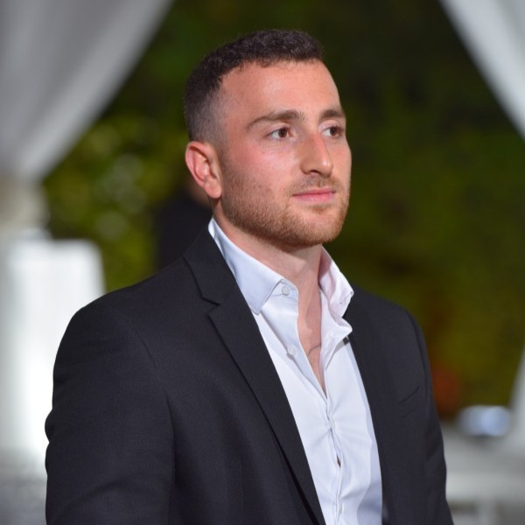
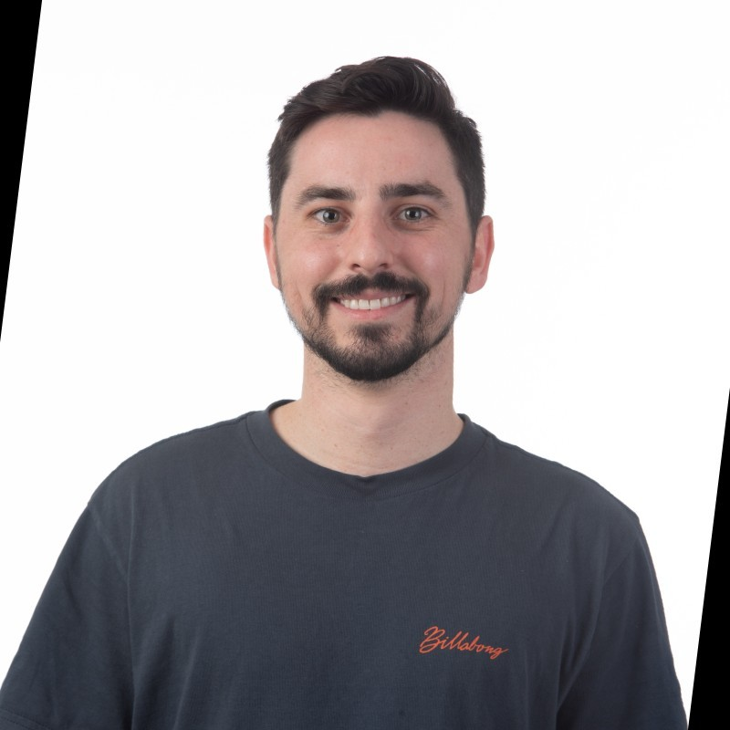
01
10
11
00
10
01
00
01
10
11
01
11 01
01
00
10
11
01
10
11
01
00 01
01
00
01
10
11
01
11 01
01
00
10
11
01
10
11
01
00
00
01
01
11 01
01
00
10
11
01
01
00 10
01
11
01
10
11
00
10
01
00
01
10
11
01
11
01
01
00
01
10
11
01
11 01
01
00
10
11
01
10
11
01
00 10
01
11
01
01
10
11
00
10
01
00
01
10
11
01
11 01
10
11
01
10
11
01
00 10
01
11
01
11
10
11
00
10
01
00
01
10
11
01
11 01
01
00
10
01
10
11
00
10
01
00
01
10
11
01
11 01
01
00
10
11
01
01
10
11
00
10
01
00
01
10
11
01
11 01
01
00
10
11
01
10
11
01
00 10
01
11
11
00
10
01
00
01
10
11
01
11 01
01
00
10
11
01
10
01
10
11
00
10
01
00
01
10
11
01
11 01
01
00
00
10
01
00
01
10
11
01
11 01
01
00
10
11
01
10
11
01
00 10
01
11
01
01
10
11
00
10
01
00
01
10
11
01
11 01
01
00
10
11
01
10
11
01
10
11
00
10
01
00
01
10
00
00
10
11
01
10
11
01
00 10
01
11
01
01
10
11
00
10
01
00
01
10
11
01
11 01
01
11
00
01
10
11
01
11 01
01
00
10
11
01
10
11
01
00 10
01
11
01
01
10
11
00
10
01
00
01
01
11 01
01
00
10
10
11
01
10
11
01
00 10
01
11
01
01
10
11
00
10
01
00
01
10
11
01
11 01
01
01
00
10
11
01
10
11
01
00 10
01
11
01
00
10
11
00
10
01
00
01
10
11
01
11 01
01
00
10
11
01
10
11
01
00 10
01
01
10
11
00
10
01
00
01
10
11
01
11 01
01
00
00
10
11
01
10
11
01
00 10
01
11
01
01
10
11
00
10
01
00
01
10
11
01
11 01
01
00
01
10
11
00
10
01
00
01
10
11
01
11 01
01
00
10
11
01
10
11
01
00
01
10
11
01
11 01
01
00
10
11
01
10
11
01
00 10
01
11
01
01
10
11
00
10
01
11
01
10
11
00
10
01
00
01
10
11
01
10
11
01
11 01
01
00
10
11
01
10
11
01
00 10
01
11
01
01
10
11
00
10
01
00
01
10
11
01
11 01
01
00
10
11
01
10
11
01
00 10
01
01
00
10
11
01
10
11
01
00 10
01
11
01
01
10
11
10
11
01
10
11
01
00 10
01
11
01
01
10
11
00
10
01
00
01
10
11
01
11 01
01
00
10
11
01
10
11
01
00
01
10
11
01
00 10
01
11
01
01
11
01
10
11
01
00 10
01
11
01
01
10
11
00
10
01
00
01
10
11
01
11 01
01
00
10
01
10
11
00
10
01
00
01
10
11
01
11 01
01
00
10
11
01
10
11
01
01
00
10
11
01
10
11
01
00 10
01
11
01
01
10
11
00
10
01
00
01
10
11
01
11 01
01
00
01
10
11
00
10
01
00
01
10
11
01
11 01
01
00
10
11
01
10
11
01
00
Thank You
Yossi Ashkenazi
Omer Kappon
B.Sc. Computer Science Student 3rd year
B.Sc. Computer Science Student 3rd year
https://www.linkedin.com/Yossi-Ashkenazi/
https://www.linkedin.com/Omer-Kappon/
Yossi1ashkenazi@gmail.com
Omer.kappon@gmail.com

