Slide 1
Building a Beam-Class LLM
The opportunity to develop a new open model that competes with Anthropic, OpenAI, Google, xAI and Meta
Executive summary · 19 October 2026 · Companion to the Research Baseline v2.0
Notes:
Purpose: decide whether and how to build a new open LLM comparable to Reflection AI's Beam, and how it could compete with the leading vendors. Detailed evidence is in the 37-page research baseline document.

Slide 2
The answer up front
30 vs 58
$11–175M
11%
Beam vs. Claude Opus 5.5 on the independent Artificial Analysis Intelligence Index
Indicative 2-year cost to field a Beam-class model: adapt Beam vs. build from scratch
Open-weight share of enterprise LLM API spend, down from 19% a year earlier
Verdict: a Beam-class model is buildable and affordable — but it will not beat Anthropic, OpenAI, Google or xAI on general capability. Win where closed models cannot follow: sovereignty, on-prem control, domain specialisation and cost. Start by adapting Beam’s Apache 2.0 weights; gate any from-scratch build on traction.
Notes:
Three numbers frame the decision. First, Beam is 28 points behind the leader on the only single-scale independent index. Second, the cost range depends mainly on whether we start from Beam's open weights. Third, enterprises are concentrating spend on closed models, so an open model must win on dimensions other than rank.

Slide 3
Beam 1.0: what Reflection AI shipped
Timeline
501B
23.4B
256 / 8
2024 · founded by ex-DeepMind team (Laskin, Antonoglou)
Oct 2025 · $2B raise led by NVIDIA
5 Oct 2026 · Beam announced
16 Oct 2026 · weights, Mirror CLI harness and DFlash2 drafter released; 40+ partners
Independent score: 30 (19th of 120)
total parameters
active per token
experts / active
1M
23.8T
Apache 2.0
token context
pre-training tokens
open weights, 16 Oct
Notes:
Beam is a sparse mixture-of-experts model: 501 billion parameters stored, about 23 billion used per token. It was released under Apache 2.0 with BF16, FP8 and NVFP4 checkpoints, a speculative-decoding drafter, and Mirror CLI, the agent harness it was trained against.

Slide 4
Architecture built for cheap tokens
1 A router reads the token
and scores every expert
2 256 specialist experts
hold the model’s knowledge
Router
Next token
3 Only the top 8 wake up
23.4B of 501B parameters (4.7%)
Compute per token
Dense 501B model
256 experts stored · 501B parameters
Beam (4.7%)
Only 8 run for this token
≈ 21× less compute
Notes:
Animated build, five clicks. Click 1: each new token goes to a router. Click 2: the router chooses among 256 specialist experts, which together hold the model's 501 billion parameters. Click 3: only the top 8 experts actually run for this token, so just 23.4 billion parameters (4.7%) do any work. Click 4: compared with a dense model of the same size, each token needs about 21 times less compute. The model has the knowledge capacity of a very large model but the running cost of a small one.

Slide 5
Why each token costs less
1 · Sparse experts
2 · Short memory in most layers
Only 8 of 256 experts run per token, so a 501B model computes like a ~23B one.
21×
43 of 52 layers only look at the last 512 tokens; just 9 read the whole context. Memory ≈ 17% of full attention.
less compute
512-token window slides along
3 · 4-bit weights (NVFP4)
4 · Fewer, faster tokens
Weights shrink to ~0.28 TB and fit one 8-GPU server, losing ≤ 1.7 points on agentic benchmarks.
16-bit 1.0 TB
A 1.9B “drafter” guesses several tokens that Beam checks in one pass, and Beam uses ~40% fewer output tokens per task.
−40%
4-bit 0.28 TB
output tokens
The trade-off: frontier-scale knowledge at small-model running cost, but capability still trails the frontier (independent index 30 vs 58).
Notes:
Animated build, five clicks, one cost lever per click. 1: sparse experts give about 21 times less compute per token than a dense model of the same size. 2: most layers keep only a 512-token short-term memory (watch the window slide), so long-context memory is about 17% of a full-attention design. 3: 4-bit weights cut memory from about 1 TB to 0.28 TB, so the model fits one 8-GPU server. 4: a small drafter model speeds up generation, and Beam finishes tasks with about 40% fewer output tokens. The levers stack, but the trade-off is capability: Beam scores 30 on the independent index against 58 for the leader.

Slide 6
Training: post-training is the big bill
1
2
3
4
5
Curate
Pre-train
Mid-train
SFT
RL
~95% of web text discarded
23.8T tokens · 6,144 GB300 · <4 wks
Context to 1M tokens
Tool use & agent traces
10,500 GB300 · 4 wks · 100M+ rollouts
RL used ~2–3× the GPU-hours of pre-training. Budget for an environment fleet (~1M tasks, ~1.3B sandboxes), not just a training cluster.
Notes:
Pre-training compute is estimated at about 3.3e24 FLOPs. The RL phase ran on roughly 1.7 times as many GPUs for a similar duration. Building verifiable environments and sandbox orchestration is the longest-lead engineering task.

Slide 7
On its own numbers, Beam trails open peers
Reflection’s launch table (vendor-reported)
Beam is roughly level with GLM-5.2 on agentic coding and science QA, but behind Kimi K3 and Qwen 3.8 Max on every shared benchmark.
Its pitch is efficiency: similar quality with 23B active parameters vs. 40–95B for peers.
Notes:
All figures here come from Reflection's own launch table. SWE-bench Verified is 81.6 per the model card, and SWE-bench Pro v1 is 66.1, where Beam beats GLM-5.2 (62.1).

Slide 8
Independent tests: a 28-point gap
Artificial Analysis Intelligence Index, Oct 2026
One scale, one harness, 120 models.
Closed frontier: 53–58
Grok and top Chinese open models: 44–46
Beam: 30, but ~40% fewer output tokens than the median
Notes:
This is the most important slide. Vendor tables put Beam near GLM-5.2, but the only single-scale independent index puts it 14 to 16 points behind the best open models and 23 to 28 behind Anthropic, OpenAI and Google. Meta's closed Muse Spark 1.3 scored 61 on an earlier index version, which is not comparable and is excluded here.

Slide 9
The vendor landscape
Vendor | Flagship | Weights | AA Index | Output $/1M | Edge
Anthropic | Claude Opus 5.5 | Closed | 58 | $20 | Top capability; 40% enterprise share
OpenAI | GPT-6 Astra | Closed | 53 | $50 | Reach; reasoning
Google | Gemini 4 Argon | Closed | 52.6 | — | Multimodal; cloud; cheap Flash tier
xAI | Grok 4.7 | Closed | 46 | $6 | Price and speed
Meta | Muse Spark / Llama 4 | Closed / open | — | — | Distribution; Llama brand
China open labs | MiMo · GLM · Kimi | Open | 44–46 | $0.28+ | Best open scores; lowest prices
Reflection | Beam 1.0 | Open | 30 | Partner | US provenance; efficiency
Weights “Open” for Reflection = Apache 2.0. Output prices per 1M tokens (aggregators, Oct 2026). Groq (inference hardware) hosts open models and is a deployment partner, not a model competitor.
Notes:
Closed vendors compete on capability; Chinese open labs compete on price and open scores. A new US- or EU-built open model sits between them and needs a clear reason to be chosen.

Slide 10
Enterprise spend favours closed models
$37B
enterprise gen-AI spend in 2025 (≈3× y/y)
19% → 11%
open-weight share in one year
Source: Menlo Ventures, late 2025. “Google & other closed” is the remainder.
The market is growing fast, but buyers pay for the most capable closed models. An open model has to offer something closed APIs cannot.
Notes:
Market-size estimates vary by definition; use them directionally. The consistent signal across sources is that open-weight share of enterprise spend has fallen.

Slide 11






Where a new open model can win
Sovereign & government
Regulated industries
Vertical specialists
Allies that cannot procure Chinese weights and need on-prem control
Finance, health, defence, legal: residency and audit beat a few index points
Post-train on proprietary environments to beat general models on narrow tasks
High-volume agents
Under-served languages
Customisation
Coding and automation agents where cost per token dominates
Hebrew, Arabic, regional European languages via targeted data
Full fine-tuning, RL on customer tasks, predictable pricing
Notes:
These are the segments where open weights win despite a lower aggregate score. Pick one or two as the commercial wedge; this choice should drive data, RL environments and evaluations.

Slide 12
Three levels of ambition
Level 1
Level 2
Level 3
Beam parity
Open-frontier parity
Frontier challenger
AA ≈ 30
AA ≈ 45
AA ≥ 53
~500B total / 23B active; Beam KPIs
1–2T total / 40–60B active; 30T+ tokens
Multi-trillion params; 10^25–10^26 FLOPs
2-yr cost: $11M–$175M
2-yr cost: $300–500M
2-yr cost: $1B+ per generation
Recommendation: commit to Level 1 now; treat Level 2 as a funded option after proof of demand. Level 3 is a hyperscaler-scale bet.
Notes:
Competing head-on with Anthropic, OpenAI, Google or xAI requires Level 3 resources. The realistic path to relevance is Level 1 with a clear niche, then Level 2 if the business case is proven.

Slide 13
Three routes to a Beam-class model
A · ≈$11M · 3–6 months
SFT + RL on Beam weights for a niche; 15–25 people
B · ≈$56M · 9–12 months
Add 3–6T domain tokens + full RL; 40–60 people
C · ≈$175M · 15–18 months
Own model, ~11–14M GPU-hours; 80–120 people
Notes:
Author estimates at US$3–5 per GPU-hour and US$300–450K per fully loaded head-year. Option A gives the fastest proof of the data, RL and evaluation stack, and its weights are a permissive Apache 2.0 derivative.

Slide 14
Staged roadmap with decision gates
Month 1
Month 6
Month 9
Month 11
Month 17
G0 Baseline
G1 Adapt
G2 Scale?
G3 Pre-train
G4 Release
Reproduce Beam & peers on our own harness
Adapted Beam +5 pts on domain evals; first paying pilot
Pilot model hits scaling targets; 20T tokens; ≥$150M funding
Stable full training run under way
Level 1 KPIs met independently; safety report; partners
G2 is the key investment decision: only proceed to a from-scratch model if Stage 1 shows demand and funding is secured.
Notes:
Each gate has explicit go criteria. Stage 1 (adapt Beam) de-risks the data engine, RL environments and evaluation harness before committing to large compute.

Slide 15




Key risks and how we manage them
Frontier keeps moving
Chinese open models at near-zero price
Don’t race the leaderboard; own a niche
Sell provenance, sovereignty, support
Claims that don’t replicate
GPU cost and availability
Independent harness from day one
Multi-provider reservations; NVFP4
RL infrastructure underestimated
Talent and legal exposure
Build environments from month 1
Equity, partnerships; provenance tracking
Notes:
A full risk register with likelihood and impact is in Section 20 of the research baseline. Also mirror Beam 1.0 weights now: the Apache 2.0 grant is irrevocable for the released version, whatever happens to Reflection's ownership.

Slide 16
Recommendation and next steps
1
Choose the wedge
Pick one or two segments: sovereign, regulated, vertical or language
2
Adapt Beam (Stage 1)
≈$11M, 3–6 months: SFT + RL on Beam 1.0 for that wedge
3
Build the hard parts early
Data engine, RL environment fleet, independent eval harness
4
Decide at Gate 2
Fund continued pre-training or a from-scratch model only on proven demand
Notes:
Decision requested: approve Stage 1 budget (about US$11M over 3–6 months) and the choice of wedge market. Revisit the larger investment at Gate 2.

Slide 17
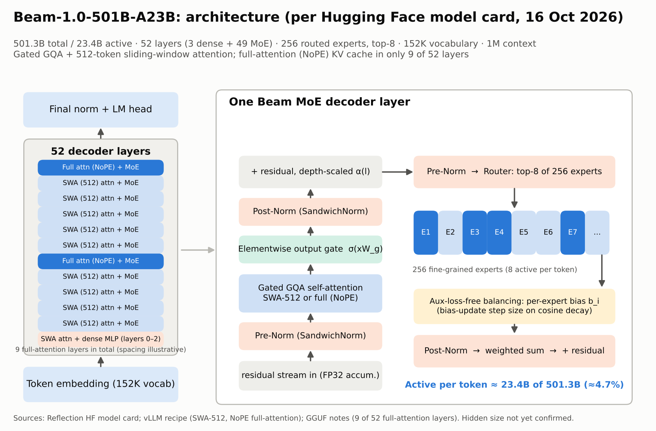
Appendix: Beam architecture detail
Notes:
Reference diagram from the research baseline (Figure 1): 52 layers (3 dense + 49 mixture-of-experts), 256 experts with top-8 routing, gated attention with a 512-token sliding window, and full-context attention in only 9 layers.

Slide 18
Sources and notes
Reflection AI: Introducing Beam (5 Oct 2026); Beam is now available (16 Oct 2026)
Hugging Face model cards: reflection/Beam-1.0-501B-A23B (BF16, FP8, NVFP4); vLLM and NVIDIA serving recipes
Artificial Analysis Intelligence Index v4.3.x and Beam article (Oct 2026)
Vendor launch materials and system cards: Anthropic (Claude Opus 5.5, Sonnet 5.5, Fable 5.1), OpenAI (GPT-6), Google (Gemini), xAI (Grok 4.7), Meta (Muse, Llama 4)
Menlo Ventures enterprise LLM market data; pricing aggregators (BenchLM, Oct 2026)
Costs, GPU-hours and team sizes are author estimates; see Sections 12 and Appendix A of the research baseline
Caveat: vendors report different benchmark versions and harnesses. Only the Artificial Analysis index puts all models on one scale; treat cross-vendor gaps under ~2 points as noise. Full source list (42 references) in the research baseline document.
Notes:
Full citations with links are in Section 24 of Beam_Research_Baseline.docx.

