Slide 1
Javascript new generation

Slide 2
first things first… ☺
it is good to come to this seminar if you already know
JavaScript
OOP
Interfaces
Design Patterns
Jquery
Ajax
All of today’s demos are available here: https://github.com/yossibo/oracleweekjsdemo.git

Slide 3
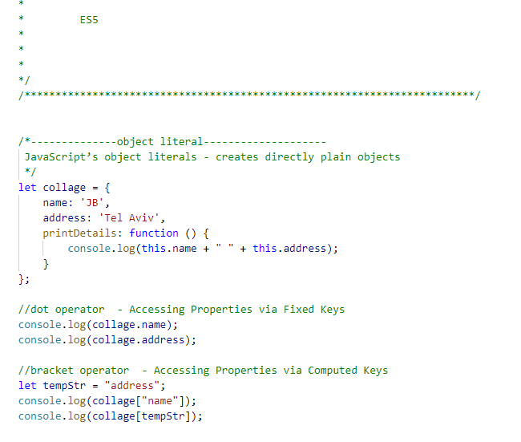
Object oriented javascript over the years . . .

Slide 4
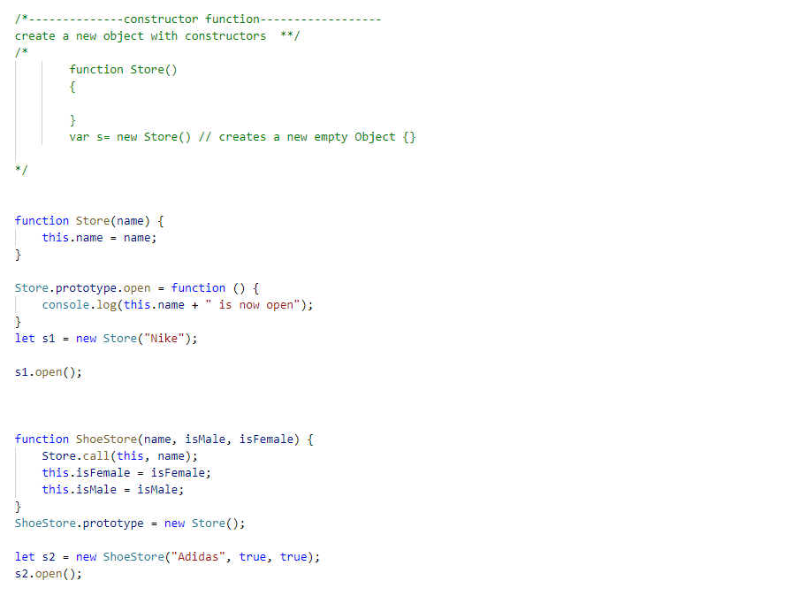
OOP in Javascript

Slide 5
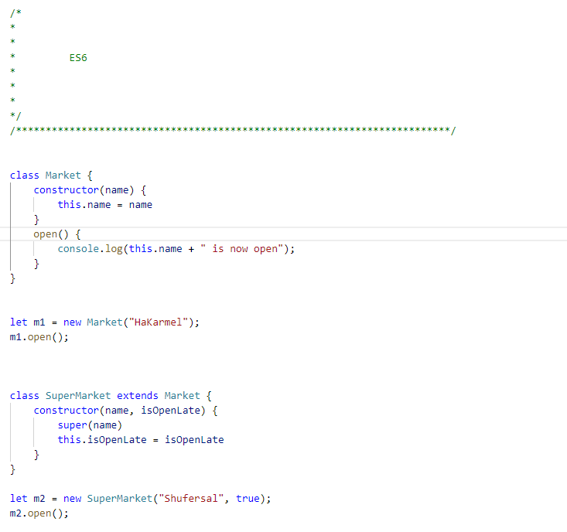
OOP in Javascript

Slide 6
Es 6-8 features

Slide 7
Es6-8 new features
Let vs Var – Scoping
Const
Arrow Functions Vs es5 Function and this key word
Extended parameters handling
Template literals
String interpulations

Slide 8
modules

Slide 9
Modules
we need JavaScript modules:
to avoid leaking code to the global namespace and thus to avoid naming collisions
to encapsulate code; to hide implementation details and control what gets exposed to the “outside”
3. to structure our applications (we cannot use a single files)
4. to manage dependencies
5. to reuse code

Slide 10
Es6 Module != Angular Module
Angular modules represent a core concept and play a fundamental role in structuring Angular applications.
An Angular Module groups together a set of Angular artifacts, namely components, directives, pipes and services that are part of that very same module. That said, it represents a logical grouping into what can be called a feature area of our application (i.e. contacts module, admin module,…). Moreover, an Angular Module also defines dependencies to other modules, that is, what other modules it needs to import and in turn which components, directives or pipes get exported.
Angular modules are a logical grouping of multiple symbols (components, services,…)

Slide 11
Creating objects

Slide 12
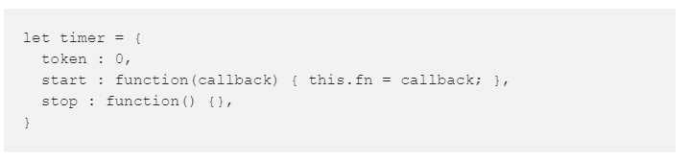
Object literal
Object literal offers a simple, elegant way of creating objects.

Slide 13
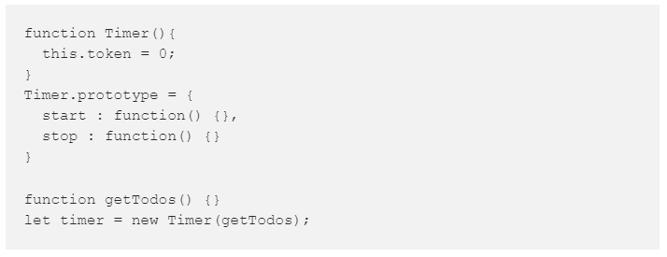
Function Constructor
Initially, the language proposed the function constructor as a sugar syntax for all this

Slide 14
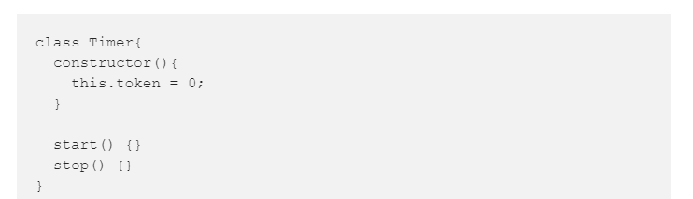
Class
EcmaScript2015 comes with a much better sugar syntax for all this.

Slide 15
Async Programing

Slide 16
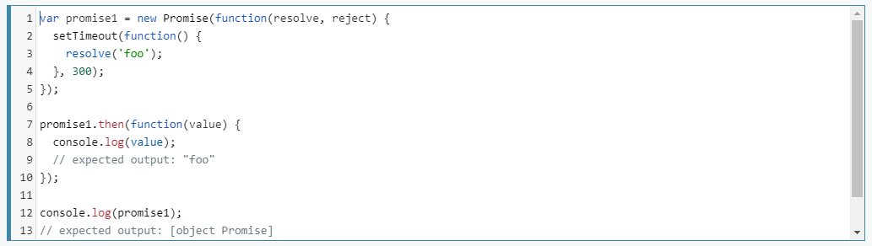
Promise
The Promise object represents the eventual completion (or failure) of an asynchronous operation, and its resulting value.

Slide 17
Async / await
There’s a special syntax to work with promises in a more comfortable fashion, called “async/await”. It’s surprisingly easy to understand and use.

Slide 18
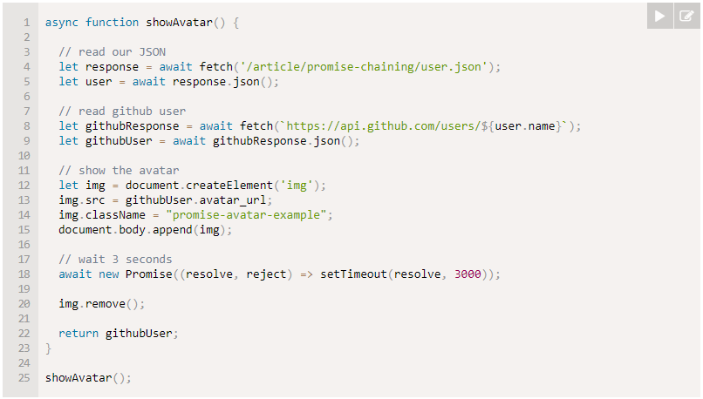
Async / await

Slide 19
observables
Observables offer significant benefits over other techniques for event handling, asynchronous programming, and handling multiple values. Observables are declarative—that is, you define a function for publishing values, but it is not executed until a consumer subscribes to it.

Slide 20
More features

Slide 21
Demo time
- Trailing commas
- GetOwnPropertyDescription
- Iteratos
- Default parameters
- Template literals
- Multi line strings
- Proxy and reflection usages
- Array and objects matching
https://github.com/yossibo/oracleweekjsdemo.git

Slide 22
typescript

Slide 23
What is typescript
TypeScript is an open-source programming language developed and maintained by Microsoft. It is a strict syntactical superset of JavaScript, and adds optional static typing to the language. TypeScript is designed for development of large applications and transcompiles to JavaScript. https://www.typescriptlang.org/

Slide 24
Typescript’s 5 principles
Single responsibility principle: a class should have one, and only one, reason to change;
Open-closed principle: it should be possible to extend the behavoir of a class without modifying it;
Liskov Substitution principle: subclasses should be substitutable for their superclasses;

Slide 25
Typescript’s 5 principles
Interface segregation principle: many small, client-specific interfaces are better than one general purpose interface;
Dependency inversion principle: depends on abstractions not concretions;

Slide 26
react

Slide 27
react
React is a JavaScript library for building user interfaces. It is maintained by Facebook and a community of individual developers and companies. React can be used as a base in the development of single-page or mobile applications. https://reactjs.org/

Slide 28
React’s concepts
1. Components.
2. JSX.
3. Props & State.
4. The Component API.
5. Component Types.

Slide 29


