Slide 1
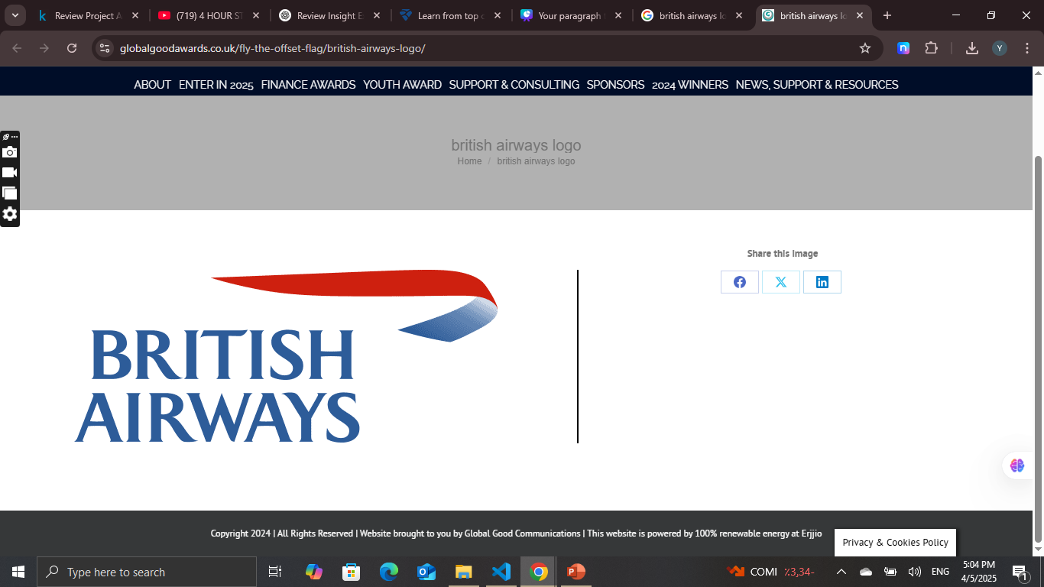
Predicting customer buying behaviour
Predicting customer buying behaviour

Slide 2
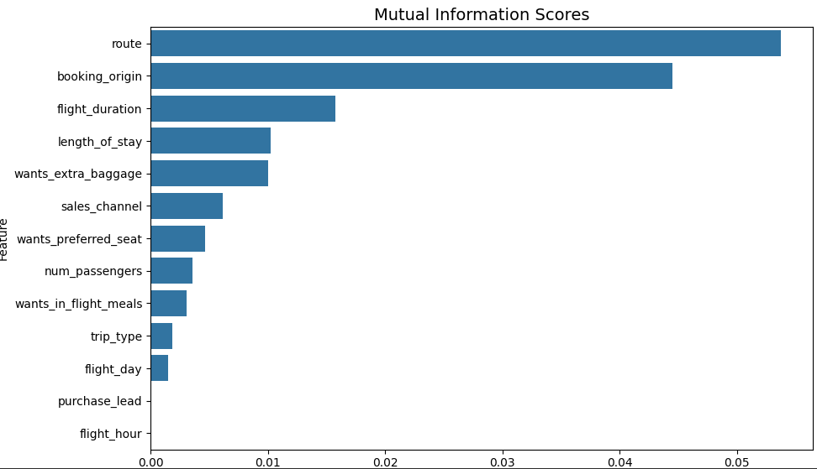
Analytics
After Cleaning the data and perform encoding and apply 3 models
We found that XGB works well with the data having accuracy 84.76%
The highly effective features are:
Route , Booking_origin , Flight_duration , length_of_stay, wants_extra_baggage

