Slide 1
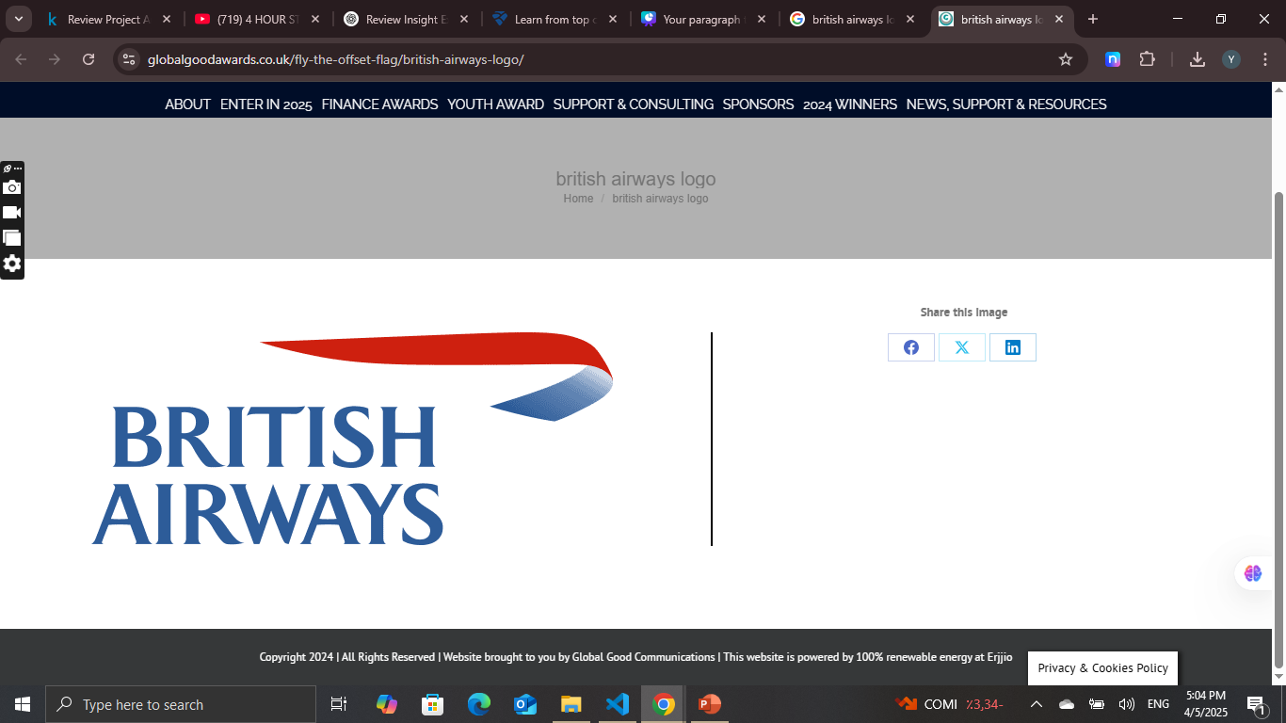
Predicting customer buying behaviour
Predicting customer buying behaviour

Slide 2
Analytics
After Cleaning the data and perform encoding and apply 3 models
Random Forest
XGB Classifier
Catboost
- We found that XGB works well with the data having accuracy 84.76%

