Slide 1

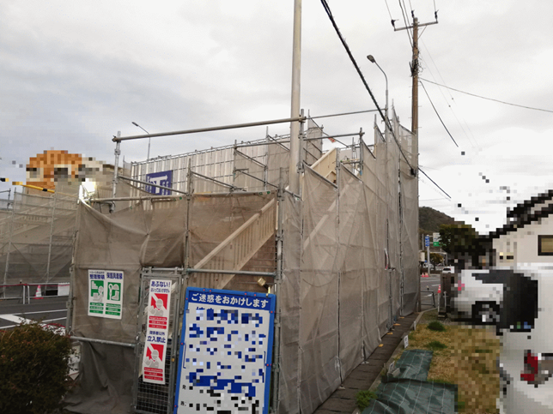

LGX-Shield ～ An Edge Monitor That Detects Bridge Anomalies in Real TimeUsing Acceleration Data × AI ～
For TRON Programming Contest 2025
December 11, 2025
Things Base Yoshiaki Sudo
Building a Safe and Secure Future Society with TRON × AI
This system detects anomalies in social infrastructure in real time and transforms inspection processes
—traditionally reliant on experience and intuition— into a data-driven framework that ensures greater safety and reliability.

Slide 2
1. Introduction
Aging infrastructure and a shortage of inspectors make maintenance increasingly challenging.
LGX Shield measures bridge vibrations with an accelerometer and instantly visualizes safety using AI.
Data is sampled at 100 Hz, analyzed by FFT, and used for inference.
Results appear on an LED and a LAN server, with no cloud or complex setup required.(for contest version)
A simple yet effective example of real-time IoT monitoring.

Slide 3
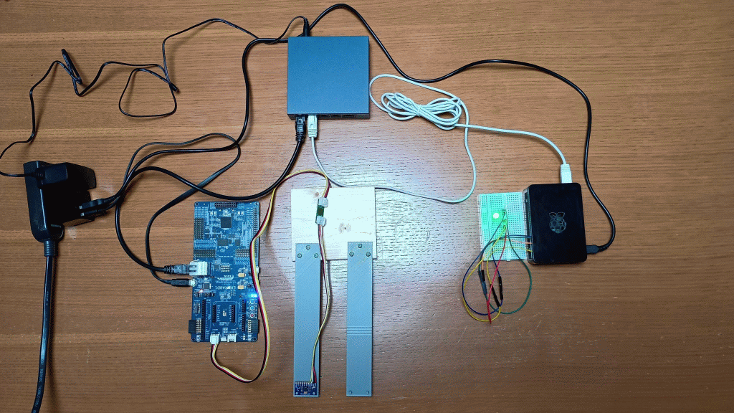


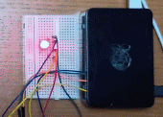
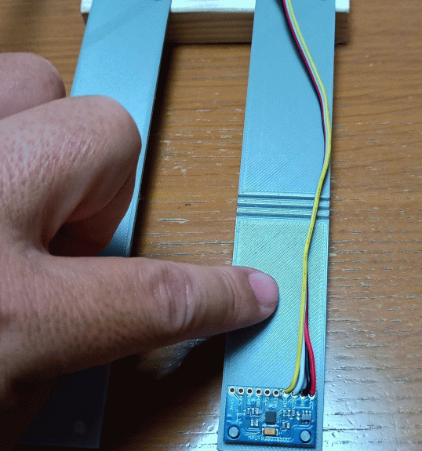
2-1. System Diagram
LGX-Shield and a pseudo-server system were developed for this contest version.
■System Diagram
■Physical Setup
In real service, the server would run in the cloud, and output would be viewed on user devices (PC / smartphone)
LAN
HUB
LAN
HUB
LGX-Shield
cantilever beams(2 types)
Contest evaluation targets
Power
supply
Safe
LGX
Shield
(EK-RA8D1)
Pseudo-Server
(RaspberryPi3)
Unsafe
Pseudo-Server
Accelerometer
■Cantilever Beam
Red LED lights when unsafe
・ Judge safe/unsafe
and control LED
(green/red)
Safe
Unsafe
・two versions prepared:
safe and unsafe
・Accelerometer fixed to the beam tip
・Beam is excited manually by
pressing with a finger
・Collect vibration
data from a cantilever
beam using an MPU-9250
accelerometer
※Raspberry Pi 3 was simply on hand; outdated
but useful for small tests

Slide 4
2-2. Task and Module Configuration
TAI: Performs FFT and runs CMSIS-NN MLP inference; returns the judgment
TNET: Sends judgment results to the LAN server via UDP
TLED: Displays safe/unsafe status using onboard LEDs
TAPP: Controls overall application; extracts features and issues inference requests
TIMU: Driven by GPT interrupt; samples accelerometer data at 100 Hz and notifies TAPP every 1024 samples (10.24 s)
A
P
P
TAI
TNET
TLED
TAPP
TIMU
Inter-task Communication
Mailboxes for messaging
Fixed-length memory pools for payloads
D
R
V
Accurate sampling via 10 ms GPT interrupt
MPU-9250 controlled via I2C, acceleration data acquired
Ethernet (UDP) used to send packets to the pseudo-cloud
GPT
I2C
ETH
H
W
On-chip
General-purpose timer
Accelometer
MPU-9250
Ethernet

Slide 5
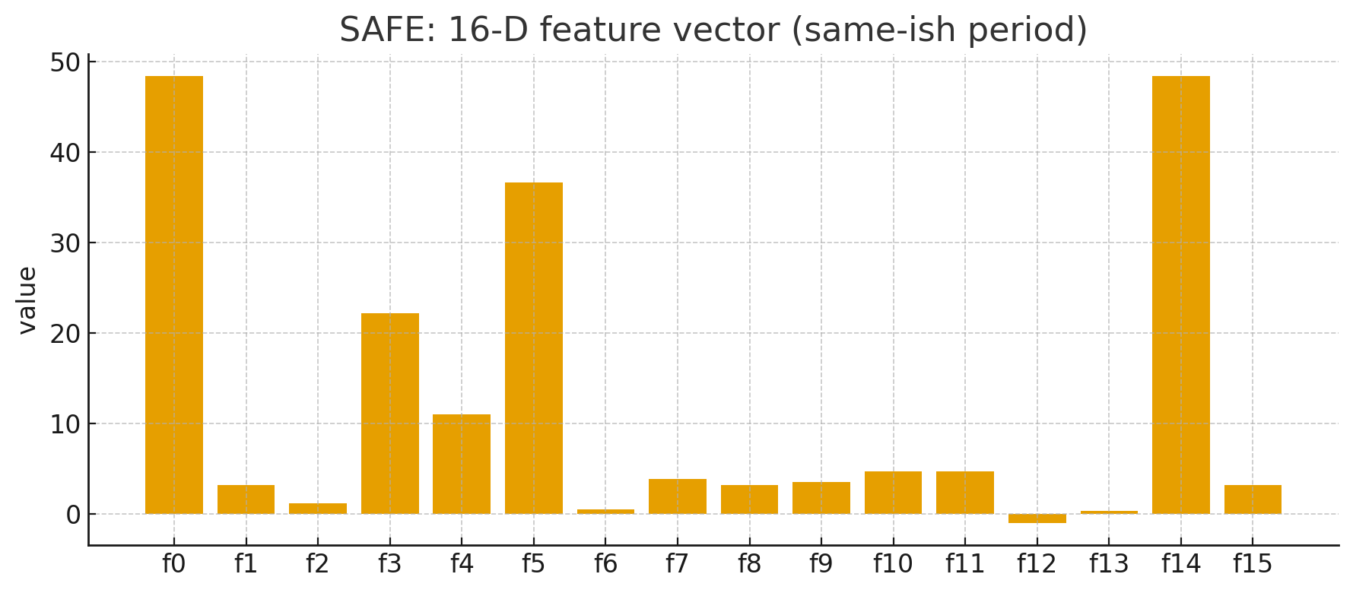
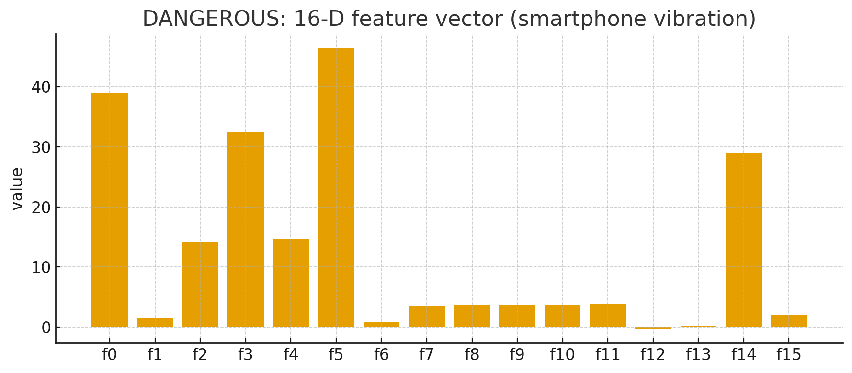
3. AI Processing Overview
FFT Processing
Performs frequency analysis on 1024 acceleration samples to extract vibration spectrum components.
16 key spectral features are selected as input for anomaly detection.
AI Inference (CMSIS-NN MLP)
Input: 16-dimensional feature vector
Output: Classification of Safe (0) / Unsafe (1)
CMSIS-NN enables lightweight and fast inference directly on the microcontroller.
Features
AI runs entirely on the microcontroller, with no cloud or external server required.
Operates in small, low-power environments, suitable for real-time monitoring in the field.
Notes
CMSIS-NN: Cortex Microcontroller Software Interface Standard – Neural Network. ARM’s optimized AI library (provided via FSP in e2-studio).
MLP: Multi-Layer Perceptron, a simple neural network model for feature classification.

Slide 6
4. Development Highlights
Real-Time Processing
tslp_tsk and rcv_mbx could not achieve cycles under 20 ms (BSP not implemented).
Using GPT interrupts enabled precise 10 ms sampling and 100 Hz data acquisition.
AI Implementation
Integrated FFT and MLP inference using the CMSIS library.
Rapid development achieved with ChatGPT-assisted code generation.
Network Implementation
This year, Ethernet on the EK-RA8D1 was used directly instead of relying on ESP32-AT.
Implemented UDP transmission based on T-Kernel driver specifications, enabling LAN data communication.
Logging
Switched from last year's UART + USB converter to SEGGER RTT.
Eliminated external hardware and greatly improved debugging efficiency.

Slide 7
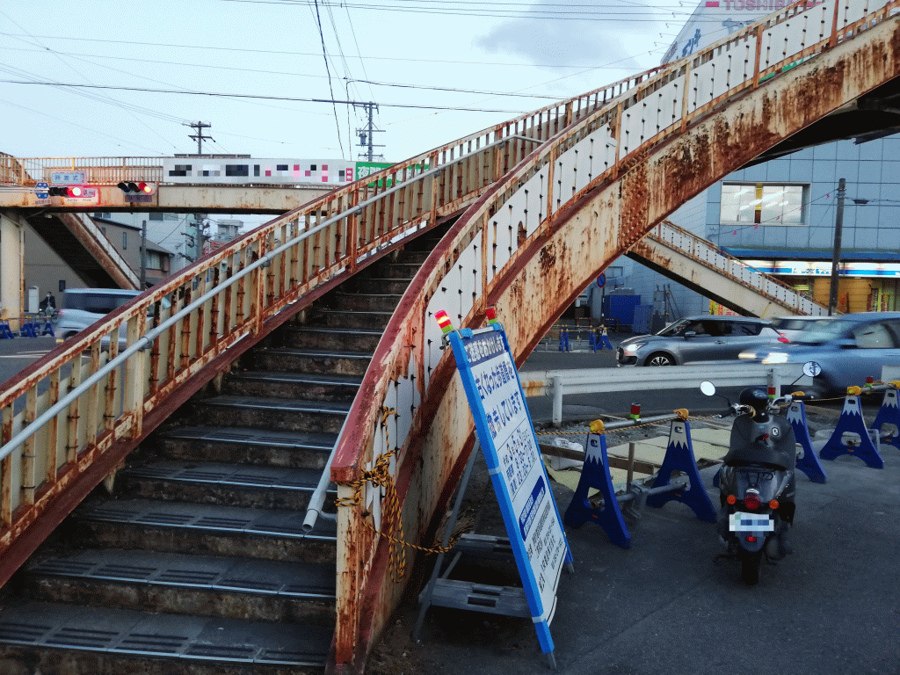
5. Future Society Vision
Bridge inspections have long relied on experience and intuition.
LGX-Shield introduces a system that uses AI and IoT to quantify safety and visualize conditions objectively.
The concept is applicable not only to bridges but also to roads, tunnels, dams, power grids, and other public infrastructure.
It can also extend to predictive maintenance in factories, helping address labor shortages and knowledge transfer issues in an aging society.
TRON × AI
is opening the way to a safe, secure,
and sustainable future society!

