Slide 1

90 COS/DOT
Assembly Programming
Basic Operations
Briefing Classification:
UNCLASSIFIED

Slide 2
Objectives
Utilize basic arithmetic and bit operations
Understand the difference between signed and unsigned values, from an assembly perspective
Understand the Two's Complement representation of signed numbers
Understand the Stack as it pertains to assembly programming, and implement functions that utilize it to load and store data

Slide 3
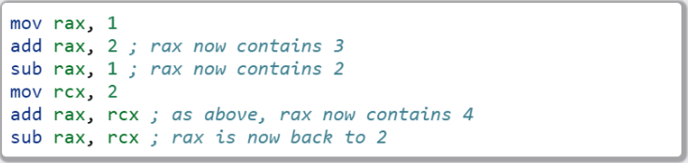
The add and sub instructions
add and sub
Description
Adds and subtracts arbitrary values. The destination (where the result is stored) is the first value provided.
Basic Use
We can use a combination of registers and immediates as operands:

Slide 4
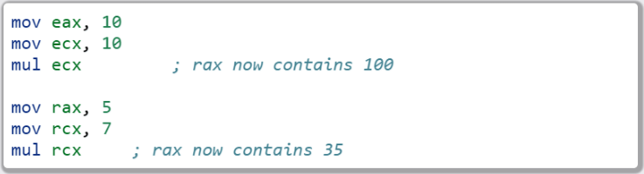
The mul instruction
mul
Description
Allow multiplication of arbitrary values. Takes a single argument, multiplies rax/eax/ax (depending on operand size) by src (whatever follows mul instruction). Result is stored in rax/eax/ax
Basic Use

Slide 5
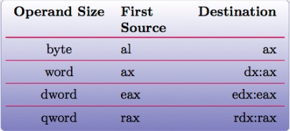
Mul: storing results
Results are stored in the source (possible), or in a combination of registers in the configuration below:

Slide 6
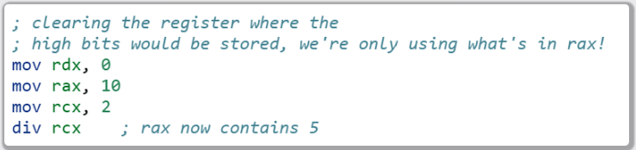
The div instruction
Description
As with mul, div takes a single argument, and divides the value stored in the dividend register(s) by it. This is typically AX/EAX/RAX (and the *dx equivalents), but may vary a bit depending on the size (chart provided on the next slide).
RDX is also needed. RDX is where the remainder will be stored. This register will need to be set to 0 before division can take place otherwise you'll get a SIGFPE.
Tl;dr: RAX/src (src = rcx in this case). Results stored in RAX, remainder stored in RDX.
Basic Use

Slide 7
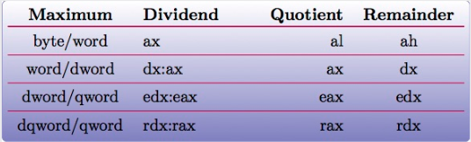
Div: Storing Results
Where to retrieve the results of a div from depends on the size of the arguments. The table below illustrates this relationship:

Slide 8
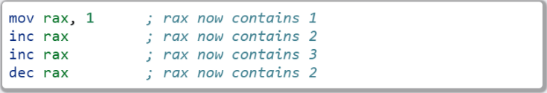
inc and dec
Description
Adds or subtracts one from the provided register, storing the result in place.
Basic Use

Slide 9

Lab 3
Arithmetic Operations
Copy the Lab3 folder (and its contents)
Modify the *.nasm file (Each function should have a comment block – lines starting with ‘;’ containing instructions)
Build and run using the following commands:

Slide 10
The Stack
Grows from high memory to low memory
Current function typically exists within a stack “frame” (but not always)

Slide 11
Strack Frames
RSP (or ESP) points to the top of the stack
RBP (or EBP) points to the “base” of the stack frame

Slide 12
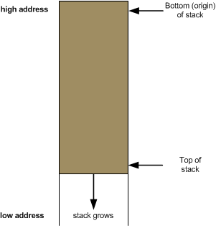
Stack Frame Layout
ADDRESS | VALUE/REG
0x0018 | RBP
0x0010 | 0x0000
0x0008 | 0x0000
0x0000 | RSP

Slide 13
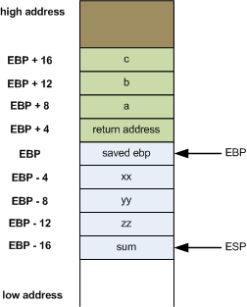
Stack Frame Layout Cont
- The green represents function parameters
- The blue represents local variables
- The base pointer separates this for us, giving us a point in the stack frame to offset from in order to grab variables
- When working on a stack, the return address will always be EBP + 4
Stack Frame

Slide 14
Expanding the Stack Frame
Can modify the value of the RSP directly to allocate more stack space:
But you must always ensure you clean up before the function returns

Slide 15
Stack Alignment
x86_64 expects 16 byte stack alignment
Allocating odd amounts of space can cause things to break
ALWAYS make sure you clean up your stack before returning

Slide 16
GDB – Stack Frames
Examining the Call Stack (backtrace / bt)
Frames and information
frame || f – Get information about the current frame
info args – Get information about function arguments
info locals – information about local variables

Slide 17
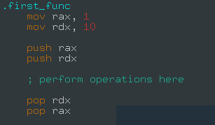
New Instructions: push and pop
Description
Push will subtract a pointer-width amount of space from RSP, and place the argument in the newly-allocated location. Pop performs the opposite action, storing the value just below RSP in the register provided, and adding a pointer-width amount to RSP. For every push, you will need to pop! It is important to pop in the opposite order in which you pushed.
Basic Use

Slide 18
Growing the Stack
After a push operation:
ADDRESS | VALUE/REG
0x0028 | RBP
0x0020 | 0x0000
0x0018 | 0x0000
0x0010 | 0x0000
0x0008 | Old RSP/Pushed Arg
0x0000 | New RSP

Slide 19
Restoring the Stack
After a pop operation
ADDRESS | VALUE/REG
0x0028 | RBP
0x0020 | 0x0000
0x0018 | 0x0000
0x0010 | 0x0000
0x0008 | RSP
0x0000 | Old RSP/Popped Arg

Slide 20

Lab 4
Stack Operations
Copy the Lab4 folder (and its contents)
Modify the *.nasm file (Each function should have a comment block – lines starting with ‘;’ containing instructions)
Build and run using the following commands:

Slide 21
Negative Numbers
Two’s Complement
Negative numbers of the x86(_64) platform are represented via Two’s Complement
In short, two's complement is just a way to tell between negative and positive numbers on the binary level.
Positive numbers remain mostly unchanged from what we have learned in previous courses. 0011 for instance is 3.
Negative numbers on the other hand use the "complement" of positive numbers. So instead of starting at 0000... negative numbers start at 1111. The 1s and 0s are flipped.
If the left most bit is 0, then the number is positive. 1 is negative.

Slide 22
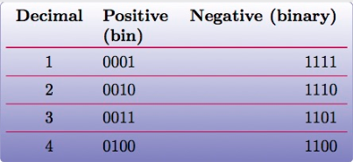
Two’s Complement
To get the negative version of a number... take the positive number, subtract by 1, then invert.
This may be hard to understand at first, but let's look at it via positive numbers first. 3 = 0011. Let's get –3. Subtract 1 from 3. 3-1=2. 2 = 0010. Invert. -3 = 1101.
Example 2:
4 = 0100.
4-1 = 3 ::: 3 = 0011
Invert: -4 = 1100

Slide 23
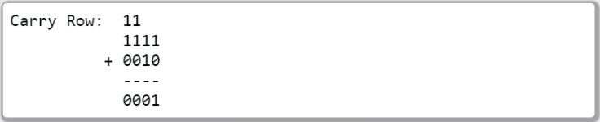
Two’s Complement (cont’d)
Simplified addition operations
Unified add/sub
Example: Adding 2 and -1

Slide 24
Sub Registers and Sign Extending
When copying smaller data into a register, sign extending may be used (rather than zero extending)
Sign extending preserves the “signed” attributes of the data being copied
The movsx instruction (just like movzx) handles this.

Slide 25
The movsx Instruction
movsx
Description
Much like movzx, movsx can be used to move data into a portion of a larger register, while preserving its sign

Slide 26
Bitwise Operations – Bit Shifting
Two unsigned shift operations:
shl – shift left
shr – shift right
Shifting moves the bits in the register over the direction (left or right) and number of bits specified
Bits that fall off the end (and overflow) will disappear, except for the last one, which ends up in the carry flag
Extra space is padded with 0’s

Slide 27
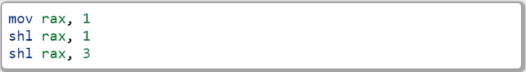
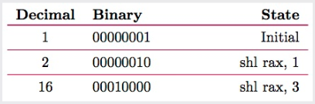
Left Shift
The following snippet of assembly:
Can be modelled by the following table:

Slide 28
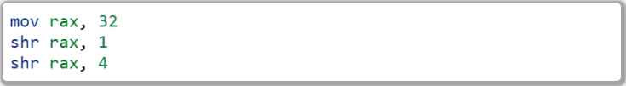
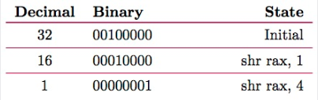
Right Shift
Similarly, the following snippet of assembly:
Can be modelled by the following table:

Slide 29
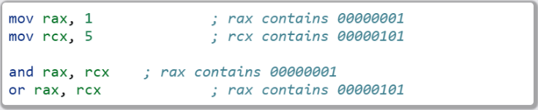
Binary and/or
And can be used to determine whether or not one or more bits are set in
Or will tell you if the bit is set in at least one place
Both take two operands, left will hold the result after the operation completes
Use:

Slide 30
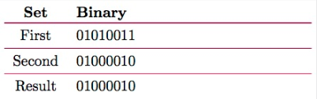
And Table

Slide 31
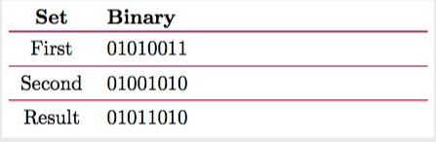
Or Table

Slide 32

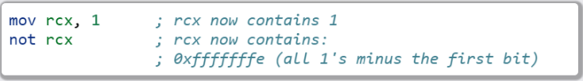
Binary Not
Inverts the bits in a given register
Example:
Similarly:

Slide 33
Properties of eXclusive OR
XOR yields 1 only if the bit is set in either the source or destination, but NOT both
Any value XOR’d with itself is 0
0 XOR’d with any value is that value
For numbers A,B, and C, if A ^ B = C, then C ^ A = B abd C ^ B = A

Slide 34
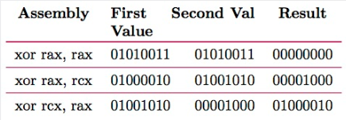
XOR Table

Slide 35
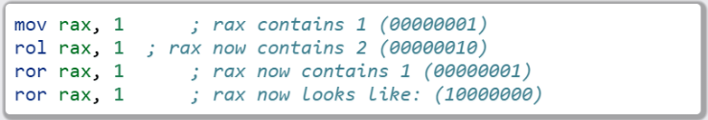
Rotating Bits
The values in the register are rotated the indicated number of places to the right or left
Bits that are rotated off the end of the register and moved back to the beginning
Instruction:

Slide 36
Signed Bit Operations
Shift operations that are sign aware exist (SAR for right and SAL for left)
Work in the same fashion as shr/shl, except for how bits shifted off the end are treated (bits still disappear, but the sign of the resulting value is retained)

Slide 37

Lab 5
Bit Operations
Copy the Lab5 folder (and its contents)
Modify the *.nasm file (Each function should have a comment block – lines starting with ‘;’ containing instructions)
Build and run using the following commands:

Slide 38
Section Review
Arithmetic Operations
The Stack
Stack frames
Stack Alignment
Signed values and Two’s Complement
Bit Operations

