Slide 1

90 COS/DOT
Assembly Programming
Control Flow
Briefing Classification:
UNCLASSIFIED

Slide 2
Objectives
Utilize status flags and conditional control flow
Understand and utilize x86(_64) string instructions and corresponding instruction prefixes.
Understand and implement methods utilizing a variety of calling conventions (both x86 and x86_64)

Slide 3
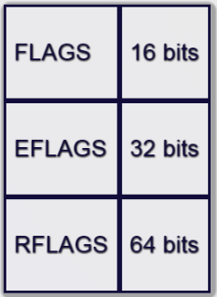
FLAGS
A register that contains a variety of bits representing state and status information
Varies in size, but many portions (in newer processors) aren’t used

Slide 4
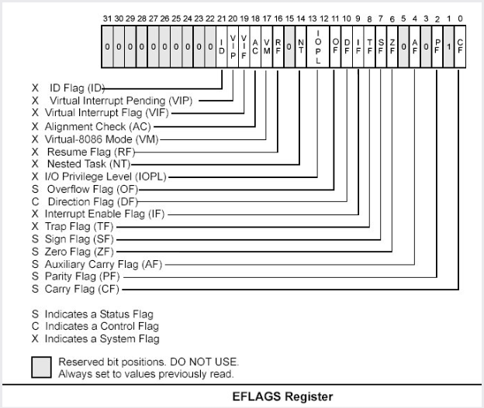
Flag Layout
Credit: the Intel Manual

Slide 5
Flags we care about now
Zero Flag (ZF) – set when an operation that sets the zero flag produces a zero- includes arithmetic and bitshift operations
Carry Flag (CF) – set when an arithmetic borrow or carry occurs during add/sub – e.g., the result of an add would have set bit 33 (in x86), or bit 65 (in x86_64)
Also set with some bitshift operations (such as when a bit falls off the end in a shr/shr)

Slide 6
Flags we care about now
Overflow flag (OF) – Indicates that sign bit of the result of an operation is different than the sign bits of the operands
Ex: Adding two large position numbers ends up producing a negative result (due to overflow)
Sign Flag (SF) – Set to indicate the result of an operation is negative

Slide 7
Accessing the Flags
Can be set and checked manually
Some have special instructions for set and clear (which we’ll talk about later)
Flag register can be accessed and set via pushf(d|q)/popf(d|q)

Slide 8
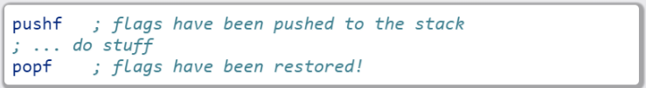
pushf and popf
Description
Pushes the flag register (or the first 16 bits…eflags(32 bits) or rflags (64 bits) if pushfd or pushfq) onto the stack, and pops the value on top of the stack into the flags register (or eflags/rflags)
Basic Use

Slide 9

Lab 6
Flag manipulations
Copy the Lab6 folder (and its contents)
Modify the *.nasm file (Each function should have a comment block – lines starting with ‘;’ containing instructions)
Build and run using the following commands:

Slide 10
Control Flow

Slide 11
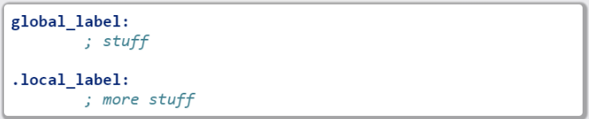
Line labels
Global and local

Slide 12
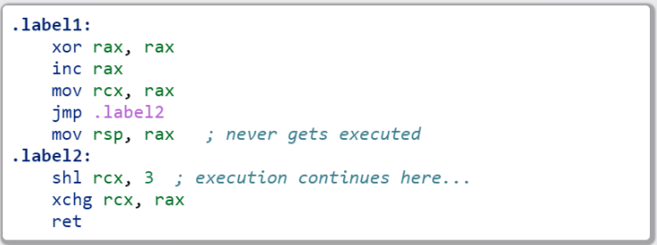
Everybody jmp .around (lol rly?)
jmp provides an unconditional branch, or transfer of execution to the target

Slide 13
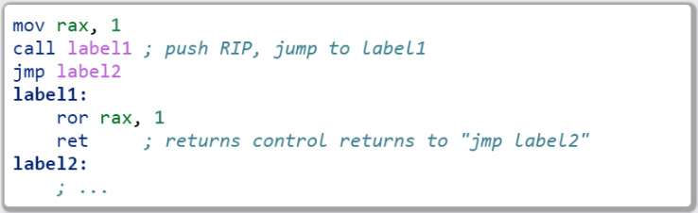
call and ret
Similar to jmp, but with a few key differences
Functionally equivalent to: push rip followed by a jmp X
Typically indicates a function call

Slide 14
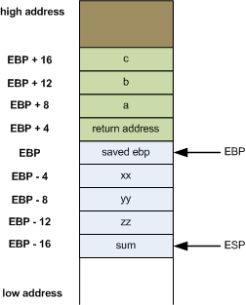
More on ret
Pops the return pointer off the stack and jumps to it
Used to return to the last point of execution (as shown on the previous slide)
FUNCTION 1
- First we call a function which:
--Pushs ret address
--Jmps to location
- Second, pop EBP
- Third (ret), pop return address
- Fourth (ret), jmp to return address
MAIN
call function1
some instruction
some instruction
some instruction
jmp
function1
push ebp
mov ebp, esp
some instructions
…
pop ebp
ret
RETURN ADDRESS
jmp

Slide 15
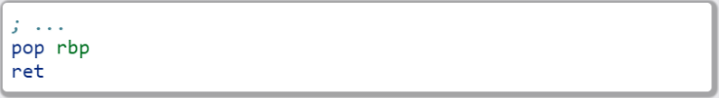
More on ret
Once we get to the end, we are ready to return:
Popping off the old RBP, then popping the return pointer, and jumping to it (effectively “pop rip”)

Slide 16
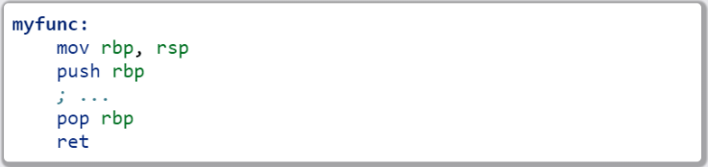
A Side Note About Functions
Typically store the stack pointer ((E|R)SP) at the top of the function
If stored must be (re)stored before returning
If we don’t, our stack location will be off
If left at the top of the stack, we will return ONTO the stack
This is not always done, as in FPO (Frame Pointer Optimization/Omission)
Functions will be covered in more depth later

Slide 17
Conditional Control Flow: Comparisons

Slide 18

cmp
Compares two values by subtraction (e.g., SUB op1, op2)
Sets flags to indicate whether the values were equal, or if one was larger
Flags set by this instruction: CF, OF, SF, ZF, AF, and PF
Example:

Slide 19
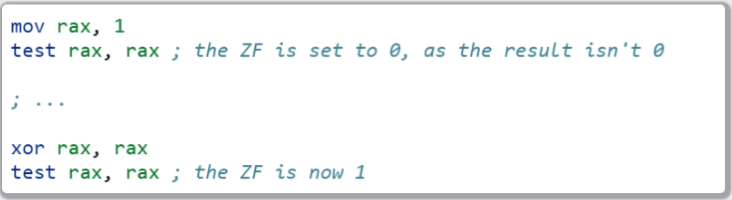
test
Compares two values by doing a bitwise AND
The SF, PF, and ZF get set by this operation
Often used to test whether or not a register is 0
Example:

Slide 20
jcc
A large set of conditional branch instructions
Most execute based on the value of one or more flags
Some more common jumps:
je or jz – Jump if Equal (or Jump if Zero)
jne, jnz – Jump if Not Equal (or Not Zero)
ja – Jump if Above (if the operand compared previously is greater)
jb/jc – Jump if Below (or Jump if Carry)
Many others – refer to the Intel manual for a comprehensive list

Slide 21
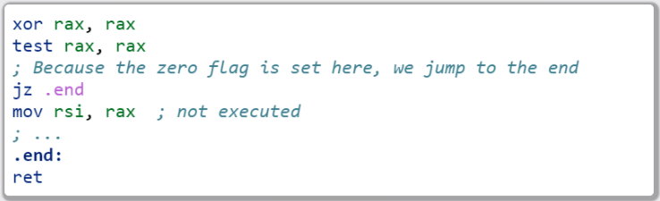
jcc
A simple check to see if the result of an operation is 0:

Slide 22
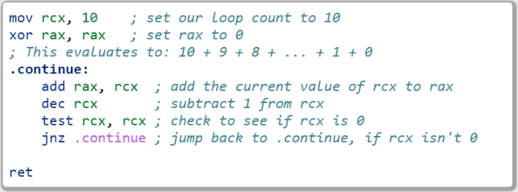
jcc
A simple loop:

Slide 23
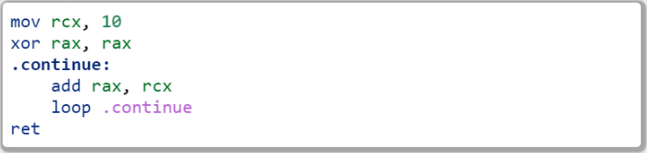
loop
A simple macro for dec rcx/test rcx, rcx/jnz <target>
Expects ECX/RCX to be populated with a counter variable
The loop from the previous slide could be re-written

Slide 24

Lab 7
Execution control flow…
Copy the Lab7 folder (and its contents)
Modify the *.nasm file (Each function should have a comment block – lines starting with ‘;’ containing instructions)
Build and run using the following commands:

Slide 25
String Instructions
What a “string” means to x86(_64)
Really just a string of bytes
No particular qualms about terminators (e.g., ‘0’)
Several prefixes and a flag that will modify behavior (more on those later)
All of them have the unit to move/copy/initialize/scan appended to the end (e.g., scasb vs scasw vs scads, etc)

Slide 26
String Instructions
Common features:
RSI (or ESI, in x86) is treated as a pointer to the beginning of the “source”
RDI (or EDI, in x86) is treated as a pointer to the beginning of the “destination”
RCX (or ECX, in x86) is assumed to hold the count, if needed
RAX (or EAX, in x86) is assumed to hold the value to evaluate, if needed (e.g., store, compare against, etc)
Typically increments source and/or destination register pointers by the amount of data operated on (e.g., movsb would add 1 to both RSI and RDI, where movsd would add 4)

Slide 27
Some Common Instructions
Scan String – scas(b/w/d/q) – scans a string located at RDI for value found in RAX/EAX/AX/AL (depending on the size used), and increments the pointer
Store String – stos(b/w/d/q) – initializes the string located at RDI to the value pointed at by RAX/EAX/AX/AL (depending on size used) and increments the pointer.
Load string – lods(b/w/d/q) – Copies the value from RSI into RAX/EAX/AX/AL, and increments the pointer
Move string – movs(b/w/d/q) – copies data from RSI into RDI, and increments both pointers
Compare string – cmps(b/w/d/q) – compares the values stored at RSI and RDI, and increments the pointer, updating the RFLAGS (or EFLAGS) register with the result

Slide 28
Prefixes
Several instruction prefixes available to modify behavior – looping the instruction over a section of memory
All of them tend to use RCX/ECX/etc as a termination condition – decrementing each execution
Some prefixes available:
REP – continue performing the action RCX times.
REPNE – continue performing the action RCX times, or until the FLAGS register indicates the operands were equal
REPE – Continue performing the action RCX times, or until the FLAGS register indicates the operands were not equal
Often Used by compilers to essentially inline C string functions (such as strlen, memset, memcpy, etc…)

Slide 29
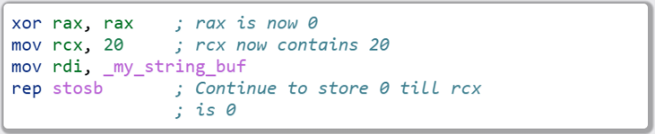
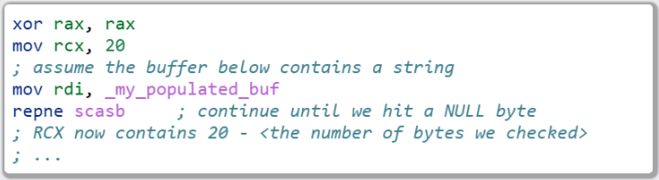
Prefix Examples
Unconditional
Conditional

Slide 30
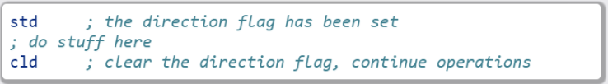
The Direction Flag
Controls the direction buffers are traversed when using the REP* prefixes
If set during execution, an operation, ALWAYS clear after (or crashes likely to occur)

Slide 31

Lab 8
String Operations
Copy the Lab8 folder (and its contents)
Modify the *.nasm file (Each function should have a comment block – lines starting with ‘;’ containing instructions)
Build and run using the following commands:

Slide 32
Functions

Slide 33
Calling Conventions: x86
Microsoft – many calling conventions exist for x86
Different implications for how arguments get passed
Different implications for stack cleanup after function returns
Name mangling is often used to differentiate
System V x86 Calling Convention
Most POSIX-compliant and (POSIX-like) platforms abide by this
Such as Linux, Solaris, BSD, OSX, etc
Also called cdecl
Other calling conventions

Slide 34
Microsoft Conventions: stdcall
Indicated to compiler (from C) by _stdcall prefix
Arguments pushed on the stack (in order from right to left)
The function being called (the “callee”) cleans up the space allocated
Name gets decorated with an appended “@X”, where X is the number of bytes to allocate (num args * 4)

Slide 35
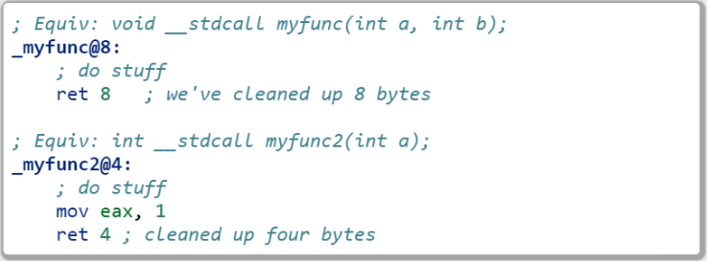
Microsoft Conventions: stdcall
Standard call in action – Stack Cleanup:

Slide 36
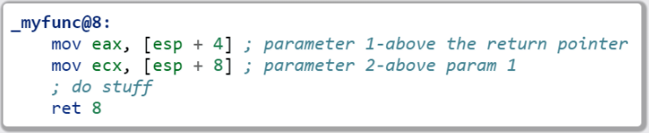
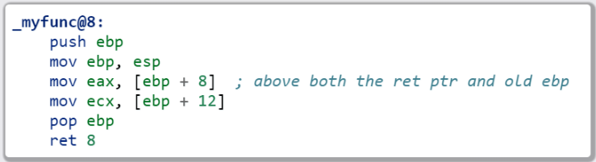
Microsoft Conventions: stdcall
Standard call in action – Accessing Parameters:
If EBP hasn’t been pushed to the stack:
Otherwise:

Slide 37
Microsoft Conventions: cdecl
This is also the System V calling convention (e.g., what most non-Microsoft platforms use)
Parameters passed in the same fashion as in stdcall
Stack cleanup is different, the calling function (e.g., caller) is responsible for cleanup
No real name mangling, aside from a leading underscore “_”

Slide 38
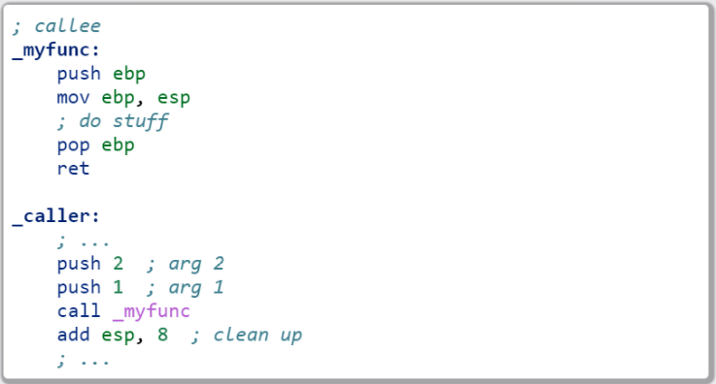
Microsoft Convention: cdecl
cdecl in action: Stack cleanup

Slide 39
Microsoft Conventions: fastcall
First two arguments (from left to right) passed via registers (ECX and EDX)
Remaining arguments pushed on the stack (right to left, as with cdecl and stdcall)
Cleanup is performed by the callee (as with stdcall)
Name mangling is similar to stdcall, but an additional “@” is prepended (e.g., “_@myfunc@8”)

Slide 40
Conventions: thiscall
“Special” convention used for C++ non-static member functions
Defines a method of passing the “this” pointer (which allows those functions access to a specific instance of a class)
Slight difference between Microsoft and System V
Microsoft: The “this” pointer is passed ECX, other parameters work like stdcall
System V: Works like cdecl, but the “this” pointer is the first argument to the function
C++ name mangling is a more complex topic (and somewhat compiler dependent)

Slide 41
x64 Calling Conventions
Only one convention for each (Mostly…there are oddballs like vectorcall, but we won’t discuss those)
thiscall on x64 (both conventions) passes the “this” pointer as an implicit first argument (as it does for System V x86)
Both conventions work similarly to _fastcall, passing arguments in registers (though the registers differ between platforms)

Slide 42
Microsoft x64 Calling Convention
Uses 4 registers to pass the first 4 parameters (RCX, RDX, R8, and R9)
Floating point values are passed via SIMD registers (XMM0-3…we’ll talk more about this later)
Remaining values are added to the stack
Caller’s responsibility to clean up (as with _cdecl)

Slide 43
Shadow Space
x64 calling conventions require stack allocation for passed variables
intent is to allow function being called to immediately spill registers (if desired)
Windows API requires space to be allocated for 4 registers (regardless of function parameter count)
Additional arguments (beyond 4) are added via the stack
BUT in the location they would normally occur at if all parameters were passed that way
Example: param 5 would begin at [rsp + 0x20]

Slide 44
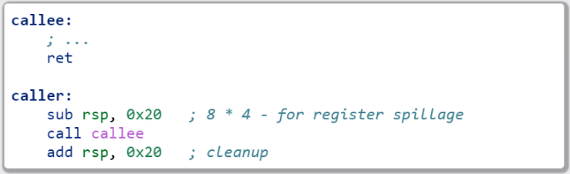
Microsoft x64 Calling Convention
No parameters:

Slide 45
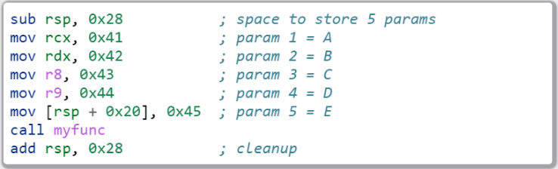
Microsoft x64 Calling Convention
5 or more parameters:

Slide 46
Microsoft x64 Calling Convention
Some additional reading on Microsoft’s x64 calling convention:
https://blogs.msdn.microsoft.com/oldnewthing/20040114-00/?p=41053/

Slide 47
System V x64 Calling Convention
Similar to the Microsoft calling convention, but more values are passed via registers
The first 6 arguments are passed via register (RDI, RSI, RDX, RCX, R8, and R9)
Floating point arguments go in SIMD registers (XMM0-7)
Additional arguments are pushed onto the stack
Shadow space is not required, but stack must remain 16-byte aligned
Red zone optimization provides free stack space for leaf functions

Slide 48
Red Zone
Allows use of the next 128 bytes below RSP without modifying stack pointer
Further function calls WILL clobber space
Because of this, Red Zone use is most suitable for leaf functions
Safe from interrupt handlers, etc.

Slide 49
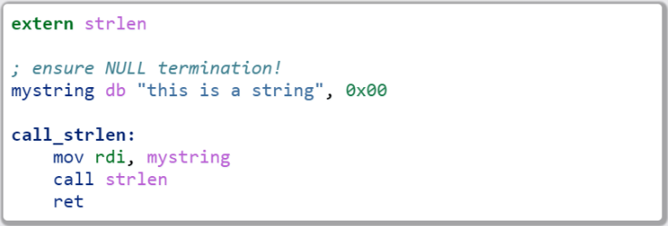
System V x64 Example
Calling strlen

Slide 50
Return Values
Typically, the value returned at the end of the function call will be stored in RAX (for x64), or EAX (for x86)

Slide 51
Register Preservation – x86
Volatile: EAX, ECX, and EDX don’t need to be saved during a function call
All others must be preserved

Slide 52
Register Preservation - x64
Windows: Volatile Registers (don’t need to be reserved by callee)
RAX, RCX, RDX, R8, R9, R10, and R11
XMM0-3 and 5
All others need to be preserved
System V
Most registers are volatile (need to be preserved by caller if the values are to be retained)
Exception: RBP, RBX, and R12-15 are non-volatile (must be preserved)

Slide 53
Additional Links
More information on both x64 calling conventions:
http://eli.thegreenplace.net/2011/09/06/stack-frame-layout-on-x86-64/

Slide 54

Lab 9
Functions
Copy the Lab9 folder (and its contents)
Modify the *.nasm file (Each function should have a comment block – lines starting with ‘;’ containing instructions)
Build and run using the following commands:

Slide 55

Windows Functions Lab
Functions – Calling Conventions (x86)
Copy the WinFunctions folder to your Windows System
Copy the nasm binary to WinFunctions\ASM\nasm.exe
Edit WinLab.nasm under WinFunctions\ASM\ASM\WinLab.nasm
build via VS2015 (as normal), or via msbuild using the following command:

Slide 56
Section Review
Flags
Jumps
Call and ret
string instructions
prefix
Functions and calling conventions

