Slide 1

90 COS/DOT
Assembly Programming
Control Flow
Briefing Classification:
UNCLASSIFIED

Slide 2
Objectives
Learn the different privilege modes of operation, and some of their implications
Understand basic memory segmentation and some descriptor tables
Understand, at a basic level, virtual memory
Understand basic processor features, control registers, and how they fit together
Understand and implement Model Specific Registers (MSRs)
Utilize x86(_64) instructions to identify the current processor, and understand how to programmatically query its capabilities

Slide 3
Processor Modes

Slide 4
User and Kernel Modes
X86(_64) defines several modes of operation (or “rings”) the processor can work in
Each mode has various instructions (and portions of memory) it is allowed to perform
User mode (which is least privileged) is Ring 3 (which is where most of your applications reside)
Kernel mode (most privileged) is Ring 0, which is where the core (or kernel) of the OS resides
Rings and 1 and 2 are (largely) unused by most operating systems

Slide 5
User Mode
Mode of least privilege (Ring 3)
Cannot touch more privileged memory sections
Cannot execute “privileged” instructions
Typically must task some facility in the kernel in order to get resources

Slide 6
Kernel Mode
Mode of most privilege (Ring 0)
Can access any portion of memory (and change protection)
Can perform privileged instructions
Device drivers often run here (in addition to the core portions of the OS)

Slide 7
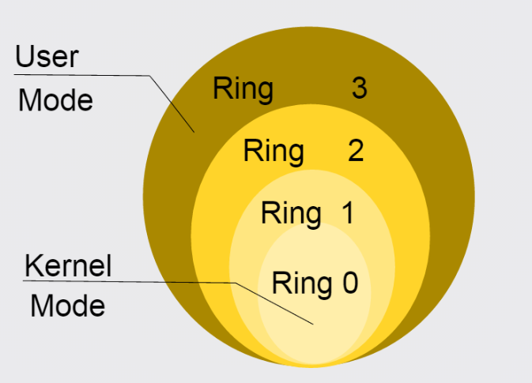
Ring Diagram

Slide 8
Interrupts and Memory Segmentation

Slide 9
Tables and Memory Segmentation
Intel specifies a number of tables, populated by the OS, which map functionality to the processor
The Interrupt Descriptor Table, or IDT
The Global Descriptor Table, or GDT
The Local Descriptor Table, or LDT
Virtual memory also relies on a set of page tables

Slide 10
Interrupts and The Interrupt Descriptor Table

Slide 11
Interrupts
What are interrupts?
Interrupts provide a special mechanism to alert the kernel of an event
Some (though not all) can be temporarily disabled
Specified via the IDT
Interrupts can be generated many ways:
Via hardware events (e.g., a keypress on a keyboard)
Page or segmentation faults
Software interrupts also exist
Many others

Slide 12
Interrupts
Interrupt Service Routines (ISRs)
Functions that respond to interrupts
Set via Interrupt Gates in the IDT (See below)
Interrupt Gates
Essentially the entry number (in the IDT) of the ISR you want to call
The ‘int’ assembly instruction will call the corresponding ISR (recall int3…)
The iret instruction is provided (in kernel mode) to return back to user mode

Slide 13
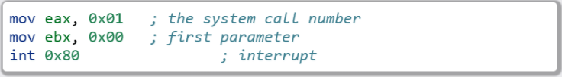
Interrupts - Example
The following code will perform an exit(0) on Linux (x86)

Slide 14
Segment Registers
Segment registers are a special type of register not covered yet, which come in a variety of flavors
Each of them can be mapped to provide a special “view” of a section of memory
Most modern operating systems use a “flat” memory model, forgoing segmentation (almost) entirely
Still have some real world applications, particularly in Windows

Slide 15
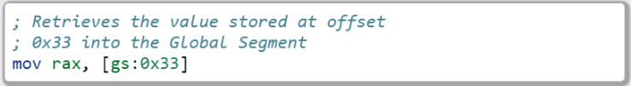
Segment Registers
The Basics:
CS – Code Segment
DS – Data Segment
SS – Stack Segment
FS – Far Segment
GS – Global Segment
Example: Getting a value from some offset into a segment

Slide 16
Segmentation - Segments
What is a segment?
Describes a logical section of memory
Specifies who can access it (e.g., what privilege level you need)
Indicates the range (start address and length)
Why are they important?
Part of the segmentation model, used to map a flat section of memory to the segment registers

Slide 17
Segmentation
The Global Descriptor Table (GDT)
Initialized by the operating system
Contains various segment descriptors in its entries
The GDT Register (GDTR) indicates where it is located
Contains information about how the memory in your system gets mapped
Also (partially) defines how the transition from user to kernel mode occurs
Intended to be a global structure

Slide 18
Segmentation
The Local Descriptor Table (LDT)
Similar to the GDT
Intended to have smaller scope: e.g., a per-process construct

Slide 19
Segmentation – Real World Examples
Microsoft uses segmentation to provide fast access to key data structures
The Thread Environment Block (TEB) in user mode
Hangs off of the FS register in x86/GS in x64
Provides lots of important per-thread information
The Processor Control Block (or KPRCB) in kernel mode
Hangs off of the FS register in x86/GS in x64
Provides lots of important per-processor information

Slide 20
Segmentation
Further reading (if interested)
The OSDev wiki describes GDT initialization - http://wiki.osdev.org/GDT_Tutorial
The Segment Descriptor Cache – Mr. Robert Collins (from a Dr. Dobbs article) - http://www.rcollins.org/ddj/Aug98/Aug98.html

Slide 21
Other Processor Features

Slide 22
Processor Security Features
DEP/NX
SMEP/SMAP
Page Protection
Write Protection

Slide 23
Control Registers
Control CPU enforcement of a variety of features
Most security features are enabled in this fashion
Requires privileged execution (Ring0) to access
Other features (such as hardware virtualization) also enabled in this fashion
Feature mappings detailed in the Intel manuals

Slide 24
Virtual Memory
Allows a virtual abstraction of hardware addresses
Paging enabled via CR1
Page Table location stored in CR3
Tables and Directories provide fast lookup of address translations

Slide 25
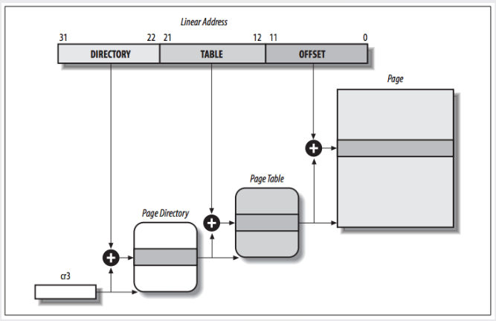
Page Tables and Directories
Image Credit: https://notes.shichao.io/utlk/ch2/

Slide 26
Model Specific Registers (MSRs)
Many of these exist for x86(_64)
Most only accessible in privileged mode
Used (sometimes) via RDMSR and WRMSR
Others have special instructions
Mainly documented by vendor (e.g., Intel manual)

Slide 27
Time Stamp Counter
Can read from user mode (via rdtsc)
Can only modify from kernel mode
Low bits of result are stored into EAX/high bits in EDX
This is the same on both x86 and x86_64
x86 – rdtsc will clear the high bits of storage registers
Results can be combined on x64 to full width with a left-shift and a bitwise or

Slide 28
Feature Support
The CPUID instruction can provide information about the CPU
Vendor string
Model number
Size of internal cache
Various features supported
The instruction behaves similarly on both x86 and x86_64

Slide 29
Feature Support
The value in EAX at the time of the CPUID call determines what information comes back
0 -> Vendor ID string – Stored in EBX/EDX/ECX
1 -> Returns a bitfield containing supporting features
- …

Slide 30

Lab 10
MSRs and CPUID
Copy the Lab10 folder (and its contents)
Modify the *.nasm file (Each function should have a comment block – lines starting with ‘;’ containing instructions)
Build and run using the following commands:

Slide 31
Section Review
Ring 0/3
Interrupts
Memory Segmentation
GDT
LDT
MSRs

