Slide 1

90 COS/(DOT)
Assembly
Practical Application
Briefing Classification:
UNCLASSIFIED

Slide 2
Utility Methods

Slide 3
Objectives
Implement a number of basic standard library functions in assembly
Implement some essential data structures in assembly
(Optional) Complete provide bonus labs

Slide 4
Assembly: A Practical Application

Slide 5
Utility Functions
Copy and search functions (Some methods from previous labs, such as the string instruction lab, may be helpful here)
strlen
memcpy
memset
memcmp
strchr
strcmp
strcpy
strstr
Conversion
atoi

Slide 6
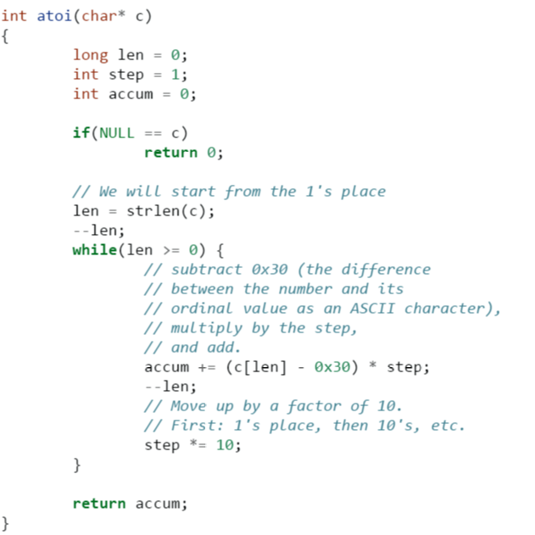
atoi

Slide 7
Sorting (Bonus Labs)
Insertion sort
Quicksort

Slide 8
Lab 13 - Utility Functions

Slide 9
System Calls - an Introduction

Slide 10
Objectives
Show comprehension of the basic function and implementation of system calls (including legacy methods)
Demonstrate comprehension of the basic functionality provided by a C Runtime
Implement a system call wrapper in assembly
Begin work on a C Runtime

Slide 11
System Calls
Mechanism by which we task the operating system (kernel) to do work
Implemented by a number of mechanisms, depending on OS/architecture

Slide 12
System Calls – Cont’d
Many operations require additional privilege to perform
File I/O
Memory allocation
Process creation
Device I/O
…
This requires kernel intervention to occur

Slide 13
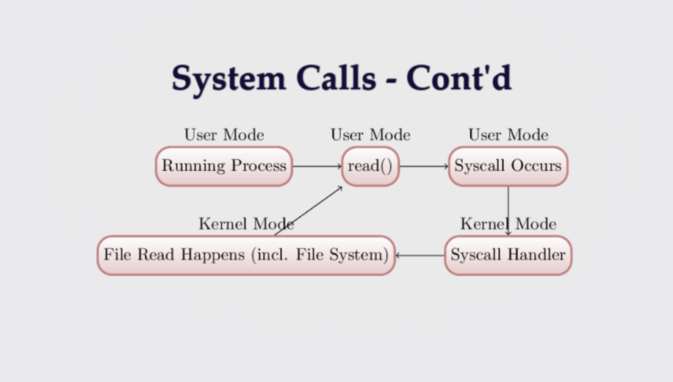
System Calls – Cont’d

Slide 14
Legacy System Call Method
In older legacy systems (32-bit included) we would set eax with the proper system call number then invoke int 80h
Int 80h = int 0x80

Slide 15
Modern Alternative
On more modern systems, we have the ability to use actual keyword type instructions.
x86: sysenter / sysexit
x64: syscall

Slide 16
My First Syscall
Wrapping system calls
x86
X64
Useful Resources:
General Info: https://www.cs.utexas.edu/~bismith/test/syscalls/syscalls.html
x86-64 syscalls: http://blog.rchapman.org/posts/Linux_System_Call_Table_for_x86_64/
32-bit syscalls: http://syscalls.kernelgrok.com/
Indepth Guide

Slide 17
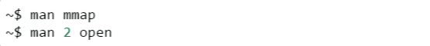
Getting Information
Man pages often have a comprehensive list of required flags (even if definitions are buried in header files)
May be more than 1 section to a man page (if the page overlaps with a utility page “2” generally has dev docs)

Slide 18
C Runtime: A good_start
What is a runtime?
int main() vs your program’s real entry point
Building without a standard library
stuff your crt usually does

Slide 19
Compiling with no CRT
All functions will need to implemented/provided
Initial effort: Wrap system functionality
sys_exit
write

Slide 20
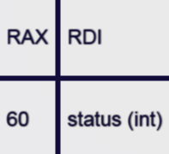
sys_exit

Slide 21
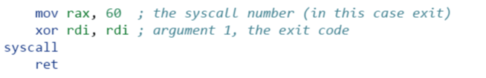
Implementing sys_exit

Slide 22
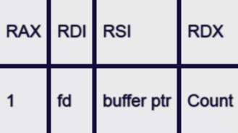
Some Setup
STDOUT – A special kind of file descriptor (1)
sys_write

Slide 23
Lab 14
Finally, time for “Hello, World!”
Required Objectives:
Populate_start, and perform the following actions:
Wrap sys_write
Wrap sys_exit
Print the string “Hello, World!” to STDOUT
Exit without seg fault

Slide 24
Lab – Enumerating Directory
Entries
List the contents of a directory
Required Objectives:
List the contents of a directory
Print them to screen
Optional:
Recursively list directory
May need to use stat to find additional directories

Slide 25
Lab 14
Finally, time for “Hello, World!”
Required Objectives:
Populate_start, and perform the following actions:
Wrap sys_write
Wrap sys_exit
Print the string “Hello, World!” to STDOUT
Exit without seg fault

Slide 26
Allocation

Slide 27
Objectives
Understand the basic roles and responsibilities of a simple allocator
Understand the function of the mmap syscall
Implement a simple allocator

Slide 28
Allocating Memory
The Heap – no longer just a call to malloc
In this case, malloc does not exist!
How do we add memory to our process?

Slide 29
Objectives
Many different strategies for heap management
Lots of special cases to consider
Multithreading adds more concerns (we’ll discuss more about this later)
Our strategy here will try to remain simple

Slide 30
Our Allocator Strategy
Getting new memory from the kernel everytime we need to allocate is very inefficient
We’ll want to build a list of unused (or “free”) chunks to hand out when allocations are requested
When a chunk is requested, we can check the free list first (if initialized), to see if we have something that will work
If not, we’ll need to allocate memory

Slide 31
Asking for More
We can actually ask for memory from the kernel in two ways:
mmap – This is the more “modern” approach; we can ask the kernel for more memory by requesting an anonymous page mapping (we’ll be discussing mmap in much greater detail over the next few sections)
Brk – We won’t really touch this too much; it lets you extend or shrink the end of the memory mapping in your program
Some additional initialization logic can also added to _start, if needed

Slide 32
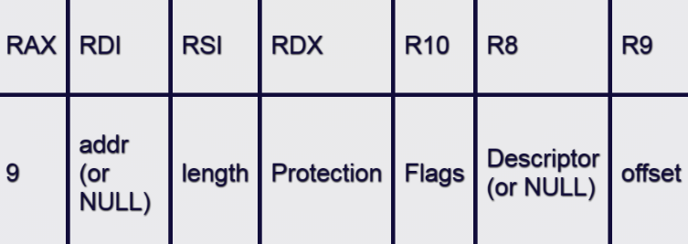
mmap
Lets us create a memory mapping
May be backed by a file, or anonymous
This will be the base for our allocator

Slide 33
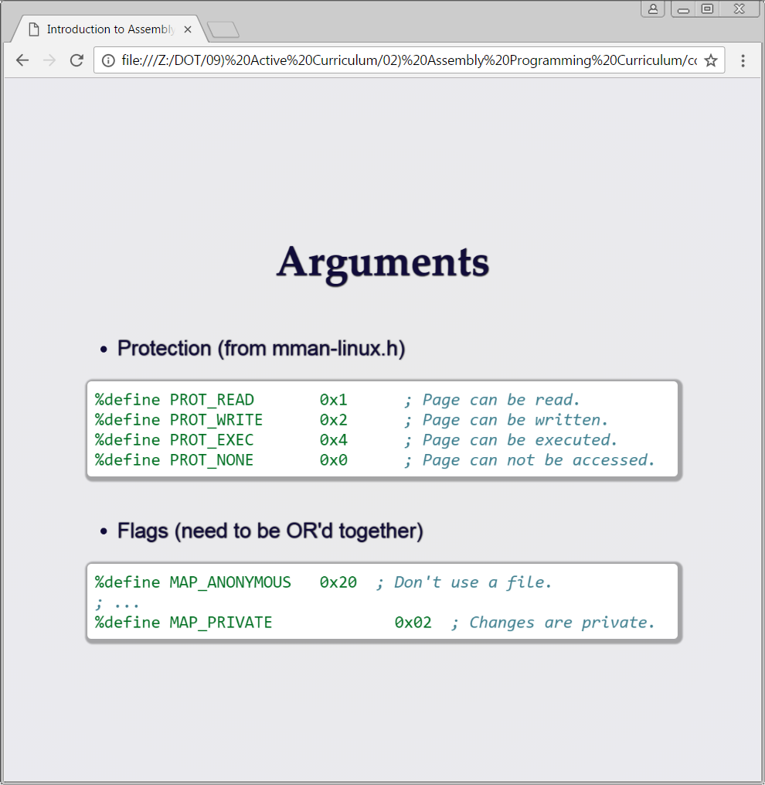
Arguments
Protection (from mman-linux.h)
Flags (need to be OR’d together)

Slide 34
Creating a Heap
Beginning the Process: malloc and free
Steps to success
Initialization: Handled in_start
Making Requests: Define a “block” size
Keeping a list: Maintain a list of “free” chunks

Slide 35
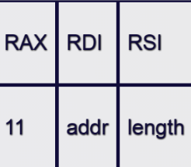
munmap

Slide 36
More About Memory Mapping
Two types of allocation:
File-backed
Anonymous
Both create an addressable buffer in your process space (assuming success)

Slide 37
Memory Mapping – Cont’d
Process (in memory)
File
On
Disk
Mapped view of File
Stack
Anon
Mapping

Slide 38
Demonstration - mmap

Slide 39
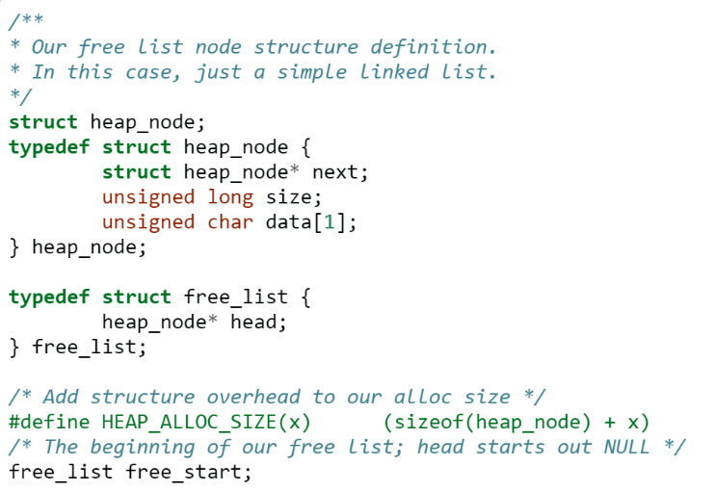
Problem Description
Some pseudo – C to describe our malloc strategy:
Some initial structure information:

Slide 40
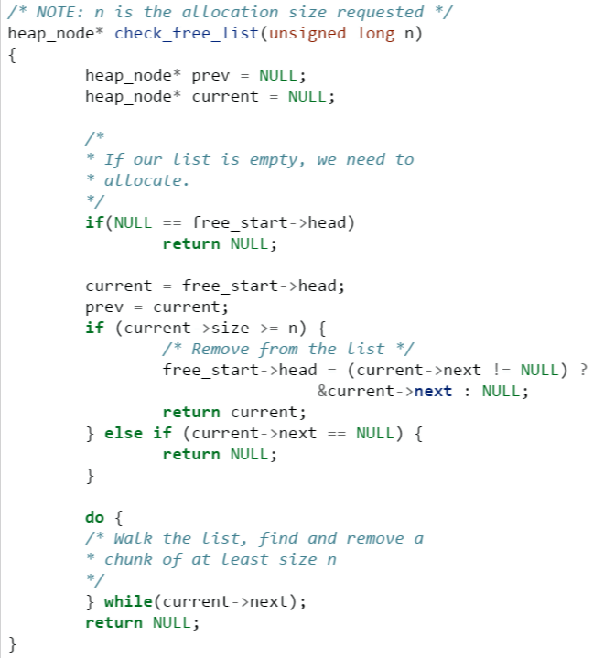
Problem Description

Slide 41
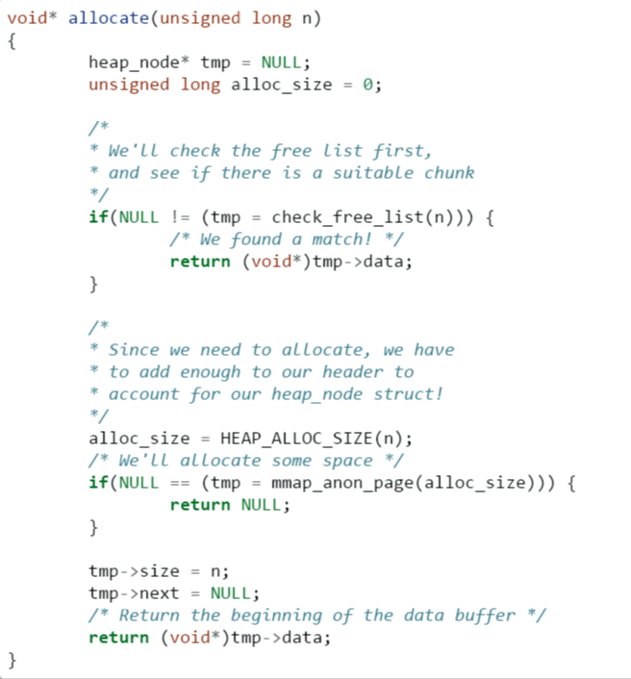
Problem Description

Slide 42
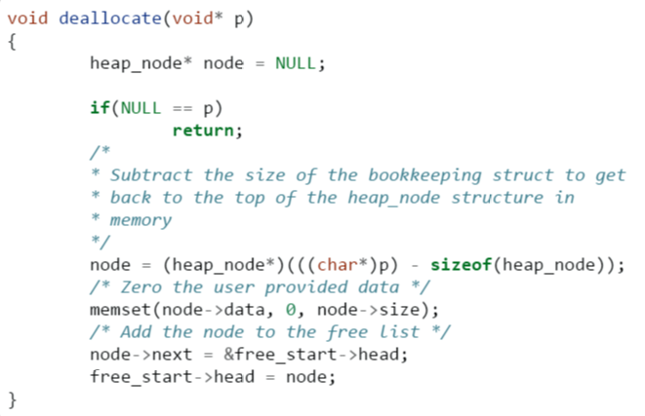
Problem Description

Slide 43
Additional Steps to Consider
Keep track of the number of items on the free list: release some if it becomes too large
Keep multiple free lists based on chunk size

Slide 44
Lab – Creating an Allocator Implement Dynamic Allocation
Required Objectives:
Implement “allocate” so that it can:
Check a list of “free” chunks for an already-allocated block
If a suitable block exists, remove it from the list and return it for use
If no suitable block exists, use mmap to get one
Implement “deallocate” so that it can:
Return “free” block to the free list
(optionally) De-allocate blocks if the free list is too large
Additionally:
You will need to keep track of how big the allocation block is somehow

