Slide 1

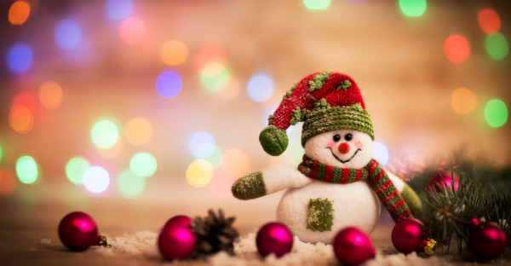
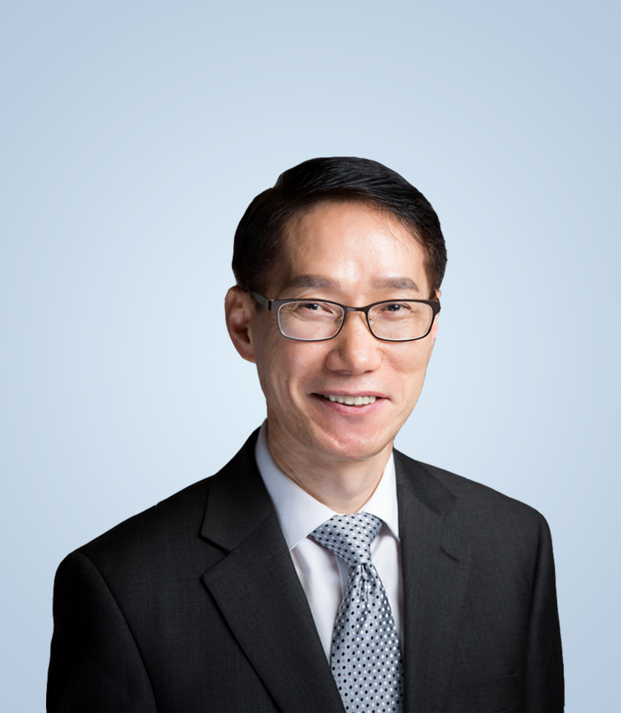
{{THUMBNAIL_DATE}}
성탄전야예배
“{{SERMON_TITLE}}”
{{SCRIPTURE_KO}}
{{PASTOR}}

Slide 2

{{THUMBNAIL_DATE}}
주일예배
“{{SERMON_TITLE}}”
{{SCRIPTURE_KO}}
{{PASTOR}}

Slide 3

{{THUMBNAIL_DATE}}
송구영신예배
“{{SERMON_TITLE}}”
{{SCRIPTURE_KO}}
{{PASTOR}}

Slide 4

{{THUMBNAIL_DATE}}
주일예배
“{{SERMON_TITLE}}”
{{SCRIPTURE_KO}}
{{PASTOR}}

Slide 5

{{THUMBNAIL_DATE}}
주일예배
“{{SERMON_TITLE}}”
{{SCRIPTURE_KO}}
{{PASTOR}}

Slide 6

{{THUMBNAIL_DATE}}
주일예배
“{{SERMON_TITLE}}”
{{SCRIPTURE_KO}}
{{PASTOR}}

Slide 7

{{THUMBNAIL_DATE}}
주일예배
“{{SERMON_TITLE}}”
{{SCRIPTURE_KO}}
{{PASTOR}}

Slide 8

{{THUMBNAIL_DATE}}
주일예배
“{{SERMON_TITLE}}”
{{SCRIPTURE_KO}}
{{PASTOR}}

Slide 9

{{THUMBNAIL_DATE}}
주일예배
“{{SERMON_TITLE}}”
{{SCRIPTURE_KO}}
{{PASTOR}}

