Slide 1
Operators
CS564: Assignment 6

Slide 2
Overview
3. Buffer Manager | 4. HeapFile Manager
5. Front-End and Database Utilities | 6. Query and Update Operators
Notes:
To do part 6, you should get familiar with part 5

Slide 3
Stage 5 & 6: an Overview
The whole project is about creating a miniature, sql like database called Minirel
We already finished the backend: the buf manager and the heapfile manager
We need to construct the front end
Take in user inputs, parse them, understand them
And, call the appropriate backend procedures
Notes:
Imagine yourself as the use, you don’t want to call createHeapfile, HeapfileScan yourself. We want to have a higher level of abstraction

Slide 4
Stage 5 & 6: How Minirel works
dbcreate <db_name>
Implemented for you in stage 5
minirel <db_name>
dbdestroy <db_name>
Implemented for you in stage 5
Note: this is the same structure used in the test file for stage 5: uttest
Notes:
I will demonstrate how to run uttest later

Slide 5
Stage 5 & 6: minirel
minirel <db_name> : runs a loop
show prompt
get a user command
call parse() to parse it into an internal format
call interp() to understand what the query wants to do
call the appropriate backend procedure
show results
All already implemented for you

Slide 6
Stage 5 & 6: minirel commands
Front-End Command Syntax
<SQL_COMMAND> ::= <DDL_STATEMENT>;
| <DML_STATEMENT>;
<DDL_STATEMENT> ::= <CREATE>
| <DESTROY>
| <LOAD>
| <PRINT>
| <HELP>
| <QUIT>

Slide 7
Stage 5: minirel commands - DDL
Front-End Command Syntax:
<SQL_COMMAND> ::= <DDL_STATEMENT>;
| <DML_STATEMENT>;
<DDL_STATEMENT> ::= <CREATE>
| <DESTROY>
| <LOAD>
| <PRINT>
| <HELP>
| <QUIT>
DDL: Data Definition Language
Note: all the DDL commands are implemented for you

Slide 8
Stage 5: demo

Slide 9
Stage 5: takeaways
Understand how minirel works
The loop structure
Parse and interpretation
Use DDL commands for testing and debugging
The RelCatalog Class and the AttrCatalog Class
You will be using attrCat and relCat global variables in stage 6
Read through and consult catalog.c and catalog.h when working on
stage 6

Slide 10
Stage 6: DML commands
<DML_STATEMENT> ::= <QUERY>
| <UPDATE>

Slide 11
Stage 6: DML commands
<DML_STATEMENT> ::= <QUERY>
| <UPDATE>
<QUERY> ::= SELECT <TARGET_LIST> [into relname] FROM <TABLE_LIST> [WHERE <QUAL>]
<TARGET_LIST> ::= (relname1.attr1, relname2.attr2, ..., relnameN.attrN)
<TABLE_LIST> ::= (relname1 [alias1], relname2 [alias2],... relnameN [aliasN])
<QUAL> ::= <SELECTION>
|<JOIN>
<SELECTION> ::= relname.attr <OP> value
<JOIN> ::= relname1.attr1 <OP> relname2.attr2 Implemented

Slide 12
Stage 6: DML commands
<DML_STATEMENT> ::= <QUERY>
| <UPDATE>
<UPDATE> ::= <DELETE>
| <INSERT>
<DELETE> ::= DELETE FROM relname [where <SELECTION>]
<INSERT> ::= INSERT INTO relname (attr1, attr2,... attrN) VALUES (val1, val2,... valN)

Slide 13
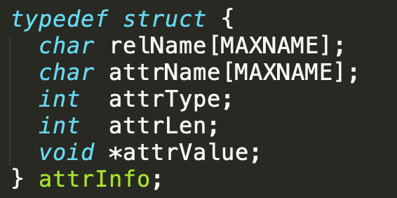
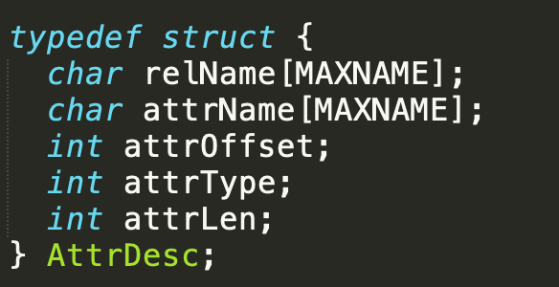
Stage 6:

Slide 14
Stage 6: insert.C
const Status QU_Insert(const string & relation, const int attrCnt, const attrInfo attrList[])
<INSERT> ::= INSERT INTO relname (attr1, attr2,... attrN) VALUES (val1, val2,... valN)
Example: insert into stars (real_name,soapid, starid, plays) values ("Bonarrigo, Laura", 3, 101, "Cassie");
The value of the attribute and the name of the attribute are already packaged into the attrInfo structure.
Since the order of the attributes in attrList[] may not be the same as in the relation, you might have to rearrange them before insertion.
If no value is specified for an attribute, you should reject the insertion as Minirel does not implement NULLs.

Slide 15
Stage 6: insert.C
const Status QU_Insert(const string & relation, const int attrCnt, const attrInfo attrList[])
Tips:
use attrCat->getRelInfo to get the attributes in order and their descriptions
Then use some loop structure to match potential unmatched attributes
void * memcpy ( void * destination, const void * source, size_t num );
destination: a buffer with size of the combined length of all attributes (the size of one record)
source: attribute value stored in attrInfo
Handle each value type (checked by the attrType member)
num: atteLen member in class AttrDesc
use insertRecord in insertFileScan to insert the record into the relation

Slide 16
Questions

Slide 17
Stage 6: delete.C
const Status QU_Delete(const string & relation, const string & attrName, const Operator op, const Datatype type, const char *attrValue)
Example: delete from stars where stars.soapid = 1;
Steps:
Construct a heapFileScan object using the relation name
hfs.startScan() => scanNext() => deleteRecord() =>* endScan() when finished
Handle cases when attrName is NULL (e.g. delete from stars;)
Null: hfs->startScan(0, 0, STRING, NULL, EQ);
If not NULL: call startScan() with different parameters for different value types
* scanNext() will return OK if there are unscanned records; if OK, keep scanNext().
delete hfs when finished
Notes:
1: because we want to scan the relation
3: endScan() doesn’t do the clean up for you

Slide 18
Questions

Slide 19
Stage 6: select.C
const Status QU_Select(const string & result, const int projCnt, const attrInfo projNames[], const attrInfo *attr, const Operator op, const char *attrValue)
const Status ScanSelect(const string & result, const int projCnt, const AttrDesc projNames[], const AttrDesc *attrDesc, const Operator op, const char *filter, const int reclen)
Notes:
Select scan for records that satisfy the condition, get the record, insert it into a temp table

Slide 20
Stage 6: select.C
Step 1: const Status QU_Select(const string & result, const int projCnt, const attrInfo projNames[], const attrInfo *attr, const Operator op, const char *attrValue)
result: the temp table to store the output in
projCnt: Projection counts
projNames[]: A list of projections; I.e.<TARGET_LIST>
attr, op, attrValue: <QUAL>
Qu_Select sets up things and then calls ScanSelect to do the actual work
Transform attrInfo to AttrDesc: for both classes, see catalog.h
const Status ScanSelect(const string & result, const int projCnt, const AttrDesc projNames[], const AttrDesc *attrDesc, const Operator op, const char *filter, const int reclen)

Slide 21
Stage 6: DML commands
<DML_STATEMENT> ::= <QUERY>
| <UPDATE>
<QUERY> ::= SELECT <TARGET_LIST> [into relname] FROM <TABLE_LIST> [WHERE <QUAL>]
<TARGET_LIST> ::= (relname1.attr1, relname2.attr2, ..., relnameN.attrN)
<TABLE_LIST> ::= (relname1 [alias1], relname2 [alias2],... relnameN [aliasN])
<QUAL> ::= <SELECTION>
|<JOIN>
<SELECTION> ::= relname.attr <OP> value
<JOIN> ::= relname1.attr1 <OP> relname2.attr2 Implemented

Slide 22
Stage 6: QU_Select
QU_Select | ScanSelect
const string & result | same
const int projCnt | same
const attrInfo projNames[] | const AttrDesc projNames[]
const attrInfo *attr | const AttrDesc *attrDesc
const Operator op | same
const char *attrValue | const char *filter (same)
Once you turn attr to attrDesc, the reclen can be retrieved from the attrLen member | const int reclen

Slide 23
Questions

Slide 24
Stage 6: ScanSelect
<QUERY> ::= SELECT <TARGET_LIST> [into relname] FROM <TABLE_LIST> [WHERE <QUAL>]
Examples:
select soapid, name, network, rating from soaps;
select network, soapid, name into ned
from soaps
where network = "CBS";

Slide 25
Stage 6: ScanSelect
Steps:
In delete.c, we use hfs scan methods to use filter to filter out records to be deleted. In scanSelect(), we use the same steps to find all records.
For each record that satisfies the filter, instead of calling deleteRecord() in delete.c, we call getRecord() to get the record
Use memcpy to copy each attribute in the record into a list of attrInfo objects.
Call QU_Insert to insert the record into the temporary table or the table specified by the user (in either case, it is the same variable called result).
Open "result" as an InsertFileScan object
Open current table (to be scanned) as a HeapFileScan object
Check if an unconditional scan is required
Check attrType: INTEGER, FLOAT, STRING
Scan the current table
If find a record, then copy stuff over to the temporary record (memcpy)
Insert into the output table
Notes:
Based on the language syntax: it looks like select works like by combining delete and insert.

Slide 26
Questions

Slide 27
Stage 6: grading
We will test your submissions using qu.1, qu.5, qu.7 only
The zip file you will submit contains insert.c, delete.c, select.c, and your group info

Slide 28
Questions

