Slide 1
BCSE303P – OPERATING SYSTEMS LAB • MINI-PROJECT REVIEW 3
File Operation
Failure Diagnoser
A Windows desktop diagnostic utility that turns generic file-operation errors into understandable, OS-evidence-supported diagnoses and safe advisory recommendations.
FINAL REVIEW 3 AT A GLANCE
Yash Pradhan
Anjini Pandey
Dhruv Kothari
4 Peer Analyzers Implemented
24BCE0702
24BCE0714
24BCE0570
157 Pytest Tests (156 Pass, 1 Skip)
Institution: School of Computer Science and Engineering, Vellore Institute of Technology (VIT), Vellore
Supervisor: Dr. N. Narayanan Prasanth • Submission Date: October 2026
14 Scenario Groups / 16 Live Runs
BCSE303P – Operating Systems Lab • Mini-Project Final Review 3 • Windows 10/11 Diagnostic Utility (Python 3.13 · Tkinter · Win32 APIs)
Notes:
Welcome to our Final Review 3 presentation for BCSE303P – Operating Systems Lab.
Our project is the File Operation Failure Diagnoser, developed by Yash Pradhan (24BCE0702), Anjini Pandey (24BCE0714), and Dhruv Kothari (24BCE0570) under the supervision of Dr. N. Narayanan Prasanth at the School of Computer Science and Engineering, VIT Vellore.
In Review 2, we demonstrated the core lock and permission prototype. Today, we present the complete, verified desktop application with all four peer analyzers, deterministic evidence correlation, 157 automated regression tests, and 16 live Windows GUI scenario executions.

Slide 2
SLIDE 2 • PROBLEM & MOTIVATION
Why Generic File-Operation Errors Need OS-Level Diagnosis
WHAT THE USER SEES ON WINDOWS
CAUSES INVESTIGATED BY THE DIAGNOSER
GAP IN EXISTING UTILITIES (TABLE 2.1)
!
Access is denied
1. Active Process Locks
Open handles held by applications or services via Windows Restart Manager.
Sysinternals Handle / ProcExp
Developer-focused handle enumeration; can close handles (risking instability); no unified attribute or sync diagnosis.
!
The file is in use
2. Permission & Ownership
Preliminary READ/WRITE/EXECUTE/DELETE access (os.access) & Win32 owner SID.
PowerToys File Locksmith
Convenient shell extension for process locks + 'End task', but reports 'No processes found' for attribute/ACL blocks.
!
Action cannot be completed
3. File Attributes
Read-only restriction vs. informational flags (Hidden, System, Archive).
LockHunter
Action-oriented unlocker/terminator; built to kill processes or force-delete files rather than explain why access failed.
The OS kernel enforces mutual exclusion and access control correctly, but hides the underlying cause — leading to guesswork, restarts, or unsafe process termination.
4. Cloud-Sync Evidence
Local OneDrive & Google Drive roots, active daemons, and client-lock correlation.
This Project (Delivered)
Correlates locks, permissions, attributes & local sync evidence; strictly read-only & advisory.
MAIN PROJECT OBJECTIVE & SAFETY PRINCIPLE
Turn an Opaque Error into Evidence-Grounded Guidance: Accept a file path and intended operation (READ, WRITE, EXECUTE, DELETE), gather structured OS evidence from four independent peer analyzers, select one deterministic primary diagnosis while preserving secondary findings, and provide a safe advisory next step — never executing the operation, modifying files, or terminating processes.
Sources: Anderson & Dahlin [1] · Silberschatz et al. [2] · Russinovich et al., Windows Internals [3] · Microsoft Learn (Sysinternals Handle [6], File Locksmith [7]) · LockHunter [8].
Notes:
When a user tries to save, modify, or delete a file on Windows and a conflict occurs, the OS surfaces generic messages like 'Access is denied' or 'The file is in use'.
While the kernel correctly enforces protection and mutual exclusion, its abstraction hides which process, permission, file attribute, or cloud-sync client is responsible.
Existing tools leave a gap: Sysinternals Process Explorer and Handle are developer-centric and can dangerously close handles; PowerToys File Locksmith only checks processes; and LockHunter focuses on brute-force unlocking or killing processes.
Our project bridges this gap by correlating four OS evidence sources into one plain-language diagnosis and a safe, strictly advisory next step.

Slide 3
SLIDE 3 • FINAL OBJECTIVES & DELIVERED SCOPE
Completed System Deliverables and Architectural Boundaries
FOUR SUPPORTED OPERATIONS (STATIC CHECK ONLY):
READ
WRITE
EXECUTE
DELETE
01
Process / Lock Analyzer
02
Permission / Ownership
03
File Attribute Analyzer
04
Cloud-Sync Analyzer
Queries Windows Restart Manager (rstrtmgr.dll) for holding process name & PID; enriches executable path via psutil.
Checks os.access() for READ, WRITE, EXECUTE & DELETE; resolves NTFS owner (DOMAIN\User) via advapi32.dll.
Reads os.stat().st_file_attributes (GetFileAttributesW fallback) to decode 6 Win32 attribute flags & hex bitmask.
Local OneDrive & Google Drive root/daemon discovery across 4 conservative tiers (none to confirmed_lock).
IMPLEMENTED
IMPLEMENTED
IMPLEMENTED
IMPLEMENTED
05
Diagnosis Engine & Correlation
06
Recommendation Engine
07
Tkinter Desktop GUI
Normalises paths, isolates analyzer exceptions (_safe_analyze_*), correlates sync locks (correlate_sync_lock), and applies the 7-rule priority policy while preserving secondary findings.
Maps all 7 DiagnosisType categories and raw evidence (holding process names/PIDs, resolved file owner, sync provider) into safe, human-readable advisory guidance.
Dark-themed scrollable window (MainWindow) with path input, Browse dialog, operation selector, 6 result panels, and _reset_panels() against stale data.
IMPLEMENTED
IMPLEMENTED
IMPLEMENTED
DELIVERED CAPABILITIES (WHAT THE TOOL DOES)
HONEST BOUNDARIES & FUTURE WORK (WHAT IT DOES NOT DO)
• Diagnoses READ, WRITE, EXECUTE, DELETE across 7 DiagnosisType categories.
• Reports Restart Manager holders, os.access() + owner, 6 Win32 attribute flags, and local OneDrive/Google Drive evidence with advisory next steps.
• Never performs the selected operation, modifies files/ACLs, or kills processes.
• Does not evaluate full NTFS DACL inheritance or parent-directory DELETE rights; does not query remote cloud APIs or providers beyond OneDrive & Google Drive.
Notes:
Slide 3 summarizes what the final project actually delivers in Review 3.
All seven core components are now fully implemented and verified — none of the analyzers remain 'proposed' or 'coming soon' as they were in Review 2.
We support all four operations: READ, WRITE, EXECUTE, and DELETE.
At the bottom, we clearly distinguish our completed diagnostic capabilities from deliberate architectural boundaries: the tool is 100% read-only and advisory, evaluates preliminary access via os.access() and Win32 owner lookup without full NTFS DACL inheritance parsing, and bounds cloud-sync discovery to local OneDrive and Google Drive state.

Slide 4
SLIDE 4 • FINAL SYSTEM ARCHITECTURE
Modular Peer-Analyzer Architecture (diagnoser Package)
USER INPUT: Target File Path + Operation (READ / WRITE / EXECUTE / DELETE)
TKINTER DESKTOP GUI (gui/main_window.py) — Presentation Layer · _run_diagnosis() · _reset_panels()
DIAGNOSIS ENGINE (engine/diagnosis.py) — Validation · Guarded _safe_analyze_* Coordination · Evidence Collection
1. PROCESS / LOCK
ANALYZER
2. PERMISSION /
OWNERSHIP ANALYZER
3. FILE ATTRIBUTE
ANALYZER
4. CLOUD-SYNC
ANALYZER
process_lock.py
Restart Manager (rstrtmgr.dll)
+ psutil path enrichment
permissions.py
os.access() (R/W/X/D)
+ advapi32 owner SID
file_attributes.py
os.stat.st_file_attributes
+ GetFileAttributesW
sync_conflict.py
OneDrive & Google Drive
local roots & daemons
→ LockDetectionResult
→ PermissionCheckResult
→ FileAttributeResult
→ SyncConflictResult
FOUR INDEPENDENT PEER ANALYZERS (extend BaseAnalyzer; none calls another — structured evidence flows back to DiagnosisEngine)
EVIDENCE CORRELATION
PRIORITY CLASSIFICATION
RECOMMENDATION ENGINE
REFRESHED GUI RESULT
correlate_sync_lock()
upgrades confirmed sync locks
DiagnosisEngine._classify()
7 rules + secondary notes
Recommender.recommend()
advisory text (never acts)
DiagnosisResult rendered
across all 6 GUI panels
Architecture matches Figure 4.1 & Table 4.2 of the Final Report: GUI is strictly the presentation layer; DiagnosisEngine owns all orchestration and classification.
Notes:
Slide 4 shows our final system architecture, corresponding to Figure 4.1 in the final report.
The user selects a file path and intended operation in the Tkinter Desktop GUI, which acts strictly as the presentation layer.
The GUI invokes the Diagnosis Engine, which normalizes the path, handles missing or directory targets, and coordinates four independent peer analyzers through exception-isolating wrappers.
Crucially, all four analyzers — Process/Lock, Permission/Ownership, File Attribute, and Cloud-Sync — are equal peers extending BaseAnalyzer. None calls or depends on another.
Each analyzer returns a typed dataclass back to the Diagnosis Engine, which correlates sync and lock evidence, runs the deterministic classification policy, invokes the Recommendation Engine, and returns the complete DiagnosisResult to refresh the GUI.

Slide 5
SLIDE 5 • DIAGNOSIS WORKFLOW & PRIORITY RULES
End-to-End Pipeline and Deterministic Classification Order
END-TO-END WORKFLOW (MainWindow & diagnose())
IMPLEMENTED PRIORITY ORDER IN DiagnosisEngine._classify()
01
Input Validation & _reset_panels()
Validates path/operation; resets all 6 GUI panels to neutral state.
Before _classify(): Missing path → FILE_NOT_FOUND | Directory target → UNKNOWN_ERROR
1
Confirmed sync-client lock (sync_res.is_conflict)
Holder matches OneDrive or Google Drive client
SYNC_CONFLICT
02
Missing-Path Early Exit → FILE_NOT_FOUND
Normalises path; if missing, skips analyzers and marks panels skipped.
2
Detected process lock (lock_res.is_locked)
Restart Manager reports >= 1 active holder
FILE_LOCKED
03
Directory Target Handling → UNKNOWN_ERROR
If path is a directory, analyzers return structured 'not a file' errors.
3
Read-only restriction for WRITE or DELETE
is_readonly=True (or write denied + read allowed)
READ_ONLY
04
Four Guarded Peer Analyses (_safe_analyze_*)
Runs Lock, Permission, Attribute & Sync analyzers with exception isolation.
4
Proven permission denial (method != 'error')
Independent denial from PermissionAnalyzer
PERMISSION_DENIED
05
Cloud-Lock Correlation (correlate_sync_lock)
Upgrades sync tier to confirmed_lock only if a holder matches a sync client.
5
Critical inspection error (perm, then lock)
Analyzer failed (e.g. RmGetList Win32 error 5)
UNKNOWN_ERROR
06
Primary Classification & Secondary Evidence
_classify() picks 1 primary DiagnosisType; secondary notes append to reason.
6
Fallback permission denial (not permitted)
Catches any remaining permission denial case
PERMISSION_DENIED
07
Advisory Recommendation & GUI Refresh
Recommender.recommend() sets suggested_action; GUI updates all 6 panels.
7
No blocking condition detected
All checks completed with no blocker found
OPERATION_ALLOWED
First matching rule wins; secondary evidence stays attached to DiagnosisResult & reason.
Notes:
Slide 5 explains how a diagnosis is produced and states the exact classification order implemented in DiagnosisEngine._classify().
On the left, when a user clicks Diagnose File, the GUI validates input and calls _reset_panels() so stale data from previous runs is cleared.
Before the normal classification rules run, diagnose() handles two early cases: a missing path immediately returns FILE_NOT_FOUND without running downstream analyzers, and a directory target runs the analyzers and returns UNKNOWN_ERROR explaining that the path is a directory.
For an existing regular file, all four peer analyzers execute inside _safe_analyze_* wrappers, correlate_sync_lock() checks whether any Restart Manager holder matches a sync daemon, and _classify() evaluates the 7 deterministic rules in exact order:
1. SYNC_CONFLICT, 2. FILE_LOCKED, 3. READ_ONLY for WRITE or DELETE, 4. Proven PERMISSION_DENIED, 5. Critical inspection error UNKNOWN_ERROR, 6. Fallback PERMISSION_DENIED, and 7. OPERATION_ALLOWED.
Secondary findings are appended to the reason and shown in their respective panels.

Slide 6
SLIDE 6 • TECHNICAL IMPLEMENTATION & OS INTERFACES
How Operating-System Evidence Is Gathered Locally
PROCESS / LOCK
Python ctypes
rstrtmgr.dll FFI
RmStartSession
Register target
RmGetList (2x)
Size + fill array
RmEndSession
finally cleanup
Primary lock detector (RmStartSession, RmRegisterResources, RmGetList, RmEndSession). Installer-oriented API, not a universal handle enumerator; psutil enriches exe paths only.
process_lock.py
PERMISSIONS &
OWNERSHIP
os.access()
R_OK / W_OK / X_OK
advapi32.dll
GetNamedSecurityInfoW
LookupAccountSidW
SID to DOMAIN\User
LocalFree()
Frees SD buffer
Preliminary access & ownership evidence (DELETE approximated via W_OK). Requests OWNER_SECURITY_INFORMATION only; full NTFS DACL is not evaluated.
permissions.py
FILE ATTRIBUTES
os.stat(path)
st_file_attributes
kernel32.dll
GetFileAttributesW
6-Flag Decoder
RO · HID · SYS · ARC
Sync Bits
REPARSE · OFFLINE
Reads os.stat().st_file_attributes (with GetFileAttributesW fallback) to decode 6 Win32 flags and raw bitmask (0xNNNN) read-only.
file_attributes.py
CLOUD SYNC &
DISCOVERY
Env + winreg
OneDrive & DriveFS
GetVolumeInformationW
DriveFS mounts
process_iter()
Finds sync daemons
Sync Lock Link
Matches RM PID
Bounded to local OneDrive & Google Drive configuration. psutil discovers running daemons & drive mounts; correlate_sync_lock() links RM locks.
sync_conflict.py
PRESENTATION
LAYER (GUI)
tkinter + ttk
Dark-themed GUI
_reset_panels
Clears stale state
Engine Call
DiagnosisResult
6 GUI Panels
Status to Advice
100% local user-mode desktop application (~3,700 lines across src/diagnoser/). Never issues raw kernel syscalls, modifies files, or contacts cloud APIs.
gui/main_window.py
Official Documentation Cited in Report: Microsoft Learn (Restart Manager [9–12, 24–25], GetNamedSecurityInfoW / DACLs [13–14, 26], File Attributes & Volumes [17–18, 27]) · Python 3.13 Stdlib [15–16, 19, 21–22] · psutil [20].
Notes:
Slide 6 details the technical implementation and operating-system interfaces used by the application.
First, ProcessLockAnalyzer uses the Windows Restart Manager API via ctypes (rstrtmgr.dll): RmStartSession, RmRegisterResources, the two-call RmGetList pattern handling ERROR_MORE_DATA (234), and RmEndSession in a finally block. Restart Manager is our primary lock detector, though as an installer-oriented interface it is not a universal enumeration of every open handle.
Second, PermissionAnalyzer combines Python's os.access() with Win32 GetNamedSecurityInfoW and LookupAccountSidW (advapi32.dll) for preliminary access and owner SID resolution.
Third, FileAttributeAnalyzer reads os.stat().st_file_attributes as its primary source with kernel32.GetFileAttributesW as fallback.
Fourth, SyncConflictAnalyzer uses winreg, environment variables, and GetVolumeInformationW for sync-root discovery, while psutil is used strictly for executable-path enrichment, sync-client process discovery, and drive mounts — never as the core lock detector.

Slide 7
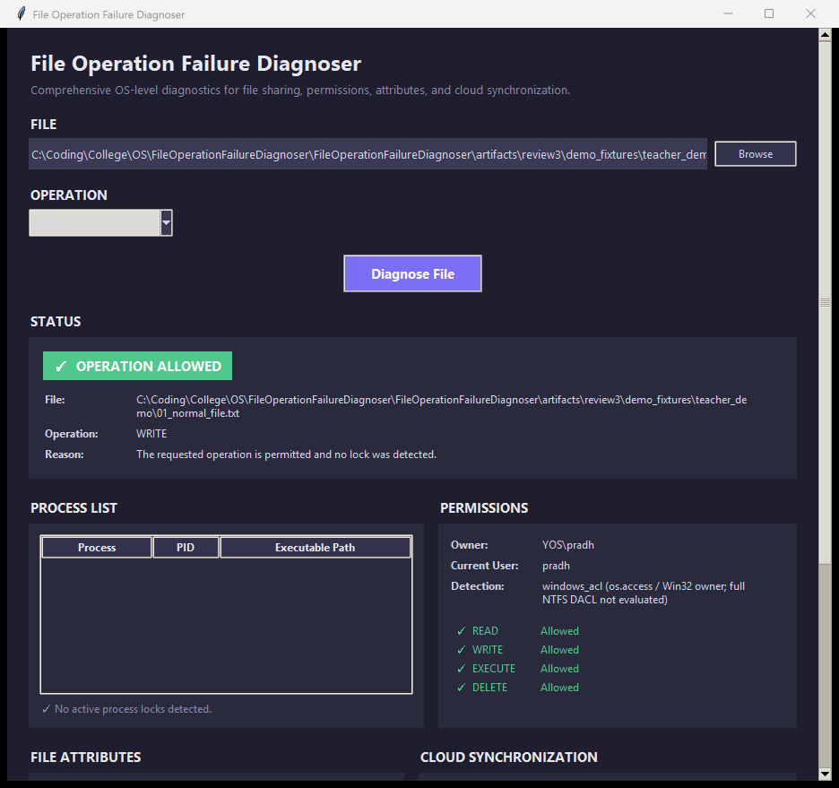
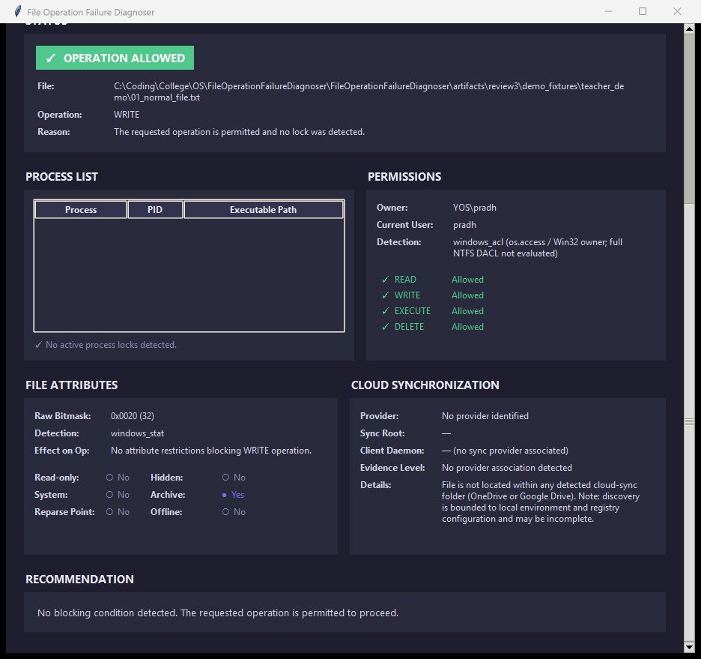
SLIDE 7 • FINAL DESKTOP APPLICATION
Tkinter Desktop Interface and Six Principal Result Panels
GENUINE PAIRED VIEWPORT CAPTURES — SCENARIO 01b (NORMAL FILE · WRITE)
SIX PRINCIPAL GUI PANELS (TABLE 4.6)
1. Status Panel
Colour-coded badge, path, operation, and primary + secondary reason text.
2. Process List
Holding process name, PID, and psutil exe path (or skipped/error status).
3. Permissions
Owner (YOS\pradh), current user, 'full NTFS DACL not evaluated', R/W/X/D rows.
4. File Attributes
Raw bitmask (0x0020), windows_stat method, operation effect, and 6 flags.
Scenario 01b (Top Viewport · Scroll 0.0)
Op: WRITE · Actual: OPERATION_ALLOWED
Scenario 01b (Bottom Viewport · Scroll 1.0)
Attr: 0x0020 · Sync: None · Advisory Action
5. Cloud Sync
Provider, sync root, client daemon, evidence tier, and discovery notes.
Read-Only Diagnostic Guarantee & Panel Reset (Scenario 14)
The application evaluates whether READ, WRITE, EXECUTE or DELETE would succeed without ever modifying, executing or deleting the target file. Before each run, _reset_panels() clears all six panels so stale process locks never leak across diagnoses.
6. Recommendation
Context-aware, human-readable advisory guidance from Recommender.
Notes:
Slide 7 introduces the final Tkinter desktop application using genuine paired viewport captures from Scenario 01b in Review 3 Evidence Pack v5.
Because the window contains six comprehensive telemetry panels inside a scrollable canvas, the evidence runner captures each execution natively at two scroll positions: the top viewport (showing the file input, operation selector, status badge, process list, and permissions) and the bottom viewport (showing file attributes, cloud synchronization, and the recommendation panel).
In Scenario 01b, we diagnose a WRITE operation on a normal accessible file, returning OPERATION_ALLOWED.
Crucially, the application only diagnoses the selected operation — it never writes to, executes, or deletes the target file.

Slide 8
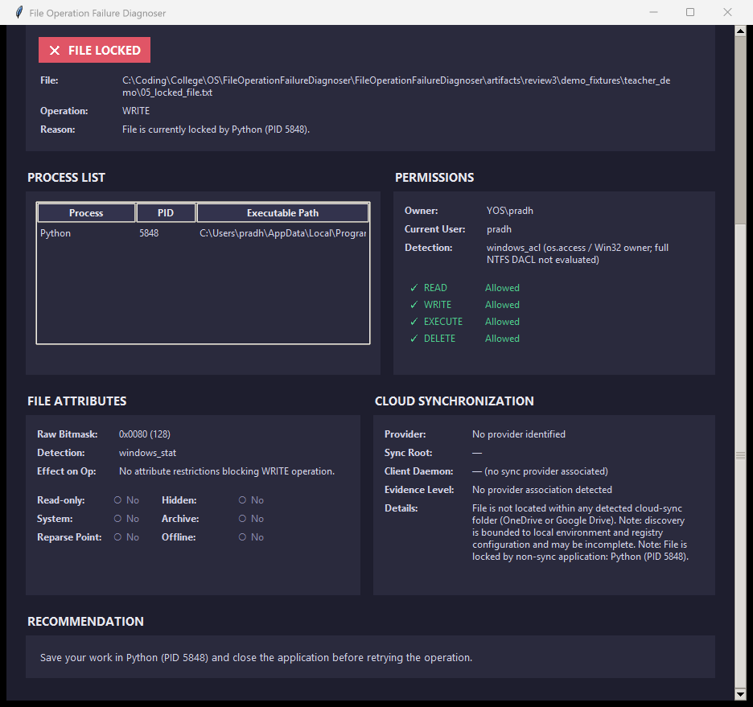
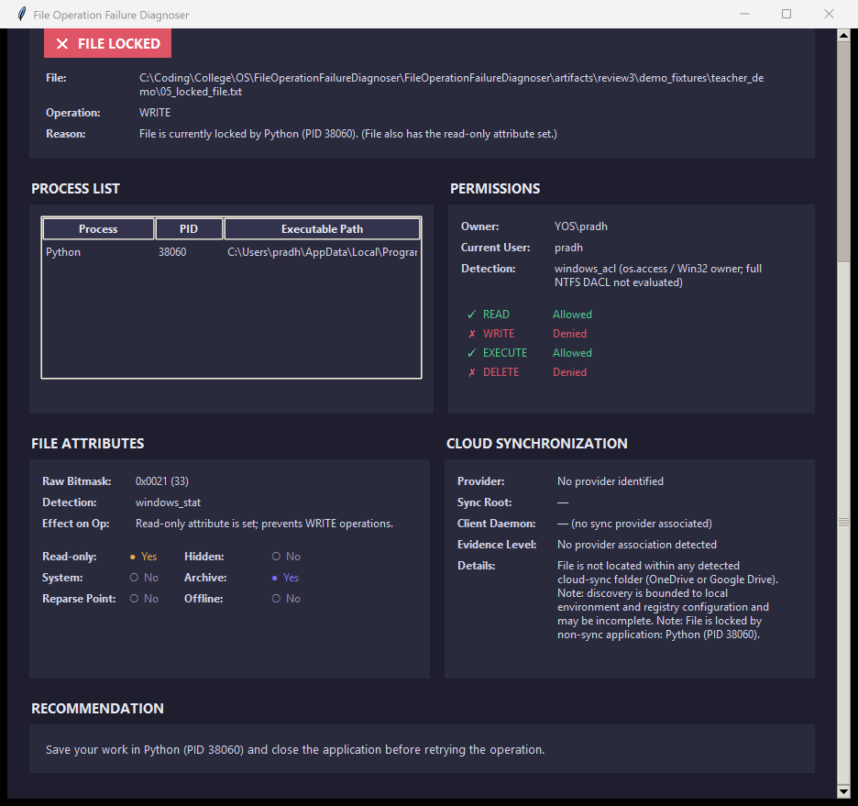
SLIDE 8 • DEMONSTRATION: LOCK DETECTION & CORRELATION
Live Process-Lock Detection and Secondary Evidence Correlation
SCENARIO 03 — ACTIVE PROCESS LOCK DETECTION
SCENARIO 08 — MULTIPLE FINDINGS (LOCK + READ-ONLY)
Captured Telemetry
• Diagnosis: FILE_LOCKED (Rule 2)
• Holder: Python (PID 5848) via Restart Manager
• Exe Path: C:\Users\pradh\...\python.exe (via psutil)
• Attributes: 0x0080 (No attribute blocker)
• Sync Note: Locked by non-sync app (PID 5848)
Coexisting Evidence
• Primary (Rule 2): FILE_LOCKED by Python (PID 38060)
• Secondary Note: '(File also has the read-only attribute set.)'
• Attributes Panel: 0x0021 (33) · Read-only = Yes, Archive = Yes
• Permissions Panel: WRITE & DELETE Denied; READ & EXECUTE Allowed
Scenario 03 · Op: WRITE on 05_locked_file.txt · Actual: FILE_LOCKED
Status Reason: "File is currently locked by Python (PID 5848)."
Scenario 08 · Op: WRITE on 05_locked_file.txt · Actual: FILE_LOCKED
Primary: Python (PID 38060) | Secondary: Read-only attribute (0x0021)
Advisory Recommendation & OS Interface Proof
"Save your work in Python (PID 5848) and close the application before retrying the operation." Confirms read-only Restart Manager session query without closing handles or terminating the process.
Why Primary Priority + Secondary Preservation Matters
Reason: "File is currently locked by Python (PID 38060). (File also has the read-only attribute set.)" Rule 2 ranks the active runtime lock first while preserving the Read-only finding as secondary evidence.
Notes:
Slide 8 demonstrates live process-lock detection and multi-finding evidence correlation using genuine screenshots from Scenarios 03 and 08.
On the left, Scenario 03 tests WRITE on 05_locked_file.txt while a controlled helper process holds it open. Windows Restart Manager identifies Python with PID 5848, and psutil enriches the full executable path. The primary diagnosis is FILE_LOCKED, and the Recommendation Engine advises saving work in Python (PID 5848) and closing it before retrying.
On the right, Scenario 08 tests WRITE on a file that is simultaneously held open by Python (PID 38060) and marked Read-only (bitmask 0x0021). Rule 2 selects FILE_LOCKED as the primary diagnosis because a live runtime handle takes precedence over a static attribute, while the read-only restriction is preserved in the Status reason ('File also has the read-only attribute set') and in the File Attributes and Permissions panels.

Slide 9
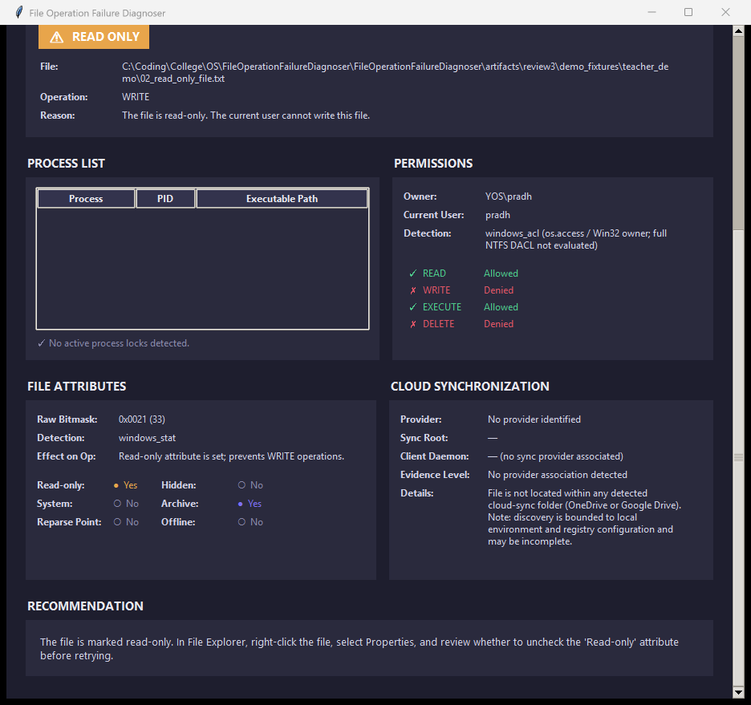
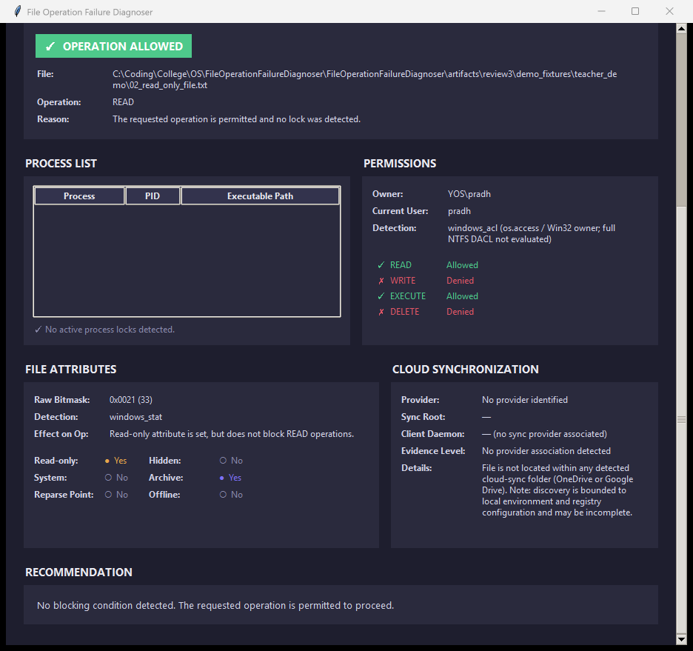
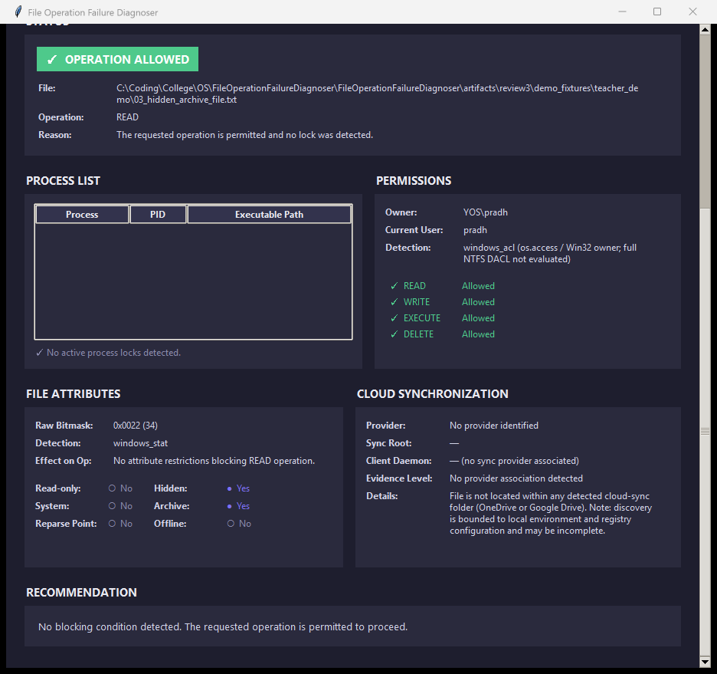
SLIDE 9 • DEMONSTRATION: ATTRIBUTES & OPERATION SEMANTICS
Operation-Aware Attribute Evaluation (READ, WRITE, DELETE)
SCENARIO 04a — WRITE ON READ-ONLY
SCENARIO 04b — READ ON READ-ONLY
SCENARIO 06 — HIDDEN & ARCHIVE FLAGS
Scenario 04a · WRITE → READ_ONLY
Scenario 04b · READ → OPERATION_ALLOWED
Scenario 06 · READ → OPERATION_ALLOWED
• Fixture: 02_read_only_file.txt (0x0021 = Read-only + Archive)
• Effect: 'Read-only attribute is set; prevents WRITE operations.'
• Also Verified for DELETE (Scenario 12 → READ_ONLY under Rule 3).
• Same Fixture: 02_read_only_file.txt (Bitmask 0x0021)
• Effect: 'Read-only attribute is set, but does not block READ operations.'
• Rule 3 applies only to WRITE/DELETE, so READ is allowed.
• Fixture: 03_hidden_archive_file.txt (0x0022 = Hidden + Archive)
• Scenario 13: 04_system_attribute_file.txt (0x0024 = System + Archive) → OPERATION_ALLOWED.
• Informational flags never trigger false failure alarms.
Complete Operation Coverage (Scenarios 10, 11, 12): Scenario 10 (EXECUTE on 08_execute_check.cmd → OPERATION_ALLOWED) and Scenario 11 (DELETE on 07_delete_check_file.txt → OPERATION_ALLOWED) verify static diagnostic evaluation: the script is never executed and the target file is never deleted.
Notes:
Slide 9 demonstrates why file attributes must be evaluated alongside the user's intended operation.
In Scenario 04a on the left, selecting WRITE on 02_read_only_file.txt (bitmask 0x0021) triggers Rule 3 and returns READ_ONLY, explaining that the read-only attribute prevents WRITE operations. Scenario 12 confirms that DELETE on the same read-only fixture also returns READ_ONLY.
In Scenario 04b in the center, selecting READ on the exact same read-only file returns OPERATION_ALLOWED. The File Attributes panel still displays Read-only = Yes, but its operation-aware effect text explains that Read-only does not block READ operations.
In Scenario 06 on the right, a file with Hidden and Archive attributes (bitmask 0x0022) — and similarly Scenario 13 with System attribute 0x0024 — returns OPERATION_ALLOWED, proving that informational flags do not trigger false failure diagnoses.

Slide 10

SLIDE 10 • CLOUD-SYNC ANALYSIS & THE HONEST BOUNDARY
Local Cloud-Sync Discovery, Evidence Tiers and Boundary
LOCAL DISCOVERY & CONSERVATIVE EVIDENCE TIERS
SCENARIO 07 — NEGATIVE BOUNDARY CAPTURE
Microsoft OneDrive
• Roots: Env vars (OneDrive*) & registry HKCU\Software\Microsoft\OneDrive
• Daemons: onedrive.exe, filecoauth.exe
Google Drive for Desktop
• Roots: Registry DriveFS mounts, psutil.disk_partitions & GetVolumeInformationW
• Daemon: googledrivefs.exe
FOUR CONSERVATIVE EVIDENCE TIERS (TABLE 5.1)
none
Primary: No
Outside detected OneDrive / Google Drive roots → 'No provider association detected'.
path_only
Primary: No
Inside sync root (is_subpath), client not running, no placeholder attributes.
Scenario 07 · READ on 01_normal_file.txt → OPERATION_ALLOWED
Cloud Sync Panel: "No provider association detected" (Negative Boundary)
potential_contention
Primary: No
Inside sync root with client running, or REPARSE_POINT / OFFLINE bits.
Honest Verification Boundary (Section 6.9 & Table 6.10)
• Scenario 07 is a negative boundary case (file outside detected sync roots); no positive live OneDrive or Google Drive lock was demonstrated (live user sync folders were left untouched for safety).
• Confirmed provider-lock classification (SYNC_CONFLICT) and non-lock contention tiers are verified by 20 automated tests in test_sync_conflict.py and test_diagnoser.py using injected evidence.
confirmed_lock
Rule 1: SYNC_CONFLICT
correlate_sync_lock() matched a Restart Manager holder to a sync daemon.
Notes:
Slide 10 explains our Cloud-Sync Analyzer and states the honest verification boundary.
SyncConflictAnalyzer supports local discovery for Microsoft OneDrive and Google Drive only, checking environment variables, Windows registry keys, DriveFS volumes, placeholder attributes, and running client processes via psutil.
Because a file sitting inside OneDrive or a running sync client is normal everyday state, we use four conservative evidence tiers: none, path_only, potential_contention, and confirmed_lock.
Only when Restart Manager reports an active lock whose process name matches a known sync daemon does correlate_sync_lock() upgrade the evidence to confirmed_lock and trigger SYNC_CONFLICT.
On the right, Scenario 07 shows the genuine negative boundary capture ('No provider association detected') for a local fixture outside sync roots. For safety, live user OneDrive files were not mutated; positive SYNC_CONFLICT classification is verified by automated tests using injected lock and sync-root evidence.

Slide 11
SLIDE 11 • TESTING & VERIFICATION RESULTS
Automated Regression Suite (Windows 11 Pro · pytest 9.1.1)
157
156
0
1
TESTS COLLECTED
PASSED
FAILED
SKIPPED (BY DESIGN)
Verified Environment: Windows 11 Pro 64-bit • Python 3.13.14 • pytest 9.1.1 • Execution Time: 4.20 s (Expanded from 72 tests in Review 2 to 157 final tests)
FINAL-RUN TEST COUNTS BY MODULE (TABLE 6.5 — logs/test_results.txt)
WHY 1 TEST IS SKIPPED ON WINDOWS
tests/test_diagnoser.py
43 / 43 Pass
Priority rules, correlation, secondary notes
TestProcessLockAnalyzerCrossPlatform :: test_unsupported_platform_message
• Decorated with @pytest.mark.skipif(sys.platform == 'win32', reason='Non-Windows platform check only').
• Verifies the fallback message returned when ProcessLockAnalyzer runs on POSIX/non-Windows platforms; on Windows 11 it is skipped by design while live Restart Manager tests run and pass.
Automated Tests vs. Live GUI Demonstrations
Automated tests (with injected + real OS state) verify all 7 classification branches; live GUI scenario runs (Slide 12) are reported separately.
tests/test_models.py
23 / 23 Pass
Enums & structured result dataclasses
tests/test_sync_conflict.py
20 / 20 Pass
OneDrive/Google Drive roots, tiers & correlation
tests/test_permissions.py
19 / 19 Pass
os.access() flags, DELETE & Win32 owner
tests/test_gui.py
17 / 17 Pass
MainWindow panels, _reset_panels() & badges
tests/test_recommender.py
15 / 15 Pass
Advisory text across all 7 DiagnosisTypes
tests/test_file_attributes.py
12 / 12 Pass
Win32 attribute bitmask & 6 flag decodings
tests/test_process_lock.py
7 / 8 Pass (1 Skip)
Restart Manager lock checks & platform guard
Notes:
Slide 11 presents our final automated regression testing results, updating the earlier 72-test milestone from Review 2 to our final verified record:
157 tests collected, 156 passed, 0 failed, and 1 skipped in 4.20 seconds on Windows 11 Pro 64-bit with Python 3.13.14 and pytest 9.1.1.
On the bottom left, Table 6.5 breaks down all 157 tests across our 8 test modules, covering the Diagnosis Engine, data models, Cloud-Sync Analyzer, Permission Analyzer, Tkinter GUI, Recommender, File Attribute Analyzer, and Process Lock Analyzer.
On the bottom right, we explain the single skipped test: test_unsupported_platform_message in test_process_lock.py verifies the fallback message on non-Windows OSes and is decorated with skipif(sys.platform == 'win32'), so skipping it on Windows is expected by design.
We also keep automated regression testing strictly separate from our live GUI scenario results on Slide 12.

Slide 12
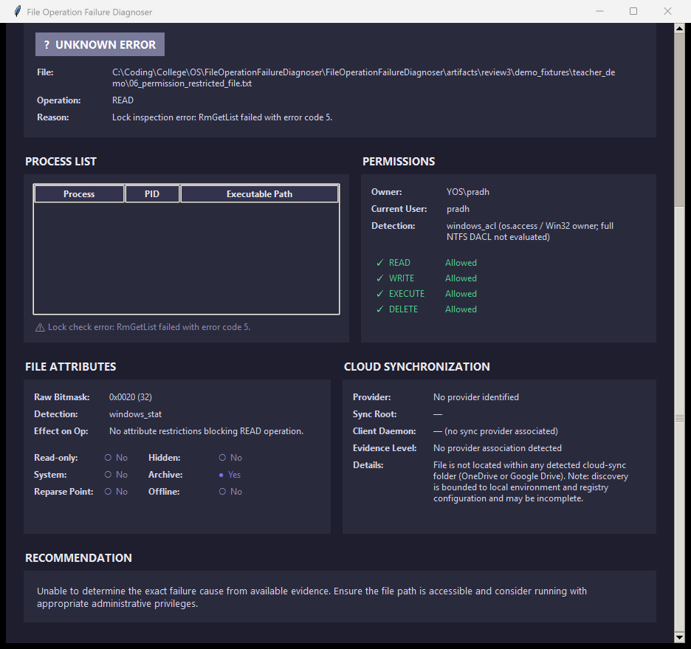
SLIDE 12 • LIVE SCENARIO RESULTS & LIMITATIONS
Live Scenario Outcomes, Scenario 05 (BLOCKED) and Limitations
14
LOGICAL SCENARIO GROUPS
Scenarios 01–14 in manifest v5
16
INDIVIDUAL EXECUTIONS
Includes 01a/01b & 04a/04b pairs
15
MATCHED EXPECTATION (PASS)
15 executions across 13 groups
1
BLOCKED (SCENARIO 05)
Explicit-deny-ACE permission case
SCENARIO 05 (BLOCKED) — EXPLICIT-DENY-ACE CASE
DOCUMENTED SYSTEM & GUI LIMITATIONS (SECTIONS 6.11 & 6.12)
Why Scenario 05 Is BLOCKED
• Expected: PERMISSION_DENIED
• Actual: UNKNOWN_ERROR
• Fixture carried an explicit NTFS deny-read ACE.
• os.access() does not evaluate NTFS DACLs, so Permissions still listed READ: Allowed.
• RmGetList returned Win32 error 5; Rule 5 honestly reported UNKNOWN_ERROR.
1. No Complete NTFS DACL Evaluation
PermissionAnalyzer uses os.access() + owner SID lookup (OWNER_SECURITY_INFORMATION); inherited permissions, group rights, and explicit deny ACEs are not retrieved or evaluated.
2. Approximated DELETE Permission
DELETE is approximated by file write access (os.access(W_OK)) and read-only checks; parent-directory deletion rights (FILE_DELETE_CHILD) are not evaluated.
3. Restart Manager Scope & Failure Modes
Designed for installers, not as a universal enumeration of all open handles; captures a single point-in-time snapshot and can fail (e.g., Win32 error 5 in Scenario 05).
4. Bounded Cloud-Sync Coverage
Discovery is bounded to local OneDrive and Google Drive roots/daemons; positive confirmed sync locks are verified by automated tests rather than live capture.
Scenario 05 · Op: READ on 06_permission_restricted_file.txt · Actual: UNKNOWN_ERROR
Reason: "Lock inspection error: RmGetList failed with error code 5." Declining to guess when an inspection fails is a deliberate design feature; PERMISSION_DENIED rules are verified via injected unit tests.
5. Two Observed Live GUI Limitations
(a) In Scenario 09, a very long directory error path is not wrapped and pushes the Cloud Sync card partly off-window; (b) in top-viewport captures, the operation drop-down text is not visible (though shown in the Status panel).
Notes:
Slide 12 presents the live GUI scenario demonstration outcomes and documented system limitations.
Across 14 logical scenario groups and 16 individual executions, 15 executions across 13 groups matched the expected diagnosis and passed.
1 execution — Scenario 05 — is transparently recorded as BLOCKED.
As shown in the genuine Scenario 05 capture on the left, 06_permission_restricted_file.txt carried an explicit NTFS deny-read ACE. Because os.access() does not evaluate NTFS DACLs, the Permissions panel still listed READ as Allowed. Meanwhile, when ProcessLockAnalyzer queried Restart Manager, RmGetList failed with Win32 error 5 (ERROR_ACCESS_DENIED). Under Rule 5, the Diagnosis Engine refused to guess and reported UNKNOWN_ERROR ('Lock inspection error: RmGetList failed with error code 5.').
On the right, we summarize the main practical limitations documented in Sections 6.11 and 6.12: no full NTFS DACL evaluation, approximated DELETE rights without parent-folder checks, Restart Manager's installer-oriented scope, bounded OneDrive/Google Drive discovery, and two observed GUI rendering artefacts.

Slide 13
SLIDE 13 • CONCLUSION & FUTURE WORK
Conclusion, Future Improvements and Questions
DELIVERED & VALIDATED SYSTEM SUMMARY
FUTURE IMPROVEMENTS (TABLE 7.1 — NOT IMPLEMENTED)
✓
Complete Four-Peer Architecture: Process/Lock (Restart Manager), Permission/Ownership (os.access + Win32 owner), File Attribute (os.stat + GetFileAttributesW), and Cloud-Sync (OneDrive & Google Drive) coordinated as equal peers.
Stronger NTFS DACL & Effective-Access Evaluation
Retrieve the security descriptor DACL (DACL_SECURITY_INFORMATION) and compute effective token rights, including inheritance and explicit deny ACEs.
✓
Deterministic Evidence Correlation: 7-rule priority classification (_classify) + correlate_sync_lock() selects one explainable primary cause while preserving secondary findings.
Parent-Directory DELETE-Right Checks
Evaluate parent-folder deletion permissions (FILE_DELETE_CHILD) alongside file write/read-only state.
✓
Safe, Read-Only Advisory Design: Recommender generates human-readable next steps naming specific PIDs, owners, or attributes; never modifies files or terminates processes.
Expanded Live Sync Testing & Provider Discovery
Capture positive live sync-lock scenarios safely using dedicated test accounts/folders and extend discovery to additional cloud providers.
✓
Verified Two-Layer Evidence Portfolio: 157 pytest tests (156 passed, 0 failed, 1 platform skip) + 16 live GUI executions across 14 scenario groups (15 passed, 1 honestly documented as BLOCKED).
GUI Path Wrapping & Operation-Selector Refinements
Wrap very long error paths inside result cards (Scenario 09) and verify operation combobox text visibility across capture modes.
Thank You — Questions & Discussion
Yash Pradhan (24BCE0702) • Anjini Pandey (24BCE0714) • Dhruv Kothari (24BCE0570)
BCSE303P – Operating Systems Lab · School of Computer Science and Engineering, VIT Vellore · Supervisor: Dr. N. Narayanan Prasanth
Notes:
Slide 13 concludes our presentation and outlines future improvements based on the documented limitations in our report.
In summary, we delivered a complete, modular Windows desktop diagnostic tool coordinating four independent peer analyzers — Process/Lock, Permission/Ownership, File Attribute, and Cloud-Sync — backed by a deterministic 7-rule priority policy, secondary evidence preservation, advisory recommendations, 157 automated regression tests, and 16 live GUI scenario executions.
For future work — none of which is claimed as implemented today — we identify stronger NTFS DACL and effective-access evaluation, parent-directory DELETE-right checks, expanded live sync testing in dedicated test accounts with broader provider support, and GUI path-wrapping and combobox refinements.
Thank you for your time and guidance throughout Reviews 1, 2, and 3. We welcome your questions.

