Slide 1
PROJECT REVIEW 2 PRESENTATION
Range-Aware Edge AI
Quantization Compiler
SSA-Based Static Analysis for Safe FP32 → INT8 Optimization
SRC
AST
SSA
RANGE
INT8
Course: BCSE307L — Compiler Design
Yash Pradhan (24BCE0702) • Anjini Pandey (24BCE0714) • Ishita Srivastava (24BDS0234)
Faculty Guide: Prof. Kanagaraj R
Notes:
Good morning. I'll be presenting my Compiler Design project review: a Range-Aware Edge AI Quantization Compiler. This is a compiler-optimization project that uses SSA and static range analysis to decide, at compile time, when FP32 values can be safely represented as INT8.

Slide 2
INTRODUCTION
A Compiler Pass for Safety-Aware Precision Reduction
The Range-Aware Edge AI Quantization Compiler is a teaching-scale compiler that examines whether supported numerical values can be represented as INT8 before rewriting them. It makes the analysis and decision visible across compiler stages rather than relying on blind datatype replacement.
Why reduced precision?
Why not cast blindly?
What this project does
Edge devices can face memory, compute and energy constraints. FP32 uses 4 bytes per value; INT8 uses 1 byte, reducing storage per quantized value.
A value may exceed [−128,127], be fractional, or change downstream results. Range alone is not enough to justify conversion.
SSA exposes individual definitions; static range and integrality analysis feed conservative safety rules. Unproven values remain unchanged.
SSA IR
→
Range + integrality
→
Safety gate
→
Selective rewrite
Versioned values
Infer bounds and integer property
Check bounds and supported operation
Only proven-safe values
Purpose: demonstrate an explainable, source-traceable compiler optimization over a small C-like language — not a full ML framework.
BCSE307L — Compiler Design | Range-Aware Edge AI Quantization Compiler
2

Slide 3
PROBLEM
Why Precision Matters at the Edge
Edge Device Constraints
FP32
32-bit floating point → higher storage & compute cost per value
M
Memory
Limited RAM/flash for weights and intermediate values.
C
Compute
Restricted CPU/accelerator throughput vs. server GPUs.
INT8
8-bit integer → lower storage footprint
E
Energy
Battery-powered operation favors low-power arithmetic.
But converting FP32 → INT8 blindly is unsafe — the compiler must first prove it is safe for each value.
D
Data Movement
Off-chip memory access dominates cost in many workloads.
BCSE307L — Compiler Design | Range-Aware Edge AI Quantization Compiler
3
Notes:
Edge devices are constrained in memory, compute, energy and data movement. FP32 uses 4 bytes per value while INT8 uses 1 byte, so precision reduction is attractive — but only if it can be done safely, which motivates the rest of the project. We do not claim automatic runtime or energy gains without measurement.

Slide 4
PROBLEM STATEMENT
The Central Question
“Can a compiler statically determine which numerical computations can be safely represented using INT8, and transform only those computations for which safety can be proven?”
FP32 Value
Can the compiler prove:
Bounded range within [−128, 127]?
Value guaranteed integral?
No possible overflow?
Operation supported for quantization?
YES → Quantize to INT8
NO → Preserve FP32
BCSE307L — Compiler Design | Range-Aware Edge AI Quantization Compiler
4
Notes:
This is the precise research question: not 'should we quantize', but 'can the compiler prove it is safe'. If the four proof obligations hold, we quantize; otherwise we conservatively keep FP32. This slide is the one I'd point to in a viva.

Slide 5
MOTIVATION
Why Compiler-Based Analysis?
Manual Conversion
Error-prone, difficult to scale across programs
Dynamic / Runtime Checking
Correct, but adds overhead on every execution
Static Compiler Analysis
Decision made once, before execution — our approach
The compiler inspects intermediate representation and reasons about value ranges before performing the optimization — the safety decision is explainable and made once, at compile time.
BCSE307L — Compiler Design | Range-Aware Edge AI Quantization Compiler
5
Notes:
Manual precision conversion doesn't scale and is error-prone. Dynamic checking works but adds runtime cost on every execution. Static compiler analysis lets us make the safety decision once, at compile time, by reasoning directly over the IR.

Slide 6
OBJECTIVES
Project Objectives
1
Build a small numerical C-like compiler front end.
5
Develop conservative INT8 safety checks.
Lexer, parser and AST for a deliberately compact language.
Reject whenever safety cannot be proven.
2
Generate Three Address Code and construct CFG.
6
Transform proven-safe computations to INT8 IR.
Lower AST to TAC and form basic blocks.
Quantize only what is provably safe.
3
Convert the IR into SSA form.
7
Preserve source-level traceability throughout.
Enable precise, flow-sensitive analysis.
Line/column tracked from lexer to diagnostics.
4
Perform static range and integrality analysis.
Interval reasoning over SSA values, including loops.
BCSE307L — Compiler Design | Range-Aware Edge AI Quantization Compiler
6
Notes:
Seven concrete objectives: from the front end through SSA, range and integrality analysis, conservative safety checks, the quantization transform itself, and source-level traceability so diagnostics can point back to the original code.

Slide 7
LITERATURE SURVEY
Research Landscape
Edge AI / Efficient Inference
Quantization / Reduced Precision
Resource-constrained deployment of ML workloads on devices.
Representing values/weights with fewer bits (e.g. INT8).
This Project — Intersection of all four areas
Compiler-Based Optimization
Static Analysis / SSA
Using compiler passes/IR to drive performance transformations.
Flow-sensitive, provable reasoning over program values.
BCSE307L — Compiler Design | Range-Aware Edge AI Quantization Compiler
7
Notes:
The literature spans four areas: Edge AI, quantization, compiler optimization, and static analysis / SSA. This project sits deliberately at the intersection — it is a compiler that uses SSA-based static analysis to make a quantization decision.

Slide 8
LITERATURE SURVEY
Key Related Work
Work | Main Idea | Relevance | Difference from Our Project
Zhou et al. [1] Proc. IEEE 2019 | Survey of edge intelligence and on-device AI systems | Frames memory, compute and energy constraints at the edge | Motivates the application; no compiler or per-value safety proof
Chen & Ran [2] Proc. IEEE 2019 | Review of deep learning with edge computing | Covers deployment, compression and edge/cloud trade-offs | Model/system-level review rather than an IR optimization
Jacob et al. [3] CVPR 2018 | Integer-only inference with quantization-aware training | Shows the practical relevance of INT8 inference | Neural-network quantization; we analyze a small program IR
Krishnamoorthi [4] arXiv 2018 | Practical guide to post-training and QAT quantization | Explains scaling, calibration and quantization choices | Model-level practice, not per-value static proof
Cousot & Cousot [5] ISOP 1976 | Static determination of dynamic program properties | Foundational interval/range abstraction | General static analysis; applied here to INT8 eligibility
Cousot & Cousot [6] POPL 1977 | Abstract interpretation and fixed-point analysis | Grounds conservative data-flow reasoning | General framework; project uses a narrow interval domain
Bourdoncle [7] LNCS 735, 1993 | Widening/narrowing for chaotic iteration | Informs bounded loop-analysis convergence | General convergence method at teaching-scale scope
Blanchet et al. [8] PLDI 2003 | Astrée static analysis for safety-critical software | Demonstrates range analysis for run-time error proofs | Industrial-scale analyzer; ours targets a small language
Reference numbering follows the accompanying Review 2 Report: [1]–[8]. Papers [9]–[12] continue on the next slide.
Notes:
Eight sources across four themes: INT8 quantization (Jacob, Krishnamoorthi, Han), the Edge AI motivation (Sze), compiler-driven optimization (TVM), and the static-analysis foundations we build on directly — SSA construction (Cytron et al.), abstract interpretation (Cousot & Cousot), and SSA-based range analysis on LLVM IR (Pereira et al.), which is the closest prior technique.

Slide 9
LITERATURE SURVEY
Additional Related Work — Compiler Foundations & Systems
Work | Central contribution | Relevance to this project | Difference from our scope
Cytron et al. [9] ACM TOPLAS 1991 | Dominance-frontier algorithm for SSA and φ-function placement. | Provides the classical SSA construction foundation. | General SSA construction; our project uses SSA for range/integrality facts.
Lattner & Adve [10] CGO 2004 | LLVM IR and compiler pass framework for program analysis and transformation. | Supports the design principle of explicit IR and modular passes. | Industrial compiler infrastructure is outside v1 scope.
Ragan-Kelley et al. [11] PLDI 2013 | Halide separates algorithm description from scheduling for locality and parallelism. | Illustrates compiler-driven optimization under hardware constraints. | Targets image-processing pipelines and schedules, not per-value INT8 safety.
Chen et al. [12] OSDI 2018 | TVM provides an end-to-end optimizing compiler for deep-learning workloads. | Demonstrates an ML compiler stack with target-aware transformations. | Optimizes model graphs/operators at a larger scale than this teaching prototype.
Synthesis
Together, references [1]–[12] motivate edge-efficient numerical representations and establish the compiler/analysis foundations; this project combines them in a compact, inspectable pipeline.
BCSE307L — Compiler Design | Range-Aware Edge AI Quantization Compiler
9

Slide 10
POSITIONING
Where This Project Fits
Existing industrial and research systems for quantization typically operate at a substantially larger model, compiler, or framework scale (e.g. whole deep-learning compilers or training frameworks).
This project instead focuses on a small, explainable compiler pipeline in which every quantization decision is directly justified by SSA structure, static range analysis, and integrality checking — making the underlying optimization principle easy to inspect and verify.
Existing Systems
Framework / Model / Compiler Scale
PROPOSED FOCUS
SSA + Range & Integrality Analysis + INT8 Safety Checking
Explainable compiler IR + static safety analysis + safe precision reduction
BCSE307L — Compiler Design | Range-Aware Edge AI Quantization Compiler
10
Notes:
We are not claiming that no one has done quantization before — we're claiming a different, complementary focus: a compact compiler where the safety reasoning is fully explainable via SSA and range analysis, rather than folded into a large framework.

Slide 11
METHODOLOGY
Compiler Pipeline Architecture
Source
Program
Lexer
Parser
AST
Semantic
Analysis
TAC
Basic Blocks
/ CFG
SSA
Range +
Integrality Analysis
INT8 Safety
Check
Quantization
Transform
Quantized
SSA IR
Simulator /
Backend
Diagnostics +
Evaluation
Shaded stages form the core static-analysis contribution of this project.
BCSE307L — Compiler Design | Range-Aware Edge AI Quantization Compiler
11
Notes:
The pipeline is a conventional front end — lexer, parser, AST, semantic analysis, TAC, CFG — followed by SSA construction and the project's core contribution: range and integrality analysis feeding an INT8 safety check, which gates the quantization transform before code generation and evaluation.

Slide 12
REVIEW 2 · MODULE DESCRIPTIONS
Module Description I — Front End & Intermediate Representation
1. Lexer
2. Parser & AST
Recognizes keywords, identifiers, literals and operators from source characters. It emits tokens with line/column positions.
Checks the supported grammar and builds a structured Abstract Syntax Tree. Source locations remain attached to AST nodes.
Input: source text → Output: positioned tokens
Input: tokens → Output: AST
3. Semantic Analysis
4. TAC Generation
Checks declarations and supported type/operand consistency before code generation. Invalid programs are reported rather than lowered.
Lowers expressions and control flow into Three Address Code with temporaries, labels and conditional/unconditional branches.
Input: AST → Output: validated AST / diagnostics
Input: validated AST → Output: TAC
5. Basic Blocks & CFG
6. SSA Construction
Partitions TAC into basic blocks and connects them with control-flow edges, including branches and loop back-edges.
Versions variable definitions and inserts φ-nodes at control-flow joins/loop headers so every SSA value has one definition.
Input: TAC → Output: CFG
Input: CFG → Output: SSA IR
These stages establish the program structure and control-flow facts consumed by the analysis passes.
BCSE307L — Compiler Design | Range-Aware Edge AI Quantization Compiler
12

Slide 13
REVIEW 2 · MODULE DESCRIPTIONS
Module Description II — Analysis, Transformation & Evaluation
7. Range & Integrality Analysis
8. INT8 Safety Analysis
Propagates interval bounds and whether values are guaranteed integral through supported SSA operations and φ-node merges. Loop widening is conservative and may yield UNKNOWN.
Checks whether the inferred interval lies within [−128,127], integrality is proven, and the operation is supported. If proof fails, it rejects quantization.
Input: SSA → Output: range + integrality facts
Input: analysis facts → Output: SAFE / REJECT + reason
9. Selective Quantization
10. Lightweight Simulator / Backend
Rewrites only operations certified safe by the preceding pass. Unsupported or unproven operations remain in their original representation.
Walks the original and transformed IR for functional comparison within the defined language. It is not an LLVM or hardware backend.
Input: SSA + safety decisions → Output: quantized SSA/IR
Input: original / quantized IR → Output: execution result
11. Diagnostics & Evaluation
Reports source line/column, inferred range, integrality, decision and rejection reason; tests correctness on supported programs. Hardware speed/energy are not measured.
Input: analysis + execution → Output: diagnostics / test evidence
Analysis decides; the transformation pass rewrites; the simulator checks functional behaviour. These are separate responsibilities.
BCSE307L — Compiler Design | Range-Aware Edge AI Quantization Compiler
13

Slide 14
COURSE ALIGNMENT
Mapping to BCSE307L Concepts
The pipeline directly exercises core compiler-design concepts from the course syllabus:
BCSE307L Topic | Project Component
Intermediate Code Generation | Three Address Code (TAC)
Control Flow / Backpatching | Control Flow Graph (CFG) construction
Data-Flow Analysis | Static range & integrality analysis
Basic Blocks | CFG partitioning for analysis
Machine-Independent Optimization | Quantization transformation pass
Static Single Assignment (SSA) | SSA intermediate representation
Code Generation | Backend / lightweight simulator
Only concepts that genuinely contribute to the design are shown.
BCSE307L — Compiler Design | Range-Aware Edge AI Quantization Compiler
14
Notes:
Rather than force every syllabus topic in, we only show the concepts that genuinely map to a real component: intermediate code generation, CFG/backpatching, data-flow analysis, basic blocks, machine-independent optimization, SSA, and code generation.

Slide 15
TECHNICAL MECHANISM
SSA Construction & Range Propagation
Source
SSA Form
Inferred Ranges
x = 10
if (c)
x = 20
y = x + 5
x1 = 10
x2 = 20
x3 = φ(x1, x2)
y1 = x3 + 5
Variable | Inferred Range
x1 | [10, 10]
x2 | [20, 20]
x3 | [10, 20]
y1 | [15, 25]
Range + Integrality
Quantization Decision
Range analysis propagates interval bounds through SSA operations; φ-nodes conservatively merge the ranges of incoming branches (union of bounds), so a value's range after a branch always covers every path that reaches it.
BCSE307L — Compiler Design | Range-Aware Edge AI Quantization Compiler
15
Notes:
A tiny example: x is assigned 10, conditionally reassigned to 20, and SSA introduces a phi node x3 merging both. Range analysis gives x3 the interval [10,20], and propagating through addition gives y1 the interval [15,25]. This range, plus integrality, feeds the quantization decision.

Slide 16
DECISION LOGIC
Safe vs. Unsafe Quantization
CASE A — SAFE
CASE B — UNSAFE (Overflow)
x ∈ [10, 20], integral = true
10 ≥ −128 ✓
20 ≤ 127 ✓
x ∈ [120, 200], integral = true
200 > 127 ✗ (out of INT8 range)
→ SAFE: FP32 → INT8
→ REJECT: retain FP32
Edge Case —
Integrality Matters
x = 1.5 → range fits numerically, BUT integral = false → ✗ REJECT
BCSE307L — Compiler Design | Range-Aware Edge AI Quantization Compiler
16
Notes:
Two symmetric cases show the decision rule directly: a range fully inside [-128,127] is quantized; a range that overflows is rejected. The bottom case is the key insight the project adds — x = 1.5 fits numerically but is not integral, so it must still be rejected.

Slide 17
CONTROL FLOW
Handling Loops Safely
Example
CFG Construction
i = 0
while (i < 100)
i = i + 1
SSA φ-node at Loop Header
Loop ranges must be computed via fixed-point iteration; naive propagation may not terminate.
A bounded / widening strategy guarantees the analysis converges to a conservative range in finite time.
Range Propagation
Fixed-Point Convergence
Safe Termination
BCSE307L — Compiler Design | Range-Aware Edge AI Quantization Compiler
17
Notes:
For a loop like this counter, SSA introduces a phi node at the loop header merging the initial and back-edge values. Range propagation must run to a fixed point; the analysis uses a bounded/widening strategy so it always converges and terminates, never looping forever trying to refine the range.

Slide 18
DEMONSTRATION
Sample Compiler Diagnostics
Source
SSA Analysis
Range Report
Quantization
Decision
Quantized IR
Variable: z
Source: line 18, column 9
Range: [30, 60]
Integral: YES
INT8 Safety: PASS
Transformation: FP32 → INT8
Variable: x
Source: line 14, column 7
Range: [120, 200]
Integral: YES
INT8 Safety: FAIL
Reason: possible overflow
BCSE307L — Compiler Design | Range-Aware Edge AI Quantization Compiler
14
Notes:
The compiler emits a diagnostic per variable: source location, inferred range, integrality, and the safety verdict. On the left, z is safely quantized. On the right, x is rejected with a clear, source-traceable reason — possible overflow at line 14, column 7.

Slide 19
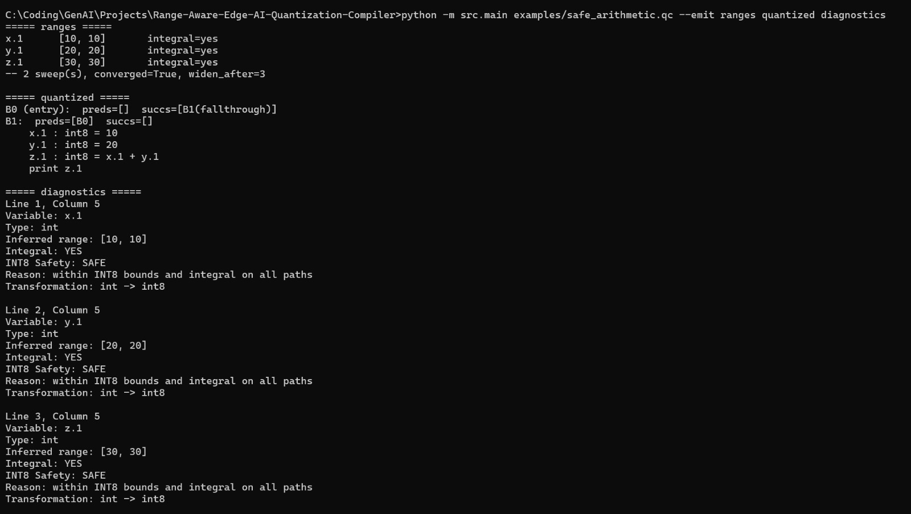
LIVE DEMONSTRATION · ORIGINAL TERMINAL CAPTURE
Demo A — Safe Arithmetic Is Accepted
OBSERVED IN CAPTURE
•
Command in the capture: examples/safe_arithmetic.qc with range, quantized IR and diagnostics output.
•
z.1 is inferred as [30,30] and is integral; the safety analysis accepts it.
•
The emitted IR rewrites x.1, y.1 and z.1 to int8; 3 analysed, 3 safe, 3 rewritten.
•
The supplied capture does not display a simulator run; simulator comparison is recorded separately in the verification summary.
BCSE307L — Compiler Design | Range-Aware Edge AI Quantization Compiler
19

Slide 20
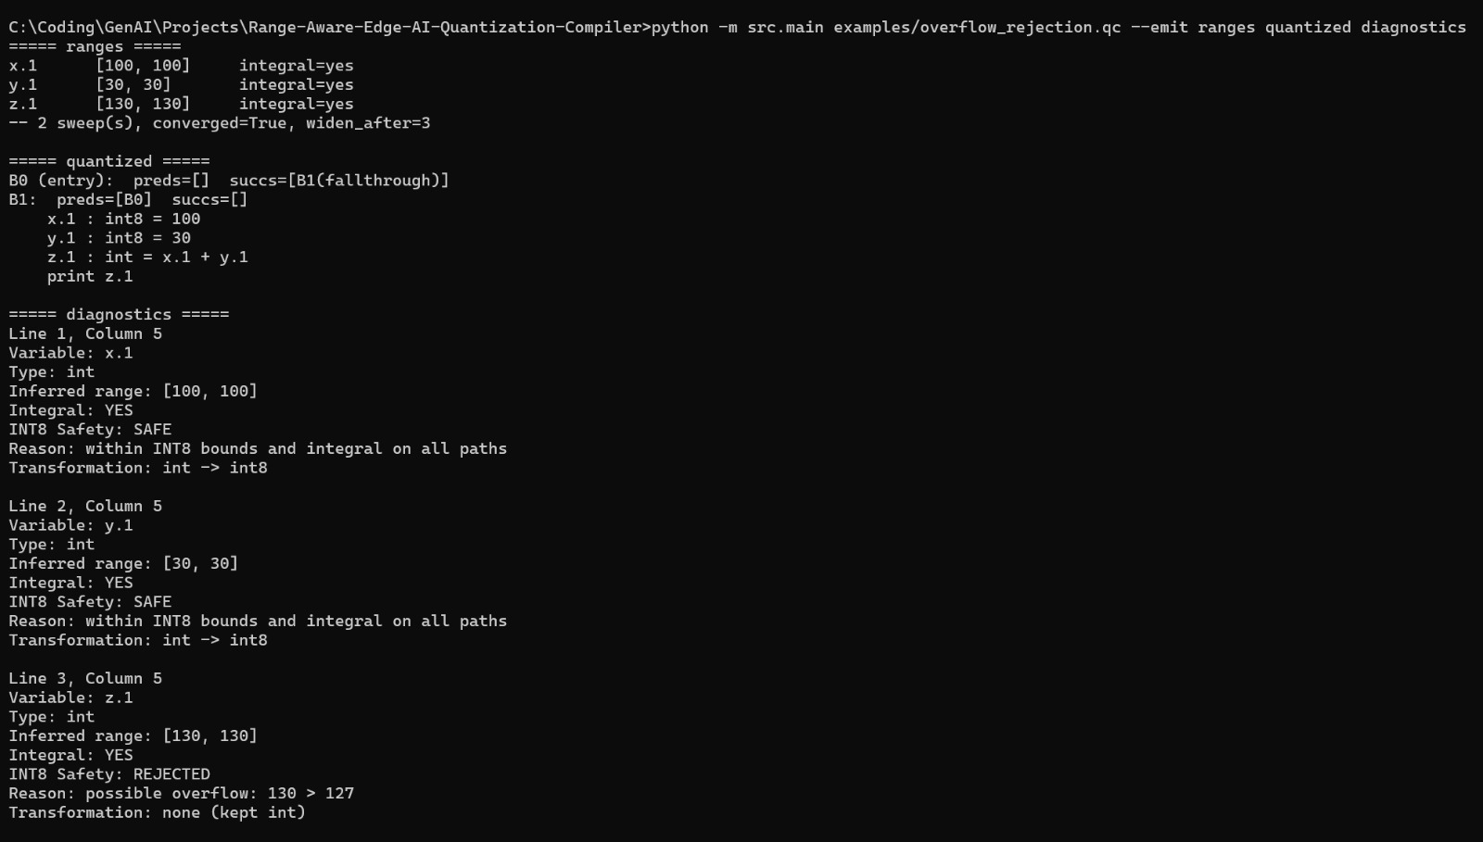
LIVE DEMONSTRATION · ORIGINAL TERMINAL CAPTURE
Demo B — Overflow Is Rejected
OBSERVED IN CAPTURE
•
Source example computes 100 + 30.
•
The result z.1 has inferred range [130,130], outside the INT8 upper bound 127.
•
The safety pass rejects z.1 for possible overflow; the unsafe result remains unquantized.
•
The safe operands x.1 and y.1 can still be rewritten independently.
BCSE307L — Compiler Design | Range-Aware Edge AI Quantization Compiler
20

Slide 21
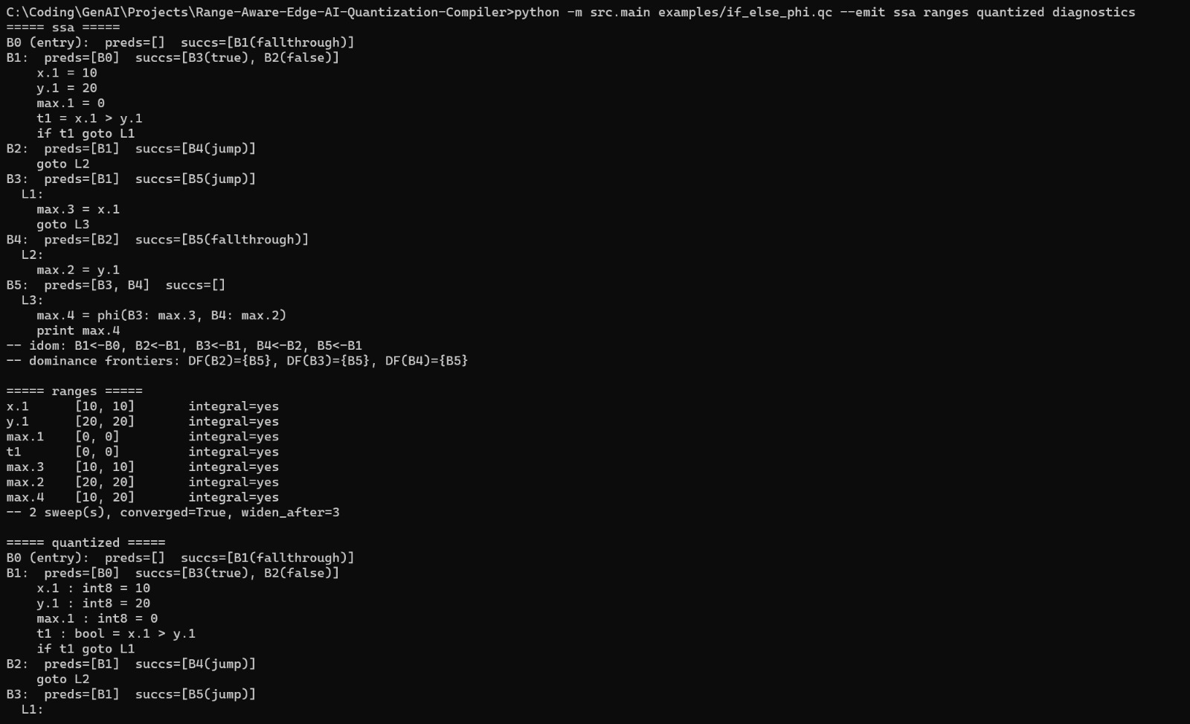
LIVE DEMONSTRATION · ORIGINAL TERMINAL CAPTURE
Demo C — If/Else SSA φ-Node and Range Merge
OBSERVED IN CAPTURE
•
The capture shows SSA and the φ-node for the if/else join.
•
The merged value max.4 has the inferred range [10,20] and is integral.
•
The unsupported relational comparison is left unquantized, consistent with the documented limits.
•
The report records matching original/quantized simulator output [20] = [20]; this capture shows analysis/IR, not that simulator run.
BCSE307L — Compiler Design | Range-Aware Edge AI Quantization Compiler
21

Slide 22
REVIEW 2 · IMPLEMENTATION STATUS
From Proposed Architecture to Implemented Compiler Core
✓
✓
✓
✓
✓
✓
✓
Source
Program
Lexer
Parser
AST
Semantic
Analysis
TAC
Basic Blocks
/ CFG
✓
✓
✓
✓
✓
✓
✓
SSA
Range +
Integrality Analysis
INT8 Safety
Analysis
Selective
Quantization
Quantized
SSA IR
Lightweight
Simulator / Backend
Diagnostics /
Evaluation
✓ Implemented for the current teaching-scale scope. This is the 60% Review 2 milestone; remaining work focuses on coverage, backend maturity, and empirical evaluation.
REVIEW 1
REVIEW 2
VERIFIED
Proposed architecture
Working compiler core
20 / 20 tests passed
Pipeline, IR choices and safety rules defined on paper.
All stages run end-to-end for the current scope.
Plus 5 representative example programs, end-to-end.
BCSE307L — Compiler Design | Range-Aware Edge AI Quantization Compiler
22
Notes:
Since the first review, the project has moved from a proposed architecture to an implemented compiler core. Every stage of the pipeline from Review 1 now exists in code: lexer, parser and AST, semantic analysis, TAC, basic blocks and CFG, SSA, range and integrality analysis, INT8 safety analysis, selective quantization, quantized SSA IR, a lightweight simulator, and diagnostics. The pipeline runs end-to-end for the current scope and is backed by 20 passing automated tests and five representative example programs. This is a teaching-scale prototype, not a production compiler — the following slides show the evidence and the current limits.

Slide 23
REVIEW 2 · COMPONENTS
Implemented Compiler Components
Component
Status
Evidence
Component
Status
Evidence
Lexer
✓ Implemented
src/lexer/, lexer tests
Integrality Analysis
✓ Implemented
Analysis tests and non-integral example
Parser
✓ Implemented
src/parser/, parser tests
Loop Widening
✓ Implemented — Conservative
Loop analysis test and while-loop example
AST
✓ Implemented
src/ast/, AST tests
INT8 Safety Analysis
✓ Implemented
Quantization tests and rejection examples
Semantic Analysis
✓ Implemented
src/semantic/, semantic tests
Quantization Transformation
✓ Implemented
Quantization tests and safe arithmetic example
TAC Generation
✓ Implemented
src/ir/, TAC tests
Backend / Simulator
✓ Implemented
Simulator and integration tests
CFG / Basic Blocks
✓ Implemented
src/cfg/, CFG tests
Diagnostics
✓ Implemented
Diagnostic outputs with source locations
SSA Construction
✓ Implemented
src/ssa/, phi-node test and control-flow examples
End-to-End Pipeline
✓ Implemented for Current Scope
Integration tests and example programs
Range Analysis
✓ Implemented
src/analysis/, interval propagation tests
Status and evidence as recorded in the Review 2 Report. Qualified entries are stated exactly as scoped: loop widening is conservative, and the end-to-end pipeline is complete for the current scope.
BCSE307L — Compiler Design | Range-Aware Edge AI Quantization Compiler
23
Notes:
This table is the implementation checklist from the Review 2 report, with the evidence for each component — the source module and the tests that exercise it. Thirteen components are fully implemented. Two are deliberately qualified: loop widening is implemented conservatively, and the end-to-end pipeline is implemented for the current scope of the language. The point is traceability: each claimed stage maps to code and to a test, rather than to a plan.

Slide 24
REVIEW 2 · VERIFICATION
Test & Verification Results
20 / 20
Representative programs examples/*.qc → analysis → quantized IR → simulator
✓
Safe arithmetic
examples/safe_arithmetic.qc
PASS
✓
Overflow rejection
examples/overflow_rejection.qc
PASS
AUTOMATED TESTS PASSED
✓
Non-integral rejection
examples/non_integral_rejection.qc
PASS
Compiler test suite — 0 failures
✓
If/else + SSA phi
examples/if_else_phi.qc
PASS
Test run (verbatim)
✓
While-loop + widening
examples/while_loop.qc
PASS
python -m unittest discover -s tests -v
Ran 20 tests in 0.018s
OK
✓
Original vs quantized — if/else
simulator
[20] = [20]
✓
Original vs quantized — loop
simulator
[15] = [15]
Simulator rows compare execution of the original and the quantized SSA IR. In every tested case, unsafe or unproven values remain unquantized.
BCSE307L — Compiler Design | Range-Aware Edge AI Quantization Compiler
24
Notes:
This is the verification evidence. The full automated suite — 20 tests — passes, run with python -m unittest discover in about 18 milliseconds. On top of the unit tests, five representative programs go through the whole pipeline: a safe case, two rejection cases for overflow and non-integrality, an if/else that exercises SSA phi nodes, and a while loop that exercises widening. For the two control-flow programs the simulator runs both the original and the quantized IR and produces identical output: 20 and 15. What this shows is correctness on the tested programs — not a guarantee for every possible program.

Slide 25
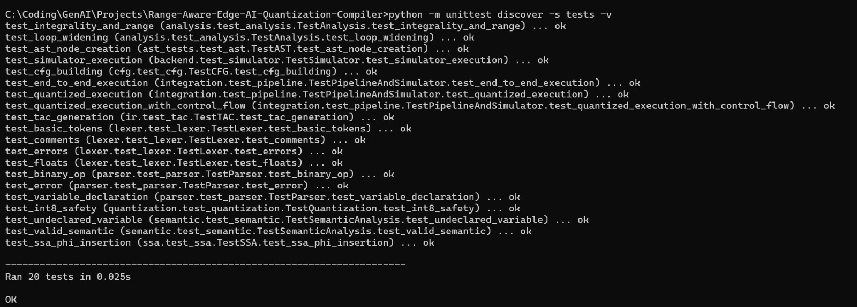
REVIEW 2 · VERIFICATION EVIDENCE
Authentic Test Suite Run
The supplied terminal capture shows the unittest discovery command completing with “Ran 20 tests” and “OK”. Test duration is run-specific.
BCSE307L — Compiler Design | Range-Aware Edge AI Quantization Compiler
25

Slide 26
REVIEW 2 · COMPILER OUTPUT
Representative Output Summary — Accepted vs. Rejected
SAFE ARITHMETIC — ANALYSIS examples/safe_arithmetic.qc
OVERFLOW REJECTION examples/overflow_rejection.qc
Source:
int x = 10; int y = 20; int z = x + y; print z;
Analysis result:
x.1 -> [10,10] -> SAFE
y.1 -> [20,20] -> SAFE
z.1 -> [30,30] -> SAFE
3 analysed, 3 safe, 3 rewritten, 0 rejected.
Source:
int x = 100; int y = 30; int z = x + y; print z;
Analysis result:
x.1 -> [100,100] -> SAFE
y.1 -> [30,30] -> SAFE
z.1 -> [130,130] -> REJECTED
Reason: possible overflow (130 > 127)
3 analysed; 2 rewritten, 1 rejected.
SAFE ARITHMETIC — QUANTIZED IR selective quantization output
NON-INTEGRAL REJECTION examples/non_integral_rejection.qc
Quantized IR:
x.1 : int8 = 10
y.1 : int8 = 20
z.1 : int8 = x.1 + y.1
Source:
float x = 10.0; float y = 3.5; float z = x + y; print z;
Analysis result:
x.1 -> [10,10] -> integral -> SAFE
y.1 -> [3.5,3.5] -> non-integral -> REJECTED
z.1 -> [13.5,13.5] -> non-integral -> REJECTED
3 analysed, 1 safe, 1 rewritten, 2 rejected.
Typeset summary from the report; genuine terminal captures are shown on demo slides 19–21. Rejection is per value: safe operands may still be quantized when a dependent result is rejected.
BCSE307L — Compiler Design | Range-Aware Edge AI Quantization Compiler
26
Notes:
These are actual outputs from the compiler, not mock-ups. On the left, the safe program: every SSA value has a known integral range inside INT8, so all three are rewritten and the quantized IR types them as int8. On the right, the same addition with 100 plus 30: z.1 is 130, which exceeds 127, so it is rejected with an explicit reason. Below it, 3.5 is in range numerically but is not integral, so it and the sum that depends on it are rejected. Rejection is selective — the safe operands in each program are still quantized.

Slide 27
REVIEW 2 · CONTROL FLOW
Control-Flow Verification: φ-Nodes & Loops
IF / ELSE + SSA φ examples/if_else_phi.qc
WHILE LOOP + WIDENING examples/while_loop.qc
B3 · max.3
B4 · max.2
Loop (back edge → φ at header)
Termination by design
Iteration at the loop header is bounded by a widening threshold.
If the range does not stabilise in time, the value becomes UNKNOWN.
UNKNOWN values are never quantized.
Range Propagation
max.4 = phi(B3: max.3, B4: max.2)
max.4 -> [10,20] integral = YES
Widening
t1 = x.1 > y.1 → rejected, left unquantized: relational ‘>’ is not supported by the quantization pass
Conservative Convergence
SAFE / UNKNOWN Decision
ORIGINAL SSA EXECUTION
=
QUANTIZED SSA EXECUTION
ORIGINAL SSA EXECUTION
=
QUANTIZED SSA EXECUTION
[20]
[20]
[15]
[15]
Report summary of simulator comparisons; the genuine terminal capture on demo slide 21 shows the SSA/phi and range output. Reported original/quantized outputs match for the tested control-flow programs.
BCSE307L — Compiler Design | Range-Aware Edge AI Quantization Compiler
27
Notes:
Straight-line code is the easy case, so this slide shows control flow. In the if/else program, SSA inserts a phi node at the join, max.4 equals phi of max.3 from B3 and max.2 from B4, and range analysis merges the branches to [10, 20], integral. The comparison temporary using the greater-than operator is not supported by the quantization pass, so it is left unquantized. In the while loop, the analysis uses conservative widening: if a range does not stabilise within the threshold it becomes UNKNOWN and is not quantized. In both programs the simulator gives the same output before and after quantization: 20 and 15. The trade-off is coverage: widening may give up on some loop values that are actually safe.

Slide 28
REVIEW 2 · SCOPE
Current Limitations & Remaining Work
1
Loop widening is conservative
60% MILESTONE — WHERE WE STAND
Can produce UNKNOWN for loop-carried values when the range does not stabilise within the configured widening threshold. Such values stay unquantized — safe, but less coverage.
Working compiler core for the current scope
2
Unsupported operations are not quantized
Operations outside the supported set — e.g. the relational comparison ‘>’ — are left untouched. Retained in their original form.
✓ Teaching-scale prototype, verified on representative programs
✓ 20/20 automated tests passed
✓ Safe integer-valued SSA operations lowered to int8
✓ Unsafe or unproven values remain unquantized
3
Lightweight backend
The backend is an IR-walking simulator, not LLVM and not a real hardware backend. Used to compare original vs. quantized execution.
4
No empirical performance measurements yet
Runtime, latency, energy and hardware-power have not been measured. No speed-up or energy gain is claimed at this milestone.
NEXT PHASE
Extend operation coverage • improve loop precision • develop a more realistic backend • measure runtime/energy
Limitations as stated in the Review 2 Report. None of them weakens the core rule: unsafe or unproven values remain unquantized.
BCSE307L — Compiler Design | Range-Aware Edge AI Quantization Compiler
28
Notes:
To keep this grounded, here is exactly what the prototype does not do yet. Loop widening is conservative and can return UNKNOWN; operations like the greater-than comparison are not quantized; the backend is a lightweight IR simulator rather than LLVM or real hardware; and we have not yet measured runtime, latency, energy or power, so we make no performance claims. Note that every limitation fails safe — when in doubt, the compiler leaves the value unquantized. At this 60 percent milestone we have a working compiler core for the current scope, verified on representative programs.

Slide 29
OUTCOME
Project Outcome
Within the current supported scope, the compiler produces three concrete outcomes — each one backed by a compile-time proof rather than a runtime check.
1
2
3
Static Safety Check
Selective Quantization
Traceable Output
Verifies at compile time that a value stays integral and remains within [−128, 127] across all execution paths.
Rewrites only certified-safe operations into INT8, leaving every uncertain operation untouched in FP32.
Emits line-by-line diagnostics stating whether each variable was converted or rejected, and the specific reason.
4×
Reduction in memory per quantized value — 4 bytes (FP32) → 1 byte (INT8), with potential for efficient integer arithmetic on suitable hardware; only values proven safe within the supported model are transformed.
Memory reduction follows directly from the width change; runtime and energy gains remain to be measured.
BCSE307L — Compiler Design | Range-Aware Edge AI Quantization Compiler
29
Notes:
To close, the project delivers three outcomes. First, a static safety check that proves at compile time that a value stays integral and inside the INT8 range on every execution path. Second, selective quantization — only certified-safe operations are rewritten to INT8, and anything unproven stays FP32. Third, a traceable output: line-by-line diagnostics saying whether each variable was converted or rejected, and why. The memory outcome is a 4x reduction per quantized value, which follows directly from the 4-byte to 1-byte width change; runtime and energy gains we will measure rather than assume. Thank you.

Slide 30
REFERENCES
References
[1] Z. Zhou, X. Chen, E. Li, L. Zeng, K. Luo, and J. Zhang, “Edge intelligence: Paving the last mile of artificial intelligence with edge computing,” Proc. IEEE, vol. 107, no. 8, pp. 1738–1762, Aug. 2019.
[2] J. Chen and X. Ran, “Deep learning with edge computing: A review,” Proc. IEEE, vol. 107, no. 8, pp. 1655–1674, Aug. 2019.
[3] B. Jacob, S. Kligys, B. Chen, M. Zhu, M. Tang, A. Howard, H. Adam, and D. Kalenichenko, “Quantization and training of neural networks for efficient integer-arithmetic-only inference,” in Proc. IEEE Conf. Computer Vision and Pattern Recognition (CVPR), 2018, pp. 2704–2713.
[4] R. Krishnamoorthi, “Quantizing deep convolutional networks for efficient inference: A whitepaper,” arXiv:1806.08342, 2018.
[5] P. Cousot and R. Cousot, “Static determination of dynamic properties of programs,” in Proc. 2nd Int. Symp. on Programming (ISOP), Paris, France: Dunod, 1976, pp. 106–130.
[6] P. Cousot and R. Cousot, “Abstract interpretation: A unified lattice model for static analysis of programs by construction or approximation of fixpoints,” in Proc. 4th ACM SIGACT-SIGPLAN Symp. on Principles of Programming Languages (POPL), 1977, pp. 238–252.
PTO
References [7]–[12] —PTO.
BCSE307L — Compiler Design | Range-Aware Edge AI Quantization Compiler
30

Slide 31
REFERENCES
References (Continued)
[7] F. Bourdoncle, “Efficient chaotic iteration strategies with widenings,” in Formal Methods in Programming and Their Applications, LNCS vol. 735. Berlin, Germany: Springer, 1993, pp. 128–141.
[8] B. Blanchet, P. Cousot, R. Cousot, J. Feret, L. Mauborgne, A. Miné, D. Monniaux, and X. Rival, “A static analyzer for large safety-critical software,” in Proc. ACM SIGPLAN Conf. on Programming Language Design and Implementation (PLDI), 2003, pp. 196–207.
[9] R. Cytron, J. Ferrante, B. K. Rosen, M. N. Wegman, and F. K. Zadeck, “Efficiently computing static single assignment form and the control dependence graph,” ACM Trans. Program. Lang. Syst., vol. 13, no. 4, pp. 451–490, Oct. 1991.
[10] C. Lattner and V. Adve, “LLVM: A compilation framework for lifelong program analysis and transformation,” in Proc. Int. Symp. on Code Generation and Optimization (CGO), 2004, pp. 75–86.
[11] J. Ragan-Kelley, C. Barnes, A. Adams, S. Paris, F. Durand, and S. Amarasinghe, “Halide: A language and compiler for optimizing parallelism, locality, and recomputation in image processing pipelines,” in Proc. ACM SIGPLAN Conf. on Programming Language Design and Implementation (PLDI), 2013, pp. 519–530.
[12] T. Chen, T. Moreau, Z. Jiang, L. Zheng, E. Yan, M. Cowan, H. Shen, L. Wang, Y. Hu, L. Ceze, C. Guestrin, and A. Krishnamurthy, “TVM: An automated end-to-end optimizing compiler for deep learning,” in Proc. 13th USENIX Symp. on Operating Systems Design and Implementation (OSDI), 2018, pp. 578–594.
BCSE307L — Compiler Design | Range-Aware Edge AI Quantization Compiler
31

