Slide 1
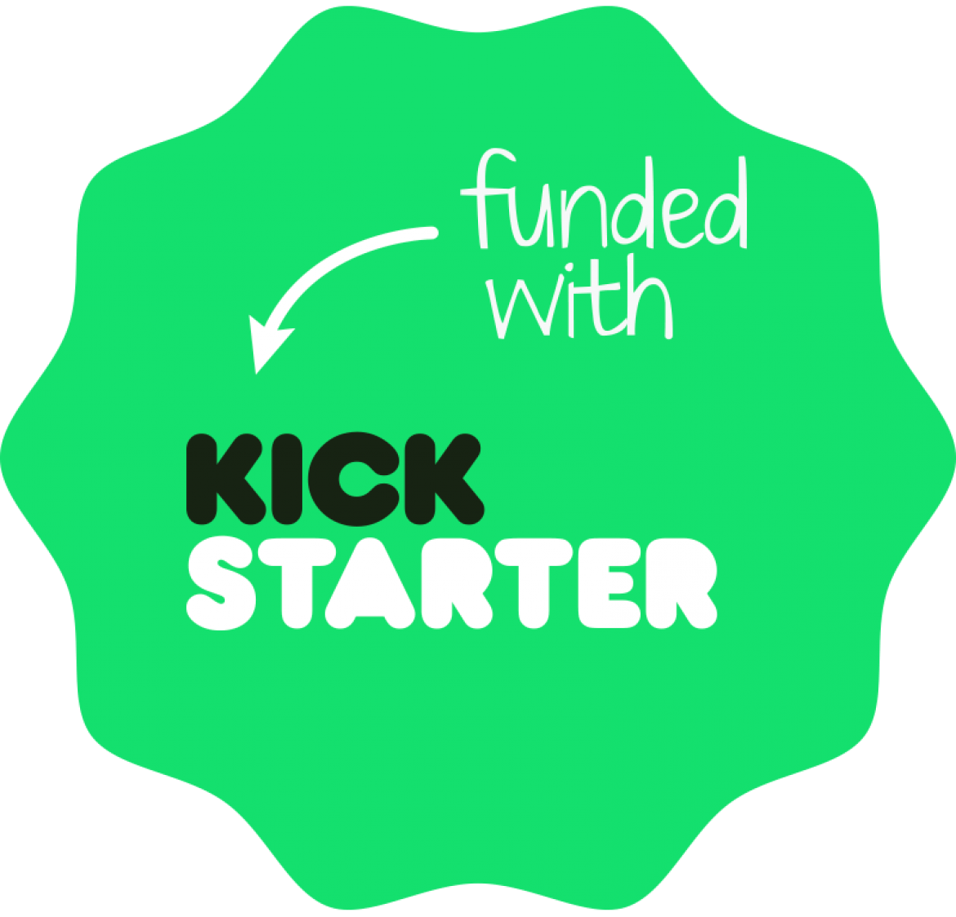
KICKSTARTER Projects:
Is This Project Going to Reach its
Crowdfunding Goal?
Lior Solomon, Eva Marciano, Omer Sarig and Yotam Aharony
T A U

Slide 2




Who Are We?
Yotam Aharony EE & CS, 4th year
Lior Solomon EE & CS, 4th year
Omer Sarig EE & CS, 4th year
Eva Marciano CS, 3rd year

Slide 3
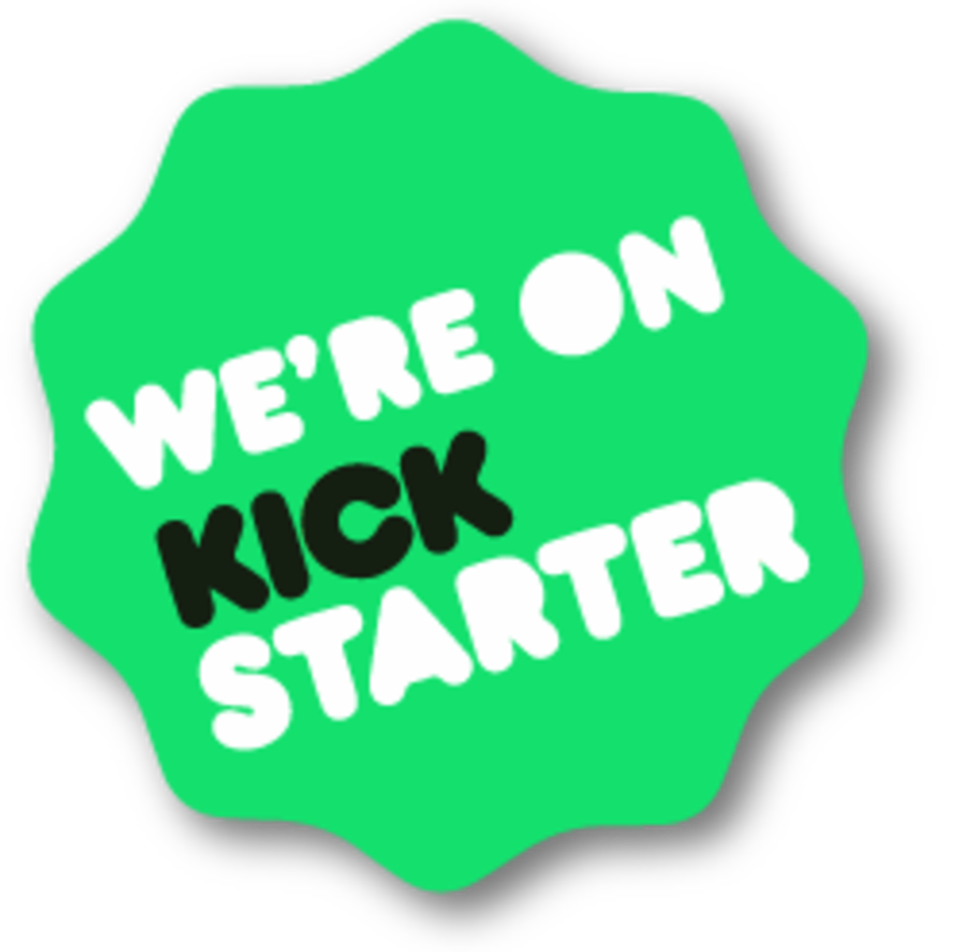
What is KICKSTARTER?
Kickstarter is an American public-benefit corporation, that maintains a global crowdfunding platform focused on creativity and merchandising.

Slide 4





How does it Work?
Project
Funding Goal
Backers Pledge
Set up a Finite work you’d like bring to life
Set up the amount of money need to complete the project
Join the creators in bringing the project to life
all-or-nothing
reward
No charged for a pledged towards a project unless it reaches its funding GOAL
A creator’s change to share a piece of their project with their backers

Slide 5

Project Problem Formulation
Determine whether a new Kickstarter project is going raise his crowdfunding goal by Machine Learning Model based on dataset of over 300k past projects

Slide 6








Our DataSet .
Over 300k projcets (entries)
id internal kickstarter ID
name name of project | state current condition the project is
Category category | main_category category of the campaign
launched date launched | deadline deadline for crowdfunding
goal fundraising goal | pledged amount pledged by “crowd” | backers number of backers
country country pledged from

Slide 7
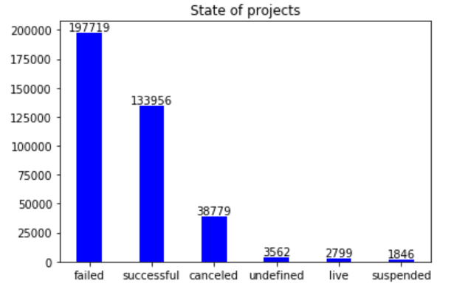


Initial Analysis #status
52.2 %
35. 4%
10.2%
Undefined, live and suspended are 1% from all entries
Failure is obviously the most common status

Slide 8
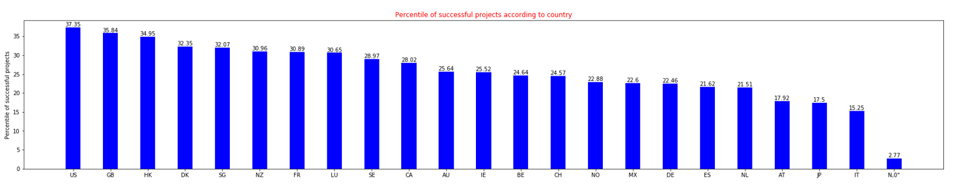
Initial Analysis #country
Initial Analysis
N,0” country – needs to be cleaned
Understand why US, GB, HK have higher success rate then IT, AT, JP (for example)

Slide 9
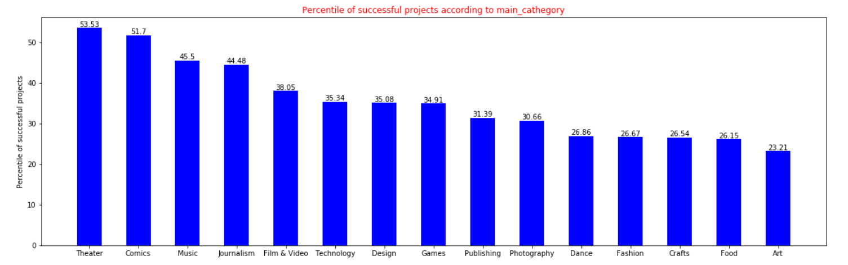
Initial Analysis #category
Initial Analysis
There are categories which the probability that the project will succeed is higher
TODO: cross country and catgeory

Slide 10

Initial Analysis #goal
Initial Analysis
Greater Goal -> Lower success rate

Slide 11
Initial Analysis #duration
Initial Analysis
* Two monts is the maximum amount of time
Seems like there’s no correlation between success and duration. TODO: try finding a correlation between time on the year (month, holiday, special event) and success rate

Slide 12
More Analysis to Come…
How does the name/description influence the status?
Does #words matter?
Does #syllables (difficult words) matter?
Specific key words promise success? (such as “machine learning”)
Does the economy status in the country influence?
Migrate with country/GDP dataset
Does the happiness state in the country influence?
Migrate with World Happiness Report

Slide 13

Previous Work
Several previous works
Most of them just clean the Dataset and try to predict whether the project is going to succeed
~60%-75% prediction accuracy
One had interesting descriptive analysis but NO PREDICTION
Analyse name/description, launch date period and more
We want higher prediction accuracy
We migrated outside information such as country’s GDP
TODO: migrate further information such as cultural preferences, country’s happiness report and more

Slide 14
More to come…

Slide 15
References
Main Kickstarter projects DATASET
https://www.kaggle.com/kemical/kickstarter-projects
Country / Gross Domestic Product DATASET
https://www.kaggle.com/stieranka/predicting-gdp-world-countries/data
World Happiness Report DATASET
https://www.kaggle.com/unsdsn/world-happiness#2019.csv
Previous works:
https://www.kaggle.com/rtatman/data-cleaning-challenge-scale-and-normalize-data
https://www.kaggle.com/shivamb/an-insightful-story-of-crowdfunding-projects

