Slide 1



Complexity and Information in Invariant Inference
Yotam Feldman
Neil Immerman
Mooly Sagiv
Sharon Shoham
@yotamfe, @SagivMooly

Slide 2
Safety of Transition Systems
Bad
Reach
Initial

Slide 3




Inductive Invariants
inductiveness
Bad
Inv
TR
Reach
initial
Initial
not bad

Slide 4


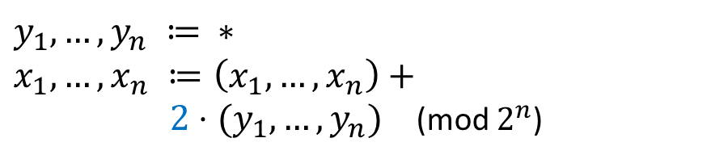









Inductive Invariants: Example
Init:
$δ$:
$${(x}_{1},…,x_{n}) ≔0…0$$
$$y_{1},…,y_{n} ≔ ∗ \\ x_{1},…,x_{n} ≔\left(x_{1},…,x_{n}\right)+$$ $2⋅(y_{1},…,y_{n})$ (mod $2^{n}$)
Bad:
$${(x}_{1},…,x_{n}) = 1…1$$
$I$: ${(x}_{1},…,x_{n}) ≠ 1…1$
Not inductive:
$$00…1$$
$$11…1$$
$$δ$$
$$I$$
$$¬I$$
$I$: $x_{n} ≠ 1$
Inductive:
$$x_{n}≠1$$
$$I$$
$$δ$$

Slide 5

SAT-Based Inference Algorithms
Goal: find inductive invariants automatically
Means: employ a SAT solver
predicate abstraction [CAV’97, POPL’02]
symbolic abstraction [VMCAI’04,’16]
interpolation [CAV’03,TACAS’06]
IC3/PDR [VMCAI’11, FMCAD’11]
abduction [OOPSLA’13]
SyGuS [FMCAD’13,…]
ICE learning [CAV’14, POPL’15]
…
Why do they succeed?
Why do they fail?
(How can we make them better?)

Slide 6

This Work
Complexity of SAT-based invariant inference in a model of exact learning with queries

Slide 7



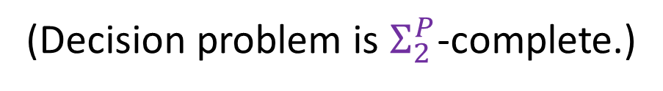
Problem Setting: Polynomial-Length Inference
Boolean transition systems, $Σ=\left\{p_{1},…,p_{n}\right\}$
Given a transition system from a class $𝒫$ (over $Σ$),
Find an inductive invariant
$$I∈CNF$$
$$\left|I\right|≤poly(n)$$
(Decision problem is $Σ_{2}^{P}$-complete.)

Slide 8

Example: PDR-1
Init:
$δ$:
$${(x}_{1},…,x_{n}) ≔0…0$$
$$y_{1},…,y_{n} ≔ ∗ \\ x_{1},…,x_{n} ≔\left(x_{1},…,x_{n}\right)+$$ $2⋅(y_{1},…,y_{n})$ (mod $2^{n}$)
Bad:
$${(x}_{1},…,x_{n}) = 1…1$$

Slide 9




Example: PDR-1
Init:
$δ$:
$${(x}_{1},…,x_{n}) ≔0…0$$
$$y_{1},…,y_{n} ≔ ∗ \\ x_{1},…,x_{n} ≔\left(x_{1},…,x_{n}\right)+$$ $2⋅(y_{1},…,y_{n})$ (mod $2^{n}$)
Bad:
$${(x}_{1},…,x_{n}) = 1…1$$
$$I$$
Bad
$$I=¬\left(x_{1}=1∧x_{2}=1∧…∧x_{n}=1\right)$$
$$δ$$
$$σ =00…1,{ σ}^{′}=1…1$$
Init

Slide 10
Example: PDR-1
Init:
$δ$:
$${(x}_{1},…,x_{n}) ≔0…0$$
$$y_{1},…,y_{n} ≔ ∗ \\ x_{1},…,x_{n} ≔\left(x_{1},…,x_{n}\right)+$$ $2⋅(y_{1},…,y_{n})$ (mod $2^{n}$)
Bad:
$${(x}_{1},…,x_{n}) = 1…1$$
$$I$$
Bad
$$I=¬\left(x_{1}=1∧x_{2}=1∧…∧x_{n}=1\right)$$
$$δ$$
 |  |  |  | ``
$$σ =00…1,{ σ}^{′}=1…1$$
Init

Slide 11
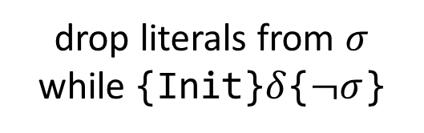
Example: PDR-1
Init:
$δ$:
$${(x}_{1},…,x_{n}) ≔0…0$$
$$y_{1},…,y_{n} ≔ ∗ \\ x_{1},…,x_{n} ≔\left(x_{1},…,x_{n}\right)+$$ $2⋅(y_{1},…,y_{n})$ (mod $2^{n}$)
Bad:
$${(x}_{1},…,x_{n}) = 1…1$$
$$I$$
Bad
$$I=¬\left(x_{1}=1∧x_{2}=1∧…∧x_{n}=1\right)$$
$$δ$$
generalize
$$σ =00…1,{ σ}^{′}=1…1$$
PDR-1:
drop literals from $σ$ while {Init}$δ${$¬σ$}
Init

Slide 12
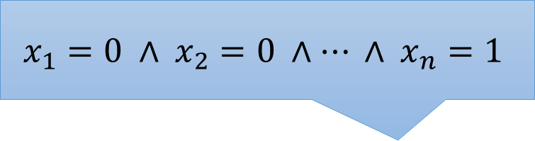
Example: PDR-1
Init:
$δ$:
$${(x}_{1},…,x_{n}) ≔0…0$$
$$y_{1},…,y_{n} ≔ ∗ \\ x_{1},…,x_{n} ≔\left(x_{1},…,x_{n}\right)+$$ $2⋅(y_{1},…,y_{n})$ (mod $2^{n}$)
Bad:
$$x_{1}=0 ∧ x_{2}=0 ∧… ∧ x_{n}=1$$
$${(x}_{1},…,x_{n}) = 1…1$$
$$I$$
Bad
$$I=¬\left(x_{1}=1∧x_{2}=1∧…∧x_{n}=1\right)$$
$$δ$$
generalize
$$σ =00…1,{ σ}^{′}=1…1$$
PDR-1:
drop literals from $σ$ while {Init}$δ${$¬σ$}
Init

Slide 13
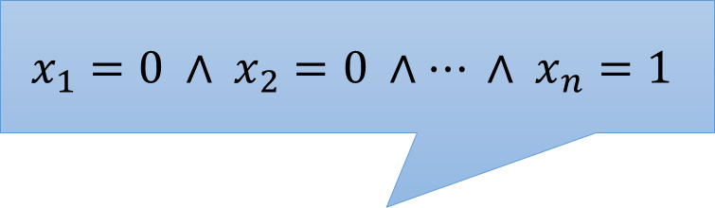
Example: PDR-1
Init:
$δ$:
$${(x}_{1},…,x_{n}) ≔0…0$$
$$y_{1},…,y_{n} ≔ ∗ \\ x_{1},…,x_{n} ≔\left(x_{1},…,x_{n}\right)+$$ $2⋅(y_{1},…,y_{n})$ (mod $2^{n}$)
Bad:
$$x_{1}=0 ∧ x_{2}=0 ∧… ∧ x_{n}=1$$
$${(x}_{1},…,x_{n}) = 1…1$$
$$I$$
Bad
$$I=¬\left(x_{1}=1∧x_{2}=1∧…∧x_{n}=1\right)$$
$$δ$$
generalize
$$σ =00…1,{ σ}^{′}=1…1$$
PDR-1:
drop literals from $σ$ while {Init}$δ${$¬σ$}
Init

Slide 14
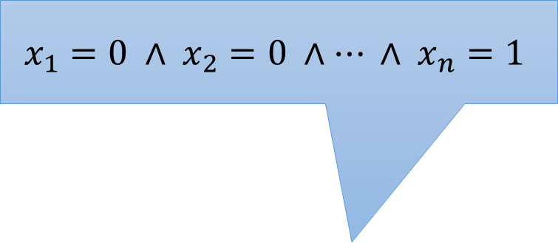
Example: PDR-1
Init:
$δ$:
$${(x}_{1},…,x_{n}) ≔0…0$$
$$y_{1},…,y_{n} ≔ ∗ \\ x_{1},…,x_{n} ≔\left(x_{1},…,x_{n}\right)+$$ $2⋅(y_{1},…,y_{n})$ (mod $2^{n}$)
Bad:
$$x_{1}=0 ∧ x_{2}=0 ∧… ∧ x_{n}=1$$
$${(x}_{1},…,x_{n}) = 1…1$$
$$I$$
Bad
$$I=¬\left(x_{1}=1∧x_{2}=1∧…∧x_{n}=1\right)$$
$$δ$$
generalize
$$σ =00…1,{ σ}^{′}=1…1$$
PDR-1:
drop literals from $σ$ while {Init}$δ${$¬σ$}
Init

Slide 15
Example: PDR-1
Init:
$δ$:
$${(x}_{1},…,x_{n}) ≔0…0$$
$$y_{1},…,y_{n} ≔ ∗ \\ x_{1},…,x_{n} ≔\left(x_{1},…,x_{n}\right)+$$ $2⋅(y_{1},…,y_{n})$ (mod $2^{n}$)
Bad:
$$x_{1}=0 ∧ x_{2}=0 ∧… ∧ x_{n}=1$$
$${(x}_{1},…,x_{n}) = 1…1$$
$$I$$
Bad
$$I=¬\left(x_{1}=1∧x_{2}=1∧…∧x_{n}=1\right)$$
$$δ$$
generalize
$$σ =00…1,{ σ}^{′}=1…1$$
PDR-1:
drop literals from $σ$ while {Init}$δ${$¬σ$}
Init

Slide 16
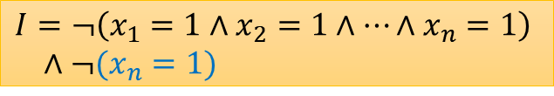
Example: PDR-1
Init:
$δ$:
$${(x}_{1},…,x_{n}) ≔0…0$$
$$y_{1},…,y_{n} ≔ ∗ \\ x_{1},…,x_{n} ≔\left(x_{1},…,x_{n}\right)+$$ $2⋅(y_{1},…,y_{n})$ (mod $2^{n}$)
Bad:
$$x_{1}=0 ∧ x_{2}=0 ∧… ∧ x_{n}=1$$
$${(x}_{1},…,x_{n}) = 1…1$$
$$I$$
Bad
$$I=¬\left(x_{1}=1∧x_{2}=1∧…∧x_{n}=1\right)$$
$$δ$$
generalize
$$σ =00…1,{ σ}^{′}=1…1$$
PDR-1:
drop literals from $σ$ while {Init}$δ${$¬σ$}
$$I=¬\left(x_{1}=1∧x_{2}=1∧…∧x_{n}=1\right) \\ ∧¬(x_{n}=1)$$
Init

Slide 17


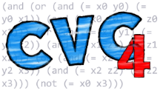

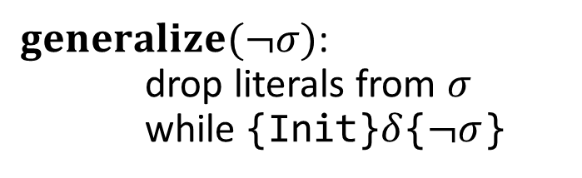
Example: PDR-1
inductiveness check
I := $¬$Bad
while !{I}$δ${I}:
$\left(σ,σ^{′}\right)$ := CTI($δ$,I)
I := I$∧generalize(¬σ)$
$generalize(¬σ)$: drop literals from 𝜎 while {Init}$δ${$¬σ$}
Hoare check
…
V

Slide 18


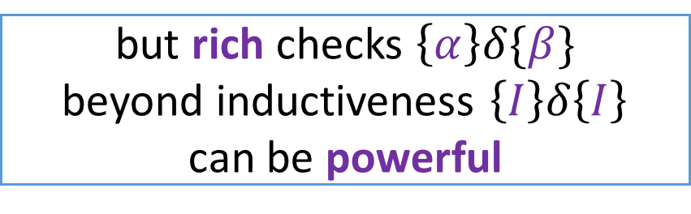
Main Results
inference is hard in general
I := $¬$Bad
while !{I}$δ${I}:
$\left(σ,σ^{′}\right)$ := CTI($δ$,I)
I := I$∧generalize(¬σ)$
but rich checks $\left\{α\right\}δ\{β\}$ beyond inductiveness $\left\{I\right\}δ\left\{I\right\}$ can be powerful
$generalize(¬σ)$: drop literals from 𝜎 while {Init}$δ${$¬σ$}

Slide 19







Hoare-Query Model
Capable of modeling PDR
inference algorithm
Hoare-query oracle
$${\{α}_{1}\}\left\{β_{1}\right\}?$$
✓ / ✘
…
$$\{α_{i}\}$$
$$δ$$
$$\{β_{i}\}$$
$${\{α}_{m}\}\left\{β_{m}\right\}?$$
✓ / ✘
Algorithms cannot access the transition relation directly, only perform Hoare queries

Slide 20

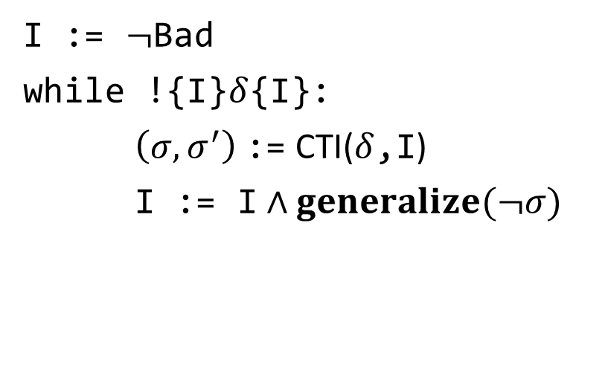

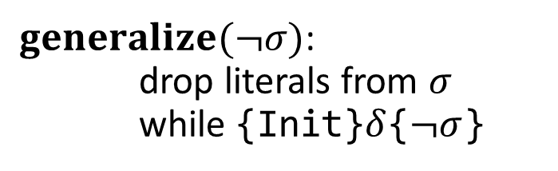

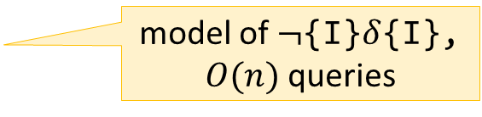


Hoare-Query Model
Capable of modeling PDR
Hoare-query oracle
PDR-1
{I$\}\left\{\text{I}\right\}?$
I := $¬$Bad
while !{I}$δ${I}:
$\left(σ,σ^{′}\right)$ := CTI($δ$,I)
I := I$∧generalize(¬σ)$
✓ / ✘
model of $¬${I}$δ${I}, $O(n)$ queries
$$\{α_{i}\}$$
$$δ$$
$$\{β_{i}\}$$
$$\left\{\text{Init}\right\}\{¬σ\}?$$
$generalize(¬σ)$: drop literals from 𝜎 while {Init}$δ${$¬σ$}
✓ / ✘
…

Slide 21
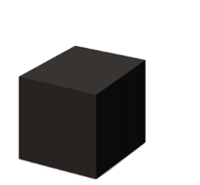


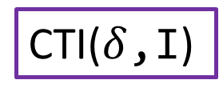





Hoare-Query Algorithms
Capable of modeling PDR
Hoare-query oracle
{I$∧p_{1}\}\left\{\text{I}\right\}?$
CTI($δ$,I)
✓
{I$∧p_{1}∧p_{2}\}\left\{\text{I}\right\}?$
$$\{α_{i}\}$$
$$δ$$
$$\{β_{i}\}$$
✘
{I$∧p_{1}∧{¬p}_{2}∧p_{3}\}\left\{\text{I}\right\}?$
✓ / ✘
…
$O(n)$ queries

Slide 22
Hoare-Query Complexity
Complexity: # Hoare queries
Hoare-query oracle
PDR-1
{I$\}\left\{\text{I}\right\}?$
I := $¬$Bad
while !{I}$δ${I}:
$\left(σ,σ^{′}\right)$ := CTI($δ$,I)
I := I$∧generalize(¬σ)$
✓ / ✘
model of $¬${I}$δ${I}, $O(n)$ queries
$$\{α_{i}\}$$
$$δ$$
$$\{β_{i}\}$$
$$\left\{\text{Init}\right\}\{¬σ\}?$$
$generalize(¬σ)$: drop literals from 𝜎 while {Init}$δ${$¬σ$}
✓ / ✘
…

Slide 23
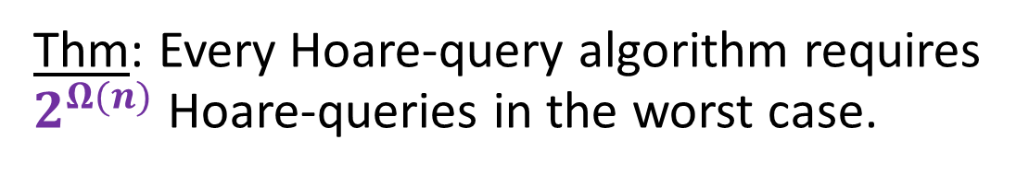
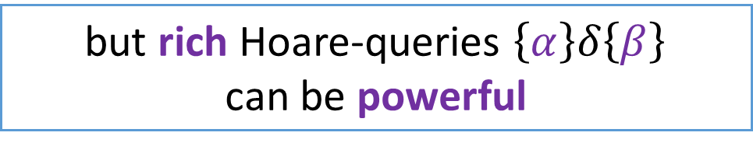

Hoare-Query Complexity
Complexity: # Hoare queries
Thm: Every Hoare-query algorithm requires $2^{Ω(n)}$ Hoare-queries in the worst case.
($n$ is the vocabulary size)
even with unlimited computational power
​unconditional lower bound
but rich Hoare-queries $\left\{α\right\}δ\left\{β\right\}$ can be powerful

Slide 24






Inductiveness-Query Model
A special case of the Hoare-query model
closely related to ICE learning [CAV’14]
inference algorithm
inductiveness-query oracle
$α_{1}$ inductive?
✓ / ✘+counterexample
…
$$\{α_{i}\}$$
$$δ$$
$$\{α_{i}\}$$
$α_{m}$ inductive?
✓ / ✘+counterexample
Complexity: # inductiveness queries worst case amongst possible counterexamples
[CAV’14] ICE: A Robust Framework for Learning Invariants. Pranav Garg, Christof Löding, P. Madhusudan, Daniel Neider.

Slide 25

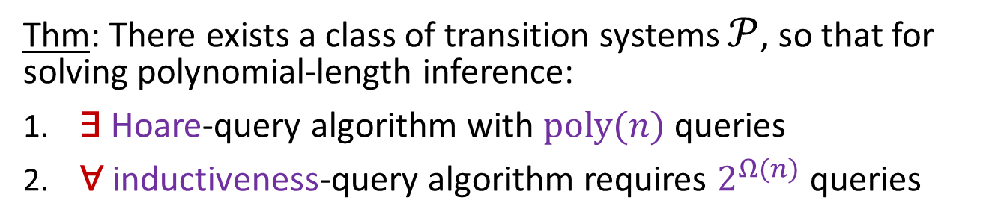
Hoare > Inductiveness
Thm: There exists a class of transition systems $𝒫$, so that for solving polynomial-length inference:
​∃ Hoare-query algorithm with $poly(n)$ queries
​∀ inductiveness-query algorithm requires $2^{Ω(n)}$ queries
a simple case of PDR
$$⇒$$
ICE cannot model PDR, and the extension of [VMCAI’17] is necessary
[VMCAI’17] IC3 - Flipping the E in ICE. Yakir Vizel, Arie Gurfinkel, Sharon Shoham, Sharad Malik.

Slide 26

Hoare > Inductiveness
Thm: There exists a class of transition systems $𝒫$, so that for solving polynomial-length inference:
​∃ Hoare-query algorithm with $poly(n)$ queries
​∀ inductiveness-query algorithm requires $2^{Ω(n)}$ queries
PDR-1
I := $¬$Bad
while !{I}$δ${I}:
$\left(σ,σ^{′}\right)$ := CTI($δ$,I)
I := I$∧generalize(¬σ)$
$generalize(¬σ)$: drop literals from 𝜎 while {Init}$δ${$¬σ$}

Slide 27
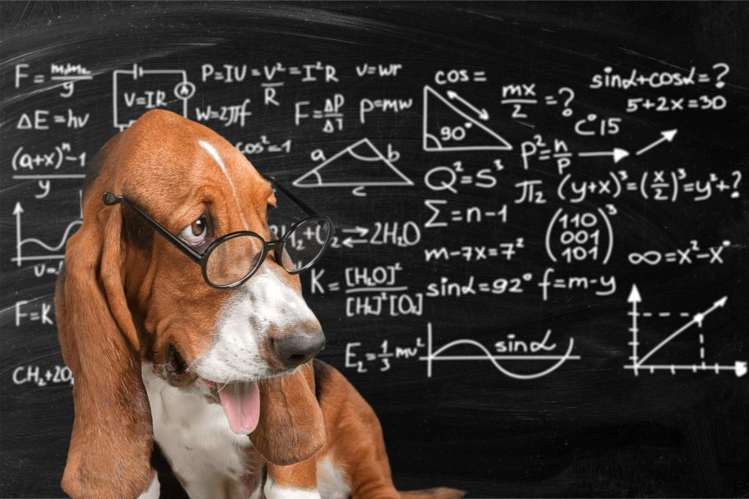
Proofs

Slide 28
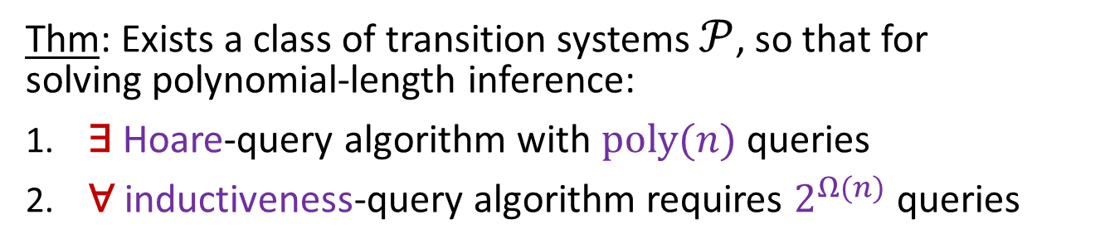


Hoare > Inductiveness
Thm: Exists a class of transition systems $𝒫$, so that for solving polynomial-length inference:
​∃ Hoare-query algorithm with $poly(n)$ queries
​∀ inductiveness-query algorithm requires $2^{Ω(n)}$ queries
Proof:
monotone CNF with $n$ clauses
propositions appear only negatively
$$φ =¬x_{1}∧(¬x_{2}∨¬x_{3})$$

Slide 29
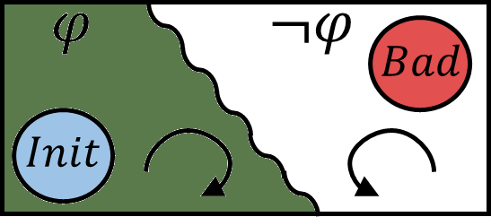
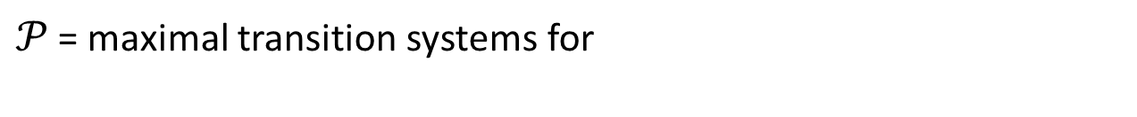


Hoare > Inductiveness
Thm: Exists a class of transition systems $𝒫$, so that for solving polynomial-length inference:
​∃ Hoare-query algorithm with $poly(n)$ queries
​∀ inductiveness-query algorithm requires $2^{Ω(n)}$ queries
Proof:
$𝒫$ = maximal transition systems for
monotone CNF with $n$ clauses
propositions appear only negatively
$$φ =¬x_{1}∧(¬x_{2}∨¬x_{3})$$
Maximal system for $φ$:

Slide 30


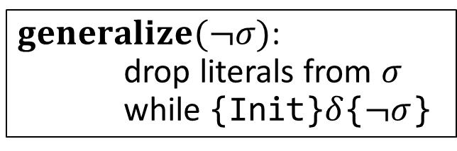

Hoare > Inductiveness
Upper bound: ​∃ Hoare-query algorithm with $poly(n)$ queries
Proof:
PDR-1 takes $O(n^{2})$ queries
$generalize(¬σ)$: drop literals from 𝜎 while {Init}$δ${$¬σ$}
$$φ⇒¬σ$$
1 iteration
1 iteration
$φ$ is monotone
minimal
$$φ =¬x_{1}∧(¬x_{2}∨¬x_{3})$$

Slide 31
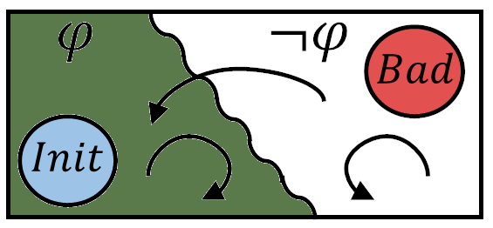




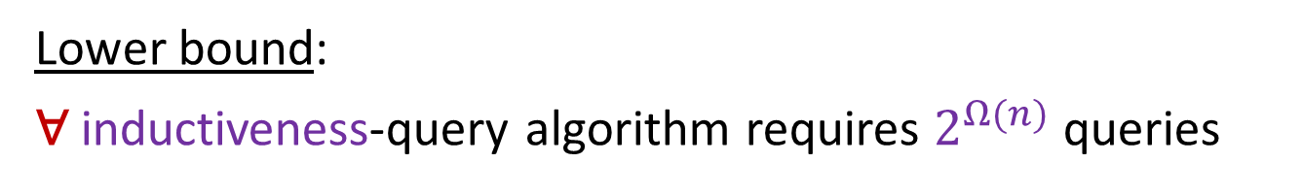







Hoare > Inductiveness
Lower bound:
​∀ inductiveness-query algorithm requires $2^{Ω(n)}$ queries
Proof:
inference algorithm
inductiveness-query oracle
$α_{1}$ inductive?
✘+counterexample
…
$$\{α_{i}\}$$
$$δ$$
$$\{α_{i}\}$$
$α_{m}$ inductive?
✘+counterexample
$$φ$$
$$¬φ$$
$$Bad$$
$$≤$$
$$α_{i}$$
$$α_{i}$$

Slide 32


Hoare > Inductiveness
Lower bound:
​∀ inductiveness-query algorithm requires $2^{Ω(n)}$ queries
Proof:
Thm: invariants in monotone CNF
general systems monotone CNF invariants
maximal systems monotone CNF invariants
$$φ$$
$$¬φ$$
$$Bad$$
$$2^{Ω(n)}$$
$$≤$$
$$≤$$

Slide 33




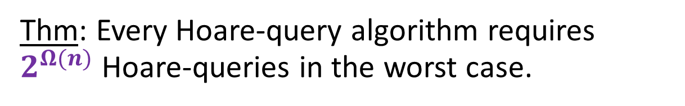






Lower Bound for General Systems
Thm: Every Hoare-query algorithm requires $2^{Ω(n)}$ Hoare-queries in the worst case.
Proof sketch:
given
construct $δ_{1},δ_{2}$ for
inference algorithm
Hoare-query oracle
with $poly(n)$ queries
$${\{α}_{1}\}\left\{β_{1}\right\}?$$
✓ / ✘
$$\{α_{i}\}$$
$$δ_{1}$$
$$\{β_{i}\}$$
…
$${\{α}_{m}\}\left\{β_{m}\right\}?$$
✓ / ✘
$$\{α_{i}\}$$
$$δ_{2}$$
$$\{β_{i}\}$$
1. $δ_{1}$ has an inductive invariants with at most $n$ clauses
2. $δ_{2}$ does not (in fact, unsafe)
3. all queries return the same answer for${ δ}_{1},δ_{2}$

Slide 34
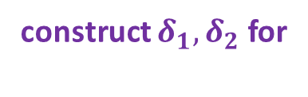
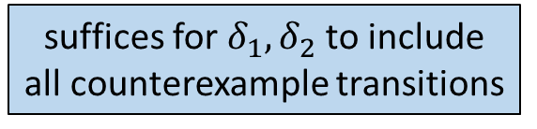
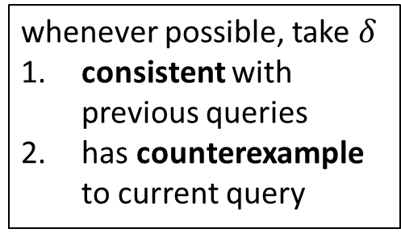
Lower Bound for General Systems
Thm: Every Hoare-query algorithm requires $2^{Ω(n)}$ Hoare-queries in the worst case.
Proof sketch:
suffices for${ δ}_{1},δ_{2}$ to include all counterexample transitions
given
construct $δ_{1},δ_{2}$ for
inference algorithm
Hoare-query oracle
with $poly(n)$ queries
$${\{α}_{1}\}\left\{β_{1}\right\}?$$
whenever possible, take $δ$
​consistent with previous queries
has counterexample to current query
✘+counterexample
…
$${\{α}_{m}\}\left\{β_{m}\right\}?$$
✘+counterexample

Slide 35
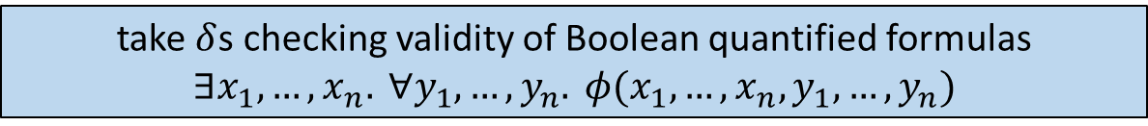
Lower Bound for General Systems
Thm: Every Hoare-query algorithm requires $2^{Ω(n)}$ Hoare-queries in the worst case.
Proof sketch:
suffices for${ δ}_{1},δ_{2}$ to include all counterexample transitions
given
construct $δ_{1},δ_{2}$ for
inference algorithm
Hoare-query oracle
with $poly(n)$ queries
$${\{α}_{1}\}\left\{β_{1}\right\}?$$
✘+counterexample
$$\{α_{i}\}$$
$$δ_{1}$$
$$\{β_{i}\}$$
…
$${\{α}_{m}\}\left\{β_{m}\right\}?$$
✘+counterexample
$$\{α_{i}\}$$
$$δ_{2}$$
$$\{β_{i}\}$$
take $δ$s checking validity of Boolean quantified formulas $∃x_{1},…, x_{n}. ∀y_{1},…,y_{n}. φ(x_{1},…,x_{n},y_{1},…,y_{n})$
a polynomial number of valuations do not determine validity!

Slide 36
Hoare > Inductiveness
Thm: There exists a class of transition systems $𝒫$, so that for solving polynomial-length inference:
​∃ Hoare-query algorithm with $poly(n)$ queries
​∀ inductiveness-query algorithm requires $2^{Ω(n)}$ queries
Thm: Learning from counterexamples to induction is harder than learning from examples labeled positive/negative.

Slide 37
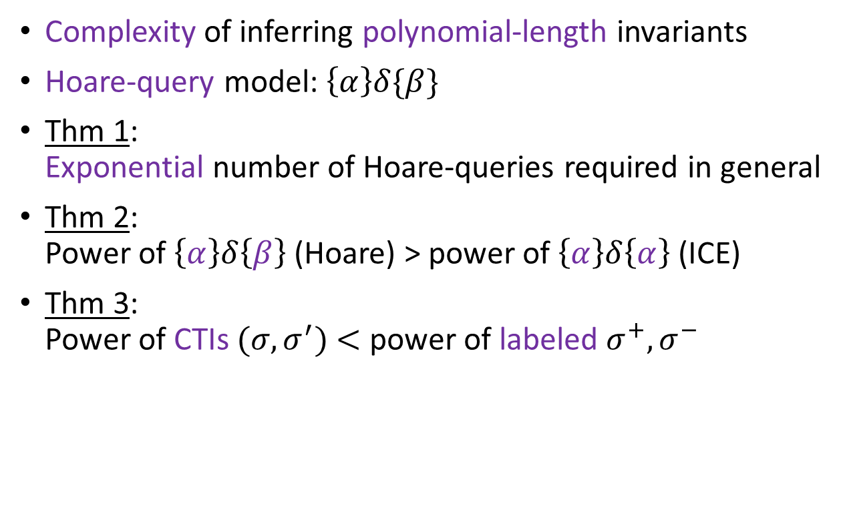
Conclusion
​Complexity of inferring polynomial-length invariants
​Hoare-query model: $\left\{α\right\}δ\{β\}$
Thm 1: Exponential number of Hoare-queries required in general
Thm 2: Power of $\left\{α\right\}δ\left\{β\right\}$ (Hoare) > power of $\left\{α\right\}δ\left\{α\right\}$ (ICE)
Thm 3: Power of CTIs $(σ,σ^{′})$ $<$ power of labeled $σ^{+},σ^{−}$

Slide 38

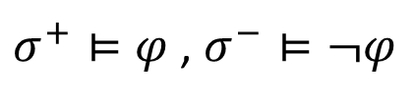




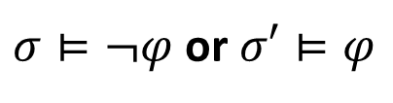
Learning from Examples
Exact concept learning with equivalence queries:
Thm: Learning from counterexamples to induction is harder than learning from labeled examples.
learning algorithm
equivalence-query oracle
is it $α_{1}$?
✓ / ✘+counterexample
…
$$φ$$
is it $α_{m}$?
✓ / ✘+counterexample
Learning monotone-CNF_{n}:
Positive/negative examples:
$σ^{+}⊨φ$ , $σ^{−}⊨¬φ$
subexponential
Counterexamples to induction:
$σ⊨¬φ$ or $σ′⊨φ$
this work:
$$2^{Ω(n)}$$
[ML’87] Queries and Concept Learning, Angluin [COLT’12] Tight Bounds on Proper Equivalence Query Learning of DNF, Hellerstein et al.

