Slide 1



Learning the Boundary of Inductive Invariants
Yotam Feldman
Mooly Sagiv
Sharon Shoham
James R. Wilcox
@yotamfe, @SagivMooly, @wilcoxjay

Slide 2


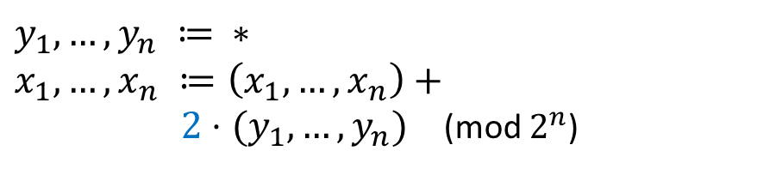

Safety of Transition Systems
Init:
$δ$:
$${(x}_{1},…,x_{n}) ≔0…0$$
$$y_{1},…,y_{n} ≔ ∗ \\ x_{1},…,x_{n} ≔\left(x_{1},…,x_{n}\right)+$$ $2⋅(y_{1},…,y_{n})$ (mod $2^{n}$)
Bad:
$${(x}_{1},…,x_{n}) = 1…1$$
Bad
Reach
Initial

Slide 3









Inductive Invariants
Init:
$δ$:
$${(x}_{1},…,x_{n}) ≔0…0$$
$$y_{1},…,y_{n} ≔ ∗ \\ x_{1},…,x_{n} ≔\left(x_{1},…,x_{n}\right)+$$ $2⋅(y_{1},…,y_{n})$ (mod $2^{n}$)
Bad:
$${(x}_{1},…,x_{n}) = 1…1$$
Bad
$I$: ${(x}_{1},…,x_{n}) ≠ 1…1$
Not inductive:
$$00…1$$
$$11…1$$
$$δ$$
$$I$$
$$¬I$$
$I$: $x_{n} ≠ 1$
Initial
Inductive:
$$x_{n}≠1$$
$$I$$
$$δ$$

Slide 4

Practice Surpasses Theory
Invariant inference is theoretically intractable
In practice, very clever algorithms often work
[CADE’09] Complexity and Algorithms for Monomial and Clausal Predicate Abstraction. Lahiri and Qadeer [POPL’20] Complexity and Information in Invariant Inference. Feldman, Immerman, Shoham, Sagiv

Slide 5
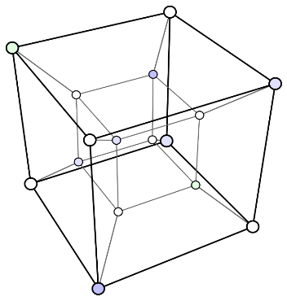


This Work
Complexity results for an interpolation-based invariant inference algorithm
+
Hamming geometry
Exact learning theory
$$⟹$$
Complexity of invariant inference

Slide 6
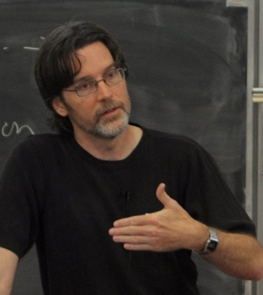

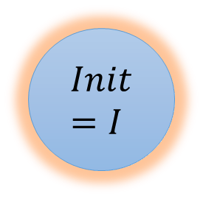

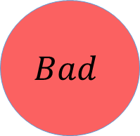





Interpolation-Based Inference
$$I=Init$$
$k+1$ times
$$Init=I$$
$$Bad$$
$$δ$$
$$δ$$
$$δ$$
$$…$$
$$δ$$
[CAV’03] Interpolation and SAT-Based Model Checking, McMillan

Slide 7
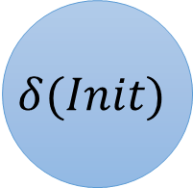

Interpolation-Based Inference
$$I=Init$$
$k$ times
$$Init=I$$
$$δ(Init)$$
$$Bad$$
$$δ$$
$$δ$$
$$…$$
$$δ$$
[CAV’03] Interpolation and SAT-Based Model Checking, McMillan

Slide 8



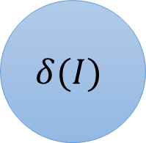
Interpolation-Based Inference
$$I=Init$$
$$δ(Init)$$
$k$ times
Interpolant
$$Init=I$$
$$δ(I)$$
$$Bad$$
$$δ$$
$$δ$$
$$…$$
$$δ$$
[CAV’03] Interpolation and SAT-Based Model Checking, McMillan

Slide 9
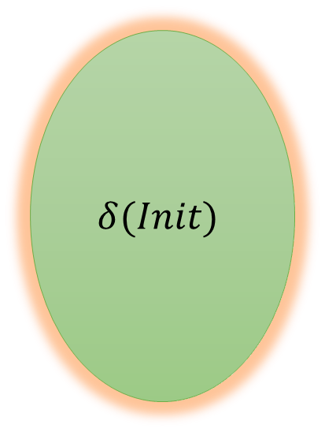

Interpolation-Based Inference
$$I=Init∨Interpolant$$
$$δ(Init)$$
$k$ times
Interpolant
$$Init=I$$
$$δ(I)$$
$$Bad$$
$$δ$$
$$δ$$
$$…$$
$$δ$$
[CAV’03] Interpolation and SAT-Based Model Checking, McMillan

Slide 10
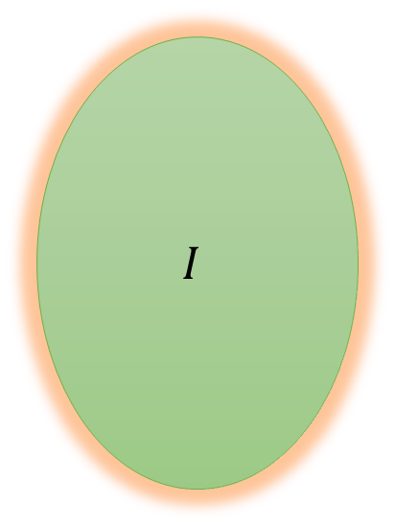
Interpolation-Based Inference
$$I=Init∨Interpolant$$
$$I$$
$k+1$ times
$$Bad$$
$$δ$$
$$δ$$
$$δ$$
$$…$$
$$δ$$
[CAV’03] Interpolation and SAT-Based Model Checking, McMillan

Slide 11
Interpolation-Based Inference
$$I=Init∨Interpolant$$
$$δ(Init)$$
$k$ times
Interpolant
$$Init=I$$
$$δ(I)$$
$$Bad$$
$$δ$$
$$δ$$
$$…$$
$$δ$$
[CAV’03] Interpolation and SAT-Based Model Checking, McMillan

Slide 12







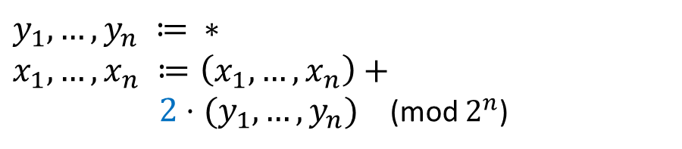
Model-Based Interpolation
Init:
$δ$:
$${(x}_{1},…,x_{n}) ≔0…0$$
$$y_{1},…,y_{n} ≔ ∗ \\ x_{1},…,x_{n} ≔\left(x_{1},…,x_{n}\right)+$$ $2⋅(y_{1},…,y_{n})$ (mod $2^{n}$)
Bad:
$${(x}_{1},…,x_{n}) = 1…1$$
$$Inter{polant}_{1}=\left(x_{1}=0∧x_{2}=1∧…∧x_{n}=1∧x_{n}=0\right)$$
$$σ_{1} =01…10$$
$k$ times
$$Init=I$$
$$Bad$$
$$δ$$
$$σ_{1}$$
$$δ$$
$$…$$
$$δ$$
$$δ(I)$$
[HVC’12] Computing Interpolants without Proofs. Chockler, Ivrii, Matsliah [LPAR’13] Instantiations, Zippers and EPR Interpolation. Bjørner, Gurfinkel, Korovin, Lahav

Slide 13
Model-Based Interpolation
Init:
$δ$:
$${(x}_{1},…,x_{n}) ≔0…0$$
$$y_{1},…,y_{n} ≔ ∗ \\ x_{1},…,x_{n} ≔\left(x_{1},…,x_{n}\right)+$$ $2⋅(y_{1},…,y_{n})$ (mod $2^{n}$)
Bad:
$${(x}_{1},…,x_{n}) = 1…1$$
$$Inter{polant}_{1}=\left(x_{1}=0∧x_{2}=1∧…∧x_{n}=1∧x_{n}=0\right)$$
$$σ_{1} =01…10$$
$k$ times
$$Init=I$$
$$Bad$$
$$δ$$
$$σ_{1}$$
$$δ$$
$$…$$
$$δ$$
$$δ(I)$$
[HVC’12] Computing Interpolants without Proofs. Chockler, Ivrii, Matsliah [LPAR’13] Instantiations, Zippers and EPR Interpolation. Bjørner, Gurfinkel, Korovin, Lahav

Slide 14
Model-Based Interpolation
Init:
$δ$:
$${(x}_{1},…,x_{n}) ≔0…0$$
$$y_{1},…,y_{n} ≔ ∗ \\ x_{1},…,x_{n} ≔\left(x_{1},…,x_{n}\right)+$$ $2⋅(y_{1},…,y_{n})$ (mod $2^{n}$)
Bad:
$${(x}_{1},…,x_{n}) = 1…1$$
$$Inter{polant}_{1}=\left(x_{1}=0∧x_{2}=1∧…∧x_{n}=1∧x_{n}=0\right)$$
$$σ_{1} =01…10$$
$k$ times
$$Init=I$$
$$Bad$$
$$δ$$
$$σ_{1}$$
$$δ$$
$$…$$
$$δ$$
$$δ(I)$$
[HVC’12] Computing Interpolants without Proofs. Chockler, Ivrii, Matsliah [LPAR’13] Instantiations, Zippers and EPR Interpolation. Bjørner, Gurfinkel, Korovin, Lahav

Slide 15

Model-Based Interpolation
Init:
$δ$:
$${(x}_{1},…,x_{n}) ≔0…0$$
$$y_{1},…,y_{n} ≔ ∗ \\ x_{1},…,x_{n} ≔\left(x_{1},…,x_{n}\right)+$$ $2⋅(y_{1},…,y_{n})$ (mod $2^{n}$)
Bad:
$${(x}_{1},…,x_{n}) = 1…1$$
$$Inter{polant}_{1}=\left(x_{1}=0∧x_{2}=1∧…∧x_{n}=1∧x_{n}=0\right)$$
$$σ_{1} =01…10$$
$k$ times
$$δ$$
$$…$$
$$δ$$
$$Init=I$$
$$Bad$$
$$δ$$
$$σ_{1}$$
$$δ$$
$$…$$
$$δ$$
$$δ(I)$$
[HVC’12] Computing Interpolants without Proofs. Chockler, Ivrii, Matsliah [LPAR’13] Instantiations, Zippers and EPR Interpolation. Bjørner, Gurfinkel, Korovin, Lahav

Slide 16
Model-Based Interpolation
Init:
$δ$:
$${(x}_{1},…,x_{n}) ≔0…0$$
$$y_{1},…,y_{n} ≔ ∗ \\ x_{1},…,x_{n} ≔\left(x_{1},…,x_{n}\right)+$$ $2⋅(y_{1},…,y_{n})$ (mod $2^{n}$)
Bad:
$${(x}_{1},…,x_{n}) = 1…1$$
$$Inter{polant}_{1}=\left(x_{1}=0∧x_{2}=1∧…∧x_{n}=1∧x_{n}=0\right)$$
$$σ_{1} =01…10$$
$k$ times
$$Init=I$$
$$Bad$$
$$δ$$
$$σ_{1}$$
$$δ$$
$$…$$
$$δ$$
$$δ(I)$$
[HVC’12] Computing Interpolants without Proofs. Chockler, Ivrii, Matsliah [LPAR’13] Instantiations, Zippers and EPR Interpolation. Bjørner, Gurfinkel, Korovin, Lahav

Slide 17
Model-Based Interpolation
Init:
$δ$:
$${(x}_{1},…,x_{n}) ≔0…0$$
$$y_{1},…,y_{n} ≔ ∗ \\ x_{1},…,x_{n} ≔\left(x_{1},…,x_{n}\right)+$$ $2⋅(y_{1},…,y_{n})$ (mod $2^{n}$)
Bad:
$${(x}_{1},…,x_{n}) = 1…1$$
$$Inter{polant}_{1}=\left(x_{1}=0∧x_{2}=1∧…∧x_{n}=1∧x_{n}=0\right)$$
$$σ_{1} =01…10$$
$k$ times
$$Init=I$$
$$Bad$$
$$δ$$
$$σ_{1}$$
$$δ$$
$$…$$
$$δ$$
$$δ(I)$$
[HVC’12] Computing Interpolants without Proofs. Chockler, Ivrii, Matsliah [LPAR’13] Instantiations, Zippers and EPR Interpolation. Bjørner, Gurfinkel, Korovin, Lahav

Slide 18

Model-Based Interpolation
Init:
$δ$:
$${(x}_{1},…,x_{n}) ≔0…0$$
$$y_{1},…,y_{n} ≔ ∗ \\ x_{1},…,x_{n} ≔\left(x_{1},…,x_{n}\right)+$$ $2⋅(y_{1},…,y_{n})$ (mod $2^{n}$)
Bad:
$${(x}_{1},…,x_{n}) = 1…1$$
$$I=Init∨{(x}_{n}=0)$$
$k$ times
$$Init=I$$
$$Bad$$
$$δ$$
$$σ_{1}$$
$$δ$$
$$…$$
$$δ$$
$$δ(I)$$
[HVC’12] Computing Interpolants without Proofs. Chockler, Ivrii, Matsliah [LPAR’13] Instantiations, Zippers and EPR Interpolation. Bjørner, Gurfinkel, Korovin, Lahav

Slide 19


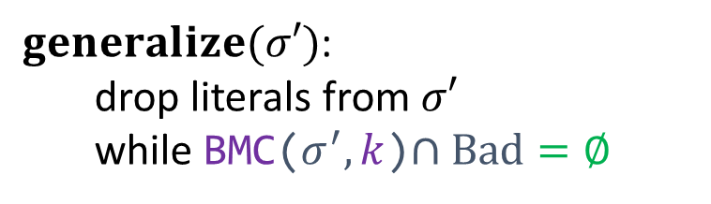

Model-Based Interpolation
Inferring invariant in DNF:
$$\left(ℓ_{1}^{1}∧…∧ℓ_{k_{1}}^{1}\right)∨ … ∨\left(ℓ_{1}^{m}∧…∧ℓ_{k_{m}}^{m}\right)$$
gen($σ_{1})$
gen($σ_{m})$
$I$ := $false$
while $(_, σ^{′})$ counterexample to Inductive($I)$:
$I$ := $I ∨generalize\left(σ^{′}\right)$
$generalize(σ′)$: drop literals from $σ′$ while BMC($σ^{′},k$)$∩Bad=∅$

Slide 20

Successful Inference?
Inferring invariant in DNF:
$$\left(ℓ_{1}^{1}∧…∧ℓ_{k_{1}}^{1}\right)∨ … ∨\left(ℓ_{1}^{m}∧…∧ℓ_{k_{m}}^{m}\right)$$
gen($σ_{1})$
gen($σ_{m})$
How many iterations are required?
How large a $k$ suffices?

Slide 21
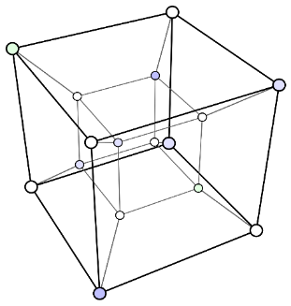
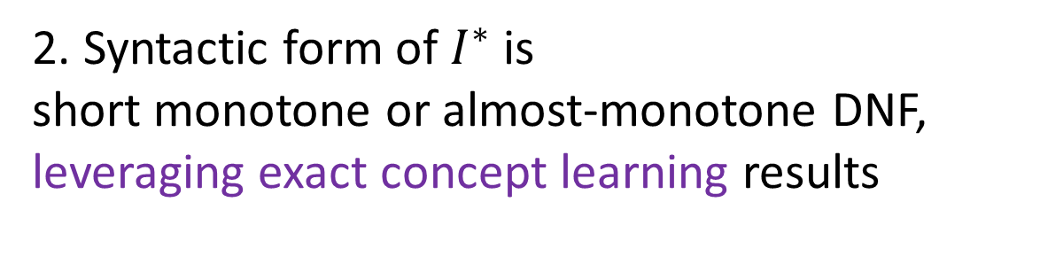
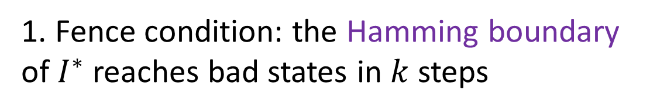
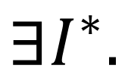
Key Results and Ideas
Interpolation-based inference finds an invariant in a polynomial number of SAT queries when
$$∃I^{∗}.$$
1. Fence condition: the Hamming boundary of $I^{∗}$ reaches bad states in $k$ steps
+
2. Syntactic form of $I^{∗}$ is short monotone or almost-monotone DNF, leveraging exact concept learning results

Slide 22



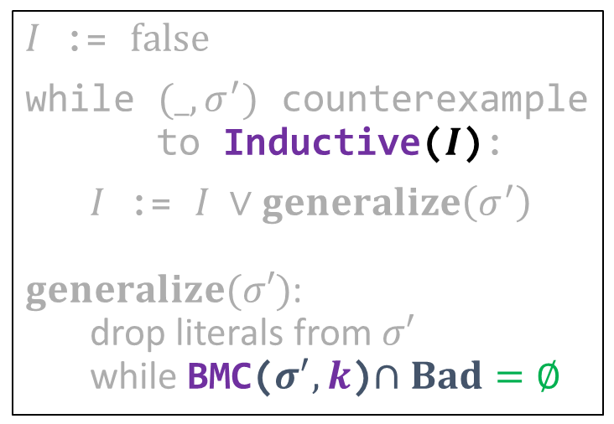

From Learning to Inference
Exact learning DNF formulas
$$⟹$$
Inferring DNF invariants
$ψ$ := $false$
while $σ′$ counterexample to Equivalence($ψ$):
$ψ$ := $ψ ∨generalize\left(σ^{′}\right)$ $generalize(σ′)$: drop literals from $σ′$ while Membership($σ^{′}$)= ✓
$I$ := $false$
while $(_, σ^{′})$ counterexample to Inductive($I$):
$I$ := $I ∨generalize\left(σ^{′}\right)$ $generalize(σ′)$: drop literals from $σ′$ while BMC($σ^{′},k$)$∩Bad=∅$
The invariant is $k$-fenced
[CACM’84] A Theory of the Learnable. Valiant [ML’87] Queries and Concept Learning. Angluin [ML’95] On the Learnability of Disjunctive Normal Form Formulas. Aizenstein and Pitt
[CAV’03] Interpolation and SAT-Based Model Checking, McMillan [HVC’12] Computing Interpolants without Proofs. Chockler, Ivrii, Matsliah [LPAR’13] Instantiations, Zippers and EPR Interpolation. Bjørner, Gurfinkel, Korovin, Lahav

Slide 23




The Boundary of Inductive Invariants
$$(1,1,1)$$
$$(0,0,0)$$
$$I^{∗}$$
$$¬I^{∗}$$

Slide 24
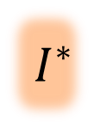
The Boundary of Inductive Invariants
$$(1,1,1)$$
$$(0,0,0)$$
$$I^{∗}$$
$$¬I^{∗}$$

Slide 25
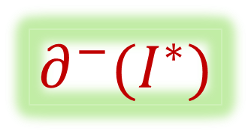
The Boundary of Inductive Invariants
$$(1,1,1)$$
$$(0,0,0)$$
$$I^{∗}$$
$$¬I^{∗}$$
$$∂^{−}(I^{∗})$$

Slide 26


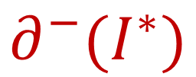
$k$-Fenced Invariants
$$(1,1,1)$$
$$(0,0,0)$$
$$I^{∗}$$
$$¬I^{∗}$$
All the states in
$$∂^{−}(I^{∗})$$
can get to a bad state in at most $k$ steps

Slide 27
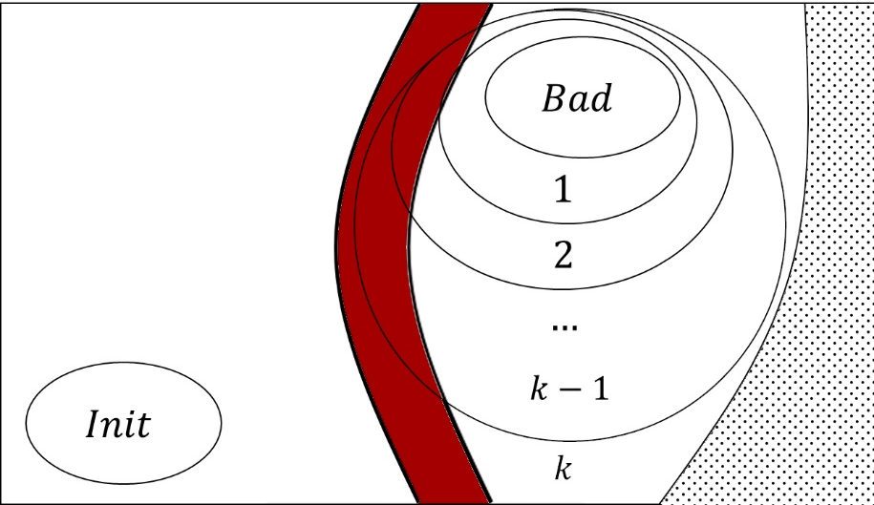



$k$-Fenced Invariants
$$I^{∗}$$
$$¬I^{∗}$$
Not all states in $¬I^{∗}$ need to reach bad
All the states in
$$∂^{−}(I^{∗})$$
can get to a bad state in at most $k$ steps

Slide 28
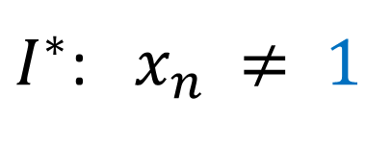

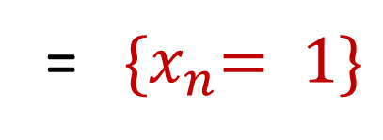
$k$-Fenced Invariants
Init:
$δ$:
$${(x}_{1},…,x_{n}) ≔0…0$$
$$y_{1},…,y_{n} ≔ ∗ \\ x_{1},…,x_{n} ≔\left(x_{1},…,x_{n}\right)+$$ $2⋅(y_{1},…,y_{n})$ (mod $2^{n}$)
$${(x}_{1},…,x_{n}) = 1…1$$
$I^{∗}$: $x_{n} ≠ 1$
All the states in
$$∂^{−}(I^{∗})$$
= ${\{x}_{n}= 1\}$
can get to a bad state in at most $k$ steps

Slide 29

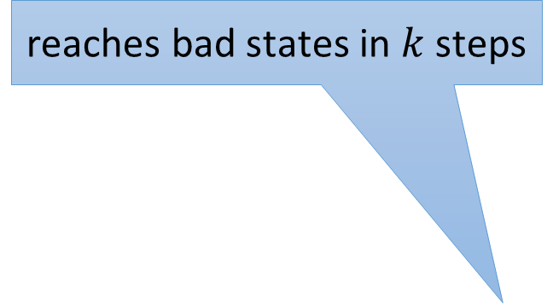

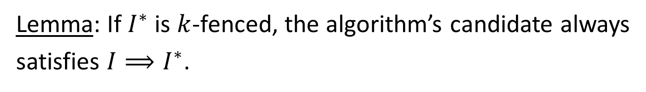
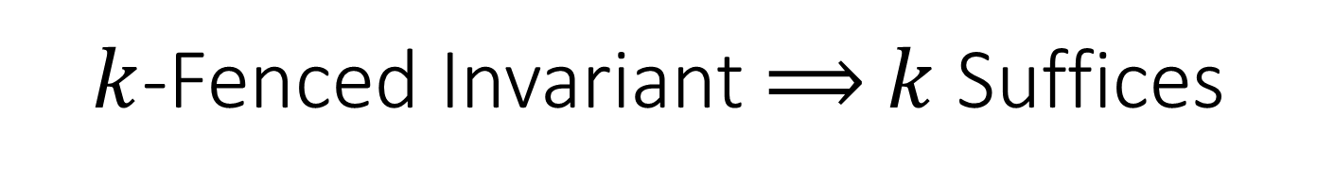
$k$-Fenced Invariant $⟹$ $k$ Suffices
Lemma: If $I^{∗}$ is $k$-fenced, the algorithm’s candidate always
satisfies $I⟹I^{∗}$.
Hence, $k$ is large enough to ensure convergence.
But how fast?
$$I^{∗}$$
$$¬I^{∗}$$
reaches bad states in $k$ steps
$$I$$
?

Slide 30
Key Results and Ideas
Interpolation-based inference finds an invariant in a polynomial number of SAT queries when
$$∃I^{∗}.$$
1. Fence condition: the Hamming boundary of $I^{∗}$ reaches bad states in $k$ steps
+
2. Syntactic form of $I^{∗}$ is short monotone or almost-monotone DNF, leveraging exact concept learning results

Slide 31






Exact Concept Learning with Equivalence & Membership Queries
learning algorithm
teacher
is it $ψ_{1}$?
✓ / ✘+counterexample
is it $ψ_{2}$?
✓ / ✘+counterexample
$$φ$$
does $σ_{3}⊨$?
✓ / ✘
…
Membership
Equivalence
[ML’87] Queries and Concept Learning. Angluin

Slide 32

Invariant Inference with Equivalence & Membership Queries
learning algorithm
teacher
is it $ψ_{1}$?
✓ / ✘+counterexample
is it $ψ_{2}$?
✓ / ✘+counterexample
$$I$$
does $σ_{3}⊨$?
Need to implement this
✓ / ✘
Need to implement this
…
In general, in invariant inference, no efficient way to implement a teacher for equivalence and membership queries
[CAV’14] ICE: A Robust Framework for Learning Invariants. Garg, Löding, Madhusudan, Neider
[POPL’20] Complexity and Information in Invariant Inference. Feldman, Immerman, Shoham, Sagiv

Slide 33

Invariant Inference with Equivalence & Membership Queries
learning algorithm
teacher
is it $ψ_{1}$?
This Work: can implement queries when the invariant is $k$-fenced and the algorithm’s queries are one-sided
✓ / ✘+counterexample
is it $ψ_{2}$?
✓ / ✘+counterexample
$$φ$$
does $σ_{3}⊨$?
✓ / ✘
…
In general, in invariant inference, no efficient way to implement a teacher for equivalence and membership queries

Slide 34
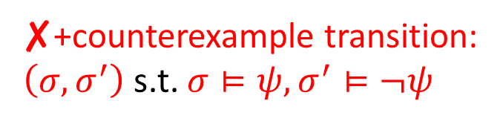
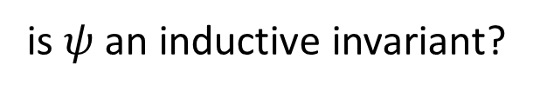


Equivalence Queries to Invariants
inference algorithm
teacher
is it $ψ$?
✓ / ✘+counterexample
$$φ$$
is $ψ$ an inductive invariant?
✓ yes hooray!
✘+counterexample transition: $\left(σ,σ^{′}\right)$ s.t. $σ⊨ψ, σ^{′}⊨¬ψ$
Always return the positive example

Slide 35

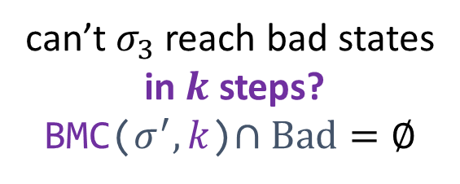

Membership Queries to Invariants
inference algorithm
teacher
is $σ_{3}⊨$?
✓ / ✘
can’t $σ_{3}$ reach bad states in $k$ steps? BMC($σ^{′},k$)$∩Bad=∅$
✓ then yes
Doesn’t always imply that $σ_{3}⊨I^{∗}$
✘ then no

Slide 36
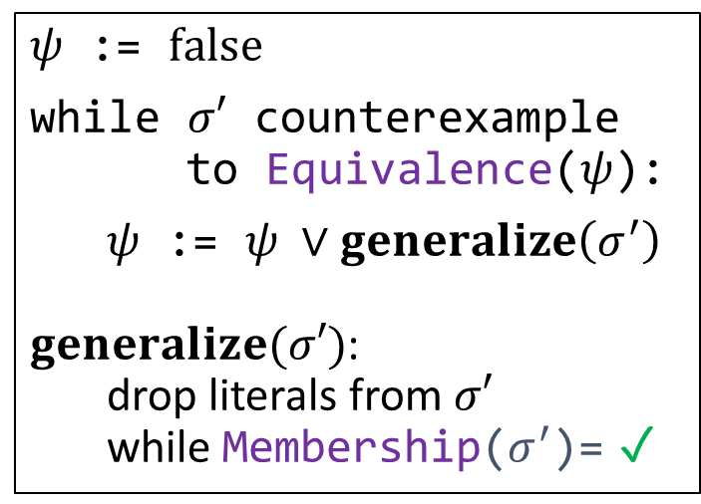
From Learning to Inference
Exact learning DNF formulas
$ψ$ := $false$
while $σ′$ counterexample to Equivalence($ψ$):
$ψ$ := $ψ ∨generalize\left(σ^{′}\right)$ $generalize(σ′)$: drop literals from $σ′$ while Membership($σ^{′}$)= ✓
[CACM’84] A Theory of the Learnable. Valiant [ML’87] Queries and Concept Learning. Angluin [ML’95] On the Learnability of Disjunctive Normal Form Formulas. Aizenstein and Pitt

Slide 37


From Learning to Inference
Exact learning DNF formulas
$$⟹$$
Inferring DNF invariants
$ψ$ := $false$
while $σ′$ counterexample to Equivalence($ψ$):
$ψ$ := $ψ ∨generalize\left(σ^{′}\right)$ $generalize(σ′)$: drop literals from $σ′$ while Membership($σ^{′}$)= ✓
$I$ := $false$
while $(_, σ^{′})$ counterexample to Inductive($I$):
$I$ := $I ∨generalize\left(σ^{′}\right)$ $generalize(σ′)$: drop literals from $σ′$ while BMC($σ^{′},k$)$∩Bad=∅$
[CACM’84] A Theory of the Learnable. Valiant [ML’87] Queries and Concept Learning. Angluin [ML’95] On the Learnability of Disjunctive Normal Form Formulas. Aizenstein and Pitt
[CAV’03] Interpolation and SAT-Based Model Checking, McMillan [HVC’12] Computing Interpolants without Proofs. Chockler, Ivrii, Matsliah [LPAR’13] Instantiations, Zippers and EPR Interpolation. Bjørner, Gurfinkel, Korovin, Lahav

Slide 38

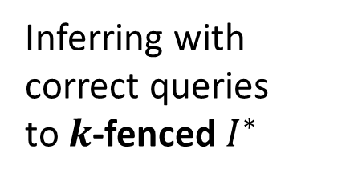
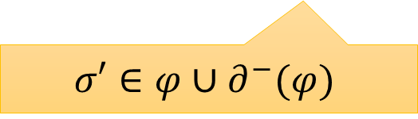
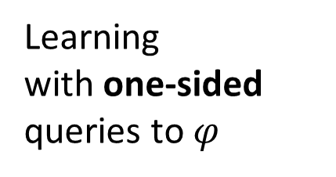
One-Sided Queries
Learning with one-sided queries to $φ$
Inferring with correct queries to $k$-fenced $I^{∗}$
$$⟹$$
$$ψ⟹φ$$
$I$ := $false$
while $(_, σ^{′})$ counterexample to Inductive($I$):
$I$ := $I ∨generalize\left(σ^{′}\right)$ $generalize(σ′)$: drop literals from $σ′$ while BMC($σ^{′},k$)$∩Bad=∅$
$ψ$ := $false$
while $σ′$ counterexample to Equivalence($ψ$):
$ψ$ := $ψ ∨generalize\left(σ^{′}\right)$ $generalize(σ′)$: drop literals from $σ′$ while Membership($σ^{′}$)= ✓
The invariant is $k$-fenced
$$σ′∈φ∪∂^{−}(φ)$$
[CACM’84] A Theory of the Learnable. Valiant [ML’87] Queries and Concept Learning. Angluin [ML’95] On the Learnability of Disjunctive Normal Form Formulas. Aizenstein and Pitt
[CAV’03] Interpolation and SAT-Based Model Checking, McMillan [HVC’12] Computing Interpolants without Proofs. Chockler, Ivrii, Matsliah [LPAR’13] Instantiations, Zippers and EPR Interpolation. Bjørner, Gurfinkel, Korovin, Lahav

Slide 39
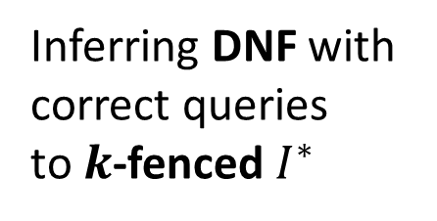
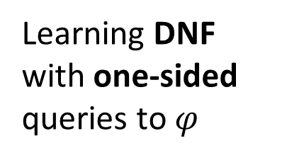
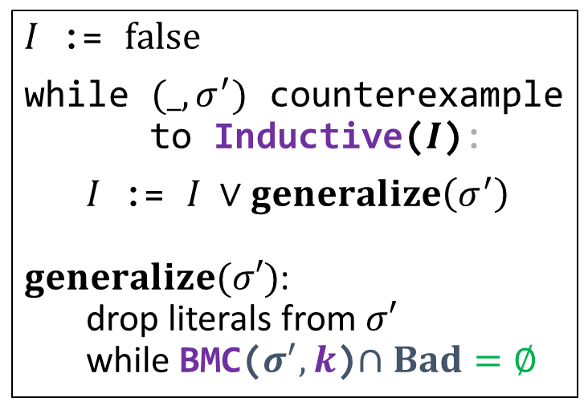
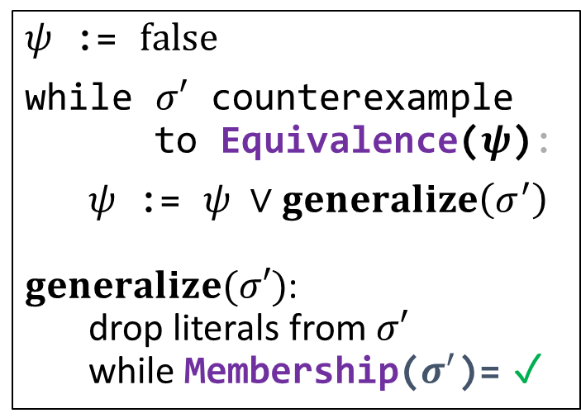
From Learning to Inference
Efficiently
Efficiently
Learning DNF with one-sided queries to $φ$
Inferring DNF with correct queries to $k$-fenced $I^{∗}$
$$⟹$$
$ψ$ := $false$
while $σ′$ counterexample to Equivalence($ψ$):
$ψ$ := $ψ ∨generalize\left(σ^{′}\right)$ $generalize(σ′)$: drop literals from $σ′$ while Membership($σ^{′}$)= ✓
$I$ := $false$
while $(_, σ^{′})$ counterexample to Inductive($I$):
$I$ := $I ∨generalize\left(σ^{′}\right)$ $generalize(σ′)$: drop literals from $σ′$ while BMC($σ^{′},k$)$∩Bad=∅$
[CACM’84] A Theory of the Learnable. Valiant [ML’87] Queries and Concept Learning. Angluin [ML’95] On the Learnability of Disjunctive Normal Form Formulas. Aizenstein and Pitt
[CAV’03] Interpolation and SAT-Based Model Checking, McMillan [HVC’12] Computing Interpolants without Proofs. Chockler, Ivrii, Matsliah [LPAR’13] Instantiations, Zippers and EPR Interpolation. Bjørner, Gurfinkel, Korovin, Lahav

Slide 40
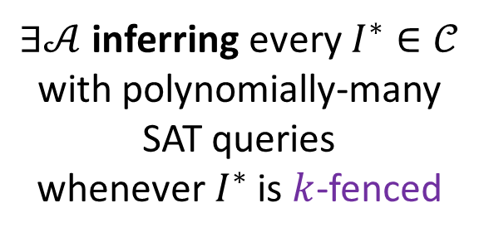
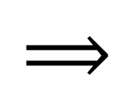
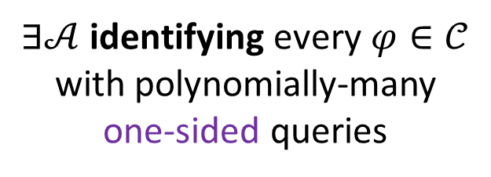
Efficient Inference
Thm: Let $𝒞$ be a class of formulas.
$∃𝒜$ inferring every $I^{∗}∈𝒞$ with polynomially-many SAT queries
whenever $I^{∗}$ is $k$-fenced
$∃𝒜$ identifying every $φ∈𝒞$ with polynomially-many one-sided queries
$$⟹$$

Slide 41
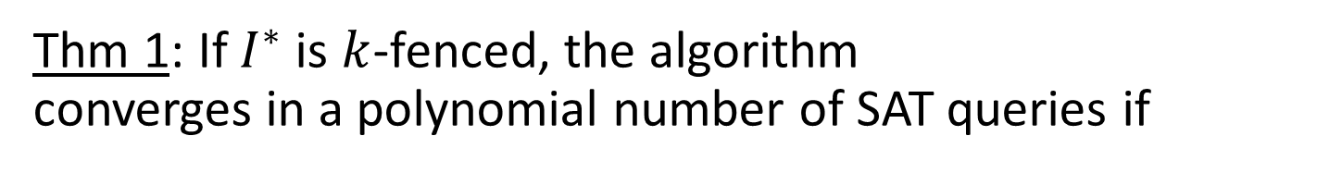
Efficient Inference
Thm 1: $𝒞=$ monotone DNF
$∃𝒜$ inferring every $I^{∗}∈𝒞$ with polynomially-many SAT queries
whenever $I^{∗}$ is $k$-fenced
$∃𝒜$ identifying every $φ∈𝒞$ with polynomially-many one-sided queries
$$⟹$$
Thm 1: If $I^{∗}$ is $k$-fenced, the algorithm converges in a polynomial number of SAT queries if
1. $I^{∗}$ has a short DNF representation
2. $I^{∗}$ is monotone – all variables appear un-negated.
[CACM’84] A Theory of the Learnable. Valiant [ML’87] Queries and Concept Learning. Angluin [ML’95] On the Learnability of Disjunctive Normal Form Formulas. Aizenstein and Pitt

Slide 42
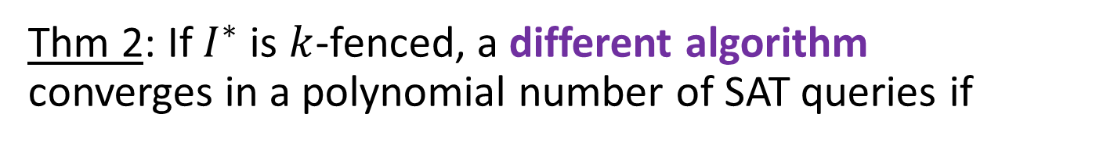
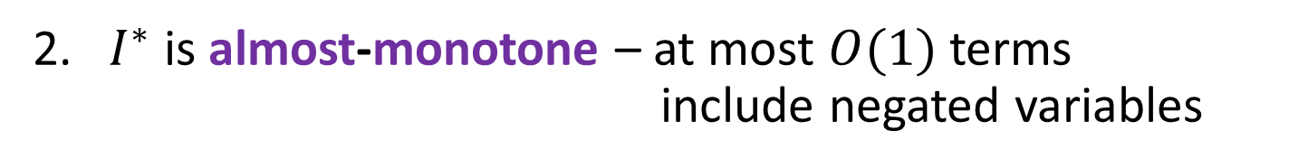
Efficient Inference
Thm 2: $𝒞=$ almost-monotone DNF
$∃𝒜$ inferring every $I^{∗}∈𝒞$ with polynomially-many SAT queries
whenever $I^{∗}$ is $k$-fenced
$∃𝒜$ identifying every $φ∈𝒞$ with polynomially-many one-sided queries
$$⟹$$
Thm 2: If $I^{∗}$ is $k$-fenced, a different algorithm converges in a polynomial number of SAT queries if
1. $I^{∗}$ has a short DNF representation
2. $I^{∗}$ is almost-monotone – at most $O(1)$ terms include negated variables
[Inf. Comput. ‘95] Exact Learning Boolean Function via the Monotone Theory. Bshouty

Slide 43
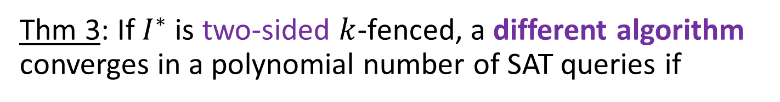

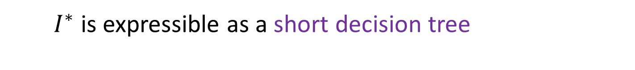
Inference from Unrestricted Queries
two-sided
Thm’: Let $𝒞$ be a class of formulas.
$∃𝒜$ inferring every $I^{∗}∈𝒞$ with polynomially-many SAT queries
whenever $I^{∗}$ is $k$-fenced
$∃𝒜$ identifying every $φ∈𝒞$ with polynomially-many one-sided queries
$$⟹$$
Thm 3: If $I^{∗}$ is two-sided $k$-fenced, a different algorithm converges in a polynomial number of SAT queries if
2. $I^{∗}$ is expressible as a short decision tree
[Inf. Comput. ‘95] Exact Learning Boolean Function via the Monotone Theory. Bshouty

Slide 44

Key Results and Ideas
Interpolation-based inference finds an invariant in a polynomial number of SAT queries when
$$∃I^{∗}.$$
1. Fence condition: the Hamming boundary of $I^{∗}$ reaches bad states in $k$ steps
+
2. Syntactic form of $I^{∗}$ is short monotone or almost-monotone DNF, leveraging exact concept learning results
Also: robustness – how do program transformations affect the fence condition?

Slide 45

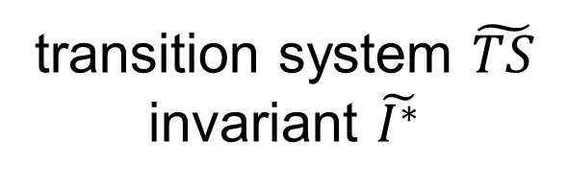

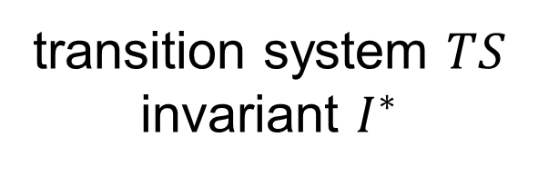
Robustness of Fenced Invariant
transition system $TS$ invariant $I^{∗}$
transition system $\tilde{TS}$ invariant $\tilde{I^{∗}}$
$I^{∗}$ is $k$-fenced
Is $\tilde{I^{∗}}$ $k$-fenced?
1. renaming $p_{i}↦p_{j}$; replacing $p$ with $¬p$
Robust ✓
2. $Init={Init}_{1}∨{Init}_{2}$; $Bad={Bad}_{1}∨{Bad}_{2}$
Robust ✓
3. instrumenting with $q≡ψ(p_{1},…,p_{n})$, same $I^{∗}$
Non robust ✘ (but new invariants may be fenced)
4. instrumenting with $q≡¬p_{i}$, new $\tilde{I^{∗}}=I^{∗}[q/¬p_{i}]$
Even the new invariant is not fenced ✘

Slide 46
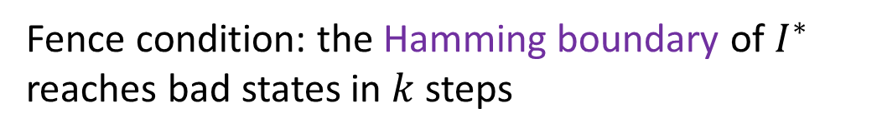



Conclusion
Interpolation-based inference finds an invariant in a polynomial number of SAT queries when
$$∃I^{∗}.$$
Fence condition: the Hamming boundary of $I^{∗}$ reaches bad states in $k$ steps
+
$I^{∗}$ is a short monotone DNF (via Angluin)
or
$I^{∗}$ is a short almost-monotone DNF (via Bshouty)
Also: the fence condition is robust under simple combinations, but not under adding new variables

