Slide 1



Property-Directed Reachability as Abstract Interpretation in the Monotone Theory
Yotam Feldman
Mooly Sagiv
Sharon Shoham
James R. Wilcox
@yotamfe
@SagivMooly
@wilcoxjay

Slide 2





Safety of Transition Systems
Init:
$δ$:
$${(x}_{n},…,x_{0}) ≔ 00…00$$
$$\left(x_{n},…,x_{0}\right)≔\left(x_{n},…,x_{0}\right)+00…10$$
Bad:
$${(x}_{n},…,x_{0}) = 10…01$$
$$Bad$$
$$Init$$

Slide 3









Inductive Invariants
Init:
$δ$:
Goal:
Find inductive invariants automatically
$${(x}_{n},…,x_{0}) ≔ 00…00$$
$$\left(x_{n},…,x_{0}\right)≔\left(x_{n},…,x_{0}\right)+00…10$$
Bad:
$${(x}_{n},…,x_{0}) = 10…01$$
$$Bad$$
$I$: ${(x}_{n},…,x_{0}) ≠ 10…01$
Not inductive:
$$01…1$$
$$10…01$$
$$δ$$
$$I$$
$$¬I$$
$I$: $x_{0}=0$
Inductive:
$$Init$$
$$x_{0}=0$$
$$I$$
$$δ$$

Slide 4

Invariant Inference with IC3/PDR
[VMCAI’11] SAT-Based Model Checking Without Unrolling. Bradley [FMCAD’11] Efficient Implementation of Property Directed Reachability. Ean, Mishchenko, Brayton

Slide 5
Invariant Inference with IC3/PDR
[VMCAI’11] SAT-Based Model Checking Without Unrolling. Bradley [FMCAD’11] Efficient Implementation of Property Directed Reachability. Ean, Mishchenko, Brayton

Slide 6
Invariant Inference with IC3/PDR
[VMCAI’11] SAT-Based Model Checking Without Unrolling. Bradley [FMCAD’11] Efficient Implementation of Property Directed Reachability. Ean, Mishchenko, Brayton

Slide 7
Invariant Inference with IC3/PDR
[VMCAI’11] SAT-Based Model Checking Without Unrolling. Bradley [FMCAD’11] Efficient Implementation of Property Directed Reachability. Ean, Mishchenko, Brayton

Slide 8
Invariant Inference with IC3/PDR
[VMCAI’11] SAT-Based Model Checking Without Unrolling. Bradley [FMCAD’11] Efficient Implementation of Property Directed Reachability. Ean, Mishchenko, Brayton

Slide 9


IC3/PDR
makeameme.org

Slide 10
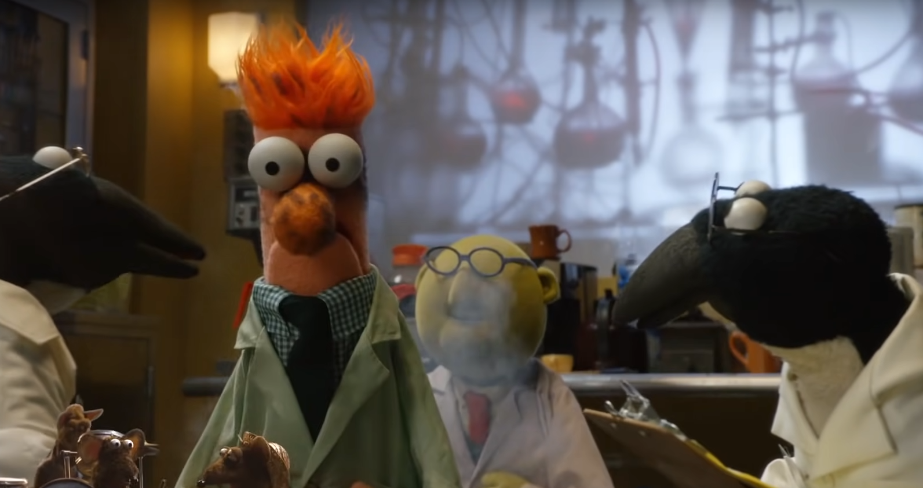
IC3/PDR
makeameme.org

Slide 11
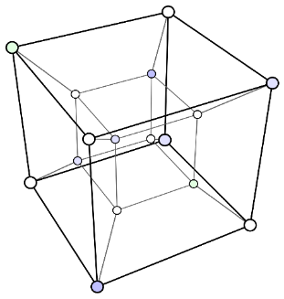



This Work
PDR is (roughly) an abstract interpretation based on Bshouty’s monotone theory from exact learning
$$γ$$
$$≈$$
+
PDR
$$α$$
Abstract Interpretation
Monotone Theory
Principle of how PDR achieves overapproximation

Slide 12




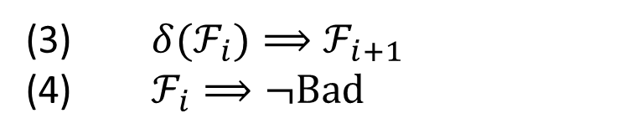


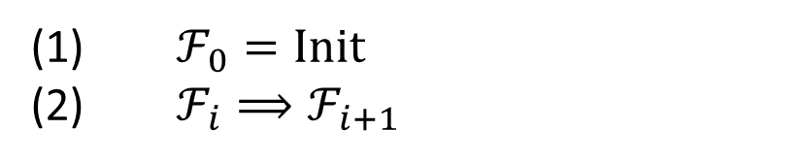



PDR’s Frames
A sequence of formulas $ℱ_{0},ℱ_{1},ℱ_{2},…$
$ℱ_{0}=Init$
$ℱ_{i}⟹ℱ_{i+1}$
(3) $δ(ℱ_{i})⟹ℱ_{i+1}$
(4) $ℱ_{i}⟹¬Bad$
inductive invariant
$$ℱ_{3}$$
$${≡ℱ}_{4}$$
$$ℱ_{2}$$
$$ℱ_{1}$$
$$ℱ_{0}$$
$$Bad$$
$$δ(ℱ_{2})$$
$$Init$$

Slide 13


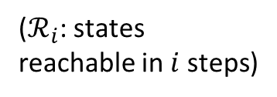


PDR’s Frames
A sequence of formulas $ℱ_{0},ℱ_{1},ℱ_{2},…$
$ℱ_{0}=Init$
$ℱ_{i}⟹ℱ_{i+1}$
$$ℛ_{i}⊆ℱ_{i}$$
(3) $δ(ℱ_{i})⟹ℱ_{i+1}$
(4) $ℱ_{i}⟹¬Bad$
($ℛ_{i}$: states reachable in $i$ steps)
$$ℱ_{3}$$
$$ℱ_{2}$$
$$ℱ_{1}$$
$$ℱ_{0}$$
$$Init$$
$$ℛ_{1}$$
$$ℛ_{2}$$
$$ℛ_{3}$$

Slide 14





PDR’s Frames
A sequence of formulas $ℱ_{0},ℱ_{1},ℱ_{2},…$
$ℱ_{0}=Init$
$ℱ_{i}⟹ℱ_{i+1}$
$$ℛ_{i}⊆ℱ_{i}$$
$$ℛ_{i}≪ℱ_{i}$$
(3) $δ(ℱ_{i})⟹ℱ_{i+1}$
(4) $ℱ_{i}⟹¬Bad$
($ℛ_{i}$: states reachable in $i$ steps)
$$ℱ_{3}$$
$$ℱ_{2}$$
$$ℱ_{1}$$
$$……$$
$$ℱ_{0}$$
$$Init$$
$$ℛ_{1}$$
$$ℛ_{2}$$
$$ℛ_{3}$$

Slide 15



PDR’s Frames
A sequence of formulas $ℱ_{0},ℱ_{1},ℱ_{2},…$
Init:
$δ$:
$ℱ_{0}=Init$
$ℱ_{i}⟹ℱ_{i+1}$
$${(x}_{n},…,x_{0}) ≔ 00…00$$
$$\left(x_{n},…,x_{0}\right)≔\left(x_{n},…,x_{0}\right)+00…10$$
$$ℛ_{i}⊆ℱ_{i}$$
$$ℛ_{i}≪ℱ_{i}$$
Bad:
(3) $δ(ℱ_{i})⟹ℱ_{i+1}$
(4) $ℱ_{i}⟹¬Bad$
$${(x}_{n},…,x_{0}) = 10…01$$
($ℛ_{i}$: states reachable in $i$ steps)
$$ℛ_{i} : \left(x_{n},…,x_{0}\right)≤2i ∧ x_{0}=0$$
$$ℱ_{3}$$
$$ℱ_{2}$$
$$ℱ_{1}$$
$$……$$
$$ℱ_{0}$$
$$Init$$
$$ℛ_{1}$$
$$ℛ_{2}$$
$$ℛ_{3}$$

Slide 16

PDR’s Frames
A sequence of formulas $ℱ_{0},ℱ_{1},ℱ_{2},…$
$ℱ_{0}=Init$
$ℱ_{i}⟹ℱ_{i+1}$
$$ℛ_{i}⊆ℱ_{i}$$
$$ℛ_{i}≪ℱ_{i}$$
(3) $δ(ℱ_{i})⟹ℱ_{i+1}$
(4) $ℱ_{i}⟹¬Bad$
($ℛ_{i}$: states reachable in $i$ steps)
$$ℱ_{3}$$
$$ℱ_{2}$$
$$ℱ_{1}$$
$$↑↓$$
$$ℱ_{0}$$
$$Init$$
$$ℛ_{1}$$
$$ℛ_{2}$$
$$ℛ_{3}$$

Slide 17
PDR’s Frames
A sequence of formulas $ℱ_{0},ℱ_{1},ℱ_{2},…$
How is overapproximation guaranteed?
$ℱ_{0}=Init$
$ℱ_{i}⟹ℱ_{i+1}$
$$ℛ_{i}⊆ℱ_{i}$$
$$ℛ_{i}≪ℱ_{i}$$
(3) $δ(ℱ_{i})⟹ℱ_{i+1}$
(4) $ℱ_{i}⟹¬Bad$
($ℛ_{i}$: states reachable in $i$ steps)
$$ℱ_{3}$$
$$ℱ_{2}$$
$$ℱ_{1}$$
$$↑↓$$
$$ℱ_{0}$$
$$Init$$
$$ℛ_{1}$$
$$ℛ_{2}$$
$$ℛ_{3}$$

Slide 18

PDR’s Frames
A sequence of formulas $ℱ_{0},ℱ_{1},ℱ_{2},…$
How is overapproximation guaranteed?
$ℱ_{0}=Init$
$ℱ_{i}⟹ℱ_{i+1}$
$$ℛ_{i}⊆ℱ_{i}$$
$$ℛ_{i}≪ℱ_{i}$$
(3) $δ(ℱ_{i})⟹ℱ_{i+1}$
(4) $ℱ_{i}⟹¬Bad$
($ℛ_{i}$: states reachable in $i$ steps)
$$ℱ_{3}$$
$$ℱ_{2}$$
$$ℱ_{1}$$
$$↑↓$$
$$ℱ_{0}$$
$$Init$$
$$ℛ_{1}$$
$$ℛ_{2}$$
$$ℛ_{3}$$

Slide 19
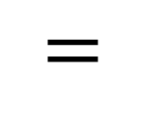
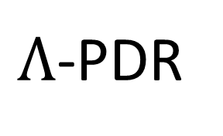


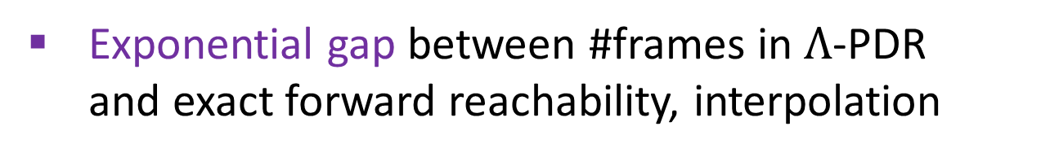

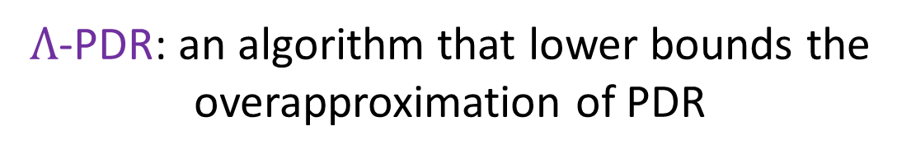
Key Ideas and Results
​$Λ$-PDR: an algorithm that lower bounds the overapproximation of PDR
$$γ$$
+
$Λ$-PDR
$$=$$
$$α$$
Abstract Interpretation
Monotone Theory
Exponential gap between #frames in $Λ$-PDR and exact forward reachability, interpolation
Convergence bounds on #frames in $Λ$-PDR from the DNF size of the transition relation

Slide 20







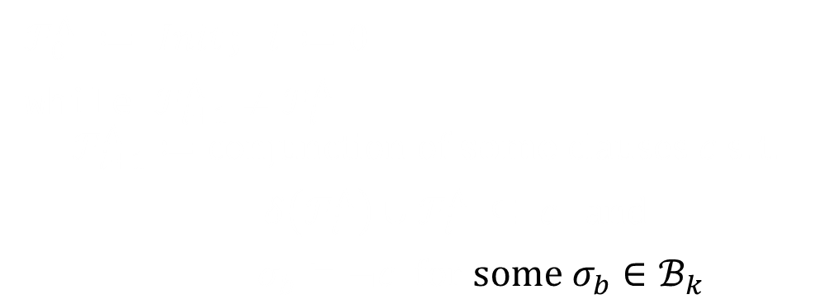

PDR’s Frames
$ℱ_{0}^{Λ}$ $≔$ $Init$; $i ≔0$
while $ℱ_{i+1}^{Λ}≠ℱ_{i}^{Λ}:$
$$ℱ_{i+1}^{Λ}≔conjunction of some clauses c s.t.$$
$δ\left(ℱ_{i}^{Λ}\right)∪ℱ_{i}^{Λ} ⊆ c and$
$σ_{b}⊨¬c for some σ_{b}∈ℬ_{k}$
$$ℱ_{3}^{}$$
$$ℬ_{k}$$
$$ℱ_{2}^{}$$
$$ℱ_{1}^{}$$
$$Bad$$
$$σ_{b}$$
$$Init$$
($ℬ_{k}$: states reaching Bad in $k$ steps)

Slide 21

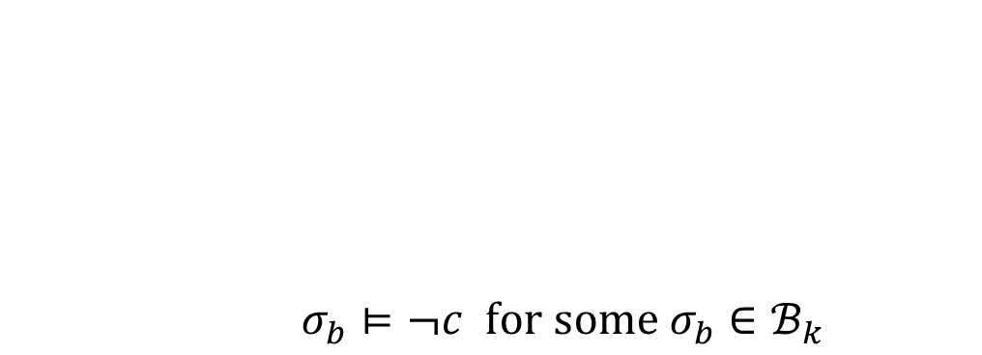
PDR’s Frames
$ℱ_{0}^{Λ}$ $≔$ $Init$; $i ≔0$
while $ℱ_{i+1}^{Λ}≠ℱ_{i}^{Λ}:$
$$ℱ_{i+1}^{Λ}≔conjunction of some clauses c s.t.$$
$δ\left(ℱ_{i}^{Λ}\right)∪ℱ_{i}^{Λ} ⊆ c and$
$σ_{b}⊨¬c for some σ_{b}∈ℬ_{k}$
$$ℱ_{3}^{}$$
$$¬c$$
$$ℬ_{k}$$
$$ℱ_{2}^{}$$
$$ℱ_{1}^{}$$
$$Bad$$
$$σ_{b}$$
$$Init$$
($ℬ_{k}$: states reaching Bad in $k$ steps)

Slide 22
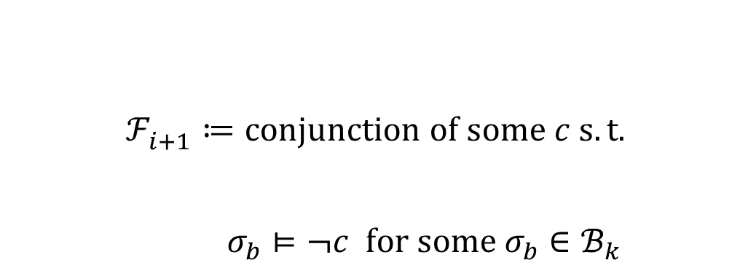
PDR’s Frames
$ℱ_{0}^{Λ}$ $≔$ $Init$; $i ≔0$
while $ℱ_{i+1}^{Λ}≠ℱ_{i}^{Λ}:$
$$ℱ_{i+1}^{Λ}≔conjunction of some c s.t.$$
$δ\left(ℱ_{i}^{Λ}\right)∪ℱ_{i}^{Λ} ⊆ c and$
$σ_{b}⊨¬c for some σ_{b}∈ℬ_{k}$
$$ℱ_{3}^{}$$
$$¬c$$
$$ℬ_{k}$$
$$ℱ_{2}^{}$$
$$ℱ_{1}^{}$$
$$Bad$$
$$σ_{b}$$
$$Init$$
($ℬ_{k}$: states reaching Bad in $k$ steps)

Slide 23


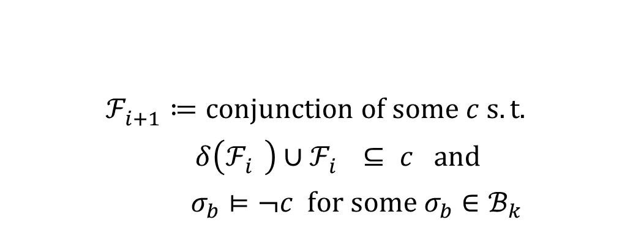
PDR’s Frames
$ℱ_{0}^{Λ}$ $≔$ $Init$; $i ≔0$
while $ℱ_{i+1}^{Λ}≠ℱ_{i}^{Λ}:$
$$ℱ_{i+1}^{Λ}≔conjunction of some c s.t.$$
$δ\left(ℱ_{i}^{Λ}\right)∪ℱ_{i}^{Λ} ⊆ c and$
$σ_{b}⊨¬c for some σ_{b}∈ℬ_{k}$
$$ℱ_{3}^{}$$
$$¬c$$
$$ℬ_{k}$$
$$ℱ_{2}^{}$$
$$δ(ℱ_{2})$$
$$ℱ_{1}^{}$$
$$Bad$$
$$σ_{b}$$
$$Init$$
($ℬ_{k}$: states reaching Bad in $k$ steps)

Slide 24
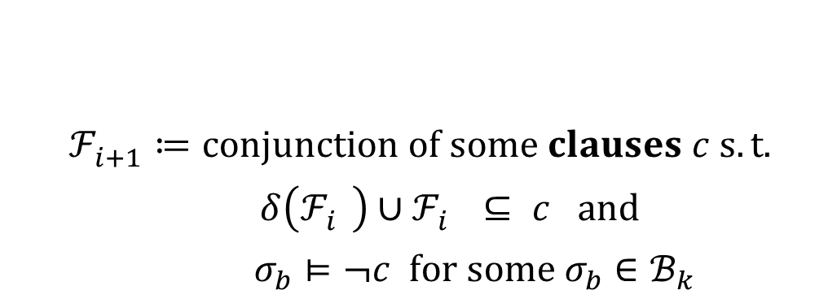
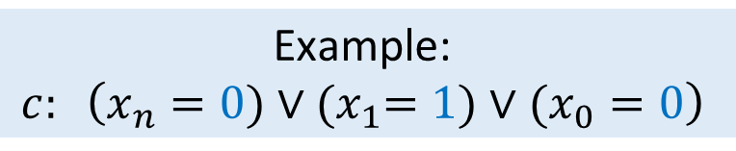
PDR’s Frames
$ℱ_{0}^{Λ}$ $≔$ $Init$; $i ≔0$
while $ℱ_{i+1}^{Λ}≠ℱ_{i}^{Λ}:$
$$ℱ_{i+1}^{Λ}≔conjunction of some clauses c s.t.$$
$δ\left(ℱ_{i}^{Λ}\right)∪ℱ_{i}^{Λ} ⊆ c and$
$σ_{b}⊨¬c for some σ_{b}∈ℬ_{k}$
Example: $$c: \left(x_{n}=0)∨{(x}_{1}=1)∨(x_{0}=0\right)$$
$$ℱ_{3}^{}$$
$$¬c$$
$$ℬ_{k}$$
$$ℱ_{2}^{}$$
$$δ(ℱ_{2})$$
$$ℱ_{1}^{}$$
$$Bad$$
$$σ_{b}$$
$$Init$$
($ℬ_{k}$: states reaching Bad in $k$ steps)

Slide 25
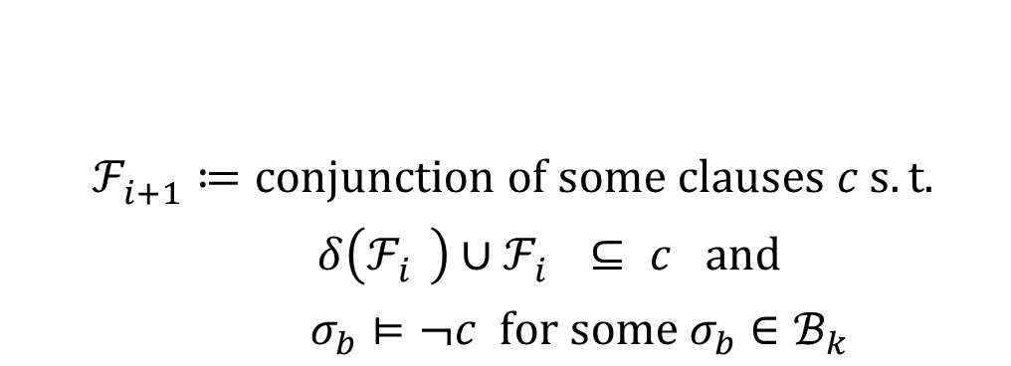
PDR’s Frames
$ℱ_{0}^{Λ}$ $≔$ $Init$; $i ≔0$
while $ℱ_{i+1}^{Λ}≠ℱ_{i}^{Λ}:$
$$ℱ_{i+1}^{Λ}≔conjunction of some clauses c s.t.$$
$δ\left(ℱ_{i}^{Λ}\right)∪ℱ_{i}^{Λ} ⊆ c and$
$σ_{b}⊨¬c for some σ_{b}∈ℬ_{k}$
$$ℱ_{3}^{}$$
$$¬c$$
$$ℬ_{k}$$
$$ℱ_{2}^{}$$
$$δ(ℱ_{2})$$
$$ℱ_{1}^{}$$
$$Bad$$
$$σ_{b}$$
$$Init$$
($ℬ_{k}$: states reaching Bad in $k$ steps)

Slide 26

PDR’s Frames
$ℱ_{0}^{Λ}$ $≔$ $Init$; $i ≔0$
while $ℱ_{i+1}^{Λ}≠ℱ_{i}^{Λ}:$
$$ℱ_{i+1}^{Λ}≔conjunction of some clauses c s.t.$$
$δ\left(ℱ_{i}^{Λ}\right)∪ℱ_{i}^{Λ} ⊆ c and$
$σ_{b}⊨¬c for some σ_{b}∈ℬ_{k}$
$$ℱ_{3}^{}$$
$$¬c$$
$$ℬ_{k}$$
$$ℱ_{2}^{}$$
$$δ(ℱ_{2})$$
$$ℱ_{1}^{}$$
$$Bad$$
$$σ_{b}$$
$$Init$$
($ℬ_{k}$: states reaching Bad in $k$ steps)

Slide 27



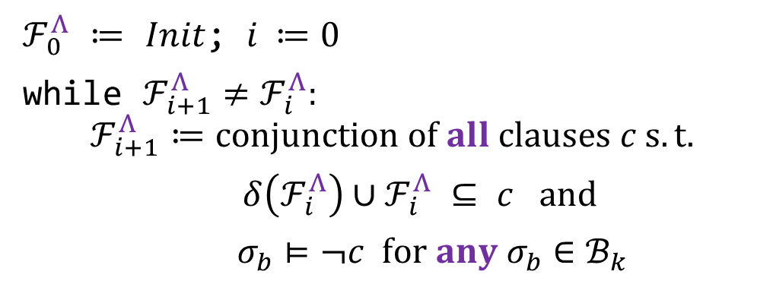


$Λ$-PDR’s Frames
$ℱ_{0}^{Λ}$ $≔$ $Init$; $i ≔0$
while $ℱ_{i+1}^{Λ}≠ℱ_{i}^{Λ}:$
$$ℱ_{i+1}^{Λ}≔conjunction of all clauses c s.t.$$
$δ\left(ℱ_{i}^{Λ}\right)∪ℱ_{i}^{Λ} ⊆ c and$
$σ_{b}⊨¬c for any σ_{b}∈ℬ_{k}$
$$¬c$$
$$ℬ_{k}$$
$$ℱ_{3}^{Λ}$$
$$ℱ_{2}^{Λ}$$
$$Bad$$
$$ℱ_{1}^{Λ}$$
$$δ(ℱ_{2}^{Λ})$$
$$σ_{b}$$
$$Init$$
($ℬ_{k}$: states reaching Bad in $k$ steps)

Slide 28

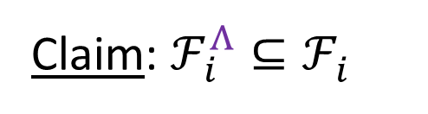


$Λ$-PDR’s Frames
$ℱ_{0}^{Λ}$ $≔$ $Init$; $i ≔0$
while $ℱ_{i+1}^{Λ}≠ℱ_{i}^{Λ}:$
$$ℱ_{i+1}^{Λ}≔conjunction of all clauses c s.t.$$
$δ\left(ℱ_{i}^{Λ}\right)∪ℱ_{i}^{Λ} ⊆ c and$
$σ_{b}⊨¬c for any σ_{b}∈ℬ_{k}$
Claim: $ℱ_{i}^{Λ}⊆ℱ_{i}^{}$
$$ℱ_{3}^{}$$
$$¬c$$
$$ℬ_{k}$$
$$ℱ_{2}^{}$$
$$ℱ_{3}^{Λ}$$
$$ℱ_{1}^{}$$
$$ℱ_{2}^{Λ}$$
$$Bad$$
$$ℱ_{1}^{Λ}$$
$$σ_{b}$$
$$Init$$
$$ℛ_{1}$$
$$ℛ_{2}$$
$$ℛ_{3}$$
($ℬ_{k}$: states reaching Bad in $k$ steps)

Slide 29










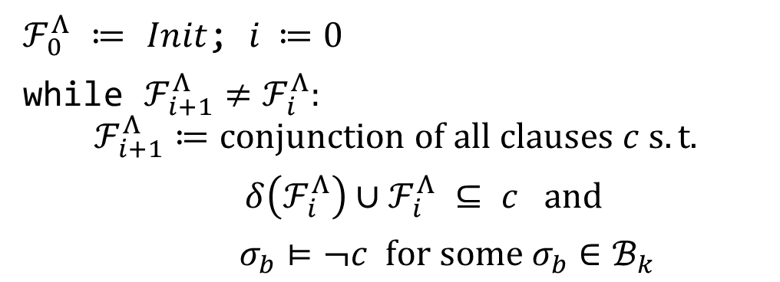






$Λ$-PDR is Eager PDR
$ℱ_{0}^{Λ}$ $≔$ $Init$; $i ≔0$
while $ℱ_{i+1}^{Λ}≠ℱ_{i}^{Λ}:$
$$ℱ_{i+1}^{Λ}≔conjunction of all clauses c s.t.$$
$δ\left(ℱ_{i}^{Λ}\right)∪ℱ_{i}^{Λ} ⊆ c and$
$σ_{b}⊨¬c for some σ_{b}∈ℬ_{k}$
$$ℱ_{3}^{Λ}$$
$$ℱ_{3}^{pdr}$$
$$ℱ_{2}^{Λ}$$
$$ℱ_{2}^{pdr}$$
$$ℱ_{1}^{Λ}$$
$$ℱ_{1}^{pdr}$$
$$ℱ_{0}^{Λ}$$
$$ℱ_{0}^{pdr}$$
$$δ$$
$$δ$$
$$Init$$
$$σ_{b}$$
$$Init$$
$$σ_{b}^{2}$$
$$σ_{b}^{1}$$
$$σ_{b}$$

Slide 30






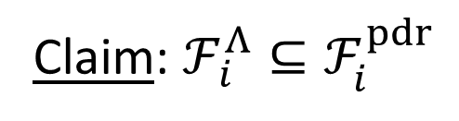






$Λ$-PDR’s Frames Are More Precise
$ℱ_{0}^{Λ}$ $≔$ $Init$; $i ≔0$
while $ℱ_{i+1}^{Λ}≠ℱ_{i}^{Λ}:$
$$ℱ_{i+1}^{Λ}≔conjunction of all clauses c s.t.$$
$δ\left(ℱ_{i}^{Λ}\right)∪ℱ_{i}^{Λ} ⊆ c and$
$σ_{b}⊨¬c for some σ_{b}∈ℬ_{k}$
Claim: $ℱ_{i}^{Λ}⊆ℱ_{i}^{pdr}$
$$ℱ_{3}$$
$$ℱ_{2}$$
$$ℱ_{1}$$
$$ℱ_{3}^{Λ}$$
$$ℱ_{0}$$
$$ℱ_{2}^{Λ}$$
$$Init$$
$$ℱ_{1}^{Λ}$$
$$ℛ_{1}$$
$$ℛ_{2}$$
$$ℛ_{3}$$

Slide 31
Key Ideas and Results
​$Λ$-PDR: an algorithm that lower bounds the overapproximation of PDR
$$γ$$
+
$Λ$-PDR
$$=$$
$$α$$
Abstract Interpretation
Monotone Theory
Exponential gap between #frames in $Λ$-PDR and exact forward reachability, interpolation
Convergence bounds on #frames in $Λ$-PDR from the DNF size of the transition relation

Slide 32




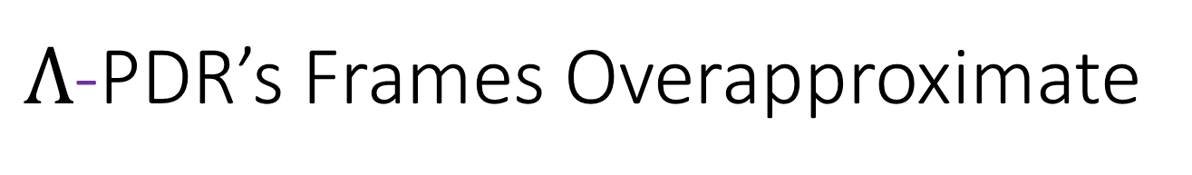
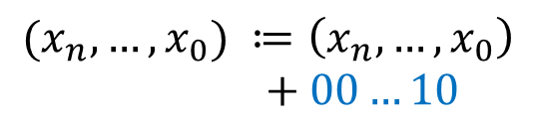












$Λ$-PDR’s Frames Overapproximate
$$ℱ_{1}^{Λ} : x_{n}=0∧ x_{0}=0$$
$$(k=0, ℬ_{k}=Bad)$$
$$ℱ_{3}^{Λ}≡$$
$$ℱ_{2}^{Λ} : x_{0}=0$$
Also from (dual) model-based interpolation
Thm:
exponential gap $↑↓$
$$ℛ_{i} : \left(x_{n},…,x_{0}\right)≤2i ∧ x_{0}=0$$
$$ℱ_{3}^{Λ}$$
Init:
$$ℱ_{2}^{Λ}$$
$${(x}_{n},…,x_{0}) ≔ 00…00$$
$$ℱ_{1}^{Λ}$$
Bad:
$$ℱ_{0}^{Λ}$$
$${(x}_{n},…,x_{0}) = 10…01$$
$$Init$$
$δ$:
$$ℛ_{2}$$
$$(x_{n},…,x_{0}) ≔\left(x_{n},…,x_{0}\right) \\ + 00…10$$
$$ℛ_{1}$$
$$ℛ_{3}$$

Slide 33
Key Ideas and Results
​$Λ$-PDR: an algorithm that lower bounds the overapproximation of PDR
$$γ$$
+
$Λ$-PDR
$$=$$
$$α$$
Abstract Interpretation
Monotone Theory
Exponential gap between #frames in $Λ$-PDR and exact forward reachability, interpolation
Convergence bounds on #frames in $Λ$-PDR from the DNF size of the transition relation

Slide 34




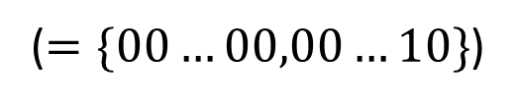
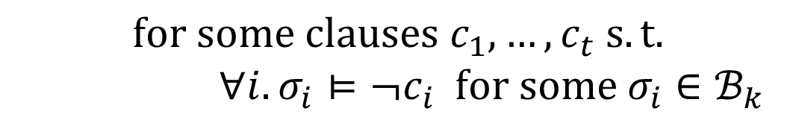

Monotone Span
Def:
$$ψ≡c_{1}∧…∧c_{t},$$
$$ψ∈MSpan\left(ℬ_{k}\right)⟺$$
$$for some clauses c_{1},…,c_{t} s.t.$$
$∀i. σ_{i}⊨¬c_{i} for some σ_{i}∈ℬ_{k}$
$$𝓑_{k}: \{10…01\}$$
$$≡\left(x_{n}=0\right)∧(x_{0}=0)$$
$$∈MSpan(ℬ_{k})$$
($=\{00…00,00…10\}$)
$$≡\left(x_{n}=0\right)∧\left(x_{n−1}=0\right)∧…∧\left(x_{2}=0\right)∧(x_{0}=0)$$
$$∉MSpan(ℬ_{k})$$

Slide 35







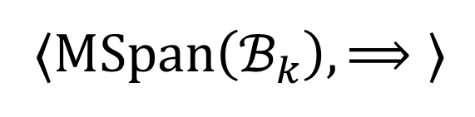

As an Abstract Domain
$$γ$$
$$\text{⟨}C, ⊆\text{⟩}$$
⟨$MSpan\left(ℬ_{k}\right), ⟹\text{⟩}$
$$true$$
$$\{00…00\}$$
$${: x}_{n}=0 \\ ∧ … \\ ∧x_{0}=0$$
$$ψ$$
$$γ$$
$$false$$

Slide 36





As an Abstract Domain
$$γ$$
$$\text{⟨}C, ⊆\text{⟩}$$
⟨$MSpan\left(ℬ_{k}\right), ⟹\text{⟩}$
$$α$$
$$true$$
$$\{00…00, 00…10\}$$
$$α$$
$$φ$$
$${: x}_{n}=0∧x_{0}=0$$
$$false$$

Slide 37

Best Abstract Transformer
$$γ$$
$$\text{⟨}C, ⊆\text{⟩}$$
⟨$MSpan\left(ℬ_{k}\right), ⟹\text{⟩}$
$$α$$
$$true$$
$$δ(γ\left(ψ\right))$$
$$ψ$$
$$γ$$
$$false$$

Slide 38


Best Abstract Transformer
$$γ$$
$$\text{⟨}C, ⊆\text{⟩}$$
⟨$MSpan\left(ℬ_{k}\right), ⟹\text{⟩}$
$$α$$
$$true$$
$$γ\left(ψ\right)∪$$
$$δ(γ\left(ψ\right))$$
$$α$$
$$φ$$
$$ψ$$
$$γ$$
$$false$$

Slide 39



Best Abstract Transformer
$$γ$$
$$\text{⟨}C, ⊆\text{⟩}$$
⟨$MSpan\left(ℬ_{k}\right), ⟹\text{⟩}$
$$α$$
$$true$$
$$γ$$
$$γ\left(ψ\right)∪$$
$$δ(γ\left(ψ\right))$$
$$α$$
$${: x}_{n}=0∧x_{0}=0$$
$$φ$$
$$\{00…00, 00…10\}$$
$$ψ$$
$$γ$$
$$false$$

Slide 40




Best Abstract Transformer
$$γ$$
$$\text{⟨}C, ⊆\text{⟩}$$
⟨$MSpan\left(ℬ_{k}\right), ⟹\text{⟩}$
$$α$$
$$true$$
$$γ\left(α\left(δ\left(ψ\right)∪ψ\right)\right):$$
$$γ$$
$$𝓕_{1}^{Λ}$$
$$ℱ_{0}^{Λ}∪{δ(𝓕}_{0}^{Λ})$$
$$α$$
$$\{00…00, 00…10\}$$
$$ψ$$
$$γ$$
$$false$$

Slide 41

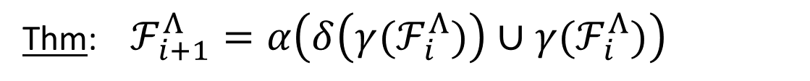






Best Abstract Transformer
$$γ$$
$$\text{⟨}C, ⊆\text{⟩}$$
⟨$MSpan\left(ℬ_{k}\right), ⟹\text{⟩}$
$$α$$
Thm: $ℱ_{i+1}^{Λ}=α\left(δ\left(γ(ℱ_{i}^{Λ})\right)∪{γ(ℱ}_{i}^{Λ})\right)$
$$true$$
$$ℱ_{i+1}^{Λ}$$
$$ℱ_{i}^{Λ}$$
$$γ$$
$$δ(ℱ_{i}^{Λ})$$
$$α$$
$$ℱ_{i+1}^{Λ}$$
$${: x}_{n}=0∧x_{0}=0$$
$$\{00…00, 00…10\}$$
$Λ$-PDR
$$ℱ_{i}^{Λ}$$
$$γ$$
$$false$$

Slide 42




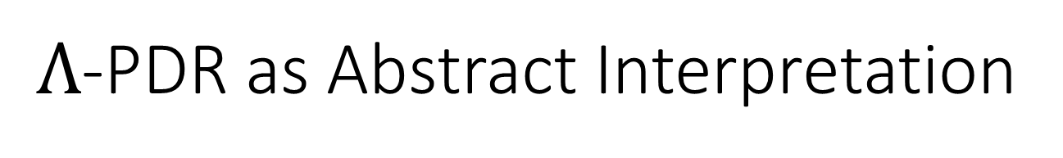

$Λ$-PDR as Abstract Interpretation
$$γ$$
$$\text{⟨}C, ⊆\text{⟩}$$
⟨$MSpan\left(ℬ_{k}\right), ⟹\text{⟩}$
$$α$$
Thm: $ℱ_{i+1}^{Λ}=α\left(δ\left(γ(ℱ_{i}^{Λ})\right)∪{γ(ℱ}_{i}^{Λ})\right)$
Corollary:
Frames in $Λ$-PDR are Kleene iterations
$$true$$
$$ℱ_{i+1}^{Λ}$$
$$ℱ_{i+3}^{Λ}$$
$$ℱ_{i}^{Λ}$$
$$γ$$
$Λ$-PDR
$Λ$-PDR
$$ℱ_{i+2}^{Λ}$$
$$δ(ℱ_{i}^{Λ})$$
$$α$$
$$ℱ_{i+1}^{Λ}$$
$Λ$-PDR
$$ℱ_{i}^{Λ}$$
$$γ$$
$$false$$

Slide 43
Abstraction
$$γ$$
$$\text{⟨}C, ⊆\text{⟩}$$
⟨$MSpan\left(ℬ_{k}\right), ⟹\text{⟩}$
$$α$$
Thm: $ℱ_{i+1}^{Λ}=α\left(δ\left(γ(ℱ_{i}^{Λ})\right)∪{γ(ℱ}_{i}^{Λ})\right)$
$$true$$
$$ℱ_{i+1}^{Λ}$$
$$ℱ_{i+3}^{Λ}$$
$$ℱ_{i}^{Λ}$$
$$γ$$
$Λ$-PDR
$Λ$-PDR
$$ℱ_{i+2}^{Λ}$$
$$δ(ℱ_{i}^{Λ})$$
$$α$$
$$ℱ_{i+1}^{Λ}$$
$Λ$-PDR
$$ℱ_{i}^{Λ}$$
$$γ$$
$$false$$

Slide 44

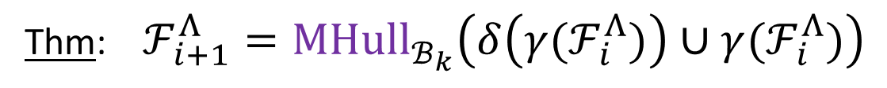
Abstraction & Monotone Theory
$$γ$$
$$\text{⟨}C, ⊆\text{⟩}$$
⟨$MSpan\left(ℬ_{k}\right), ⟹\text{⟩}$
$$α={MHull}_{ℬ_{k}}$$
Thm: $ℱ_{i+1}^{Λ}={MHull}_{ℬ_{k}}\left(δ\left(γ(ℱ_{i}^{Λ})\right)∪{γ(ℱ}_{i}^{Λ})\right)$
$$true$$
$$ℱ_{i+1}^{Λ}$$
$$ℱ_{i+3}^{Λ}$$
$$ℱ_{i}^{Λ}$$
$$γ$$
$Λ$-PDR
$Λ$-PDR
$$ℱ_{i+2}^{Λ}$$
$$δ(ℱ_{i}^{Λ})$$
$$α$$
$$ℱ_{i+1}^{Λ}$$
$Λ$-PDR
$$ℱ_{i}^{Λ}$$
$$γ$$
$$false$$

Slide 45






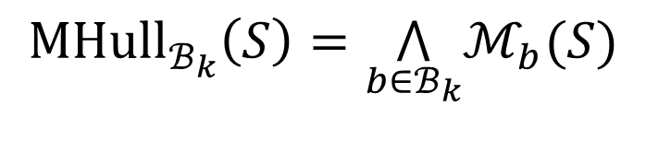






Abstraction & Monotone Theory
$$γ$$
$$\text{⟨}C, ⊆\text{⟩}$$
⟨$MSpan\left(ℬ_{k}\right), ⟹\text{⟩}$
$$α={MHull}_{ℬ_{k}}$$
Thm: $ℱ_{i+1}^{Λ}={MHull}_{ℬ_{k}}\left(δ\left(γ(ℱ_{i}^{Λ})\right)∪{γ(ℱ}_{i}^{Λ})\right)$
Def:
$${MHull}_{ℬ_{k}}\left(S\right)=\underset{b∈ℬ_{k}}{⋀}ℳ_{b}(S)$$
$$ℱ_{i+1}^{Λ}$$
$$ℱ_{i}^{Λ}$$
$$ℬ_{k}$$
$$…$$
$$ℱ_{1}^{Λ}$$
$$Bad$$
$$δ\left(ℱ_{i}^{Λ}\right)$$
$$…$$
$$b_{2}$$
$$Init$$
$$…$$
$$σ$$
$$b_{1}$$
(shortest paths in the Hamming cube)

Slide 46








Abstraction & Monotone Theory
$$γ$$
$$\text{⟨}C, ⊆\text{⟩}$$
⟨$MSpan\left(ℬ_{k}\right), ⟹\text{⟩}$
$$α={MHull}_{ℬ_{k}}$$
Thm: $ℱ_{i+1}^{Λ}={MHull}_{ℬ_{k}}\left(δ\left(γ(ℱ_{i}^{Λ})\right)∪{γ(ℱ}_{i}^{Λ})\right)$
Def:
$$σ∈{MHull}_{ℬ_{k}}\left(S\right)$$
iff
$$111$$
$$001$$
$$101$$
$$010$$
$$110$$
$$000$$
$$100$$

Slide 47


Abstraction & Monotone Theory
$$γ$$
$$\text{⟨}C, ⊆\text{⟩}$$
⟨$MSpan\left(ℬ_{k}\right), ⟹\text{⟩}$
$$α={MHull}_{ℬ_{k}}$$
Thm: $ℱ_{i+1}^{Λ}={MHull}_{ℬ_{k}}\left(δ\left(γ(ℱ_{i}^{Λ})\right)∪{γ(ℱ}_{i}^{Λ})\right)$
Def:
$$σ∈{MHull}_{ℬ_{k}}\left(S\right)$$
iff
$$111$$
$$001$$
$$101$$
$$010$$
$$110$$
$$∈S$$
$$000$$
$$100$$

Slide 48
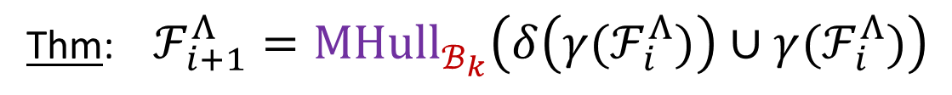


Abstraction & Monotone Theory
$$γ$$
$$\text{⟨}C, ⊆\text{⟩}$$
⟨$MSpan\left(ℬ_{k}\right), ⟹\text{⟩}$
$$α={MHull}_{ℬ_{k}}$$
Thm: $ℱ_{i+1}^{Λ}={MHull}_{ℬ_{k}}\left(δ\left(γ(ℱ_{i}^{Λ})\right)∪{γ(ℱ}_{i}^{Λ})\right)$
Def:
$$σ∈{MHull}_{ℬ_{k}}\left(S\right)$$
iff
$$111$$
$$001$$
$$ℬ_{k}$$
$$101$$
$$010$$
$$110$$
$$∈S$$
$$000$$
$$100$$

Slide 49

Abstraction & Monotone Theory
$$γ$$
$$\text{⟨}C, ⊆\text{⟩}$$
⟨$MSpan\left(ℬ_{k}\right), ⟹\text{⟩}$
$$α={MHull}_{ℬ_{k}}$$
Thm: $ℱ_{i+1}^{Λ}={MHull}_{ℬ_{k}}\left(δ\left(γ(ℱ_{i}^{Λ})\right)∪{γ(ℱ}_{i}^{Λ})\right)$
Def:
$$σ∈{MHull}_{ℬ_{k}}\left(S\right)$$
iff
$$111$$
$$001$$
$$ℬ_{k}$$
$$101$$
$$010$$
$$σ$$
$$110$$
$$∈S$$
$$000$$
$$100$$

Slide 50
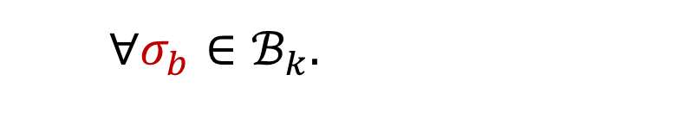

Abstraction & Monotone Theory
$$γ$$
$$\text{⟨}C, ⊆\text{⟩}$$
⟨$MSpan\left(ℬ_{k}\right), ⟹\text{⟩}$
$$α={MHull}_{ℬ_{k}}$$
Thm: $ℱ_{i+1}^{Λ}={MHull}_{ℬ_{k}}\left(δ\left(γ(ℱ_{i}^{Λ})\right)∪{γ(ℱ}_{i}^{Λ})\right)$
$$σ∈{MHull}_{ℬ_{k}}\left(S\right)$$
$$∀σ_{b}∈ℬ_{k}. ∃π, σ\underset{→}{π}σ_{b}. \\ S∩π≠∅$$
Def:
iff
$$111$$
$$001$$
$$ℬ_{k}$$
$$101$$
$$σ_{b}$$
$$010$$
$$σ$$
$$110$$
$$∈S$$
$$000$$
$$100$$

Slide 51
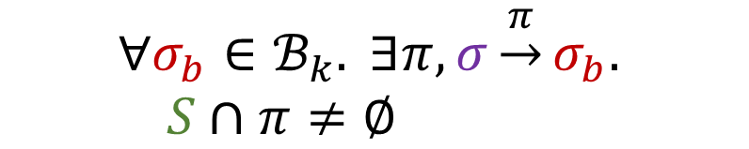

Abstraction & Monotone Theory
$$γ$$
$$\text{⟨}C, ⊆\text{⟩}$$
⟨$MSpan\left(ℬ_{k}\right), ⟹\text{⟩}$
$$α={MHull}_{ℬ_{k}}$$
Thm: $ℱ_{i+1}^{Λ}={MHull}_{ℬ_{k}}\left(δ\left(γ(ℱ_{i}^{Λ})\right)∪{γ(ℱ}_{i}^{Λ})\right)$
$$σ∈{MHull}_{ℬ_{k}}\left(S\right)$$
$$∀σ_{b}∈ℬ_{k}. ∃π, σ\underset{→}{π}σ_{b}. \\ S∩π≠∅$$
Def:
iff
$$111$$
$$001$$
$$ℬ_{k}$$
$$101$$
$$σ_{b}$$
$$010$$
$$σ$$
$$110$$
$$∈S$$
$$000$$
$$100$$

Slide 52

Abstraction & Monotone Theory
$$γ$$
$$\text{⟨}C, ⊆\text{⟩}$$
⟨$MSpan\left(ℬ_{k}\right), ⟹\text{⟩}$
$$α={MHull}_{ℬ_{k}}$$
Thm: $ℱ_{i+1}^{Λ}={MHull}_{ℬ_{k}}\left(δ\left(γ(ℱ_{i}^{Λ})\right)∪{γ(ℱ}_{i}^{Λ})\right)$
$$σ∈{MHull}_{ℬ_{k}}\left(S\right)$$
$$∀σ_{b}∈ℬ_{k}. ∃π, σ\underset{→}{π}σ_{b}. \\ S∩π≠∅$$
Def:
iff
$$111$$
$$001$$
$$ℬ_{k}$$
$$101$$
$$σ_{b}$$
$$010$$
$$σ$$
$$110$$
$$∈S$$
$$000$$
$$100$$

Slide 53

Abstraction & Monotone Theory
$$γ$$
$$\text{⟨}C, ⊆\text{⟩}$$
⟨$MSpan\left(ℬ_{k}\right), ⟹\text{⟩}$
$$α={MHull}_{ℬ_{k}}$$
Thm: $ℱ_{i+1}^{Λ}={MHull}_{ℬ_{k}}\left(δ\left(γ(ℱ_{i}^{Λ})\right)∪{γ(ℱ}_{i}^{Λ})\right)$
$$σ∈{MHull}_{ℬ_{k}}\left(S\right)$$
$$∀σ_{b}∈ℬ_{k}. ∃π, σ\underset{→}{π}σ_{b}. \\ S∩π≠∅$$
Def:
iff
$$111$$
$$001$$
$$ℬ_{k}$$
$$101$$
$$σ_{b}$$
$$010$$
$$σ$$
$$∈{MHull}_{B_{k}}(S)$$
$$110$$
$$∈S$$
$$000$$
$$100$$

Slide 54


Abstraction & Monotone Theory
$$γ$$
$$\text{⟨}C, ⊆\text{⟩}$$
⟨$MSpan\left(ℬ_{k}\right), ⟹\text{⟩}$
$$α={MHull}_{ℬ_{k}}$$
Thm: $ℱ_{i+1}^{Λ}={MHull}_{ℬ_{k}}\left(δ\left(γ(ℱ_{i}^{Λ})\right)∪{γ(ℱ}_{i}^{Λ})\right)$
$$σ∈{MHull}_{ℬ_{k}}\left(S\right)$$
$$∀σ_{b}∈ℬ_{k}. ∃π, σ\underset{→}{π}σ_{b}. \\ S∩π≠∅$$
Def:
iff
$$ℱ_{i+1}^{Λ}$$
$$ℱ_{i}^{Λ}$$
$$ℬ_{k}$$
$$…$$
$$ℱ_{1}^{Λ}$$
$$Bad$$
$$δ\left(ℱ_{i}^{Λ}\right)$$
$$…$$
$$Init$$
$$…$$
$$σ$$
$$σ_{b}$$

Slide 55



Abstraction & Monotone Theory
$$γ$$
$$\text{⟨}C, ⊆\text{⟩}$$
⟨$MSpan\left(ℬ_{k}\right), ⟹\text{⟩}$
$$α={MHull}_{ℬ_{k}}$$
Thm: $ℱ_{i+1}^{Λ}={MHull}_{ℬ_{k}}\left(δ\left(γ(ℱ_{i}^{Λ})\right)∪{γ(ℱ}_{i}^{Λ})\right)$
$$σ∈{MHull}_{ℬ_{k}}\left(S\right)$$
$$∀σ_{b}∈ℬ_{k}. ∃π, σ\underset{→}{π}σ_{b}. \\ S∩π≠∅$$
Def:
iff
$$ℱ_{i+1}^{Λ}$$
$$ℱ_{i}^{Λ}$$
$$ℬ_{k}$$
$$…$$
$$ℱ_{1}^{Λ}$$
$$…$$
$$Bad$$
$$δ\left(ℱ_{i}^{Λ}\right)$$
$$Init$$
$$…$$
$$σ_{b}$$
$$σ$$
$$…$$

Slide 56











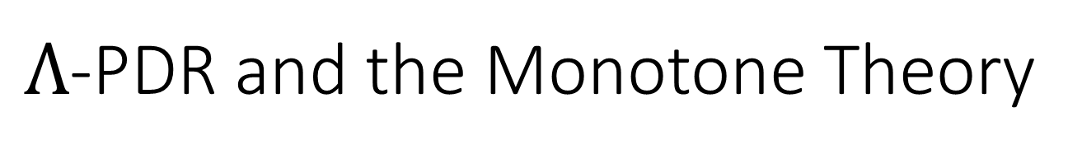


$Λ$-PDR and the Monotone Theory
$$γ$$
$$\text{⟨}C, ⊆\text{⟩}$$
⟨$MSpan\left(ℬ_{k}\right), ⟹\text{⟩}$
$$α={MHull}_{ℬ_{k}}$$
Init:
$δ$:
$${(x}_{n},…,x_{0}) ≔ 00…00$$
$$\left(x_{n},…,x_{0}\right)≔\left(x_{n},…,x_{0}\right)+00…10$$
Bad:
$${(x}_{n},…,x_{0}) = 10…01$$
$$ℬ_{0}$$
$$:$$
$$\left(x_{n},…,x_{0}\right)=10…01$$
$${δ(ℱ}_{0}^{Λ})∪ℱ_{0}^{Λ}$$
$$:$$
$$\left(x_{n},…,x_{0}\right)=00…00$$
$$∨\left(x_{n},…,x_{0}\right)=00…10$$
$${MHull}_{ℬ_{0}}{(δ(ℱ}_{0}^{Λ})∪ℱ_{0}^{Λ})$$
$$:$$
$$\left(x_{n},…,x_{0}\right)=0?…?0$$

Slide 57
Key Ideas and Results
​$Λ$-PDR: an algorithm that lower bounds the overapproximation of PDR
$$γ$$
+
$Λ$-PDR
$$=$$
$$α$$
Abstract Interpretation
Monotone Theory
Exponential gap between #frames in $Λ$-PDR and exact forward reachability, interpolation
Convergence bounds on #frames in $Λ$-PDR from the DNF size of the transition relation

Slide 58







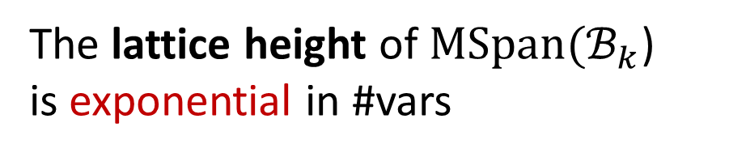







Convergence Bounds
Problem:
The lattice height of $MSpan(ℬ_{k}$) is exponential in #vars
Goal:
Identify properties of the transition system that lead to fast convergence
$$true$$
# frames?
$$ℱ_{i+1}^{Λ}$$
$$ℱ_{i+3}^{Λ}$$
$$ℱ_{i}^{Λ}$$
$$γ$$
$Λ$-PDR
$Λ$-PDR
$$ℱ_{i+2}^{Λ}$$
$$δ(ℱ_{i}^{Λ})$$
$$α$$
$$ℱ_{i+1}^{Λ}$$
$Λ$-PDR
$$ℱ_{i}^{Λ}$$
$$γ$$
$$false$$

Slide 59
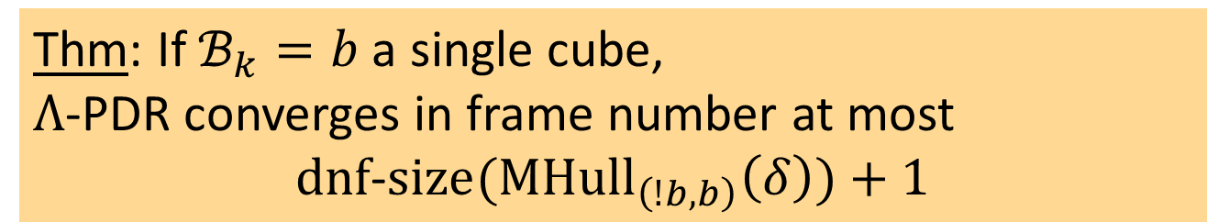
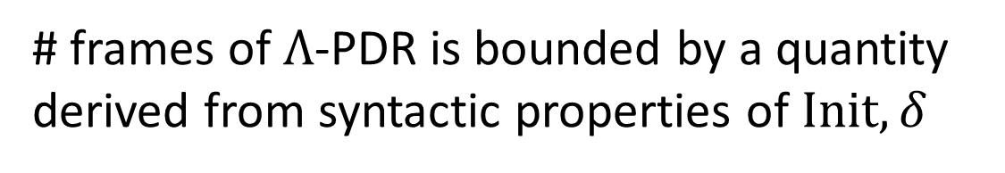
Convergence Bounds
Problem:
The lattice height of $MSpan(ℬ_{k}$) is exponential in #vars
Goal:
Identify properties of the transition system that lead to fast convergence
Method:
# frames of $Λ$-PDR is bounded by a quantity derived from syntactic properties of $Init,δ$
Thm: If $ℬ_{k}=b$ a single cube, $Λ$-PDR converges in frame number at most
$$dnf\text{−}size({MHull}_{\left(!b,b\right)}\left(δ\right))+1$$

Slide 60





Convergence Bounds
Init:
$δ$:
$${(x}_{n},…,x_{0}) ≔ 00…00$$
$$\left(x_{n},…,x_{0}\right)≔\left(x_{n},…,x_{0}\right)+00…10$$
Bad:
$${(x}_{n},…,x_{0}) = 10…01$$
$$Ω(2^{n})$$
DNF form of $δ$:
$$\left(x_{n},…,x_{0}\right)=00…0000∧\left(x_{n}^{′},…,x_{0}^{′}\right)=00…0010$$
$$∨$$
$$\left(x_{n},…,x_{0}\right)=00…0010∧\left(x_{n}^{′},…,x_{0}^{′}\right)=00…0100$$
$$∨$$
$$\left(x_{n},…,x_{0}\right)=00…0100∧\left(x_{n}^{′},…,x_{0}^{′}\right)=00…0110$$
$$∨$$
$$…$$
$$∨$$
$$\left(x_{n},…,x_{0}\right)=01…1110∧\left(x_{n}^{′},…,x_{0}^{′}\right)=10…0000$$
$$∨$$
$$…$$

Slide 61

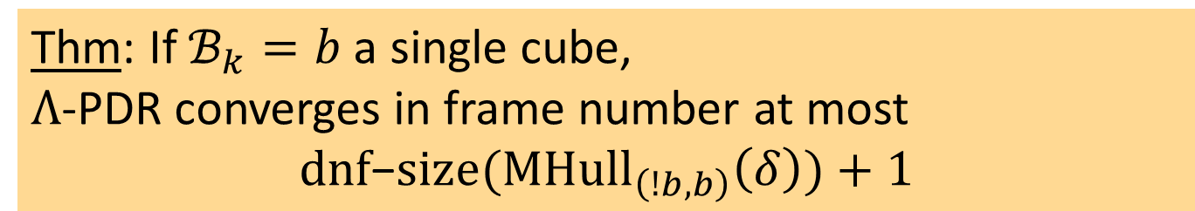
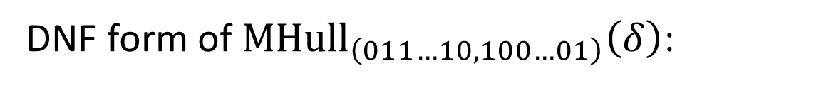


Convergence Bounds
Thm: If $ℬ_{k}=b$ a single cube, $Λ$-PDR converges in frame number at most
$$dnf\text{−}size({MHull}_{\left(!b,b\right)}\left(δ\right))+1$$
DNF form of ${MHull}_{\left(011…10,100…01\right)}\left(δ\right)$:
O(1)
$$\left(x_{n},…,x_{0}\right)=00…0000∧\left(x_{n}^{′},…,x_{0}^{′}\right)=00…0010$$
$$∨$$
$$\left(x_{n},…,x_{0}\right)=00…0010∧\left(x_{n}^{′},…,x_{0}^{′}\right)=00…0100$$
$$∨$$
$$\left(x_{n},…,x_{0}\right)=00…0100∧\left(x_{n}^{′},…,x_{0}^{′}\right)=00…0110$$
$$⇓$$
$$⇑$$
$$∨$$
$$…$$
$$∨$$
$$\left(x_{n},…,x_{0}\right)=01…1110∧\left(x_{n}^{′},…,x_{0}^{′}\right)=10…0000$$
$$∨$$
$$…$$
$$≡{ x}_{0}^{′}=0$$

Slide 62
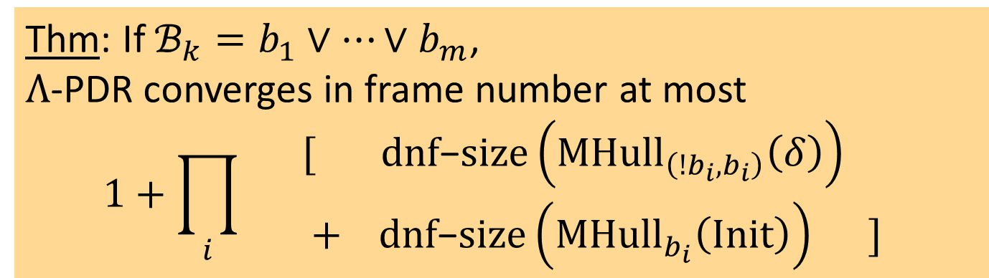
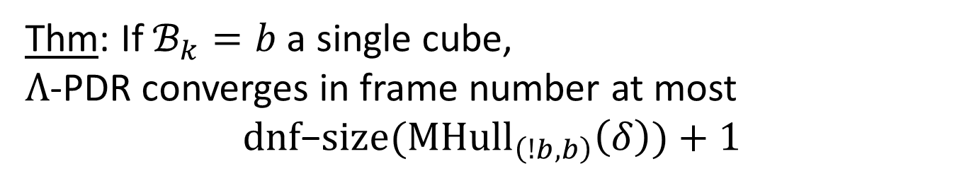
Convergence Bounds
Thm: If $ℬ_{k}=b$ a single cube, $Λ$-PDR converges in frame number at most
$$dnf\text{−}size({MHull}_{\left(!b,b\right)}\left(δ\right))+1$$
Thm: If $ℬ_{k}=b_{1}∨…∨b_{m}$, $Λ$-PDR converges in frame number at most
$$1+\prod_{i}{\begin{aligned} [ dnf\text{−}size\left({MHull}_{\left(!b_{i},b_{i}\right)}\left(δ\right)\right) \\ + dnf\text{−}size\left({MHull}_{b_{i}}\left(Init\right)\right) ] \end{aligned} }$$

Slide 63
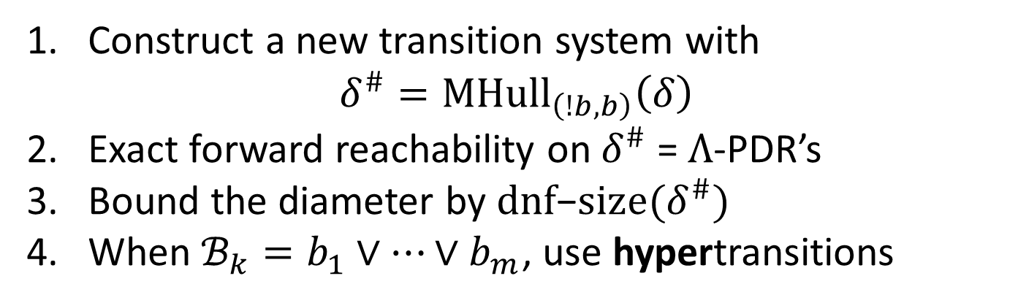
Convergence Bounds: Proof Idea
Thm: If $ℬ_{k}=b$ a single cube, $Λ$-PDR converges in frame number at most
$$dnf\text{−}size({MHull}_{\left(!b,b\right)}\left(δ\right))+1$$
Proof:
Construct a new transition system with ${δ^{\#}=MHull}_{\left(!b,b\right)}\left(δ\right)$
Exact forward reachability on $δ^{\#}$ = $Λ$-PDR’s
Bound the diameter by $dnf\text{−}size(δ^{\#})$
When $ℬ_{k}=b_{1}∨…∨b_{m}$, use hypertransitions

Slide 64

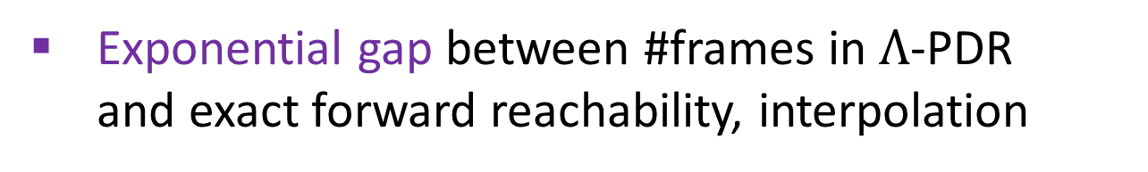

Summary
​$Λ$-PDR: an algorithm that lower bounds the overapproximation of PDR
$$γ$$
+
$Λ$-PDR
$$=$$
$$α$$
Abstract Interpretation
Monotone Theory
Exponential gap between #frames in $Λ$-PDR and exact forward reachability, interpolation
Convergence bounds on #frames in $Λ$-PDR from the DNF size of the transition relation
@yotamfe, @SagivMooly, @wilcoxjay

Slide 66



















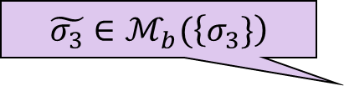






Abstract Transition System
$$δ^{\#}=ℳ_{\left(1−b,b\right)}(δ)$$
$$σ_{0}$$
$$∈ℛ_{0}$$
$$δ$$
$$σ_{1}$$
$$∈ℛ_{1}$$
$$ℬ_{k}=b$$
$$δ$$
$$σ_{2}$$
$$∈ℛ_{2}$$
$$\tilde{σ_{3}}∈ℳ_{b}(\left\{σ_{3}\}\right)$$
$$δ$$
$$∈ℛ_{4}^{\#}$$
$$\tilde{σ_{3}}$$
$$δ^{\#}$$
$$σ_{3}$$
$$∈ℛ_{3}$$
$$δ$$
$$δ$$
$$b$$
$$∈ℛ_{5}^{\#}$$
$$…$$
$$δ$$
$$\tilde{σ}$$
$$∈ℛ_{6}^{\#}$$
$$∈ℛ_{42}$$

Slide 67






Abstract HyperTransition System
$$δ^{\#}=ℳ_{\left(1−b_{1},b_{1}\right)}\left(δ\right)∧ℳ_{\left(1−b_{2},b_{2}\right)}(δ)$$
$$ℬ_{k}=b_{1}∨b_{2}$$
$$σ_{0}$$
$$δ$$
$$σ_{1}$$
$$\tilde{σ_{3}}∈ℳ_{b_{2}}(\left\{σ_{2}\}\right)$$
$$δ$$
$$σ_{2}$$
$$\tilde{σ_{3}}∈ℳ_{b_{1}}(\left\{σ_{3}\}\right)$$
$$b_{2}$$
$$δ$$
$$δ^{\#}$$
$$σ_{3}$$
$$∈ℛ_{4}^{\#}$$
$$\tilde{σ_{3}}$$
$$δ$$
$$δ$$
$$b_{1}$$
$$∈ℛ_{5}^{\#}$$
$$…$$
$$δ$$
$$\tilde{σ}$$
$$∈ℛ_{6}^{\#}$$

Slide 68







$Λ$-PDR vs. PDR
$$ℱ_{i}^{Λ}⊆ℱ_{i}^{pdr}$$
$$∈MSpan(ℬ_{k})$$
PDR may converge with fewer or simpler frames
$$ℱ_{3}$$
$$ℱ_{2}$$
$$ℱ_{3}^{Λ}$$
$$ℱ_{1}$$
$$ℱ_{2}^{Λ}$$
$$ℱ_{0}$$
$$ℱ_{1}^{Λ}$$
$$Init$$

Slide 69





$Λ$-PDR’s vs. PDR’s Frames
A sequence of formulas $ℱ_{0},ℱ_{1},ℱ_{2},…$
$ℱ_{0}=Init$
$ℱ_{i}⟹ℱ_{i+1}$
$$∀i. ℱ_{i}^{Λ}⊆ℱ_{i}^{pdr}$$
(3) $δ(ℱ_{i})⟹ℱ_{i+1}$
(4) $ℱ_{i}⟹¬Bad$
(5) $ℱ_{i}∈MSpan(ℬ_{k})$
For every sequence ${{\{ℱ}_{i}^{pdr}\}}_{i=0,1,…}$ satisfying properties 1-5
$$ℱ_{3}$$
$$ℱ_{2}$$
$$ℱ_{3}^{Λ}$$
$$ℱ_{1}$$
$$ℱ_{2}^{Λ}$$
$$ℱ_{0}$$
$$ℱ_{1}^{Λ}$$
$$Init$$

