Slide 1



Quadratic Scaling Bosonic Path Integral Molecular Dynamics
Yotam Feldman
Barak Hirshberg
@yotamfe
@barak_hirshberg
arXiv:2305.18025

Slide 2
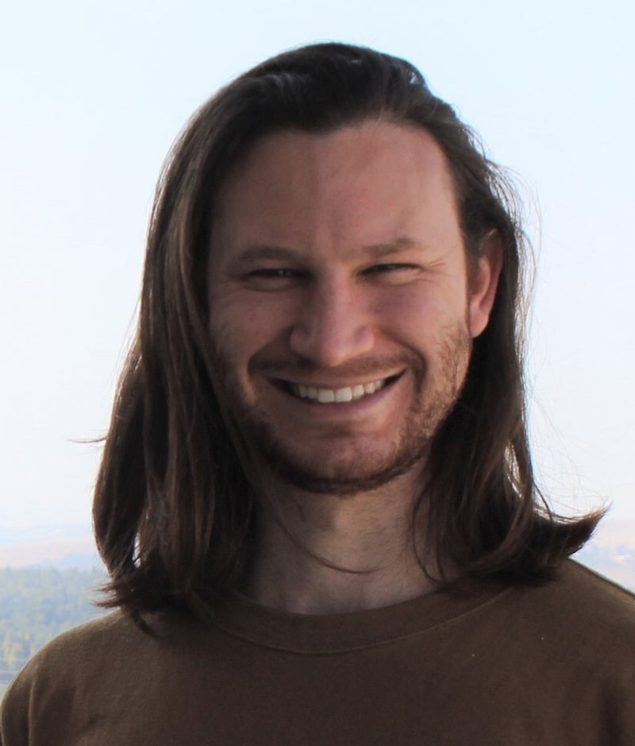
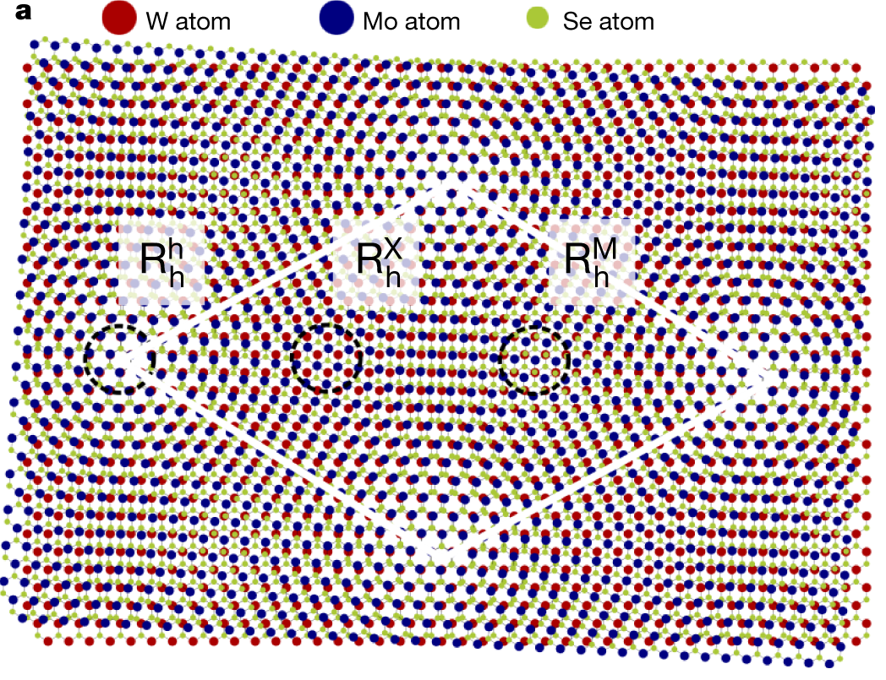
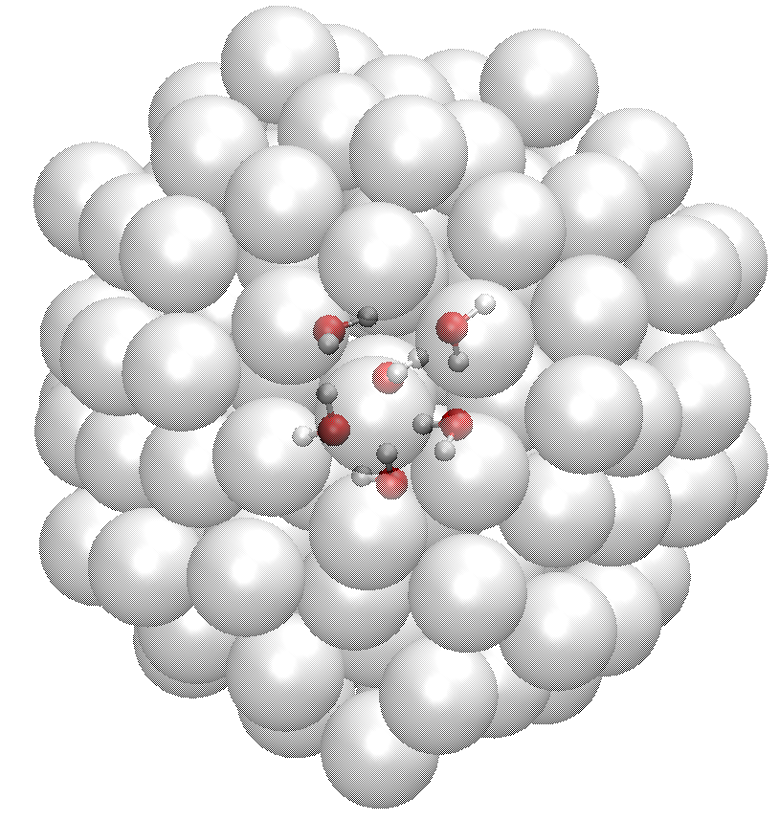
Motivation
Quantum symmetry is a fundamental property of quantum particles.
Exchange effects at finite T are important for many systems:
Netanel Bachar Schwartz
Tran, Moody et al. Nature 567, 71–75 (2019)

Slide 3
Motivation
Quantum symmetry is a fundamental property of quantum particles.
Exchange effects at finite T are important for many systems:
Performing PIMD simulations of bosons
fast
Netanel Bachar Schwartz
Tran, Moody et al. Nature 567, 71–75 (2019)

Slide 4
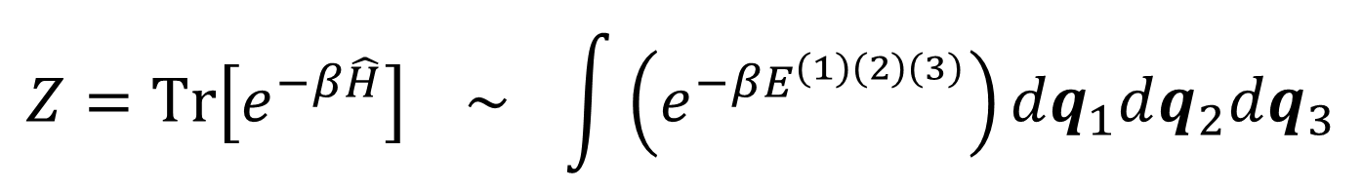
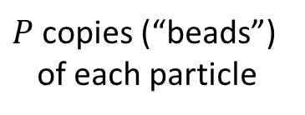

Path-Integral Molecular Dynamics
$P$ copies (“beads”) of each particle
$$Z=Tr\left[e^{−β\hat{H}}\right] \sim \int{\left(e^{−βE^{(1)(2)(3)}}\right)dq_{1}dq_{2}dq_{3}}$$
$$E^{(1)(2)(3)}$$
1
2
3

Slide 5
Exchange Symmetry

Slide 6



Exchange Symmetry
$$Z\sim \frac{1}{6}\int{\left(\begin{aligned}e^{−βE^{(1)(2)(3)}}+e^{−βE^{(12)(3)}}+e^{−βE^{(1)(23)}}+e^{−βE^{(13)(2) }} \\ +e^{−βE^{(123)}}+e^{−βE^{(132)}}\end{aligned}\right)dq_{1}dq_{2}dq_{3}}$$
1
$$P$$
$$1$$
2
1
$$P$$
$$P$$
$$1$$
3
$$E^{(1)(2)(3)}$$

Slide 7













Exchange Symmetry
$$Z\sim \frac{1}{6}\int{\left(\begin{aligned}e^{−βE^{(1)(2)(3)}}+e^{−βE^{(12)(3)}}+e^{−βE^{(1)(23)}}+e^{−βE^{(13)(2) }} \\ +e^{−βE^{(123)}}+e^{−βE^{(132)}}\end{aligned}\right)dq_{1}dq_{2}dq_{3}}$$
1
$$P$$
$$1$$
2
1
$$P$$
$$1$$
2
1
$$P$$
1
$$P$$
$$P$$
$$P$$
$$1$$
3
$$1$$
3
$$E^{(1)(2)(3)}$$
$$E^{(12)(3)}$$
2
$$P$$
1
1
$$1$$
2
$$P$$
$$1$$
$$1$$
$$P$$
$$1$$
$$P$$
1
$$P$$
1
$$P$$
3
3
$$E^{(1)(23)}$$
$$E^{(13)(2)}$$

Slide 8






Exchange Symmetry
$$Z\sim \frac{1}{6}\int{\left(\begin{aligned}e^{−βE^{(1)(2)(3)}}+e^{−βE^{(12)(3)}}+e^{−βE^{(1)(23)}}+e^{−βE^{(13)(2) }} \\ +e^{−βE^{(123)}}+e^{−βE^{(132)}}\end{aligned}\right)dq_{1}dq_{2}dq_{3}}$$
1
$$P$$
$$1$$
2
1
$$P$$
$$1$$
2
1
$$P$$
$$1$$
2
1
$$P$$
1
$$P$$
1
$$P$$
$$P$$
$$P$$
$$P$$
3
$$1$$
3
$$1$$
3
$$1$$
$$E^{(1)(2)(3)}$$
$$E^{(12)(3)}$$
$$E^{(123)}$$
2
$$P$$
1
1
$$1$$
2
1
$$1$$
$$P$$
2
$$P$$
$$1$$
$$1$$
$$P$$
$$1$$
$$P$$
$$P$$
$$1$$
1
$$P$$
1
$$P$$
$$1$$
$$P$$
3
3
3
$$E^{(1)(23)}$$
$$E^{(13)(2)}$$
$$E^{(132)}$$

Slide 9
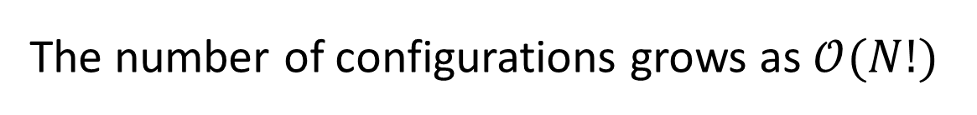
Exchange Symmetry
$$Z\sim \frac{1}{6}\int{\left(\begin{aligned}e^{−βE^{(1)(2)(3)}}+e^{−βE^{(12)(3)}}+e^{−βE^{(1)(23)}}+e^{−βE^{(13)(2) }} \\ +e^{−βE^{(123)}}+e^{−βE^{(132)}}\end{aligned}\right)dq_{1}dq_{2}dq_{3}}$$
1
$$P$$
$$1$$
1
$$P$$
$$1$$
2
1
$$P$$
$$1$$
2
2
The number of configurations grows as $𝒪(N!)$
1
$$P$$
1
$$P$$
1
$$P$$
$$P$$
$$P$$
$$P$$
3
$$1$$
3
$$1$$
3
$$1$$
$$E^{(1)(2)(3)}$$
$$E^{(12)(3)}$$
$$E^{(123)}$$
2
$$P$$
1
1
$$1$$
2
1
$$1$$
$$P$$
2
$$P$$
$$1$$
$$1$$
$$P$$
$$1$$
$$P$$
$$P$$
$$1$$
1
$$P$$
1
$$P$$
$$1$$
$$P$$
3
3
3
$$E^{(1)(23)}$$
$$E^{(13)(2)}$$
$$E^{(132)}$$

Slide 10
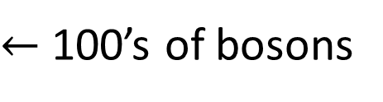

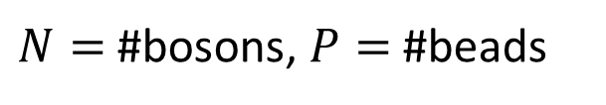



Scaling of Bosonic Path-Integral MD
$N=$ #bosons, $P=$#beads
All permutations:
$$𝒪(PN!)$$
Hirshberg et al.:
$$𝒪(PN^{3})$$
$←$ 100’s of bosons
This work:
$$𝓞(N^{2}+PN)$$
$←$ 1000’s of bosons
Hirshberg et al. (2019) PNAS
Feldman and Hirshberg. arXiv:2305.18025

Slide 11

Speedup $𝒪(PN)$
slope=0.9
Feldman and Hirshberg. arXiv:2305.18025

Slide 12

1600 Particles
9 days of simulation rather than > 20 years
2D density of $N=1600$ trapped bosons without and with Gaussian repulsive interaction
Feldman and Hirshberg. arXiv:2305.18025

Slide 13

1372 Particles
7 days of simulation rather than > 14 years
Pair correlation of $N=1372$ ⁴He atoms
Feldman and Hirshberg. arXiv:2305.18025

Slide 14
The Cost of Bosonic Exchange
Bosons (previously)
distinguishable
Feldman and Hirshberg. arXiv:2305.18025

Slide 15




The Cost of Bosonic Exchange
Bosons (previously)
$$×15,000$$
Bosons (now)
$$×88$$
$$×16$$
distinguishable
$$×1.37$$
Feldman and Hirshberg. arXiv:2305.18025

Slide 16
The Algorithm
@yotamfe
@barak_hirshberg

Slide 17
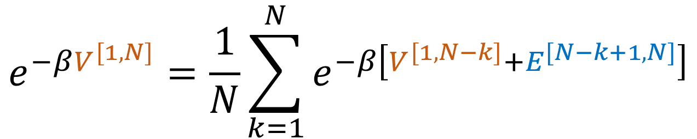
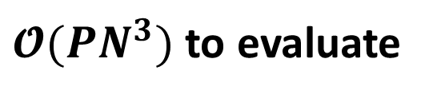
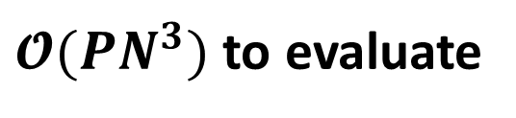
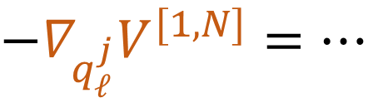
Hirshberg et al.’s Recurrence Relations
Potential:
$$e^{−βV^{[1,N]}}=\frac{1}{N}\sum_{k=1}^{N}{e^{−β\left[V^{[1,N−k]}+E^{[N−k+1,N]}\right]}}$$
$𝓞(PN^{3})$ to evaluate
Forces:
${−∇}_{q_{ℓ}^{j}}V^{[1,N]}=…$
$𝓞(PN^{3})$ to evaluate

Slide 18
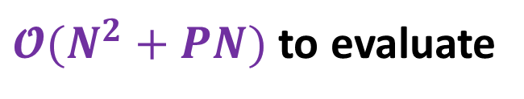

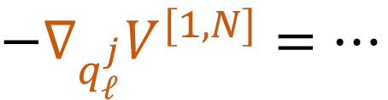
Our Technique
Potential:
$$e^{−βV^{[1,N]}}=\frac{1}{N}\sum_{k=1}^{N}{e^{−β\left[V^{[1,N−k]}+E^{[N−k+1,N]}\right]}}$$
$𝓞(N^{2}+PN)$ to evaluate
Forces:
${−∇}_{q_{ℓ}^{j}}V^{[1,N]}=…$
$𝓞(N^{2}+PN)$ to evaluate

Slide 19


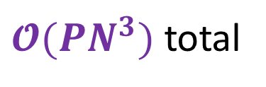





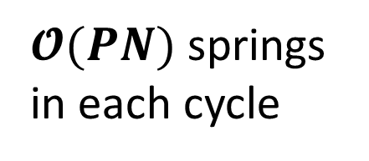




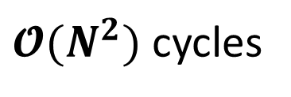








Hirshberg et al.’s Recurrence Relations
Potential:
“cycle energies”
$$e^{−βV^{[1,N]}}=\frac{1}{N}\sum_{k=1}^{N}{e^{−β\left[V^{[1,N−k]}+E^{[N−k+1,N]}\right]}}$$
$$E^{[2,2]}$$
$$E^{[1,2]}$$
$$E^{[1,3]}$$
$𝓞(N^{2})$ cycles
2
$$P$$
1
$$P$$
$$1$$
2
1
$$P$$
$$1$$
2
$$E^{[1,1]}$$
$𝓞(PN)$ springs in each cycle
1
1
$$P$$
1
$$P$$
1
$$P$$
$$P$$
3
$$1$$
1
$$E^{[3,3]}$$
$$E^{[2,3]}$$
$𝓞(PN^{3})$ total
3
$$P$$
2
$$P$$
$$1$$
3
1
1
$$P$$

Slide 20

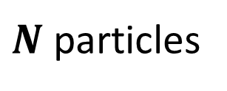








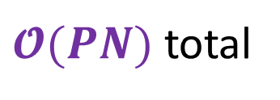



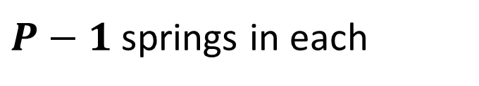
Evaluating the Potential (1): Interior Springs
$$E^{[1,1]}$$
$$E^{[1,2]}$$
$$P$$
$$P$$
$$1$$
1
1
2
1
1
$$P$$
$$E^{[1,3]}$$
$N$ particles
$$P$$
$$1$$
1
2
$P−1$ springs in each
1
$$P$$
$𝓞(PN)$ total
$$P$$
$$1$$
3

Slide 21

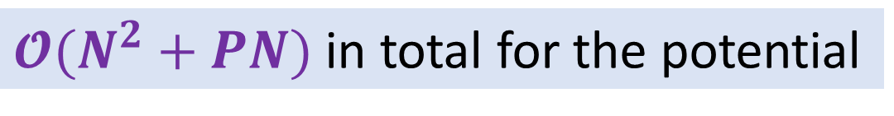



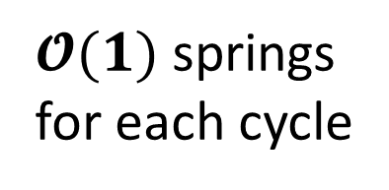

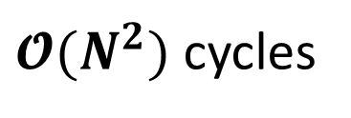

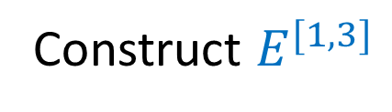
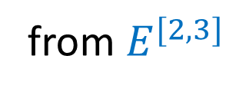
Evaluating the Potential (2): Extending Cycles
$𝓞(N^{2}+PN)$ in total for the potential
Construct $E^{[1,3]}$
from $E^{[2,3]}$
$$P$$
$𝓞(N^{2})$ cycles
1
2
$$1$$
$𝓞(1)$ springs for each cycle
1
summed earlier
$$P$$
$$P$$
$$𝓞(N^{2})$$
3 spring terms
$$1$$
3
Feldman and Hirshberg. arXiv:2305.18025

Slide 22
Our Technique
Potential:
$$e^{−βV^{[1,N]}}=\frac{1}{N}\sum_{k=1}^{N}{e^{−β\left[V^{[1,N−k]}+E^{[N−k+1,N]}\right]}}$$
$𝓞(N^{2}+PN)$ to evaluate
Forces:
${−∇}_{q_{ℓ}^{j}}V^{[1,N]}=…$
$𝓞(N^{2}+PN)$ to evaluate

Slide 23
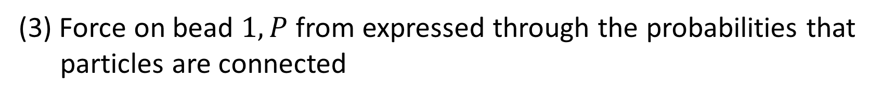

Our Technique
Potential:
$$e^{−βV^{[1,N]}}=\frac{1}{N}\sum_{k=1}^{N}{e^{−β\left[V^{[1,N−k]}+E^{[N−k+1,N]}\right]}}$$
$$e^{−βV^{[1,N]}}=\frac{1}{N}\sum_{k=1}^{N}{e^{−β\left[V^{[1,N−k]}+E^{[N−k+1,N]}\right]}}$$
$$e^{−βV^{[1,N]}}=\frac{1}{N}\sum_{k=1}^{N}{e^{−β\left[V^{[1,N−k]}+E^{[N−k+1,N]}\right]}}$$
(1) The force is a weighted average over the ring polymer configurations
(2) Force on bead $j=2,…,P−1$ not affected by exchange
(3) Force on bead $1,P$ from expressed through the probabilities that particles are connected
$𝓞(N^{2}+PN)$ to evaluate
$𝓞(N^{2}+PN)$ to evaluate
Forces:
${−∇}_{q_{ℓ}^{j}}V^{[1,N]}=…$
$𝓞(N^{2}+PN)$ to evaluate

Slide 24

Potential as an Average Over Permutations
$$e^{−βV^{[1,N]}}=\frac{1}{N}\sum_{k=1}^{N}{e^{−β\left[V^{[1,N−k]}+E^{[N−k+1,N]}\right]}}$$
1
$$P$$
$$1$$
2
1
$$P$$
$$1$$
2
1
$$P$$
$$1$$
2
1
$$P$$
1
$$P$$
1
$$P$$
$$P$$
$$P$$
$$P$$
3
$$1$$
3
$$1$$
3
$$1$$
2
1
$$1$$
2
1
$$1$$
$$P$$
2
$$P$$
1
$$P$$
$$P$$
$$1$$
$$P$$
$$1$$
$$1$$
$$P$$
$$1$$
1
$$P$$
$$1$$
$$P$$
1
$$P$$
3
3
3

Slide 25
Potential as an Average Over Permutations
$$e^{−βV^{[1,N]}}=\frac{1}{N}\sum_{k=1}^{N}{e^{−β\left[V^{[1,N−k]}+E^{[N−k+1,N]}\right]}}$$
1
$$P$$
$$1$$
2
1
$$P$$
$$1$$
2
1
$$P$$
$$1$$
2
1
$$P$$
1
$$P$$
1
$$P$$
$$P$$
$$P$$
$$P$$
3
$$1$$
3
$$1$$
3
$$1$$
2
1
$$1$$
2
1
$$1$$
$$P$$
2
$$P$$
1
$$P$$
$$P$$
$$1$$
$$P$$
$$1$$
$$1$$
$$P$$
$$1$$
1
$$P$$
$$1$$
$$P$$
1
$$P$$
3
3
3

Slide 26
1
$$P$$
$$1$$
1
$$P$$
$$1$$
2
1
$$P$$
$$1$$
2
2
1
$$P$$
1
$$P$$
1
$$P$$
$$P$$
$$P$$
$$P$$
$$1$$
3
$$1$$
3
$$1$$
3
1
$$1$$
2
1
$$1$$
$$P$$
2
2
$$P$$
1
$$P$$
$$1$$
$$1$$
$$P$$
$$1$$
$$P$$
$$P$$
$$1$$
$$1$$
1
$$P$$
1
$$P$$
3
$$P$$
3
3

Slide 27
Potential as an Average Over Permutations
$$e^{−βV^{[1,N]}}=\frac{1}{N}\sum_{k=1}^{N}{e^{−β\left[V^{[1,N−k]}+E^{[N−k+1,N]}\right]}}$$
1
$$P$$
$$1$$
2
1
$$P$$
$$1$$
2
1
$$P$$
$$1$$
2
1
$$P$$
1
$$P$$
1
$$P$$
$$P$$
$$P$$
$$P$$
3
$$1$$
3
$$1$$
3
$$1$$
2
1
$$1$$
2
1
$$1$$
$$P$$
2
$$P$$
1
$$P$$
$$P$$
$$1$$
$$P$$
$$1$$
$$1$$
$$P$$
$$1$$
1
$$P$$
$$1$$
$$P$$
1
$$P$$
3
3
3

Slide 28
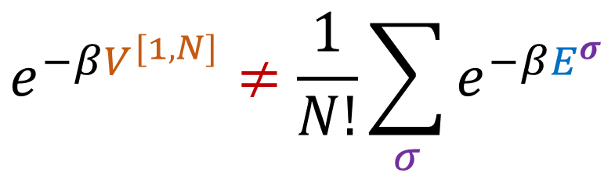
Potential as an Average Over Permutations
$$e^{−βV^{[1,N]}}≠\frac{1}{N!}\sum_{σ}{e^{−βE^{σ}}}$$
1
$$P$$
$$1$$
2
1
$$P$$
$$1$$
2
1
$$P$$
$$1$$
2
1
$$P$$
1
$$P$$
1
$$P$$
$$P$$
$$P$$
$$P$$
3
$$1$$
3
$$1$$
3
$$1$$
2
1
$$1$$
2
1
$$1$$
$$P$$
2
$$P$$
1
$$P$$
$$P$$
$$1$$
$$P$$
$$1$$
$$1$$
$$P$$
$$1$$
1
$$P$$
$$1$$
$$P$$
1
$$P$$
3
3
3

Slide 29
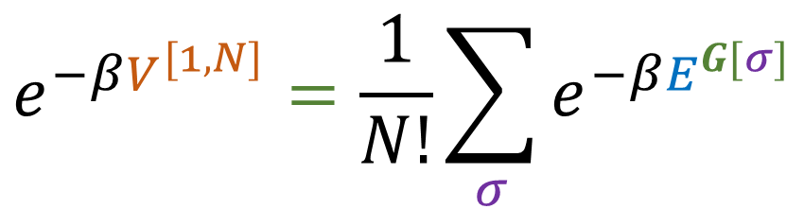


Potential as an Average Over Permutations
$$e^{−βV^{[1,N]}}=\frac{1}{N!}\sum_{σ}{e^{−βE^{G[σ]}}}$$
1
$$P$$
$$1$$
2
1
$$P$$
$$1$$
2
1
$$P$$
$$1$$
2
1
$$P$$
1
$$P$$
1
$$P$$
$$G$$
$$P$$
$$P$$
$$P$$
3
$$1$$
3
$$1$$
3
$$1$$
2
1
$$1$$
2
1
$$1$$
$$P$$
2
$$P$$
1
$$P$$
$$P$$
$$1$$
$$P$$
$$1$$
$$1$$
$$P$$
$$1$$
1
$$P$$
$$1$$
$$P$$
1
$$P$$
3
3
3
Feldman and Hirshberg. arXiv:2305.18025
$$G$$

Slide 30

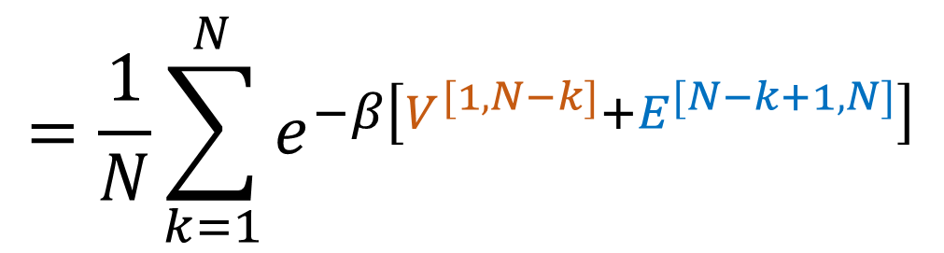
Potential as an Average Over Permutations
Theorem:
$$e^{−βV^{[1,N]}}=\frac{1}{N!}\sum_{σ}{e^{−βE^{G[σ]}}}$$
$$=\frac{1}{N}\sum_{k=1}^{N}{e^{−β\left[V^{[1,N−k]}+E^{[N−k+1,N]}\right]}}$$
(formal proof that $V^{[1,N]}$ indeed yields correct sampling)
$⟹$force = weighted average over permutations
Feldman and Hirshberg. arXiv:2305.18025

Slide 31
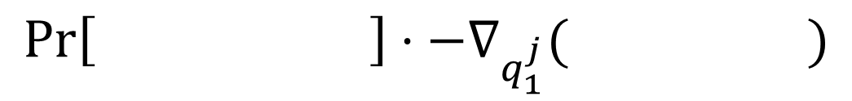
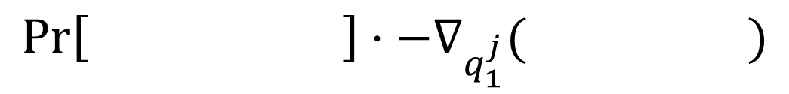
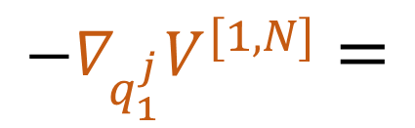


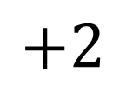


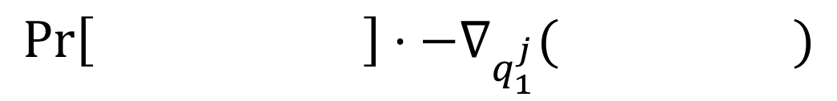
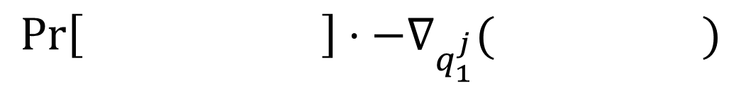
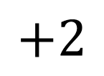

$$E^{(1)(2)(3)}$$
$${−∇}_{q_{1}^{j}}V^{[1,N]}=$$
1
$$P$$
$$1$$
2
1
$$P$$
$$1$$
2
$$Pr\left[ \right]⋅−∇_{q_{1}^{j}}( )$$
1
$$P$$
1
$$P$$
$$P$$
$$P$$
$$1$$
3
$$1$$
3
$$E^{(12)(3)}$$
$$+$$
1
$$P$$
$$1$$
2
1
$$P$$
$$1$$
2
$$Pr\left[ \right]⋅−∇_{q_{1}^{j}}( )$$
1
$$P$$
1
$$P$$
$$P$$
$$P$$
$$1$$
3
$$1$$
3
$$E^{(1)(23)}$$
$$+2$$
2
$$P$$
1
2
$$P$$
1
$$Pr\left[ \right]⋅−∇_{q_{1}^{j}}( )$$
$$P$$
$$1$$
$$1$$
$$P$$
$$1$$
$$1$$
1
$$P$$
1
$$P$$
3
3
$$E^{(123)}$$
$$+2$$
$$Pr\left[ \right]⋅−∇_{q_{1}^{j}}( )$$
1
$$P$$
$$1$$
2
1
$$P$$
$$1$$
2
1
$$P$$
1
$$P$$
$$P$$
$$P$$
3
$$1$$
3
$$1$$

Slide 32



$$E^{(1)(2)(3)}$$
$${−∇}_{q_{1}^{j}}V^{[1,N]}=$$
1
$$P$$
$$1$$
2
1
$$P$$
$$1$$
2
$$Pr\left[ \right]⋅−∇_{q_{1}^{j}}( )$$
1
$$P$$
1
$$P$$
$$P$$
$$P$$
$$1$$
3
$$1$$
3
$$E^{(12)(3)}$$
Weight of a permutation:
$$+$$
1
$$P$$
$$1$$
2
1
$$P$$
$$1$$
2
$$Pr\left[ \right]⋅−∇_{q_{1}^{j}}( )$$
1
$$P$$
1
$$P$$
1
$$P$$
$$1$$
$$P$$
$$∝$$
2
$$P$$
$$exp(−β⋅E\left( \right))$$
1
$$1$$
2
$$P$$
$$1$$
$$Pr\left[ \right]$$
3
$$1$$
3
1
$$P$$
1
$$P$$
$$P$$
$$P$$
$$1$$
$$E^{(1)(23)}$$
3
$$1$$
3
$$+2$$
2
$$P$$
1
2
$$P$$
1
$$Pr\left[ \right]⋅−∇_{q_{1}^{j}}( )$$
$$P$$
$$1$$
$$1$$
$$P$$
$$1$$
$$1$$
1
$$P$$
1
$$P$$
3
3
$$E^{(123)}$$
$$+2$$
$$Pr\left[ \right]⋅−∇_{q_{1}^{j}}( )$$
1
$$P$$
$$1$$
2
1
$$P$$
$$1$$
2
1
$$P$$
1
$$P$$
$$P$$
$$P$$
3
$$1$$
3
$$1$$

Slide 33

$$E^{(1)(2)(3)}$$
$${−∇}_{q_{1}^{j}}V^{[1,N]}=$$
1
$$P$$
$$1$$
2
1
$$P$$
$$1$$
2
$$Pr\left[ \right]⋅−∇_{q_{1}^{j}}( )$$
1
$$P$$
1
$$P$$
$$P$$
$$P$$
$$1$$
3
$$1$$
3
Interior bead
$$j≠1,P$$
$$E^{(12)(3)}$$
$$+$$
1
$$P$$
$$1$$
2
1
$$P$$
$$1$$
2
$$Pr\left[ \right]⋅−∇_{q_{1}^{j}}( )$$
1
$$P$$
1
$$P$$
$$P$$
$$P$$
$$1$$
3
$$1$$
3
$$E^{(1)(23)}$$
$$+2$$
2
$$P$$
1
2
$$P$$
1
$$Pr\left[ \right]⋅−∇_{q_{1}^{j}}( )$$
$$P$$
$$1$$
$$1$$
$$P$$
$$1$$
$$1$$
1
$$P$$
1
$$P$$
3
3
$$E^{(123)}$$
$$+2$$
$$Pr\left[ \right]⋅−∇_{q_{1}^{j}}( )$$
1
$$P$$
$$1$$
2
1
$$P$$
$$1$$
2
1
$$P$$
1
$$P$$
$$P$$
$$P$$
3
$$1$$
3
$$1$$

Slide 34
$$E^{(1)(2)(3)}$$
$${−∇}_{q_{1}^{j}}V^{[1,N]}=$$
1
$$P$$
$$1$$
2
1
$$P$$
$$1$$
2
$$Pr\left[ \right]⋅−∇_{q_{1}^{j}}( )$$
1
$$P$$
1
$$P$$
$$P$$
$$P$$
$$1$$
3
$$1$$
3
Interior bead
$$j≠1,P$$
$$E^{(12)(3)}$$
$$+$$
1
$$P$$
$$1$$
2
1
$$P$$
$$1$$
2
$$Pr\left[ \right]⋅−∇_{q_{1}^{j}}( )$$
1
$$P$$
1
$$P$$
$$P$$
$$P$$
$$1$$
3
$$1$$
3
$$E^{(1)(23)}$$
$$+2$$
2
$$P$$
1
2
$$P$$
1
$$Pr\left[ \right]⋅−∇_{q_{1}^{j}}( )$$
$$P$$
$$1$$
$$1$$
$$P$$
$$1$$
$$1$$
1
$$P$$
1
$$P$$
3
3
$$E^{(123)}$$
$$+2$$
$$Pr\left[ \right]⋅−∇_{q_{1}^{j}}( )$$
1
$$P$$
$$1$$
2
1
$$P$$
$$1$$
2
1
$$P$$
1
$$P$$
$$P$$
$$P$$
3
$$1$$
3
$$1$$

Slide 35

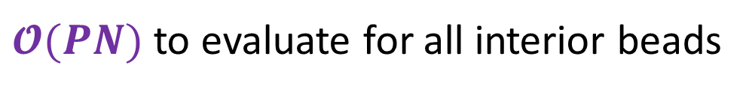


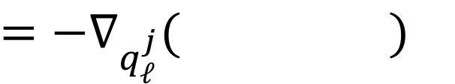
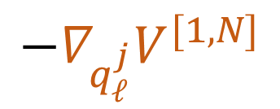

Evaluating the Forces: Interior Beads
$${−∇}_{q_{ℓ}^{j}}V^{[1,N]}$$
$$P$$
$=−∇_{q_{ℓ}^{j}}( )$
$$ℓ$$
$$j$$
1
Interior bead
$$j≠1,P$$
$𝓞(PN)$ to evaluate for all interior beads

Slide 36


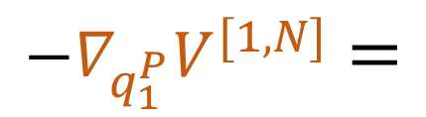
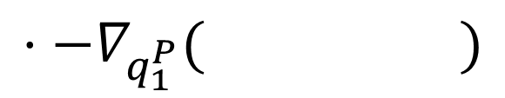
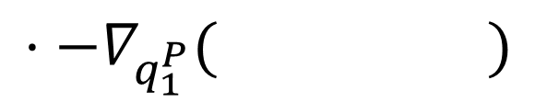

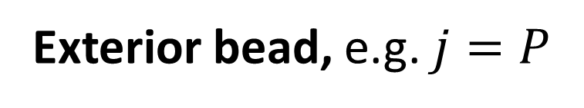
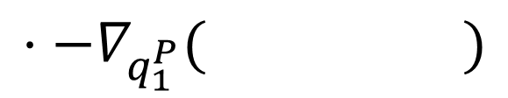

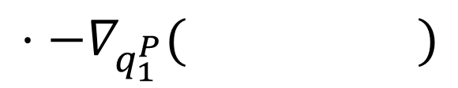
$$E^{(1)(2)(3)}$$
1
$$P$$
$$1$$
1
$$P$$
$$1$$
2
$${−∇}_{q_{1}^{P}}V^{[1,N]}=$$
2
$$⋅−∇_{q_{1}^{P}}( )$$
$$Pr\left[ \right]$$
1
$$P$$
1
$$P$$
$$P$$
$$P$$
$$1$$
3
$$1$$
3
Exterior bead, e.g. $j=P$
$$E^{(12)(3)}$$
$$+$$
1
$$P$$
$$1$$
2
1
$$P$$
$$1$$
2
$$Pr\left[ \right]$$
$$⋅−∇_{q_{1}^{P}}( )$$
1
$$P$$
1
$$P$$
$$P$$
$$P$$
$$1$$
3
$$1$$
3
$$E^{(1)(23)}$$
$$+2$$
2
$$P$$
1
2
$$P$$
1
$$Pr\left[ \right]$$
$$⋅−∇_{q_{1}^{P}}( )$$
$$P$$
$$1$$
$$1$$
$$P$$
$$1$$
$$1$$
1
$$P$$
1
$$P$$
3
3
$$E^{(123)}$$
$$+2$$
$$Pr\left[ \right]$$
1
$$P$$
$$1$$
1
$$P$$
$$1$$
2
$$⋅−∇_{q_{1}^{P}}( )$$
2
1
$$P$$
1
$$P$$
$$P$$
$$P$$
3
$$1$$
3
$$1$$

Slide 37
$$E^{(1)(2)(3)}$$
1
$$P$$
$$1$$
1
$$P$$
$$1$$
2
$${−∇}_{q_{1}^{P}}V^{[1,N]}=$$
2
$$⋅−∇_{q_{1}^{P}}( )$$
$$Pr\left[ \right]$$
1
$$P$$
1
$$P$$
$$P$$
$$P$$
$$1$$
3
$$1$$
3
Exterior bead, e.g. $j=P$
$$E^{(12)(3)}$$
$$+$$
1
$$P$$
$$1$$
2
1
$$P$$
$$1$$
2
$$Pr\left[ \right]$$
$$⋅−∇_{q_{1}^{P}}( )$$
1
$$P$$
1
$$P$$
$$P$$
$$P$$
$$1$$
3
$$1$$
3
$$E^{(1)(23)}$$
$$+2$$
2
$$P$$
1
2
$$P$$
1
$$Pr\left[ \right]$$
$$⋅−∇_{q_{1}^{P}}( )$$
$$P$$
$$1$$
$$1$$
$$P$$
$$1$$
$$1$$
1
$$P$$
1
$$P$$
3
3
$$E^{(123)}$$
$$+2$$
$$Pr\left[ \right]$$
1
$$P$$
$$1$$
1
$$P$$
$$1$$
2
$$⋅−∇_{q_{1}^{P}}( )$$
2
1
$$P$$
1
$$P$$
$$P$$
$$P$$
3
$$1$$
3
$$1$$

Slide 38





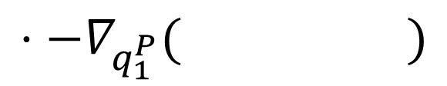









$$E^{(1)(2)(3)}$$
$$($$
1
$$P$$
$$1$$
2
$$+2$$
2
$$)$$
$${−∇}_{q_{1}^{P}}V^{[1,N]}=$$
$$P$$
1
$$Pr\left[ \right]$$
$$Pr\left[ \right]$$
1
$$P$$
$$1$$
$$E^{(1)(23)}$$
$$P$$
$$1$$
$$P$$
$$1$$
1
$$P$$
Exterior bead, e.g. $j=P$
3
3
1
$$P$$
$$1$$
2
$$⋅−∇_{q_{1}^{P}}( )$$
1
$$P$$
$$P$$
$$1$$
3
$$+$$
$$($$
1
$$P$$
$$1$$
2
$$+2$$
$$)$$
$$E^{(12)(3)}$$
$$Pr\left[ \right]$$
$$Pr\left[ \right]$$
1
$$P$$
$$1$$
2
1
$$P$$
1
$$P$$
$$E^{(123)}$$
$$P$$
$$P$$
3
$$1$$
3
$$1$$
1
$$P$$
$$1$$
$$⋅−∇_{q_{1}^{P}}( )$$
2
1
$$P$$
$$P$$
3
$$1$$

Slide 39
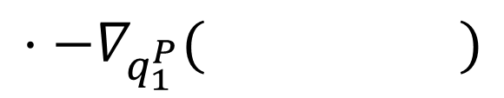






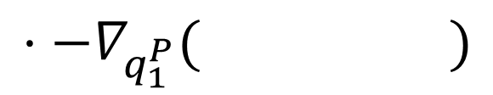
$$($$
$$)$$
$$P$$
$$1$$
$${−∇}_{q_{1}^{P}}V^{[1,N]}=$$
$$Pr\left[1→1\right]$$
1
2
$$⋅−∇_{q_{1}^{P}}( )$$
1
$$P$$
$$P$$
$$1$$
Exterior bead, e.g. $j=P$
3
$$($$
$$)$$
1
$$P$$
$$1$$
$$⋅−∇_{q_{1}^{P}}( )$$
$$+$$
$$Pr\left[1→2\right]$$
2
1
$$P$$
$$P$$
3
$$1$$

Slide 40







Evaluating the Forces: Exterior Beads
$${−∇}_{q_{ℓ}^{P}}V^{[1,N]}$$
$$P$$
$$1$$
$=\sum_{ℓ^{′}=1}^{N}{Pr}\left[ℓ→ℓ^{′}\right]⋅−∇_{q_{ℓ}^{P}}( )$
$$ℓ$$
$$ℓ′$$
1
$$P$$
Once $Pr\left[ℓ→ℓ^{′}\right]$are known, $𝓞(N)$ to evaluate per exterior bead,
$𝓞(N^{2})$ in total
$𝓞(N^{2})$ to evaluate all $Pr\left[ℓ→ℓ^{′}\right]$ through another recurrence relation
Feldman and Hirshberg. arXiv:2305.18025

Slide 41




Evaluating the Forces: Summary
$${−∇}_{q_{ℓ}^{j}}V^{[1,N]}$$
$$P$$
$=−∇_{q_{ℓ}^{j}}( )$
$$ℓ$$
$$j$$
1
$$(j≠1,P)$$
$𝓞(PN)$ to evaluate for all interior beads
$${−∇}_{q_{ℓ}^{P}}V^{[1,N]}$$
$$P$$
$$1$$
$=\sum_{ℓ^{′}=1}^{N}{Pr}\left[ℓ→ℓ^{′}\right]⋅−∇_{q_{ℓ}^{P}}( )$
$$ℓ$$
$$ℓ′$$
1
$$P$$
$𝓞(N^{2})$ to evaluate all $Pr\left[ℓ→ℓ^{′}\right]$ through another recurrence relation
Feldman and Hirshberg. arXiv:2305.18025

Slide 42
Conclusion
Bosonic path integral molecular dynamics in quadratic time
​Same potential, forces, and dynamics, with less computational cost
Implemented in LAMMPS and i-Pi
​> 1000 bosons in days rather than decades
Eliminates most of the overhead of bosonic exchange in PIMD
@yotamfe, @barak_hirshberg
arXiv:2305.18025

Slide 44
The Cost of Bosonic Exchange in i-Pi

Slide 45

Hirshberg et al.’s Recurrence Relations
Potential:
$$e^{−βV^{[1,N]}}=\frac{1}{N}\sum_{k=1}^{N}{e^{−β\left[V^{[1,N−k]}+E^{[N−k+1,N]}\right]}}$$
Forces:
${−∇}_{q_{ℓ}^{j}}V^{[1,N]}=$ $$−\sum_{k=1}^{N}{\frac{e^{−β\left[V^{[1,N−k]}+E^{[N−k+1,N]}\right]}}{e^{−βV^{[1,N]}}}⋅\left(∇_{q_{ℓ}^{j}}V^{\left[1,N−k\right]}+∇_{q_{ℓ}^{j}}E^{\left[N−k+1,N\right]}\right)}$$

Slide 46









Connection Probabilities
$$Pr\left[1→1\right]=$$
1
$$P$$
$$1$$
2
$$+2$$
2
$$P$$
1
$$Pr\left[ \right]$$
$$Pr\left[ \right]$$
1
$$P$$
$$P$$
$$1$$
$$1$$
$$P$$
$$1$$
1
$$P$$
3
3
$$=\frac{1}{e^{−βV^{[1,3]}}}⋅e^{−βE^{[1,1]}}⋅e^{−βV^{[2,3]}}$$
$$Pr\left[1→2\right]=$$
1
$$P$$
$$1$$
2
$$+2$$
$$Pr\left[ \right]$$
$$Pr\left[ \right]$$
1
$$P$$
$$1$$
2
1
$$P$$
1
$$P$$
$$P$$
$$P$$
3
$$1$$
3
$$1$$
$$=1−\frac{1}{e^{−βV^{[1,3]}}}⋅e^{−βV^{[1,1]}}⋅e^{−βV^{[2,3]}}$$

Slide 47

Hirshberg et al.’s Recurrence Relations
$$e^{−βV^{[1,N]}}=\frac{1}{N}\sum_{k=1}^{N}{e^{−β\left[V^{[1,N−k]}+E^{[N−k+1,N]}\right]}}$$

Slide 48


Yet Another Recurrence Relation
$$e^{−βV^{[1,N]}}=\frac{1}{N}\sum_{k=1}^{N}{e^{−β\left[V^{[1,N−k]}+E^{[N−k+1,N]}\right]}}$$
$$e^{−βV^{[u,N]}}=\sum_{ℓ=u}^{N}{{\frac{1}{ℓ}e}^{−β\left[E^{[u,ℓ]}+V^{[ℓ+1,N]}\right]}}$$
$𝓞(N^{2})$ to evaluate

