Slide 1


Invariant Inference With Provable Complexity From the Monotone Theory
Yotam Feldman
Sharon Shoham
@yotamfe

Slide 2





Safety of Transition Systems
Init:
$δ$:
$${(x}_{n},…,x_{0}) ≔ 00…00$$
$$\left(x_{n},…,x_{0}\right)≔\left(x_{n},…,x_{0}\right)+00…10$$
Bad:
$${(x}_{n},…,x_{0}) = 10…01$$
$$Bad$$
$$Init$$

Slide 3









Inductive Invariants
Init:
$δ$:
Goal:
Find inductive invariants automatically
$${(x}_{n},…,x_{0}) ≔ 00…00$$
$$\left(x_{n},…,x_{0}\right)≔\left(x_{n},…,x_{0}\right)+00…10$$
Bad:
$${(x}_{n},…,x_{0}) = 10…01$$
$$Bad$$
$I$: ${(x}_{n},…,x_{0}) ≠ 10…01$
Not inductive:
$$01…1$$
$$10…01$$
$$δ$$
$$I$$
$$¬I$$
$I$: $x_{0}=0$
Inductive:
$$Init$$
$$x_{0}=0$$
$$I$$
$$δ$$

Slide 4
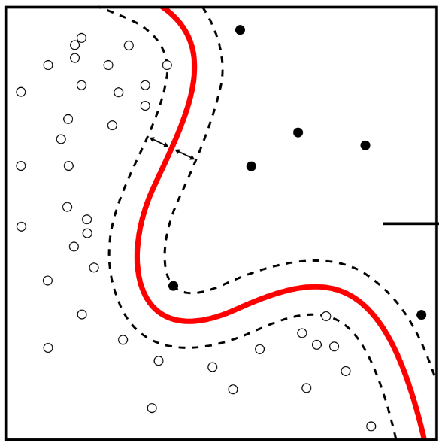
Learning and Invariant Inference
Invariant Inference
Exact Concept Learning
vs.
theory & algorithms
theory & algorithms

Slide 5
This Work
Invariant Inference
Exact Concept Learning
vs.
Abstract interpretation & interpolation with provable complexity
Monotone theory [Bshouty]

Slide 6
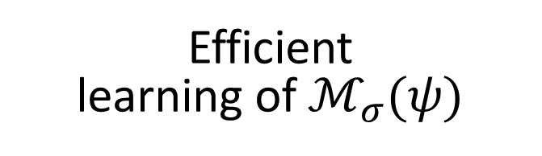
The Monotone Theory
Efficient learning of $ℳ_{σ}(ψ)$
“monotonization”
Efficient learning of complex formulas

Slide 7

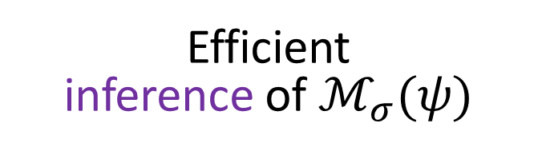
This Work
Efficient inference of $ℳ_{σ}(ψ)$
Efficient inference of complex invariants
(No efficient way to implement in invariant inference a teacher for equivalence and membership queries.)
[POPL’20] Complexity and Information in Invariant Inference. F., Immerman, Shoham, Sagiv

Slide 8

This Work
Efficient inference of $ℳ_{σ}(ψ)$
Efficient abstract interpretation in $MSpan\left(ℬ\right)$
Efficient inference of complex invariants
with provable complexity

Slide 9
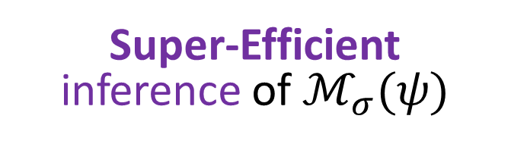
This Work
Super-Efficient inference of $ℳ_{σ}(ψ)$
Efficient abstract interpretation in $MSpan\left(ℬ\right)$
Efficient inference of complex invariants
with provable complexity

Slide 10
This Work
Super-Efficient inference of $ℳ_{σ}(ψ)$
Efficient abstract interpretation in $MSpan\left(ℬ\right)$
Efficient inference of complex invariants
Goal:
Efficiently infer complex invariants beyond monotone

Slide 11



Model-Based Interpolation
$$Bad$$
$$σ$$
$$Init$$
[HVC’12] Computing Interpolants without Proofs. Chockler, Ivrii, Matsliah [LPAR’13] Instantiations, Zippers and EPR Interpolation. Bjørner, Gurfinkel, Korovin, Lahav

Slide 12
Model-Based Interpolation
$$Bad$$
$$σ$$
$$Init$$
[HVC’12] Computing Interpolants without Proofs. Chockler, Ivrii, Matsliah [LPAR’13] Instantiations, Zippers and EPR Interpolation. Bjørner, Gurfinkel, Korovin, Lahav

Slide 13
Model-Based Interpolation
$$Bad$$
$$σ$$
$$Init$$
[HVC’12] Computing Interpolants without Proofs. Chockler, Ivrii, Matsliah [LPAR’13] Instantiations, Zippers and EPR Interpolation. Bjørner, Gurfinkel, Korovin, Lahav

Slide 14

Model-Based Interpolation
$$Bad$$
$$σ$$
$$Init$$
$$Init$$
$$Init$$
BMC($δ,Init,k$)$∩σ=∅$
Bounded model checking
[HVC’12] Computing Interpolants without Proofs. Chockler, Ivrii, Matsliah [LPAR’13] Instantiations, Zippers and EPR Interpolation. Bjørner, Gurfinkel, Korovin, Lahav

Slide 15


Model-Based Interpolation
$$χ$$
$$Bad$$
$$σ$$
$$Init$$
BMC($δ,Init,k$)$∩χ=∅$
[HVC’12] Computing Interpolants without Proofs. Chockler, Ivrii, Matsliah [LPAR’13] Instantiations, Zippers and EPR Interpolation. Bjørner, Gurfinkel, Korovin, Lahav

Slide 16
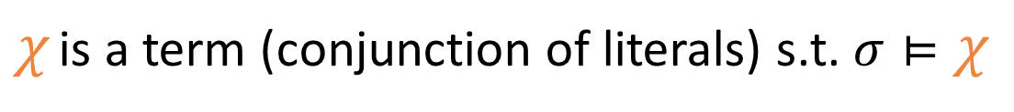
Model-Based Interpolation
$$χ$$
$$Bad$$
$$σ$$
$$Init$$
BMC($δ,Init,k$)$∩χ=∅$
$χ$ is a term (conjunction of literals) s.t. $σ⊨χ$
[HVC’12] Computing Interpolants without Proofs. Chockler, Ivrii, Matsliah [LPAR’13] Instantiations, Zippers and EPR Interpolation. Bjørner, Gurfinkel, Korovin, Lahav

Slide 17
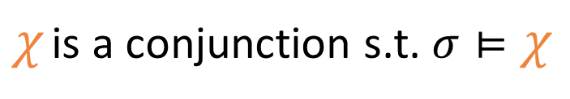
Model-Based Interpolation
$$χ$$
$$Bad$$
$$σ: \left(x_{n}=1\right)∧\left(x_{n−1}=0\right)∧…∧\left(x_{1}=0\right)∧(x_{0}=1)$$
$$χ: \left(x_{n}=1\right)∧\left(x_{n−1}=0\right)∧…∧\left(x_{1}=0\right)∧(x_{0}=1)$$
$$I: I∧¬\left(\left(x_{n}=1\right)∧(x_{0}=1)\right)$$
$$σ$$
$$Init$$
BMC($δ,Init,k$)$∩χ=∅$
$χ$ is a conjunction s.t. $σ⊨χ$
[HVC’12] Computing Interpolants without Proofs. Chockler, Ivrii, Matsliah [LPAR’13] Instantiations, Zippers and EPR Interpolation. Bjørner, Gurfinkel, Korovin, Lahav

Slide 18
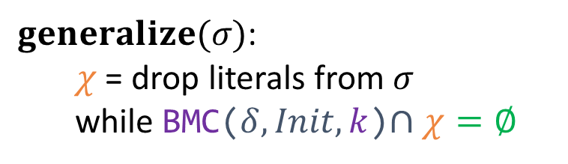



Model-Based Interpolation
Inferring invariant in CNF:
$$\left(ℓ_{1}^{1}∨…∨ℓ_{k_{1}}^{1}\right)∧ …∧\left(ℓ_{1}^{m}∨…∨ℓ_{k_{m}}^{m}\right)$$
gen($σ_{1})$
gen($σ_{m})$
$I$ := $¬Bad$
while $(σ, _)$ counterexample to Inductive($δ,I)$:
$I$ := $I∧¬generalize\left(σ\right)$
$generalize(σ)$: $χ$ = drop literals from $σ$ while BMC($δ,Init,k$)$∩χ=∅$
[HVC’12] Computing Interpolants without Proofs. Chockler, Ivrii, Matsliah [LPAR’13] Instantiations, Zippers and EPR Interpolation. Bjørner, Gurfinkel, Korovin, Lahav

Slide 19
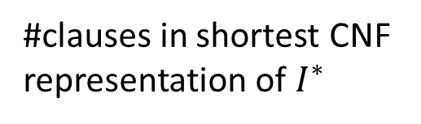
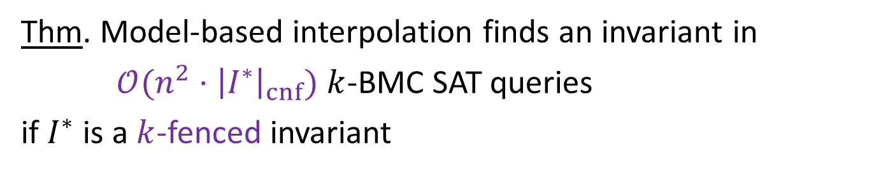
Model-Based Interpolation
Thm. Model-based interpolation finds an invariant in
$𝒪({n^{2}⋅\left|I^{∗}\right|}_{cnf})$ $k$-BMC SAT queries
if $I^{∗}$ is a $k$-fenced invariant
which is monotone.
#variables
#clauses in shortest CNF representation of $I^{∗}$
$I$ := $¬Bad$
while $(σ, _)$ counterexample to Inductive($δ,I)$:
$I$ := $I∧¬generalize\left(σ\right)$
$generalize(σ)$: $χ$ = drop literals from $σ$ while BMC($δ,Init,k$)$∩χ=∅$
[POPL’21] Learning the Boundary of Inductive Invariants. F., Sagiv, Shoham, Wilcox

Slide 20





Model-Based Interpolation
Thm. Model-based interpolation finds an invariant in
$𝒪({n^{2}⋅\left|I^{∗}\right|}_{cnf})$ $k$-BMC SAT queries
if $I^{∗}$ is a $k$-fenced invariant
which is monotone.
$$(1,1,1)$$
$$(0,1,0)$$
$$(0,0,1)$$
$$(0,0,0)$$
$$(1,0,0)$$
[POPL’21] Learning the Boundary of Inductive Invariants. F., Sagiv, Shoham, Wilcox

Slide 21


Model-Based Interpolation
Thm. Model-based interpolation finds an invariant in
$𝒪({n^{2}⋅\left|I^{∗}\right|}_{cnf})$ $k$-BMC SAT queries
if $I^{∗}$ is a $k$-fenced invariant
which is monotone.
$$¬I^{∗}$$
$$(1,1,1)$$
$$(0,1,0)$$
$$(0,0,1)$$
$$(0,0,0)$$
$$(1,0,0)$$
$$I^{∗}$$
[POPL’21] Learning the Boundary of Inductive Invariants. F., Sagiv, Shoham, Wilcox

Slide 22
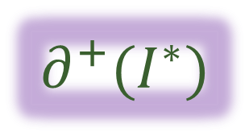
Model-Based Interpolation
Thm. Model-based interpolation finds an invariant in
$𝒪({n^{2}⋅\left|I^{∗}\right|}_{cnf})$ $k$-BMC SAT queries
if $I^{∗}$ is a $k$-fenced invariant
which is monotone.
$$¬I^{∗}$$
$$(1,1,1)$$
Boundary:
$$(0,1,0)$$
$$∂^{+}(I^{∗})$$
$$(0,0,1)$$
$$(0,0,0)$$
$$(1,0,0)$$
$$I^{∗}$$
[POPL’21] Learning the Boundary of Inductive Invariants. F., Sagiv, Shoham, Wilcox

Slide 23
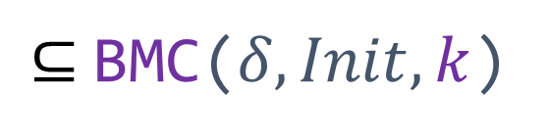

Model-Based Interpolation
Thm. Model-based interpolation finds an invariant in
$𝒪({n^{2}⋅\left|I^{∗}\right|}_{cnf})$ $k$-BMC SAT queries
if $I^{∗}$ is a $k$-fenced invariant
which is monotone.
$$¬I^{∗}$$
$$(1,1,1)$$
Fence condition:
$$(0,1,0)$$
$$∂^{+}(I^{∗})$$
$⊆$BMC($δ,Init,k$)
$$(0,0,1)$$
$$(0,0,0)$$
$$(1,0,0)$$
$$I^{∗}$$
[POPL’21] Learning the Boundary of Inductive Invariants. F., Sagiv, Shoham, Wilcox

Slide 24
Model-Based Interpolation
Thm. Model-based interpolation finds an invariant in
$𝒪({n^{2}⋅\left|I^{∗}\right|}_{cnf})$ $k$-BMC SAT queries
if $I^{∗}$ is a $k$-fenced invariant
All variables appear positively (un-negated)
which is monotone.
[POPL’21] Learning the Boundary of Inductive Invariants. F., Sagiv, Shoham, Wilcox

Slide 25
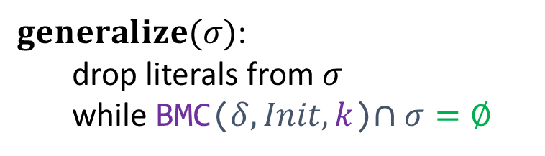

Model-Based Interpolation
Thm. Model-based interpolation finds an invariant in
$𝒪({n^{2}⋅\left|I^{∗}\right|}_{cnf})$ $k$-BMC SAT queries
if $I^{∗}$ is a $k$-fenced invariant
All variables appear positively (un-negated)
which is monotone.
Example:
$I$ := $¬Bad$
while $(σ, _)$ counterexample to Inductive($δ,I)$:
$I$ := $I∧¬generalize\left(σ\right)$
$$\left((x_{n}=1\right)∧\left(x_{0}=1\right))∨(x_{2}=1)$$
monotone
$$\left((x_{n}=1\right)∧\left(x_{0}=0\right))∨(x_{2}=1)$$
not monotone
$generalize(σ)$: drop literals from $σ$ while BMC($δ,Init,k$)$∩σ=∅$
[POPL’21] Learning the Boundary of Inductive Invariants. F., Sagiv, Shoham, Wilcox

Slide 26
Model-Based Interpolation
Thm. Model-based interpolation finds an invariant in
$𝒪({n^{2}⋅\left|I^{∗}\right|}_{cnf})$ $k$-BMC SAT queries
if $I^{∗}$ is a $k$-fenced invariant
which is monotone.
Example: At least two variables 0, at least two variables 1
$I$ := $¬Bad$
while $(σ, _)$ counterexample to Inductive($δ,I)$:
$I$ := $I∧¬generalize\left(σ\right)$
$$I^{∗}=⋁_{i_{1}≠i_{2}≠i_{3}≠i_{4}}\left(x_{i_{1}}=0∧x_{i_{2}}=0∧x_{i_{3}}=1∧x_{i_{4}}=1\right)$$
$generalize(σ)$: drop literals from $σ$ while BMC($δ,Init,k$)$∩σ=∅$
[POPL’21] Learning the Boundary of Inductive Invariants. F., Sagiv, Shoham, Wilcox

Slide 27
Model-Based Interpolation
Thm. Model-based interpolation finds an invariant in
$𝒪({n^{2}⋅\left|I^{∗}\right|}_{cnf})$ $k$-BMC SAT queries
if $I^{∗}$ is a $k$-fenced invariant
which is monotone.
Goal:
Efficiently infer complex invariants beyond monotone

Slide 28
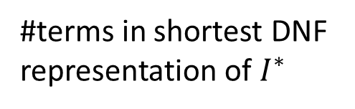
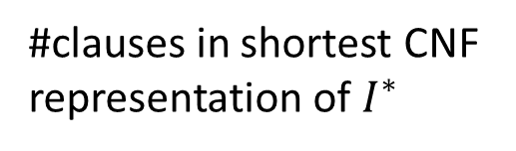
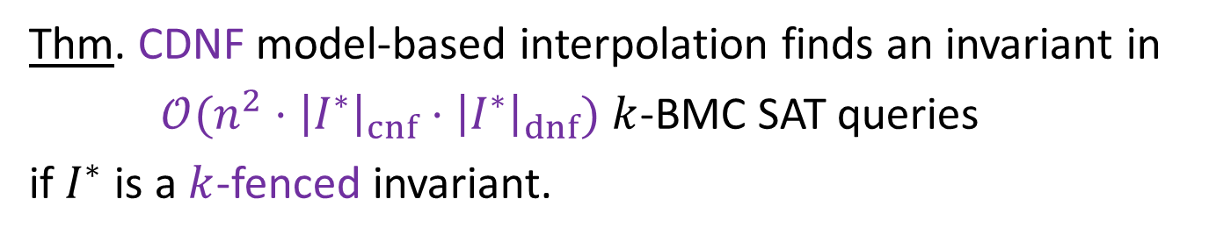
CDNF Interpolation
Thm. CDNF model-based interpolation finds an invariant in
$𝒪({n^{2}⋅\left|I^{∗}\right|}_{cnf}⋅{\left|I^{∗}\right|}_{dnf})$ $k$-BMC SAT queries
if $I^{∗}$ is a $k$-fenced invariant.
#variables
#clauses in shortest CNF representation of $I^{∗}$
#terms in shortest DNF representation of $I^{∗}$

Slide 29



CDNF Interpolation
Thm. CDNF model-based interpolation finds an invariant in
$𝒪({n^{2}⋅\left|I^{∗}\right|}_{cnf}⋅{\left|I^{∗}\right|}_{dnf})$ $k$-BMC SAT queries
if $I^{∗}$ is a $k$-fenced invariant.
Example: At least two variables 0, at least two variables 1
$$I^{∗}=⋁_{i_{1}≠i_{2}≠i_{3}≠i_{4}}\left(x_{i_{1}}=0∧x_{i_{2}}=0∧x_{i_{3}}=1∧x_{i_{4}}=1\right)$$
$${\left|I^{∗}\right|}_{dnf}≤𝒪(n^{4})$$
$I^{∗}=\left(⋀_{i}⋁_{j≠i} x_{j}=0\right) ⋀$ $\left(⋀_{i}⋁_{j≠i} x_{j}=1\right)$
$${\left|I^{∗}\right|}_{cnf}≤𝒪(n)$$
$⟹$ efficient inference

Slide 30
CDNF Interpolation
Thm. CDNF model-based interpolation finds an invariant in
$𝒪({n^{2}⋅\left|I^{∗}\right|}_{cnf}⋅{\left|I^{∗}\right|}_{dnf})$ $k$-BMC SAT queries
if $I^{∗}$ is a $k$-fenced invariant.
Efficient for Boolean decision trees

Slide 31
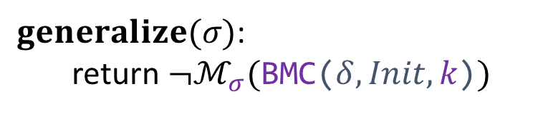
CDNF Interpolation
Thm. CDNF model-based interpolation finds an invariant in
$𝒪({n^{2}⋅\left|I^{∗}\right|}_{cnf}⋅{\left|I^{∗}\right|}_{dnf})$ $k$-BMC SAT queries
if $I^{∗}$ is a $k$-fenced invariant.
$I$ := $¬Bad$
while $(σ, _)$ counterexample to Inductive($δ,I)$:
$I$ := $I∧¬generalize\left(σ\right)$
$generalize(σ)$: return $¬ℳ_{σ}(\text{BMC}\text{(}δ,Init,k\text{)})$

Slide 32
This Work
Super-Efficient inference of $ℳ_{σ}(ψ)$
Efficient abstract interpretation in $MSpan\left(ℬ\right)$
Efficient inference of CDNF invariants

Slide 33

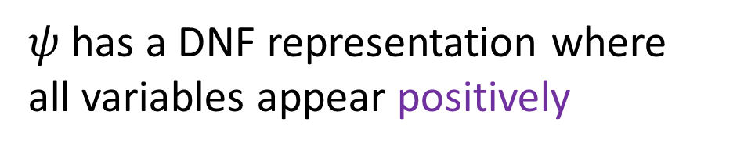


Monotone Formulas
Def:
$$ψ$$
is monotone
$$⟺$$
$ψ$ has a DNF representation where all variables appear positively
$$v⊨ψ ⟹ v\left[x_{i}↦1\right]⊨ψ$$

Slide 34



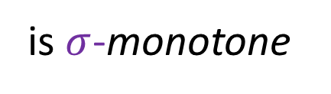

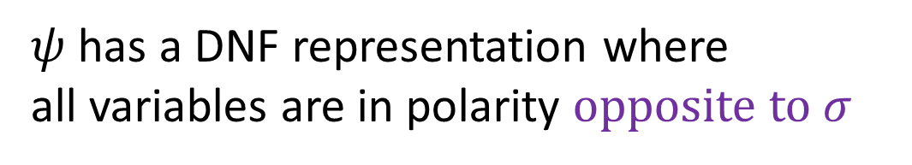
$σ$-Monotone Formulas
Def:
$$ψ$$
is $σ$-monotone
$$⟺$$
$ψ$ has a DNF representation where all variables are in polarity opposite to $σ$
$$σ=00…00$$
$$\left((x_{n}=1\right)∧\left(x_{0}=1\right))∨(x_{2}=1)$$
$00…00$-monotone
$$\left((x_{n}=1\right)∧\left(x_{0}=0\right))∨(x_{2}=1)$$
not $00…00$-monotone

Slide 35



$σ$-Monotone Formulas
Def:
$$ψ$$
is $σ$-monotone
$$⟺$$
$ψ$ has a DNF representation where all variables are in polarity opposite to $σ$
$$σ=00…10$$
$$\left((x_{n}=1\right)∧\left(x_{0}=1\right))∨(x_{2}=1)$$
not $00…10$-monotone
$$\left((x_{n}=1\right)∧\left(x_{0}=0\right))∨(x_{2}=1)$$
$00…10$-monotone

Slide 36


$σ$-Monotone Formulas
Def:
$$ψ$$
is $σ$-monotone
$$⟺$$
$ψ$ has a DNF representation where all variables are in polarity opposite to $σ$
$$v⊨ψ ⟹ v\left[x_{i}↦¬σ[x_{i}]\right]⊨ψ$$

Slide 37


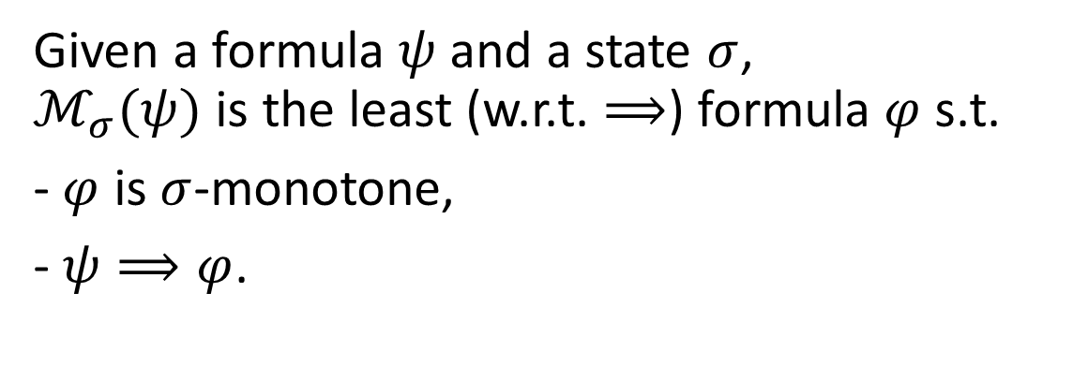
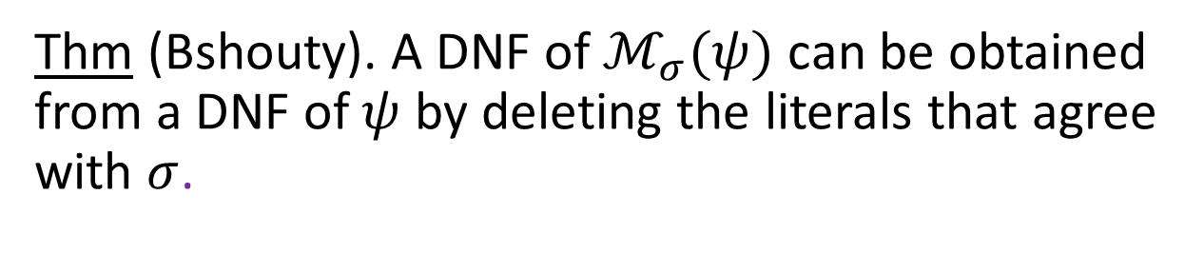
Monotonization
Given a formula $ψ$ and a state $σ$, $ℳ_{σ}(ψ)$ is the least (w.r.t. $⟹$) formula $φ$ s.t.
- $φ$ is $σ$-monotone,
- $ψ⟹φ$.
$$x_{n}=0∧x_{n−1}=0∧…{∧x}_{1}=0∧x_{0}=0$$
Example:
$$ψ:$$
$$ℳ_{10…01}(ψ):$$
$$x_{n}=0∧x_{n−1}=0∧…{∧x}_{1}=0∧x_{0}=0$$
Thm (Bshouty). A DNF of $ℳ_{σ}(ψ)$ can be obtained from a DNF of $ψ$ by deleting the literals that agree with $σ$.

Slide 38
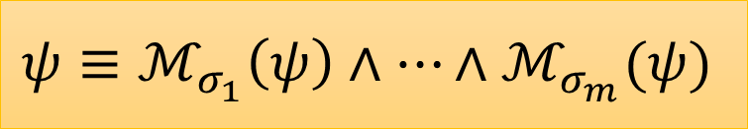
The Monotone Theory
Efficient learning of $ℳ_{σ}(ψ)$
Efficient learning of CDNF formulas
$$ψ≡ℳ_{σ_{1}}\left(ψ\right)∧…∧ℳ_{σ_{m}}(ψ)$$

Slide 39
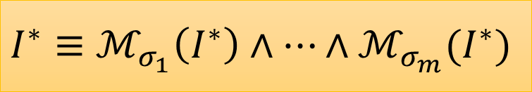
This Work
Efficient inference of $ℳ_{σ}(ψ)$
Efficient inference of CDNF invariants
$$I^{∗}≡ℳ_{σ_{1}}\left(I^{∗}\right)∧…∧ℳ_{σ_{m}}(I^{∗})$$

Slide 40
CDNF Interpolation
Thm. CDNF model-based interpolation finds an invariant in
$𝒪({n^{2}⋅\left|I^{∗}\right|}_{cnf}⋅{\left|I^{∗}\right|}_{dnf})$ $k$-BMC SAT queries
if $I^{∗}$ is a $k$-fenced invariant.
$I$ := $¬Bad$
while $(σ, _)$ counterexample to Inductive($δ,I)$:
$I$ := $I∧¬generalize\left(σ\right)$
$generalize(σ)$: return $¬ℳ_{σ}(\text{BMC}\text{(}δ,Init,k\text{)})$

Slide 41



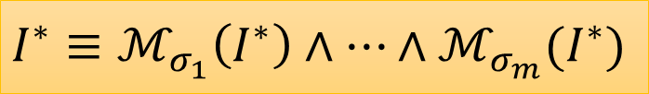
Proof Idea
Thm. CDNF model-based interpolation finds an invariant in
$𝒪({n^{2}⋅\left|I^{∗}\right|}_{cnf}⋅{\left|I^{∗}\right|}_{dnf})$ $k$-BMC SAT queries
if $I^{∗}$ is a $k$-fenced invariant.
$$ℳ_{σ}(\text{BMC}\text{(}δ,Init,k\text{)})$$
Claim. If $I^{∗}$ is $k$-fenced,
$${=ℳ}_{σ}(I^{∗})$$
$$I^{∗}≡ℳ_{σ_{1}}\left(I^{∗}\right)∧…∧ℳ_{σ_{m}}(I^{∗})$$

Slide 42
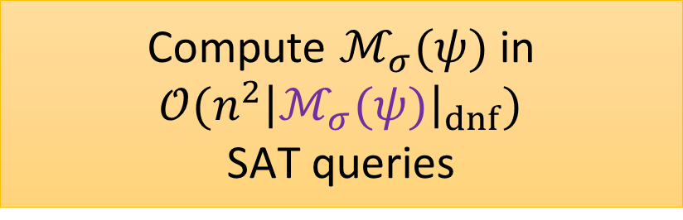
Super-Efficient Monotonization
Thm. CDNF model-based interpolation finds an invariant in
$𝒪({n^{2}⋅\left|I^{∗}\right|}_{cnf}⋅{\left|I^{∗}\right|}_{dnf})$ $k$-BMC SAT queries
if $I^{∗}$ is a $k$-fenced invariant.
$I$ := $¬Bad$
while $(σ, _)$ counterexample to Inductive($δ,I)$:
$I$ := $I∧¬generalize\left(σ\right)$
Compute $ℳ_{σ}(ψ)$ in $𝒪(n^{2}{\left|ℳ_{σ}(ψ)\right|}_{dnf})$ SAT queries
$generalize(σ)$: return $¬ℳ_{σ}(\text{BMC}\text{(}δ,Init,k\text{)})$

Slide 43

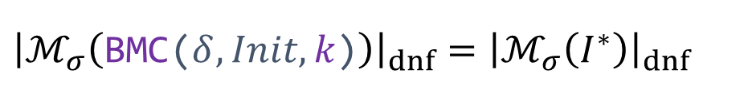
Proof Idea
Thm. CDNF model-based interpolation finds an invariant in
$𝒪({n^{2}⋅\left|I^{∗}\right|}_{cnf}⋅{\left|I^{∗}\right|}_{dnf})$ $k$-BMC SAT queries
if $I^{∗}$ is a $k$-fenced invariant.
$$ℳ_{σ}(\text{BMC}\text{(}δ,Init,k\text{)})$$
Claim. If $I^{∗}$ is $k$-fenced,
$${=ℳ}_{σ}(I^{∗})$$
Corollary.
$${\left|ℳ_{σ}\left(\text{BMC}\text{(}δ,Init,k\text{)}\right)\right|}_{dnf}={\left|ℳ_{σ}\left(I^{∗}\right)\right|}_{dnf}$$
$${≤\left|I^{∗}\right|}_{dnf}$$

Slide 44
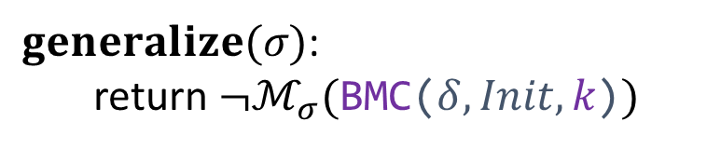
CDNF Interpolation
Thm. CDNF model-based interpolation finds an invariant in
$𝒪({n^{2}⋅\left|I^{∗}\right|}_{cnf}⋅{\left|I^{∗}\right|}_{dnf})$ $k$-BMC SAT queries
if $I^{∗}$ is a $k$-fenced invariant.
$I$ := $¬Bad$
while $(σ, _)$ counterexample to Inductive($δ,I)$:
$I$ := $I∧¬generalize\left(σ\right)$
Significantly different from Bshouty’s CDNF learning algorithm
$generalize(σ)$: return ${¬ℳ}_{σ}(\text{BMC}\text{(}δ,Init,k\text{)})$

Slide 45
This Work
Super-Efficient inference of $ℳ_{σ}(ψ)$
Efficient abstract interpretation in $MSpan\left(ℬ\right)$
Efficient inference of CDNF invariants

Slide 46


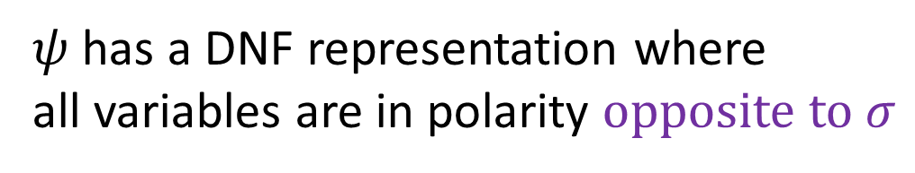

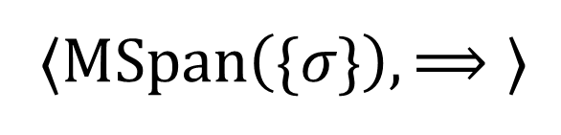

As an Abstract Domain
Def:
$$ψ$$
is $σ$-monotone
$$⟺$$
$ψ$ has a DNF representation where all variables are in polarity opposite to $σ$
Notation:
$$ψ∈MSpan(\left\{σ\right\})$$
$$γ$$
$$\text{⟨}C, ⊆\text{⟩}$$
⟨$MSpan\left(\{σ\}\right), ⟹\text{⟩}$
$$α$$

Slide 47

As an Abstract Domain
Def:
$$ψ$$
is $σ$-monotone
$$⟺$$
$ψ$ has a DNF representation where all variables are in polarity opposite to $σ$
Notation:
$$ψ∈MSpan(\left\{σ\right\})$$
$$γ$$
$$\text{⟨}C, ⊆\text{⟩}$$
⟨$MSpan\left(\{σ\}\right), ⟹\text{⟩}$
$$α=𝓜_{σ}$$
Used to study overapproxmation in property-directed reachability (IC3/PDR)
[POPL’22] Property-directed reachability as abstract interpretation in the monotone theory. F., Sagiv, Shoham, Wilcox

Slide 48
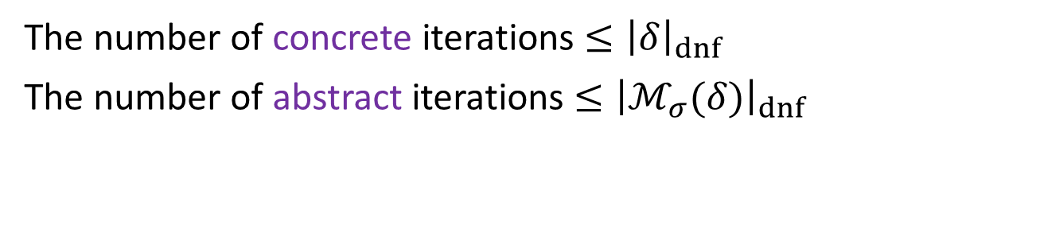
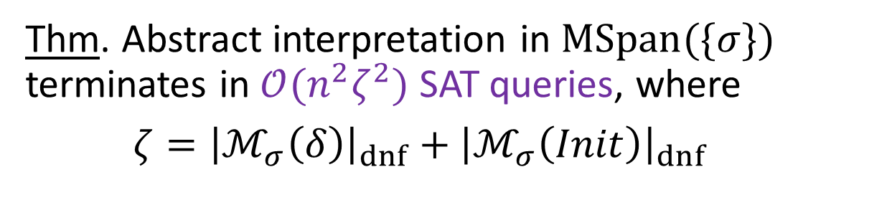
Efficient Abstract Interpretation
Thm. Abstract interpretation in $MSpan(\{σ\})$ terminates in $𝒪(n^{2}ζ^{2})$ SAT queries, where
$ζ={\left|ℳ_{σ}\left(δ\right)\right|}_{dnf}+{\left|ℳ_{σ}\left(Init\right)\right|}_{dnf}$
indicator of overapproximation
The number of concrete iterations $≤{\left|δ\right|}_{dnf}$
The number of abstract iterations $≤{\left|ℳ_{σ}(δ)\right|}_{dnf}$
[POPL’22] Property-directed reachability as abstract interpretation in the monotone theory. F., Sagiv, Shoham, Wilcox

Slide 49
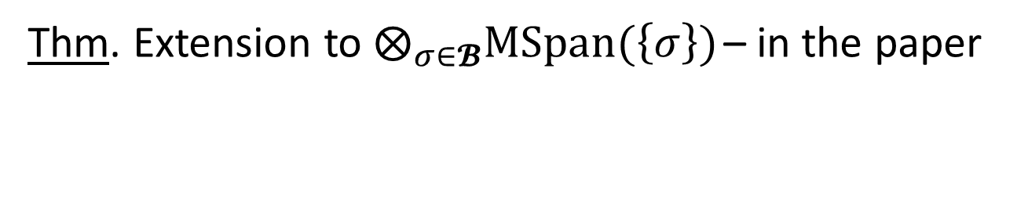
Efficient Abstract Interpretation
Thm. Abstract interpretation in $MSpan(\{σ\})$ terminates in $𝒪(n^{2}ζ^{2})$ SAT queries, where
$ζ={\left|ℳ_{σ}\left(δ\right)\right|}_{dnf}+{\left|ℳ_{σ}\left(Init\right)\right|}_{dnf}$
Thm. Extension to $⨂_{σ∈𝓑}MSpan(\left\{σ\right\})$ – in the paper

Slide 50


Invariant Inference from the Monotone Theory
Super-Efficient inference of $ℳ_{σ}(ψ)$
Efficient abstract interpretation in $MSpan\left(ℬ\right)$
Efficient inference of CDNF invariants

Slide 53







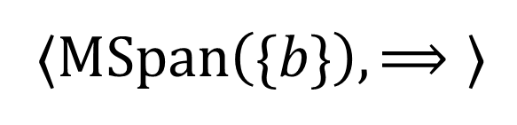
Monotone Span Domain
$$γ$$
$$\text{⟨}C, ⊆\text{⟩}$$
⟨$MSpan\left(\{b\}\right), ⟹\text{⟩}$
$$α$$
$$true$$
$$ψ$$
$$γ$$
$$false$$

Slide 54





Monotone Span Domain
$$γ$$
$$\text{⟨}C, ⊆\text{⟩}$$
⟨$MSpan\left(\{b\}\right), ⟹\text{⟩}$
$$α$$
$$b=10…01$$
$$true$$
$$\{00…00\}$$
$$α$$
$$φ$$
$${: x}_{n}=0∧x_{0}=0$$
$$false$$

Slide 55

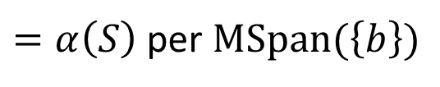
Monotone Span Domain
$$γ$$
$$\text{⟨}C, ⊆\text{⟩}$$
⟨$MSpan\left(\{b\}\right), ⟹\text{⟩}$
$$α$$
$$b=10…01$$
$$ℳ_{b}\left(S\right)$$
$=α\left(S\right)$ per $MSpan(\left\{b\right\})$
$$\{00…00\}$$
$$α$$
$$φ$$
$${: x}_{n}=0∧x_{0}=0$$
$$false$$

Slide 56




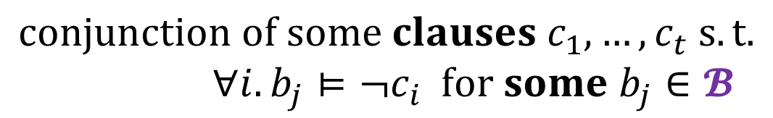

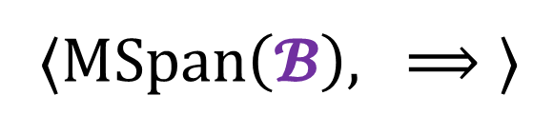


Monotone Span (Full)
$$γ$$
$$\text{⟨}C, ⊆\text{⟩}$$
⟨$MSpan\left(\{b\}\right), ⟹\text{⟩}$
$$α$$
$$γ$$
$$\text{⟨}C, ⊆\text{⟩}$$
⟨$MSpan\left(𝓑\right), ⟹\text{⟩}$
$$α$$
$${=⨂}_{b∈𝓑}MSpan(\left\{b\right\})$$
Thm (Bshouty):
$$ψ∈MSpan\left(𝓑\right)$$
$$⟺$$
$$ψ≡c_{1}∧…∧c_{t}$$
$$conjunction of some clauses c_{1},…,c_{t} s.t.$$
$∀i. b_{j}⊨¬c_{i} for some b_{j}∈𝓑$

Slide 57
Monotone Span (Full)
$$γ$$
$$\text{⟨}C, ⊆\text{⟩}$$
⟨$MSpan\left(\{b\}\right), ⟹\text{⟩}$
$$α$$
$$γ$$
$$\text{⟨}C, ⊆\text{⟩}$$
⟨$MSpan\left(𝓑\right), ⟹\text{⟩}$
$$α$$
$${=⨂}_{b∈𝓑}MSpan(\left\{b\right\})$$
Used to study overapproxmation in property-directed reachability (IC3/PDR)
[POPL’22] Property-directed reachability as abstract interpretation in the monotone theory. F., Sagiv, Shoham, Wilcox

Slide 58



Efficient Abstract Interpretation
Thm. Abstract interpretation in $MSpan(\{b\})$ terminates in $𝒪(n^{2}ζ^{2})$ SAT queries, where
$ζ={\left|ℳ_{!b∧b^{′}}\left(δ\right)\right|}_{dnf}+{\left|ℳ_{b}\left(Init\right)\right|}_{dnf}$
Alg:
$$i=0$$
$$ξ_{0}=ℳ_{b}\left(Init\right)$$
until $ξ_{i}⟹ξ_{i−1}:$
$ξ_{i+1}=ℳ_{b}\left(post\left(δ, ξ_{i}\right)\right)$
$i=i+1$
Super-Efficient inference of $ℳ_{b}(ψ)$

Slide 59

Efficient Abstract Interpretation
Thm. Abstract interpretation in $MSpan(\{b\})$ terminates in $𝒪(n^{2}ζ^{2})$ SAT queries, where
$ζ={\left|ℳ_{!b∧b^{′}}\left(δ\right)\right|}_{dnf}+{\left|ℳ_{b}\left(Init\right)\right|}_{dnf}$
indicator of overapproximation
The number of concrete iterations $≤{\left|δ\right|}_{dnf}$
The number of abstract iterations $≤{\left|ℳ_{!b∧b^{′}}(δ)\right|}_{dnf}$
[POPL’22] Property-directed reachability as abstract interpretation in the monotone theory. F., Sagiv, Shoham, Wilcox

Slide 60







𝜁 : Monotonization of $δ$
Init:
$δ$:
$${(x}_{n},…,x_{0}) ≔ 00…00$$
$$\left(x_{n},…,x_{0}\right)≔\left(x_{n},…,x_{0}\right)+00…10$$
Bad:
$${(x}_{n},…,x_{0}) = 10…01$$
$$b=10…01$$
$$Ω(2^{n})$$
DNF form of $δ$:
$$\left(x_{n},…,x_{0}\right)=00…0000∧\left(x_{n}^{′},…,x_{0}^{′}\right)=00…0010$$
$$∨$$
$$\left(x_{n},…,x_{0}\right)=00…0010∧\left(x_{n}^{′},…,x_{0}^{′}\right)=00…0100$$
$$∨$$
$$\left(x_{n},…,x_{0}\right)=00…0100∧\left(x_{n}^{′},…,x_{0}^{′}\right)=00…0110$$
$$∨$$
$$…$$
$$∨$$
$$\left(x_{n},…,x_{0}\right)=01…1110∧\left(x_{n}^{′},…,x_{0}^{′}\right)=10…0000$$
$$∨$$
$$…$$

Slide 61
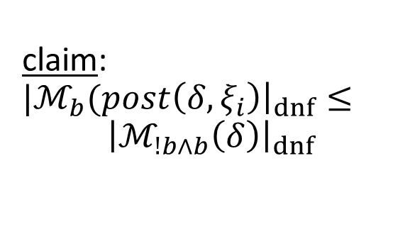
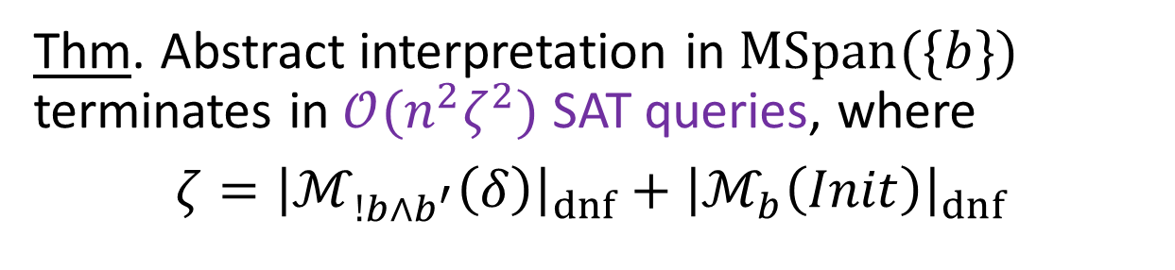
Efficient Abstract Interpretation
Thm. Abstract interpretation in $MSpan(\{b\})$ terminates in $𝒪(n^{2}ζ^{2})$ SAT queries, where
$ζ={\left|ℳ_{!b∧b^{′}}\left(δ\right)\right|}_{dnf}+{\left|ℳ_{b}\left(Init\right)\right|}_{dnf}$
Alg:
$$i=0$$
$$ξ_{0}=ℳ_{b}\left(Init\right)$$
until $ξ_{i}⟹ξ_{i−1}:$
$ξ_{i+1}=ℳ_{b}\left(post\left(δ, ξ_{i}\right)\right)$
$i=i+1$
Super-Efficient inference of $ℳ_{b}(ψ)$
claim: $|ℳ_{b}(post\left(δ,ξ_{i}\right){\left.​\right|}_{dnf}≤$ $${\left|ℳ_{!b∧b}\left(δ\right)\right|}_{dnf}$$

Slide 62
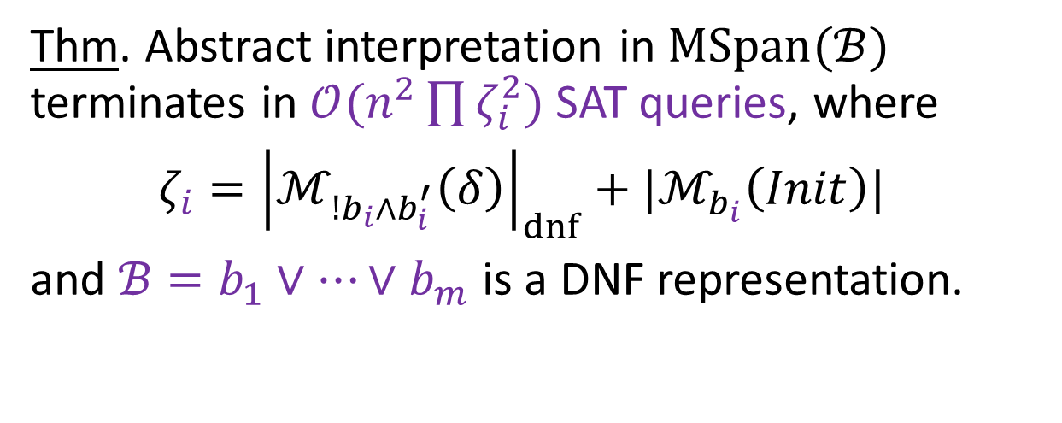

Efficient Abstract Interpretation
Thm. Abstract interpretation in $MSpan(\{b\})$ terminates in $𝒪(n^{2}ζ^{2})$ SAT queries, where
$ζ={\left|ℳ_{!b∧b^{′}}\left(δ\right)\right|}_{dnf}+|ℳ_{b}\left(Init\right)|$
Thm. Abstract interpretation in $MSpan(ℬ)$ terminates in $𝒪(n^{2}\prod{ζ_{i}^{2}})$ SAT queries, where
$ζ_{i}={\left|ℳ_{!b_{i}∧b_{i}^{′}}\left(δ\right)\right|}_{dnf}+|ℳ_{b_{i}}\left(Init\right)|$
and $ℬ=b_{1}∨…∨b_{m}$ is a DNF representation.

Slide 63






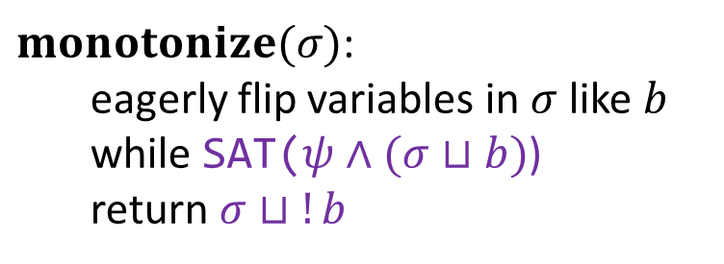




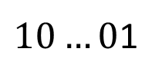



Super-Efficient Inference
$$𝓜_{b}\left(ψ\right):$$
$$ℳ_{10…01}(x_{n}=0∧x_{n−1}=0∧…{∧x}_{1}=0∧x_{0}=0)$$
$H$ := $false$
while $σ$ counterexample to $ψ⟹H$:
$H$ := $H∨monotonize\left(σ\right)$
$$σ:$$
$$00…00$$
$monotonize(σ)$: eagerly flip variables in $σ$ like $b$
while SAT($ψ∧(σ⊔b)$)
return $σ⊔!b$
$$00…01$$
$$x_{n}=0$$
$$σ:$$
$σ⊔b$:
SAT:
$$00…00$$
$$∗0…0∗$$
✓
$$00…01$$
$$∗0…01$$
✓
$$10…01$$
$10…0$1
✘

Slide 64









Super-Efficient Inference
$$𝓜_{b}\left(ψ\right):$$
$$ℳ_{00…00}(even number of 1 bits)$$
$H$ := $false$
while $σ$ counterexample to $ψ⟹H$:
$H$ := $H∨monotonize\left(σ\right)$
$$σ:$$
$$00…11$$
not a state of $ψ$!
$monotonize(σ)$: eagerly flip variables in $σ$ like $b$
while SAT($ψ∧(σ⊔b)$)
return $σ⊔!b$
$$00…00$$
$$true$$
$$σ:$$
$σ⊔b$:
SAT:
$$00…11$$
$$00…∗∗$$
✓
$$00…01$$
$$00…0∗$$
✓
$$00…00$$
$$00…00$$
✓

Slide 65





𝜁 : Monotonization of $δ$
Init:
$δ$:
$${(x}_{n},…,x_{0}) ≔ 00…00$$
$$\left(x_{n},…,x_{0}\right)≔\left(x_{n},…,x_{0}\right)+00…10$$
Bad:
$${(x}_{n},…,x_{0}) = 10…01$$
$$b=10…01$$
DNF form of $ℳ_{01…10∧{\left(100…01\right)}^{′}}\left(δ\right)$:
$$ζ=𝒪(1)$$
$$\left(x_{n},…,x_{0}\right)=00…0000∧\left(x_{n}^{′},…,x_{0}^{′}\right)=00…0010$$
$$∨$$
$$\left(x_{n},…,x_{0}\right)=00…0010∧\left(x_{n}^{′},…,x_{0}^{′}\right)=00…0100$$
$$∨$$
$$\left(x_{n},…,x_{0}\right)=00…0100∧\left(x_{n}^{′},…,x_{0}^{′}\right)=00…0110$$
$$⇓$$
$$⇑$$
$$∨$$
$$…$$
$$∨$$
$$\left(x_{n},…,x_{0}\right)=01…1110∧\left(x_{n}^{′},…,x_{0}^{′}\right)=10…0000$$
$$∨$$
$$…$$
$$≡{ x}_{0}^{′}=0$$

