Slide 1


Towards a Theory of Learning Inductive Invariants
ב"ה
Yotam Feldman
@yotamfe

Slide 2

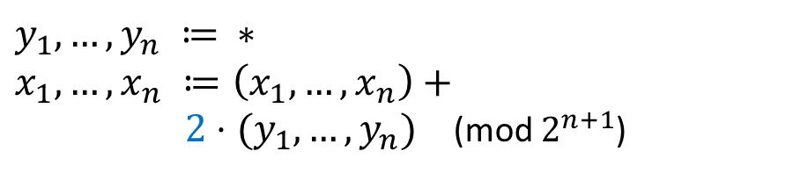




Safety of Transition Systems
Init:
$δ$:
$${(x}_{n},…,x_{0}) ≔ 00…00$$
$$y_{1},…,y_{n} ≔ ∗ \\ x_{1},…,x_{n} ≔\left(x_{1},…,x_{n}\right)+$$ $2⋅(y_{1},…,y_{n})$ (mod $2^{n+1}$)
Bad:
$${(x}_{n},…,x_{0}) = 11…11$$
$$Bad$$
$$Init$$

Slide 3









Inductive Invariants
Init:
$δ$:
$${(x}_{n},…,x_{0}) ≔ 00…00$$
$$y_{1},…,y_{n} ≔ ∗ \\ x_{1},…,x_{n} ≔\left(x_{1},…,x_{n}\right)+$$ $2⋅(y_{1},…,y_{n})$ (mod $2^{n+1}$)
Bad:
$${(x}_{n},…,x_{0}) = 11…11$$
$$Bad$$
$I$: ${(x}_{n},…,x_{0}) ≠ 11…11$
Not inductive:
$$00…1$$
$$11…11$$
$$δ$$
$$I$$
$$¬I$$
$I$: $x_{0}=0$
Inductive:
$$Init$$
$$x_{0}=0$$
$$I$$
$$δ$$

Slide 4

Inductive Invariants
Init:
$δ$:
$$y_{1},…,y_{n} ≔ ∗ \\ x_{1},…,x_{n} ≔\left(x_{1},…,x_{n}\right)+$$ $2⋅(y_{1},…,y_{n})$ (mod $2^{n}$)
Invariant Inference:
Find inductive invariants automatically
$${(x}_{n},…,x_{0}) ≔ 00…00$$
Bad:
$${(x}_{n},…,x_{0}) = 11…11$$
$$Bad$$
$I$: ${(x}_{n},…,x_{0}) ≠ 11…11$
Not inductive:
$$00…1$$
$$11…11$$
$$δ$$
$$I$$
$$¬I$$
$I$: $x_{0}=0$
Inductive:
$$Init$$
$$x_{0}=0$$
$$I$$
$$δ$$

Slide 5














Inductive Invariants
Init:
$δ$:
$$y_{1},…,y_{n} ≔ ∗ \\ x_{1},…,x_{n} ≔\left(x_{1},…,x_{n}\right)+$$ $2⋅(y_{1},…,y_{n})$ (mod $2^{n}$)
SAT-based Invariant Inference:
Find inductive invariants automatically employing a SAT solver
$${(x}_{n},…,x_{0}) ≔ 00…00$$
Bad:
$${(x}_{n},…,x_{0}) = 11…11$$
$$Bad$$
$I$: ${(x}_{n},…,x_{0}) ≠ 11…11$
Not inductive:
$$00…1$$
$$11…11$$
$$δ$$
$$I$$
$$¬I$$
$I$: $x_{0}=0$
Inductive:
$$Init$$
$$x_{0}=0$$
$$I$$
$$δ$$

Slide 6


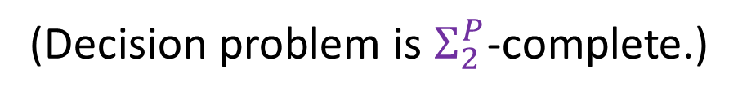
Problem Setting
Boolean transition systems, $Σ=\left\{p_{1},…,p_{n}\right\}$
Given a transition system, find an inductive invariant
$$\left|I\right|≤poly(n)$$
(Decision problem is $Σ_{2}^{P}$-complete.)
[CADE’09] Complexity and Algorithms for Monomial and Clausal Predicate Abstraction. Lahiri, Qadeer
[POPL’20] Complexity and Information in Invariant Inference. F., Immerman, Shoham, Sagiv

Slide 7
SAT-Based Invariant Inference
Significant advances in practice
predicate abstraction [CAV’97, POPL’02]
symbolic abstraction [VMCAI’04,’16]
interpolation [CAV’03,TACAS’06]
IC3/PDR [VMCAI’11, FMCAD’11]
abduction [OOPSLA’13]
SyGuS [FMCAD’13,…]
ICE learning [CAV’14, POPL’15]
…

Slide 8
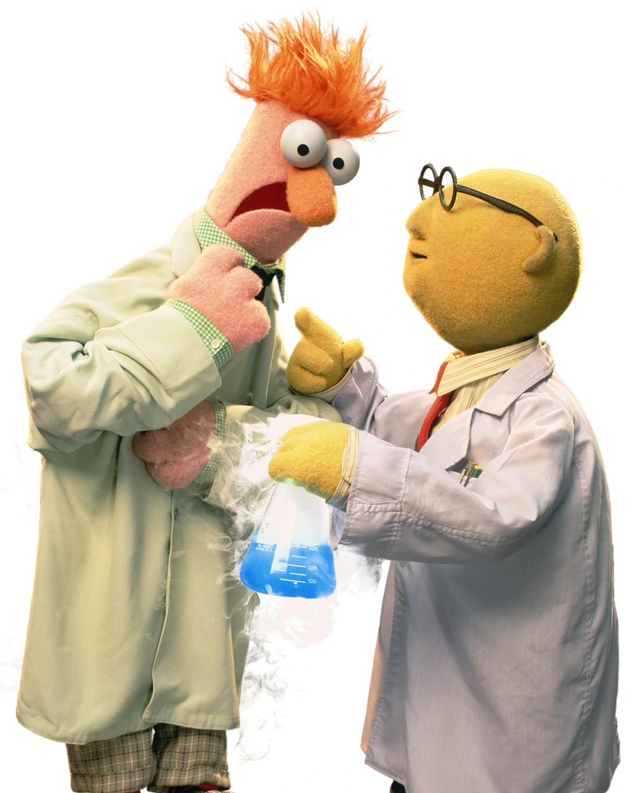

SAT-Based Invariant Inference
makeameme.org

Slide 9
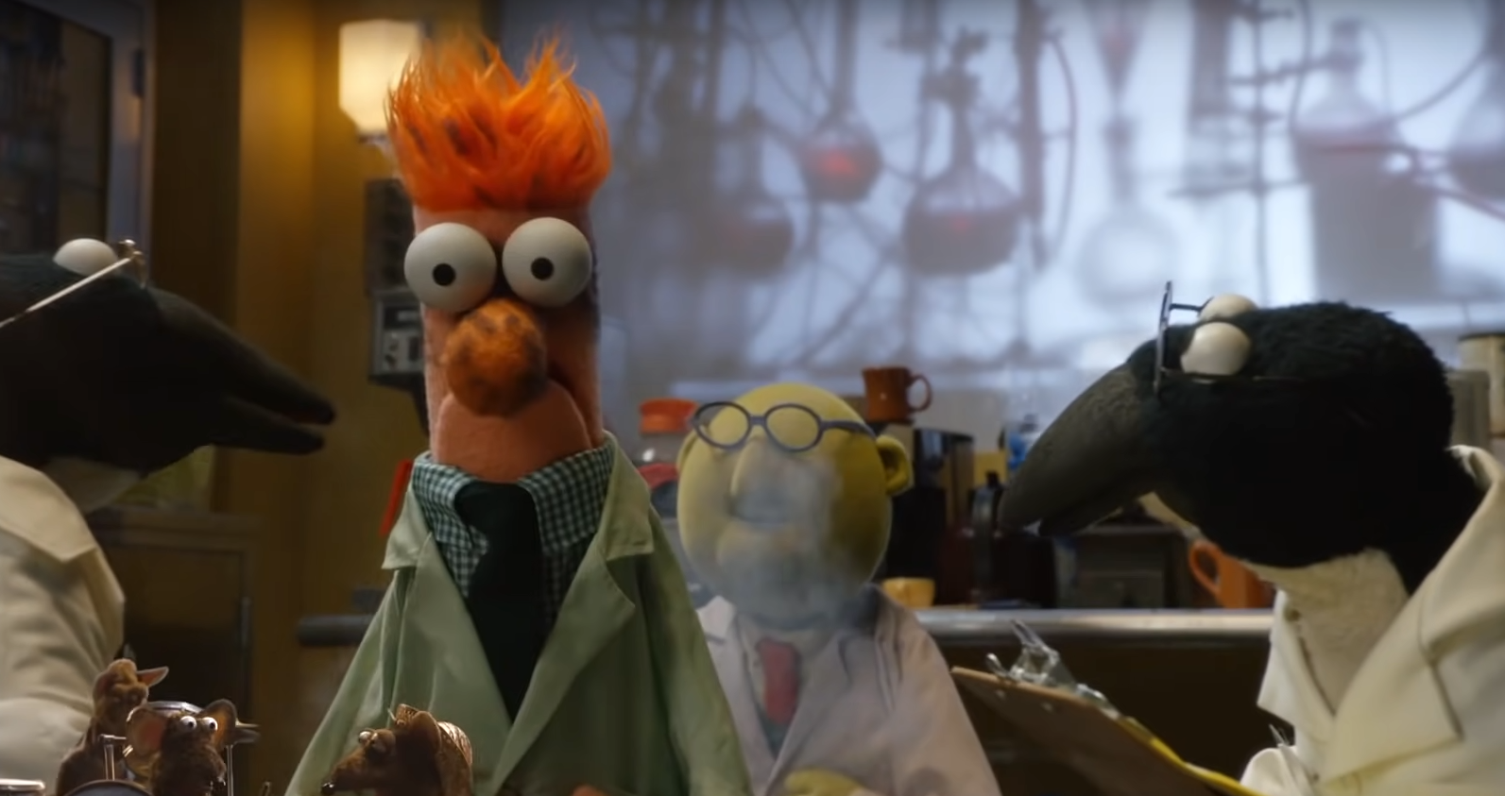
SAT-Based Invariant Inference
makeameme.org

Slide 10
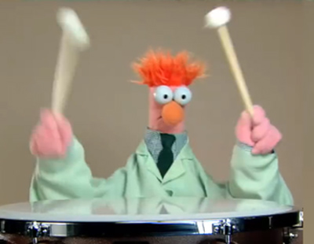
A Theory of Learning Invariants
Shed light on the design choices and principles underlying modern SAT-based invariant inference algorithms
[POPL’20] Complexity and Information in Invariant Inference. F., Immerman, Shoham, Sagiv
[POPL’21] Learning the Boundary of Inductive Invariants. F., Sagiv, Shoham, Wilcox
[POPL’22] Property-Directed Reachability as Abstract Interpretation in the Monotone Theory. F., Sagiv, Shoham, Wilcox
[SAS’22] Invariant Inference With Provable Complexity From the Monotone Theory. F., Shoham

Slide 11
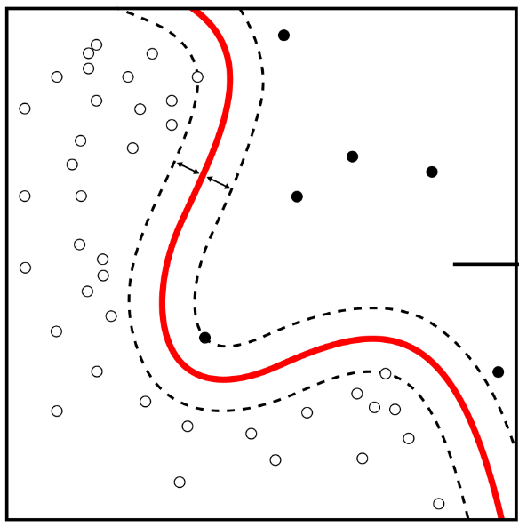
A Theory of Learning Invariants
Invariant Inference
Exact Concept Learning
vs.
[POPL’20] Complexity and Information in Invariant Inference. F., Immerman, Shoham, Sagiv
[POPL’21] Learning the Boundary of Inductive Invariants. F., Sagiv, Shoham, Wilcox
[POPL’22] Property-Directed Reachability as Abstract Interpretation in the Monotone Theory. F., Sagiv, Shoham, Wilcox
[SAS’22] Invariant Inference With Provable Complexity From the Monotone Theory. F., Shoham

Slide 12
A Theory of Learning Invariants
Invariant Inference
Exact Concept Learning
vs.
- Query-based learning models for invariant inference
- Invariant inference is harder than concept learning
- Complexity results for invariant inference algorithms from concept learning algorithms
- Analysis of overapproximation in PDR from the monotone theory

Slide 13
Model-Based Interpolation
[HVC’12] Computing Interpolants without Proofs. Chockler, Ivrii, Matsliah [LPAR’13] Instantiations, Zippers and EPR Interpolation. Bjørner, Gurfinkel, Korovin, Lahav

Slide 14
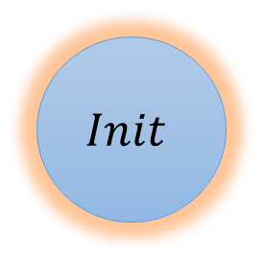

Model-Based Interpolation
$$Init$$
$I$ := $Init$
[HVC’12] Computing Interpolants without Proofs. Chockler, Ivrii, Matsliah [LPAR’13] Instantiations, Zippers and EPR Interpolation. Bjørner, Gurfinkel, Korovin, Lahav

Slide 15


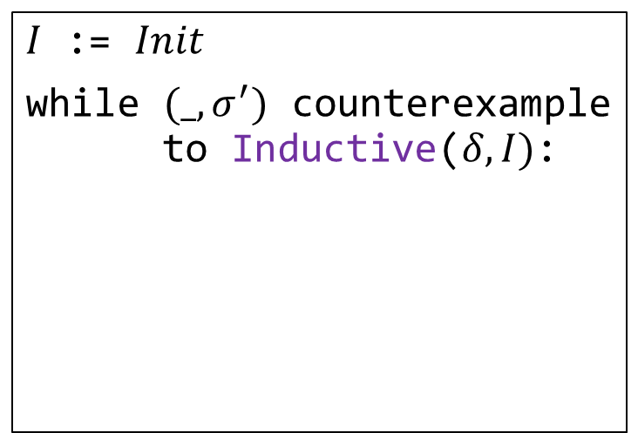
Model-Based Interpolation
$$Init$$
$$δ$$
$$σ^{′}$$
$I$ := $Init$
while $(_, σ^{′})$ counterexample to Inductive($δ,I)$:
[HVC’12] Computing Interpolants without Proofs. Chockler, Ivrii, Matsliah [LPAR’13] Instantiations, Zippers and EPR Interpolation. Bjørner, Gurfinkel, Korovin, Lahav

Slide 16
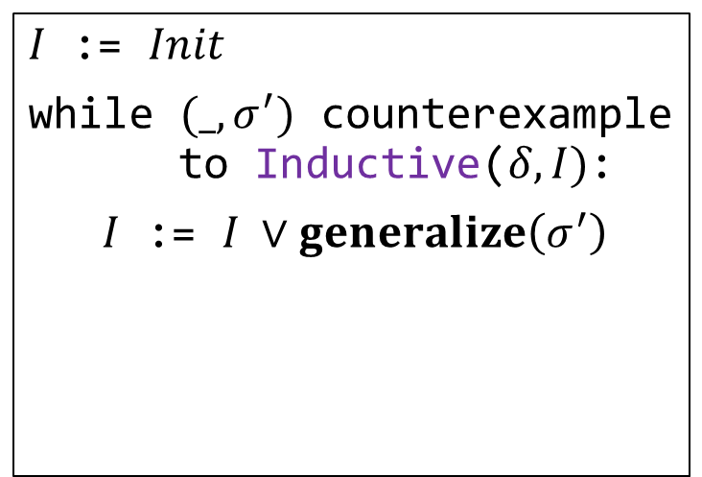
Model-Based Interpolation
$$Init$$
$$δ$$
$$σ^{′}$$
$I$ := $Init$
while $(_, σ^{′})$ counterexample to Inductive($δ,I)$:
$I$ := $I ∨generalize\left(σ^{′}\right)$
[HVC’12] Computing Interpolants without Proofs. Chockler, Ivrii, Matsliah [LPAR’13] Instantiations, Zippers and EPR Interpolation. Bjørner, Gurfinkel, Korovin, Lahav

Slide 17
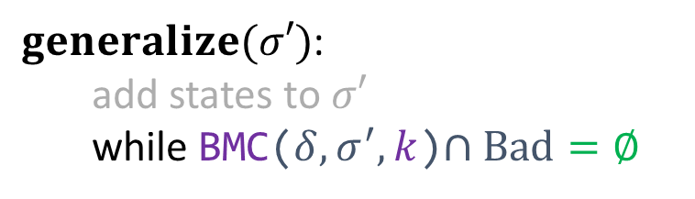

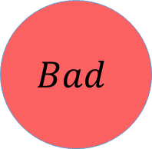




Model-Based Interpolation
$k$ times
$$Init$$
$$Bad$$
$$δ$$
$$σ^{′}$$
$$δ$$
$$…$$
$$δ$$
$I$ := $Init$
while $(_, σ^{′})$ counterexample to Inductive($δ,I)$:
$I$ := $I ∨generalize\left(σ^{′}\right)$
$generalize(σ′)$: add states to $σ′$ while BMC($δ,σ^{′},k$)$∩Bad=∅$
[HVC’12] Computing Interpolants without Proofs. Chockler, Ivrii, Matsliah [LPAR’13] Instantiations, Zippers and EPR Interpolation. Bjørner, Gurfinkel, Korovin, Lahav

Slide 18
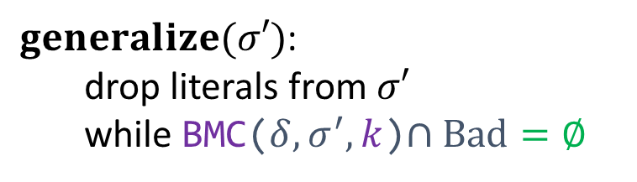


Model-Based Interpolation
$k$ times
$$Init$$
$$Bad$$
$$δ$$
$$σ^{′}$$
$$δ$$
$$…$$
$$δ$$
$I$ := $Init$
while $(_, σ^{′})$ counterexample to Inductive($δ,I)$:
$I$ := $I ∨generalize\left(σ^{′}\right)$
$generalize(σ′)$: drop literals from $σ′$ while BMC($δ,σ^{′},k$)$∩Bad=∅$
[HVC’12] Computing Interpolants without Proofs. Chockler, Ivrii, Matsliah [LPAR’13] Instantiations, Zippers and EPR Interpolation. Bjørner, Gurfinkel, Korovin, Lahav

Slide 19


Model-Based Interpolation
$k$ times
$$Init$$
$$Bad$$
$$δ$$
$$σ^{′}$$
$$δ$$
$$…$$
$$δ$$
$I$ := $Init$
while $(_, σ^{′})$ counterexample to Inductive($δ,I)$:
$I$ := $I ∨generalize\left(σ^{′}\right)$
$$Inter{polant}_{1}=\left(x_{n}=0∧x_{n−1}=1∧…∧x_{1}=1∧x_{0}=0\right)$$
$$σ′ =01…10$$
$generalize(σ′)$: drop literals from $σ′$ while BMC($δ,σ^{′},k$)$∩Bad=∅$
[HVC’12] Computing Interpolants without Proofs. Chockler, Ivrii, Matsliah [LPAR’13] Instantiations, Zippers and EPR Interpolation. Bjørner, Gurfinkel, Korovin, Lahav

Slide 20
Model-Based Interpolation
$I$ := $Init$
while $(_, σ^{′})$ counterexample to Inductive($δ,I)$:
$I$ := $I ∨generalize\left(σ^{′}\right)$
$generalize(σ′)$: drop literals from $σ′$ while BMC($δ,σ^{′},k$)$∩Bad=∅$

Slide 21
Model-Based Interpolation
$I$ := $Init$
while $(_, σ^{′})$ counterexample to Inductive($δ,I)$:
$I$ := $I ∨generalize\left(σ^{′}\right)$
$generalize(σ′)$: drop literals from $σ′$ while BMC($δ,σ^{′},k$)$∩Bad=∅$

Slide 22
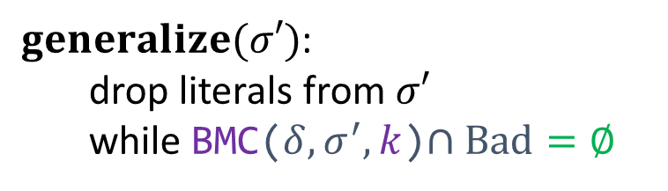

Understanding Invariant Inference
$I$ := $Init$
while $(_, σ^{′})$ counterexample to Inductive($δ,I)$:
$I$ := $I ∨generalize\left(σ^{′}\right)$
$generalize(σ′)$: drop literals from $σ′$ while BMC($δ,σ^{′},k$)$∩Bad=∅$
Complexity bounds from exact classification algorithms
The power of rich queries – learning-based models

Slide 23

Understanding Invariant Inference
Invariant Inference
Exact Concept Learning
$I$ := $false$
while $(_, σ^{′})$ counterexample to Inductive($δ,I)$:
$I$ := $I ∨generalize\left(σ^{′}\right)$
vs.
$generalize(σ′)$: drop literals from $σ′$ while BMC($δ,σ^{′},k$)$∩Bad=∅$
Complexity bounds from exact classification algorithms
The power of rich queries – learning-based models

Slide 24






Exact Concept Learning with Equivalence & Membership Queries
learning algorithm
oracle
is it $ψ_{1}$?
✓ / ✘+counterexample
is it $ψ_{2}$?
✓ / ✘+counterexample
$$φ$$
does $σ_{3}⊨$?
✓ / ✘
…
Membership
Equivalence
[ML’87] Queries and Concept Learning. Angluin

Slide 25


Invariant Inference with Equivalence & Membership Queries
learning algorithm
oracle
is it $ψ_{1}$?
✓ / ✘+counterexample
is it $ψ_{2}$?
$$δ$$
✓ / ✘+counterexample
$$I$$
does $σ_{3}⊨$?
Need to implement this
✓ / ✘
Need to implement this
…
[CAV’14] ICE: A Robust Framework for Learning Invariants. Garg, Löding, Madhusudan, Neider

Slide 26





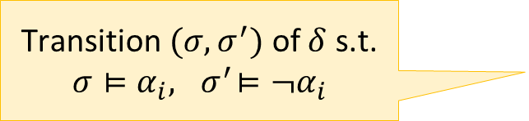

Inductiveness-Query Model
inference algorithm
inductiveness-query oracle
$α_{1}$ inductive?
✓ / ✘+counterexample
…
$$\{α_{i}\}$$
$$δ$$
$$\{α_{i}\}$$
$α_{m}$ inductive?
Transition $(σ,σ^{′})$ of $δ$ s.t. $$σ⊨α_{i}, { σ}^{′}⊨¬α_{i}$$
✓ / ✘+counterexample
Algorithms cannot access the transition relation directly, only perform inductiveness queries
Complexity: # inductiveness queries worst case amongst possible counterexamples
[CAV’14] ICE: A Robust Framework for Learning Invariants. Garg, Löding, Madhusudan, Neider

Slide 27



Inductiveness-Query Model
inference algorithm
inductiveness-query oracle
$α_{1}$ inductive?
✓ / ✘+counterexample
…
$$\{α_{i}\}$$
$$δ$$
$$\{α_{i}\}$$
$α_{m}$ inductive?
✓ / ✘+counterexample
$I$ := $false$
while $(_, σ^{′})$ counterexample to Inductive($δ,I)$:
$I$ := $I ∨generalize\left(σ^{′}\right)$
$I$ inductive?
✓ / ✘
$generalize(σ′)$: drop literals from $σ′$ while BMC(${δ,σ}^{′},k$)$∩Bad=∅$
?

Slide 28
A Theory of Learning Invariants
Invariant Inference
Exact Concept Learning
vs.
- Query-based learning models for invariant inference
POPL20
- Invariant inference is harder than concept learning
- Complexity results for invariant inference algorithms from concept learning algorithms
- Analysis of overapproximation in PDR from the monotone theory

Slide 29






Hoare-Query Model
Capable of modeling several interesting algorithms
inference algorithm
Hoare-query oracle
$${\{α}_{1}\}\left\{β_{1}\right\}?$$
✓ / ✘
…
$$\{α_{i}\}$$
$$δ$$
$$\{β_{i}\}$$
$${\{α}_{m}\}\left\{β_{m}\right\}?$$
✓ / ✘
Algorithms cannot access the transition relation directly, only perform Hoare queries
[POPL’20] Complexity and Information in Invariant Inference. F., Immerman, Shoham, Sagiv

Slide 30



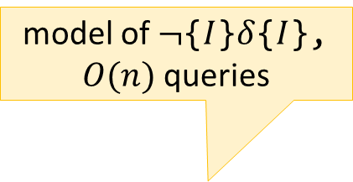

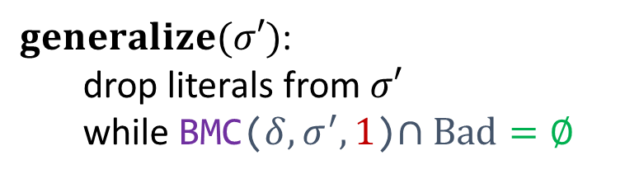


Hoare-Query Model
Capable of modeling several interesting algorithms
Hoare-query oracle
model of $¬${$I$}$δ${$I$}, $O(n)$ queries
$$\left\{I\right\}\left\{I\right\}?$$
✓ / ✘
$I$ := $false$
while $(_, σ^{′})$ counterexample to Inductive($δ,I)$:
$I$ := $I ∨generalize\left(σ^{′}\right)$
$$\{α_{i}\}$$
$$δ$$
$$\{β_{i}\}$$
$$\left\{σ′\right\}\left\{¬Bad\right\}?$$
$generalize(σ′)$: drop literals from $σ′$ while BMC(${δ,σ}^{′},1$)$∩Bad=∅$
✓ / ✘
…

Slide 31

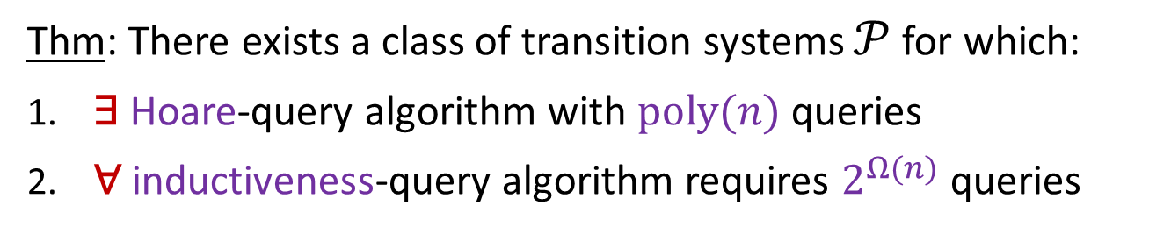
Hoare > Inductiveness
Thm: There exists a class of transition systems $𝒫$ for which:
​∃ Hoare-query algorithm with $poly(n)$ queries
​∀ inductiveness-query algorithm requires $2^{Ω(n)}$ queries
a simple case of IC3/PDR
$$⇒$$
ICE cannot model PDR, and the extension of [VMCAI’17] is necessary
[POPL’20] Complexity and Information in Invariant Inference. F., Immerman, Shoham, Sagiv
[VMCAI’17] IC3 - Flipping the E in ICE. Vizel, Gurfinkel, Shoham, Malik.

Slide 32



Hoare > Inductiveness
Thm: There exists a class of transition systems $𝒫$ for which:
​∃ Hoare-query algorithm with $poly(n)$ queries
​∀ inductiveness-query algorithm requires $2^{Ω(n)}$ queries
$I$ := $false$
while $(_, σ^{′})$ counterexample to Inductive($δ,I)$:
$I$ := $I ∨generalize\left(σ^{′}\right)$
$$\left\{σ′\right\}\left\{¬Bad\right\}?$$
$generalize(σ′)$: drop literals from $σ′$ while BMC(${δ,σ}^{′},1$)$∩Bad=∅$
✓ / ✘
…

Slide 33
A Theory of Learning Invariants
Invariant Inference
Exact Concept Learning
vs.
- Query-based learning models for invariant inference
- Invariant inference is harder than concept learning
POPL20
- Complexity results for invariant inference algorithms from concept learning algorithms
- Analysis of overapproximation in PDR from the monotone theory

Slide 34
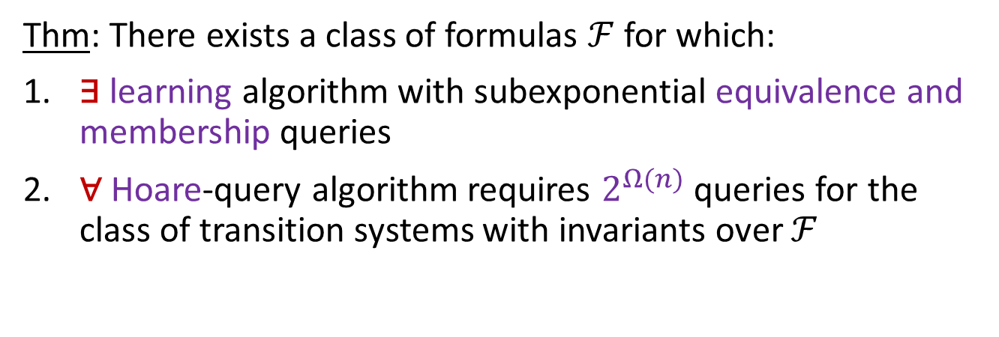
Inference is Harder than Learning
Thm: There exists a class of formulas $ℱ$ for which:
​∃ learning algorithm with subexponential equivalence and membership queries
​∀ Hoare-query algorithm requires $2^{Ω(n)}$ queries for the class of transition systems with invariants over $ℱ$
Corollary: Learning from counterexamples to induction is harder than learning from labeled examples
[POPL’20] Complexity and Information in Invariant Inference. F., Immerman, Shoham, Sagiv

Slide 35
A Theory of Learning Invariants
Invariant Inference
Exact Concept Learning
vs.
- Query-based learning models for invariant inference
- Invariant inference is harder than concept learning
- Complexity results for invariant inference algorithms from concept learning algorithms
POPL21
- Analysis of overapproximation in PDR from the monotone theory

Slide 36
Invariant Inference with Equivalence & Membership Queries
learning algorithm
oracle
is it $ψ_{1}$?
✓ / ✘+counterexample
is it $ψ_{2}$?
$$δ$$
✓ / ✘+counterexample
$$I$$
does $σ_{3}⊨$?
Need to implement this
✓ / ✘
Need to implement this
…
Thm. In general, in the Hoare-query model, no efficient way to implement a teacher for equivalence and membership queries
[CAV’14] ICE: A Robust Framework for Learning Invariants. Garg, Löding, Madhusudan, Neider
[POPL’20] Complexity and Information in Invariant Inference. F., Immerman, Shoham, Sagiv

Slide 37

Invariant Inference with Equivalence & Membership Queries
learning algorithm
teacher
is it $ψ_{1}$?
✓ / ✘+counterexample
Sufficient conditions for
is it $ψ_{2}$?
exact learning algorithms
$$⟹$$
invariant inference algorithms
✓ / ✘+counterexample
$$I$$
does $σ_{3}⊨$?
✓ / ✘
…
Thm. In general, in the Hoare-query model, no efficient way to implement a teacher for equivalence and membership queries

Slide 38
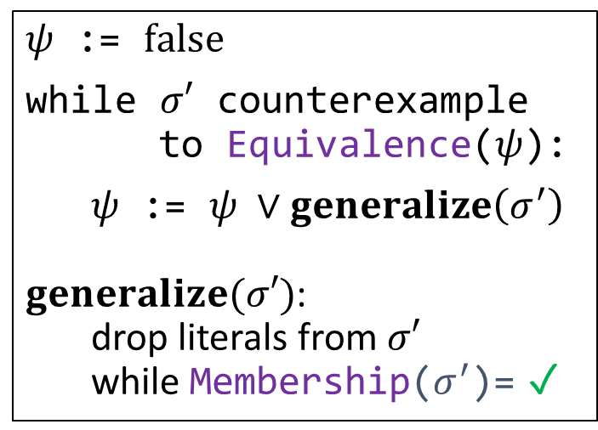
From Learning to Inference
Exact learning DNF formulas
$ψ$ := $false$
while $σ′$ counterexample to Equivalence($ψ$):
$ψ$ := $ψ ∨generalize\left(σ^{′}\right)$ $generalize(σ′)$: drop literals from $σ′$ while Membership($σ^{′}$)= ✓
[CACM’84] A Theory of the Learnable. Valiant [ML’87] Queries and Concept Learning. Angluin [ML’95] On the Learnability of Disjunctive Normal Form Formulas. Aizenstein and Pitt

Slide 39
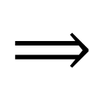

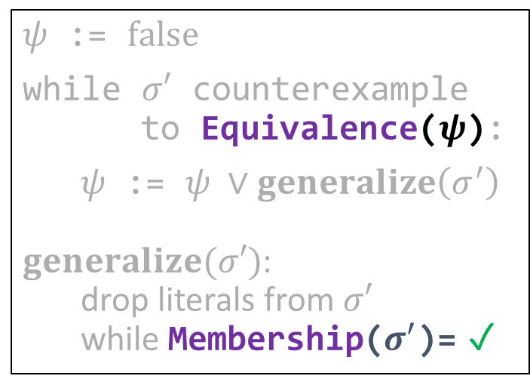
From Learning to Inference
$$⟹$$
Exact learning DNF formulas
$ψ$ := $false$
while $σ′$ counterexample to Equivalence($ψ$):
$ψ$ := $ψ ∨generalize\left(σ^{′}\right)$ $generalize(σ′)$: drop literals from $σ′$ while Membership($σ^{′}$)= ✓
$I$ := $false$
while $(_, σ^{′})$ counterexample to Inductive($I$):
$I$ := $I ∨generalize\left(σ^{′}\right)$ $generalize(σ′)$: drop literals from $σ′$ while BMC($σ^{′},k$)$∩Bad=∅$
[CACM’84] A Theory of the Learnable. Valiant [ML’87] Queries and Concept Learning. Angluin [ML’95] On the Learnability of Disjunctive Normal Form Formulas. Aizenstein and Pitt

Slide 40
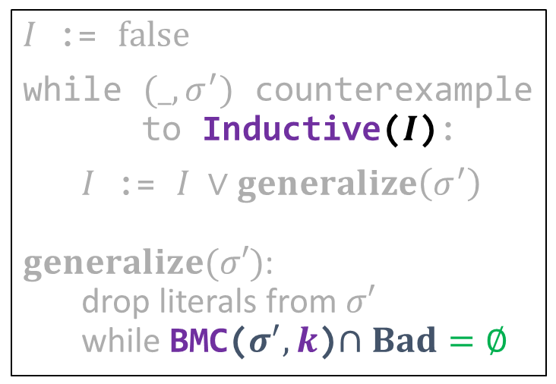
From Learning to Inference
$$⟹$$
Exact learning DNF formulas
Inferring DNF invariants
$ψ$ := $false$
while $σ′$ counterexample to Equivalence($ψ$):
$ψ$ := $ψ ∨generalize\left(σ^{′}\right)$ $generalize(σ′)$: drop literals from $σ′$ while Membership($σ^{′}$)= ✓
$I$ := $false$
while $(_, σ^{′})$ counterexample to Inductive($I$):
$I$ := $I ∨generalize\left(σ^{′}\right)$ $generalize(σ′)$: drop literals from $σ′$ while BMC($σ^{′},k$)$∩Bad=∅$
[CACM’84] A Theory of the Learnable. Valiant [ML’87] Queries and Concept Learning. Angluin [ML’95] On the Learnability of Disjunctive Normal Form Formulas. Aizenstein and Pitt
[CAV’03] Interpolation and SAT-Based Model Checking, McMillan [HVC’12] Computing Interpolants without Proofs. Chockler, Ivrii, Matsliah [LPAR’13] Instantiations, Zippers and EPR Interpolation. Bjørner, Gurfinkel, Korovin, Lahav

Slide 41
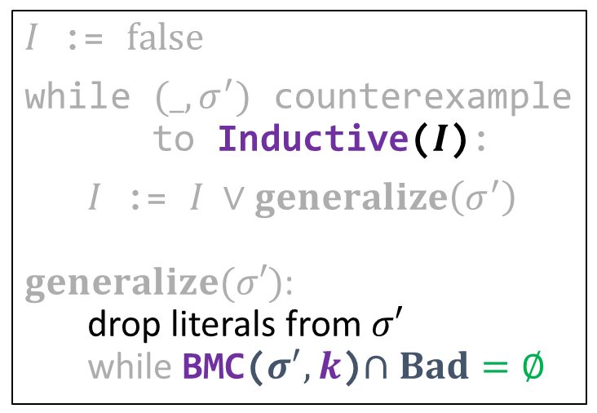

From Learning to Inference
$$⟹$$
Exact learning DNF formulas
Inferring DNF invariants
$ψ$ := $false$
while $σ′$ counterexample to Equivalence($ψ$):
$ψ$ := $ψ ∨generalize\left(σ^{′}\right)$ $generalize(σ′)$: drop literals from $σ′$ while Membership($σ^{′}$)= ✓
$I$ := $false$
while $(_, σ^{′})$ counterexample to Inductive($I$):
$I$ := $I ∨generalize\left(σ^{′}\right)$ $generalize(σ′)$: drop literals from $σ′$ while BMC($σ^{′},k$)$∩Bad=∅$
[CACM’84] A Theory of the Learnable. Valiant [ML’87] Queries and Concept Learning. Angluin [ML’95] On the Learnability of Disjunctive Normal Form Formulas. Aizenstein and Pitt
[CAV’03] Interpolation and SAT-Based Model Checking, McMillan [HVC’12] Computing Interpolants without Proofs. Chockler, Ivrii, Matsliah [LPAR’13] Instantiations, Zippers and EPR Interpolation. Bjørner, Gurfinkel, Korovin, Lahav

Slide 42
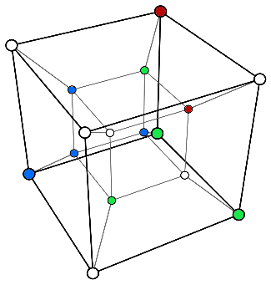
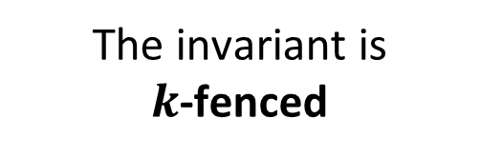
From Learning to Inference
Efficiently
Efficiently
$$⟹$$
Exact learning DNF formulas
Inferring DNF invariants
$ψ$ := $false$
while $σ′$ counterexample to Equivalence($ψ$):
$ψ$ := $ψ ∨generalize\left(σ^{′}\right)$ $generalize(σ′)$: drop literals from $σ′$ while Membership($σ^{′}$)= ✓
$I$ := $false$
while $(_, σ^{′})$ counterexample to Inductive($I$):
$I$ := $I ∨generalize\left(σ^{′}\right)$ $generalize(σ′)$: drop literals from $σ′$ while BMC($σ^{′},k$)$∩Bad=∅$
The invariant is $k$-fenced
[CACM’84] A Theory of the Learnable. Valiant [ML’87] Queries and Concept Learning. Angluin [ML’95] On the Learnability of Disjunctive Normal Form Formulas. Aizenstein and Pitt
[CAV’03] Interpolation and SAT-Based Model Checking, McMillan [HVC’12] Computing Interpolants without Proofs. Chockler, Ivrii, Matsliah [LPAR’13] Instantiations, Zippers and EPR Interpolation. Bjørner, Gurfinkel, Korovin, Lahav

Slide 43
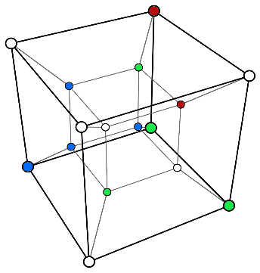
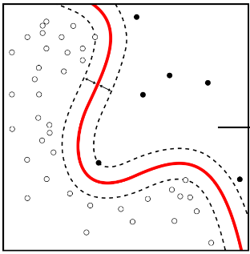
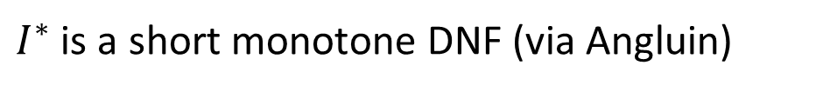

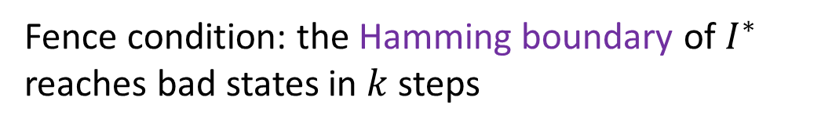
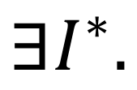
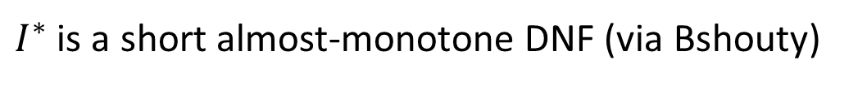
Complexity Upper Bounds
Thm. Interpolation-based inference finds an invariant in a polynomial number of SAT queries when
$$∃I^{∗}.$$
Fence condition: the Hamming boundary of $I^{∗}$ reaches bad states in $k$ steps
+
No negated variables
$I^{∗}$ is a short monotone DNF (via Angluin)
or
$I^{∗}$ is a short almost-monotone DNF (via Bshouty)
$O(1)$ terms with negated variables
[POPL’21] Learning the Boundary of Inductive Invariants. F., Sagiv, Shoham, Wilcox

Slide 44
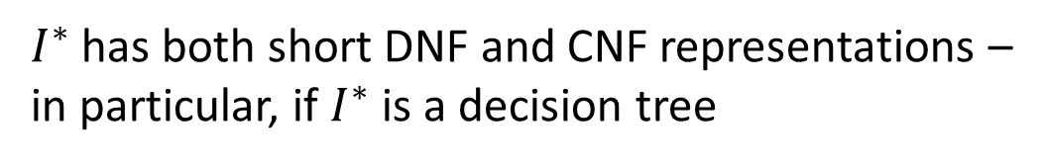
Complexity Upper Bounds
Thm. Interpolation-based inference finds an invariant in a polynomial number of SAT queries when
$$∃I^{∗}.$$
Fence condition: the Hamming boundary of $I^{∗}$ reaches bad states in $k$ steps
+
$I^{∗}$ has both short DNF and CNF representations – in particular, if $I^{∗}$ is a decision tree
New algorithm inspired by Bshouty’s CDNF algorithm
[SAS’22] Invariant Inference With Provable Complexity From the Monotone Theory. F., Shoham

Slide 45
A Theory of Learning Invariants
Invariant Inference
Exact Concept Learning
vs.
- Query-based learning models for invariant inference
- Invariant inference is harder than concept learning
- Complexity results for invariant inference algorithms from concept learning algorithms
- Analysis of overapproximation in PDR from the monotone theory
POPL22

Slide 46



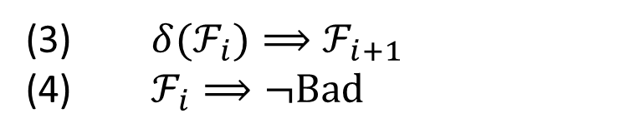


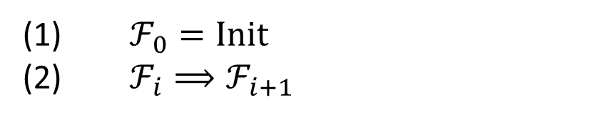



PDR’s Frames
A sequence of formulas $ℱ_{0},ℱ_{1},ℱ_{2},…$
$ℱ_{0}=Init$
$ℱ_{i}⟹ℱ_{i+1}$
(3) $δ(ℱ_{i})⟹ℱ_{i+1}$
(4) $ℱ_{i}⟹¬Bad$
inductive invariant
$$ℱ_{3}$$
$${≡ℱ}_{4}$$
$$ℱ_{2}$$
$$ℱ_{1}$$
$$ℱ_{0}$$
$$Bad$$
$$δ(ℱ_{2})$$
$$Init$$

Slide 47


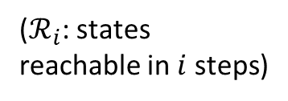


PDR’s Frames
A sequence of formulas $ℱ_{0},ℱ_{1},ℱ_{2},…$
$ℱ_{0}=Init$
$ℱ_{i}⟹ℱ_{i+1}$
$$ℛ_{i}⊆ℱ_{i}$$
(3) $δ(ℱ_{i})⟹ℱ_{i+1}$
(4) $ℱ_{i}⟹¬Bad$
($ℛ_{i}$: states reachable in $i$ steps)
$$ℱ_{3}$$
$$ℱ_{2}$$
$$ℱ_{1}$$
$$ℱ_{0}$$
$$Init$$
$$ℛ_{1}$$
$$ℛ_{2}$$
$$ℛ_{3}$$

Slide 48



PDR’s Frames
A sequence of formulas $ℱ_{0},ℱ_{1},ℱ_{2},…$
$ℱ_{0}=Init$
$ℱ_{i}⟹ℱ_{i+1}$
$$ℛ_{i}⊆ℱ_{i}$$
$$ℛ_{i}≪ℱ_{i}$$
(3) $δ(ℱ_{i})⟹ℱ_{i+1}$
(4) $ℱ_{i}⟹¬Bad$
($ℛ_{i}$: states reachable in $i$ steps)
$$ℱ_{3}$$
$$ℱ_{2}$$
$$ℱ_{1}$$
$$……$$
$$ℱ_{0}$$
$$Init$$
$$ℛ_{1}$$
$$ℛ_{2}$$
$$ℛ_{3}$$

Slide 49

PDR’s Frames
A sequence of formulas $ℱ_{0},ℱ_{1},ℱ_{2},…$
$ℱ_{0}=Init$
$ℱ_{i}⟹ℱ_{i+1}$
$$ℛ_{i}⊆ℱ_{i}$$
$$ℛ_{i}≪ℱ_{i}$$
(3) $δ(ℱ_{i})⟹ℱ_{i+1}$
(4) $ℱ_{i}⟹¬Bad$
($ℛ_{i}$: states reachable in $i$ steps)
$$ℱ_{3}$$
$$ℱ_{2}$$
$$ℱ_{1}$$
$$↑↓$$
$$ℱ_{0}$$
$$Init$$
$$ℛ_{1}$$
$$ℛ_{2}$$
$$ℛ_{3}$$

Slide 50
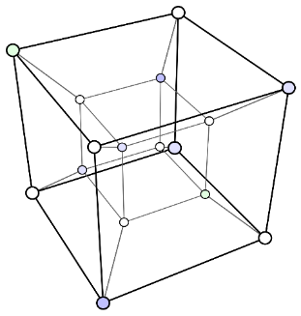



Overapproximation in PDR
PDR is (roughly) an abstract interpretation based on Bshouty’s monotone theory from exact learning
$$γ$$
$$≈$$
+
PDR
$$α$$
Abstract Interpretation
Monotone Theory
Principle of how PDR achieves overapproximation

Slide 51
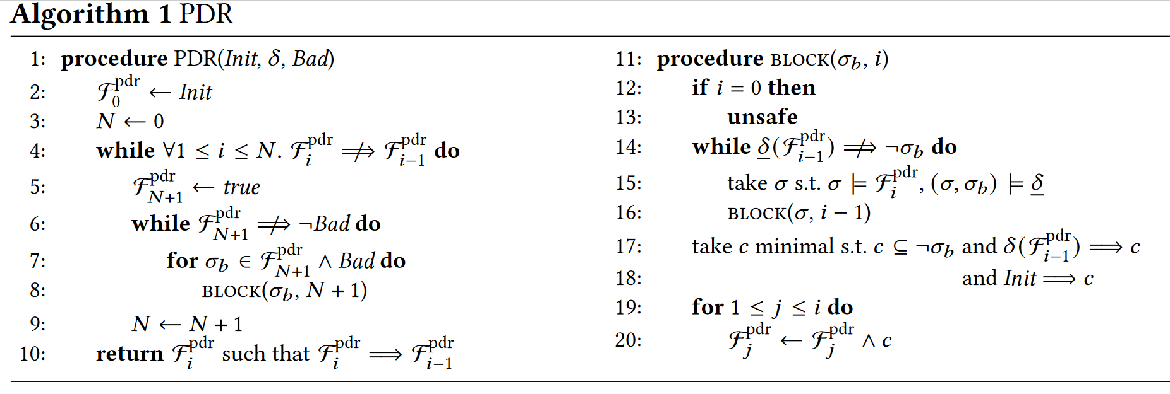


Understanding PDR
Frames
$$BMC(k)$$
$$Init$$
Rich SAT queries necessary for incremental construction (Hoare queries)
POPL20
Efficient construction from learning algorithms
POPL21
Convergence to invariants with nice reachability properties (fence condition)
Frames generate successive overapproximation
POPL22

Slide 52
A Theory of Learning Invariants
Invariant Inference
Exact Concept Learning
vs.
- Query-based learning models for invariant inference
POPL20
- Invariant inference is harder than concept learning
POPL20
- Complexity results for invariant inference algorithms from concept learning algorithms
POPL21
- Analysis of overapproximation in PDR from the monotone theory
POPL22

Slide 53
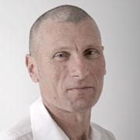
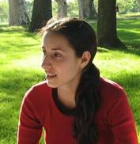


Thanks

Slide 54
Future Work
Invariant Inference
Exact Concept Learning
vs.
- Separation between Hoare($k$) and Hoare(1)
- Probabilistic analysis of interpolation-based inference
- Complexity results for PDR itself
- Practical takeaways

