Slide 1
R.E.M
Rail Residential Estimating Program

Slide 2
What this is for:
- Parts and Price estimates in the field.
- Alumarail Standard profile railing systems.
- 0-150 lf approximate span.

Slide 3
What this is not for:
- Custom/ Commercial style railing systems.
- Excessive mounting to wooden posts.
- Unique cable fittings/ layouts.
- Switching infills or mounting methods.

Slide 4

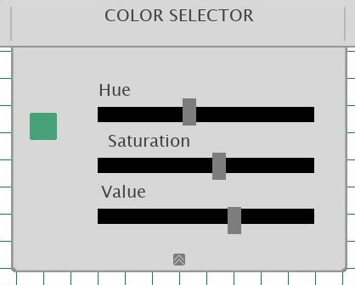
Draw
Upon opening the line tool will be selected. Click the Left mouse button to start drawing and release it to finish the line.
There is also a Pen tool, Rectangle tool, Eraser, text tool and measuring tool.
Press “W” or click the line width button to adjust line thickness.
To the right is the color selector, it is on a pull down menu to select a color. When you are done close the menu to continue drawing.

Slide 5
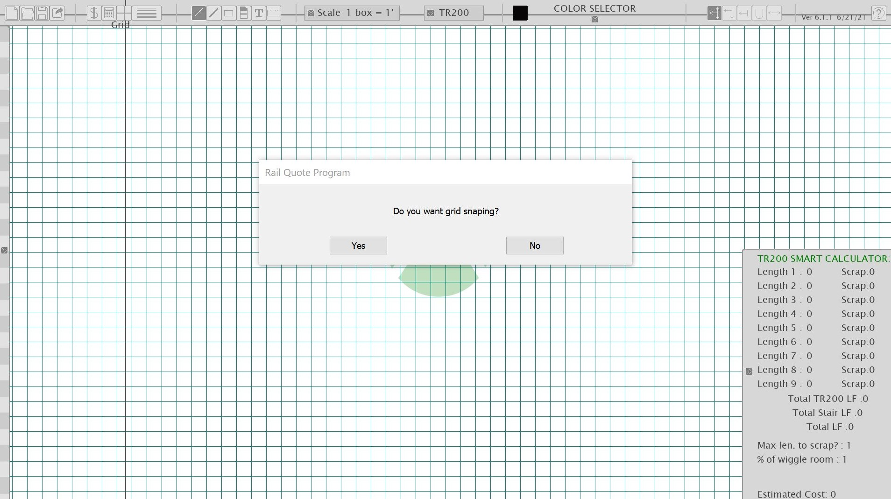
Grid/ Grid snapping
Now comes with Grid snap so your line and posts can click in to points on the grid.
Click “Grid Snap” and press “yes” for grid snapping and “no” for no snapping.

Slide 6
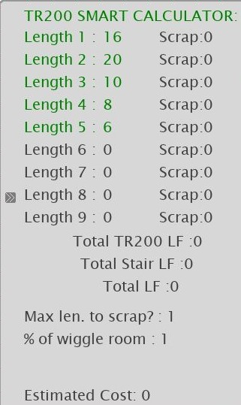
Measure
The Draw Tools has a built in measuring function, scaling with the grid.
If you just need to measure, press the “Scale” Tools. This will Allow you to measure without drawing on pad.
It will put the measurement on the calculator and you can adjust it by pressing the corresponding number.

Slide 7

Lay Out Posts
Once you are done with the drawing you will need to insert posts.
The post selection bar is on the top right of the screen. To select different posts please use mouse scroll wheel OR click the desired post.
To add a post to drawing, simply hover your mouse where you would like to place the post and press “insert” OR right mouse button.
To delete a post, hover on the post with the mouse and press “delete”.

Slide 8
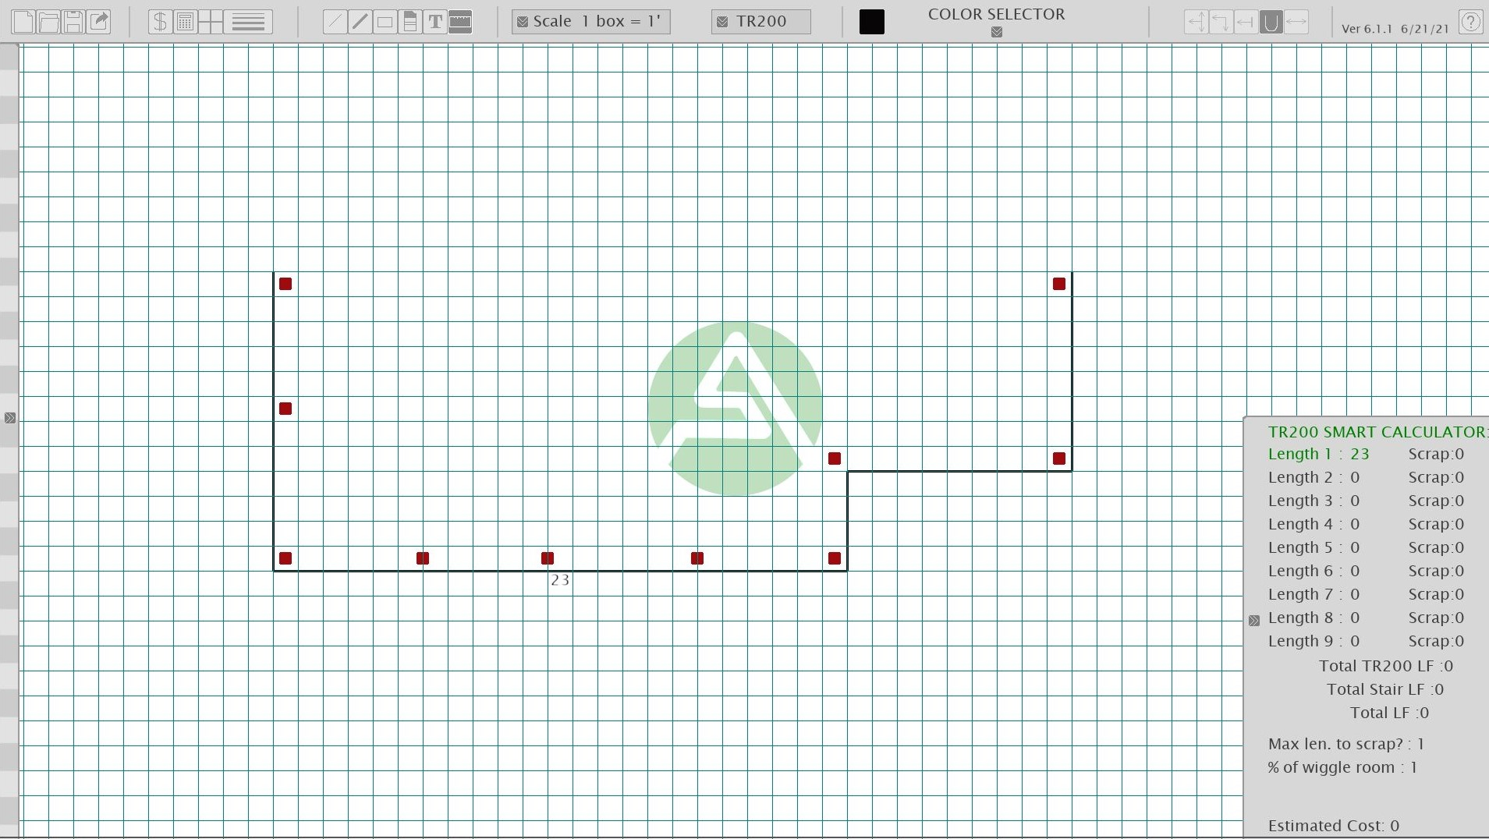

Slide 9
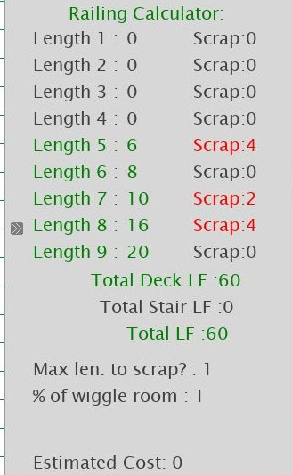
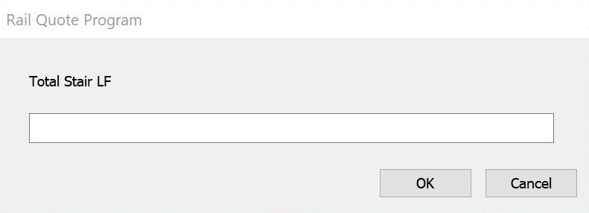
Railing Calculator
This is what keeps track of your deck top railing and stair top railing. It makes sure you will get enough top rail no matter the layout!
It will count scrap values and use scrap whenever possible.
Add lengths by pressing 1-9 on the keyboard or using the measuring tool. Add stair railing as total stair LF. Press 0 to add stair LF.

Slide 10
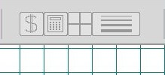
Calculate
After drawing is done, posts are inserted and calculator has been used. Press “R” OR the total button to calculate other factors in the drawing.
This will prompt questions that will need to be answered.
If anything needs to be changed or updated make those changes and re calculate.
Once you are done the left bar will have all the parts need for your take off!

Slide 11
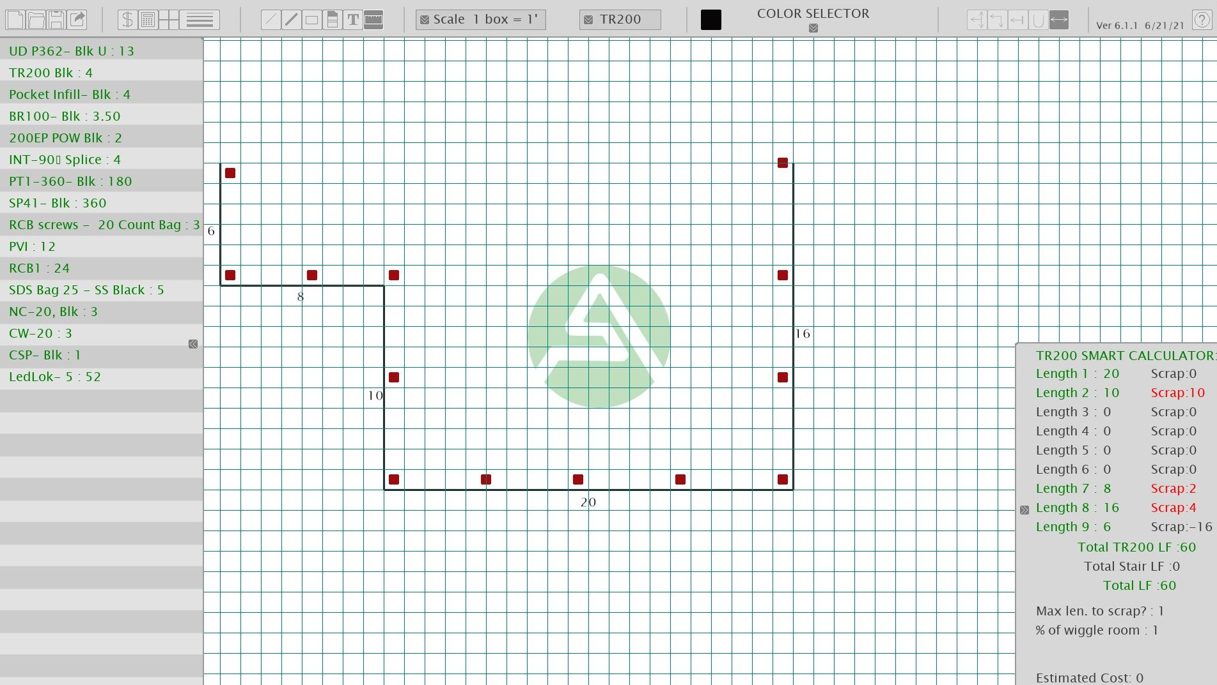

Slide 12
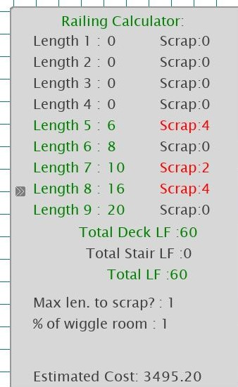
Price Estimate
For an approximate pricing estimate press “T” or the total button.
Your price will be displayed at the bottom of the calculator.

Slide 13

Save & Submit
Once everything looks good you can...
Save your drawing by clicking the save button.
Export all the parts onto an excel sheet by pressing the export button.
Start from scratch and create a new drawing by pressing the new button.
Open a previous drawing or hand drawn drawing.
New
Save
Open
Export

Slide 14
Thank you for watching!

