Slide 1

Opening a fine-dining restaurant in Paris

Slide 2
Introduction
This project is targeting stakeholders who are interesting in opening a fine dinign restaurant in Paris, France !
Locations will be chosen with those criteria :
High income
Not crowded with restaurants
No fine-dining restaurants in vicinity

Slide 3
Data Acquisition and cleaning
Districts of Paris (geojson file) : www.data.gouv.fr
Boroughs of Paris (geojson file) : www.opendata.paris.fr
Annual income median from districts (csv file) : www.insee.fr
Centers of candidate areas will be generated algorithmically and approximate addresses of centers of those areas : Google Maps API reverse geocoding
Number of restaurants and their location in every neighborhood : Foursquare API
Price range of restaurants : Zomato API and Yelp API
Coordinate of Paris center : Google Maps API geocoding of Notre-Dame de Paris.
In total, we selected 4 districts and found 1276 restaurants. Duplicate and out-of-borders restaurants were dropped.

Slide 4
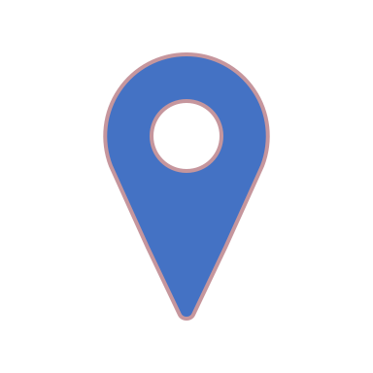
Results
22.32 restaurants in every area with radius=300m
Fine dining restaurant can be found within ~240m from every area center candidate

Slide 5
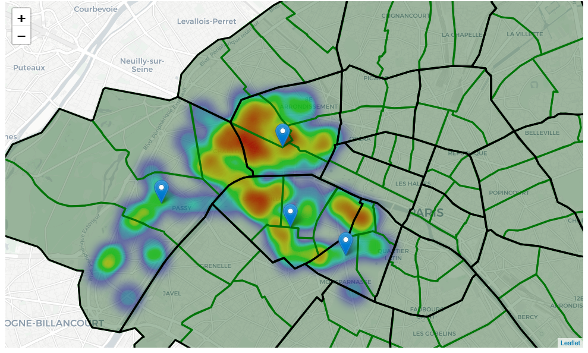
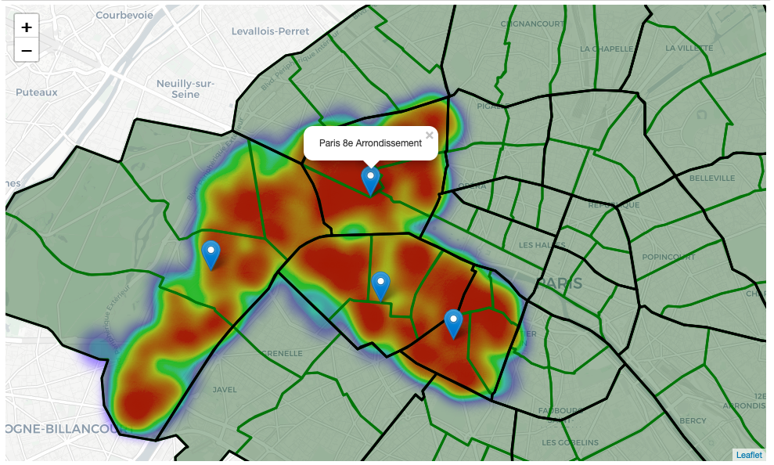
Heatmap of restaurants (left) / fine dining restaurants (right)

Slide 6
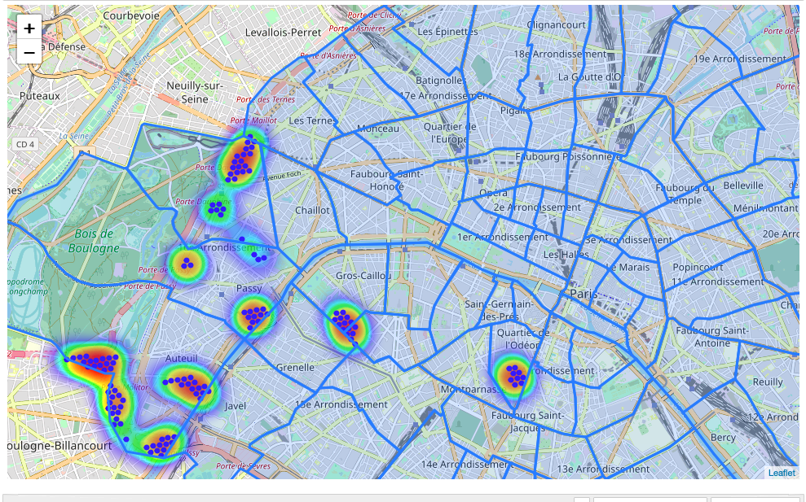
Heatmap of good locations
Locations with no more than two restaurants nearby: 287
Locations with no fine dining restaurants within 400m: 263
Locations with both conditions met: 127

Slide 7
Addresses obtained from k-means clusters
Marbeau, 75116 Paris => 2.8km from Pont Alexandre III
Unnamed Road, 75016 Paris => 4.0km from Pont Alexandre III
9 Avenue Emile Acollas, 75007 Paris => 1.6km from Pont Alexandre III
24 Rue du Commandant Guilbaud, 75016 Boulogne-Billancourt => 5.2km from Pont Alexandre III
Stade de Roland-Garros, 2 Avenue Gordon Bennett, 75016 Paris => 5.2km from Pont Alexandre III
Unnamed Road, 75006 Paris => 2.7km from Pont Alexandre III
92 Avenue du Président Kennedy, 75016 Paris => 2.6km from Pont Alexandre III
20 Rue du Général Malleterre, 75016 Paris => 5.0km from Pont Alexandre III
151 Rue de Longchamp, 75116 Paris => 3.0km from Pont Alexandre III
6 Avenue Raphaël, 75016 Paris => 3.4km from Pont Alexandre III
34 Square du Trocadéro, 75116 Paris => 2.3km from Pont Alexandre III

Slide 8
Conclusions and future directions
We found 127 locations within 11 centers of area meting our conditions
More informations are needed to take a decision :
attractiveness of each location (proximity to park or water)
levels of noise / proximity to major roads
real estate availability
prices, social and economic dynamics of every neighborhood

