Slide 1
Workshop HSLU – Hands On
Train Watson Visual Recognition

Slide 2
Content – Train Watson Visual Recognition
Description
Prepare your images
Train your custom model
Test your trained model
Deploy your model
Links

Slide 3
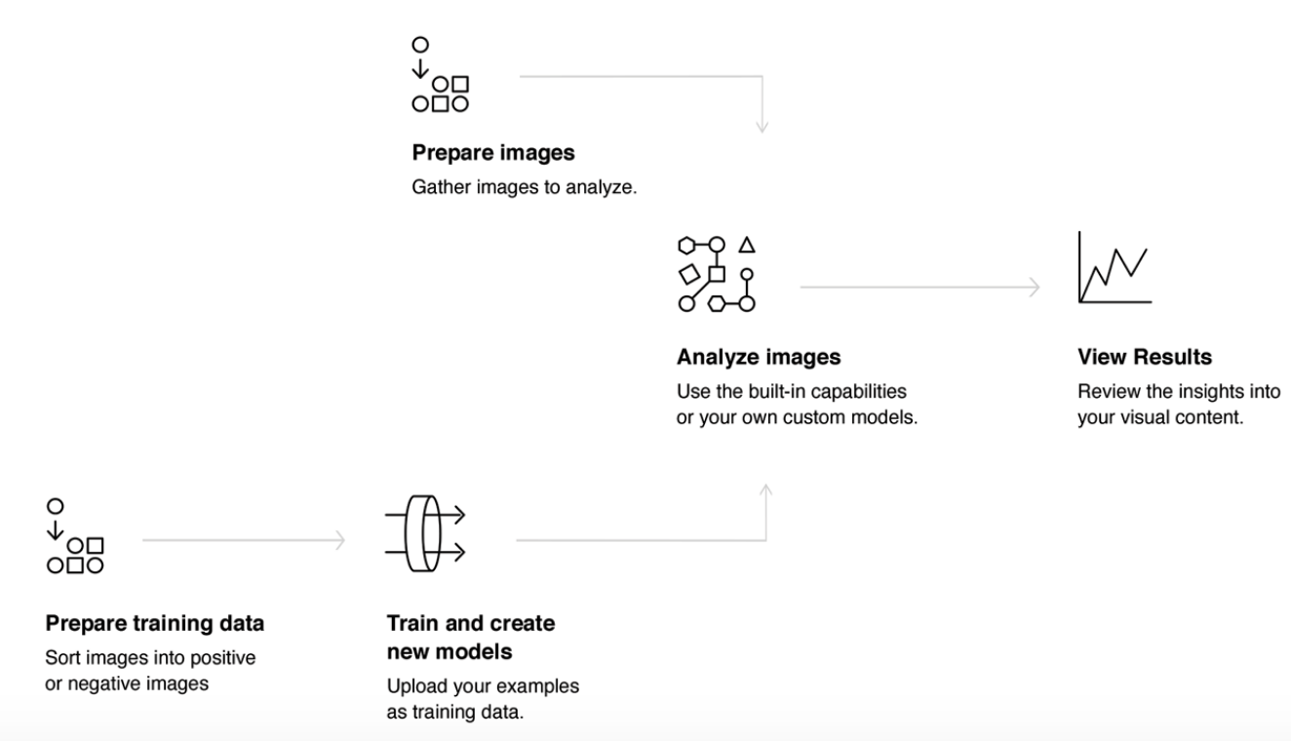
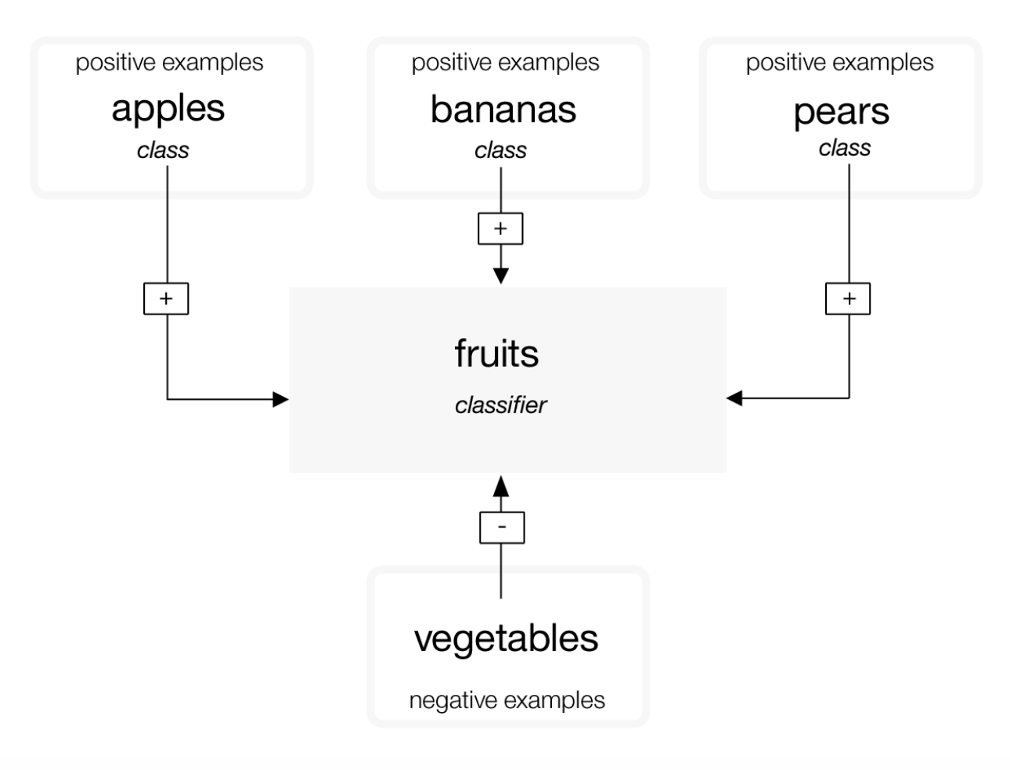
1. Description
Procedure
Prepare your images We are going to train a classifier called dogs and we prepared for you some pictures to train the individual classes.
Train your custom model To create your classes you can use 2 options: - The Model Builder in Watson Studio - Command Line Tool We are going to use the Builder.
Test your trained model After your model is trained, in the Watson Studio you can use the Test area of the model builder to classify test images using your custom model.
(Optional) Retrain your model You can improve the performance of your model by adding or removing training images and then retraining the model.
Deploy your model In the last step we will implement the new model into the previous exercise
Classifier vs. Classifier

Slide 4
2. Prepare your images
Download the four classes (zip-files): https://cloud.ibm.com/docs/services/visual-recognition?topic=visual-recognition-tutorial-custom-classifier&locale=en-US#tutorial-custom-classifier
Direct Links:
Beagle: https://watson-developer-cloud.github.io/doc-tutorial-downloads/visual-recognition/beagle.zip
Husky: https://watson-developer-cloud.github.io/doc-tutorial-downloads/visual-recognition/husky.zip
Golden-retriever: https://watson-developer-cloud.github.io/doc-tutorial-downloads/visual-recognition/golden-retriever.zip
Cats: https://watson-developer-cloud.github.io/doc-tutorial-downloads/visual-recognition/cats.zip
If you want to train your own classifier, read carefully the guidelines: https://dataplatform.cloud.ibm.com/docs/content/wsj/analyze-data/visual-recognition-prepare.html?linkInPage=true https://console.bluemix.net/docs/services/visual-recognition/customizing.html#guidelines-for-training-classifiers

Slide 5
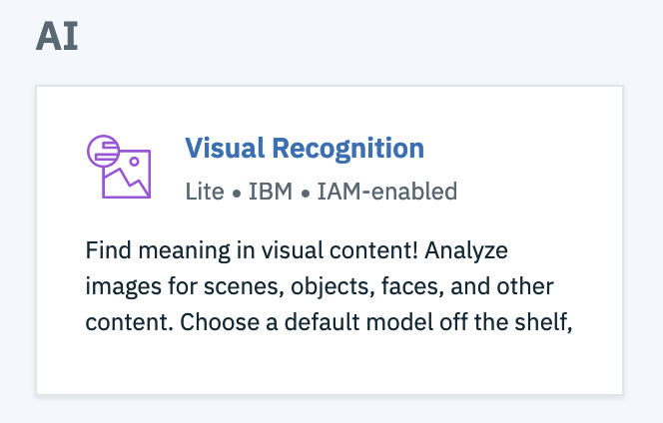
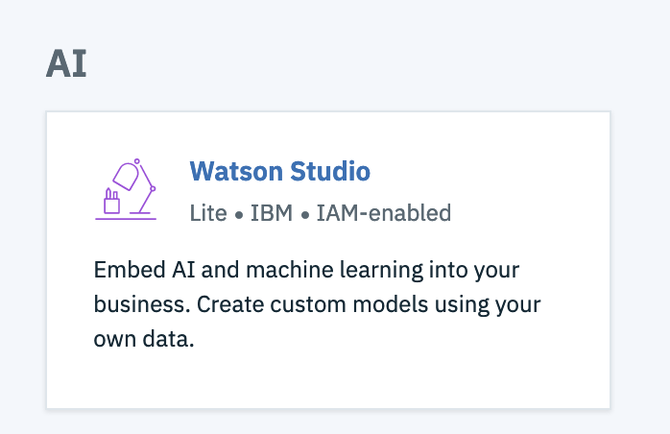
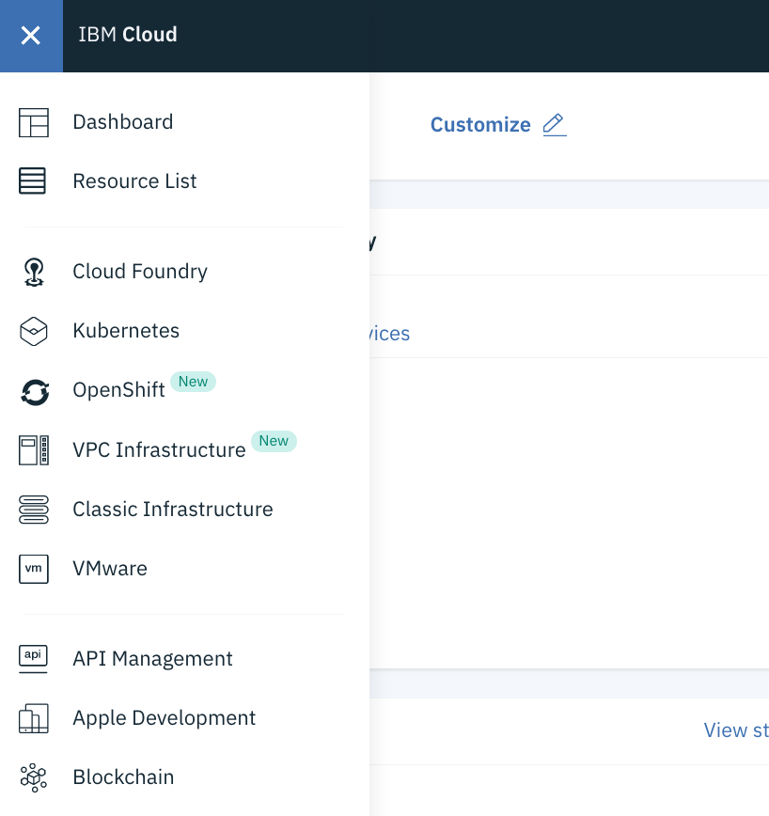
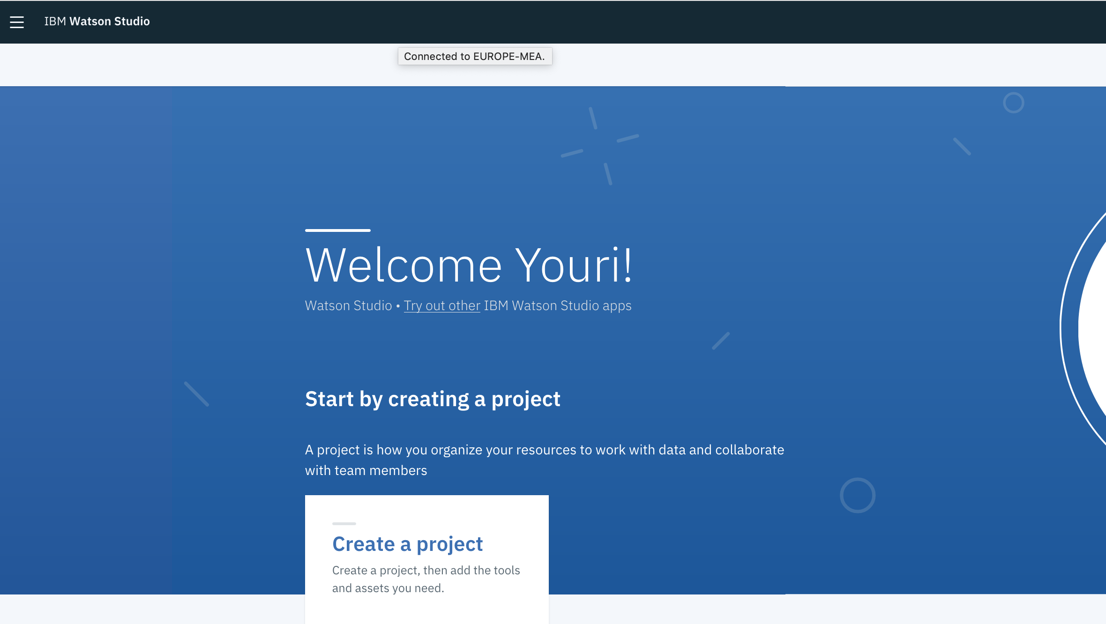
3. Train your custom model (in the Watson Studio) – (1/4)
Sign in to the IBM Cloud: https://cloud.ibm.com/
Search in the catalog for «Watson Studio» and create an instance
Region “Dallas”
Optional enter «Service Name»
Wait a few seconds to start
If not already done create an instance of the Visual Recognition service
Search in the Resource List for the newly created Watson Studio and open it.
Skip the Tour

Slide 6
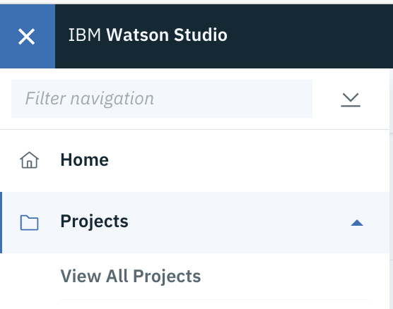
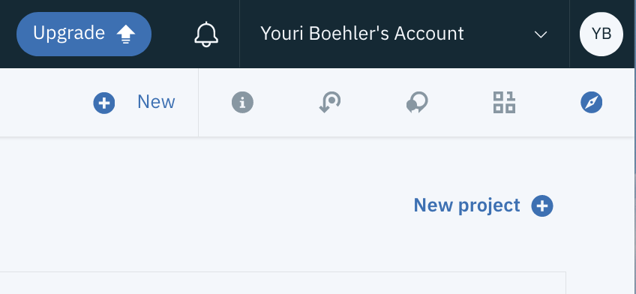
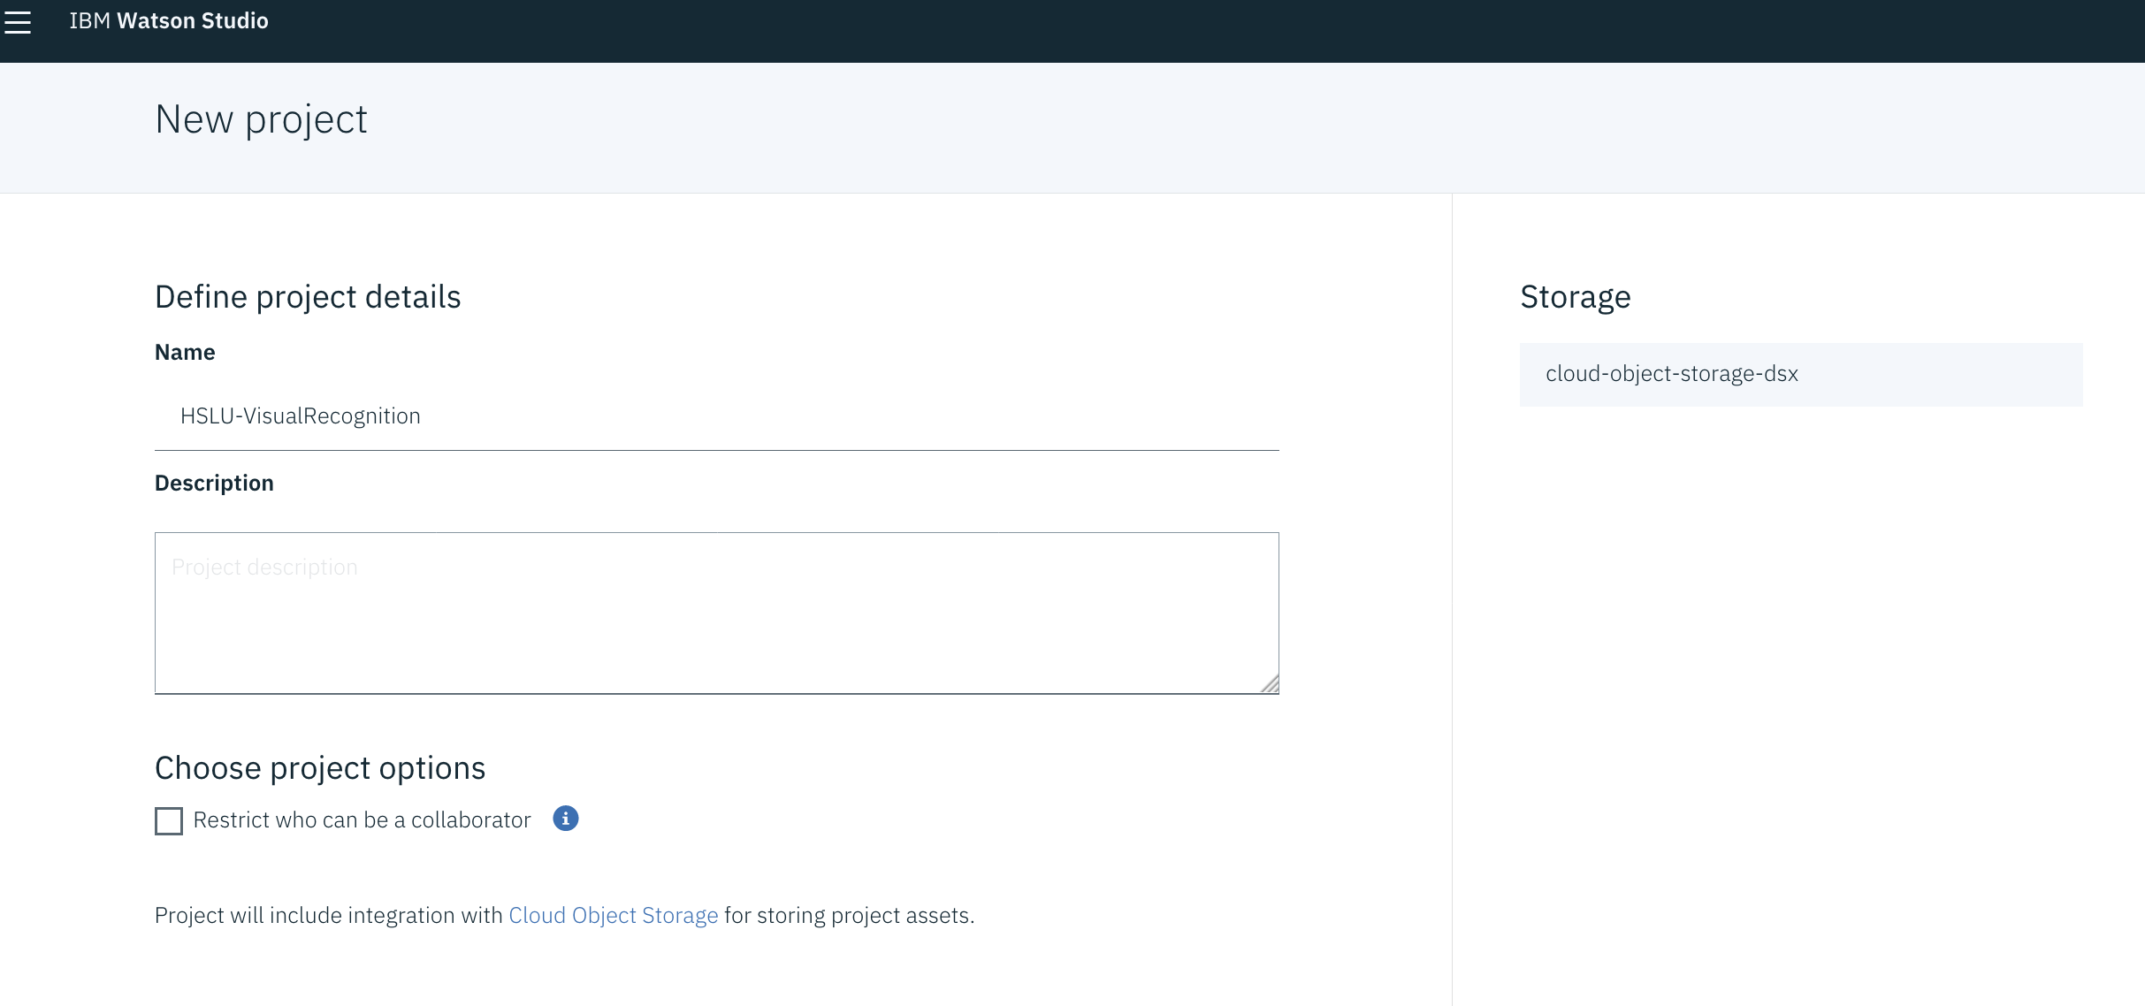
3. Train your custom model (in the Watson Studio) – (2/4)
Go to the home screen of the Watson Studio and open your projects with the menu bar
Create a New project
Define project Details → «Create model» → Enter Projectname (z.B. «HSLU-Visual Recognition») → Make sure cloud-object storage is available → «Create»

Slide 7
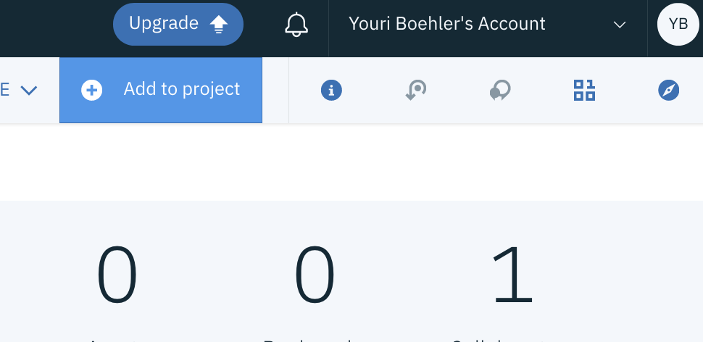
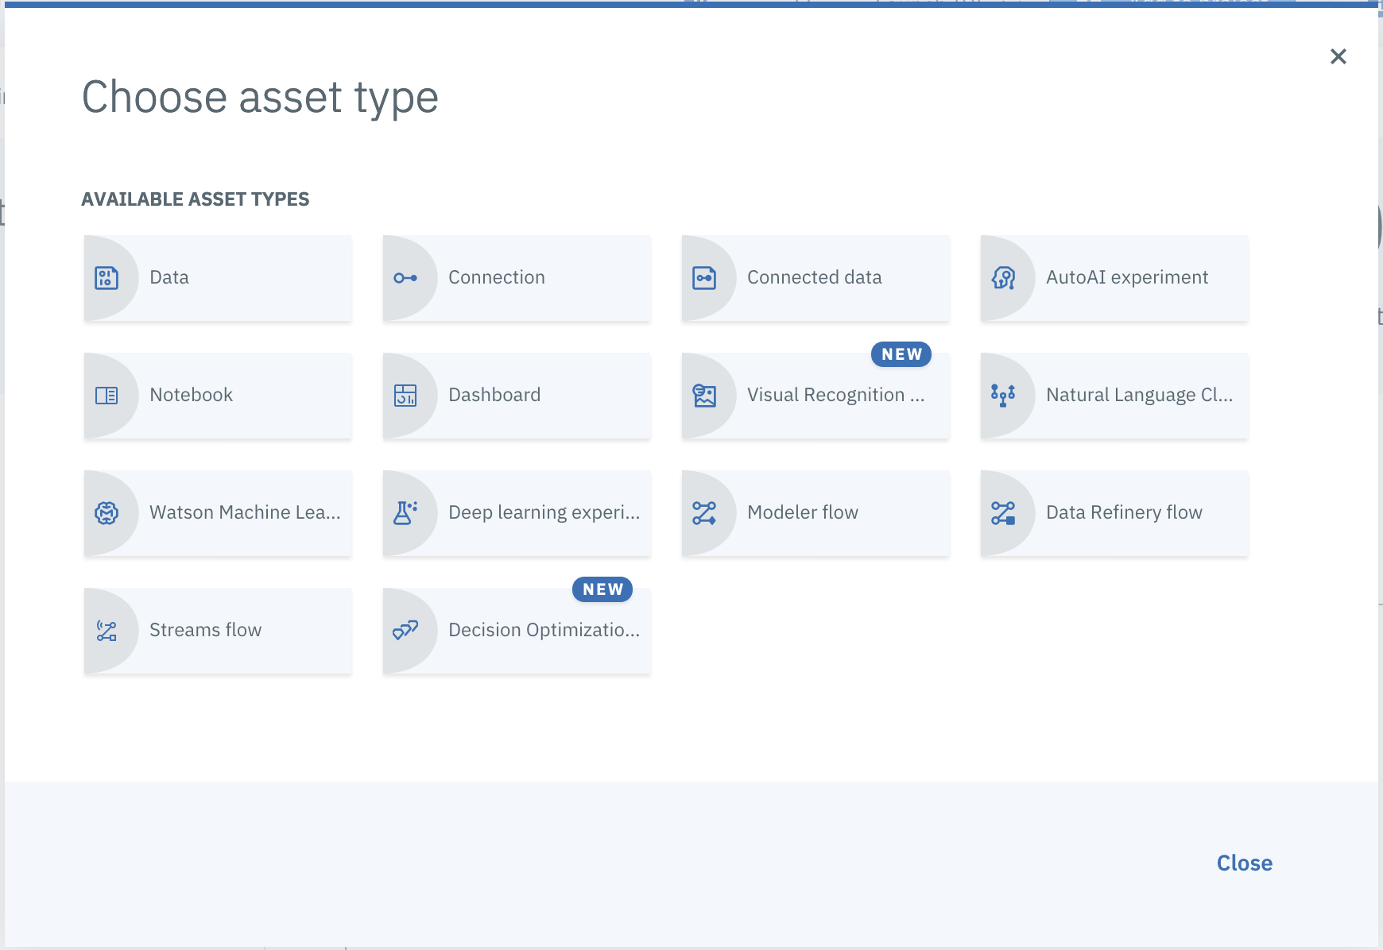
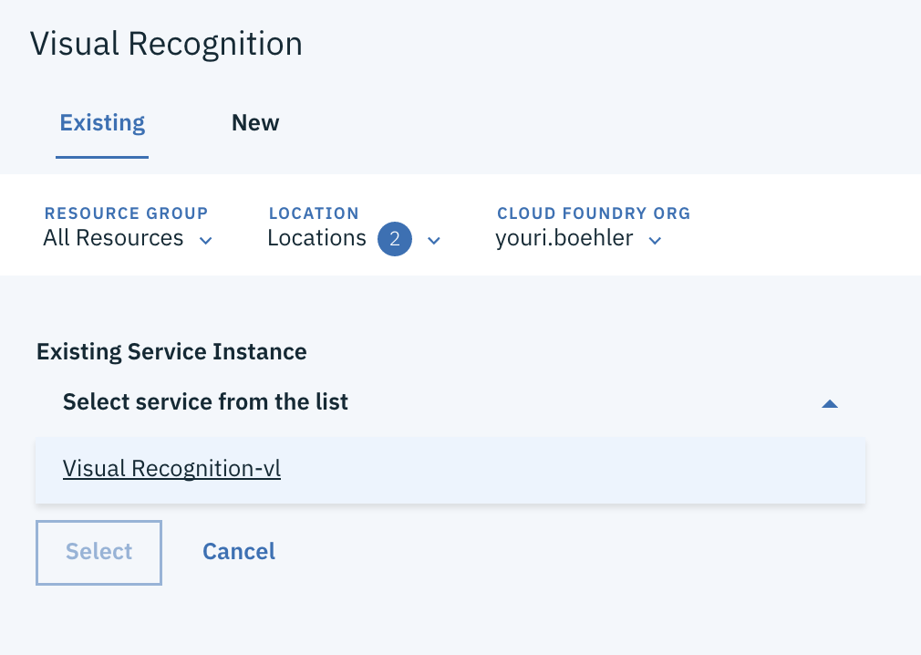
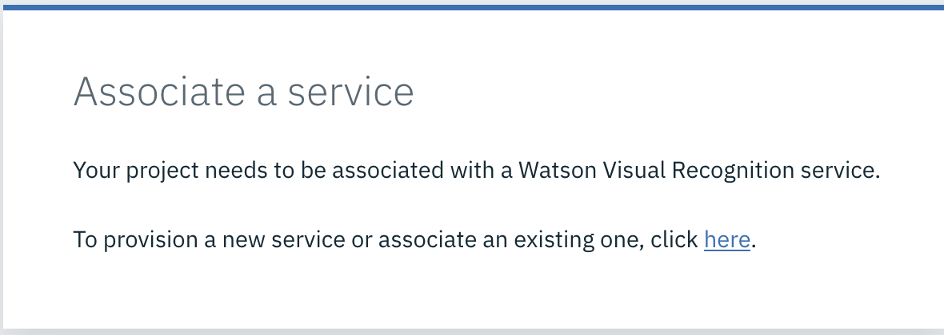
3. Train your custom model (in the Watson Studio) – (3/4)
Skip Tour
In the project click “Add to project”
Choose asset type → Visual Recognition
Associate a service → Click here → Select the Visual Recognition Service which you already created from the list → Make sure location of service is selected → Press «Select»

Slide 8
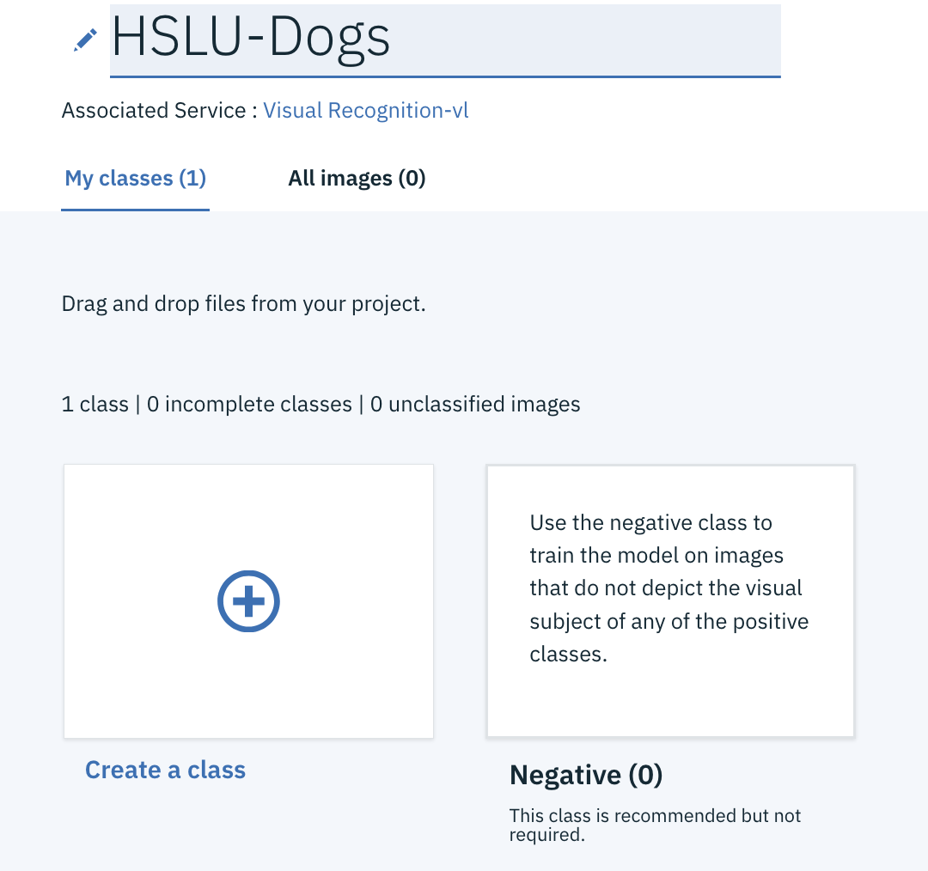
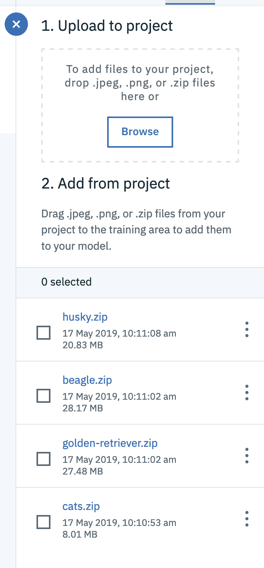
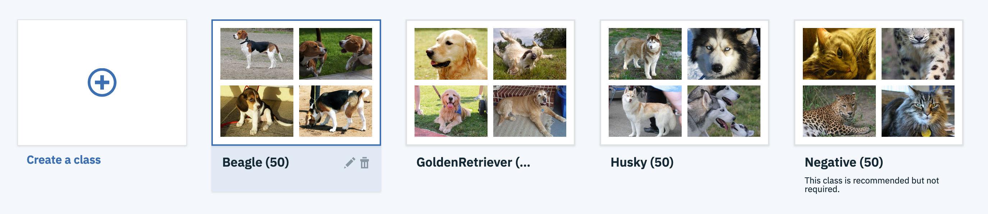
3. Train your custom model (in the Watson Studio) – (4/4)
Enter a the name of the classifier (e.g.Dogs or something else)
Upload the 3 positive classes (Beagle, GoldenRetriever and Husky) respectively the downloaded zip-files and wait until uploaded
Add the 3 positive classes to the model → Maybe this is done automatically
Additionally you can now upload the negative class (Cats). → If the cats are not in the Negative Folder, delete the class “cats” from the model (mark the box: «Also delete the images in this class) → Open the Negative class. Now you should be able to Drag&Drop them.
Click «Train model» and wait (+5 min)

Slide 9
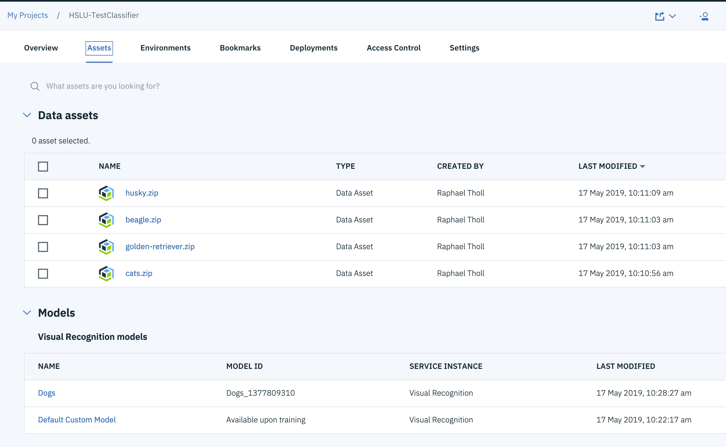
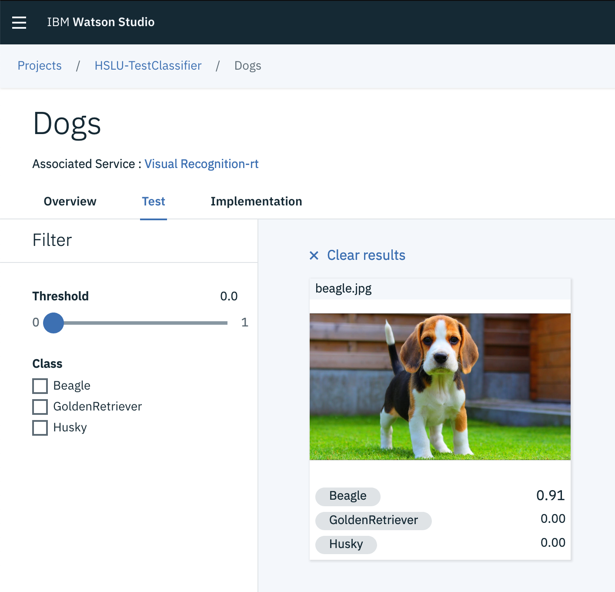
4. Test your trained model
As soon the model is trained navigate back to your project → «Assets» → «Visual recognition models»
Test Model → Click «HSLU-Dogs» → Test
Upload a test picture and see the results

Slide 10
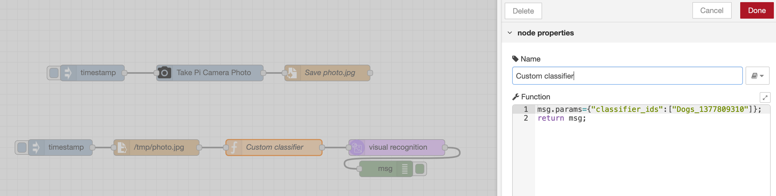
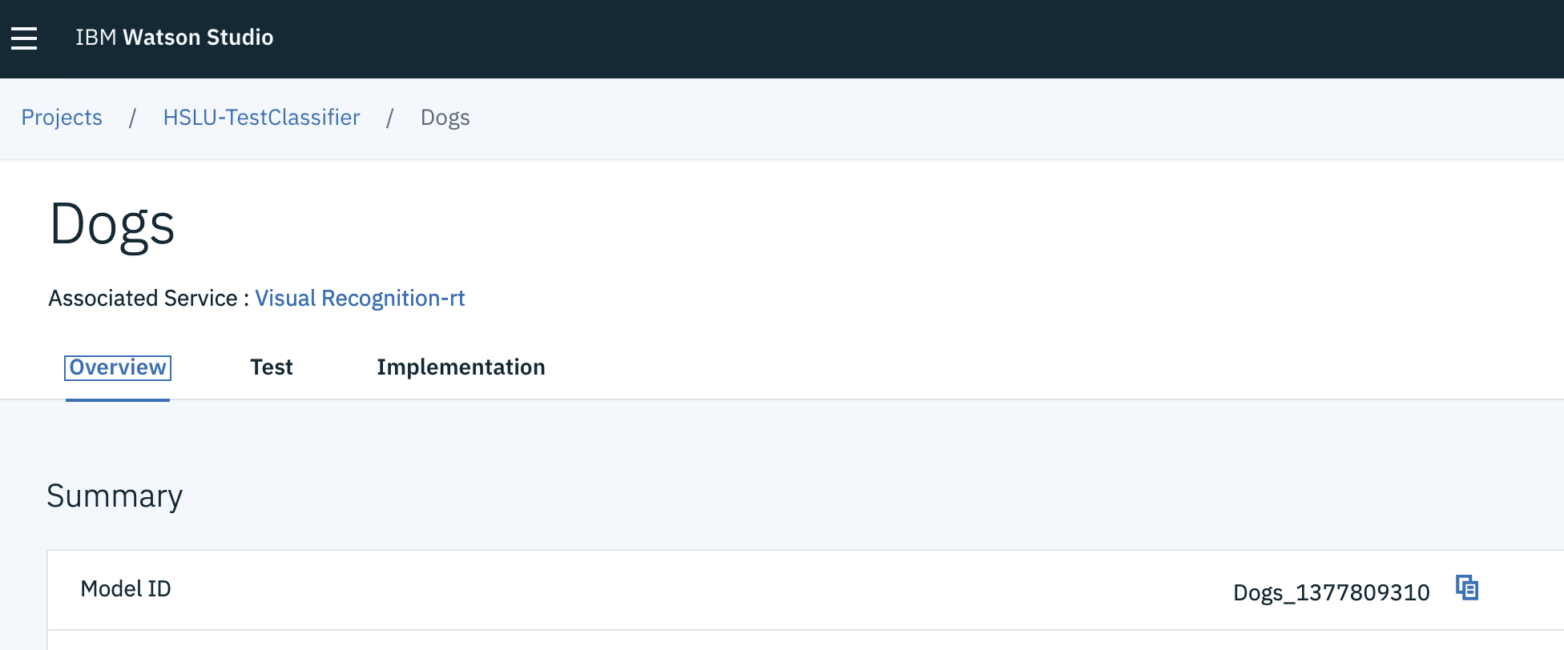
5. Deploy your model
Hint: To integrate your custom model in the previous exercise, the service needs to know which class it has to use. This is specified with the Model ID.
In the Watson Studio click on new created project
Click on the Model
Copy the Model ID
Add an additional function Node before the Visual Recognition Node → open the function node and add your Model ID: msg.params={"classifier_ids":[Model-ID]}; (replace Model-ID with your ID)
Deploy and Test Your flow

Slide 11
6. Links
Getting started: https://console.bluemix.net/docs/services/visual-recognition/getting-started.html#getting-started-tutorial
Custom Classifier: https://dataplatform.cloud.ibm.com/docs/content/wsj/analyze-data/visual-recognition-create-model.html?linkInPage=true https://console.bluemix.net/docs/services/visual-recognition/tutorial-custom-classifier.html#creating-a-custom-model
Prepare images
Guidelines: https://console.bluemix.net/docs/services/visual-recognition/customizing.html#guidelines-for-training-classifiers
How to extract pictures from a vides: https://www.wikihow.com/Export-Image-Files-from-a-Video-File-using-VLC

