Slide 1
The Zen of Coding
Day 1
Sept 19, 2016

Slide 2

Quick Introductions! (30 seconds)
Name
Location
Background (Career, Education, Interests)
Why learn web development?
Fears about class?

Slide 3
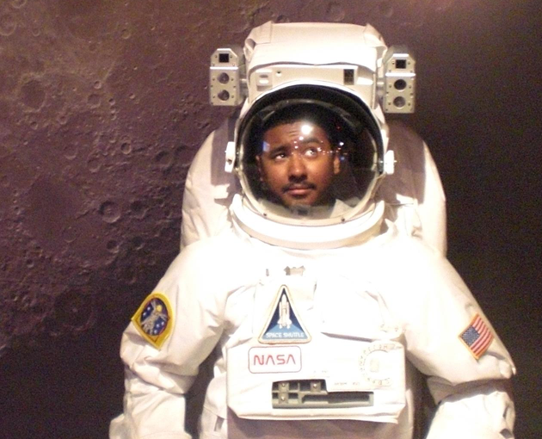
Instructor
Sean Wragg
BS in Computer Science from ITT Tech
Solutions Architect for The Walt Disney Company
Over 15 years coding, (with plenty of experience being a n00b at it.)
LOVES comics and movies
Secretly, aspiring to become Batman

Slide 4
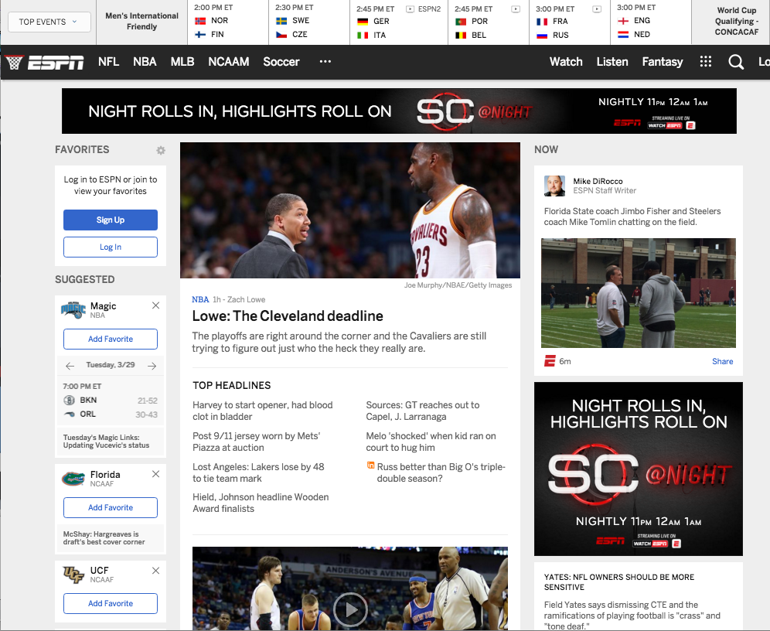
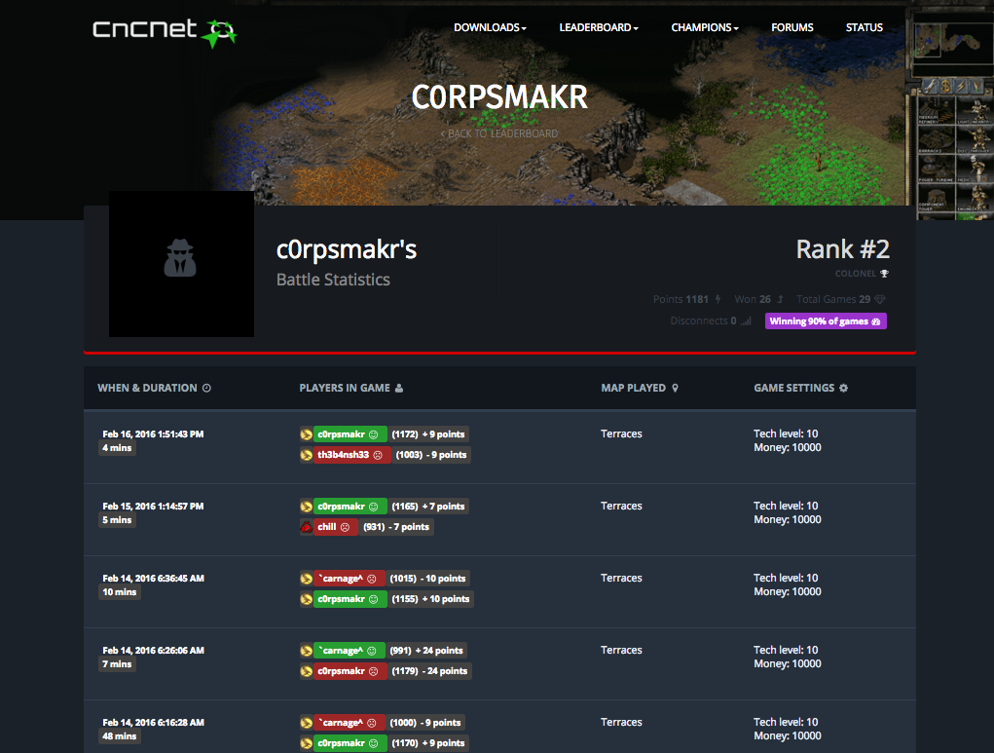
Some Cool Stuff I Made…
Biomarers
Developed EA Sponsored C&C Ladder
Node, Mongo, Angular
Developed ESPN.com framework
Java (Tea), MySQL

Slide 5
The Path of Learning

Slide 6
Common Student Goals
“To land a solid career.. and be able to support a family.”
“Hope to make something of myself one day…”
“An opportunity to be more creative in my day-to-day work.”
“…to get a better paying job.”
“I want nothing more in the entire world than to be a game designer.”
“Change careers and become a web developer.”
“…to build mastery. To learn a skill that I haven’t yet explored.”
“[a chapter] better than the last.”

Slide 7
Your Goal = Our Goal
As instructors,
we take your goals very, very seriously.

Slide 8
Support Team
Our Promise:
If you’re willing to put in the time – and you take our advice, we’re here to help you 100% of the way.
This goes for everyone working behind the program:
Instructors
TAs
Student Success Team
Career Coaches
Everyone Else!

Slide 9
Nothing Comes Easy…
As students, you face two HUGE obstacles!

Slide 10
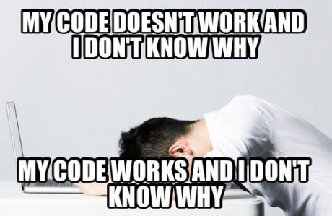
Obstacle #1 – The Great Confusion

Slide 11
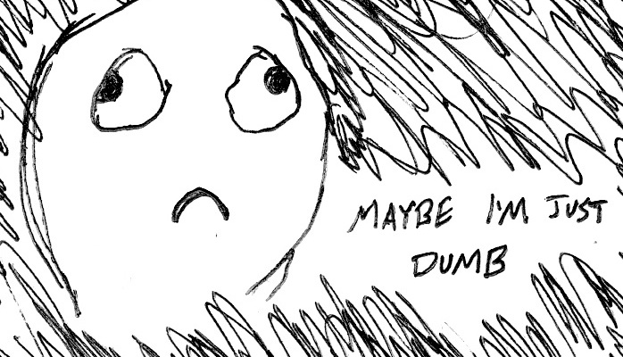
Obstacle #2 – The Great Doubt

Slide 12
Nothing Comes Easy…
Learning Coding Requires Two Things:
Persisting in the face of something that feels incredibly hard and confusing.
Maintaining the self-confidence necessary to believe that you CAN DO THIS!

Slide 13
Learning is “Frustrating”
“You can’t tell whether you’re learning something when you’re learning it—in fact, learning feels a lot more like frustration.”
“What I’ve learned is that during this period of frustration is actually when people improve the most, and their improvements are usually obvious to an outsider. If you feel frustrated while trying to understand new concepts, try to remember that it might not feel like it, but you’re probably rapidly expanding your knowledge.”
Phillip Dickey, Author of Write Modern Web Apps with the MEAN Stack: Mongo, Express, AngularJS, and Node.JS

Slide 14
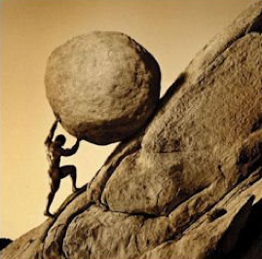
Advice for the Journey
Throughout this course, always remember to:
Work Hard!!

Slide 15
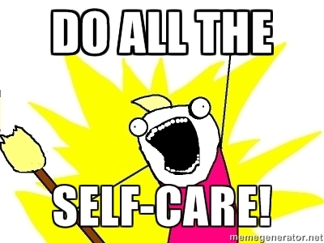
Advice for the Journey
Throughout this course, always remember to:
Work Hard!!
Appreciate your successes

Slide 16

Advice for the Journey
Throughout this course, always remember to:
Work Hard!!
Appreciate your successes
Trust yourself

Slide 17
Course Structure

Slide 18
Daily Schedule
For each class we’ll run through the following:
Set Objectives
Brief Background Lecture
Watch Me / Coding Demos
Code Discussions
In-Class Exercises
Project Work

Slide 19
Daily Schedule
For each class we’ll run through the following:
Set Objectives
Brief Background Lecture
Watch Me / Coding Demos
Code Discussions
In-Class Exercises
Project Work
The Super Important Stuff!!!
i.e. Always be coding!

Slide 20
Today’s Schedule
Students will get to know their classmates, Instructor, TA's, and Support Team.
Students will resolve any issues regarding pre-work and computer setup.
Students will understand the course structure.
Students will learn common Terminal (Mac) / Git Bash (Windows) commands to set up your file and folder structures.
Students will be able to use common Terminal (Mac) / Git Bash (Windows) commands for web development.
Students will be able to set up a basic HTML document.

Slide 21
On the Modern Web

Slide 22
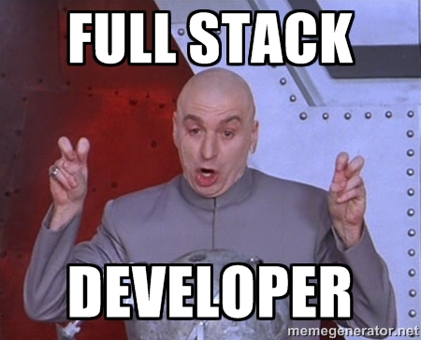
Full-Stack Development?

Slide 23
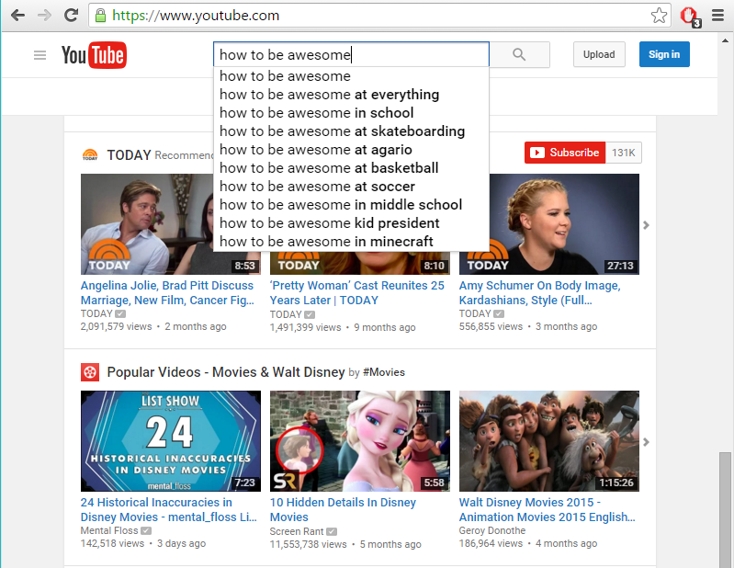
The “Magic” of YouTube

Slide 24
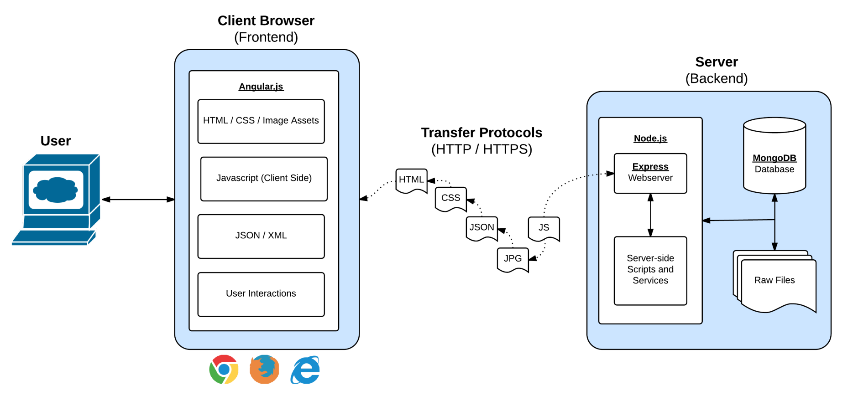
Full-Stack Development
In modern web apps, there’s a constant back-and-forth communication between two key components: the visuals displayed on the user’s browser (frontend), and the data and logic stored on the server (backend).

Slide 25
Full-Stack Development
Full-Stack Development is the concept of building every aspect of the web application – from the visuals and interactions, to the data transfer and processing.

Slide 26
Full-Stack Development
The Browser
Dev Tools
Server Side
HTML
CSS
JavaScript
jQuery
Bootstrap
SEO
Heroku
Git
GitHub
Templating Engines
Sessions
Writing tests
Node.js
Express.js
Creating APIs
MVC
User Authentication
ORM (Sequelize)
Meteor.js
Databases
MySQL
MongoDB
API Interaction
APIs (Consuming)
JSON
AJAX
Real Time Cloud Database via Firebase
Algorithms
Design Patterns
CS Fundamentals
Cutting Edge Development
React.js and React Native

Slide 27
Let’s Get Crackin!

Slide 28
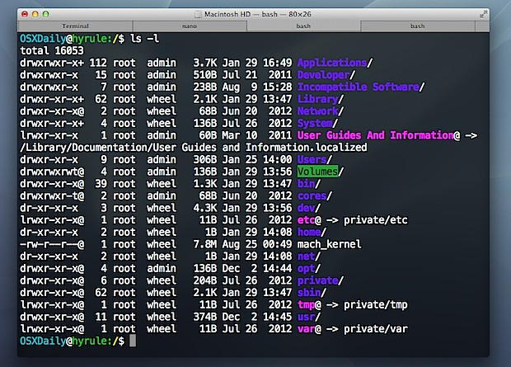
Intro to Console / Terminal

Slide 29
INSTRUCTOR DEMO
Instructor: Demo
(1-ConsoleCommands)

Slide 30
> YOUR TURN!
Activity: Get Situated | Suggested Time: 1 min
Assignment:
Make a folder on your desktop named code.
Put all of you code that you do inside of that folder.
Best Practices:
Always use lowercase for folder and file names.
Never put in spaces in your folder and file names.
Use dashes to separate.

Slide 31
> YOUR TURN!
Activity: Console Commands | Suggested Time: 12 min
Assignment:
From the Terminal / Console and using only the command line, create:
A new folder with the name of first_day_stuff.
A new HTML file with the name of first_day.html.
Open the current folder containing the new HTML file.
Bonus:
Create multiple directories/folders with the names one_folder and second_folder in one command.
Create multiple files with the names one.html and two.html in one command in the first_day_stuff directory.

Slide 32
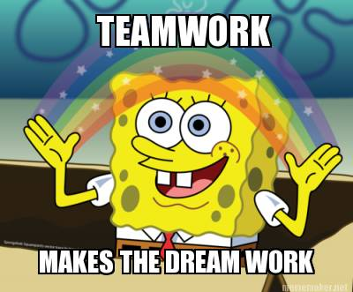
Intro to Console
Discuss with Neighbors

Slide 33
Hello, HTML

Slide 34

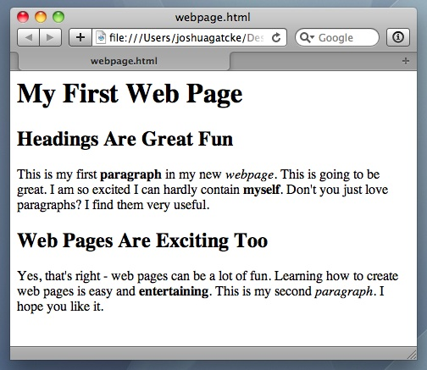
<title> Intro to HTML </title>
HTML is one of the three base languages behind every single website.
It defines all of the basic content and a bit of formatting.

Slide 35
> YOUR TURN
Assignment:
In a new HTML file, create the basic structure of an HTML document and include the following in it:
DOCTYPE declaration.
Head tag with a title tag.
H1 tag with a title of your choice.
Embed an image.
Create the following three links on your page:
One link that is target="_blank" so that it opens a new tab when clicked on.
Make the second link bold.
Make the third link a placeholder so it goes nowhere.
Bonus:
Create an ordered list of steps to make a sandwich.
Create an unordered list of 5 bands/musicians you like.
Create a table with 2 columns (animal class, animal name) and have 4 rows of animals
Use an alternate way of separating links without line breaks.
Embed a YouTube video of your favorite band/musician.

Slide 36
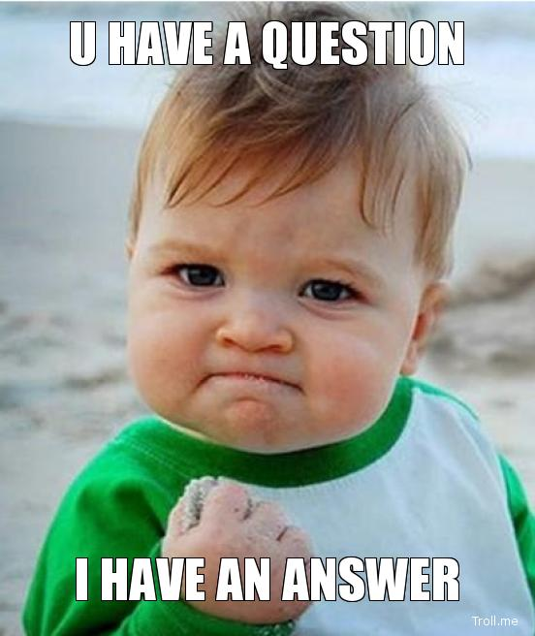
<title> Intro to HTML </title>
How’d it go?

Slide 37
Homework!

