Slide 1
Javascript Juggernauts
Day 9
Oct 15, 2016

Slide 2

This will soon be you…
Javascript Juggernauts.

Slide 3
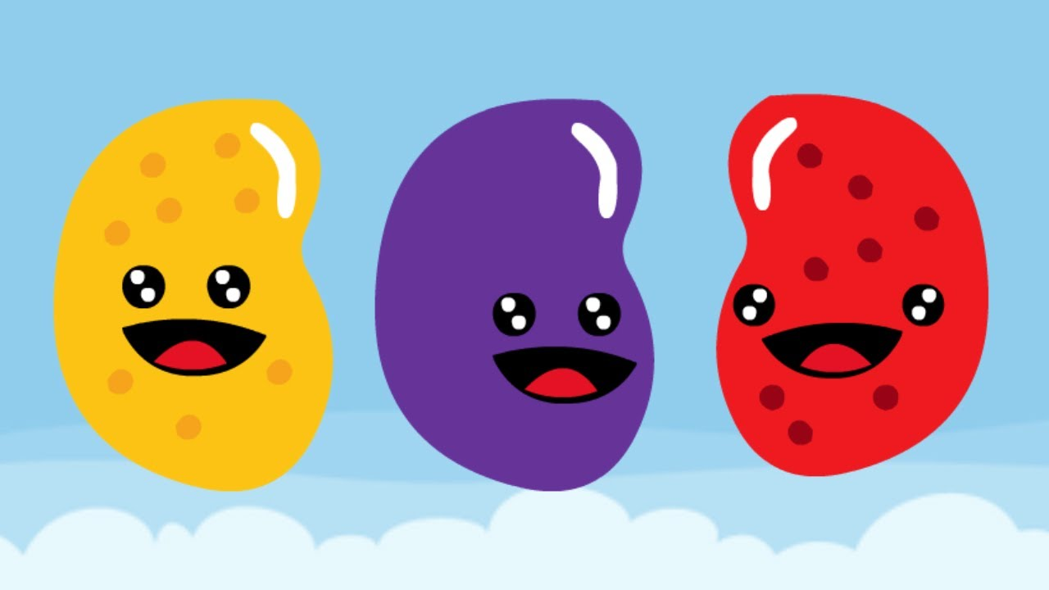
But right now…
Probably feeling like
Javascript Jellybeans.

Slide 4
Transformation to Come
HANG IN THERE!

Slide 5
Today’s Class

Slide 6
Objectives
In today’s class we’ll be covering:
Javascript Functions
Javascript Objects
Building Simple Javascript Applications

Slide 7
Juggernauts be Born
Let’s get straight to it!

Slide 8
Functions!

Slide 9
> YOUR TURN!!
Activity: 1-LoopTV | Suggested Time: 10 min
Code Dissection: Array Building
Run the program sent to you via slack.
Then, with a partner fill in the missing comments for each line of code.
Make sure both of you can fully explain what each line means.
Be prepared to share!

Slide 10
Demo Time
Instructor: Demo
(SuperHeroLogging_NoFunctions.html | 2-SuperHeroLogging)

Slide 11
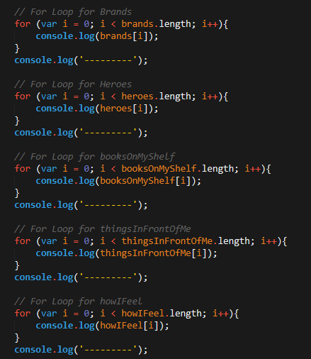
Mondo Repetitive…
Who wants to maintain this??
Hint: No one.

Slide 12
Demo Time
Instructor: Demo
(SuperHeroLogging_WithFunctions.html | 2-SuperHeroLogging)

Slide 13
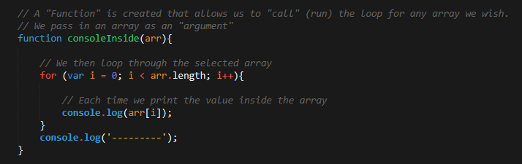
Much Better with Functions!
Squeaky Clean Code.
With very minimal repetition

Slide 14
> YOUR TURN!!
Activity: 3-MyFirstFunctions | Suggested Time: 20 min
Code Creation: Function Building
Working in pairs and using the starter file sent to you via slack – fill in the missing functions and function calls.
Note: Try to finish all four functions if you can. But don’t beat yourself if you only get 1 or 2. The important thing is that you get at least one function fully done.
Hint: Look back the example just slacked to you.

Slide 15
Objects!

Slide 16
Demo Time
Instructor: Demo
(GoodArray.html | 4-GoodArray)

Slide 17
Demo Time
Instructor: Demo
(JoanofArcArrays.html | 5-JoanofArcArrays)

Slide 18
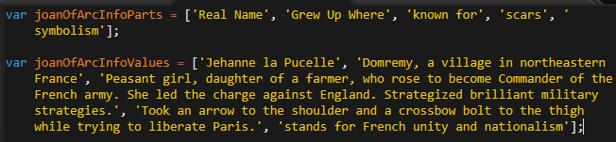
Associated Data ==/== Arrays
Relating two separate arrays is not fun.

Slide 19
Demo Time
Instructor: Demo
(JoanofArcObjects.html | 6-JoanofArcObjects)

Slide 20
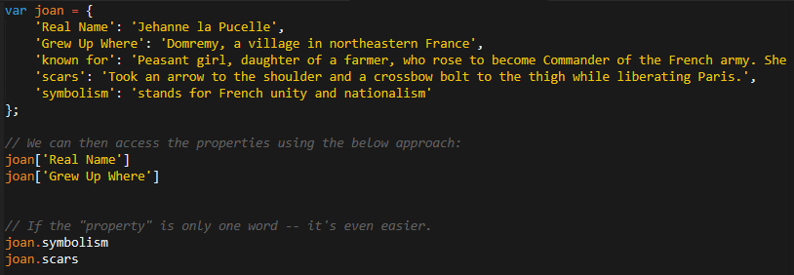
Joan of Arc – The Maid of Le’Objects
Now, Joan’s “properties” and “values are associated in object form. Making it easy to recall specific data

Slide 21
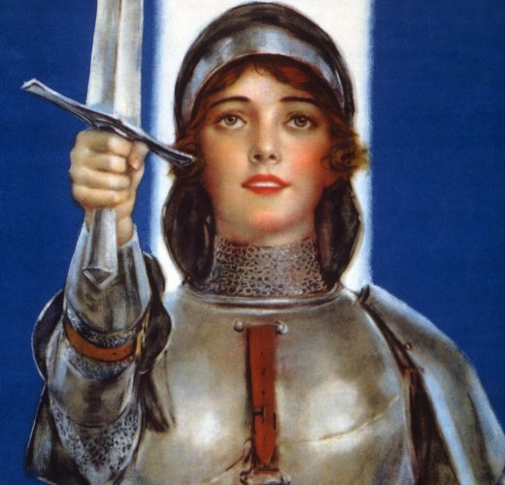
Objects Visualized
var joan
=
{
“Real Name”
:
“Jehane La Pucelle”
,
“scars”
:
“Took an arrow to shoulder…”
,
“symbolism”
:
“Stands up for French Unity..”
}
This is Joan. According to code… Joan is an Object

Slide 22
Objects Visualized
var joan
=
{
“Real Name”
:
“Jehane La Pucelle”
,
“scars”
:
“Took an arrow to shoulder…”
,
“symbolism”
:
“Stands up for French Unity..”
}
These are Joan’s properties (like descriptors)

Slide 23
Objects Visualized
var joan
=
{
“Real Name”
:
“Jehane La Pucelle”
,
“scars”
:
“Took an arrow to shoulder…”
,
“symbolism”
:
“Stands up for French Unity..”
}
These are the “values” of Joan’s Properties

Slide 24
Objects Visualized
var joan
=
{
“Real Name”
:
“Jehane La Pucelle”
,
“scars”
:
“Took an arrow to shoulder…”
,
“symbolism”
:
“Stands up for French Unity..”
}
Thus: Joan.scars = “took an arrow to shoulder”

Slide 25
Demo Time
Instructor: Repeat Demo
(JoanofArcObjects.html | 6-JoanofArcObjects)

Slide 26
> YOUR TURN!!
Activity: 7-MyFirstObject | Suggested Time: 15 min
Code Dissection / Creation: Basic Objects
With a partner, spend the next few moments studying the code just slacked to you.
Then fill in the missing comments to log the relevant information about the provided `car` object.
Bonus: If you finish early, begin creating an object of your own in HTML. Slack out a snippet of the code to the class when you are done. Be Creative!

Slide 27
Demo Time
Instructor: Demo in Browser
(carGame_Solved.html | 8-CarGame)

Slide 28
> YOUR TURN!!
Activity: 8-CarGame | Suggested Time: 20-30 min
Code Creation: Run that Car!
Using the code sent to you from the previous activity, create a complete application such that:
Users can enter keyboard input (letters)
These letters then trigger the car’s functions to get run
These letters also trigger a global function called reWriteStats() that logs the car’s make, model, color, mileage, and isWorking status to the console.

Slide 29
Demo Time
TA: Demo
(Homework Videos!)

Slide 30
> YOUR TURN!!
Activity: 9-TriviaGame | Suggested Time: 45 min
Extra Activity: Trivia Game
With whatever class time remains, complete the following activity in pairs.
Starting from a blank HTML file:
Create an object with 10 questions. The object should be structured like this: q1: [“QUESTION”, “ANSWER”] q2: [“QUESTION”, “ANSWER”]
Then create code that goes through the questions one by one and asks users each question. Users must hit t (for true) or f (for false).
Check the user’s answer against the correct answer and provide the user an alert of some sort if they are right or wrong.
Bonus: Keep track of the number of questions the user gets right or wrong.
Hint:
Don’t worry about having DRY code to start with. Just focus on getting working code first.

Slide 31
Questions

