Slide 1
Express Yourself
Day 42
April 26, 2016

Slide 2
Early Concerns…

Slide 3
Comment #1 - Concern
“This is all so confusing…”

Slide 4
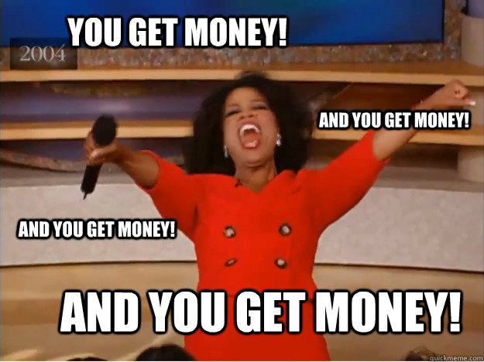
Comment #1 - Response
And it will be for your employer as well.

Slide 5
Comment #2 - Concern
“I feel like I’m just copying and pasting”

Slide 6
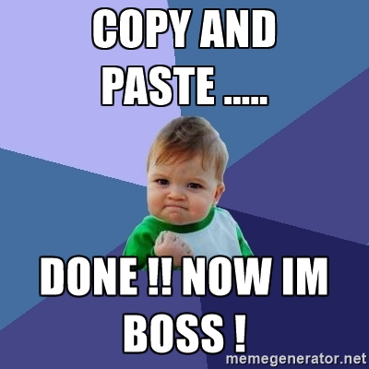
Comment #2 - Response
Backend code libraries mean YOU have to code less.
Often you are just copying “best-practices” over and over again.

Slide 7
Today’s Class

Slide 8
Your Objectives
Before you walk out the door you should…
Know how to create a generic Express Server (copy and paste is fine).
Know how to create a basic Express GET route
Know how to create an Express POST route
Know what POST Man is for
Understand “conceptually” how to use AJAX to GET and POST data to an Express server

Slide 9
A Moment to Refresh

Slide 10
A Big Box
Server
Take a few moments to answer the following questions with the person next to you:
How does this box represent a server?
What modules or “sub-boxes” commonly exist inside?

Slide 11
Inside the Box: And More!
Server
In a way, servers can be represented as hardware boxes with modules of server-side code contained inside.
Servers typically contain code for tasks such as listening, parsing URLs, route handling, and more.
Listen
URL Parse
Route Handling
Send HTML
Send JSON
Receive POSTs
Server Side Logic
And More!

Slide 12
Express

Slide 13
Remind me again…
What is Express?
In modern web applications there is a constant back-and-forth communication between the visuals displayed on the user’s browser (frontend) and the data and logic stored on the server (backend).

Slide 14
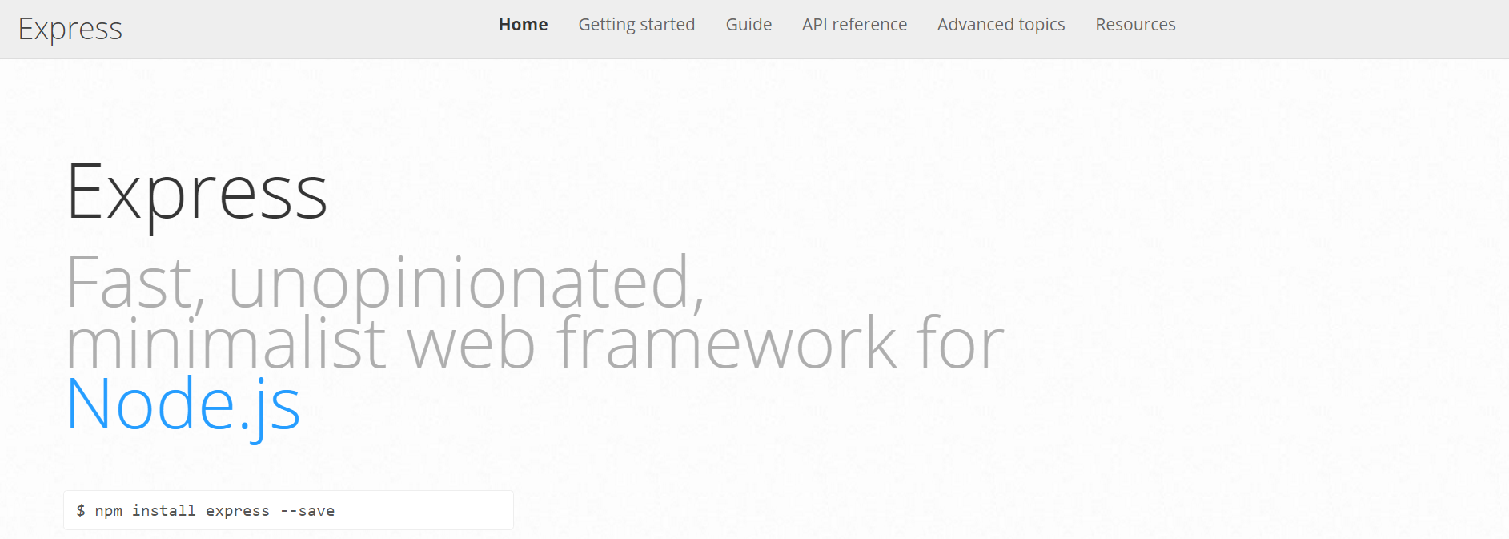
Express.JS
Web framework for node to make creating code for server much simpler
In modern web applications there is a constant back-and-forth communication between the visuals displayed on the user’s browser (frontend) and the data and logic stored on the server (backend).

Slide 15
Remind me again…
What is a route?
In modern web applications there is a constant back-and-forth communication between the visuals displayed on the user’s browser (frontend) and the data and logic stored on the server (backend).

Slide 16
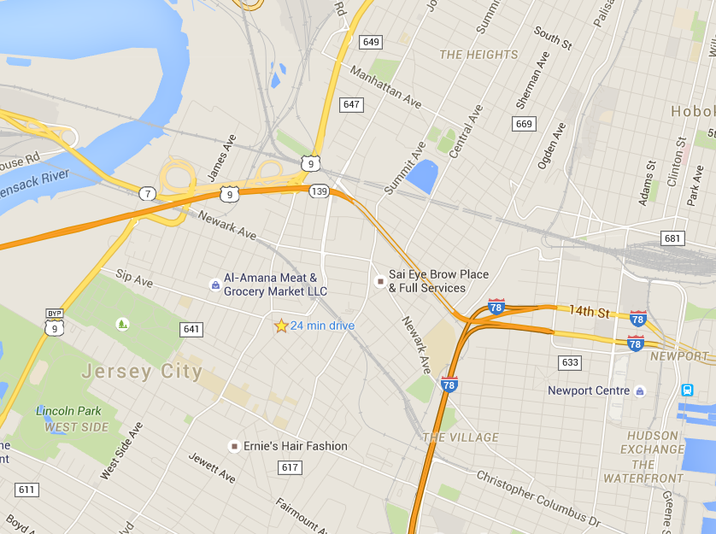
Routes = Maps
In modern web applications there is a constant back-and-forth communication between the visuals displayed on the user’s browser (frontend) and the data and logic stored on the server (backend).

Slide 17
Routes = Maps
/join
User is shown the “Join” Page
/add
User is shown the “Add” Page
User visits a link…
/search/:name
User is shown the “search” page with just the results relevant to the name.

Slide 18
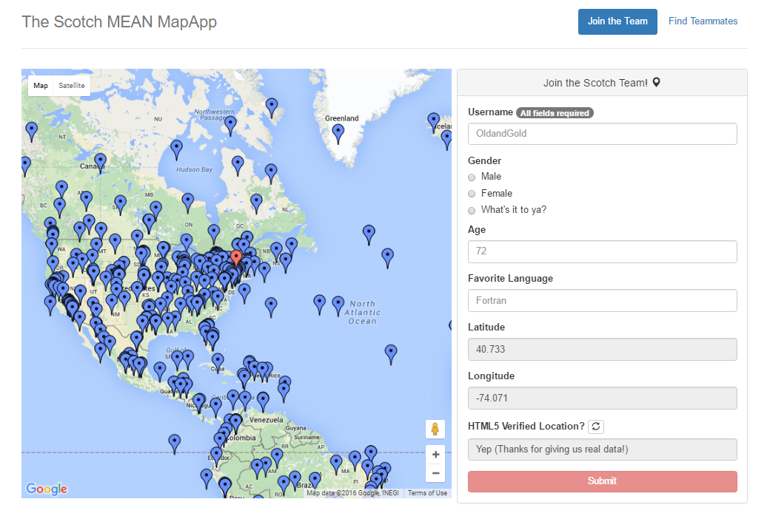
Quick Example
https://mean-map.herokuapp.com/#/join

Slide 19
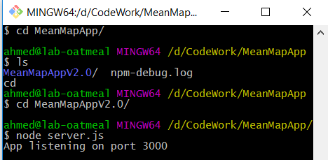
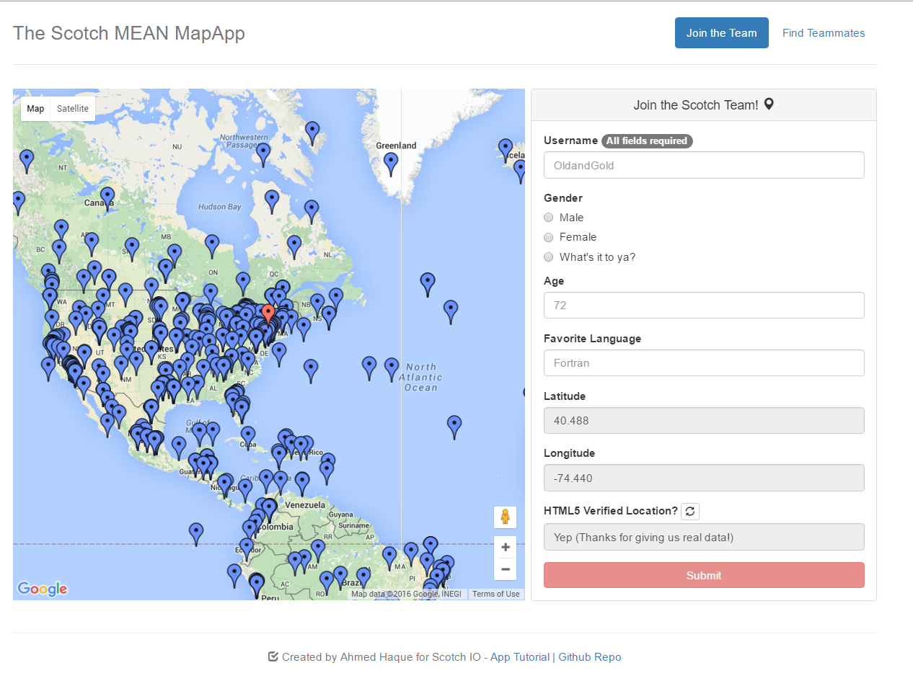
Client-Server Communication (GET)
Client Browser
Node Server
1) User visits /join
(GET Request)

Slide 20
Client-Server Communication (GET)
Client Browser
Node Server
1) User visits /join
(GET Request)
3) Server responds by providing HTML with web form data
2) Request triggers the code in the Server route. The server then finds the relevant HTML content and data

Slide 21
Client-Server Communication (POST)
Client Browser
Node Server
1) User submits form entry
(POST Request)

Slide 22
Client-Server Communication (POST)
Client Browser
Node Server
1) User submits form entry
(POST Request)
3) Server responds by providing HTML with web form data
2) Request triggers the code in the Server route. The server then adds the user to the map and database.

Slide 23
Activity Time!

