Slide 1
COMP90054 AI Planning for Autonomy Workshop Week10

Slide 2
Objectives
MCTs(Monte Carlo Tree Search)
UCT ---- Better Version of MCTs
UCT = MCTs + UCB1
(UCT balances exploitation and exploration)

Slide 3
Offline Planning
We solve problem offline for all possible state, and then use the policy online.
e.g. Value iteration, Policy iteration.
Online Planning
Actions are selected online at each state, with the calculation of which action to select being done during execution.
e.g. Monte Carlo Tree Search(MCT)
Q(s, a) is approximated using simulations

Slide 4
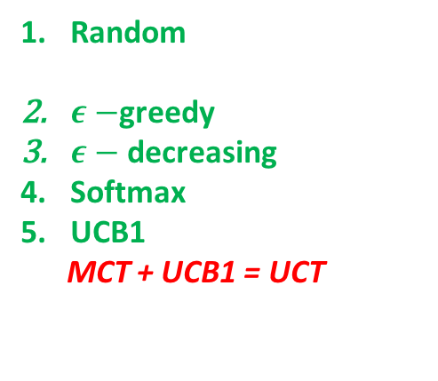
Monte Carlo Tree Search (MCT)
Random
$ε−$greedy
$ε−$ decreasing
Softmax
UCB1
MCT + UCB1 = UCT
Step1: Selection
Start from root R and select successive child nodes by applying actions until a leaf node L is reached.
Action selection is according to a Tree Policy
Can balance
exploitation and exploration
Step2: Expansion
If this leaf node L has been visited before, then expand this node to add its child as a new state to do the following simulation. Otherwise, do simulation from this leaf node L.
Step3: Simulation
From the expanded node, perform a complete random simulation within time limit or computational budget.
Step4: Backpropagate
Finally, the value of the node is backpropagated to the root node, updating the value of each ancestor node on the way

Slide 5
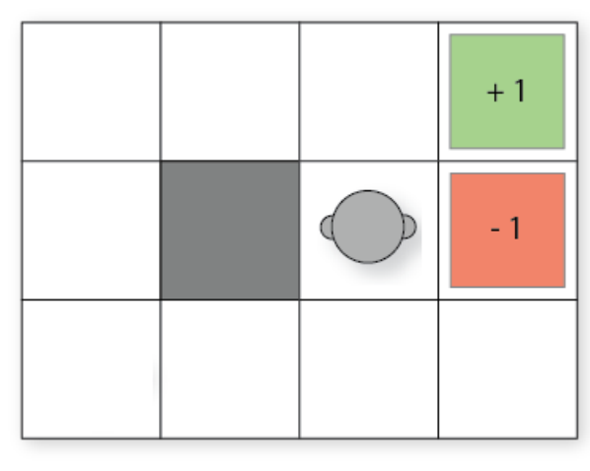
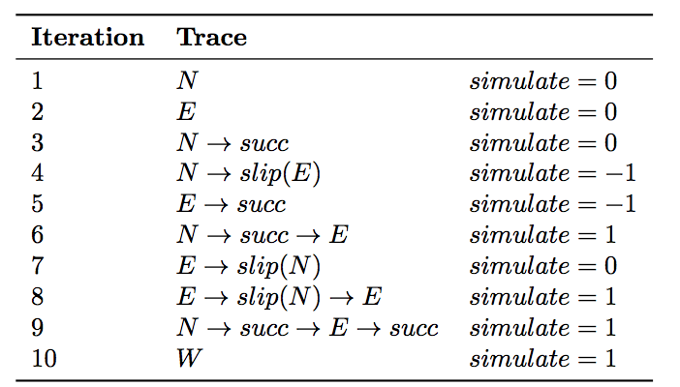
General Idea of MCTs
I am at cell(2,1) now, and want to know which action should I take to maximize the reward of this state
Online Planning.
I use 10 simulations to draw a Monte Carlo Tree, so that I can
approximate the reward of each action, Q(s,a), with the help
of the tree.
3. After I finished drawing the tree, I can get the Q(s,a) of each action a at state s, which means the tree can return me a best action so far.

Slide 6
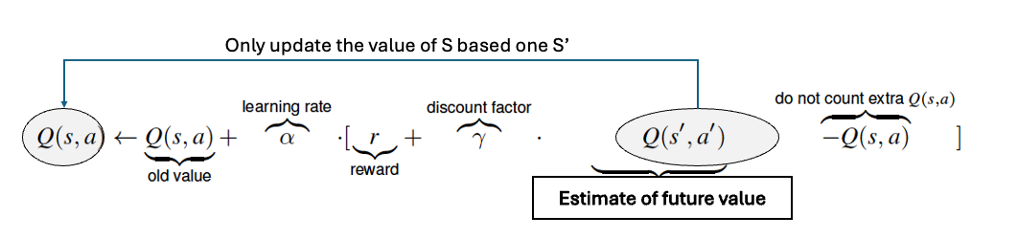

Slide 7
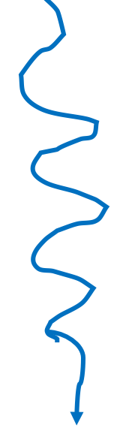
Iteration 1
total reward/visit count
0/0
0/1
= avg reward
N
Step1: Selection
Step2: Expansion
0/0
0/1
Step3: Simulation
(take random actions until
arrive terminate states
or reach time limit
or computational budget)
Step4: Backpropagate
0/1

Slide 8
Iteration 2
total reward/visit count
0/1
0/2
= avg reward
N
E
Step1: Selection
0/1
0/0
0/1
Step2: Expansion
Step3: Simulation
(take random actions until
arrive terminate states
or reach time limit
or computational budget)
Step4: Backpropagate
0/1

Slide 9
Iteration 3
total reward/visit count
0/2
0/3
= avg reward
action selections
N
E
0/1
0/2
0/1
probabilistic outcomes
of those actions
succ
0/0
0/1
0/1

Slide 10
Iteration 4
total reward/visit count
0/3
-1/4
= avg reward
action selections
N
E
0/2
-1/3
0/1
probabilistic outcomes
of those actions
succ
slip(E)
0/1
0/0
-1/1
Actually for this iteration,
no need to simulate
-1/1

Slide 11
Iteration 5
-2/5
total reward/visit count
-1/4
= avg reward
action selections
N
E
-1/3
0/1
-1/2
probabilistic outcomes
of those actions
succ
slip(E)
succ
0/1
-1/1
0/0
-1/1
Actually for this iteration,
no need to simulate
-1/1

Slide 12
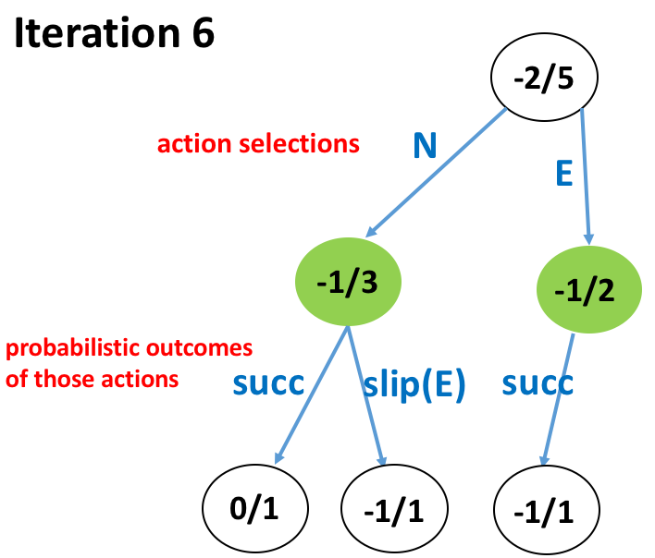
-1/6
total reward/visit count
= avg reward
0/4
1/2
E
1/1
0/0
1/1

Slide 13
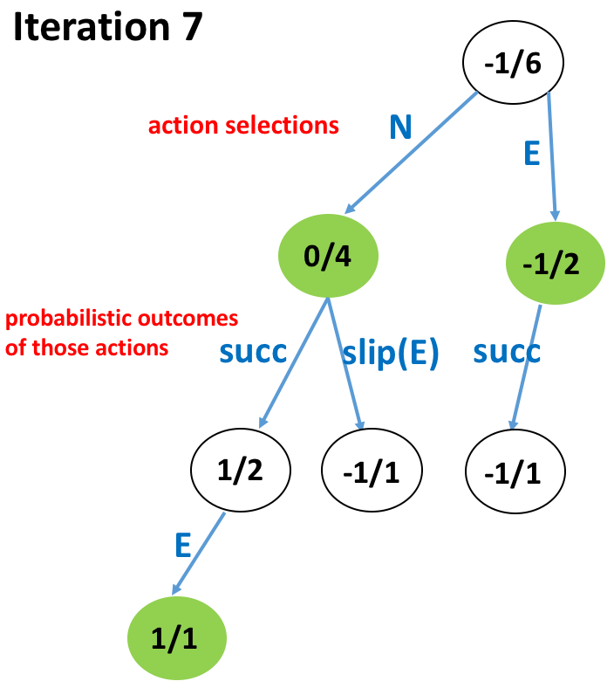
-1/7
total reward/visit count
= avg reward
-1/3
slip(N)
0/0
0/1
0/1

Slide 14
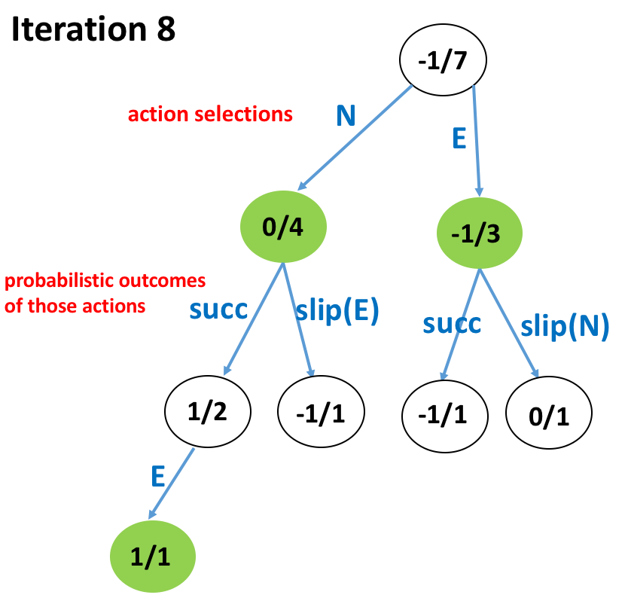
0/8
total reward/visit count
= avg reward
0/4
1/2
E
1/1
0/0
1/1

Slide 15
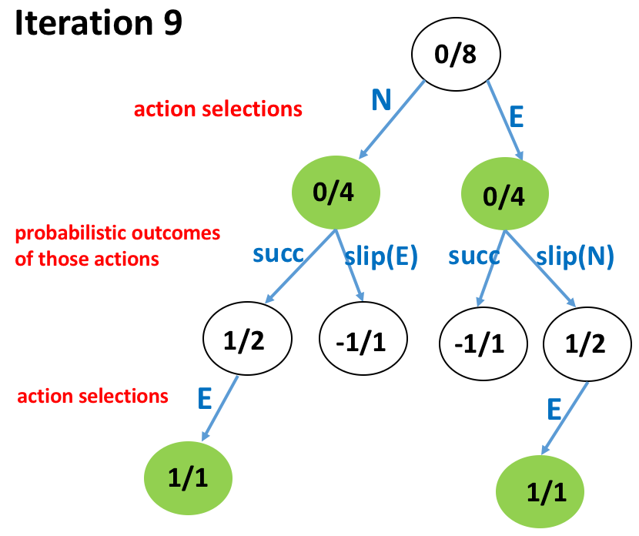
1/9
total reward/visit count
= avg reward
1/5
2/3
2/2
succ
1/1
0/0
Actually for this iteration,
no need to simulate
1/1

Slide 16
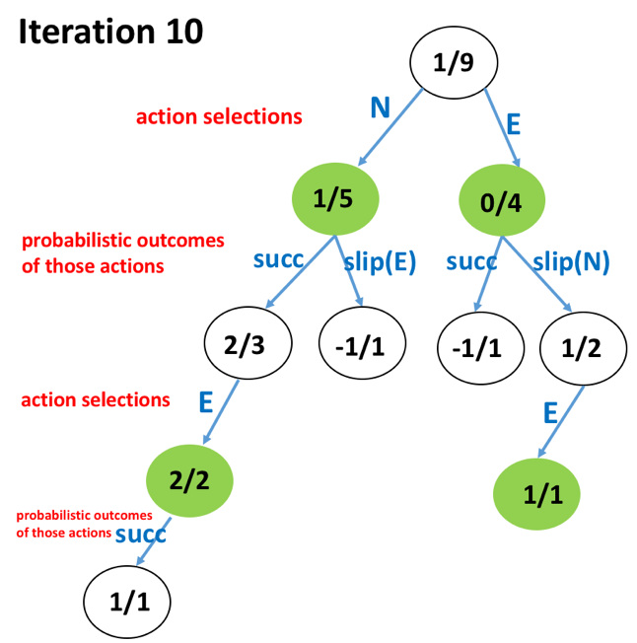
2/10
total reward/visit count
W
= avg reward
0/0
1/1
1/1

Slide 17
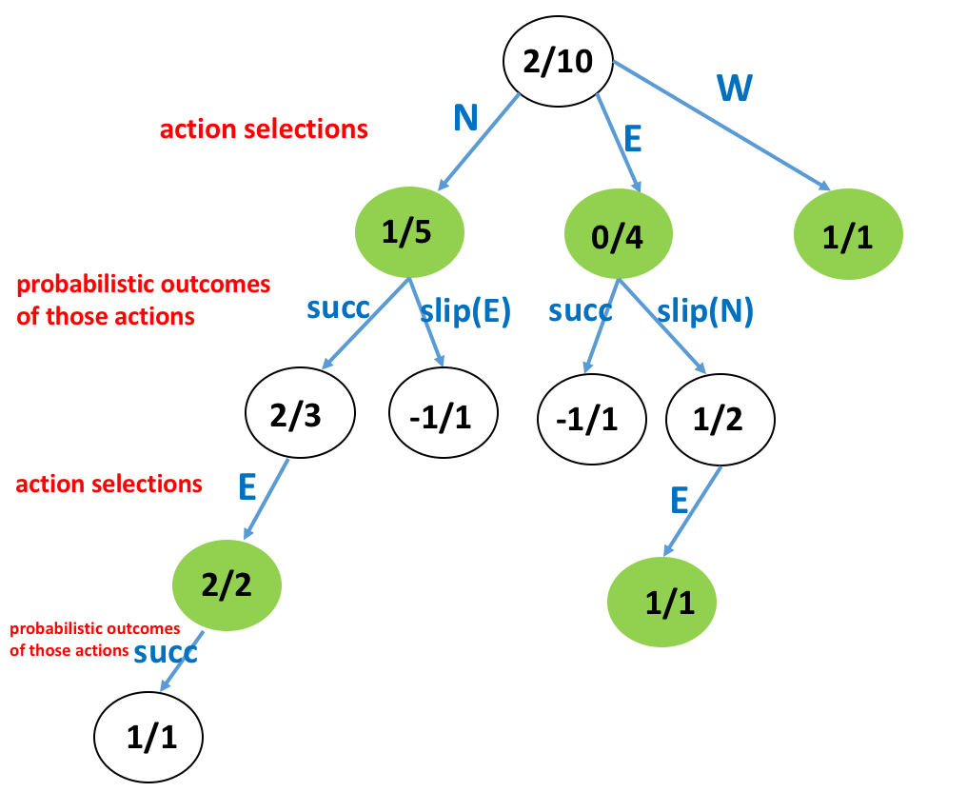
total reward/visit count
= avg reward
approximate
Q(s, N) =
1/5
Q-value
Q(s, E) =
0/4 = 0
Q(s, W) =
1/1 = 1
So, the agent should go West at cell(2,1)
Notes:
West doesn’t make sense.
Because we don’t have enough simulations, we only have 10.
And another reason is our action selection is random. What if South is a good action? But we didn’t explore it.

Slide 18
Monte Carlo Tree Search (MCT)
Random
$ε−$greedy
$ε−$ decreasing
Softmax
UCB1
MCT + UCB1 = UCT
Step1: Selection
Start from root R and select successive child nodes by applying actions until a leaf node L is reached.
Action selection is according to a Tree Policy
Can balance
exploitation and exploration
Step2: Expansion
If this leaf node L has been visited before, then expand this node to add its child as a new state to do the following simulation. Otherwise, do simulation from this leaf node L.
Step3: Simulation
From the expanded node, perform a complete random simulation within time limit or computational budget.
Step4: Backpropagate
Finally, the value of the node is backpropagated to the root node, updating the value of each ancestor node on the way

Slide 19
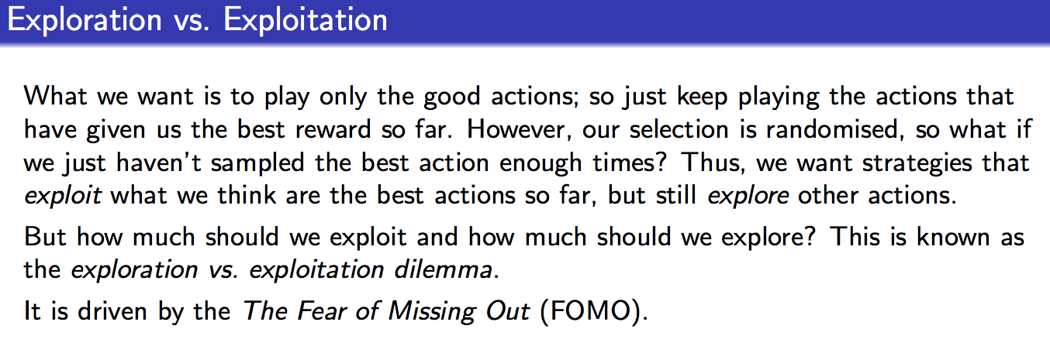

Slide 20
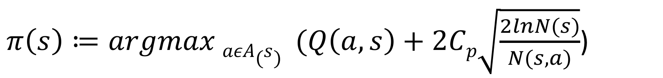
UCT = MCTS + UCB1(Upper Confidence Bound)
$π\left(s\right)≔argmax aεA(s) (Q\left(a,s\right)+2Cp\sqrt{\frac{2lnN(s)}{N(s,a)}}$)
Exploitation
Q(a, s) is the estimated Q-value
Exploration
N(s) is the number of times s has been visited.
N(s, a) is the number of times I chose action a
at this state s
Cp is exploration constant, which determines can be increased to encourage more exploration, and decreased to encourage less exploration. Ties are broken randomly
→The left–hand side encourages exploitation: the Q-value is high for actions that have had a high reward.
→The right–hand side encourages exploration: it is high for actions that have been explored less.

Slide 21
Random selection
Select by UCT value of each action
11

Slide 22
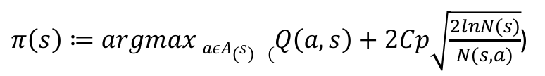




If, in Step 1, Action Selection by UCT , instead of Random
$π\left(s\right)≔argmax aεA(s) (Q\left(a,s\right)+2Cp\sqrt{\frac{2lnN(s)}{N(s,a)}}$)
UCT(s, N) = $\frac{1}{5}+\sqrt{\frac{2∗ ln10}{5} }$
UCT(s, E) = $\frac{0}{4}+\sqrt{\frac{2∗ ln10}{4} }$
UCT(s, W) = $\frac{1}{1}+\sqrt{\frac{2∗ ln10}{1} }$
UCT(s, S) = $0+\sqrt{\frac{2∗ ln10}{0}}$ = $∞$
So, according to UCT, South action will be selected as iteration 11.

Slide 23
S
0/0
11 S simulate = ?

