Slide 1
COMP90054 AI Planning for Autonomy Workshop Week8

Slide 2
Objectives
Markov Decision Processes (MDPs)
2. How to solve MDPs
Value Iteration
Policy Iteration

Slide 3
In classical planning actions are deterministic.
We also consider:
Probabilistic actions
(s,a) -> s_1 (0.5); (s,a)->s_2 (0.5);
Non- deterministic actions
(s,a) -> s_1; (s,a)->s_2;
Stochastic actions
Notes:
But in our lectures and workshops, we only talk about the 2nd one.
For Discounted reward MDPs, there is no goal, there is no cost. Goals and cost are just modelld as positive reward or negative reward

Slide 4
MDPs has 2 Type:
1. Goal-Cost MDPs
2. Discounted Reward MDPs
Notes:
But in our lectures and workshops, we only talk about the 2nd one.
For Discounted reward MDPs, there is no goal, there is no cost. Goals and cost are just modelld as positive reward or negative reward

Slide 5
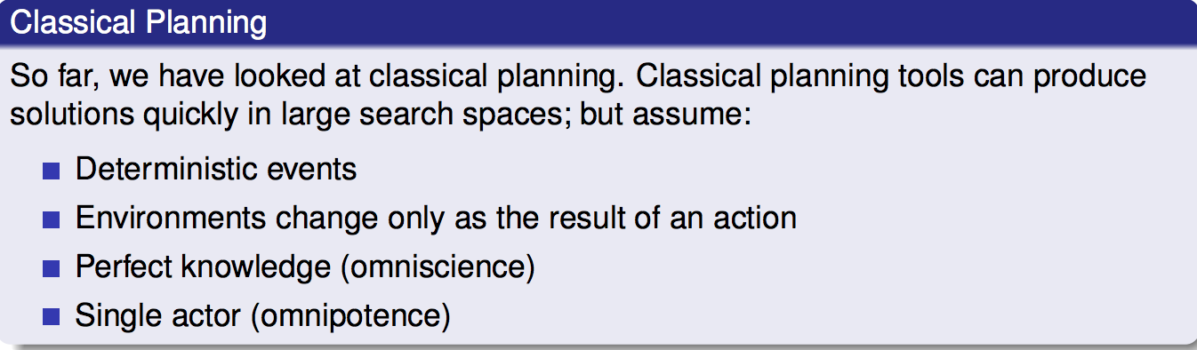
Classical Planning VS MDPs
Markov Decision Processes (MDPs) remove the assumption of deterministic events.
Instead MDPs assume that each action could have multiple outcomes, with each outcome associated with a probability.
For example:

Slide 6
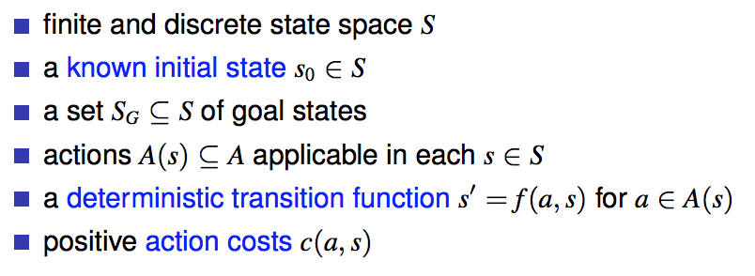
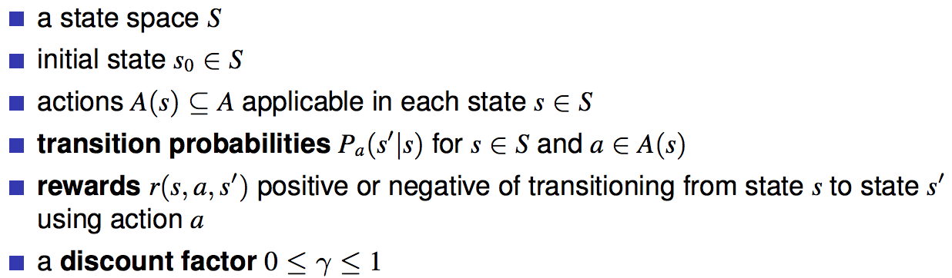
State Model
Classical Planning
MDPs
What is different from classical planning?
The discount factor determines how much a future reward should be discounted compared to a current reward.

Slide 7
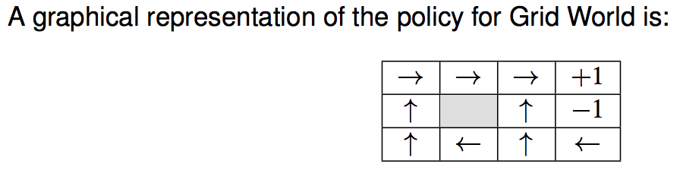
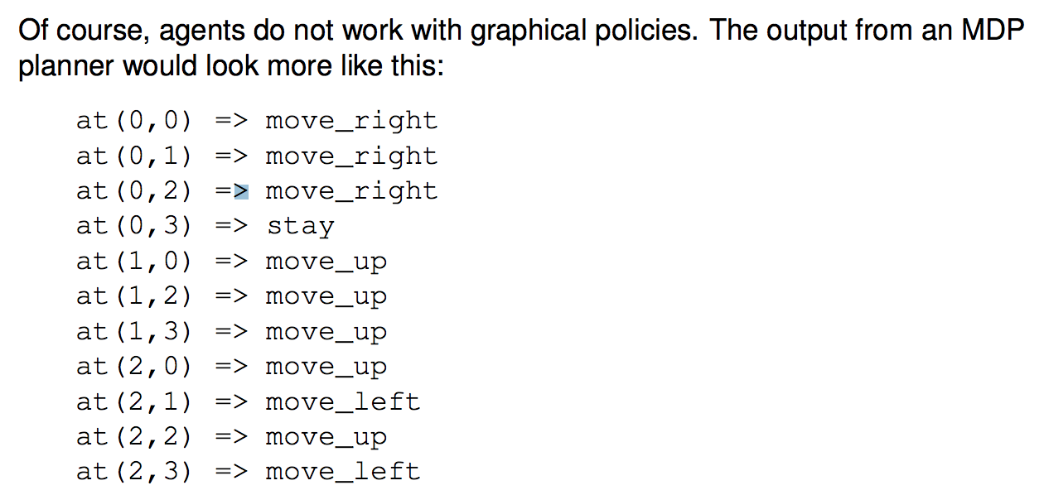
Solution for Classical Planning:
Action Sequence
(from initial state to goal state)
Solution for MDPs:
Policy

Slide 8
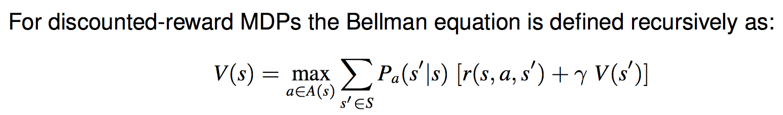

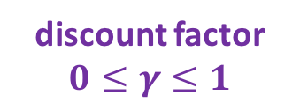
How to solve MDPs?
Q(s,a)
Q-value of being in a state s, choosing action a
Bellman equations
the probability of that action occurring
immediate reward resulting from that action
discounted future reward
discount factor
$$0≤γ≤1$$
Expected value of being in state s and acting optimally according to our policy

Slide 9
How to solve MDPs?
1.Value Iteration

Slide 10
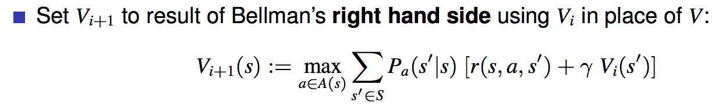
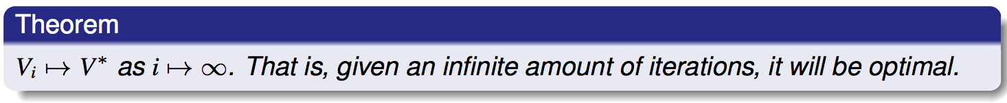
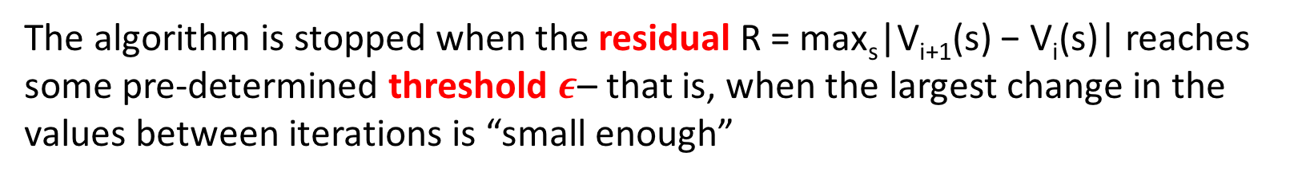
Value Iteration
Step1:
Step2:
In practice, we set a threshold $ε$.
The algorithm is stopped when the residual R = max_{s}|V_{i+1}(s) − V_{i}(s)| reaches some pre-determined threshold $ε$– that is, when the largest change in the values between iterations is “small enough”

Slide 11
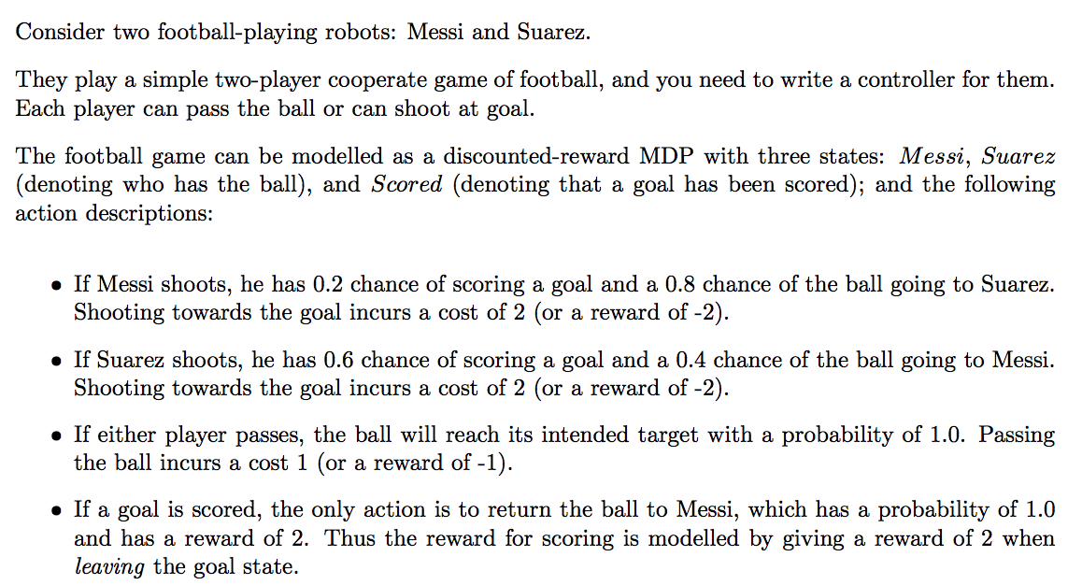
Scored
Return P(1)
r = 2
Shoot P(0.2)
r = -2
Shoot P(0.6)
r = -2
Shoot P(0.8)
r = -2
Messi
Suarez
Pass P(1.0)
r = -1
Shoot P(0.4)
r = -2

Slide 12
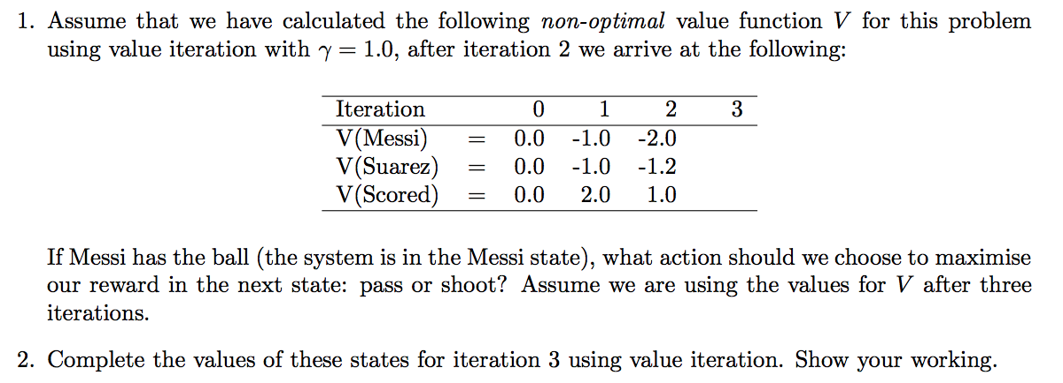
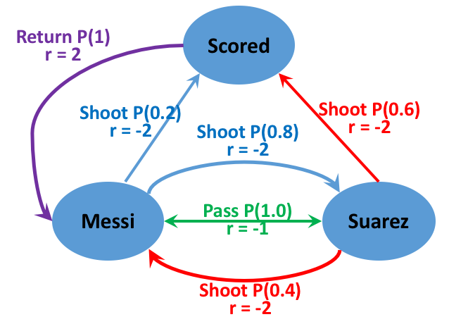
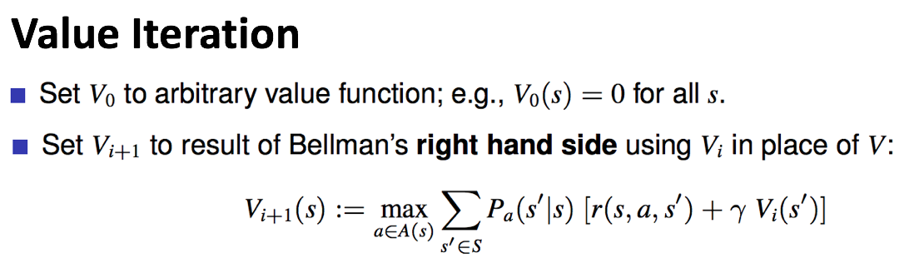

Slide 13





$$Σ$$
（
immediate
reward
+
future
reward
）
action
Q-value(s,a) =
probability
*
0.2
（
-2
+
）
shoot
-2.76
*
$γ$* V2 (Scored)
= -0.2
$$Σ$$
0.8
*
（
-2
+
）
= -2.56
$γ$* V2 (Suarez)
pass
-2.2
1
*
（
-1
+
）
$γ$* V2 (Suarez)
= -2.2

Slide 14

How to do value iteration?
$$γ=1$$
 | Iteration0 | Iteration1 | Iteration2 | Iteration3
V(Messi)
V(Suarez)
V(Scored)
0
0
0
V₀ (Messi) = 0, V₀ (Suarez) = 0, V₀ (Scored) = 0
How to calculate V1(Messi) ?
Question: What actions can Messi take?
Shoot Pass

Slide 15
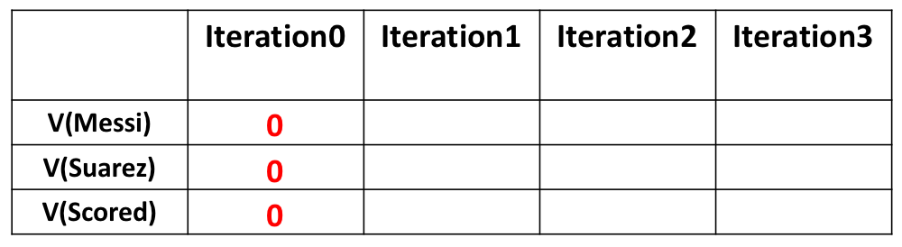


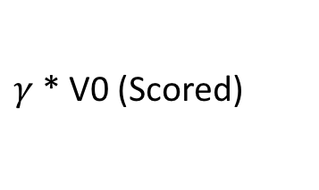
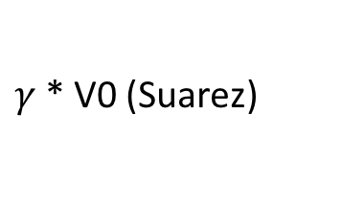

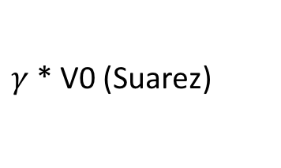
How to do value iteration?
$$γ=1$$
-1
V₀ (Messi) = 0, V₀ (Suarez) = 0, V₀ (Scored) = 0
$$Σ$$
（
immediate
reward
+
future
reward
）
action
Q-value(s,a) =
probability
*
0.2
（
-2
+
）
shoot
-2
*
$γ$* V0 (Scored)
= -0.4
$$Σ$$
0.8
*
（
-2
+
）
= -1.6
V1(Messi)
$γ$* V0 (Suarez)
pass
-1
1
*
（
-1
+
）
$γ$* V0 (Suarez)
= -1

Slide 16
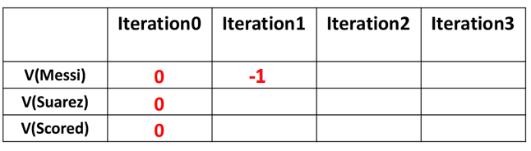

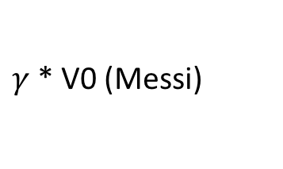
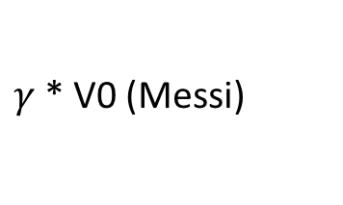
How to do value iteration?
$$γ=1$$
-1
V₀ (Messi) = 0, V₀ (Suarez) = 0, V₀ (Scored) = 0
$$Σ$$
（
immediate
reward
+
future
reward
）
action
Q-value(s,a) =
probability
*
0.6
（
-2
+
）
shoot
-2
*
$γ$* V0 (Scored)
= -1.2
$$Σ$$
0.4
*
（
-2
+
）
= -0.8
V1(Suarez)
$γ$* V0 (Messi)
pass
-1
1
*
（
-1
+
）
$γ$* V0 (Messi)
= -1

Slide 17
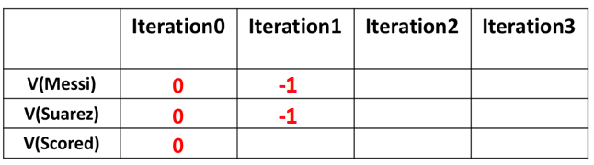
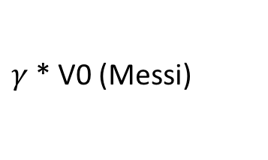
How to do value iteration?
$$γ=1$$
2
V₀ (Messi) = 0, V₀ (Suarez) = 0, V₀ (Scored) = 0
$$Σ$$
（
immediate
reward
+
future
reward
）
action
Q-value(s,a) =
probability
*
2
*
（
+
）
V1(Scored)
return
1
2
$γ$* V0 (Messi)
= 2

Slide 18
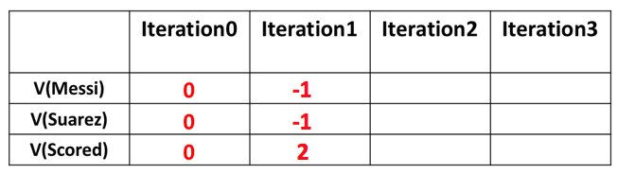

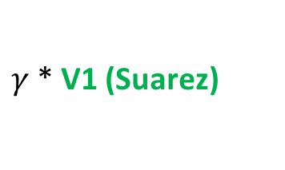
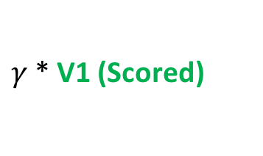
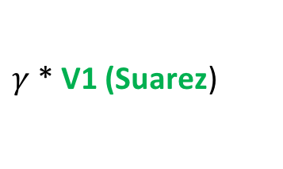
-2
-1.2
1
V₀ (Messi) = 0, V₀ (Suarez) = 0, V₀ (Scored) = 0
V1(Messi) = -1, V1(Suarez) = -1, V1(Scored) = 2
$$Σ$$
（
immediate
reward
+
future
reward
）
action
Q-value(s,a) =
probability
*
0.2
（
-2
+
）
shoot
-2.4
*
$γ$* V1 (Scored)
= 0
$$Σ$$
0.8
*
（
-2
+
）
= -2.4
V2(Messi)
$γ$* V1 (Suarez)
pass
-2
1
*
（
-1
+
）
$γ$* V1 (Suarez)
= -2

Slide 19
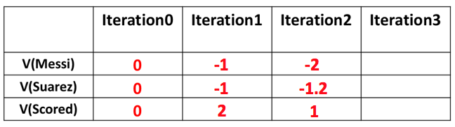
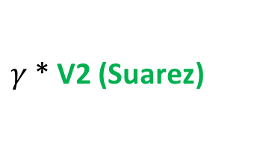
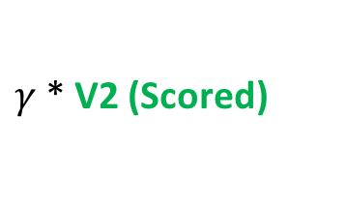
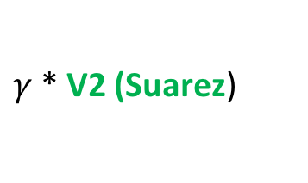
-2.2
V₀ (Messi) = 0, V₀ (Suarez) = 0, V₀ (Scored) = 0
V1(Messi) = -1, V1(Suarez) = -1, V1(Scored) = 2
V2(Messi) = -2, V2(Suarez) = -1.2, V2(Scored) = 1
$$Σ$$
（
immediate
reward
+
future
reward
）
action
Q-value(s,a) =
probability
*
0.2
（
-2
+
）
shoot
-2.76
*
$γ$* V2 (Scored)
= -0.2
$$Σ$$
0.8
*
（
-2
+
）
= -2.56
V3(Messi)
$γ$* V2 (Suarez)
pass
-2.2
1
*
（
-1
+
）
$γ$* V2 (Suarez)
= -2.2

Slide 20
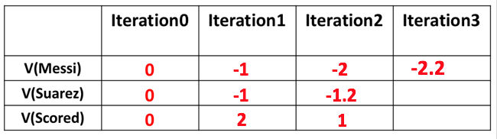
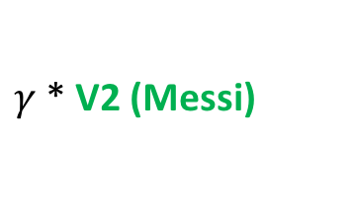
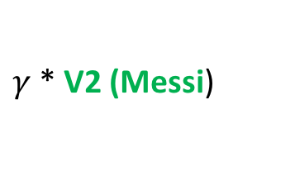
-2.2
V₀ (Messi) = 0, V₀ (Suarez) = 0, V₀ (Scored) = 0
V1(Messi) = -1, V1(Suarez) = -1, V1(Scored) = 2
V2(Messi) = -2, V2(Suarez) = -1.2, V2(Scored) = 1
$$Σ$$
（
immediate
reward
+
future
reward
）
action
Q-value(s,a) =
probability
*
0.6
（
-2
+
）
shoot
-2.2
*
$γ$* V2 (Scored)
= -0.6
$$Σ$$
0.4
*
（
-2
+
）
= -1.6
V3(Suarez)
$γ$* V2 (Messi)
pass
-3
1
*
（
-1
+
）
$γ$* V2 (Messi)
= -3

Slide 21
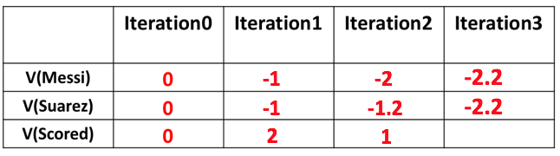


0
V₀ (Messi) = 0, V₀ (Suarez) = 0, V₀ (Scored) = 0
V1(Messi) = -1, V1(Suarez) = -1, V1(Scored) = 2
V2(Messi) = -2, V2(Suarez) = -1.2, V2(Scored) = 1
$$Σ$$
（
immediate
reward
+
future
reward
）
action
Q-value(s,a) =
probability
*
0
*
（
+
）
V3(Scored)
return
1
2
$γ$* V2 (Messi)
= 0

Slide 22
0
Question: If we just do 3 iterations, what action did we take to maximize the reward of each state in iteration 3?
Messi Pass,
Suarez Shoot,
Scored Return
Notes:
This is a policy for now, it maybe not optimal.

Slide 23
How to solve MDPs?
2.Policy Iteration

Slide 24


Policy Iteration
While value iteration iterates over value functions,
policy iteration iterates over policies themselves, creating a strictly improved policy in each iteration (except if the iterated policy is already optimal).
Step1: Start with a random policy $π$
Step2: policy evaluation (Linear Equations)
Calculate the value of each state V$π$(s) of the MDP given that policy $π$
Step3: improvement
Improve policy $π$ by setting
Step4: If policy $π$ changed in Step3, then go back to Step2, else finish

Slide 25
Compare Policy Iteration and Value Iteration
Policy Iteration finishes with an optimal policy π ∗ after a finite number of iterations, because the number of policies is finite, bounded by O(|A||S| ),
unlike value iteration, which can theoretically require infinite iterations.
Notes:
It Converge quicker than value iteration.

Slide 26
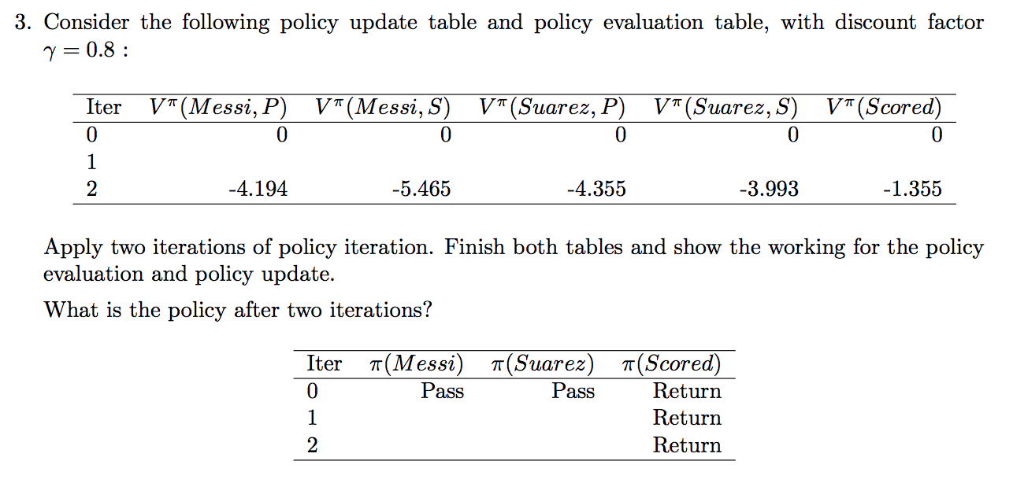

Slide 27
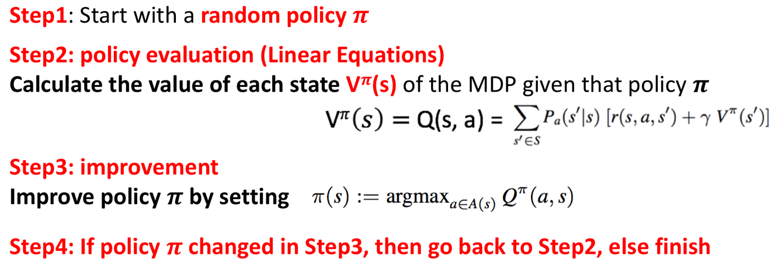
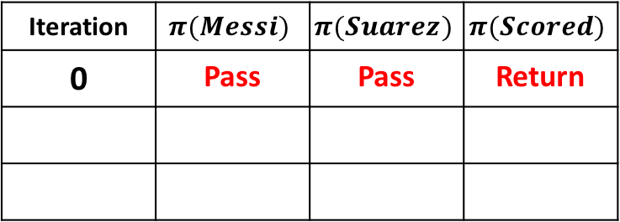
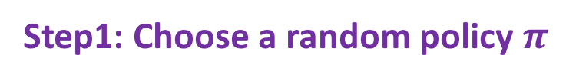
How to do policy iteration?
Step1: Choose a random policy $π$
Iteration | $$π(Messi)$$ | $$π(Suarez)$$ | $$π(Scored)$$
0 | Pass | Pass | Return
Step2: Policy Evaluation
V^{𝝅}(𝑴𝒆𝒔𝒔𝒊) V^{𝝅}(Suarez) V^{𝝅}(Scored)
Q^{𝝅}(𝑴𝒆𝒔𝒔𝒊,Pass) Q^{𝝅}(Suarez,Pass) Q^{𝝅}(Scored,Return)
a b c

Slide 28
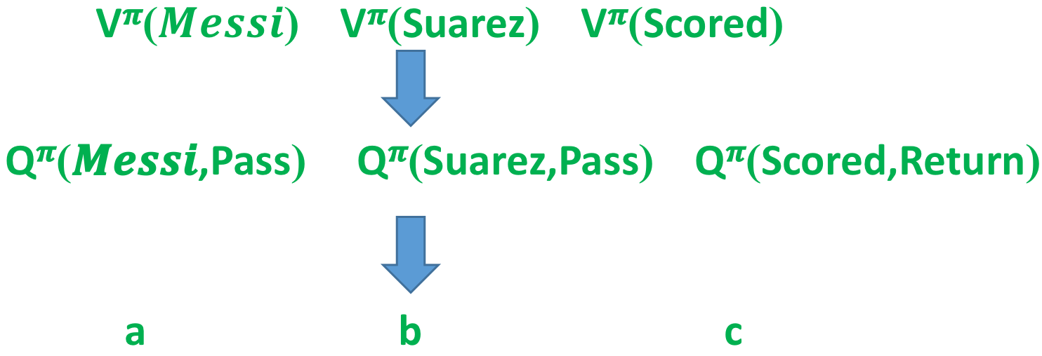
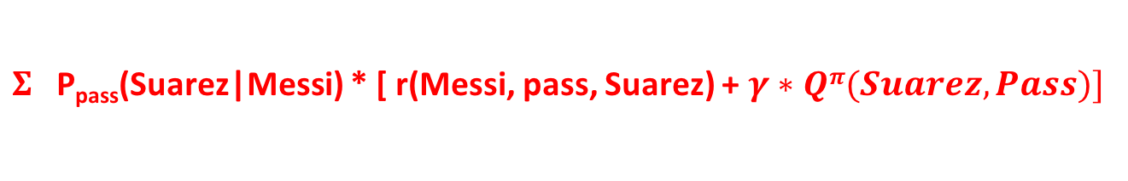
Step2: Policy Evaluation
Q^{𝝅}(𝑴𝒆𝒔𝒔𝒊,Pass) =
$Σ$P_{pass}(Suarez|Messi) * [ r(Messi, pass, Suarez) + $γ∗Qπ(Suarez,Pass)]$
a
1
-1
0.8
b
a = 1* ( -1 + 0.8*b)

Slide 29

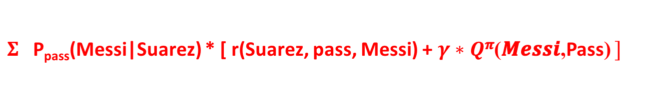
Step2: Policy Evaluation
Q^{𝝅}(𝑴𝒆𝒔𝒔𝒊,Pass) =
$Σ$P_{pass}(Suarez|Messi) * [ r(Messi, pass, Suarez) + $γ∗Qπ(Suarez,Pass)]$
a = 1* ( -1 + 0.8*b)
$Qπ(Suarez,Pass)$=
$Σ$P_{pass}(Messi|Suarez) * [ r(Suarez, pass, Messi) + $γ∗Q$^{𝝅}(𝑴𝒆𝒔𝒔𝒊,Pass) $]$
b
1
-1
0.8
a
b = 1* ( -1 + 0.8*a)

Slide 30
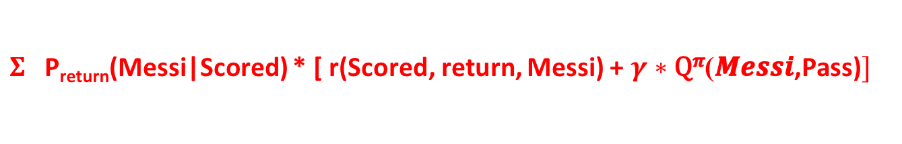
Step2: Policy Evaluation
Q^{𝝅}(𝑴𝒆𝒔𝒔𝒊,Pass) =
$Σ$P_{pass}(Suarez|Messi) * [ r(Messi, pass, Suarez) + $γ∗Qπ(Suarez,Pass)]$
a = 1* ( -1 + 0.8*b)
$Qπ(Suarez,Pass)$=
$Σ$P_{pass}(Messi|Suarez) * [ r(Suarez, pass, Messi) + $γ∗Q$^{𝝅}(𝑴𝒆𝒔𝒔𝒊,Pass) $]$
b = 1* ( -1 + 0.8*a)
Q^{𝝅}(Scored,Return) =
$Σ$P_{return}(Messi|Scored) * [ r(Scored, return, Messi) + $γ∗\text{Q}\text{π}\text{(}\text{Messi}\text{,}\text{Pass}\text{)}]$
c
1
2
0.8
a
c = 1* ( 2 + 0.8*a)

Slide 31
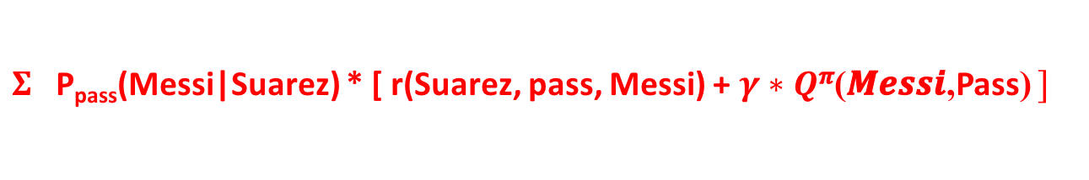
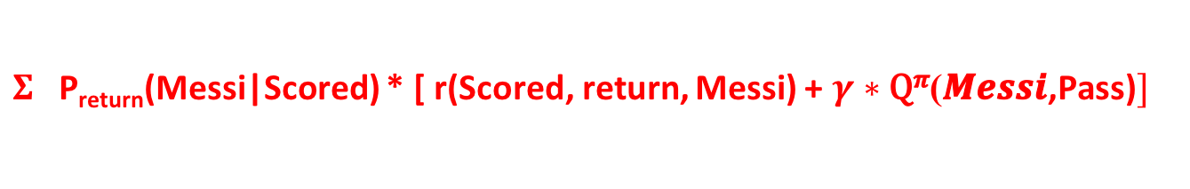
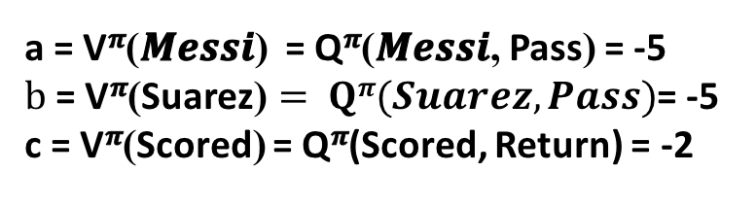
Step2: Policy Evaluation
Q^{𝝅}(𝑴𝒆𝒔𝒔𝒊,Pass) =
$Σ$P_{pass}(Suarez|Messi) * [ r(Messi, pass, Suarez) + $γ∗Qπ(Suarez,Pass)]$
a = 1* ( -1 + 0.8*b)
$Qπ(Suarez,Pass)$=
$Σ$P_{pass}(Messi|Suarez) * [ r(Suarez, pass, Messi) + $γ∗Q$^{𝝅}(𝑴𝒆𝒔𝒔𝒊,Pass) $]$
b = 1* ( -1 + 0.8*a)
Q^{𝝅}(Scored,Return) =
$Σ$P_{return}(Messi|Scored) * [ r(Scored, return, Messi) + $γ∗\text{Q}\text{π}\text{(}\text{Messi}\text{,}\text{Pass}\text{)}]$
c = 1* ( 2 + 0.8*a)
a = -5, b = -5, c = -2
a = V^{𝝅}(𝑴𝒆𝒔𝒔𝒊) = Q^{𝝅}(𝑴𝒆𝒔𝒔𝒊, Pass) = -5
$b \text{= }\text{V}\text{π}\text{(}\text{Suarez}\text{)}= Qπ(Suarez,Pass)$= -5
c = V^{𝝅}(Scored) = Q^{𝝅}(Scored, Return) = -2

Slide 32

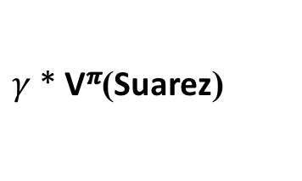

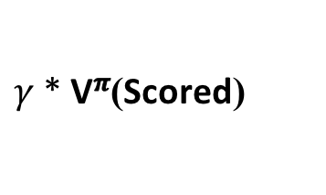
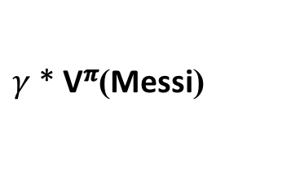
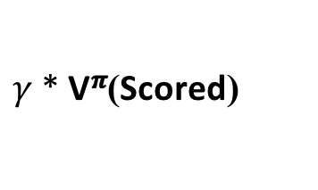


Iteration | $$π(Messi)$$ | $$π(Suarez)$$ | $$π(Scored)$$
0 | Pass | Pass | Return
Step3: Improvement
V^{𝝅}(𝑴𝒆𝒔𝒔𝒊) = Q^{𝝅}(𝑴𝒆𝒔𝒔𝒊, Pass) = -5,
$\text{V}\text{π}\text{(}\text{Suarez}\text{)}= Qπ(Suarez,Pass)$= -5,
V^{𝝅}(Scored) = Q^{𝝅}(Scored, Return) = -2
1
Pass
Shoot
Return
0.2
（
-2
+
）
*
$γ$* V^{𝝅}(Scored)
= -0.72
Q^{𝝅}(𝑴𝒆𝒔𝒔𝒊, Shoot) =
$$Σ$$
0.8
（
-2
+
）
= -4.8
*
$γ$* $\text{V}\text{π}\text{(}\text{Suarez}\text{)}$
-5.52
0.6
（
-2
+
）
*
$γ$* V^{𝝅}(Scored)
= -2.16
Q^{𝝅}(Suarez, Shoot) =
$$Σ$$
0.4
（
-2
+
）
= -2.4
*
$γ$* $\text{V}\text{π}\text{(}\text{Messi}\text{)}$
-4.56

Slide 33

Step4: Go back to Step 2 and Step3
Policy Evaluation
V^{𝝅}(𝑴𝒆𝒔𝒔𝒊) V^{𝝅}(Suarez) V^{𝝅}(Scored)
Q^{𝝅}(𝑴𝒆𝒔𝒔𝒊,Pass) Q^{𝝅}(Suarez,Shoot) Q^{𝝅}(Scored,Return)
a b c

Slide 34






Step2: Policy Evaluation
Q^{𝝅}(𝑴𝒆𝒔𝒔𝒊,Pass) =
$Σ$P_{pass}(Suarez|Messi) * [ r(Messi, pass, Suarez) + $γ∗Qπ(Suarez,Shoot)]$
a = 1* ( -1 + 0.8*b)
$Qπ(Suarez, Shoot)$=
$$Σ$$
P_{shoot}(Scored|Suarez) * [ r(Suarez, shoot, Scored) + $γ∗Q$^{𝝅}(Scored, Return) $]$
P_{shoot}(Messi|Suarez) * [ r(Suarez, shoot, Messi) + $γ∗Q$^{𝝅}(Messi, Pass) $]$
b = 0.6* ( -2 + 0.8*c) + 0.4* (-2 + 0.8a)
Q^{𝝅}(Scored,Return) =
$Σ$P_{return}(Messi|Scored) * [ r(Scored, return, Messi) + $γ∗\text{Q}\text{π}\text{(}\text{Messi}\text{,}\text{Pass}\text{)}]$
c = 1* ( 2 + 0.8*a)
a = -4.194, b = -3.993, c = -1.355
a = V^{𝝅}(𝑴𝒆𝒔𝒔𝒊) = Q^{𝝅}(𝑴𝒆𝒔𝒔𝒊, Pass) = -4.194
$b \text{= }\text{V}\text{π}\text{(}\text{Suarez}\text{)}= Qπ(Suarez,Shoot)$= -3.993
c = V^{𝝅}(Scored) = Q^{𝝅}(Scored, Return) = -1.355

Slide 35


Iteration | $$π(Messi)$$ | $$π(Suarez)$$ | $$π(Scored)$$
0 | Pass | Pass | Return
Step3: Improvement
a = V^{𝝅}(𝑴𝒆𝒔𝒔𝒊) = Q^{𝝅}(𝑴𝒆𝒔𝒔𝒊, Pass) = -4.194
$b \text{= }\text{V}\text{π}\text{(}\text{Suarez}\text{)}= Qπ(Suarez,Shoot)$= -3.993
c = V^{𝝅}(Scored) = Q^{𝝅}(Scored, Return) = -1.355
1
Pass
Shoot
Return
2
Pass
Shoot
Return
0.2
（
-2
+
）
*
$γ$* V^{𝝅}(Scored)
= -0.617
Q^{𝝅}(𝑴𝒆𝒔𝒔𝒊, Shoot) =
$$Σ$$
0.8
（
-2
+
）
= -4.156
*
$γ$* $\text{V}\text{π}\text{(}\text{Suarez}\text{)}$
-4.77
Q^{𝝅}(Suarez, Pass) =
1
（
-1
+
）
*
$γ$* V^{𝝅}(Messi)
= -4.355
-4.355
So, after 2 iterations,
the policy is Messi Pass, Suarez Shoot, Scored Return.

Slide 36


Slide 37


Slide 38



