Slide 1
COMP90054 AI Planning for Autonomy Workshop Week9

Slide 2
When we have a new problem, there are different ways to solve it:
Program
Learning
Model (classical planning, MDP)
Supervised Learning
Unsupervised Learning
Reinforcement Learning
Machine Learning

Slide 3
Declarative Transitions
MDP -> Value iteration
Dynamic Programming
Search
Small Scale
Large Scale
Temporal Difference Learning
Controlled Temporal
Reinforcement Learning
(optimal)
Monte Carlo Tree Search
(not optimal)
Generative Transitions

Slide 4
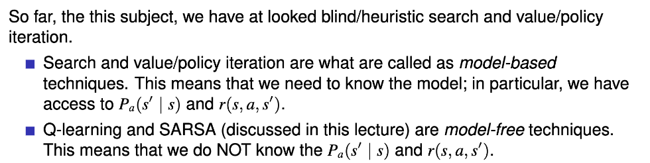

Slide 5
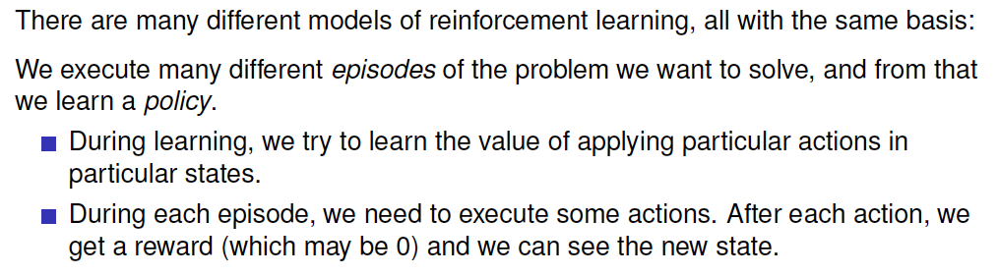

Slide 6
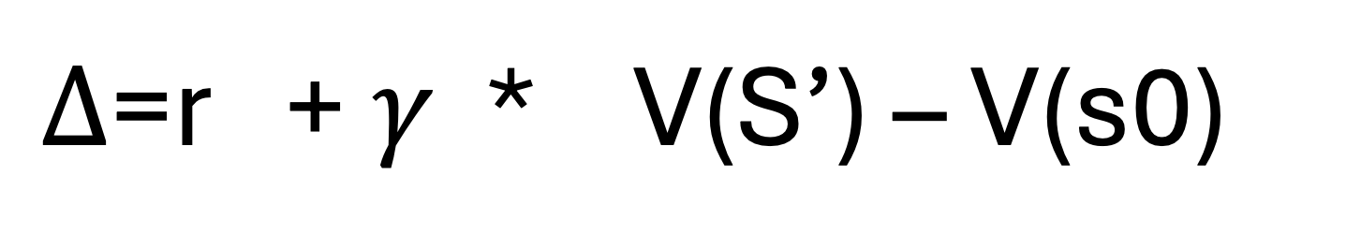
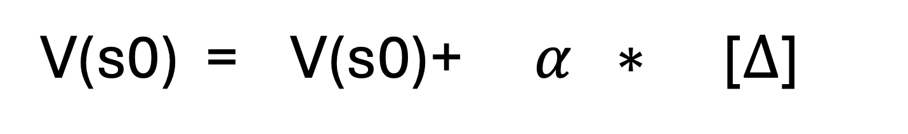
In TD, when we have a data sequence: S0->(a1)->S1->(a2)->S2, which is also named as episode. In TD, we want to learn from the episode, in each step of learning, we learn from each transition.
V(s0) = V(s0)+$α ∗$ [$Δ$]
V value of state s0
Original V value of state s0
Learning Rate
Temporal difference value
$Δ$=r +$γ$ * V(S’) – V(s0)
Reward
Discount factor
V value in the next state

Slide 7
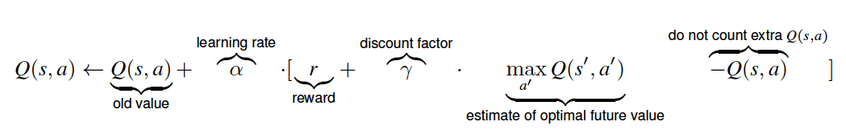
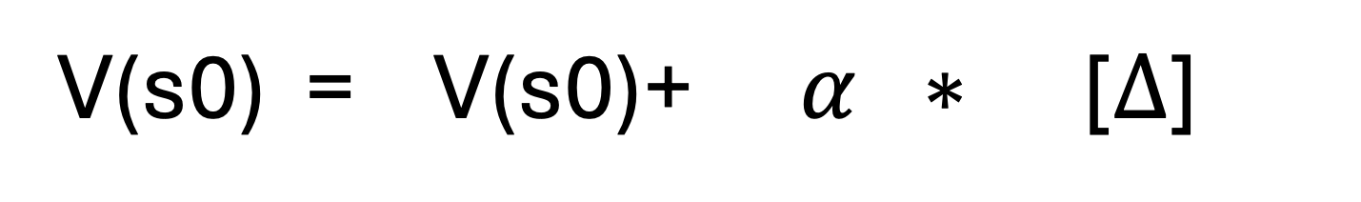
V(s0) = V(s0)+$α ∗$ [$Δ$]
V value of state s0
Original V value of state s0
Learning Rate
Temporal difference value
Only update the value of S based one S’
Estimate of future value

Slide 8


Only update the value of S based one S’
Estimate of future value
S0->(a1)->S1->(a2)->S2->(a3)->s3->(a4)->(s4)
r=0 r=0 r=0 r=1
TD($λ$)
S0->(a1)->S1->(a2)->S2->(a3)->s3->(a4)->(s4)
r=0 r=0 r=0 r=1
N-step TD (not exam)

Slide 9
Q table is updated
but the episode is
still generated by the old Q table
S0->(a1)->S1->(a2)->S2
episode 1
Q(s,a) table
S0->(a1)->S1->(a2)->S2
episode 2
Q(s,a) table
In TD
agent
S0->(a1)->S1->(a2)->S2
episode 3
Q(s,a) table
episode 4
Q(s,a) table
S0->(a1)->S1->(a2)->S2
S0->(a1)->S1->(a2)->S2
episode 1
Q(s,a) table
For each episode If we use s1 to update s0 the next action may not a2 furthermore
S0->(a1)->S1->(a2)->S2
episode 2
Q(s,a) table
In TD
agent
S0->(a1)->S1->(a2)->S2
episode 3
Q(s,a) table
episode 4
Q(s,a) table
S0->(a1)->S1->(a2)->S2

Slide 10
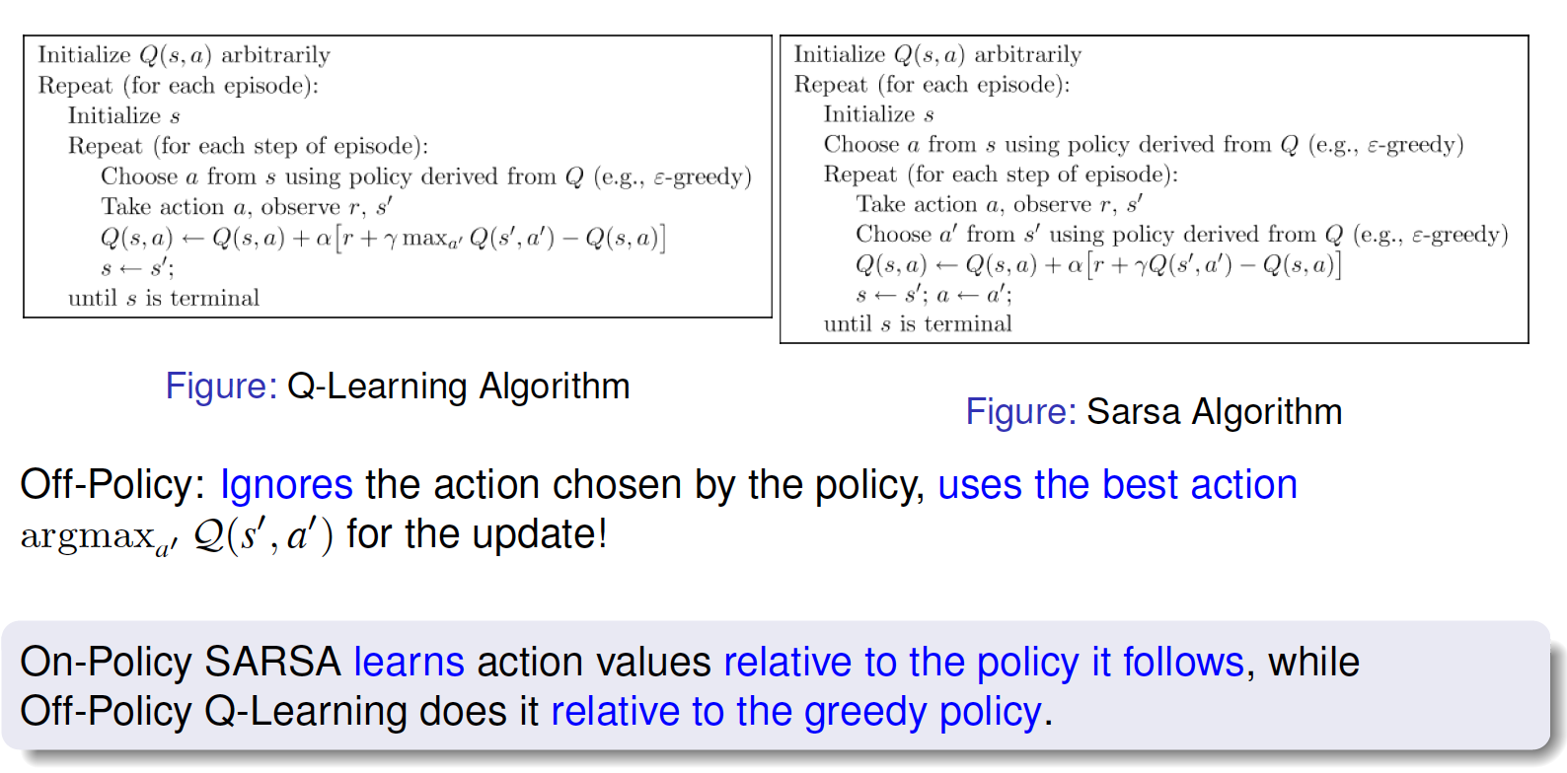
Control TD: generate the data sequence while learning!
From the last iteration, in the next iteration, we may select another a rather than a’
For the next iteration, we must use a'

Slide 11
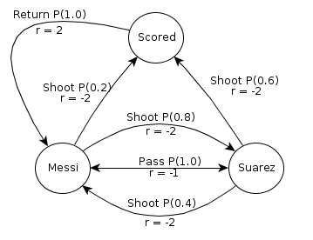
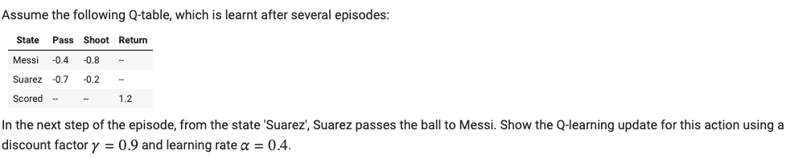
Q(Suarez,pass)
-0.7
-0.7
0.4
-1
0.9
-0.4

Slide 12
Q(Suarez,pass)
-0.7
-0.7
0.4
-1
0.9
-0.8

Slide 13
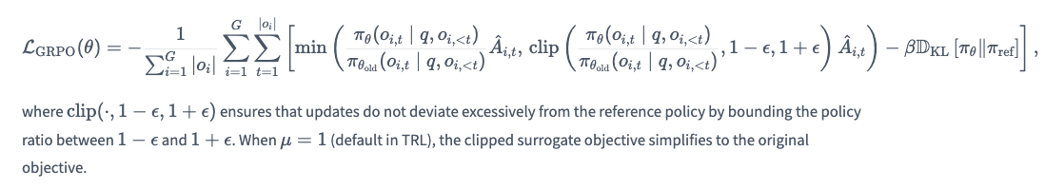

Group Relative Policy Optimization (GRPO)

