Slide 1
COMP90054 AI Planning for Autonomy Workshop Week11

Slide 2
Game
Normal Form (each player will choose strategies at same time)
N(number of player)
A_i(Pure Strategies; Mixed Strategies)
A (profile, the actions selected by different agents)
U(utility function)
Extensive Form (one by one)

Slide 3
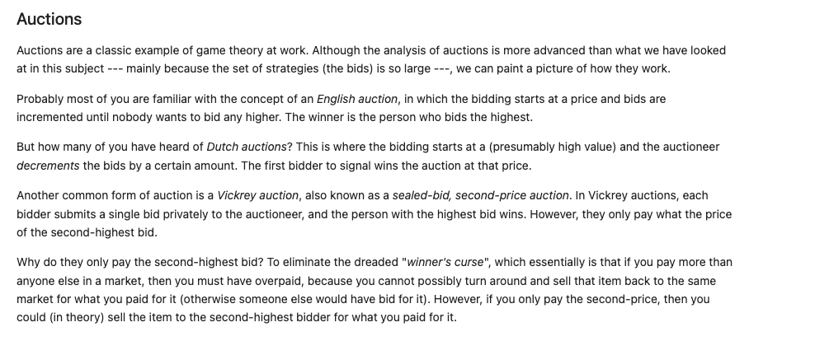

Slide 4
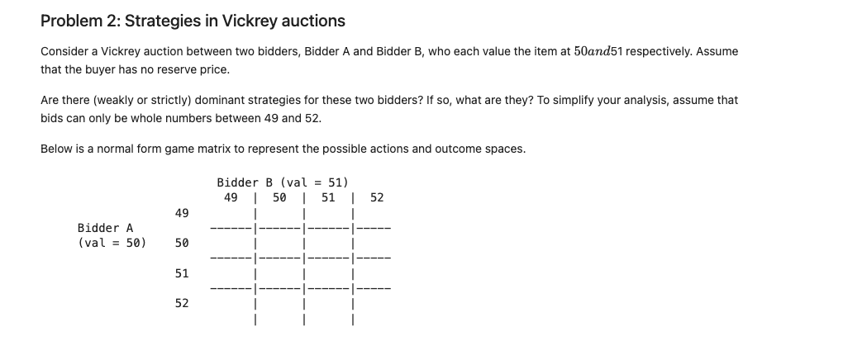

Slide 5
Bidder B
(val=51)
 | 49 | 50 | 51 | 52
49 | 0.5/1 | 0/2 | 0/2 | 0/2
50 | 1/0 | 0/0.5 | 0/1 | 0/1
51 | 1/0 | 0/0 | -0.5/0 | 0/0
52 | 1/1 | 0/0 | -1/0 | -1/-0.5
Bidder A
(val=50)

Slide 6
Weakly Dominant Strategies for Bidder A
Weakly Dominant Strategies for Bidder B
Bidder B
(val=51)
 | 49 | 50 | 51 | 52
49 | 0.5/1 | 0/2 | 0/2 | 0/2
50 | 1/0 | 0/0.5 | 0/1 | 0/1
51 | 1/0 | 0/0 | -0.5/0 | 0/0
52 | 1/0 | 0/0 | -1/0 | -1/-0.5
Bidder A
(val=50)

Slide 7
Nash equilibrium State, We have 10 in this tasks
Bidder B
(val=51)
 | 49 | 50 | 51 | 52
49 | 0.5/1 | 0/2 | 0/2 | 0/2
50 | 1/0 | 0/0.5 | 0/1 | 0/1
51 | 1/0 | 0/0 | -0.5/0 | 0/0
52 | 1/0 | 0/0 | -1/0 | -1/-0.5
Bidder A
(val=50)

Slide 8
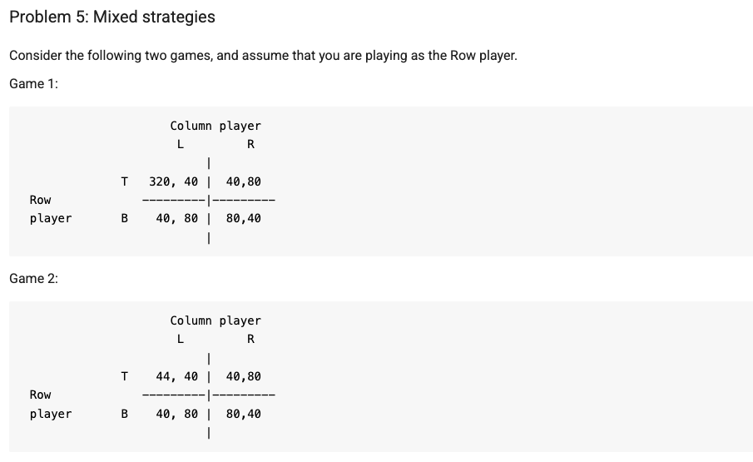

Slide 9
Column
Player
 | L | R
T | 320/40 | 40/80
B | 40/80 | 80/40
Row
Player

Slide 10
Column
Player
 | L (Y) | R (1-Y)
T (X) | 320/40 | 40/80
B (1-X) | 40/80 | 80/40
EUc=E(L)*Y+E(R)*(1-Y)
Row
Player
EUr=E(T)*X+E(B)*(1-X)
If E(L)=E(R)
E(L)=X*40+(1-X)*80
E(R)=X*80+(1-X)*40
E(L)=E(R)
X=0.5
E(T)=320*Y+40*(1-Y)
E(B)=40*Y+80*(1-Y)
Y=0.125
EUc=E(L)*Y+E(R)*(1-Y)
EUc=E(L)*Y+E(R)-E(R)Y
EUc=E(R)

