Slide 1
COMP90054 AI Planning for Autonomy
Workshop - 1

Slide 2

Chao Lei
Email: clei1@student.unimelb.edu.au
If you have any questions about the lecture or workshop, pls put them on (ED) Discussion Board.

Slide 3
Why Planning
Industry
Amazon
https://aws.amazon.com/blogs/quantum-computing/optimization-of-robot-trajectory-planning-with-nature-inspired-and-hybrid-quantum-algorithms/
NASA
https://ai.jpl.nasa.gov/
Airbus
https://www.airbus.com/en/innovation/digital-transformation/artificial-intelligence
J.P. Morgan AI Research
IBM….
Conference:
ICAPS
AAAI
ICLR
ICML
Neurips
https://icaps25.icaps-conference.org/

Slide 4
Objectives of today’s workshop:
Question 1: State Model
Question 2: Travailing Salesman Problem (TSP)
Question 3: Grid problem

Slide 5
State Model
• State space S
• Initial state s₀ ∈ S
• Set of goal states s_{G} ⊆ S
• Applicable actions function A(s) for each state s ∈ S
• Transition function f (s, a) for s ∈ S and a ∈ A(s)
• Cost of each action c(a, s) for s ∈ S and a ∈ A(s)

Slide 6
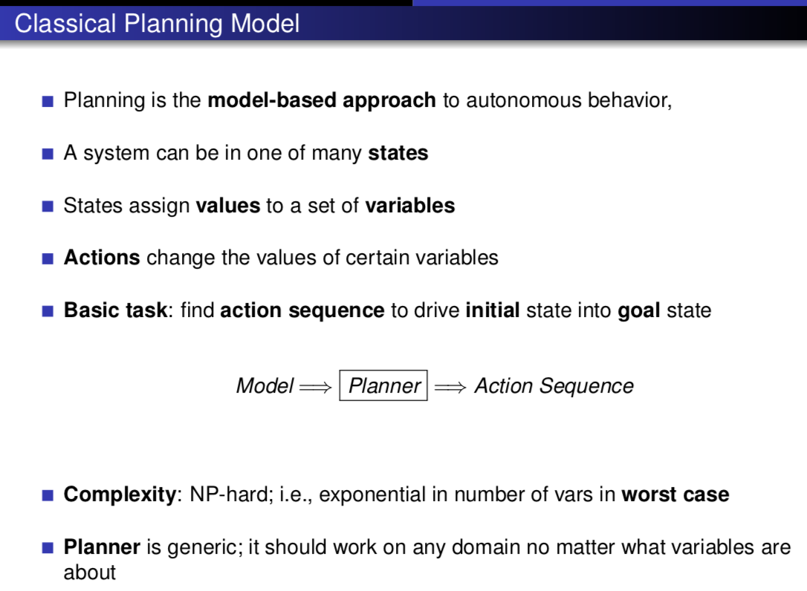

Slide 7
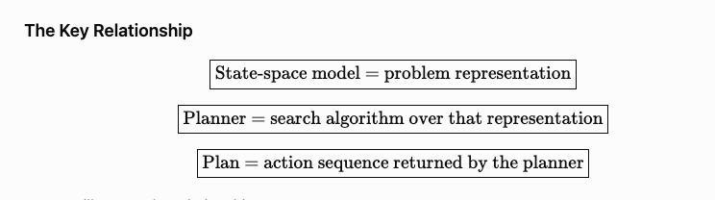

The state-space model describes the problem: what states exist, where the agent starts, what the goal is, what actions are available, how actions change the state, and what each action costs.
The planner takes this model and searches through the state space.
The output is a plan, which is an action sequence that takes the initial state to a goal state.

Slide 8
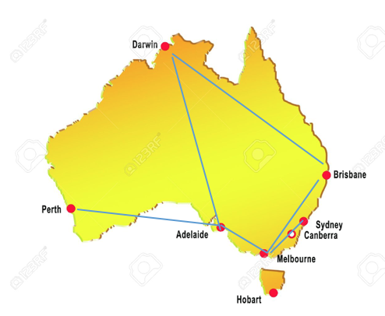
Travelling Salesman Problem
Consider:
A set of cities V to visit in any order
A starting city location v_{start}
A set of edges E specifying if there is an edge between two cities <v, v’>
The goal for the salesman is to visit all the cities at least once and return to the starting city (where the salesman lives).
State space
{Current city, Visited cities}

Slide 9


State space
{Current city, Visited cities}
Travelling Salesman Problem
Initial State
Applicable actions function
Cost of each action
Transition function
Goal State

Slide 10
Travelling Salesman Problem
State space
{Current city, Visited cities}
Q1: Assuming the number of cities is 4, what is the size of the state space given the above state space model?
$v_{\text{current}}$ =4
{A,B,C,D},
V’ =2^{4.} ∅,{A},{B},…,{A,B},…,{A,B,C,D}.
∣S∣=4×16

Slide 11
Travelling Salesman Problem
Goal State
Q2: Assuming the number of cities is 4, how many states are considered as goal achieved?
SG​={⟨A,{A,B,C,D}⟩}.

Slide 12



Travelling Salesman Problem
Goal State
Q3: If the salesman does not need to return to the starting city, assuming the number of cities is 4, how many states are considered as goal achieved?
$v_{\text{current}}$ =4
{A,B,C,D},
⟨A,V⟩
$$\left\langle B , V\right\rangle$$
$$\left\langle C , V\right\rangle$$
$$\left\langle D , V\right\rangle .$$

Slide 13
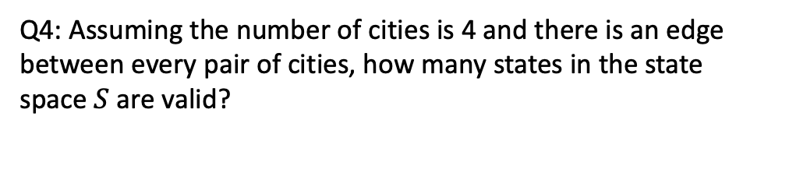
Travelling Salesman Problem
State space
{Current city, Visited cities}
Q4: Assuming the number of cities is 4 and there is an edge between every pair of cities, how many states in the state space $S$are valid?
$v_{\text{current}}$ =4
{A,B,C,D},
When
$v_{\text{current}}$ =A then V’ must include A.
For B C D, they can be visited or not visited
So there are 2³=8
Then for B we have 8, for C we have 8 and for D we have 8.
So |S|=4*8=32< 4×16
There are invalid states such as <A, {B,C}>

Slide 14
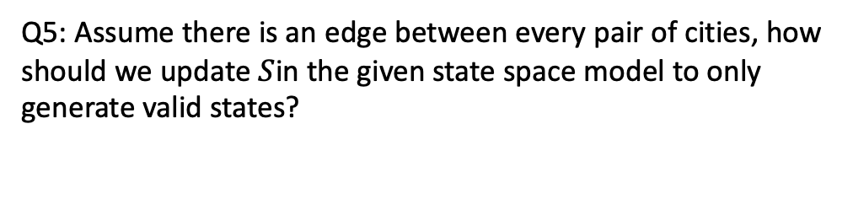
Travelling Salesman Problem
State space
{Current city, Visited cities}
Q5: Assume there is an edge between every pair of cities, how should we update $S$in the given state space model to only generate valid states?

Slide 15
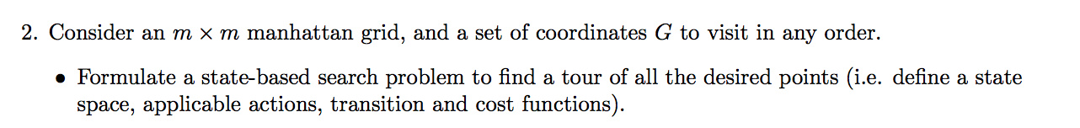


Question 2
Manhattan Grid
state space
Remaining coordinates
domain
v={(x,y)| x,y $∈$ {0….m}}
Already visited

Slide 16
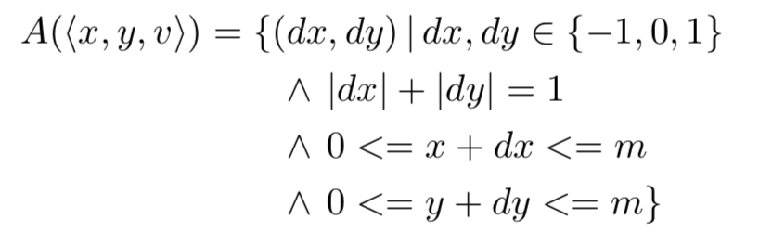

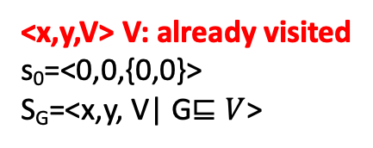
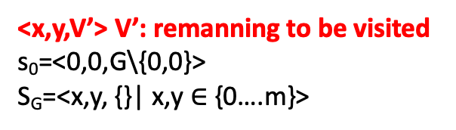
state space
Applicable actions function A(s) for each state s
Transition function
cost
<x,y,V’> V’: remanning to be visited
s₀=<0,0,G\{0,0}>
S_{G}=<x,y, {}| x,y $∈$ {0….m}>
<x,y,V> V: already visited
s₀=<0,0,{0,0}>
S_{G}=<x,y, V| G$⊑V$>

Slide 17
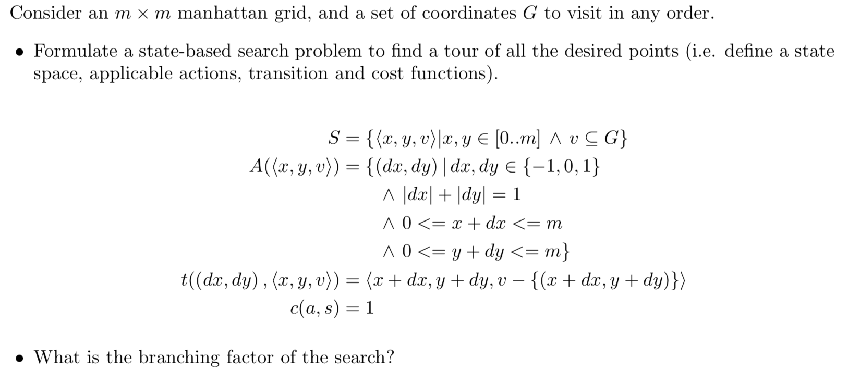
Approx 4

Slide 18
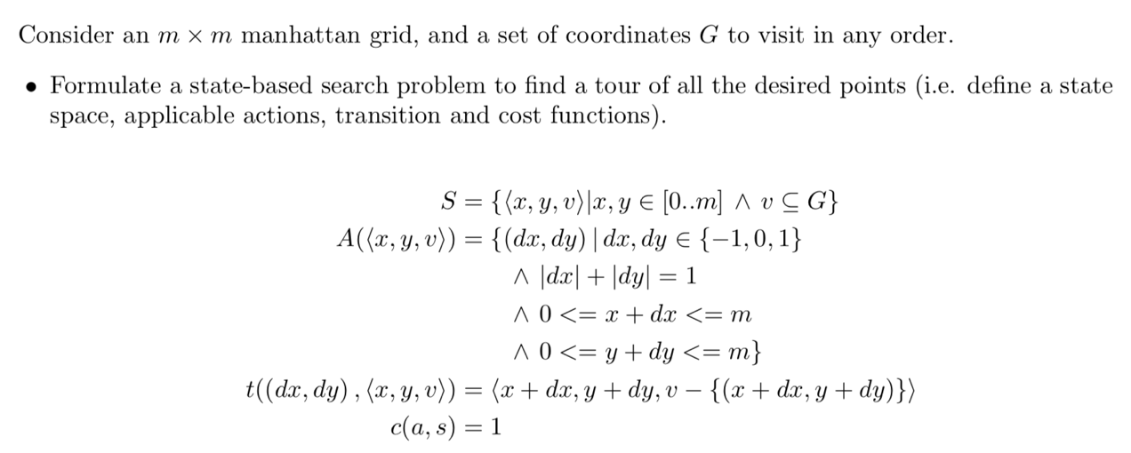
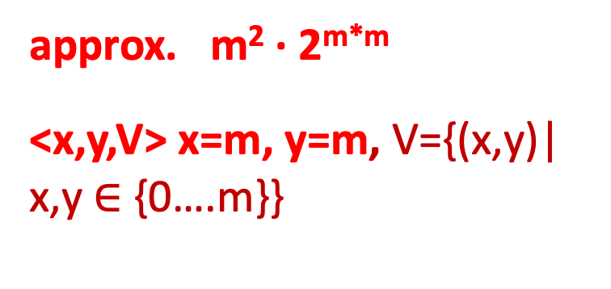
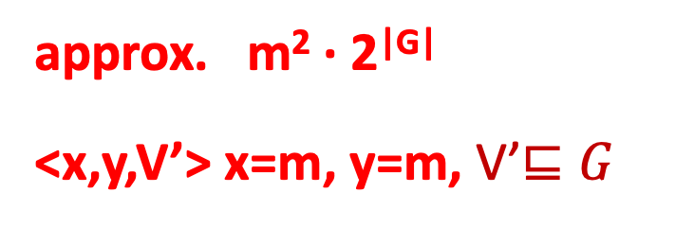
approx. m² · 2^{|G|}
<x,y,V’> x=m, y=m, V’$⊑G$
approx. m² · 2^{m*m}
<x,y,V> x=m, y=m, V={(x,y)| x,y $∈$ {0….m}}
Notes:
Absolute value of G’s power of 2

