Slide 1


Code Example:
Calculation Report:
Design Portal:
N/A

Slide 2


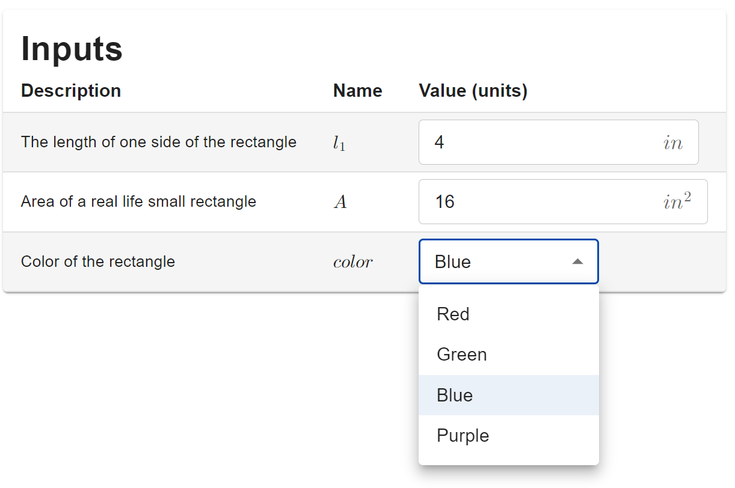
Code Example:
Calculation Report:
Design Portal:

Slide 3

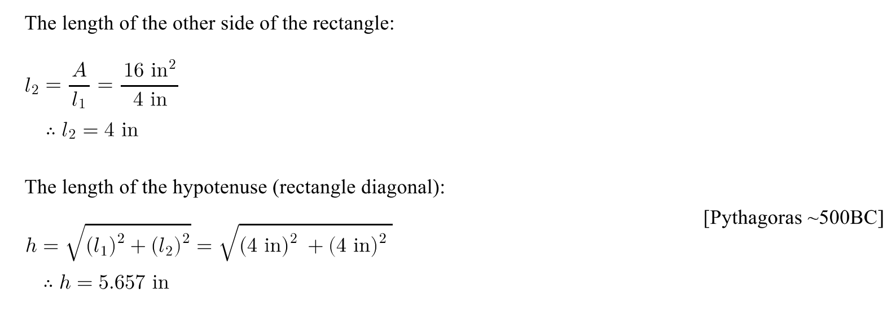

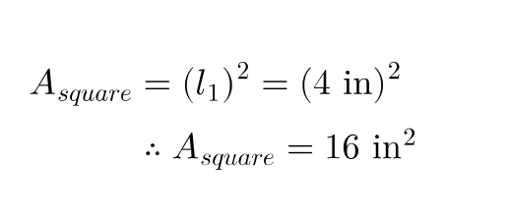
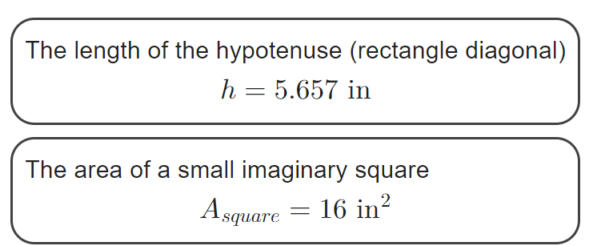
Code Example:
Calculation Report:
Design Portal:

Slide 4

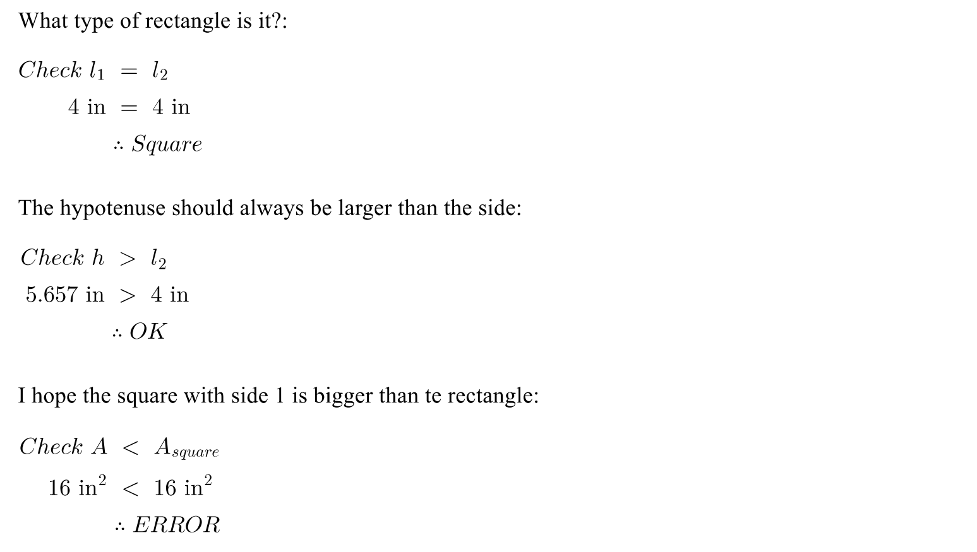

Code Example:
Calculation Report:
Design Portal:

Slide 5



Code Example:
Calculation Report:
Design Portal:
N/A

Slide 6
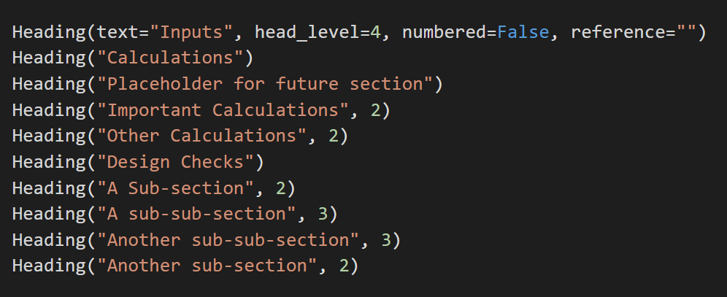
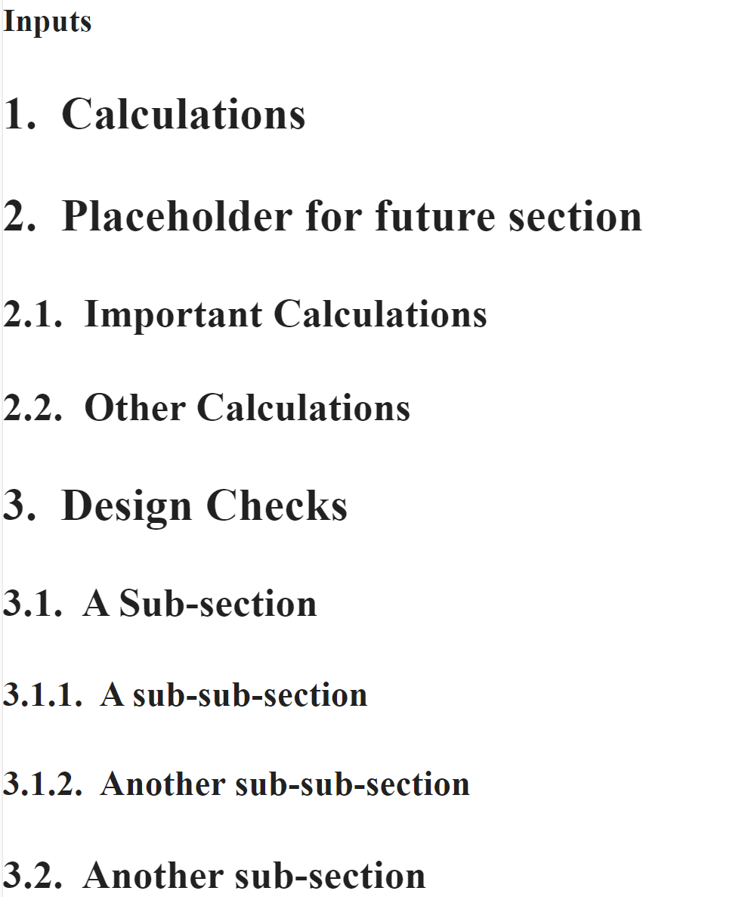
Code Example:
Calculation Report:
Design Portal:
N/A

Slide 7
Code Example:
Calculation Report:
Design Portal:
N/A

Slide 8

Code Example:
Calculation Report:
Design Portal:
N/A

