Slide 1
Web Technologies

Slide 2
Agenda
Web core technologies
Web page key technologies
JavaScript language
Object Oriented Programming paradigm

Slide 3
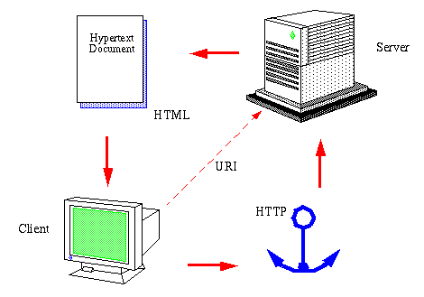
World Wide Web
Information system where documents and other web resources are identified by Uniform Resource Locators, which may be interlinked by hypertext, and are accessible over the Internet. The resources of the WWW may be accessed by users by a software application called a web browser.
https://www.youtube.com/watch?v=J8hzJxb0rpc

Slide 4

WWW Consortium
the main international standards organization for the World Wide Web
https://www.w3.org/

Slide 5
Web Core Technologies
WWW
HTTP
HTML
URI
HTTP Hypertext Transfer Protocol
HTML Hypertext Markup Language
URI Uniform Resource Identifier

Slide 6
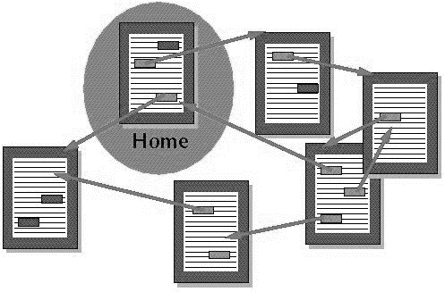
Hypertext
Hypertext is text displayed on a computer display or other electronic devices with references (hyperlinks) to other text that the reader can immediately access
https://www.youtube.com/watch?v=1TVW9wE_jdw

Slide 7

Web Page delivering
HTTP requests to Web Server
Internet
Web Server
Local Computer
http://www.example.com/abc.html
Responses from Web Server (HTML, CSS, Javascript, Images, …)
HTML pages abc.html

Slide 8
Web Page Key Technologies
Web Page
HTML
CSS
JavaScript

Slide 9


Web Technologies Basic Resources
Educational website for learning web technologies online
https://www.w3schools.com/
Resources for developers, by developers
https://developer.mozilla.org/

Slide 10

HTML document structure
<!DOCTYPE html> <html> <head> … </head> <body> … </body> </html>

Slide 11
HTML Elements and attributes
<tagname> … </tagname>
opening and closing tag
<tagname attrname=”value” attrname=”value”> … </tagname>
name/value pair additional info about element in opening tag

Slide 12
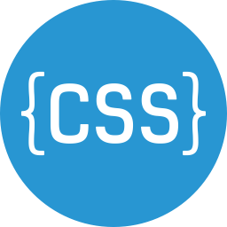
CSS Content styling
Inline <h1 style="color:blue;">text</h1>
Internal <style> … </style>
External (CSS document) <link rel="stylesheet" type="text/css" href="mystyle.css">

Slide 13
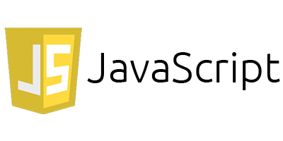
JavaScript
Programming language
Object-oriented, imperative, functional programming
Prototype-based (class-based vs. prototype-based)
Interpreted (just-in-time compilation)
WWW core technology
Tutorials: MDN w3schools
How Javascript works
https://www.youtube.com/watch?v=b1ieJtIx1NY

Slide 14
JS Location
Internal
HTML files (head / body)
<script> … JavaScript code … </script>
External
JavaScript files
<script src="/js/myScript.js"> </script>

Slide 15
Input / Output
Dialog / popup windows: alert, confirm, prompt
Console: Chrome DevTools
HTML DOM
var x = document.getElementById("elementID").textContent;
document.getElementById("elementID").innerHTML = "text";

Slide 16
Data types and variables
Boolean
Null
Undefined
Number
String
Object
Dynamic types
Variable declaration
var abc = value;
Variable scope
global, local
Grammar and types

Slide 17
Strings and numbers
Strings var name = "John May";
Numbers var price = 120.5;
String functions JavaScript String Reference
Number functions JavaScript Number Reference
Numbers and dates

Slide 18
Arrays
Store multiple values in a single variable
Array declaration
var array-name = [item1, item2, ...];
Array methods to operate on array

Slide 19
Flow control
Block statement { statements; }
Conditional statements if…else, switch
Loops and iteration for, do…while, while

Slide 20
Functions
function name(parameter1, parameter2, …) {
code to be executed
return value; // optional
}
Defining and calling functions
JavaScript Functions

Slide 21
Events
HTML code
<HTML-element some-event="some JavaScript">
JS code
element.addEventListener(event, function);
eg. var el = document.getElementById("h1");
el.addEventListener("click", myFunction);
Event reference

Slide 22
Software development tools
Static code analysis: JSLint (lint, linter)
Text editor: Microsoft Visual Studio Code
Authoring and debugging: Chrome DevTools
https://developers.google.com/web/tools/chrome-devtools/

Slide 23
Object Oriented Programming
JSON
https://www.youtube.com/watch?v=GpOO5iKzOmY
OOP
https://www.youtube.com/watch?v=pTB0EiLXUC8

Slide 24

Objects
Properties
name age student interests address
Methods
greeting()

Slide 25
Object definition
var objectName = {
name1: value1, name2: value2, name3: value3, … }
value – number, string, array, object, function, …
Introducing JavaScript objects JavaScript Objects

Slide 26
Object definition
var person = {
name: "Adam", age: 23, student: true, interests: ["swimming", "reading"], address: {city:"Krakow", street:"Rakowicka"},
greeting: function() { alert("Hi, I’m " + this.name); }
}

Slide 27
Object manipulation
alert(person.name);
person.student = false;
alert(person.fullname());
person.age = 24;
person.address.city = "Zakopane";
person.interests[0] = "shopping";
person.phone = "566 534 039";

Slide 28
Constructor functions
function Person(name, age, student) { this.name = name; this.age = age; this.student = student; this.greeting = function(){ alert("Hi, I’m " + this.name); } }
var person1 = new Person("Adam", 23, true);

Slide 29
Object prototypes
JavaScript – prototype-based language
Prototype-based (class-based vs. prototype-based)
Introduction to object prototypes

