Slide 1
Web Services

Slide 2
Agenda
Client –server model
HTTP protocol
REST
XMLHTTPRequest

Slide 3
Core Web Technologies
HTML
HTTP
URL

Slide 4
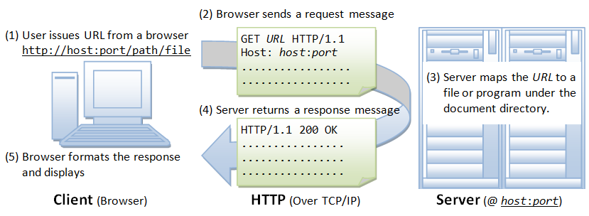
Client – Server model

Slide 5
HTTP
Hypertext Transfer Protocol
protocol for sending hypertext documents
standardized way computers communicate with each other

Slide 6
HTTP Methods
GET
POST
HEAD
PUT
DELETE
CONNECT
OPTIONS
TRACE

Slide 7
HTTP details
The Internet, HTTP & HTML
https://www.youtube.com/watch?v=kBXQZMmiA4s
The Http and the Web
https://www.youtube.com/watch?v=eesqK59rhGA

Slide 8
REST
REpresentational State Transfer
software architectural style that defines a set of constraints to be used for creating Web Services
Architectural constrains: client-server, statelessness, cacheability, layered system, code on demand, uniform interface
Request – Response
Web Service
a service offered by an electronic device to another electronic device, communicating with each other via the World Wide Web

Slide 9
REST API
Czym jest REST API
https://www.youtube.com/watch?v=P9b8-BrWdYs
Kanał REST API
https://www.youtube.com/playlist?list=PLjHmWifVUNMLjh1nP3p-U0VYrk_9aXVjE

Slide 10
XMLHTTPRequest
an API in the form of an object whose methods transfer data between a web browser and a web server
An object is provided by the browser's JavaScript environment

Slide 11
XMLHTTPRequest methods
abort()
getAllResponseHeaders()
getResponseHeader( headerName )
open( method, URL )
send()
setRequestHeader( HeaderName, HeaderContent)

Slide 12
XMLHTTPRequest properties
onreadystatechange
readyState
responseText
responseXML
status
statusText
readyState | Description
0 | The request is not initialized
1 | The request has been set up
2 | The request has been sent
3 | The request is in process
4 | The request is completed
Status | Description
200 | OK
403 | Forbidden
404 | Page not found
... | List of status messages

Slide 13
XMLHttpRequest example
var request = new XMLHttpRequest(); request.onreadystatechange = function () { if (this.readyState==4 && this.status==200){ // Typical action to be performer // when the document is ready // document.getElementById(...) = ... } };
request.open('GET', 'somepage.xml'); request.send();

Slide 14
XMLHTTPRequest doc
Using XMLHttpRequest
https://developer.mozilla.org/en-US/docs/Web/API/XMLHttpRequest/Using_XMLHttpRequest
https://www.w3schools.com/xml/xml_http.asp

Slide 15
AJAX
a set of web development techniques using many web technologies on the client side to create asynchronous web applications
a change content dynamically without the need to reload the entire page
Ajax Tutorial
https://www.youtube.com/watch?v=My0MDTl0Zv4

Slide 16
JSON
String → JS object conversion
JSON.parse(String)
https://www.w3schools.com/js/js_json_parse.asp
JS object → String conversion
JSON.stringify(Object)
https://www.w3schools.com/js/js_json_stringify.asp

