Slide 1
Meteorite Landings
Machine learning in space exploration

Slide 2
1. What is this about?
This project is, unsurprisingly, about meteorites. The main purpose of this analysis is to try to alleviate some of the ambiguity engendered by those fascinating space rocks, via the panoply of tools that data science offers.

Slide 3
2. Objectives
A few words about the purpose of this project:
Collect a reasonably large dataset about meteorites
Clean it and try to understand it
Visualize it, plot it and explore it further
Build a coherent machine learning model
Apply its results in real world situations

Slide 4
3. Who is concerned?
I chose to work on this project because I have a personal interest in space exploration. Unfortunately, when it comes to this particular area the choice is very restricted; indeed, very few datasets were available. I was lucky enough to find a relatively large meteorite dataset on the NASA’s website.
This analysis should be interesting to astrophysicists and to everyone who is fascinated by the mysteries that surround us.

Slide 5
4. Dataset
A few words about the dataset:
I have chosen to work on an interesting dataset that I found on the NASA’s website (https://data.nasa.gov/Space-Science/Meteorite-Landings/gh4g-9sfh), encompassing the complete list of around 45000 meteorite landings on earth since the year 601. Each meteorite is further described by 10 features, including its class, its mass, its year of landing…etc.

Slide 6
5. Tools/Programming Language
I have used Python to conduct this analysis. R would have been quite useful as well but I have a personal preference for Python (mainly because I think Python has more interesting ML and DL libraries).
Python comes with a multitude of powerful libraries, including Pandas, Matplotlib, Seaborn, Scipy, Numpy and Scikit Learn. All have been extremely useful in this particular project.

Slide 7
6. Structure
The project is segmented into four main sections:
Exploratory Data Analysis: I used Pandas and Numpy to visualize, understand, clean and wrangle, via different data structures, the dataset
Data Visualization: I have plotted different aspects of the dataset that were the most relevant to me, using Matplotlib, Seaborn and Plotly
Statistical Thinking: I have used Scipy for statistical inference
Machine Learning: I built a relatively accurate ML model to predict where the next meteorite landings will occur

Slide 8
6.1 Exploratory Data Analysis
What I learnt:
There are 45000 rows and 10 columns
A non negligible number of missing values exists
There are 422 different meteorite classes but only 10 of which encompass about 80% of the meteorites – the analysis will be axed on those top 10 classes

Slide 9
6.2 Data Visualization
What I learnt:
The heaviest meteorite belongs to the H5 class (60 tons)
The class L6 is more homogenous
The class CM2 has the lightest meteorites
Accurate landing records really started in the 19th century
Recent meteorites seem to be heavier
Surprisingly, most of the meteorites didn’t land on the sea/ocean but on the ground

Slide 10
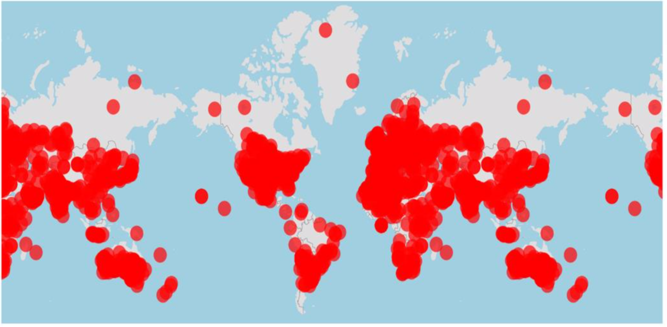
6.2 Data Visualization
Geographical distribution of the landings

Slide 11
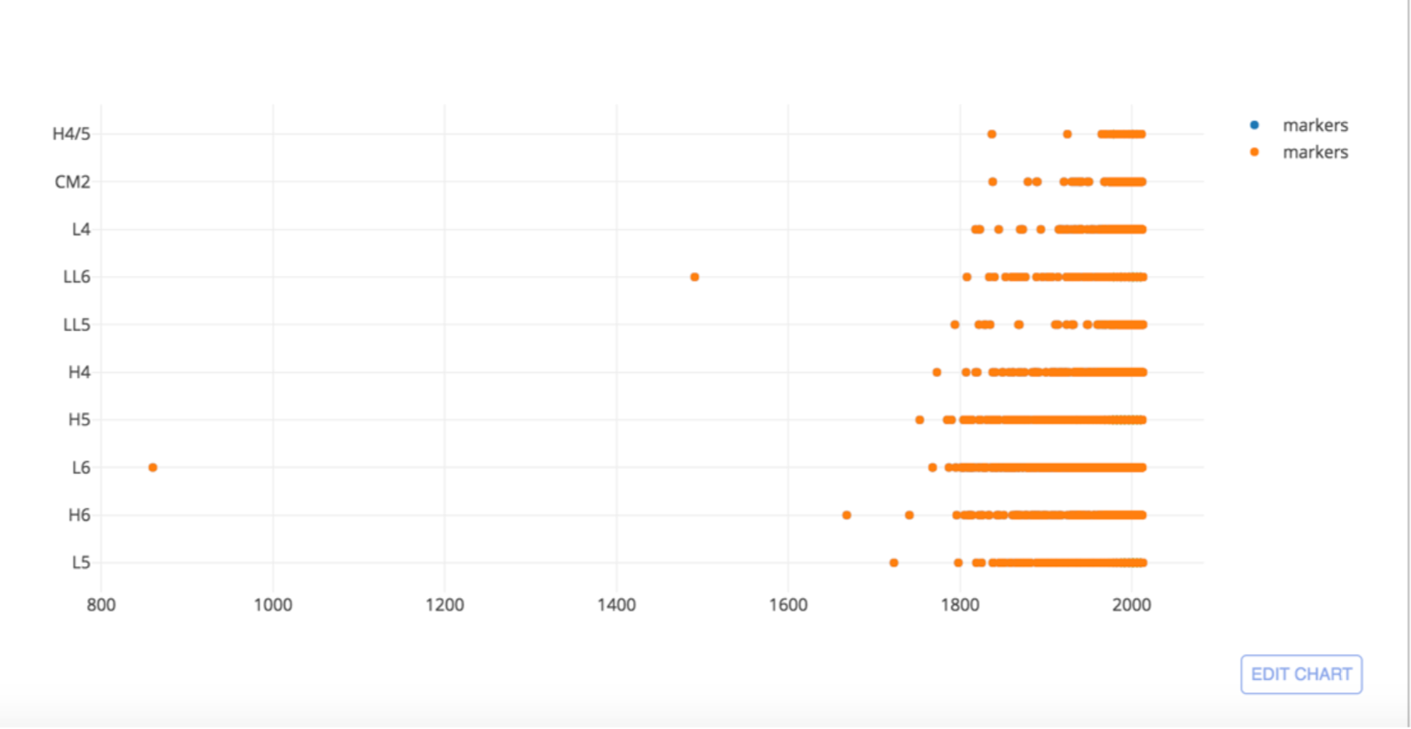
6.2 Data Visualization
Landing records sine the 9th century

Slide 12
6.3 Machine Learning
The work I did:
Did some Feature Engineering to process the dataset
Split the dataset chronologically and used the 6000 most recent columns as a test set
Used Random Forest Regressor to predict the emplacement of the landings of those rows
Enhanced the model via Grid Search
Got around 60% accuracy

Slide 13
6.3 Machine Learning
A bit about the model:
Dependent variables: Latitude and Longitude
Independent variables: meteorites’ mass, class and year of landing
Algorithm: Random Forest Regressor
Library: Scikit-Learn

Slide 14
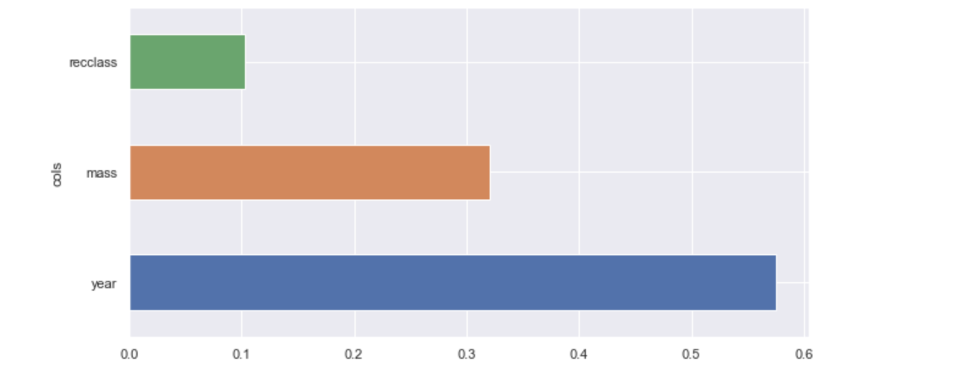
6.3 Machine Learning
Very high correlation

Slide 15
6.3 Machine Learning
Conclusion:
Splitting the data randomly gave better results
The reason why the chronological splitting of the dataset failed was because recently the world has experimented a drastic intensification of meteorite showers
Clearly, three independent variables are not enough. The dataset needs more information (like, for example, the chemical composition of each meteorite class)
The ‘year’ variable has a gigantic impact on the model, which is a sign that the dataset lacks information

Slide 16
Summary
The dataset was properly cleaned;
The dataset was separated into different segments, each segment having a specific purpose;
Important segments were adequately visualized via scatter plots, histograms, box plots and map boxes;
Interesting statistical analysis were conducted on the dataset (t-test, EDF, PDF...);
The dataset was correctly encoded to be ready for the machine learning part;
After experimenting different machine learning algorithms (supervised and unsupervised) and combinations (classification and regression), Random Forest Regressor was always giving satisfying results;

Slide 17
Summary
After a multitude of tests, determining where the next meteorite landings will occur was the most realistic prediction;
With only three features that can be observed and determined via telescopes, the algorithm was giving a fair score;
A cross validation and a grid search were performed on the dataset to enhance the test score and to reduce over-fitting, successfully;
An application of the model was performed and the results were shown on a new dataframe.

Slide 18
Prospective
The dataset was indeed very interesting to explore. However, the lack of information prevented me to obtain concrete results via the machine learning model that I built. I would encourage anyone who has more information about meteorites to continue the work and potentially to ameliorate the score on the test set.

Slide 19
Notebook
https://github.com/youcefjd/Capstone-Final-V1.0/blob/master/Capstone-Project-1-Version-1.2.ipynb

