Slide 1
組員：陳秉彥、陳威佐、陳宥儒

Slide 3
Rational

Slide 4
Rational
This study explores Multi-Agent Pathfinding (MAPF) in 2D and 3D grids with potential obstacles that could disrupt rule distribution (see Figure 1). The main objective of MAPF is to find conflict-free paths for agents from their start to target configurations. Although finding optimal solutions is important, MAPF optimization is NP-hard (Surynek, 2010; Yu & LaValle, 2013b), even in planar settings (Yu, 2015) and obstacle-free grids (Demaine et al., 2019). MAPF algorithms are applicable in real-world scenarios such as formation reconfiguration (Poduri & Sukhatme, 2004), object transportation (Rus, Donald, & Jennings, 1995), and multi-robot systems (Preiss et al., 2017; Hönig et al., 2018). Despite grid constraints, MAPF algorithms are widely used in large-scale applications, including warehouse automation (Wurman, D'Andrea, & Mountz, 2008), grocery order fulfillment (Mason, 2019), and parcel sorting (Wan et al., 2018).

Slide 5
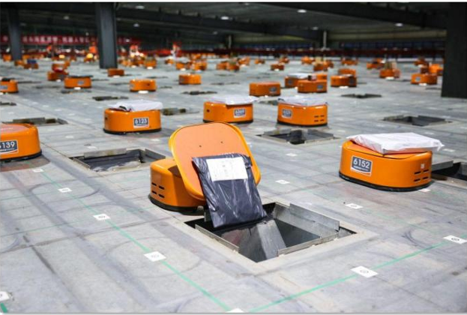
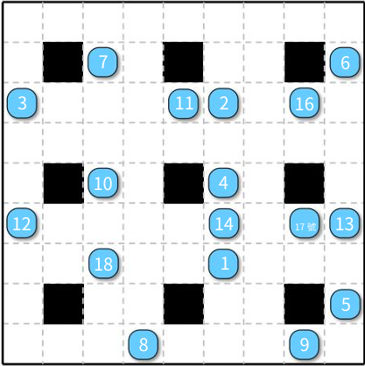
Rational
Figure 1
Figure 2
Real-world parcel sorting system (at JD.com) using many agents on a large grid-like environment with holes for dropping parcels; (b) A snapshot of a similar MAPFinstance our methods can solve in polynomial-time with provable optimality guarantees. In practice, our algorithms scale to 2D maps of size over 450 × 300, supporting over 45K agents and achieving better than 1.5-optimality (see, e.g., Fig. 14). They scale further in 3D settings

Slide 6
Industry status

Slide 7
Industry status
In the field of warehouse logistics automation, Multi-Agent Path Finding (MAPF) technology is widely used to address the pathfinding problem of multiple agents (such as robots) in complex environments. The primary goal of MAPF is to find collision-free paths for multiple agents from their starting positions to their target positions. For large-scale applications like warehouse automation, the optimality of the solution is crucial, especially in environments with high agent density. However, solving the MAPF problem is NP-hard (Surynek, 2010; Yu & LaValle, 2013b), even in planar environments (Yu, 2015) and on obstacle-free grid environments (Demaine et al., 2019), making it computationally challenging.

Slide 8
MAPF algorithms are widely applied in various real-world scenarios, such as formation reconfiguration (Poduri & Sukhatme, 2004), object transportation (Rus, Donald, & Jennings, 1995), and swarm robotics (Preiss et al., 2017; Hönig et al., 2018). In warehouse logistics automation, the application of MAPF technology is particularly critical, especially in scenarios such as order fulfillment and parcel sorting. By utilizing multi-agent pathfinding, automated warehouses can efficiently perform tasks like item handling and sorting, significantly improving warehouse efficiency.

Slide 9
As intelligent warehouse systems continue to evolve, how to achieve efficient and near-optimal path planning in high-density, complex grid environments has become one of the key factors driving the advancement of the warehouse logistics automation industry.

Slide 10
Formula

Slide 11

Challenges in Multi-Agent Path Finding (MAPF): MAPF is NP-hard, making optimal solutions computationally expensive, even in simple grid settings.
Existing algorithms offer polynomial-time solutions but often with impractically large suboptimality.
Demand for High-Density Scenarios: Real-world applications like warehouse logistics and robot swarms need efficient solutions for high-density grids.
Current methods struggle with performance in dense settings and lack optimality guarantees.

Slide 12
Objective Efficient Solutions for High-Density Scenarios: Develop MAPF algorithms that handle high-density grids (up to full density) and obstacles, with polynomial-time computation.
Near-Optimal Performance: Achieve low constant-factor optimality (1.x asymptotic makespan) for broad scenarios.
Advancing MAPF Theory and Practice: Propose a general Grid Rearrangement (GR)-based framework for solving MAPF.
Extend applicability to multidimensional grids, including 2D, 3D, and beyond.

Slide 13
The goal is to develop efficient solutions for Multi-Agent Pathfinding (MAPF) problems, particularly in high-density environments with obstacles. The solutions should be computed in polynomial time and offer near-optimal performance (with a makespan close to optimal, around 1.x).
Key objectives include:
Designing a general approach based on Grid Rearrangement (GR) for solving MAPF problems.
Demonstrating the method's applicability in multi-dimensional grids, including 2D, 3D, and higher dimensions.
4 𝑚 1 + 8 𝑚 2

Slide 14
Future Directions

Slide 15
Future Directions
Support for More Application Scenarios: Extend the proposed algorithms to other types of graph structures, such as irregular graphs or dynamic graphs.
Handling Dynamic Scenarios: Develop solutions for "lifelong MAPF" to address scenarios involving continuous movement and reallocation of agents.
Further Reducing Complexity: Explore techniques to further minimize the number of shuffles required, particularly in high-dimensional scenarios.

Slide 16
Summary

Slide 17
Summary
Overall, the algorithmic framework proposed in this paper not only achieves significant theoretical breakthroughs but also demonstrates its feasibility and superiority in practical applications through extensive experiments. This study lays a solid foundation for the future development of efficient multi-agent pathfinding technologies.

Slide 18
謝謝觀看

